Slide 1
PIP Update
Feb 19th 2014

Slide 2
Agenda
Summary Update
Current Activities/Updates
Upcoming Talks, Reports, Meetings
Updates/Talks:
Domann – Financial Update
Chandra Bhat – Recent Booster Injection/Energy Studies

Slide 3
Update
Linac SBK – Initial kickoff meeting completed - PDR next month.
Linac Laser Notching – working on timing and electronics
Modulator work – EE: Progress on 9 cell moving along – SLAC: issues with the current design which does not accommodate a feedback system. Trevor is working with them on their plan/issues.
Booster Beam: Issues with current damper system somewhat resolved – but more tweaking
Transverse damper – no news
Cogging software work continues – no recent news
Booster optics software – meeting to decide operational issues -
Booster Longitudinal dampers - no news
Booster RF
Booster RF 13 cavity installed yesterday. Vacuum looks good with lots of vac-seal
Booster RF3 work - will go on test stand
RF #19 removed – it dies last week, lots of sparking from lower tuner.
Cone work continues –
New Cavities – working to set some cavity design specifications
Perpendicular Cavities – progress on simulations and testing of TRIUMF cavity – working on solenoid design.
High mu cores - A new batch, initial results are good μ but q lower than our trial batch
The two samples arrived yesterday and will be tested today!
Anneal in process that should help in this regard. If so then will be ready to press the big cores
Booster Anode Supplies – A req. going thru for the cap bank, currently working on the diode specification, VCB specification, and solid state crowbar. Matt is working on ignitrons and load break switches. We may need an alternate vendor due to lead time, but there may be no other options. Working towards completing design signoff this month! Want to install this summer shutdown.
Booster Bias supplies – Work being done with EE supt. help - plan to have a prototype done in Feb.
Booster Shielding – bi-weekly safety meetings – discussing simulations and next step(s) to take

Slide 4
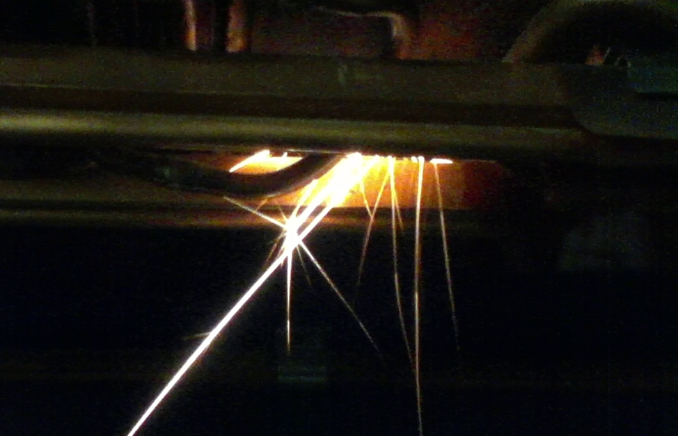

Slide 5
Recent PIP Budget/News
Budget Issues: none
Labor: Will be in Ken’s Slides
General:
PIP2: Next week review (CY Tan, B Zwaska – talks)
Keeping an eye on it for impact to PIP
PIP talks planned
FY14 Q1 Report
Done – will submit today
PMG – March

Slide 6
Upcoming Talks
Future Meetings to be Scheduled:
Pat Sheehan – Booster Bias Supplies
Tom Kubicki – New Booster Cavity Plan
Ryan Crawford – Booster Anodes
Eddy – Booster damper plans
CY Tan – Perpendicular Cavities
Bill Pellico - Loss Scans and Shielding Assessment
John Reid - Solid State Installation - Final Report

