Slide 1
High Field Magnet Development Toward the High Luminosity LHC
Giorgio Apollinari, Fermilab
for the HiLumi-LHC/LARP Collaboration
IPAC14 – June 15th – 20th, 2014 – Dresden, Germany

Slide 2
Participants
BNL, CERN, FNAL, LBL, SLAC
  F. Borgnolutti, G. Ambrosio, S. Izquierdo-Bermudez, D. Cheng, D. R. Dietderich, H. Felice, P. Ferracin, G. L. Sabbi, A. Ballarino, E. Todesco, B. Bordini, M. Yu, M. Anerella, R. Bossert, A. Ghosh, A. Godeke, P. Fessia, S. Krave, M. Juchno, J. C. Perez, L. Oberli, H. Allain, F. Cerutti, L. Esposito, P. Wanderer, R. Van Weelderen, R. De Maria, S. Fartoukh, R. Gupta, R. Kersevan, N. Mokhov, T. Nakamoto, I. Rakno, J. M. Rifflet, L. Rossi, M. Segreti, F. Toral, Q. Xu, N. Andreev, E. Barzi, M. Buehler, G. Chlachidze, J. DiMarco, J. Escallier, R. Hafalia, G. Jochen, M.J. Kim, P. Kovach, M. Lamm, M. Marchevsky, J. Muratore, F. Nobrega, D. Orris, E. Prebys, S. Prestemon, J. Schmalzle, C. Sylvester, M. Tartaglia, D. Turrioni, G. Velev, X. Wang, G. Whitson, A.V. Zlobin, S. Caspi, R. Hafalia, R. Hannaford, V.V. Kashikhin, A. Lietzke, A. McInturff, I. Novitsky, S. Peggs, X. Wang
  …and many others….

Slide 3
Content
Strategy, Justification and Needs
HL-LHC High Field Magnets Scope
  IR Quadrupoles
  11 T Dipoles
Design Considerations
Technology Development and Achievements
Plans
Conclusions

Slide 4


HEP Strategy
European Strategy for Particle Physics - Update 2013
Europe’s top priority should be the exploitation of the full potential of the LHC, including the high-luminosity upgrade of the machine and detectors with a view to collecting ten times more data than in the initial design, by around 2030…
US Prioritization for Particle Physics (P5) - May 2014
Complete the LHC phase-1 upgrades and continue the strong collaboration in the LHC with the phase-2 (HL-LHC) upgrades of the accelerator and both general-purpose experiments (ATLAS and CMS). The LHC upgrades constitute our highest-priority near-term large project (Recommendation to HEPAP).
HL-LHC from a study to a PROJECT
300 fb⁻¹ → 3000 fb⁻¹

Slide 5
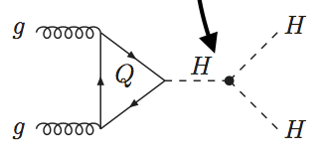
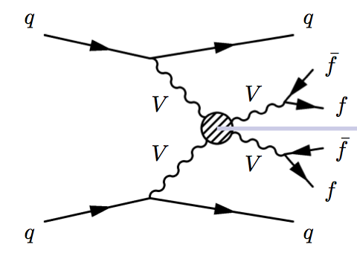
Justification & ….
“Known” Justifications
  Measure as many Higgs couplings to fermions as precisely as possible
  Measure Higgs self-coupling
  Verify that Higgs boson fixes the SM problem with W/Z scattering at high E
“Unknown” Justifications/Questions
  Why is Higgs so light ?
  What is nature of Matter-Antimatter asymmetry in Universe ?
  Why is gravity so weak ?
  What is Dark Matter ?
Access to rare processes -> Luminosity
Self-coupling
g_{HHH}~ λv
Vector boson fusion

Slide 6
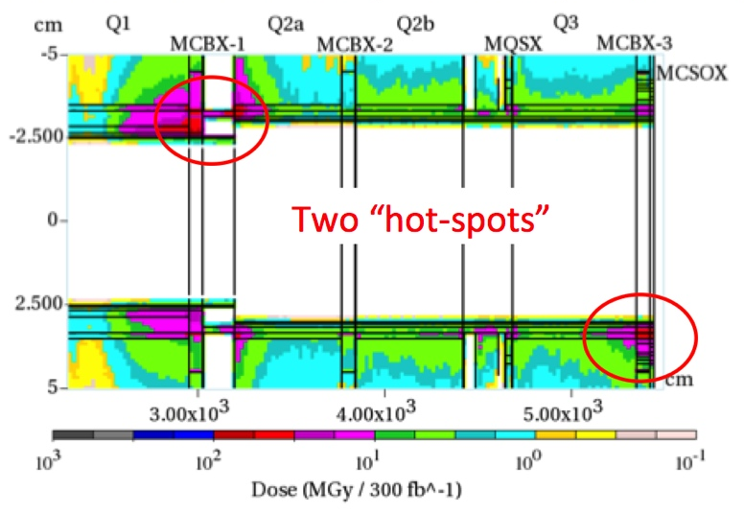
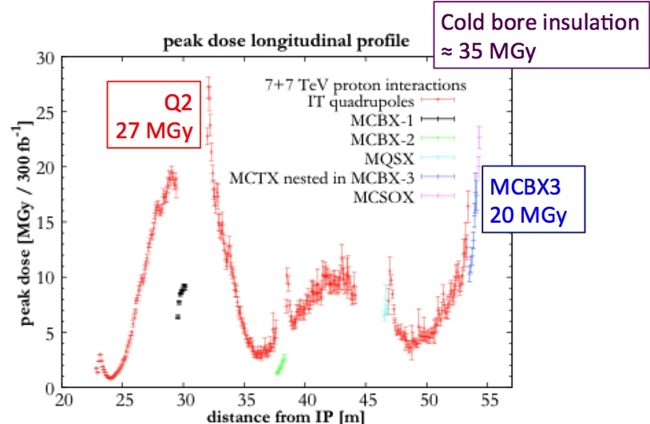
…Needs
Radiation dose in present IR Focusing Triplet after 300 fb⁻¹
  Peak dose as high as ~30MGy (~50% uncertainty)
  Bonding strength (shear) of epoxies is strongly degraded (80%) above 20 MGy.
  Fracture strength of insulating materials degrades by about 50% in the 20 MGy
  (G11) to 50 MGy (kapton) range
Triplets magnets may experience mechanically induced insulation failure in the range of 300 fb⁻¹ (~LS3)
Not a surprise (known since~ 2001)

Slide 7
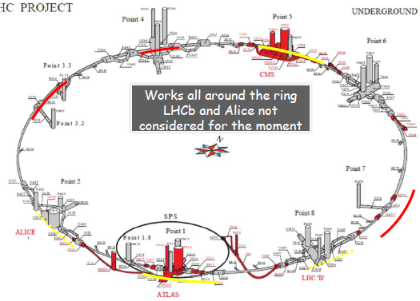
The HL-LHC Project
Physics driven requirements:
  Increase luminosity limiting Pile-Up (PU) to ~140 events/crossing
    L = 5 x 10³⁴ cm⁻² s⁻¹
  Limit PU linear density to ~1 event/mm
New IR-quads Nb₃Sn (inner triplets)
  New 11 T Nb₃Sn (short) dipoles
  Crab Cavities
  Collimation upgrade
  Cryogenics upgrade
  Machine protection
  …
Major intervention on more than 1.2 km of the LHC

Slide 8
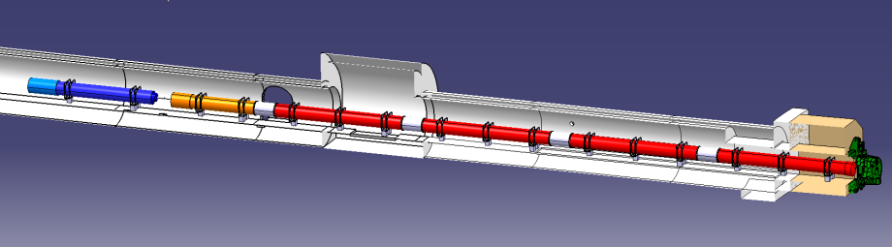





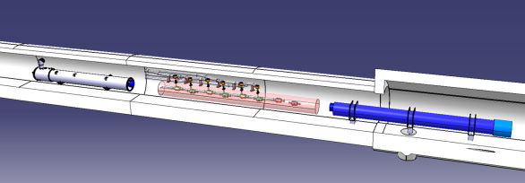


New IRs
ATLAS
CMS
Q1-Q3 : R&D, Design, Prototypes and in-kind USA
D1 : R&D, Design, Prototypes and in-kind JP
MCBX : Design and Prototype ES
HO Correctors: Design and Prototypes IT
Q4 : Design and Prototype FR
CC : R&D, Design and in-kind USA
CC : R&D and Design UK
L. Rossi @Kick-off Meeting 11 Nov 2013
8

Slide 9
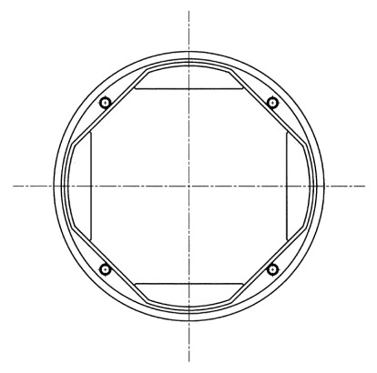
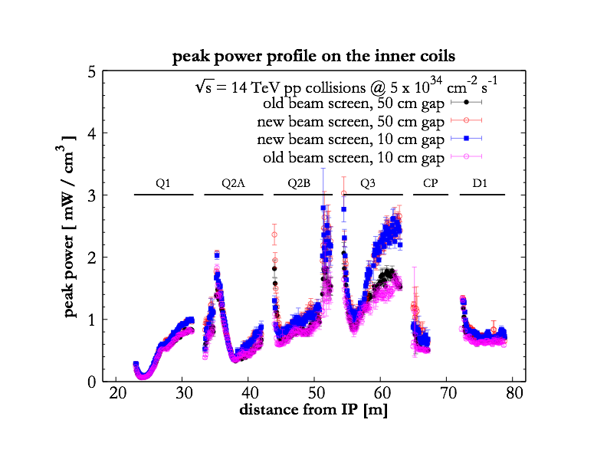
Magnets Design Constraints
Shielding is the answer:
Goal: Peak Luminosity leveled at 5x10³⁴ cm⁻²s⁻¹
  Higher intensity and larger focusing in IP. Beam size reduced by a factor of 2 (i.e. doubling aperture of IR quads)
    Critical design parameter is peak magnetic field in coil: NbTi (8T) to Nb₃Sn(15T) allows ~50% higher field
  Radiation Damage goals: limit radiation to 25 MGy on essential components for magnet fabrication
  Heat Deposition goals: limit heat deposition to 4 mW/cm³
  Field quality not critical at injection (b₆~ 25) but critical at full energy (b₆ <0.5)
    Large set of correctors in the layout
Cold bore
Tungsten
Beam screen

Slide 10
Super Conductor/Coil Design
In SC Magnet, field is proportional to current density in coil
SC Critical surface defines the maximum field in relation to the critical current and temperature.
With large coil widths, loadline has lower slope and higher fields can be reached:
  Not only a cost/size problem: higher current densities induce larger mechanical stresses (in compact magnet forces may damage SC or insulation) and difficult protection during quenches

Slide 11
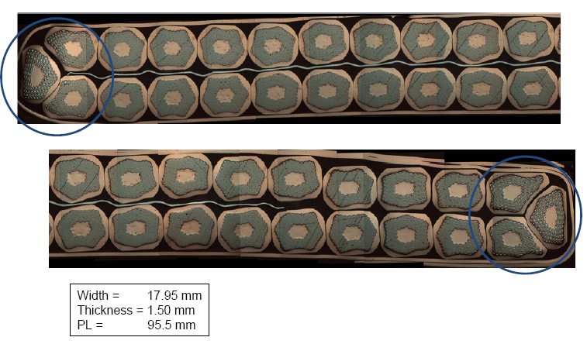
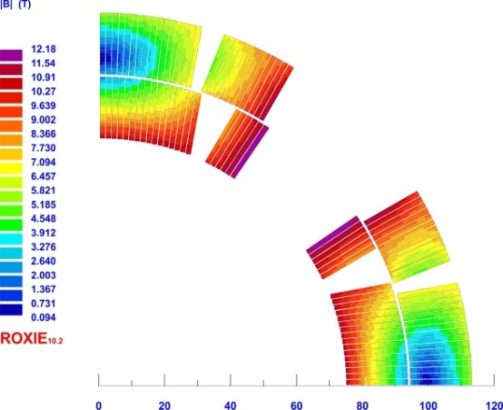
Coil Design
In order to maintain stresses under ~200 MPa in 150 mm aperture quadrupoles, a coil width of ~35 mm was selected
  Gradient ~ 140 T/m
  Benefit from experience in 90 mm and 120 mm aperture quads and SC cables
Cable Choice
  40 strands Rutherford Cable with 0.85 mm strands and 25 μm thick SS core
Coil Design
  Double Layer, four Blocks

Slide 12
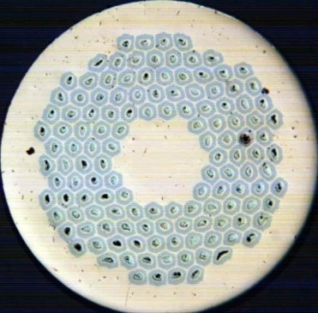
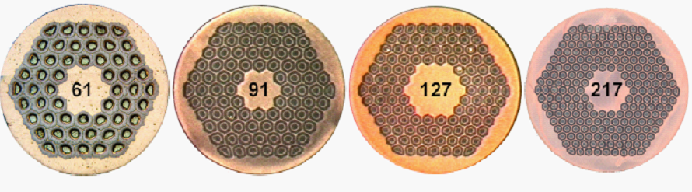

Nb₃Sn Conductor
The 150 mm aperture QXF magnets will use either 132/169 RRP® Ti-Ternary strand or 192 PIT
  Sub-element size kept below 50 mm to minimize flux jumps (improve stability) and decrease filament magnetizations
  Ti (rather than Ta) accelerates Nb₃Sn reaction, has higher Jc(15T) and higher strain tolerance
169
Smaller Filament Size
Courtesy of Jeff Parrell (OST)

Slide 13
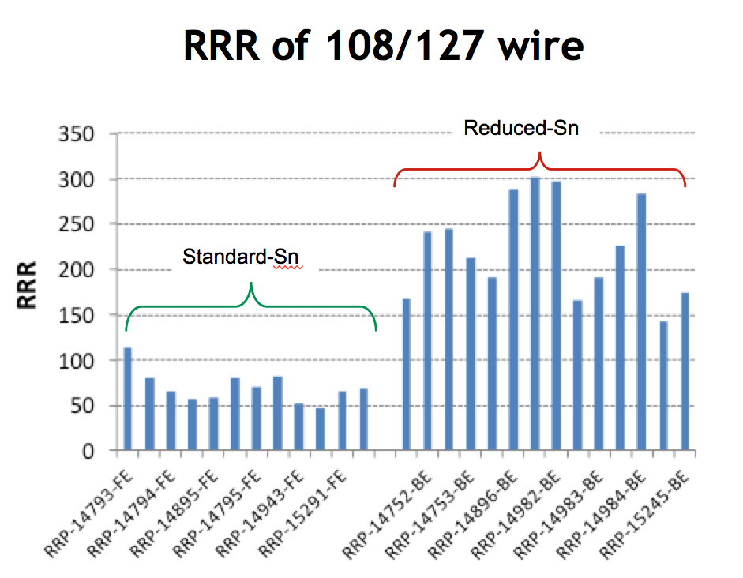
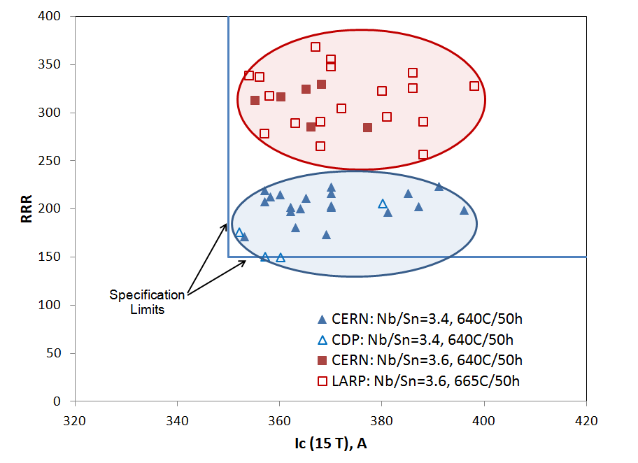
Specification for SC Strand
J_{c}(15 T) > 1400 A/mm²
5 % Reduced-Sn
At. Nb/Sn = 3.6
Standard-Sn
At. Nb/Sn = 3.4
  Recent Nb₃Sn Delivery
  Headroom in RRR to increase Ic by longer treatment at 665 C
  Manufacturing margin in Ic increased by better Nb/Sn Control

Slide 14
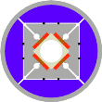
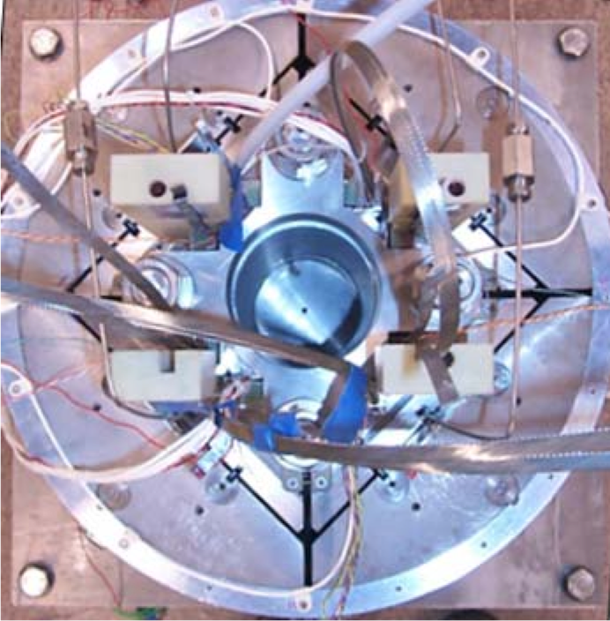
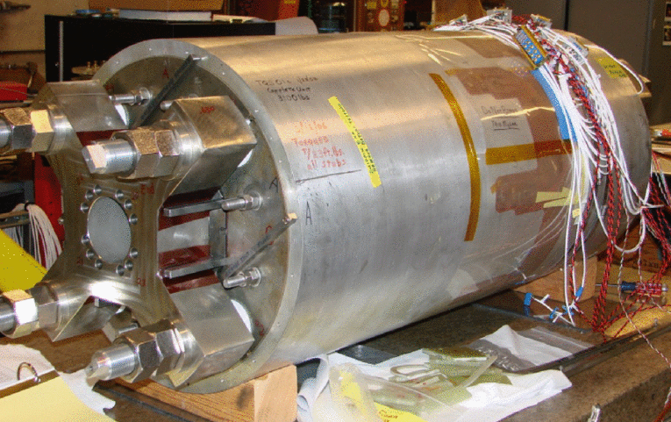
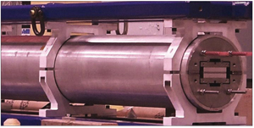


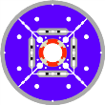
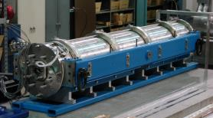
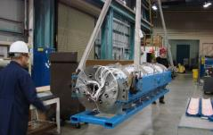
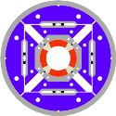
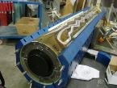
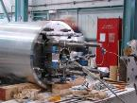
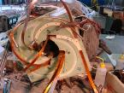
Development History (LARP)
Subscale Quad. SQ
0.3 m long
110 mm bore
2004-2006
SQ02
TQS01
LRS01
Technology Quadrupole
TQS - TQC
1 m long
90 mm bore
2006-2010
Long Racetrack LRS
3.6 m long
No bore
2006-2008
Manufacturing & Reproducibility
of Cos2θ Coils, Mech. Structure
LQS01
LQS03
Long Quadrupole LQS
3.7 m long
90 mm bore
2007-2012
First (and only) length
scale up
HQ01b-c
HQ01d-e
HQ02
High Field Quadrupole HQ
1 m long
120 mm bore
2008-2014
Aperture increase, Acc. Quality

Slide 15
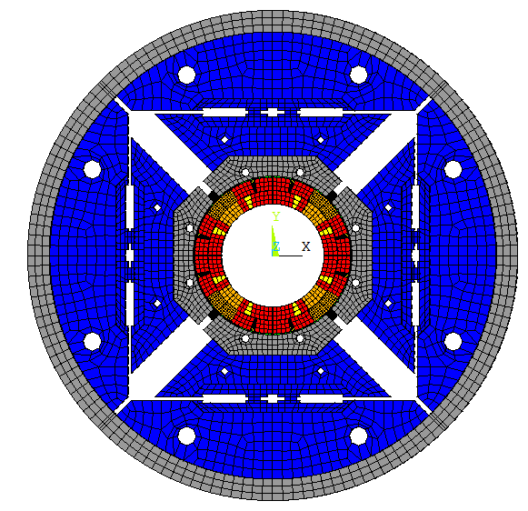
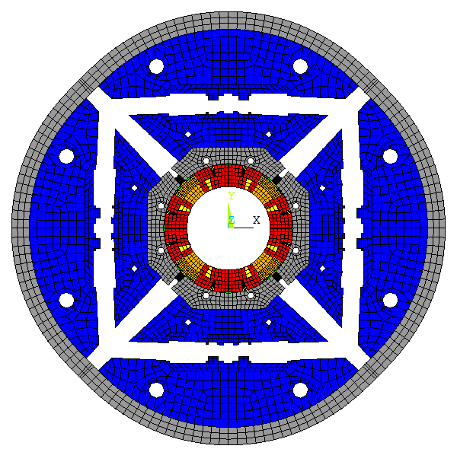
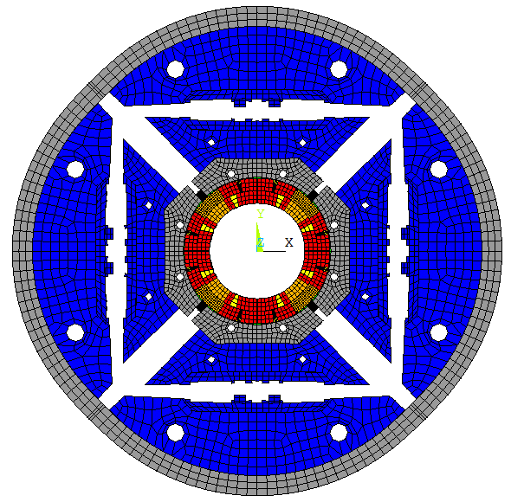
Mechanical structure
Two mechanical structure developed during the LARP phase:
  “Traditional” SS Collars
  Al Shell preloaded using water-pressurized bladders and interference keys during assembly
After test of several models, the bladder and key structure demonstrated a better capability of controlling stresses and was selected as the default option.

Slide 16
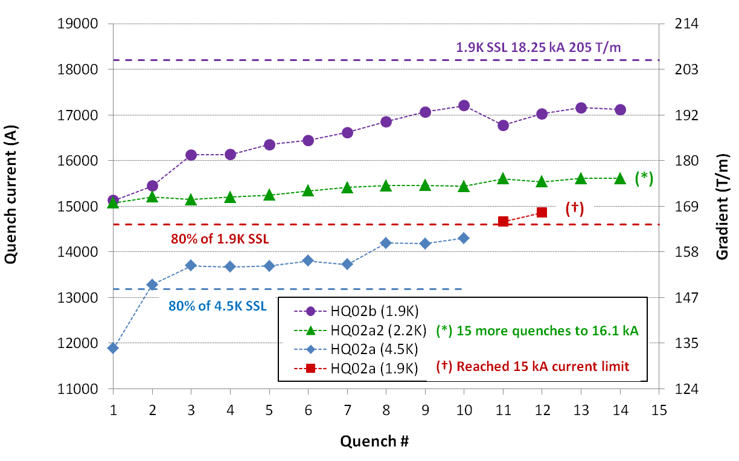
HQ (120 mm) Achievements
Goal to demonstrate all performance requirements for Nb₃Sn IR Quads in the range of interest for HL-LHC (magnetic, mechanical, quench protection etc.)
  120 mm aperture, 15 T peak field at 220 T/m (1.9K)
  First LARP design incorporating all provisions for accelerator field quality:
    Control of geometry, saturation, magnetization, eddy currents
    Alignment at all stages of coil fabrication, assembly & powering
Stainless steel core biased toward the thick edge
Dramatic reduction of ramp rate dependence
  14.6 kA (80% SSL) up to 150 A/s (1.9K)
  Safe discharge up to 300 A/s
Partial core coverage to control eddy currents while maintaining current sharing

Slide 17
HQ Quench Protection
Significant challenges in protection of high field, large aperture magnets
  Energy density, brittle SC
HL-LHC/LARP adopted HQ as the focus of quench protection studies.
  Basic Plan: Energy distribution using quench heaters.
Innovative idea under study: CLIQ = Coupling Loss Induced Quench system
HQ tests have shown no or small permanent degradation at hot-spot temperature of ~ 400 K
  MQXF target is hot-spot temperature less than ~ 300 K

Slide 18
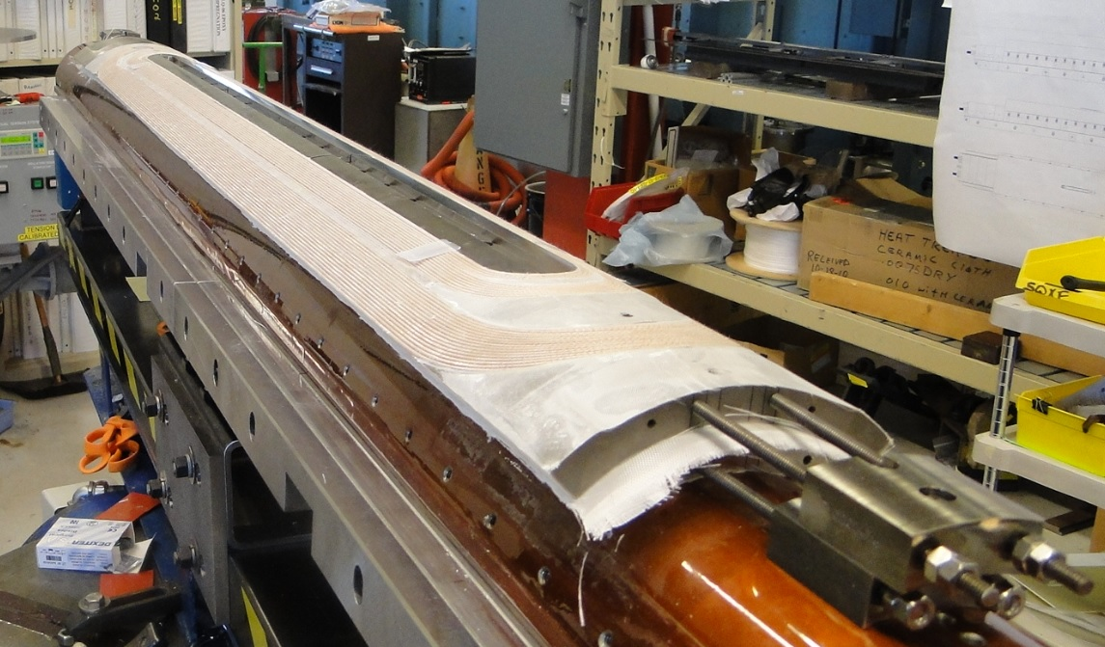
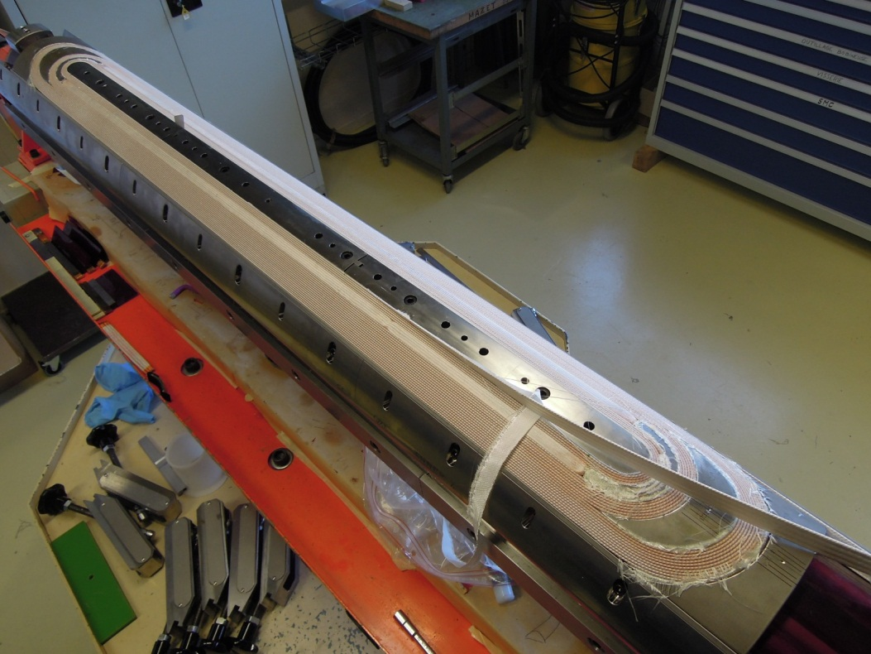
QXF (HL-LHC Quads) Plans
Short model program: 2014-2016
  First SQXF coil test (Mirror struct.) in Dec. 2014
  First magnet test (SQXF1) in May 2015
  2 (LARP) + 3 (CERN) short models + reassembly (~4)
Long model program: 2015-2018
  Coil winding starts in 2015: Jan. (LARP)
  First LQXF coil test (Mirror structure) in Dec. 2015
  First model test in Oct. 2016 (LARP) and July 2017 (CERN)
  3 (LARP) + 2 (CERN) models in total
Series production: 2018-2022
LARP
CERN

Slide 19
Risk Control
The 120 mm LARP program is providing risk reduction before we start testing QXF models
  HQ02 reached 95% of SSL at 1.9K:
    Coil fabrication technology is OK
    Magnet assembly process is OK
  Quench protection tests:
    With sufficient prestress hot-spot 300+ K is OK
    CLIQ is very effective for Nb₃Sn coils
  Field Quality OK with magnetic shims
  LHQ (2.5 m long) coil test in a few months
Items to address
  Developing different heater designs and different techniques to avoid heater detachment from coil (observed in HQ)
  Modifications to test facilities for testing/demonstrating CLIQ on S/LQXF

Slide 20
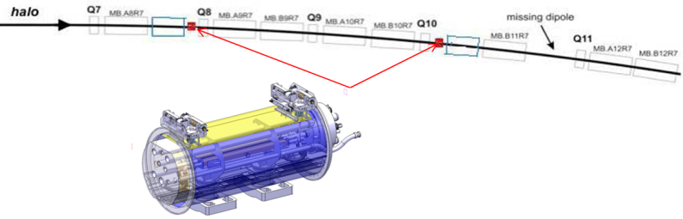
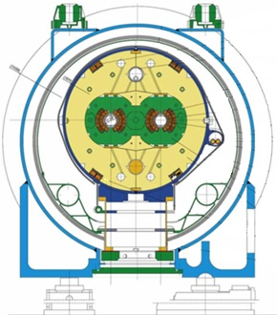
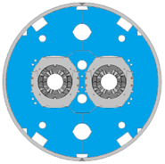
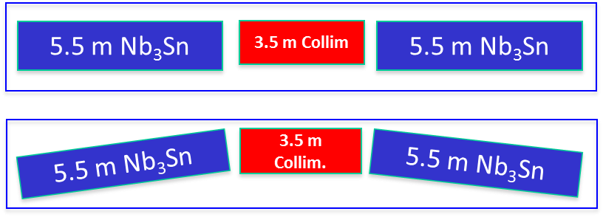
11 T Dipoles Motivation
LHC particles losing momentum due to diffractive scattering or interactions at IR can only be intercepted by cold collimators in the Dispersion Suppression (DS) regions where the Main Dipoles are located.
Due to the high filling fraction of the LHC arcs, the only viable solution is to create space by substitution an 8 T main dipole with an upgraded 11 T, shorter dipole

Slide 21
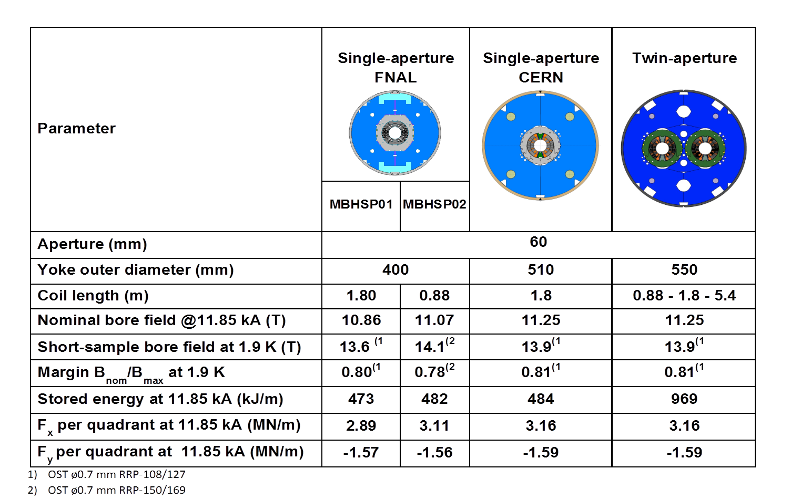
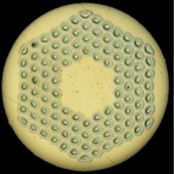

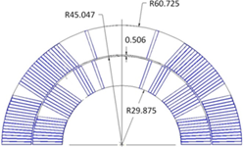
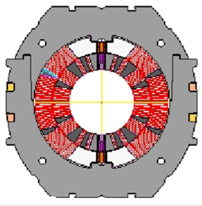
Magnet Design
0.7 mm Nb₃Sn RRP strand
40-strand cable
Chellenges: high field, forces, stored energy
Stainless steel collar

Slide 22
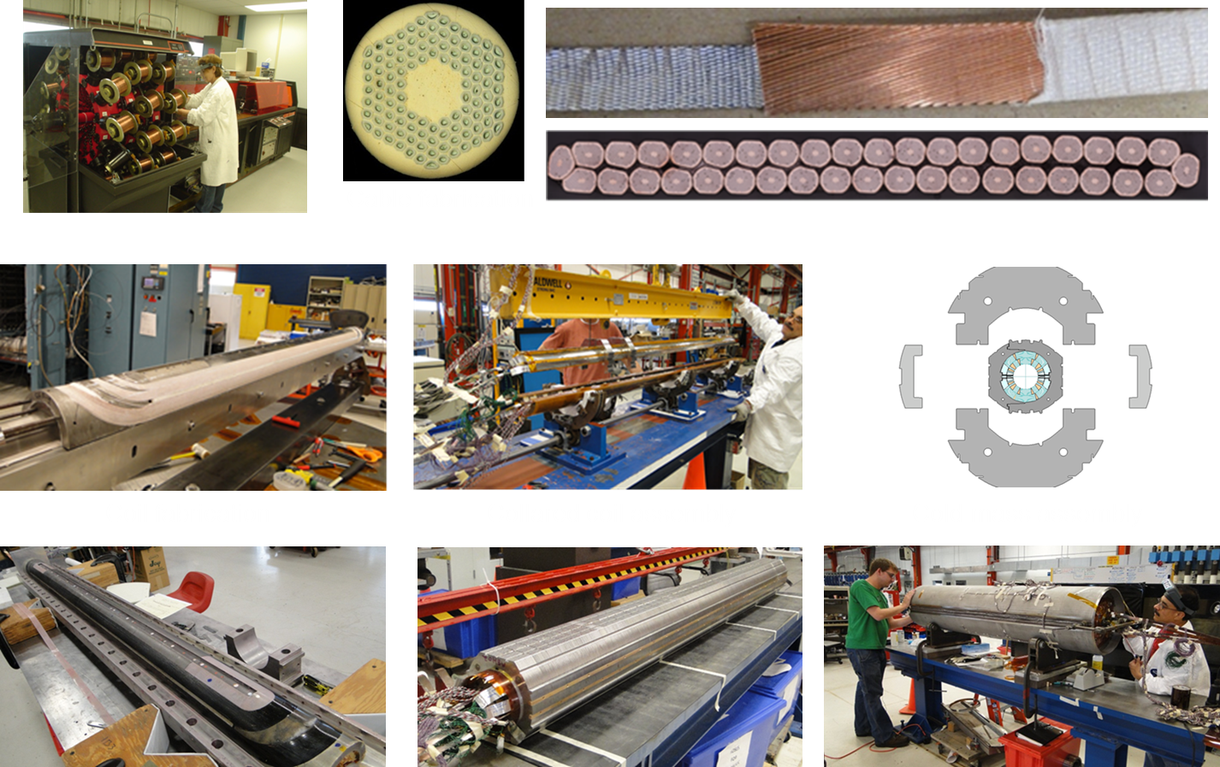
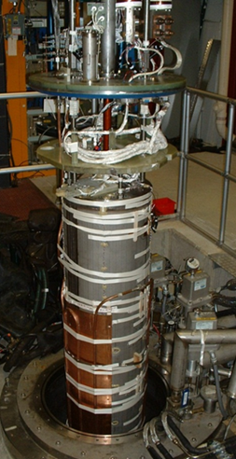

Fabrication
Fabrication: from cable to magnet
Test: VMTF, quench performance, magnetic measurements, quench protection

Slide 23
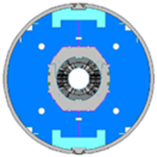
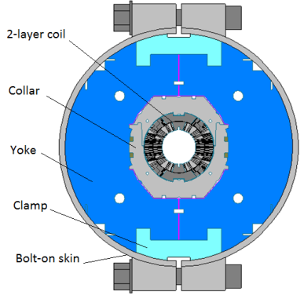
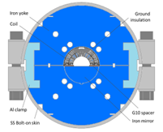
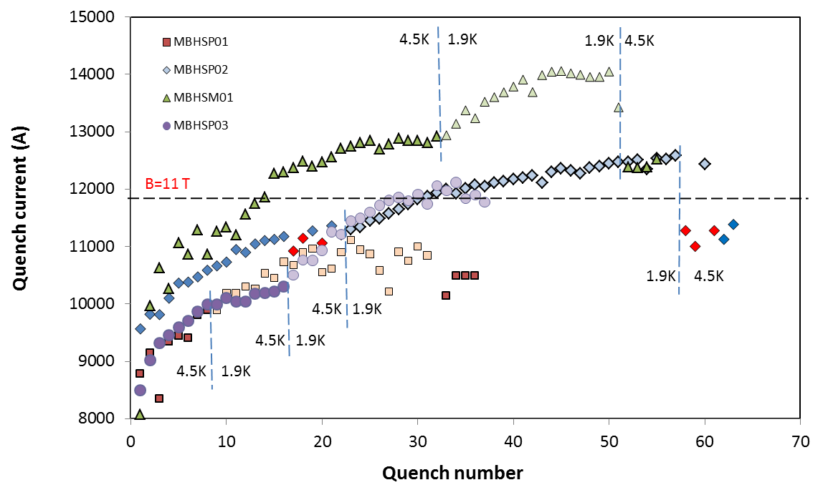
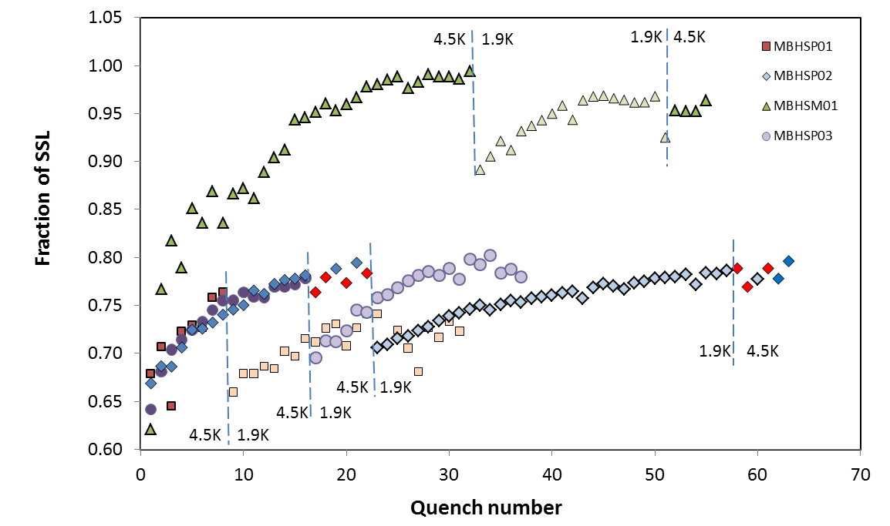
Quench Performance (FNAL)
MBHSP01:
  B_{max}=10.4 T at 1.9 K, 50A/s
  strong ramp rate sensitivity
  holding quenches
MBHSP02:
  B_{max}=11.7 T at 1.9 K
  97.5% of B_{des}=12 T
  low ramp rate sensitivity
  holding quenches
MBHSM01:
  B_{max}=12.5 T at 1.9 K
  ~100(97)% at 4.5 (1.9) K of SSL
  low ramp rate sensitivity
  no holding quenches
MBHSP03: test just concluded
MBHSP01
MBHSP02, 03
MBHSM01

Slide 24
Conclusions
After a decade of development, Nb₃Sn magnets have reached maturity for application in accelerators.
Nb₃Sn IR Focusing Quadrupoles (G ~140 T/m, 150 mm aperture) and Dipoles (11 T) are foreseen for upgrades to the LHC in order to deliver ~3000 fb⁻¹ to the CMS and ATLAS experiments in the next decades
The CERN/LARP Collaboration has finalized the design of the Quadrupoles and Dipoles needed for the HL-LHC and is now embarking in a ~3 years program to transfer technology and to deliver working prototypes of each magnet.
Construction of the magnets is planned in the ’18-’22 period with installation during LS3.

