Slide 1
Switchyard External Beamlines
From the past to the present
Michael Geelhoed
Aria Soha
Paul Reimer
1 July 2014

Slide 2
Switchyard External Beamlines
Items to be covered
  Switchyard’s History
  Switchyard’s Present
  Delivery Method
  Users
    FTBF
    SeaQuest

Slide 3
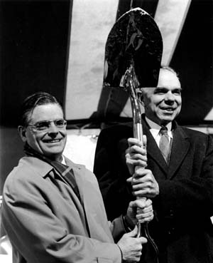
Switchyard’s History – Begins with Fermilab’s History
NAL breaks ground Dec 1st 1968
Robert R. Wilson (l) and Glenn Seaborg (r) at the NAL Groundbreaking

Slide 4
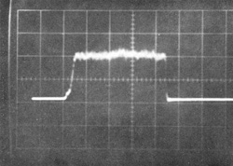
Switchyard’s History – Begins with Fermilab’s History
NAL breaks ground Dec 1st 1968
Linac beam (1970)
A photo of the early accelerated proton beam from NAL's pre-accelerator: 200 milliamperes during 80 microseconds pulse

Slide 5
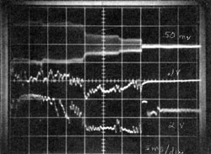
Switchyard’s History – Begins with Fermilab’s History
NAL breaks ground Dec 1st 1968
Linac beam (1970)
Booster beam (1971)
Scope display of first Booster beam to 8 GeV. Upper trace is beam intensity; middle trace is beam pulse

Slide 6
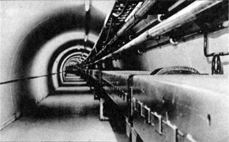
Switchyard’s History – Begins with Fermilab’s History
NAL breaks ground Dec 1st 1968
Linac beam (1970)
Booster beam (1971)
Main Ring (1972)
Main Ring machine

Slide 7
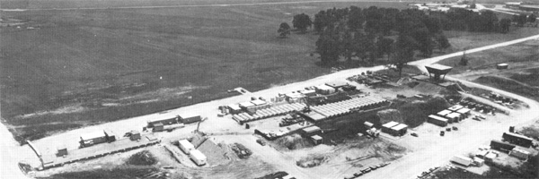
Switchyard’s History – Begins with Fermilab’s History
NAL breaks ground Dec 1st 1968
Linac beam (1970)
Booster beam (1971)
Main Ring (1972)
Proton (1972)
Aerial view of Proton experimental area. Pagoda control center may be seen at right

Slide 8
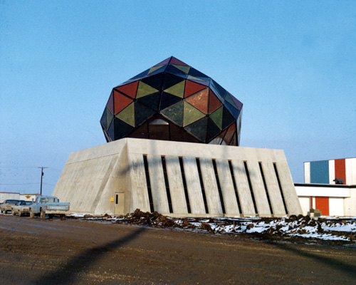
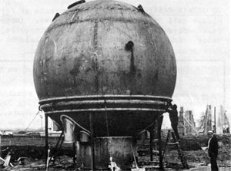
Switchyard’s History – Begins with Fermilab’s History
NAL breaks ground Dec 1st 1968
Linac beam (1970)
Booster beam (1971)
Main Ring (1972)
Proton (1972)
Neutrino (1972)
Neutrino Dome Feb 24, 1972
Photo by Tim Fielding, NAL

Slide 9
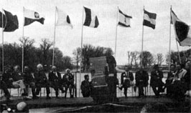
Switchyard’s History – Begins with Fermilab’s History
NAL breaks ground Dec 1st 1968
Linac beam (1970)
Booster beam (1971)
Main Ring (1972)
Proton (1972)
Neutrino (1972)
NAL became FNAL May 11th 1974
Distinguished guests dedicate Fermilab

Slide 10
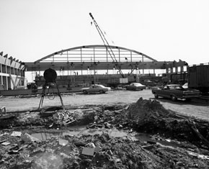
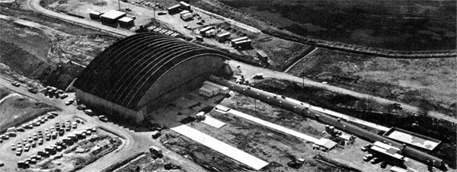
Switchyard’s History – Begins with Fermilab’s History
NAL breaks ground Dec 1st 1968
Linac beam (1970)
Booster beam (1971)
Main Ring (1972)
Proton (1972)
Neutrino (1972)
NAL became FNAL May 11th 1974
Meson (1977)
Meson Detector Building

Slide 11
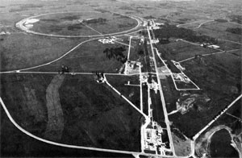
Switchyard’s History – Begins with Fermilab’s History
Meson
Neutrino
Proton
In 1972 Main Ring reached design energy of 200 GeV
Main Ring

Slide 12
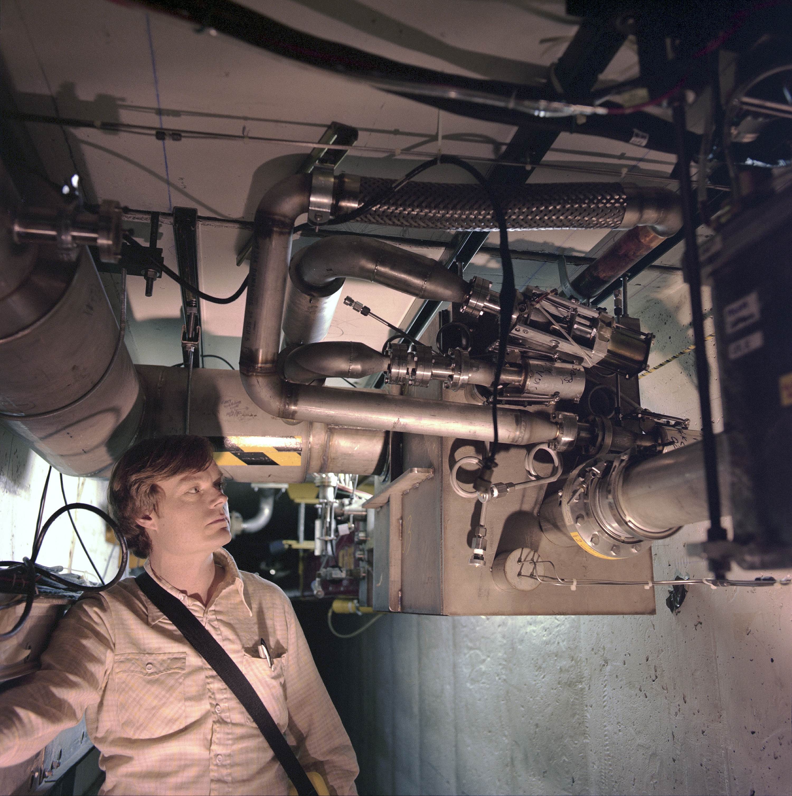
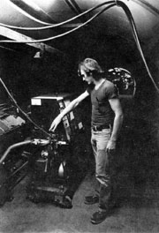
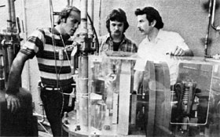
Switchyard’s History – Begins with Fermilab’s History
On July 3rd 1983 the Energy Doubler better known as the Tevatron reached 512 Gev.
Feb 16th 1984 800 Gev was achieved and extracted towards the Switchyard area.

Slide 13
Switchyard’s Present – Begins with Change
Fermilab’s Main Injector initial design started 1987
Construction began 1993
MI ready for HEP in 1999

Slide 14
Switchyard’s Present – Begins with Change
Source Linac & Booster
Meson
Main Injector

Slide 15
Switchyard’s Present
Things still changing…

Slide 16
Switchyard’s Present
Source Linac & Booster
MTest
MCenter
Neutrino Muon
SeaQuest
Main Injector

Slide 17
Switchyard’s Delivery
Source Linac & Booster
Beam is produced from AD’s Proton source which includes three machines. The Source, Linac and the Booster Ring.

Slide 18
Switchyard’s Delivery
Source Linac & Booster
Main Injector
Beam is injected at 8 and ramped to 120 Gev Beam is at this flattop value and is resonantly extracted over 4 seconds.

Slide 19
Switchyard’s Delivery
Field Free Region
Field Region
2 Electrostatic Septa
Not to scale*

Slide 20
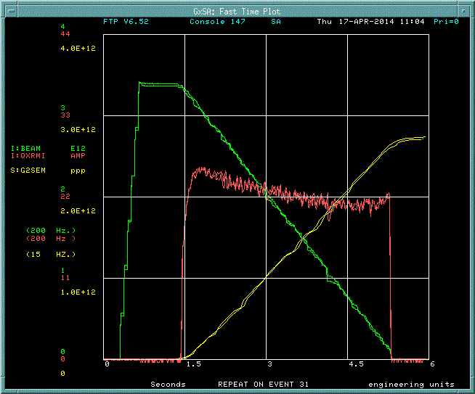
Switchyard’s Delivery
QXR regulates Slow Extraction

Slide 21
Switchyard’s Present
Source Linac & Booster
MTest
MCenter
Neutrino Muon
SeaQuest
Main Injector
P3
Beam is extracted from the MI52 area transported through the P1, P2, and P3 (Main Ring remnant) beamlines. In Switchyard, Electrostatic Septa split beam twice.
First split beam to Neutrino Muon and Meson in enclosure B, the second split is in the F1 Manhole and splits beam between MTest and MCenter.
P2
P1

Slide 22
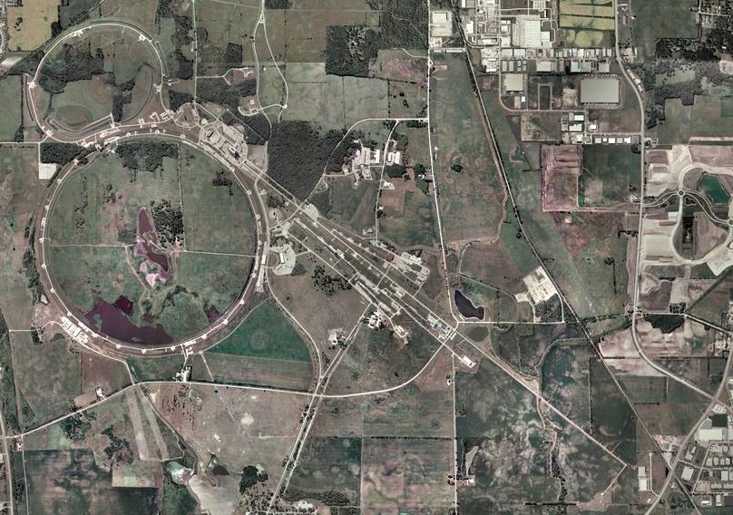
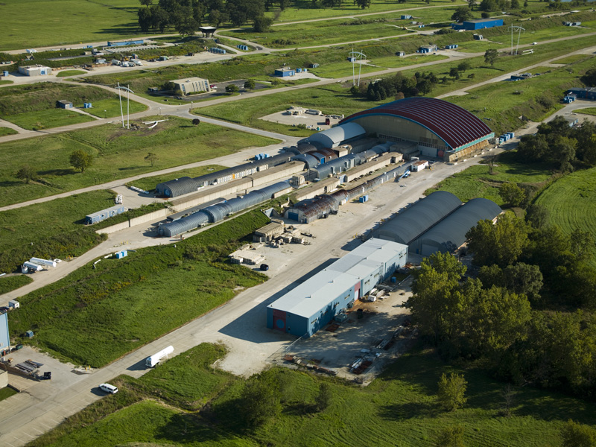
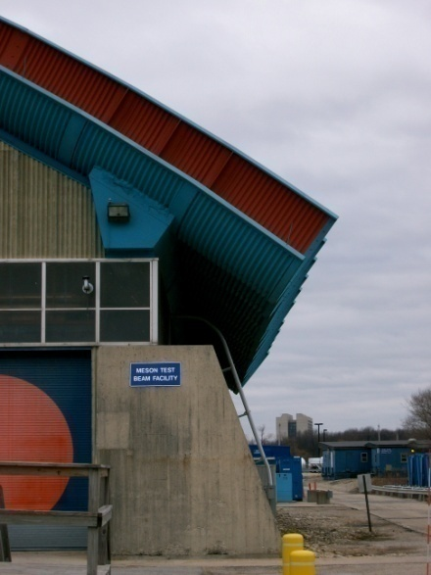
Switchyard’s User – FTBF Location
Meson Detector Building – West

Slide 23
Switchyard’s User – FTBF Users
World Class Facility
The only U.S. HEP Test Beam
Detector R&D focus
In 2014:
  17 experiments
  316 collaborators
  85 institutions
  20 countries
*Number of Collaborators has been scaled to fit on plot
*Number of Institutions has been scaled to fit on plot.
Accelerator Shutdown FY12 & FY13

Slide 24
Switchyard’s User –FTBF Weekly Usage

Slide 25
Switchyard’s User – FTBF 2014 Experiments
Dual Readout Calorimetry – General R&D
Spacordian – Support of LHC experiment
ATLAS Tile Electronics Test – Support of LHC experiment
High Rate Pixel Detector for CMS Upgrade – Support of LHC experiment
FlYSUB – General R&D
CMS Forward Calorimetry R&D – Support of LHC experiment
Muon g-2 Straw Tracker – Fermilab Experiment
sPHENIX Calorimetry Tests – Nuclear Physics Experiment
PHENIX Fast TOF – Nuclear Physics Experiment
ATLAS large scale Thin Gap Chambers – Support of LHC experiment
sPHENIX PreShower – Nuclear Physics Experiment
ATLAS DBM Module Qualification – Support of LHC experiment
FP420 Fast Timing Group – General R&D
Fast Timing Counters for PSEC – General R&D
DAMIC – Fermilab Dark Energy Experiment
SLHC sensor tests – Support of LHC experiment
JASMIN – Nuclear Physics Research

Slide 26
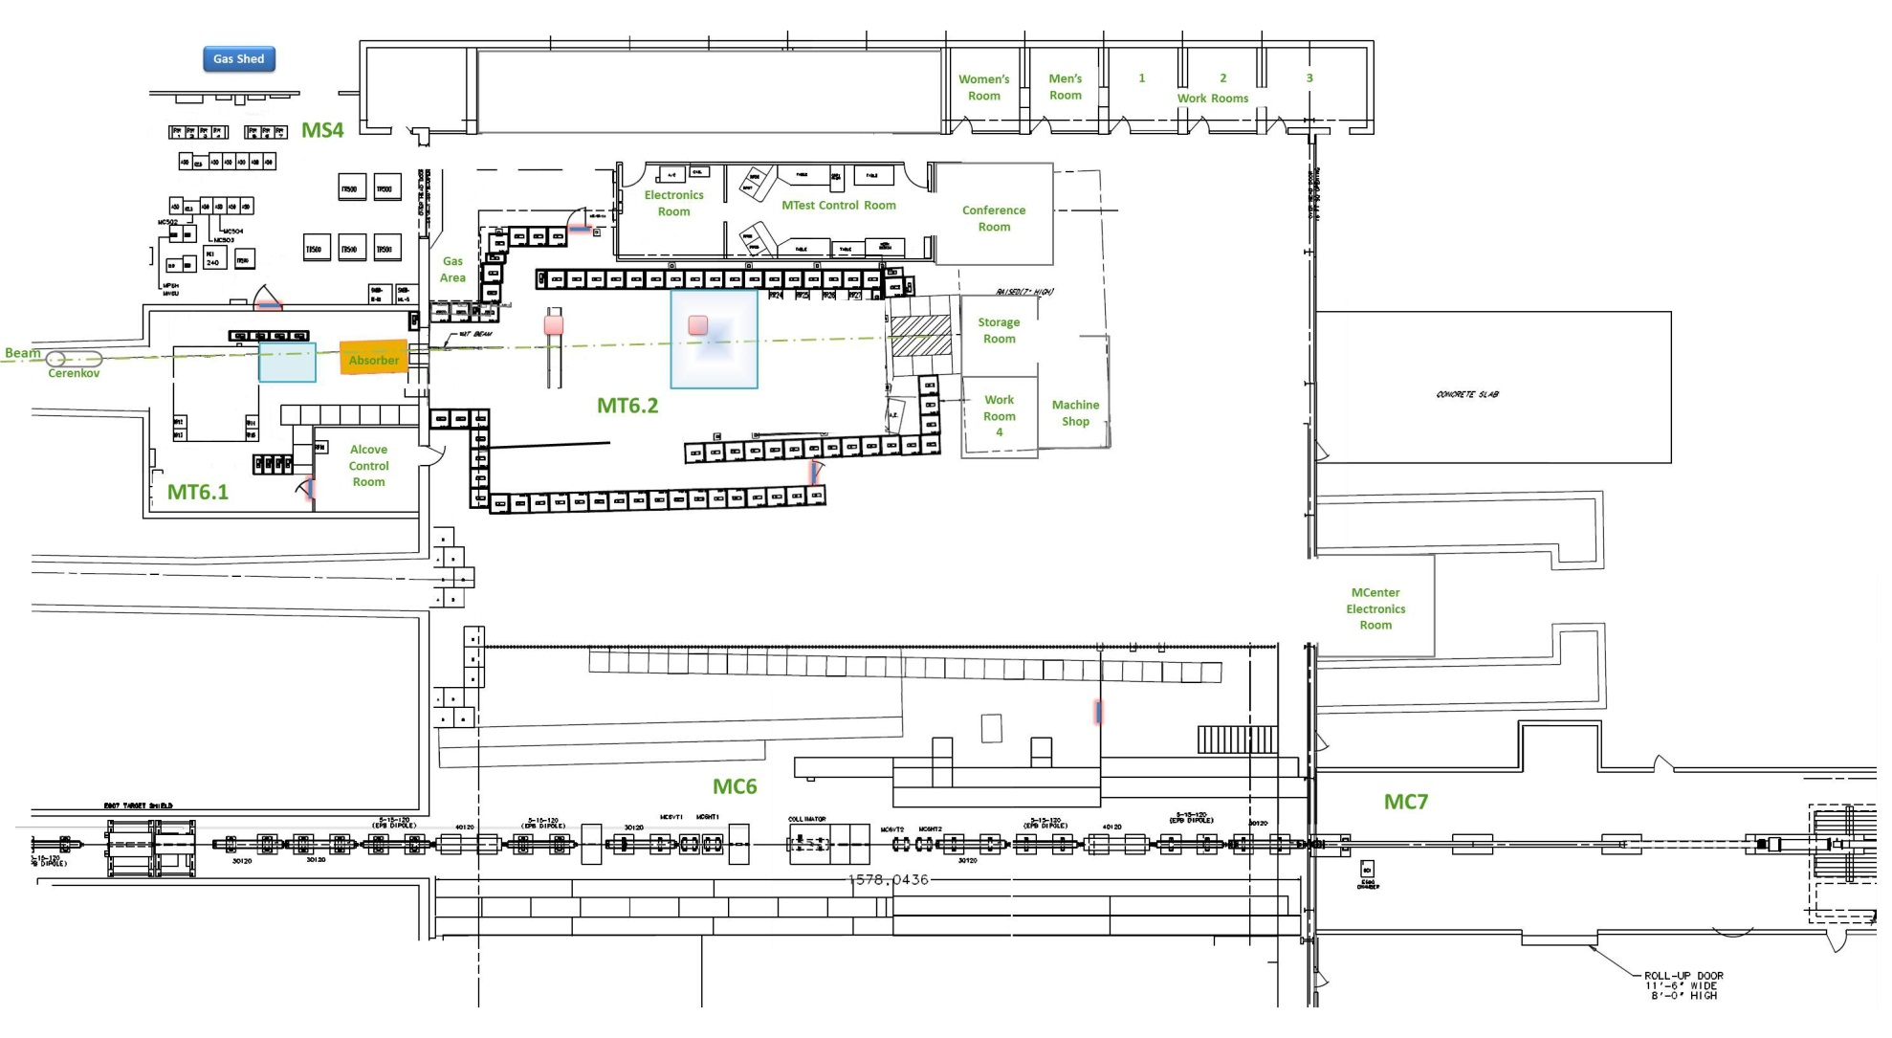
Switchyard’s User – FTBF Facility Layout
Beam Areas
Work Areas
Control Rooms

Slide 27
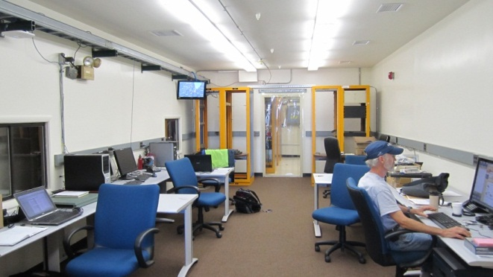
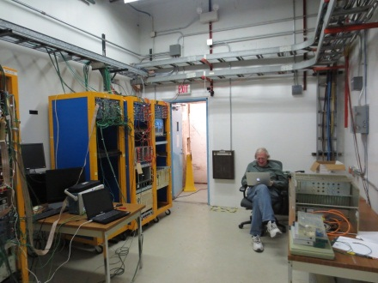
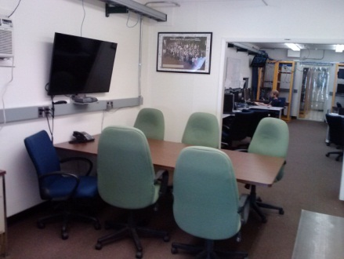
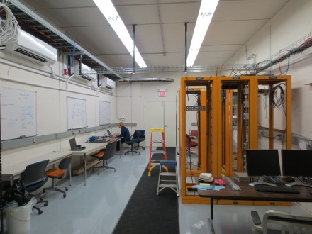
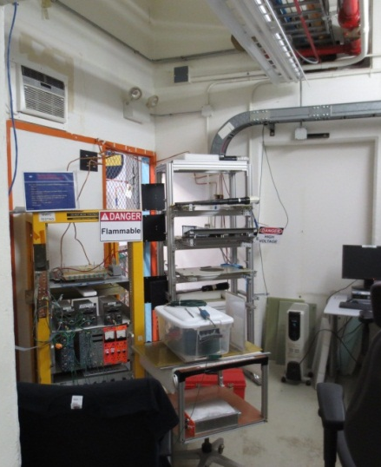
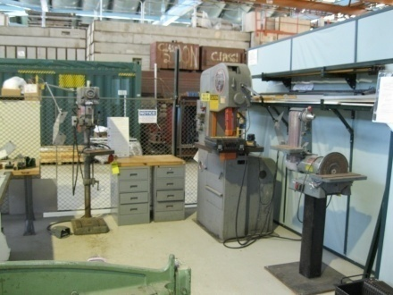
Switchyard’s User – FTBF Rooms
Multiple Control Rooms
  Mtest Ctrl Rm
    Electronics Rm
  Alcove Ctrl Rm
  MCntr Ctrl Rm
Video Conference Room
Machine Shop
Cosmic Test Area

Slide 28
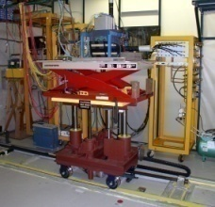
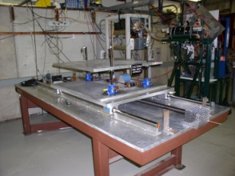
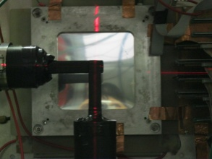
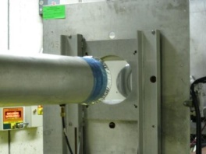

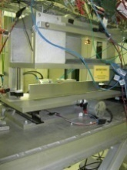
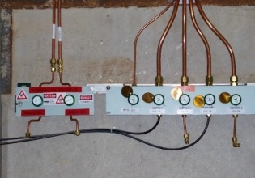
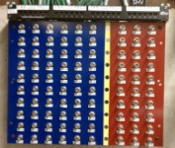
Switchyard’s User – FTBF Infrastructure
ACNET controlled Motion Tables
Laser Alignment
Helium Tubes
State-of-the-Art, web-based Cameras
Crane Coverage (30 tons)
Climate controlled Huts
Gas Patch panels
Signal, Network, & High Voltage cable patch panels

Slide 29
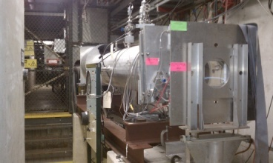
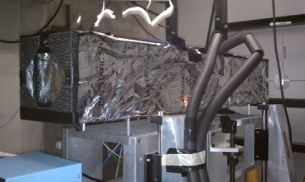
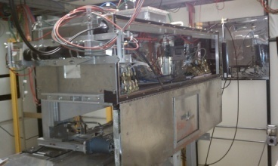
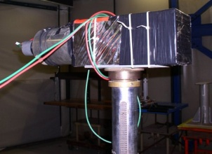
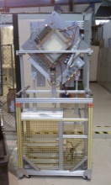
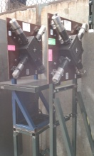
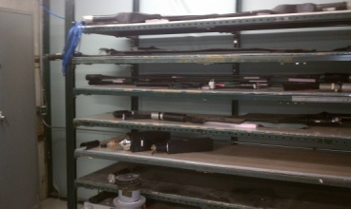
Switchyard’s User – FTBF Facility Instrumentation
2 Cerenkov
Detectors
2 Pixel Telescopes
4 MWPC Tracking System
Time of Flight System
Lead Glass
Calorimeters
Assorted Trigger scintillators

Slide 30
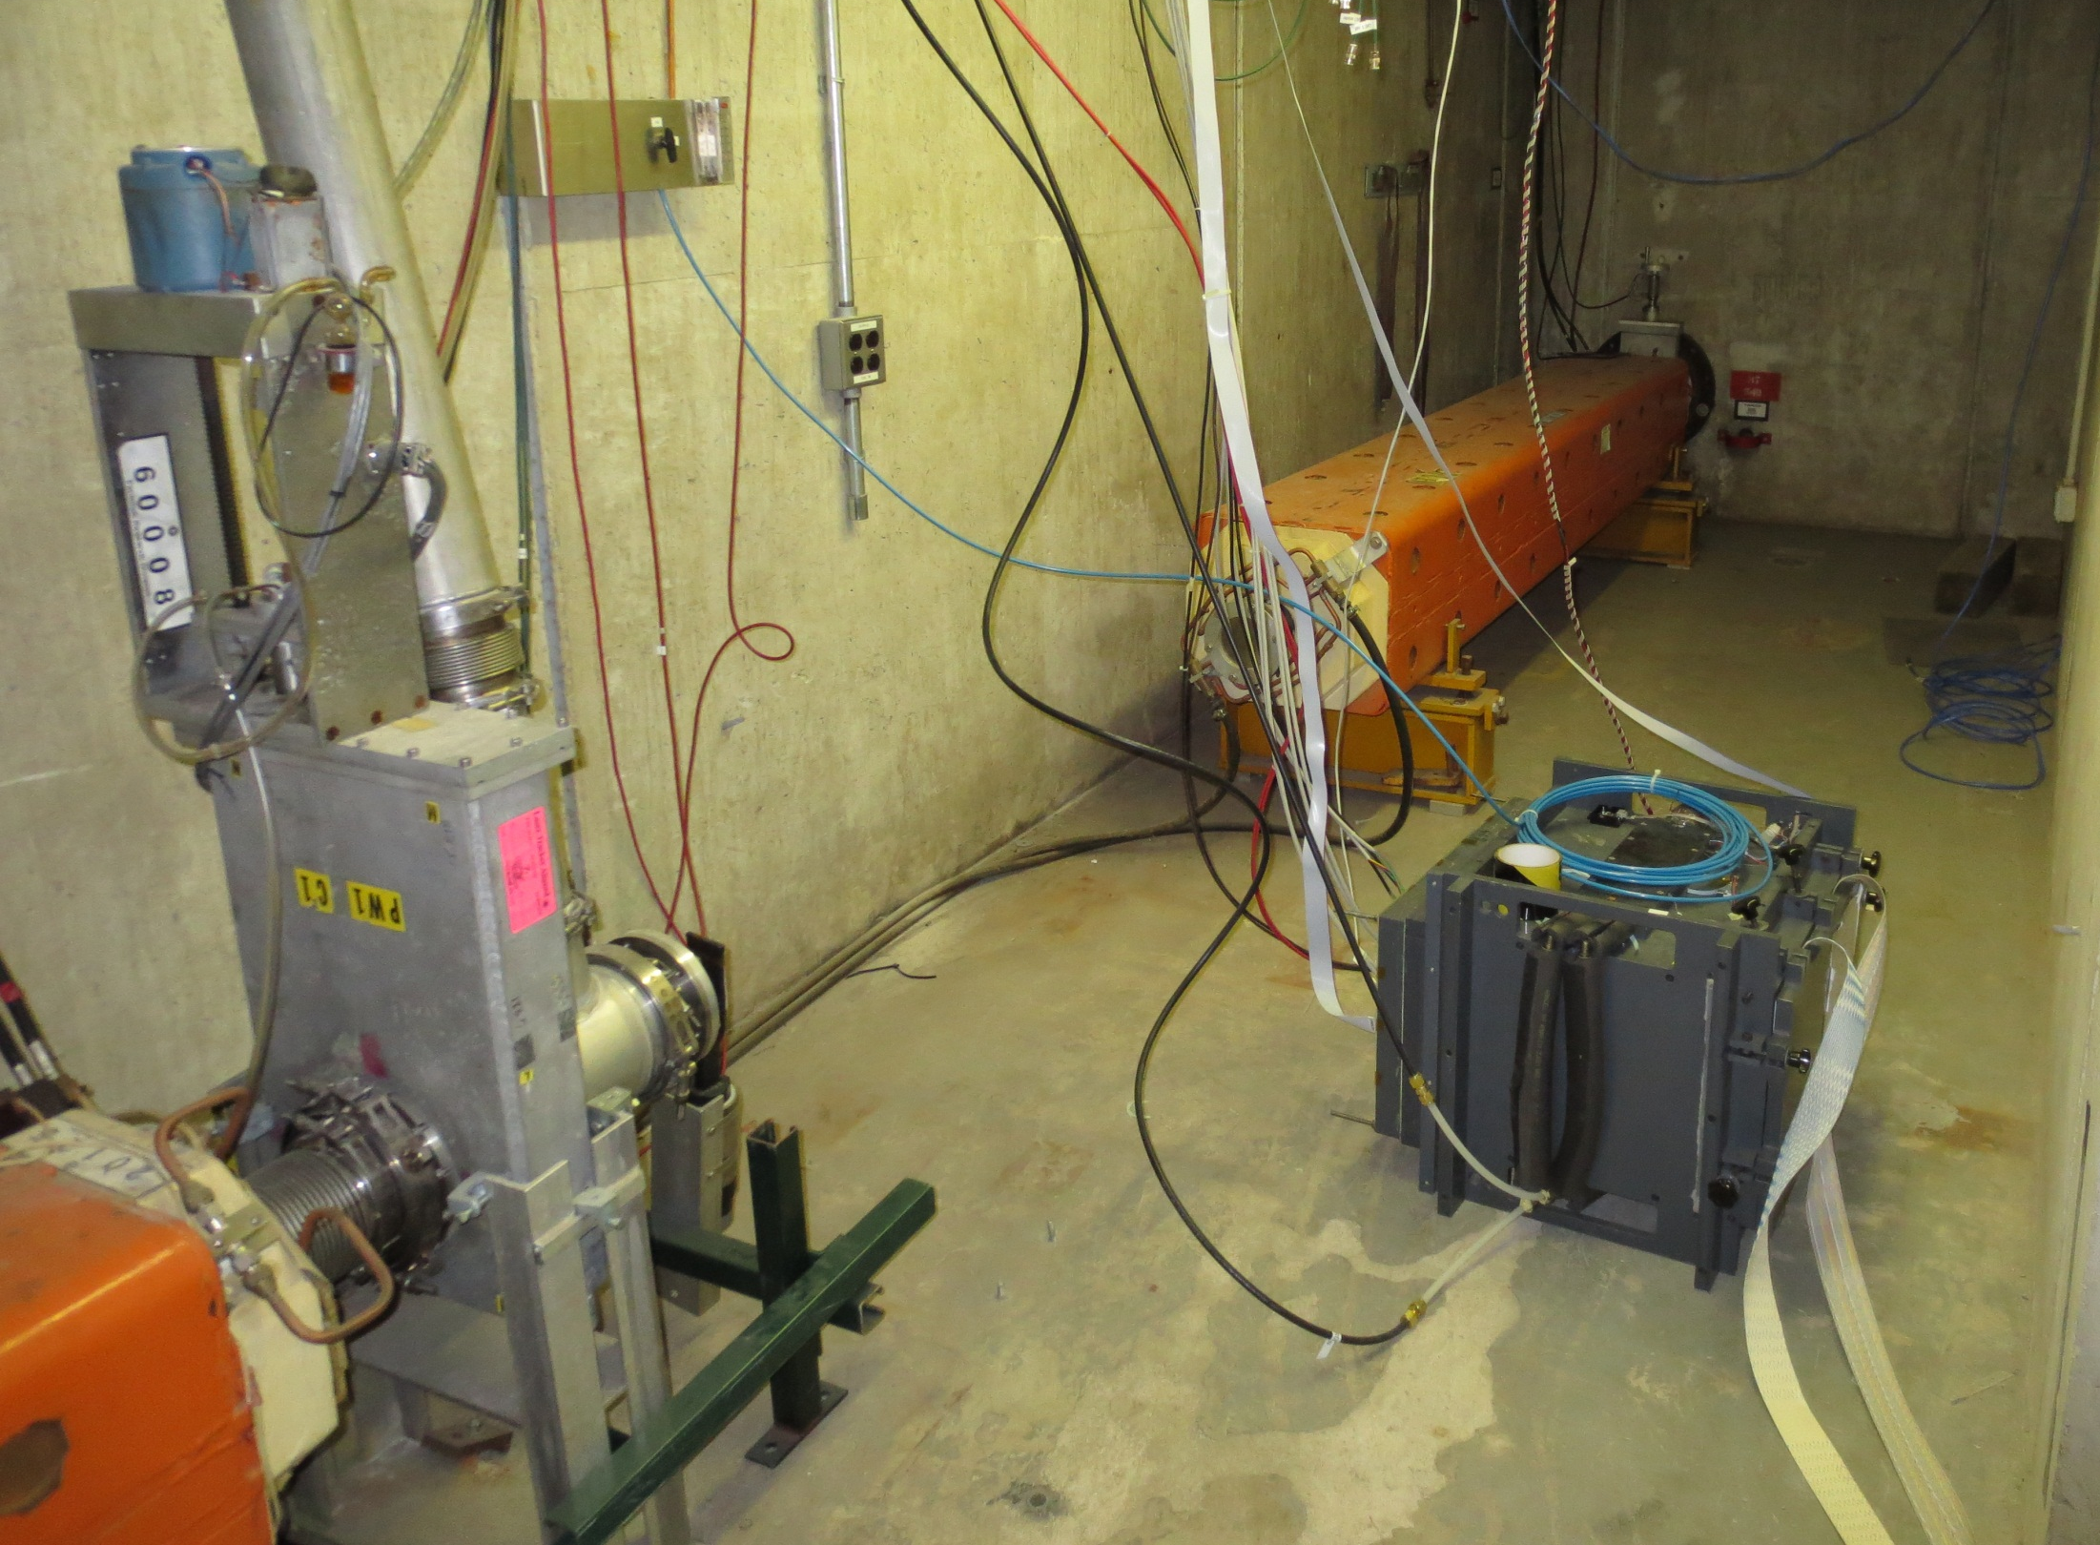
Switchyard’s User – FTBF High Rate Tracking Area
Located in MTest beamline upstream of pinhole collimator (MT3 Alcove)
2.5 GHz/cm² Rates for protons
Patch panels for signal, HV, and network link the enclosure alcove area with the MS3 service Building
Acnet controlled table
Pions also available

Slide 31
Switchyard’s User – MTest Particles and Energies
120 Gev Proton Mode (primary beam)
  Maximum intensity: 5E5 p/spill
High Energy Pion Mode
  + 60
  + 50
  + 40
Muon Mode:
  Every LE or HE Pion Mode with additional absorbers in MT6-1.
Low Energy Pion Mode
  +/- 32
  +/- 30
  +/- 25
  +/- 20
  +/- 16
  +/- 15
  +/- 12
  +/- 10
  +/- 8
  +/- 6
  +/- 5
  +/- 4
  +/- 3.5
  +/- 3
  +/- 2.5
  +/- 2
  +/- 1.5
  +/- 1
P
π
Some kaons
k
μ
Mostly Electrons/
Positrons
e

Slide 32
Switchyard’s User – FTBF Summary
Fermilab Test Beam Facility is an High Energy Beam facility for world-wide Detector R&D
Extensive facility infrastructure & instrumentation
Flexible beam delivery
  Protons, pions, muons, electrons, kaons
  200 MeV – 120 GeV
  1 – 300 kHz intensities
Beam time available!
  http://www-ppd.fnal.gov/FTBF
  Become a User

Slide 33
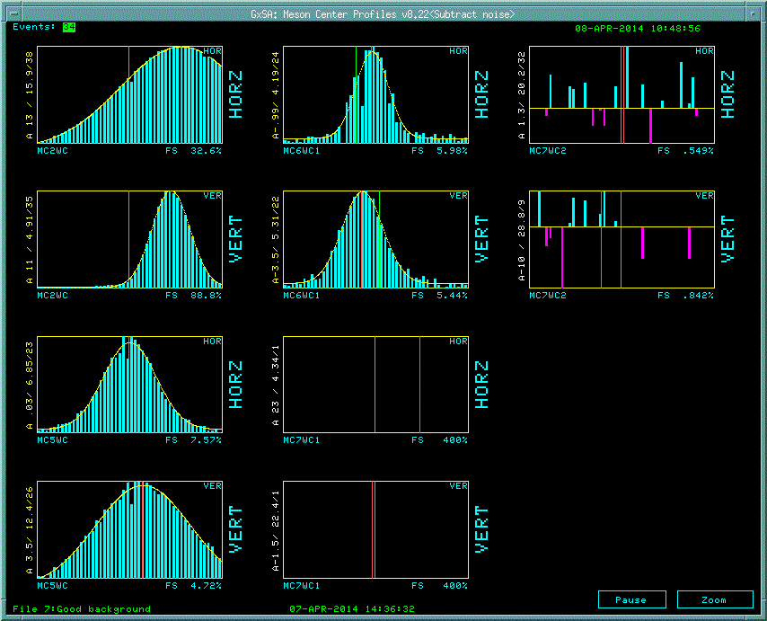
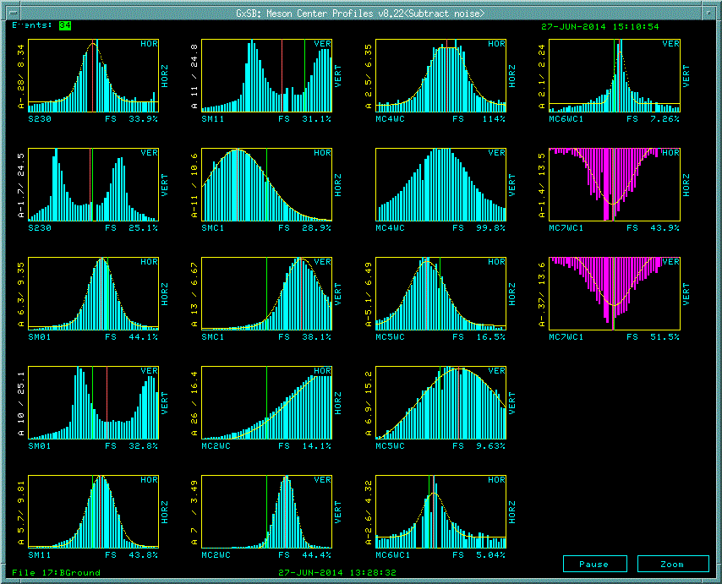
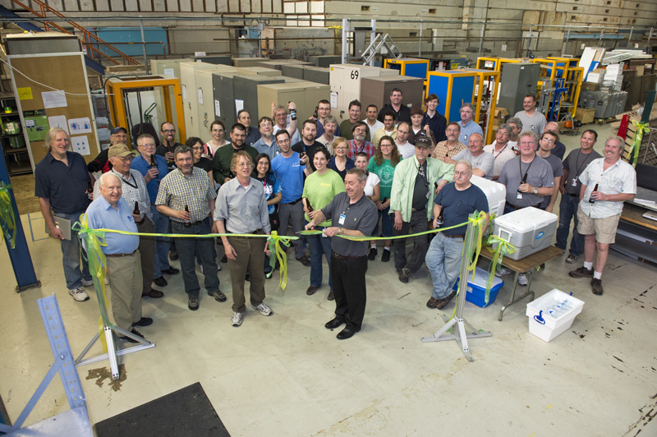
Switchyard’s User – MCenter Summary
Primary Beam Commissioned April 8th
Secondary Beam continues to be commissioned

Slide 34

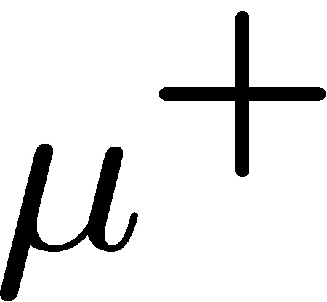
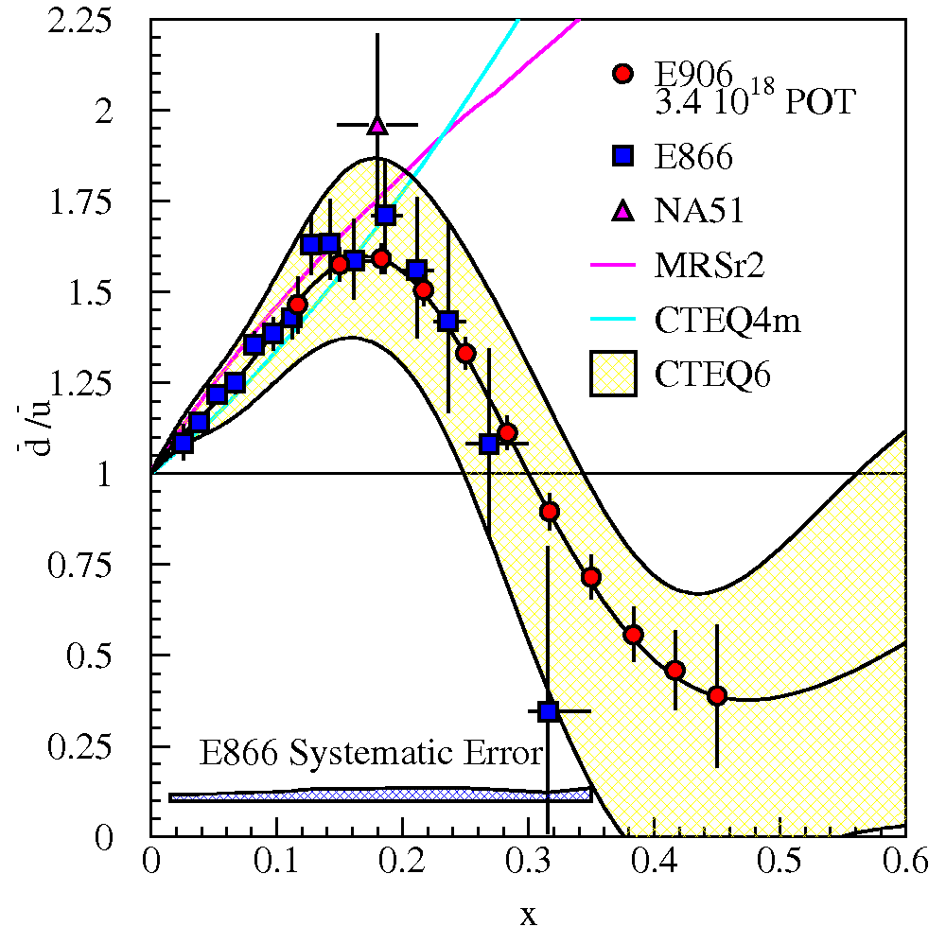


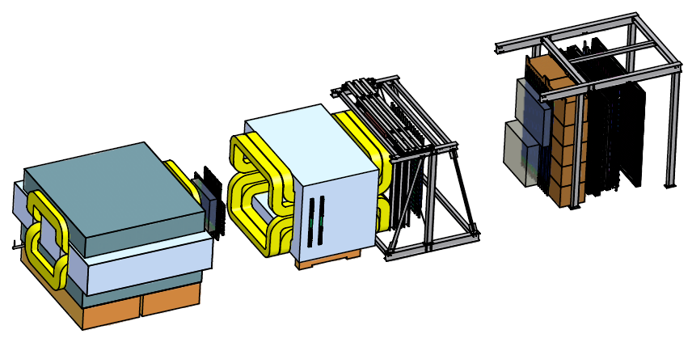
Switchyard’s User - SeaQuest
Paul E. Reimer
Physics Division
Argonne National Laboratory
This work is supported in part by the U.S. Department of Energy, Office of Nuclear Physics, under Contract No. DE-AC02-06CH11357.

Slide 35
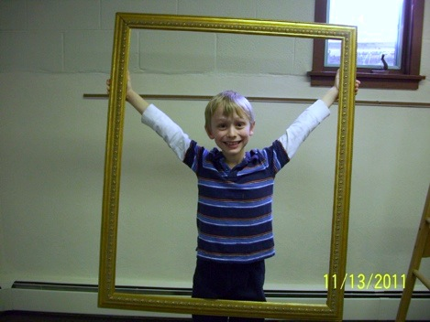
Switchyard’s User - SeaQuest
The Big Picture

Slide 36
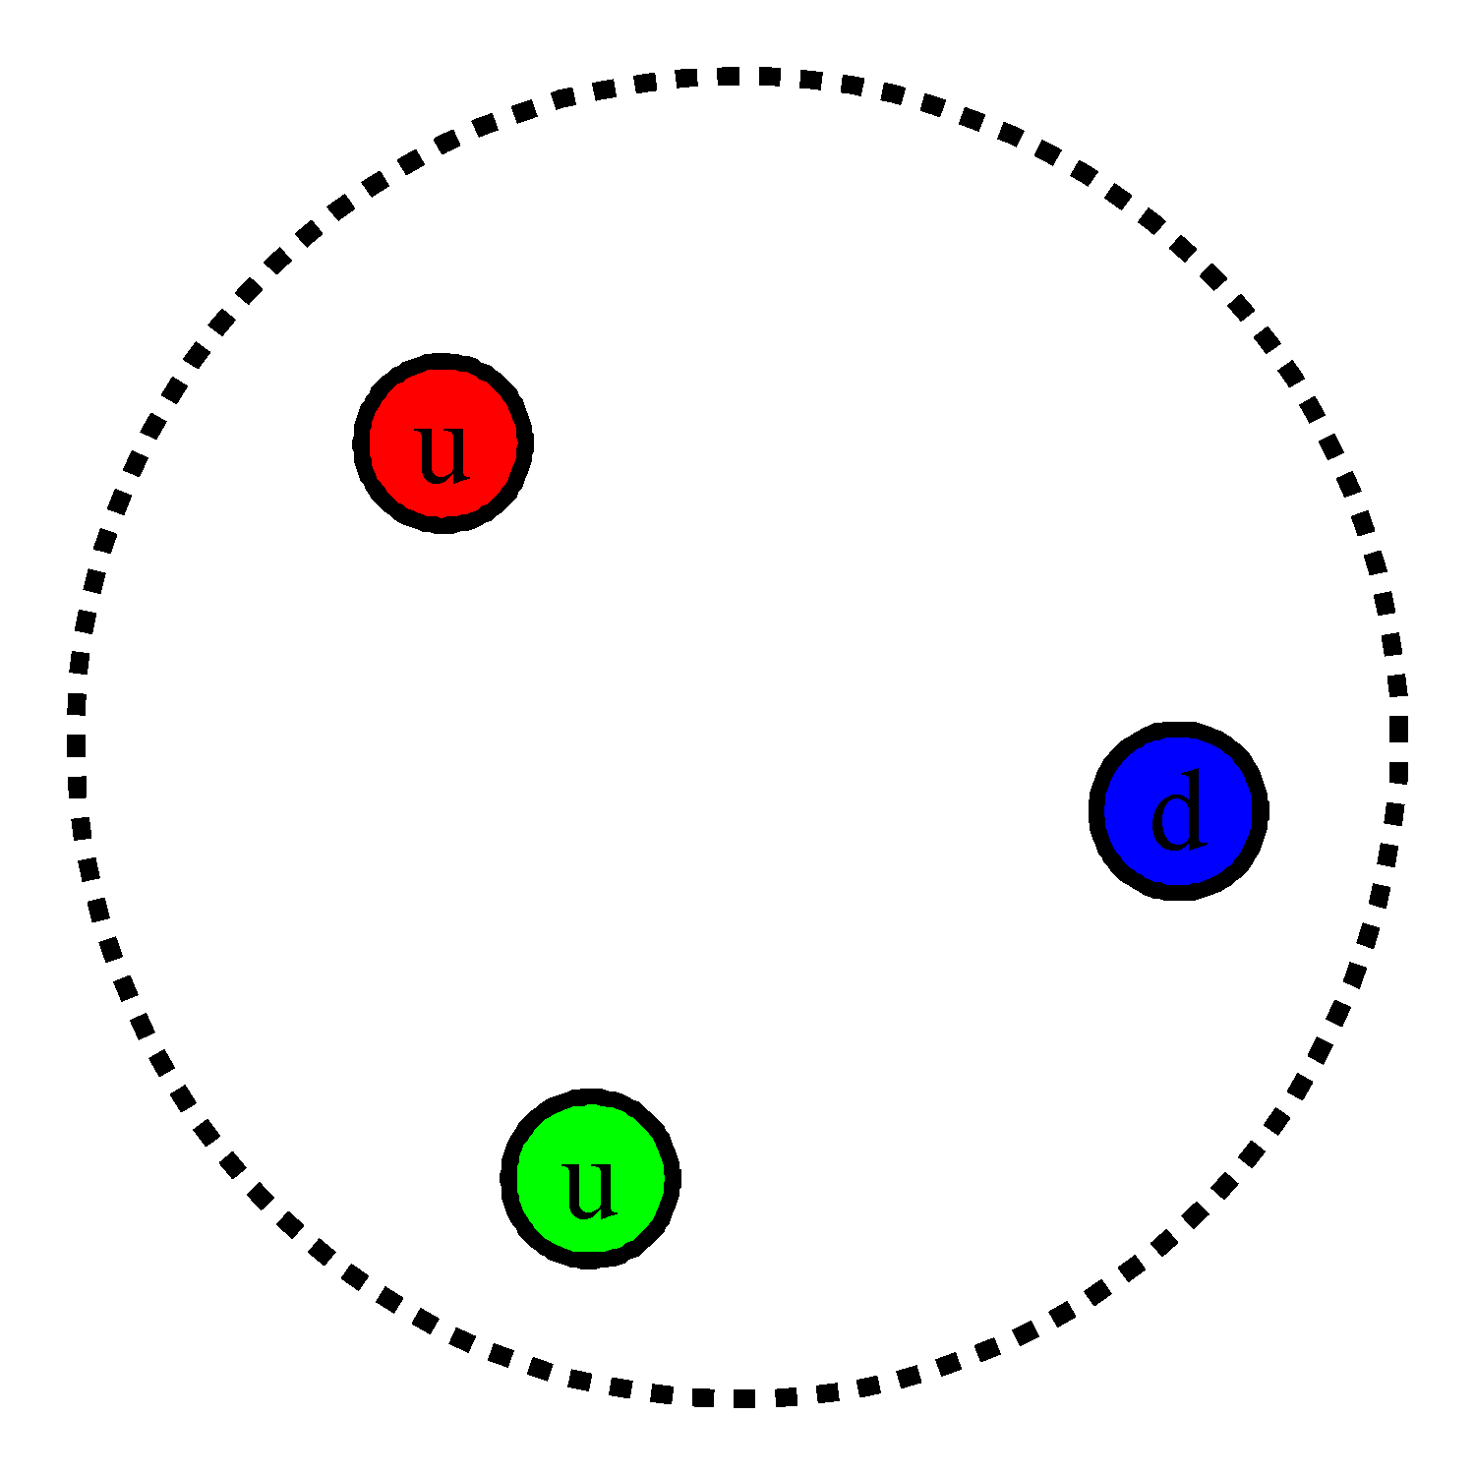
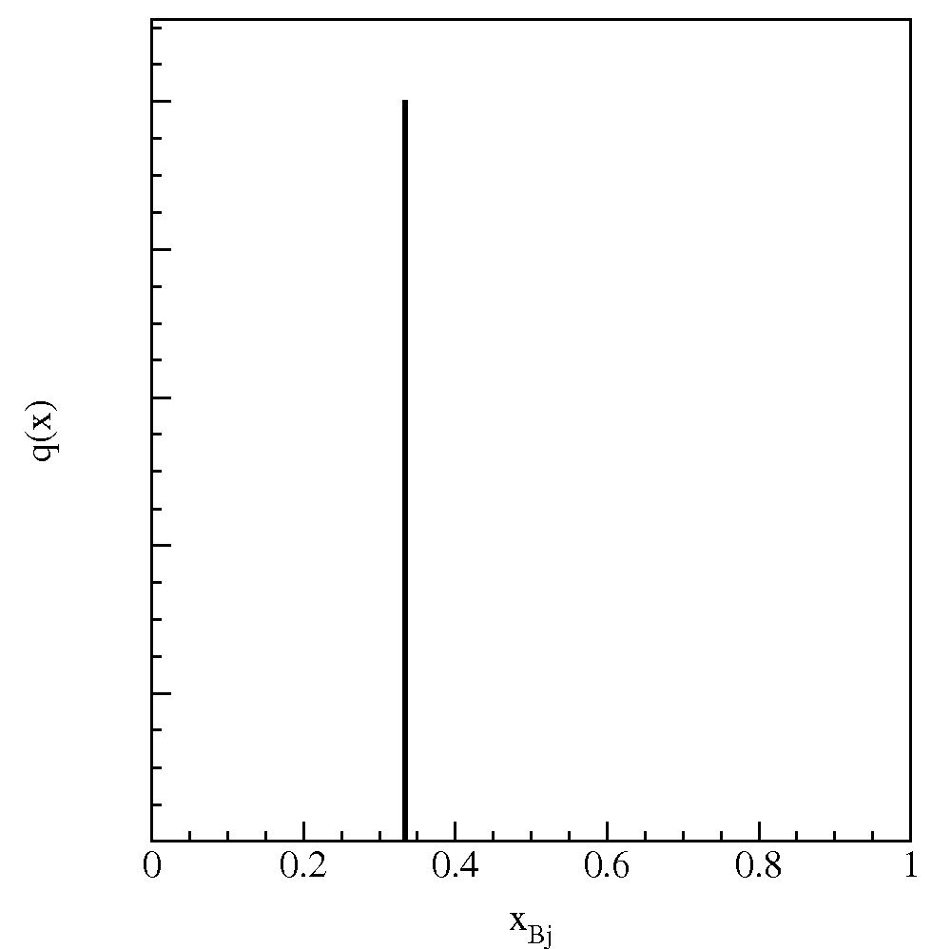
Switchyard’s User – SeaQuest The Proton’s Sea
Proton is 3 quarks—two up and one down
Bjorken-x (x_{Bj}) represents the fraction of the total momentum carried by the interacting quark

Slide 37
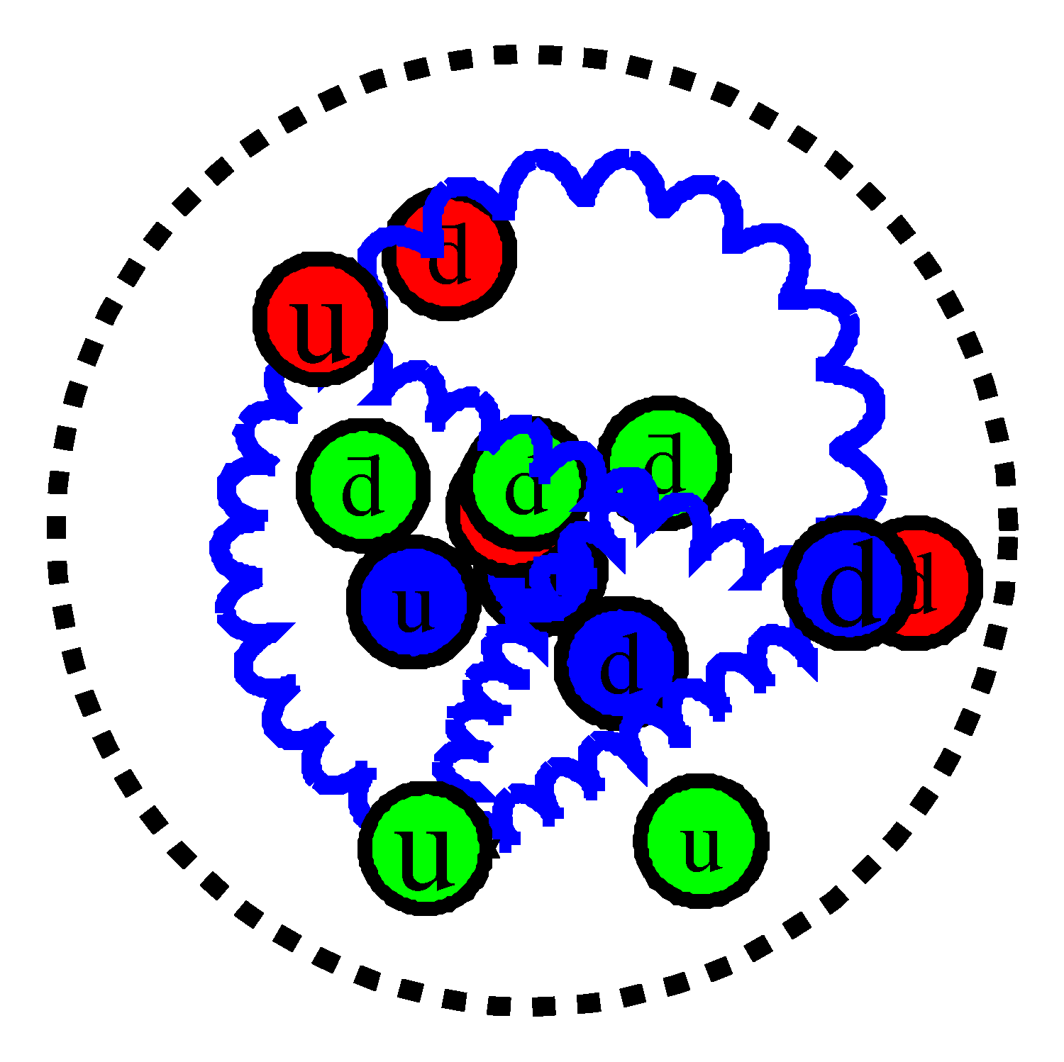

Switchyard’s User – SeaQuest The Proton’s Sea
Proton is 3 quarks—two up and one down
Bjorken-x (x_{Bj}) represents the fraction of the total momentum carried by the interacting quark
Glue at low relative momentum
Sea quarks from gluon splitting

Slide 38

Switchyard’s User – SeaQuest Light Antiquark Flavor Asymmetry:
This picture produces
  Sea generated by gluon splitting.
  Gluons couple to color, not flavor!
  Strange Sea: similar shape and origin—M_{s} suppresses.

Slide 39




Switchyard’s User – SeaQuest Light Antiquark Flavor Asymmetry:
NMC (Gottfried Sum Rule)
NA51 (Drell-Yan)

Slide 40

Switchyard’s User – SeaQuest Light Antiquark Flavor Asymmetry:
NMC (Gottfried Sum Rule)
NA51 (Drell-Yan)
E866/NuSea (Drell-Yan)
Knowledge of sea dist. are data driven
  Sea quark distributions are difficult for Lattice QCD
Non perturbative QCD models can explain excess d-bar quarks, but not return to symmetry or deficit of d-bar quarks

Slide 41



Switchyard’s User – SeaQuest Early Pair Data
Muon Pairs in the mass range 1 < m_{μμ} < 6.7 GeV/c² have been observed in collisions of high-energy protons with uranium nuclei. At an incident energy of 29 GeV, the cross section varies smoothly as dσ/dm_{μμ} ≈ 10⁻³² / m_{μμ}⁵ cm² (GeV/c)⁻² and exhibits no resonant structure. The total cross section increases by a factor of 5 as the proton energy rises from 22 to 29.5 GeV.

Slide 42

Switchyard’s User – SeaQuest Drell-Yen
Drell-Yan Process
In leading order
u-quark dominance
Forward x_{F} spectrometer acceptance
Suggested by Martin, Stirling and Roberts Phys.Lett. B308 (1993) 377

Slide 43
Switchyard’s User – SeaQuest Extracting d-bar/u-bar
E906/Drell-Yan will extend these measurements and reduce statistical uncertainty.
E906 expects systematic uncertainty to remain at approx. 1% in cross section ratio.

Slide 44

Switchyard’s User – SeaQuest Spectrometer Guiding Principles
Follow basic design of MEast spectrometer (don’t reinvent the wheel):
  Two magnet spectrometer
  Bean dump within first magnet
  Hadron Absorber within first magnet
  Muon-ID wall before final element
Where possible and practical, reuse elements of the E866 spectrometer.
  Tracking chamber electronics
  Hadron absorber, beam dump, muon ID walls
  Station 2 tracking chambers
  Hodoscope array PMT’s
  SM3 Magnet

Slide 45




Switchyard’s User – SeaQuest Event Reconstruction
We measure
  Direction of particles
  Absolute momentum of particles
We assume
  Particles are muons
momentum vector
Relativistic energy-momentum vector P
Add 4-vectors of muons to get 4-vectors of virtual photon P
  Now we know everything

Slide 46


Switchyard’s User – SeaQuest
Beam Structure—Why is it important to us?
SeaQuest is dominated by random combinations that form triggers
  Protons interact more than neutrinos
Tevatron—Decades to develop
MI—SeaQuest is the first significant demand on duty factor
  very significant progress

Slide 47

Switchyard’s User – SeaQuest Event Display and Trigger
Trigger on pattern of hodoscopes that show likely high p_{T} tracks
  Number of protons in Rf bucket increases number of hodoscopes
  Trigger looks at all combinations of hodoscopes
  Additional Hodoscope hits greatly increase combinatorics

Slide 48

Switchyard’s User – SeaQuest Event Display and Trigger
Trigger on pattern of hodoscopes that show likely high p_{T} tracks
  Number of protons in Rf bucket increases number of hodoscopes
  Trigger looks at all combinations of hodoscopes
  Additional Hodoscope hits greatly increase combinatorics

Slide 49

Switchyard’s User – SeaQuest Event Display and Trigger
Trigger on pattern of hodoscopes that show likely high p_{T} tracks
  Number of protons in Rf bucket increases number of hodoscopes
  Trigger looks at all combinations of hodoscopes
  Additional Hodoscope hits greatly increase combinatorics
This event has
120,000 proton in the trigger 19ns Rf bucket
800,000 protons in +/- 9 buckets surrounding trigger

Slide 50

Switchyard’s User – SeaQuest Proton spectra within a spill
Present beam spill structure:
  approx 3.5 x 10¹² protons/4 sec spill
  20,000 protons/19 ns
Goal
  approx 10 x 10¹² protons/4 sec spill
  50,000 protons/19 ns
Measurement with beam line Cherenkov
dependent on frequency at which measurement is made
multiply x axis by 33 to get protons
zoom to relevant scale
120,000 proton/19ns

Slide 51

Switchyard’s User – SeaQuest
Good News

Slide 52

Switchyard’s User – SeaQuest Duty Factor
Duty factor strongly correlated with triggers/proton due to pileup of random coincidences

Slide 53



Switchyard’s User – SeaQuest
Reconstructed Kinematic distributions match Monte Carlo predictions

Slide 54
Switchyard’s User – SeaQuest Summary
Knowledge of parton distributions is data driven and
  The sea quarks surprise us every time we look at them
SeaQuest is running!
SeaQuest is very sensitive to instantaneous beam intensity
  AD (especially MI) have been working hard on this
Data looks good, need statistics

Slide 55
Switchyard External Beamlines
Items covered
  Switchyard’s History
  Switchyard’s Present
  Delivery Method
  Users
    MTest
    SeaQuest
    MCenter
Thanks to Fermilab’s History & Archives Project
Valerie Higgins & Adrienne Kolb

Slide 56
Switchyard External Beamlines
Backup slides

Slide 57
Slow Extraction to MTest – Running Modes
  Low Energy Pion Mode
    +/- 32
    +/- 30
    +/- 25
    +/- 20
    +/- 16
    +/- 15
    +/- 12
    +/- 10
    +/- 8
    +/- 6
    +/- 5
    +/- 4
    +/- 3.5
    +/- 3
    +/- 2.5
    +/- 2
    +/- 1.5
    +/- 1
  120 Gev Proton Mode
  High Energy Pion Mode
    + 60
    + 50
    + 40
  Muon Mode
  Every LE or HE Pion Mode with additional absorbers in MT6-1.

Slide 58
Switchyard’s Present – Begins with Change
Source Linac & Booster
MTest
MCenter
Neutrino Muon
SeaQuest
Main Injector

Slide 59


Switchyard’s Pictures

Slide 60

Slow Extraction to MTest – Running Modes

Slide 61
Switchyard’s Delivery
1 RF Bucket (53 MHz) = 19 nanoseconds
Booster = 1.6 microsecond (84*19ns)
Main Injector = 11.2 microsecond (1.6*7)
Length of spill 4 seconds
4E6 / 11.2 microseconds = 357,143 revolutions
One slow spill event is equivalent to 175 million RF buckets of possible beam*
*That assumes 492 buckets in MI occupied

Slide 62



MCenter Beamline
Beamline Now Operational!
  Similar beam to MTest
  Long dwell time experiments
  Overflow/make-up experiments
Supports Liquid Argon (Under development)
Tertiary beamline Option
  Protons & Pions
  200 MeV – 1 GeV range
Large Dipole Magnets
  ~ 1 Tesla
  1 meter bore
Notes:
2 Areas under development

Slide 63
Experiments

Slide 64
2014 Institutions
National Labs:
103 occurrences
US Universities:
105 occurrences
International:
140 occurrences

