Slide 1
Linac Marx Modulator Update
Trevor Butler
10/29/2014

Slide 2
Overall Status
25 Cell Modulator
Many parts to make 25 cell modulator have arrived except;
Heat sinks (in machine shop)
New modifications (to be describe later)
Control System (presently being designed)
Enclosure (Expected to be delivered soon)
53 Cell – All parts except the Main Storage Capacitors and IGBT’s
35 main storage capacitors (expected 2/1/15)
40 IGBT switches (expected 1/1/15)
The project WBS has to major upcoming milestones
25 cell modulator completed 7/9/15
53 cell modulator completed 9/4/15
Desire to commit funds on complete design by FY15Q4
The have been significant delays to developing the modulator
Short Circuit Current (more details to follow)
Shutdown Activities (minor slowdown)
Underestimate of required resources (control cards drafting and layout)
Personal Availability
Presently have small percentage of Howie’s time (lead engineer)
Have majority of both Nick Gurley (electrical tech) and Kevin Roon (mechanical tech)
Need
More engineering time from Howie
Drafting time from EE Support ORCAD drafters
Additional electrical tech to aid in assembly

Slide 3
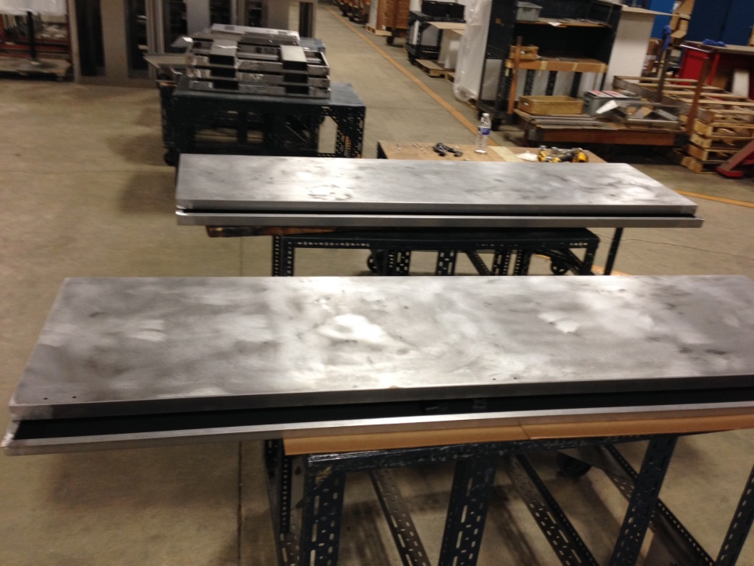
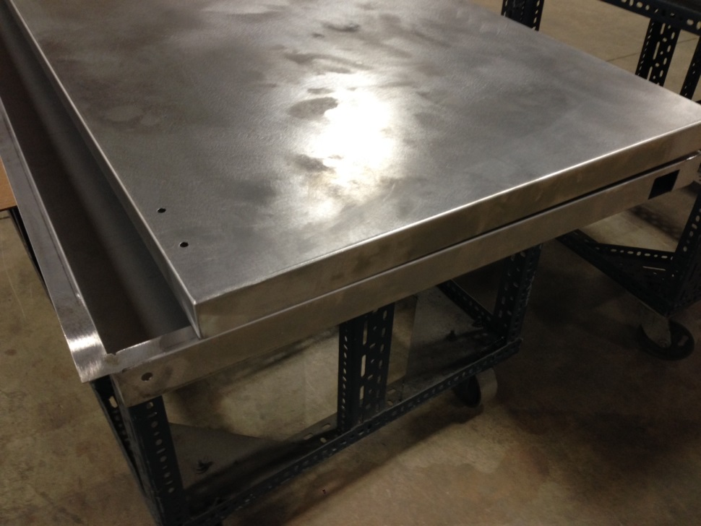
Marx Modulator Cabinet for Cells

Slide 4
Short Circuit Problems
Gate Driver Circuit Board
Controls the firing of the main IGBT to create the modulator waveform
25 Gate Drive Boards have already been built
Automatically reduces the drive level in slow and controlled manor during short circuit conditions to protect the IGBT
Snubber capacitors
Rated to withstand 1500 peak Amps
Measure peak current during short circuit as 2500 amps
Snubber capacitors where being destroyed on the 9 cell prototype due to this excess current, causing excessive ripple due to change in capacitance after failure
Made two changes to reduce the short circuit current to half of the rated value
Add dual parallel capacitors for the snubber network (made low inductance strip line)
Reduce the gate drive on the IGBT from the Gate Driver
Miller Capacitance (a parasitic capacitance between the gate and drain on the main IGBT) was causing extra drive voltage on the IGBT gate during a spark
Excess gate voltage was then driving the IGBT harder, increasing the current drawing during a short circuit
Solution: add fast FET switch, driven by B-dot coil, to clamp the IGBT to lower voltage, reducing the short circuit current. Set the clamp voltage level to reduce the current.
Reduced short circuit current across the capacitors from 2500 Amps to 800-900 Amps, giving the desired overhead
Still need to run the ring test, where the cell is fired at the full loading conditions to verify the reduction in surge current during spark at full loading current.
Once the modification passes the full load test, more gate driver boards could be ordered and the boards we have already have made could be modified.

Slide 5
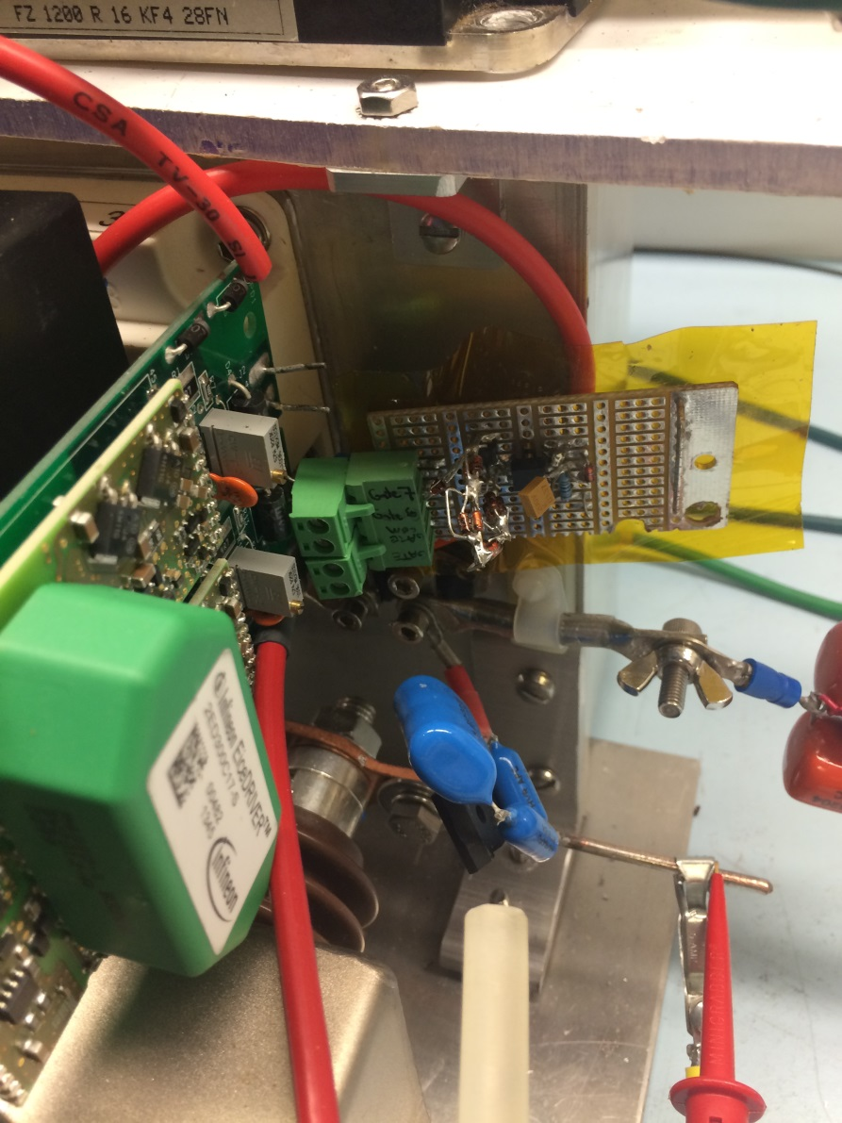
Single Cell Short Circuit Test

Slide 6
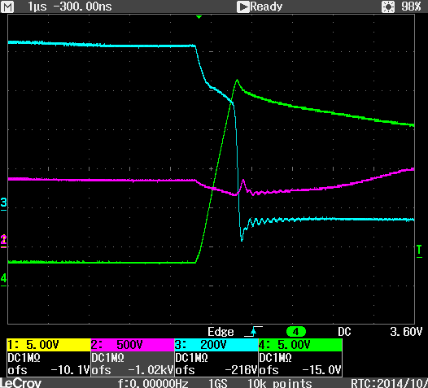
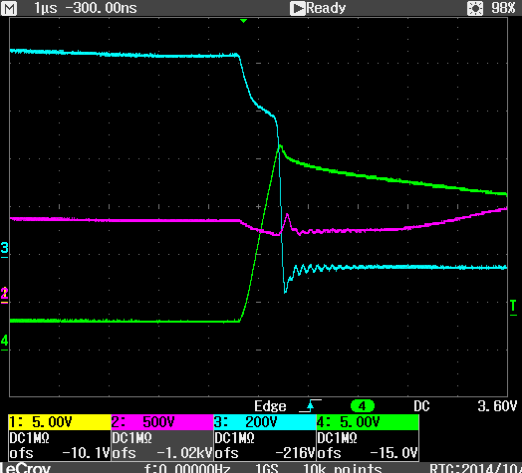
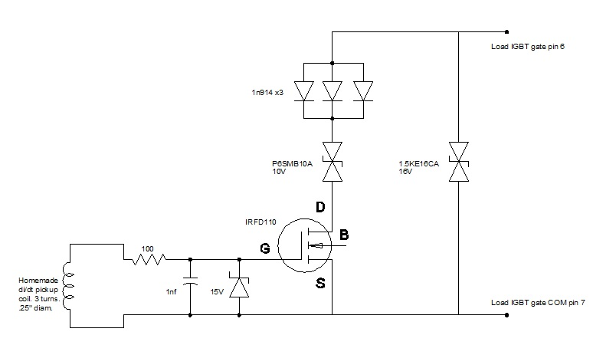
Single Cell Short Circuit Test
Without Clamping (2500 Amps)
With Clamping Circuit (1700 Amps)
Ch.2 Vcap
Ch.3 Load IGBT output voltage
Ch.4 Load Current (100A/V)

Slide 7
Work to build 25 Cell Modulator (1)
Finish Individual Cell Development
Finish full current short circuit test (1 weeks engineering & 1 week elec. tech.)
Design circuit board incorporating changes (2 week elec. tech.)
Order Components (2 – 6 week delivery)
Build circuit boards (2 weeks of elec. tech. + 2 weeks of board assembly)
Design Charging Supply System (1.2 kV, 100 kW, $165k)
Design system to meet 15 Hz, full power conditions (2 month of engineering)
Draw Schematics (3 weeks schematics)
Order components (3 days of elec. tech., followed by 2-6 weeks delivery, assuming no long lead time items)
Build charging supply (3 weeks elec. tech.)
Test charging supply (1 week elec. tech.)
This should not hold up 25 cell testing
Could either purchase a lower power unit and test the cells at a lower repetition rate
Running at 1 Hz reduces the power required to 7kW
Another option is to use one of the cap chargers we already have
For example, the charging supply for the Klystron Vernier could be used
Limited to pulsing every 2-10 seconds for testing
Would also need to build a higher power dummy load to run at full rep. rate.
Could test the 25 cell in RF7 as load to save cost and test the system in actual load

Slide 8
Work to build 25 Cell Modulator (2)
Layout Marx Control Cards (7 Cards + 1 Backplane)
Initially thought a 25 cell kludged together modulator control system could be built, but it was decided to start development on the full 53 cell version so it could be tested on both the 25 and 53 cell version, saving both time and money
Schematics nearing completion, layout done on 2 boards so far over past few months
Charge Control Board is presently being laid out (4 weeks layout)
Layout Remaining Boards 4 board (4 weeks layout each (16 weeks total))
Design Chassis (3 weeks mech. tech.)
Fabricate Chassis (3 weeks mech. tech.)
Design and Layout Backplane (3 weeks for schematic, 4 weeks for layout)
Mechanically Assemble 25 cell and related interconnection bus work in Cabinet
Presently waiting for heat sinks from machine shop. Delay due to equipment failure. Act as the backplane for the construction of each cell.
Collect parts (2 days)
Modify 25 Gate cards with modification (1 week elec. tech.). Gate cards are already stuffed.
Build 25 cells (8 weeks or elec. tech.)
Assemble Cells in Cabinet enclosure. (4 weeks of mech. tech.)
Test 25 cell modulator
Test in lab at low repetition rate if using same load as 9 cell test
(2 weeks elec. tech. & engineering )
Test at 15 Hz with charging supply at full current
(1 weeks elec. tech. & engineering )
Test at LRF7 for testing into 7835 with feedforward loop. (2 weeks)
(2 weeks elec. tech. & engineering )
Test in LRF1 to verify feedforward operation into accelerating cavity
(2 weeks elec. tech. & engineering )

Slide 9
Work to build 53 Cell Modulator
Receive remaining parts to build cells
Main Storage Capacitors
35 remain to be delivered
Expected by 2/1/15
IGBT switches
40 remain to be delivered
Expected by 1/1/15
Mechanically Assemble 28 additional cells and bus work in Cabinet
Collect parts (2 days)
Build 28 Gate cards with modification (3 weeks elec. tech.)
Build 25 cells (8 weeks elec. tech.)
Assemble Cells in Cabinet enclosure. (4 weeks of mech. tech.)
Test 53 cell modulator
Test in lab at low repetition rate if using same load as 9 cell test
(2 weeks elec. tech. & engineering )
Test at 15 Hz with charging supply at full current
(1 weeks elec. tech. & engineering )
Test at LRF7 for testing into 7835 with feedforward loop. (2 weeks)
(2 weeks elec. tech. & engineering )
Test in LRF5 to verify feedforward operation into accelerating cavity
(2 weeks elec. tech. & engineering )

Slide 10
Marx Modulator Summary
25 cell Marx labor requirements
Engineering (Howie) – 13 weeks
Schematics (Jim B.) – 6 weeks
Elec. Tech. (Nick) – 24 weeks
Mech. Tech. (Kevin) – 10 weeks
Could also aid Nick in building cells
Layout Drafting (Nick or EE Support Drafting) – 24 weeks
Board Assembly – 2 weeks
53 cell Marx labor requirements
Engineering (Howie) – 7 weeks
Elec. Tech. (Nick) – 18 weeks
Could be supplemented with additional technical support
Mech. Tech. (Kevin) – 4 weeks
Could also aid Nick in building cells
Plan to increase rate of development
Work with EE Support to emphasize the priority of the Marx modulator with PIP for the division, which is second behind operations
Determine if and when support from EE Support Drafting can aid in creating layout
Determine if additional electrical and mechanical technical support staff is available to assist in building the 25 cell modulator. This help could come from outside EE Support Department
Update WBS to adequately represent the labor listed above

