Slide 1
PIP Update
Oct 29th 2014

Slide 2
Agenda
Summary Update
Current Activities
Updates
Additional Meetings/Notes

Slide 3
Update
Linac SBK: Progressing – working on agreement with SLAC for certification testing
Linac LN: Final Amp still being worked on – Early Nov delivery date
Linac Modulator:
Parts for 53 are arriving – all except caps (talk by Trevor)
Linac Utilities:
Duel Temp replacement work continues – preparing to install duct work (Roof work on Nov 14th) AC units in Dec.
55 LCW pump – Piping complete, still cleaning up - waiting for electricians (2 days)
Injector: Still tuning up – new fiber interface, new DTI extractor switches, Elens redesign underway
Booster Beam:
Cogging – starting studies again
Booster optics software – still need to tune on higher intensity with new tunes and beta corrections
Booster Longitudinal dampers - Looking to start some studies – (meeting N Eddy)
Booster BPMs – Need to understand plane – (meeting N Eddy, P Prieto..)
Booster RF:
Booster RF9 shipped last week
Booster RF5 in test stand – should start testing today?
Booster RF2 just off mill – ready for tuners
Cavity 20 – prep work done for install of upstairs hardware – need to start upstairs work?
15 Hz testing of Station 2 continues – will be switching all East gallery stations to 15Hz soon
Perpendicular Cavities – working on design – having regular meetings
Booster Anode Supplies – housing finally arrived two weeks ago – Ryan C
Booster Bias supplies – Not sure where we are with this task- labor back from shutdown?
New Cavities – details are being worked on – PIP II/PIP III
Booster Shielding: TLM installed and collecting data – modules being built and will be installed
Booster Transformer: What is the plan to finish the East install?
Booster Absorber/Kicker:
Running on new short kickers
Absorber has new upstream insert
Looking at loss profile and tuning – will need to have meeting when we have collected operational data

Slide 4
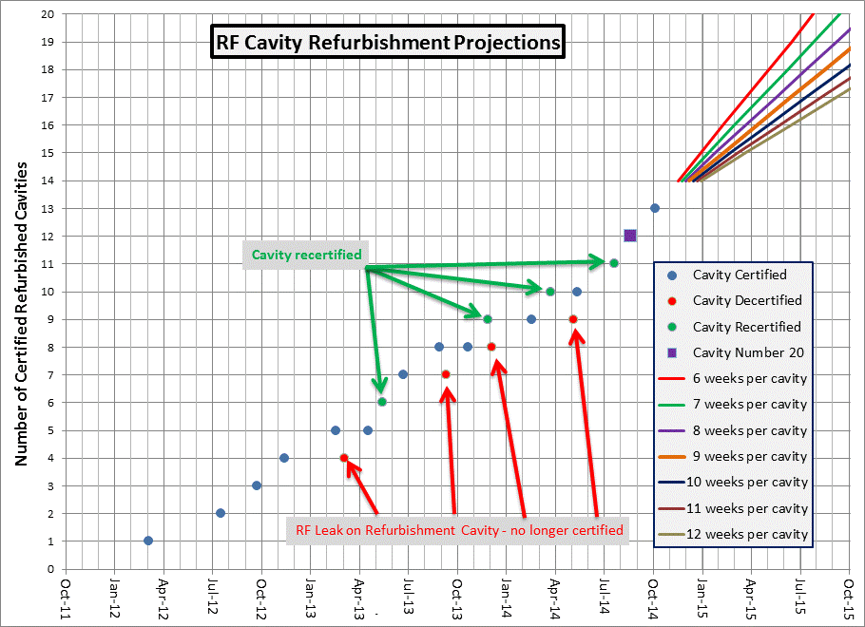
Next one in two vweeks?
Updated October 7, 2014 by K Gollwitzer

Slide 5
Recent PIP Budget/News
FY15 Budget:
No issues with spending $$ now
Lab upload should be complete
PIP working on RLS and making Task allocations corrections
Update of RLS – Some Booster items remain
Mostly cavities related
Meetings to discuss transition PIP to PIP-II continue\
DOE REVIEW of PIP in Jan!! Managers may give talks
AAC review
The AAC finds the goals, deliverables and plans for PIP to be well understood and achievable, and endorses the plans to address the Linac and Booster vulnerabilities. The Booster cavities refurbishing plan proceeds well, and is likely on track for July 2015 15 Hz Booster operation with all refurbished cavities (before long SD). Booster losses need to be understood in order to support operation at high beam power levels.

Slide 6
Upcoming Talks
Salah Chaurize – Notch system operations
Keith/Tony – TLM install and operations
Nathan Eddy / Alexei Semenov - Longitudinal Dampers
New Cavities(plans)
Install of Cavity 21 and 22 (plans)
15 Hz testing

