Slide 1
Booster 2nd harmonic cavity Loss density in ferrite
Gennady Romanov
November 11, 2014

Slide 2
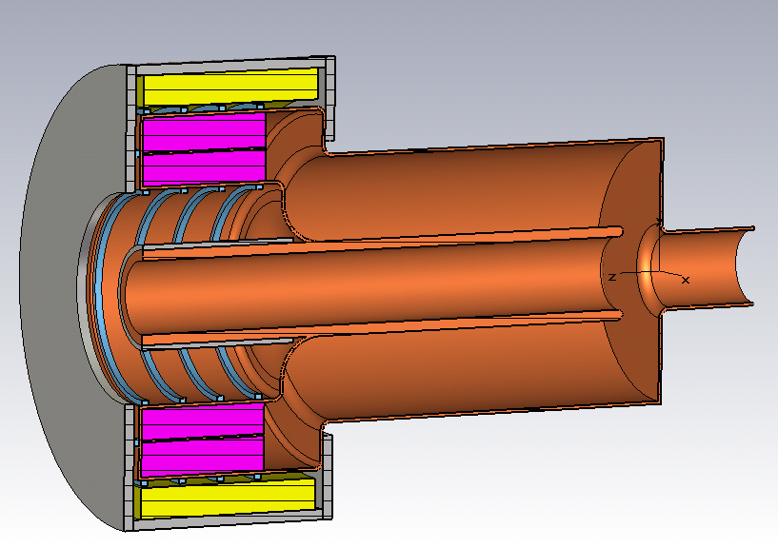
Current design (no changes since last meeting)
Yoke
Copper cooling cylinder (optional)
Coil, 30 kA·turns max
Garnet Al800
Magnetic shielding (optional)
Current dimensions:
Ferrite: R = 170 mm; r = 105 mm; L = 130 mm;
L_total = 555 mm; L_coax = 355 mm; L_tuner= 200 mm; R_drift_tube = 45 mm;
R_coax = 128 mm; Aperture=70 mm (2.76”)
Water cooling

Slide 3
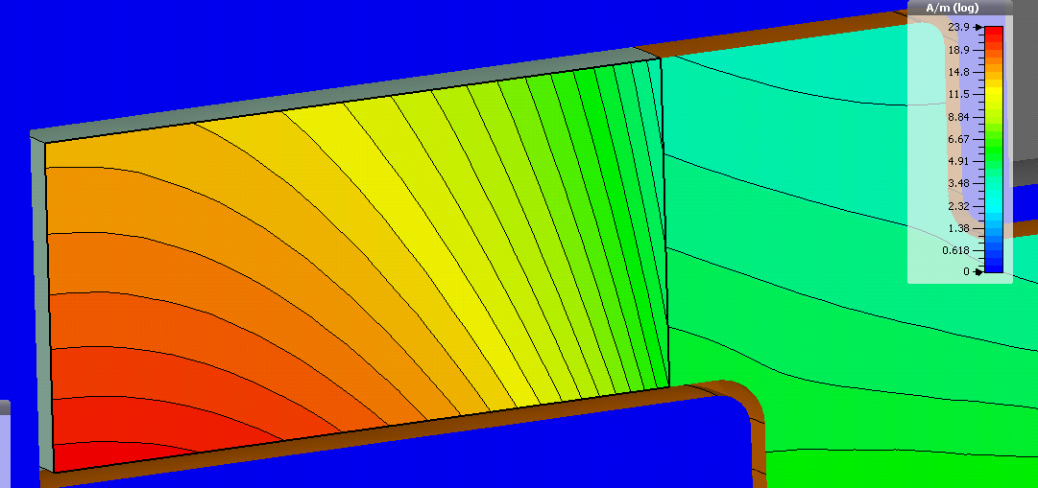
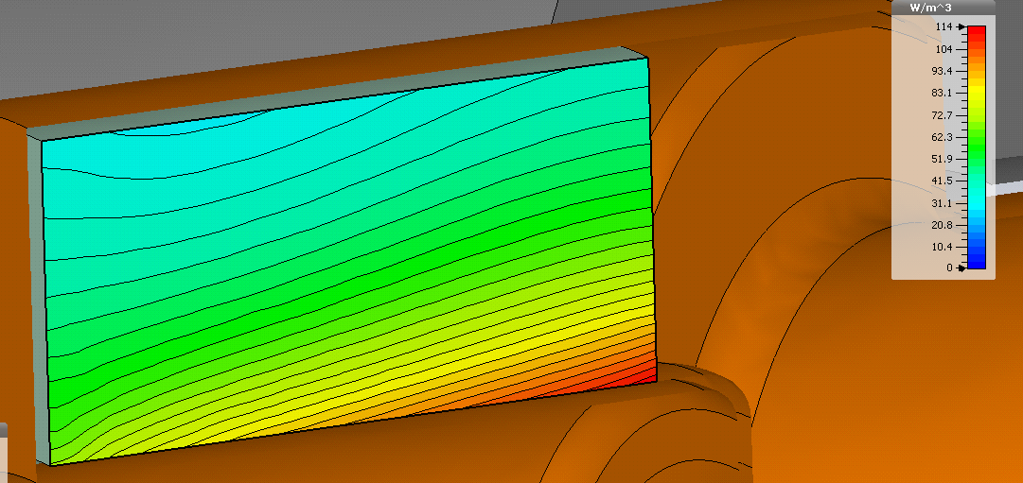
Model with solenoid. Volume loss density
RF |H|-field distribution in ferrite at bias current 950 A (µ≈1.5)
Coil length = 190 mm
Coil outer R = 283 mm
Coil inner R = 183 mm
Number of turns = 30
RF loss density distribution in ferrite at bias current 950 A (µ≈1.5)
RF |H|-field distribution in ferrite at bias
current 230 A (µ≈3)
RF loss density distribution in ferrite at bias
current 230 A (µ≈3)

Slide 4
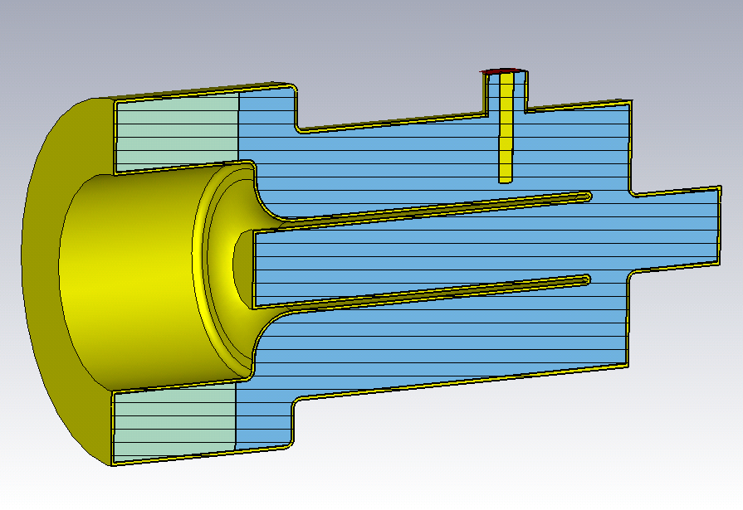
Decreasing loss density
L_coax
Changes that reduce losses. The most effective is the ferrite stack length.
Decreasing of ferrite length -> R_sh up, ferrite volume down, µ`` and losses up, cavity length increases.

Slide 5
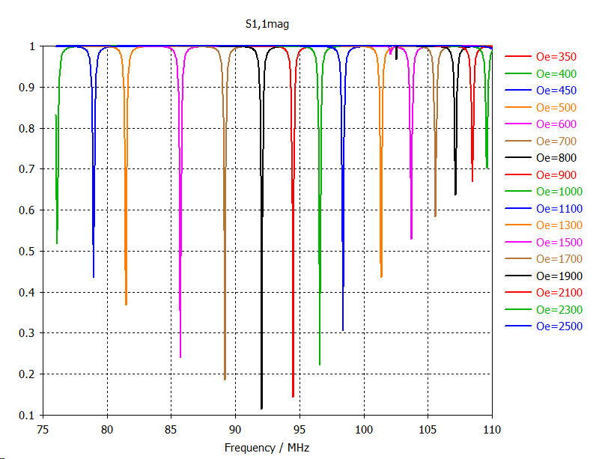
Tuning curve with uniform bias
The coupler is matched
Ferrite: R=170, r=105, L=130 mm

