Slide 1
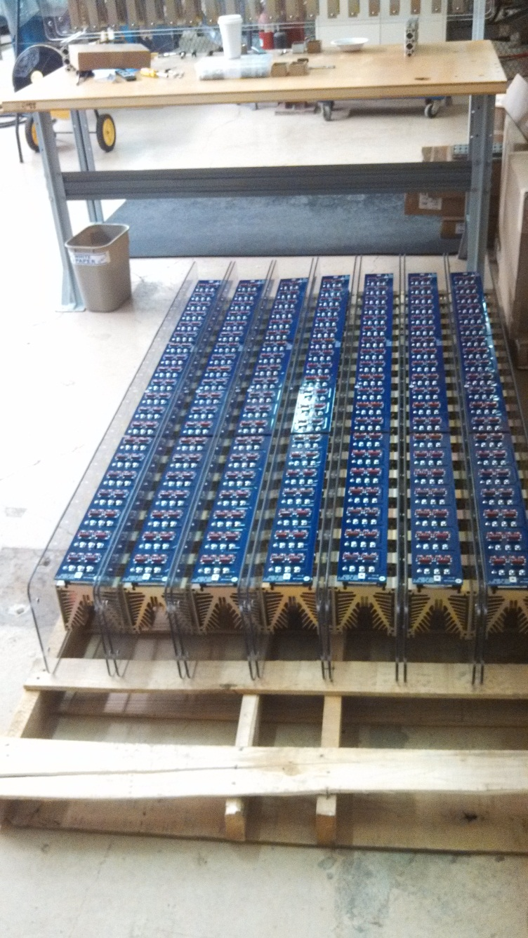
Diode Bridge
11 Legs built
12 by the end of day
Boards are being stuffed
Support Frame is being worked on

Slide 2
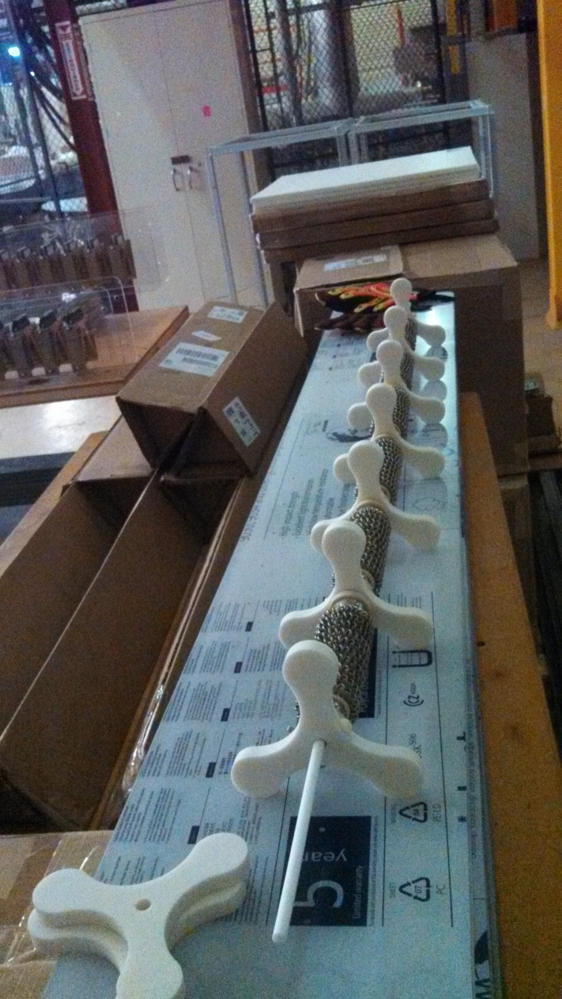
Water Cooled Resistor

Slide 3
Controls
More complicated than expected
Will not merely be plug and play with old system
Minor modifications required for step start cabinet
Terminal blocks and wiring need to be added
SEL relay needs to be programmed
Add brass box

Slide 4
Booster East Transformer
Currently working on cost estimates
Reuse old switchgear vs. buy new
Reuse old will require sheet metal work and a custom throat
Will also require a crane for when the switchgear is eventually replaced
Need to measure to make sure the transformer and switchgear will fit on the pad nicely when a throat is attached
New Switchgear will require gear that is similar to the square d lineup that is currently in use on other transformers

