Slide 1
Laser Notching Demonstration Experiment (Preliminary Results)
David Johnson, Todd Johnson, Matt Gardner, Vic Scarpine, Rick Tesarek

Slide 2
Thanks to all who made this happen
Todd Johnson
Matt Gardner
Vic Scarpine
Rick Tesarek
Andrea Saewert
Mike Kucera
Kevin Duel
Jamie Santucci
Fred Mach
High Rise & PPD Machine shops
Matt Quinn
Dave Baird
Ray Lewis
Fernanda Garcia, Bob Zwaska, Bill Pellico

Slide 3
Goals of Demonstration Experiment
1. Demonstrate the neutralization of a single bunch at the exit of the RFQ using the installed optical cavity.
2. Measure the neutralization fraction as a function of laser pulse energy to compare with the predicted values.
3. Measure the vertical ion beam size to determine the optimal vertical size of the laser pulse to maximize neutralization.
4. Refine installation details of the transport system and dump system.
5. Get practice in and understand the tuning process for launching the laser into the cavity and the transport to the dump for energy and profile monitoring.

Slide 4
Burst mode seed pulses to Fiber Amplifier followed by Free Space Amp
λ₁=1064nm
120 mW CW
SW=0.1 nm
Output modulator/Input fiber pre-amp:
201.25MHz pulses (1.25 ns pulse), 458kHz burst
10 GHz Mach-Zehnder
Modulator
L_{i}~1.8dB
Isolator
PM Fiber
Diode + TC
controlled
L_{ins} ~5dB
Pulse Generator
Amplifier, Timing
Line filter
Fiber Amp 2
Fiber Amp 1
Free
Space
Fiber Pre-Amp
*Notch 12 bunches -> 60 ns
10 notches/linac pulse
Pulsed at 15 Hz
Quasi CW or continuous burst
Clean up filter
Free Space Amp
Pulse energy 2 mJ
Pulse width 2 ns
Peak pulse power 1 MW
Power per linac cycle 10 kW
Average power 5.7 W
Grumman CEO DPSS OEM
15 Hz
TRANSPORT BEAM SHAPING OPTICS & OPTICAL CAVITY
OPTICAL BOARD

Slide 5
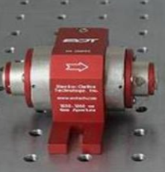
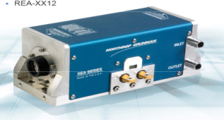
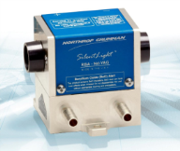
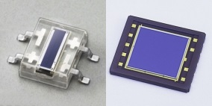
Free Space Amplifier configuration 2.2
(Pulsed at 15 Hz)
Gain: ~ 23 dB (total for both modules)
Output: 2 mJ 10 kW (450 kHZ) 3.2 mW (15 Hz)
Faraday
Isolator
8mm
REA (6.35 mm rod)
2 mJ pulse/2 ns
1 MW peak
HRM
HRM
6.0”
HRM
80 bars
Faraday
Isolator
4mm
Faraday
Isolator
4mm
RBA (2mm rod)
λ/2
532 nm alignment laser
HRM
3.07”
Telescope to reduce beam
(1/e² diameter to 1.6 mm)
Telescope to expand beam
(1/e² diameter to 5.08 mm)
Beam Stacker
HRM
Fiber port and optics
to generate
1/e² diameter of 1.6 mm
8 uJ pulse/2 ns
4 kW peak
9 bars
HRM
HRM
BPM
090
Input fiber
From fiber amplifier
045
135
000
Polarization orientation
Used by EOTech

Slide 6
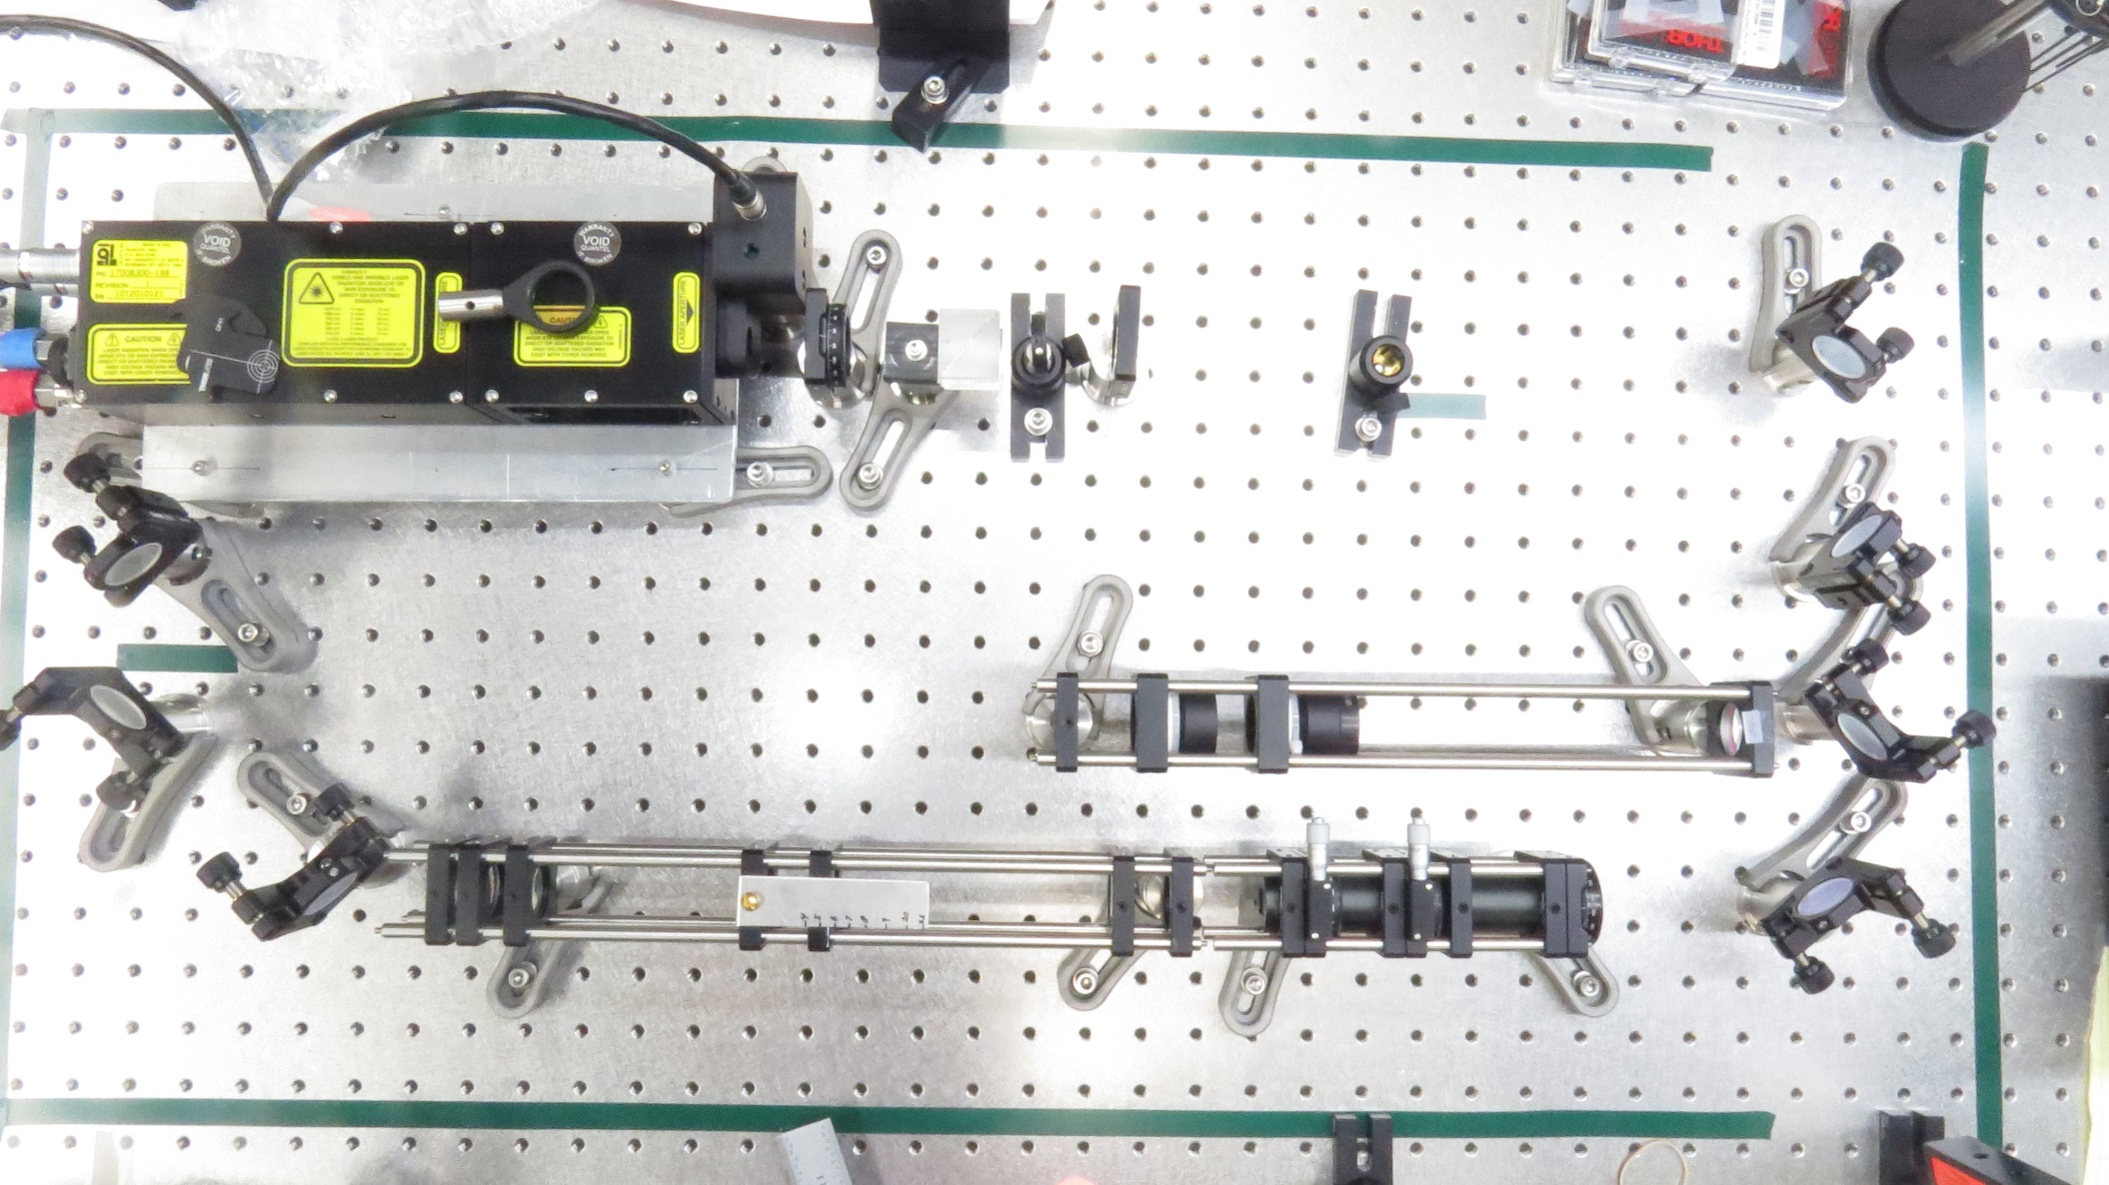
Demonstration Experiment Initial Layout in LAB
Quantel Nd:YAG flashlamp pumped Laser 100 mJ FWHM ~5ns
dump
Safety shutter
PBS cube
λ/2 waveplate
Matching Telescope
Output mirror
Vertical Telescope
Stacker
Horizontal Squeezer

Slide 7
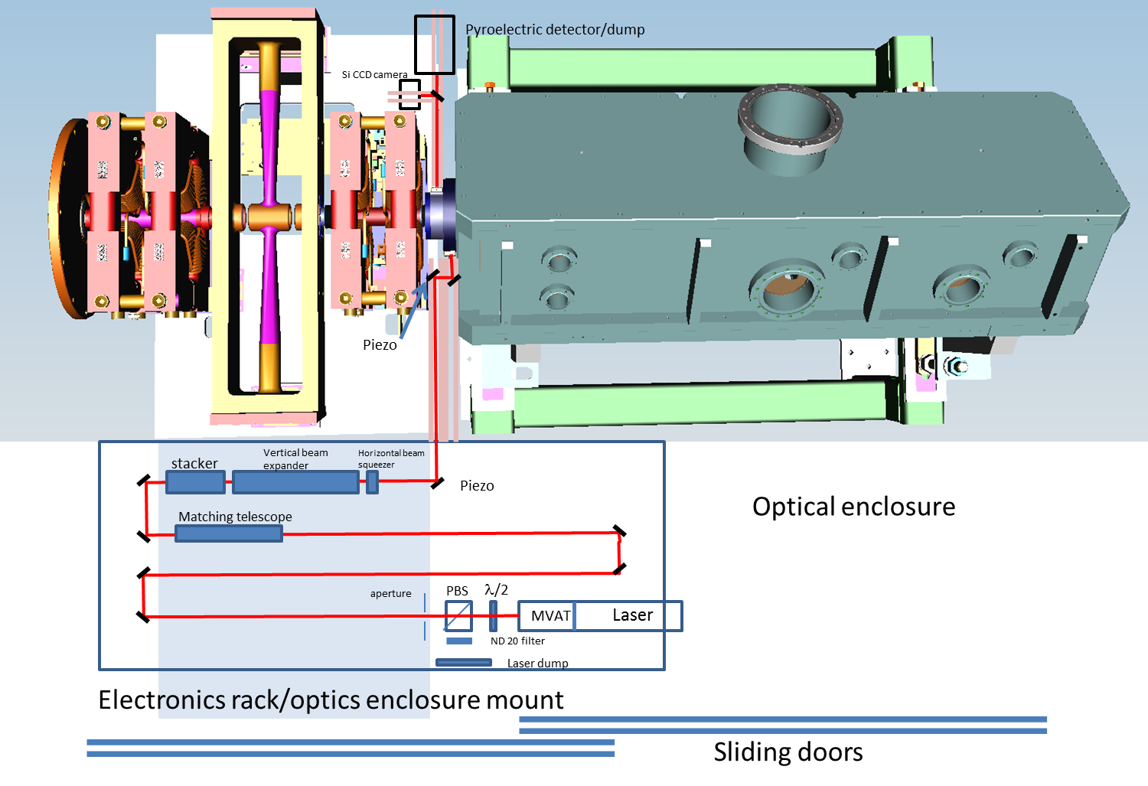
Cartoon of Demonstration Experiment Layout

Slide 8
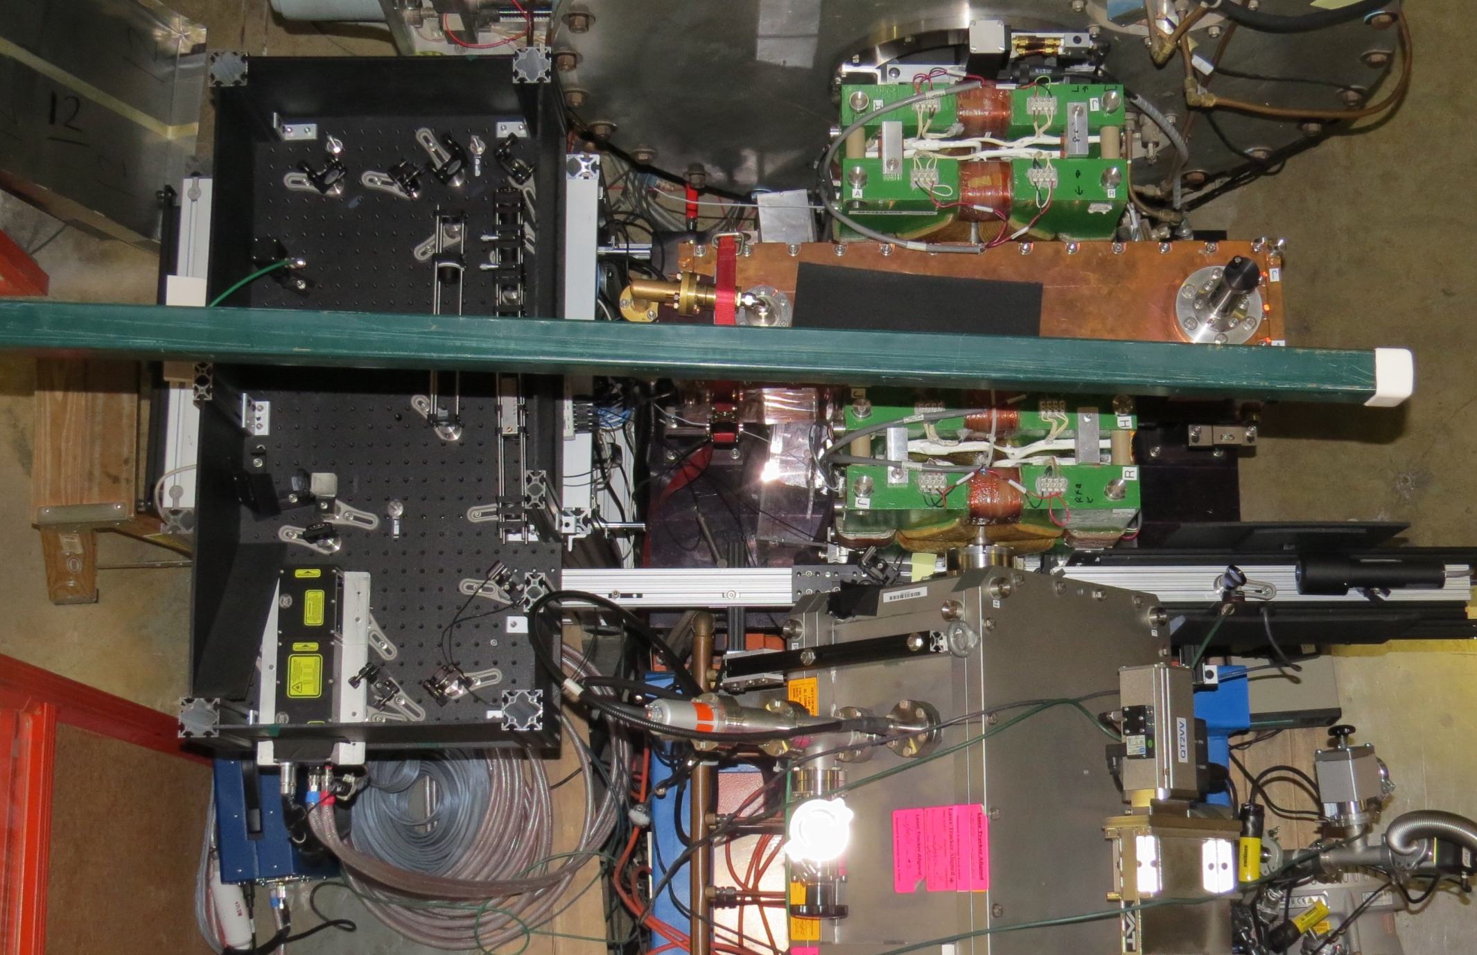
Installation with laser optics box cover & transport shielding removed

Slide 9
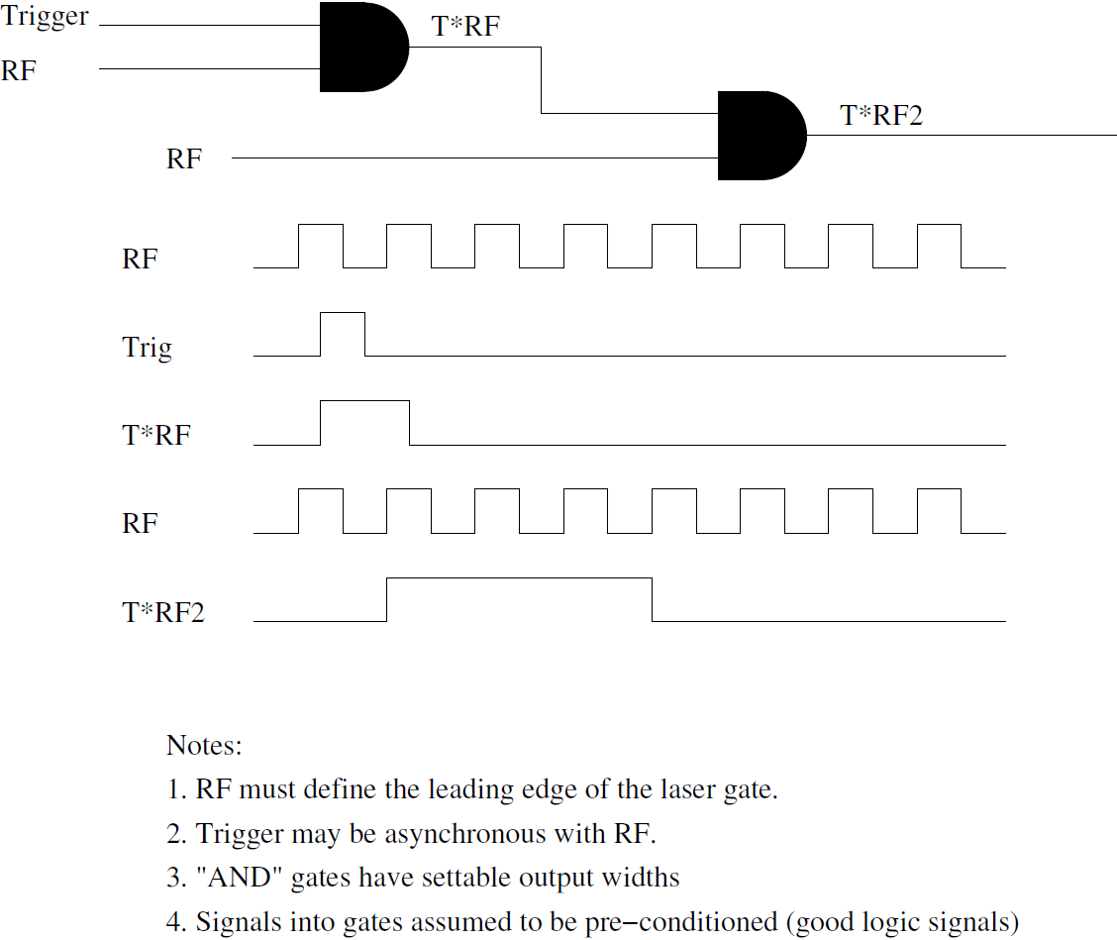
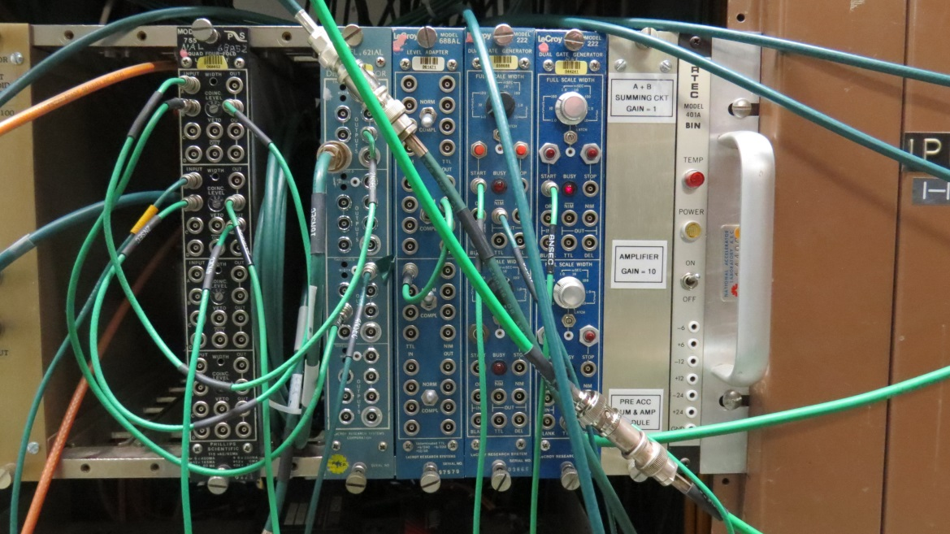
Timing System
TCLK
Q-switch
Q-switch trigger (to laser)
Laser requires two triggers:
Flash lamp
Q-switch
Two 377 channels defined as
FLTRIG (1368 us)
QSTRIG (1952 us)
Variable delay line to center laser on selected bunch
Timing scan- data being analyzed …
Variable delay
+/- 10 ns
Laser Q-switch
trigger
From: Rick Tesarek

Slide 10
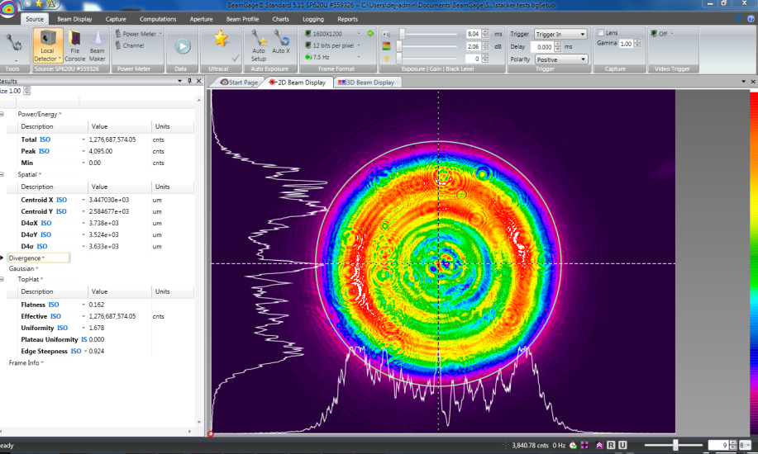
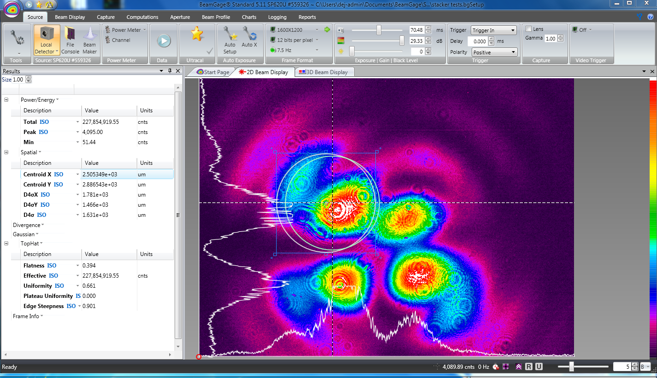
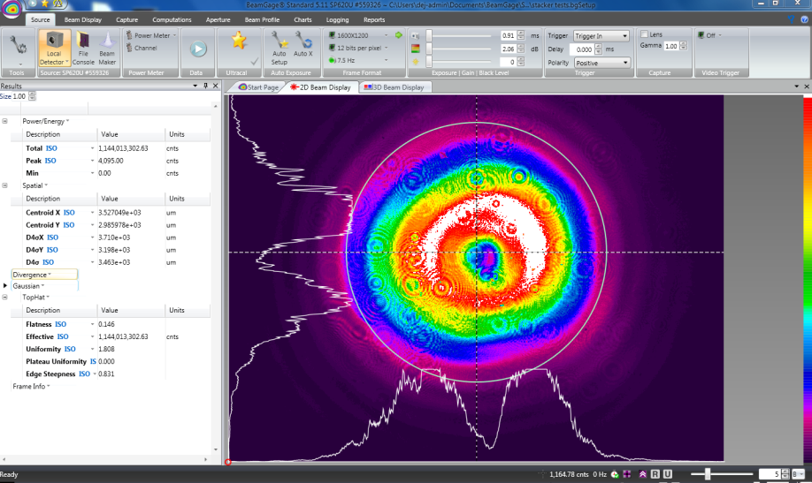
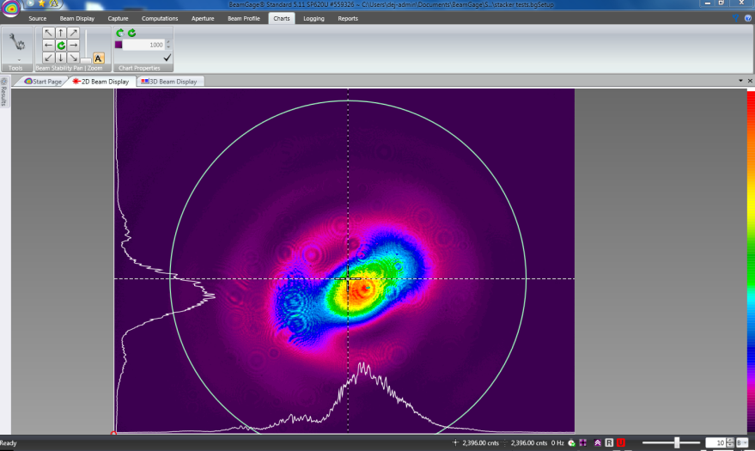
Source Laser Spatial Profiles
Output of Quantel (14 cm)
Occasional Output (TM11)
Output of Quantel (100 cm)
Output of Quantel (216 cm)

Slide 11
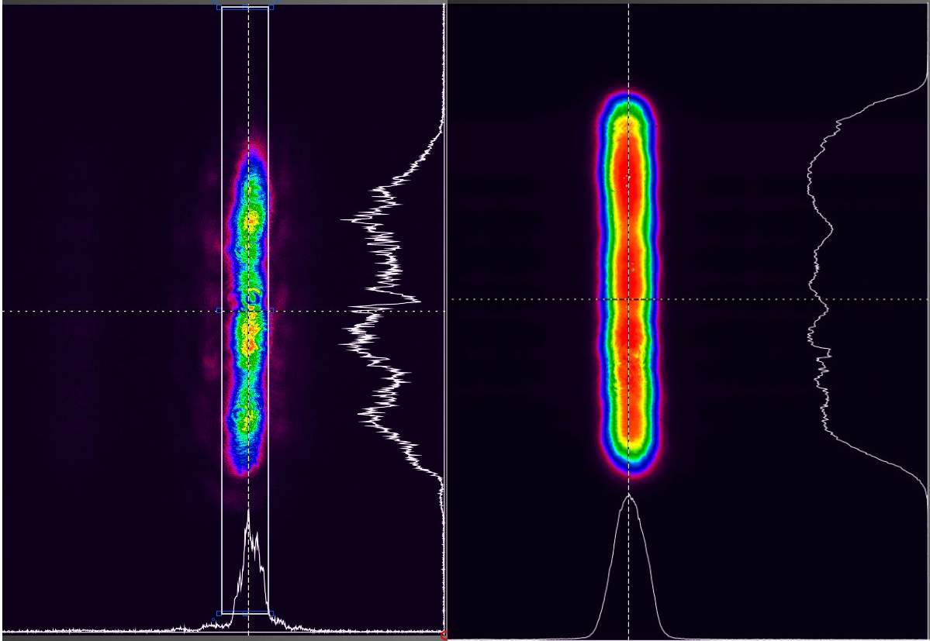
Profile Comparison at the output of the stacker
(input to cavity)
Quantel
Diode

Slide 12
Adjusting Vertical Laser Size with Cylindrical Telescope
5mm
6mm
7mm
8mm
9mm
10mm
Profiles taken at a distance equal to entrance into cavity

Slide 13
Time Line
Request for Demonstration Experiment 11/20/14
Kick-off meeting 11/25/14
Installed system Wednesday 1/7/15
Got approval to run Wednesday afternoon
Tried to inject laser into cavity Thursday owl (from about 12:30 to 4:30)
Thursday evening successfully injected into cavity (using internal triggering)
Switched to external triggering (from timing system) – found notch within 10 min.
Attempted first optimization of laser position and size
Took energy scan and time scan measurements
Piezomirror
Fixed “D”
mirror

Slide 14
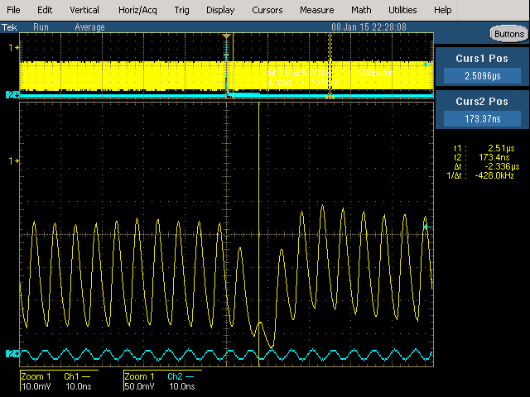
First Sign of Notching
~4.1 us
Zoom
PD signal
Notch

Slide 15
Laser Temporal Profile
Only about 17% of laser pulse interacted with bunch being neutralized
Minimize impact on preceding bunch by adjusting timing of laser relative to RF.
Tail of laser pulse hits following bunch

Slide 16
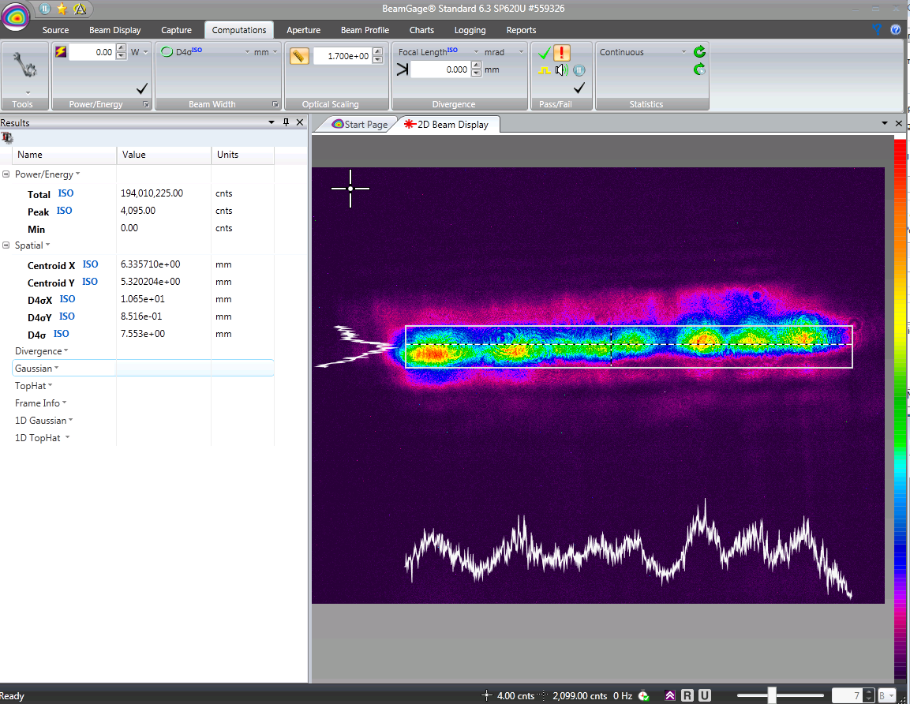
Spatial profile during Energy scan Data
(Need to verify)

Slide 17
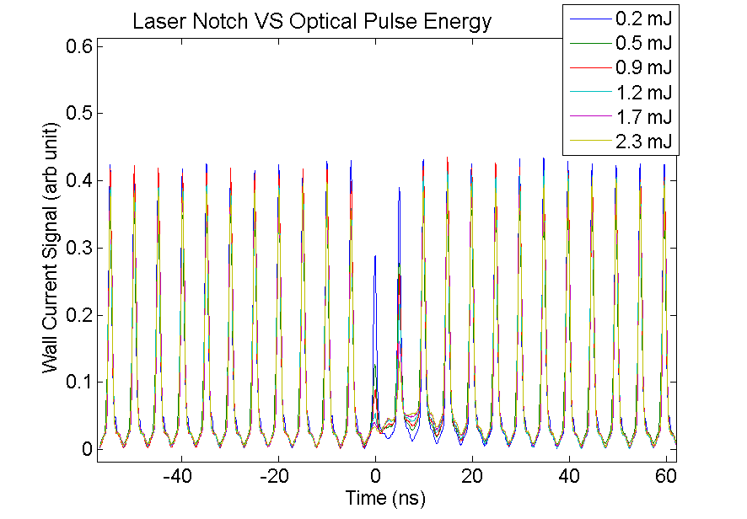
Wall Current Monitor Data

Slide 18
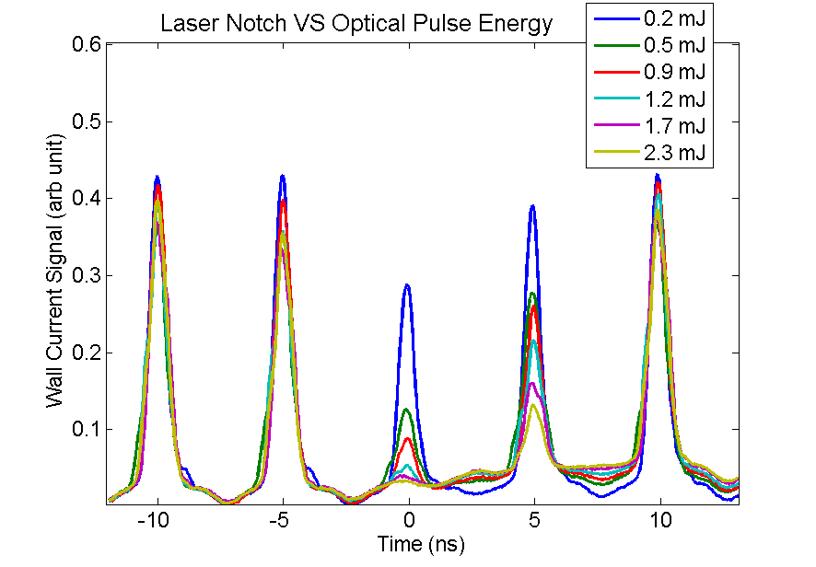
Wall Current Monitor: Notched Beam

Slide 19
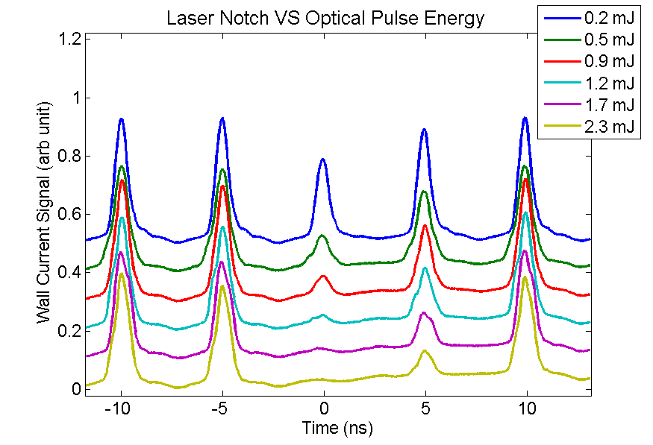
Wall Current Monitor: Notched Beam

Slide 20
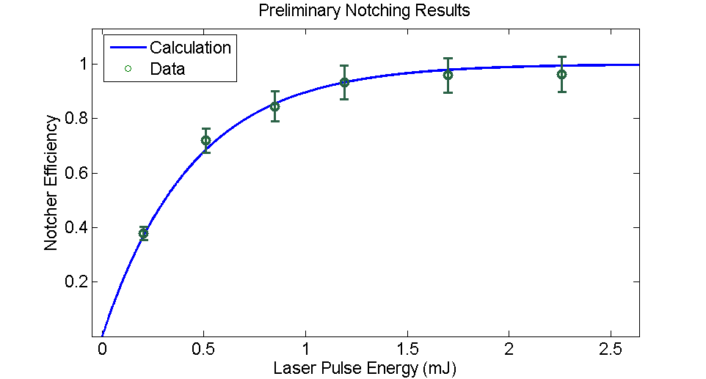
Errors are in rms
Efficiency error sources
Baseline uncertainty (~5%)
Pulse amplitude uncertainty (~5%)
Effective laser pulse energy error sources
Temporal and geometric matching to beam pulse
Calculation assume:
1.5 ns bunch length
0.8 mm H profile
10 mm V profile

Slide 21
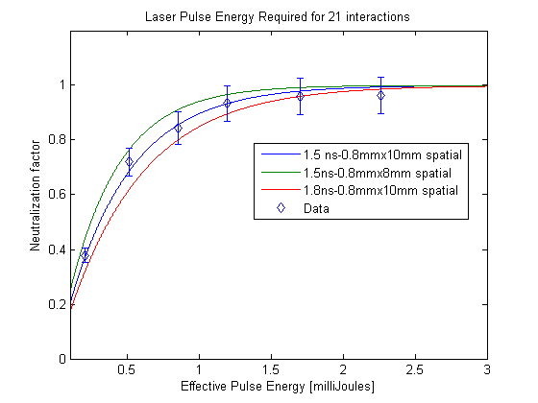
Impact of Spatial profile and laser pulse length
$${NF}_{single pass}=1−e^{−Fστ}$$
$${NF}_{multi pass}=1−{(1−{NF}_{single pass})}^{N_{pass}}$$
$$where F=\frac{number of photons}{(area)(pulse length)}$$

Slide 22
Future Plans
Although we have looked at some of these items qualitatively, we want to repeat the study taking csv data for off line analysis.
Take physical measurements for final laser shielding (dump and transport).
Measure profile and energy into and out of the cavity.
Measure laser motion on camera from piezo mirror motion (Horizontal & vertical tuning range)
Perform a vertical scan with the laser to measure vertical beam size of H- beam out of RFQ. (laser crawling wire)
Center the laser on the ion beam and vary the laser vertical size measuring Neutralization. Adjust pulse energy as needed to get back to same neutralization (photon density)
Optimize neutralization efficiency and then tune LEBT to maximize transmission and see if the

