Slide 1
Update on Model/Mock Cavity
Robyn Madrak
02/03/2015

Slide 2
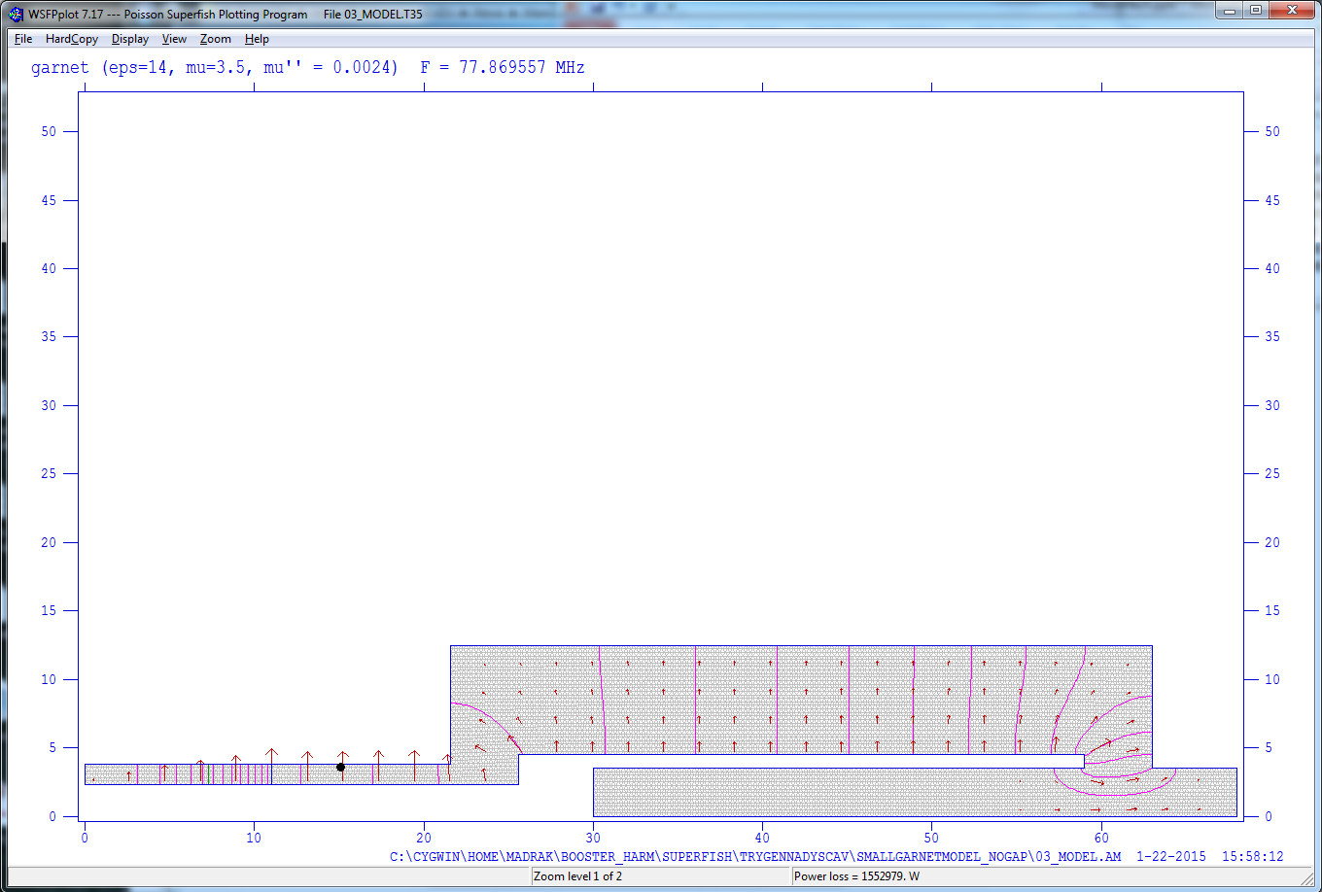
l2
l1
Current superfish model of the REAL cavity
Ratio of OD/ID in this region the same
l2
l1
Current superfish model of the MODEL cavity
L1: 13.000 → 19.685
L2: 47.400 → 39.915

Slide 3
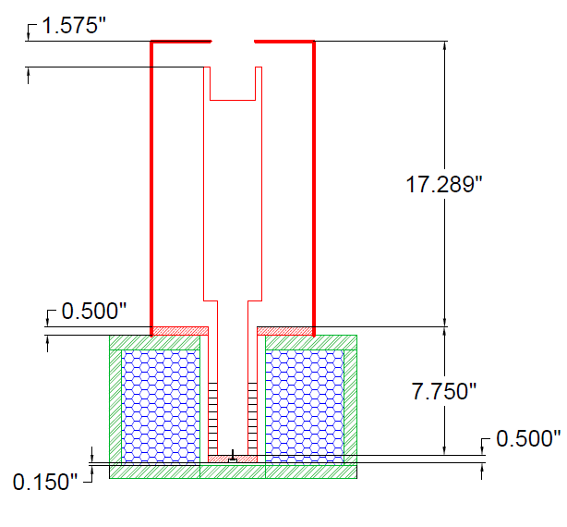
“outer conductor”
“inner conductor”
The gap
Critical dimensions for RF:
Generally, the volume enclosed between the outer and inner conductors
Inside length
OD of outer conductor
ID of inner conductor
Geometry in the gap
OD/ID/length of ferrite
Garnet
(ferrite)
0.43” Stack of 10:
3” OD,
1.853” ID
“shorted end”
Inner conductor is connected to outer conductor
solenoid
Cavity uses solenoid as a support (sits on it)

Slide 4
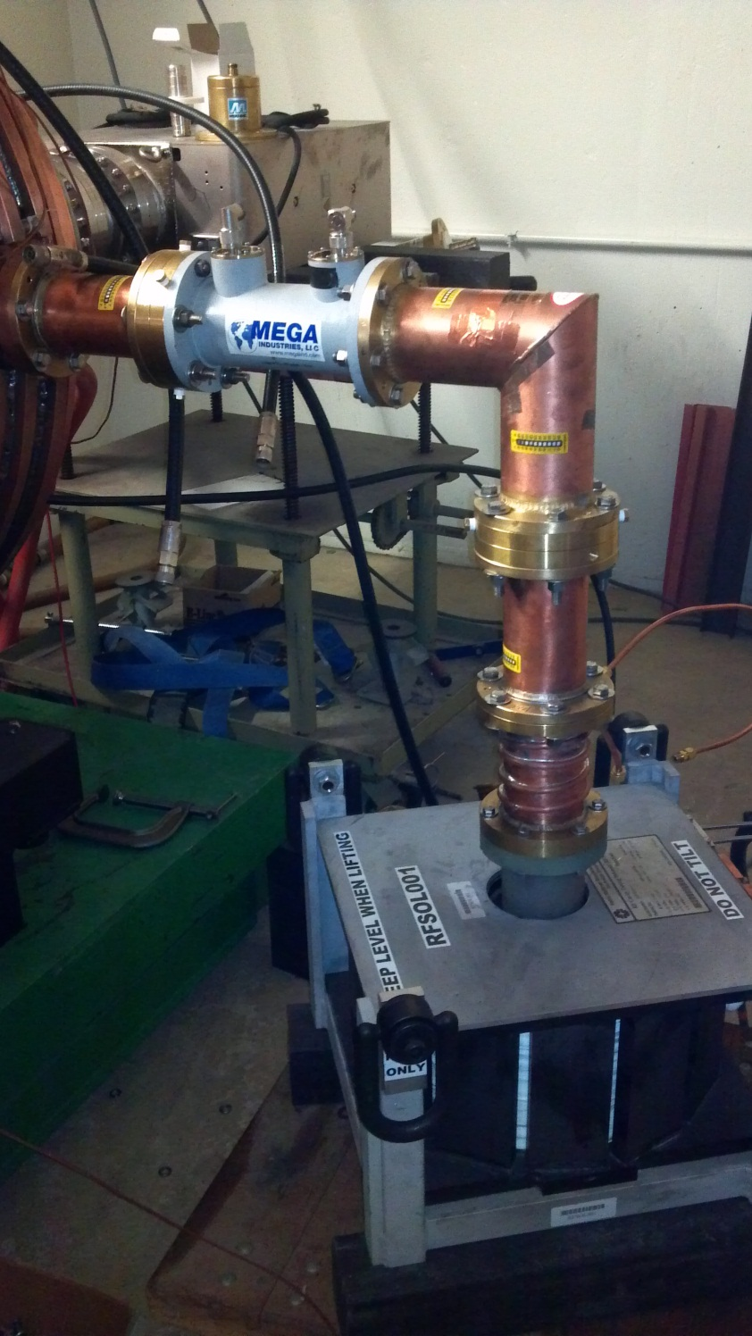
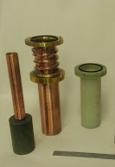
Tuner:
1 goes inside of 2 (center and outer)
2 goes inside of 3
Center is shrink fit with LN2 to fit in ferrite
1
2
3
The solenoid we need to use:
(spare solenoid from RR cavity tuner)

Slide 5
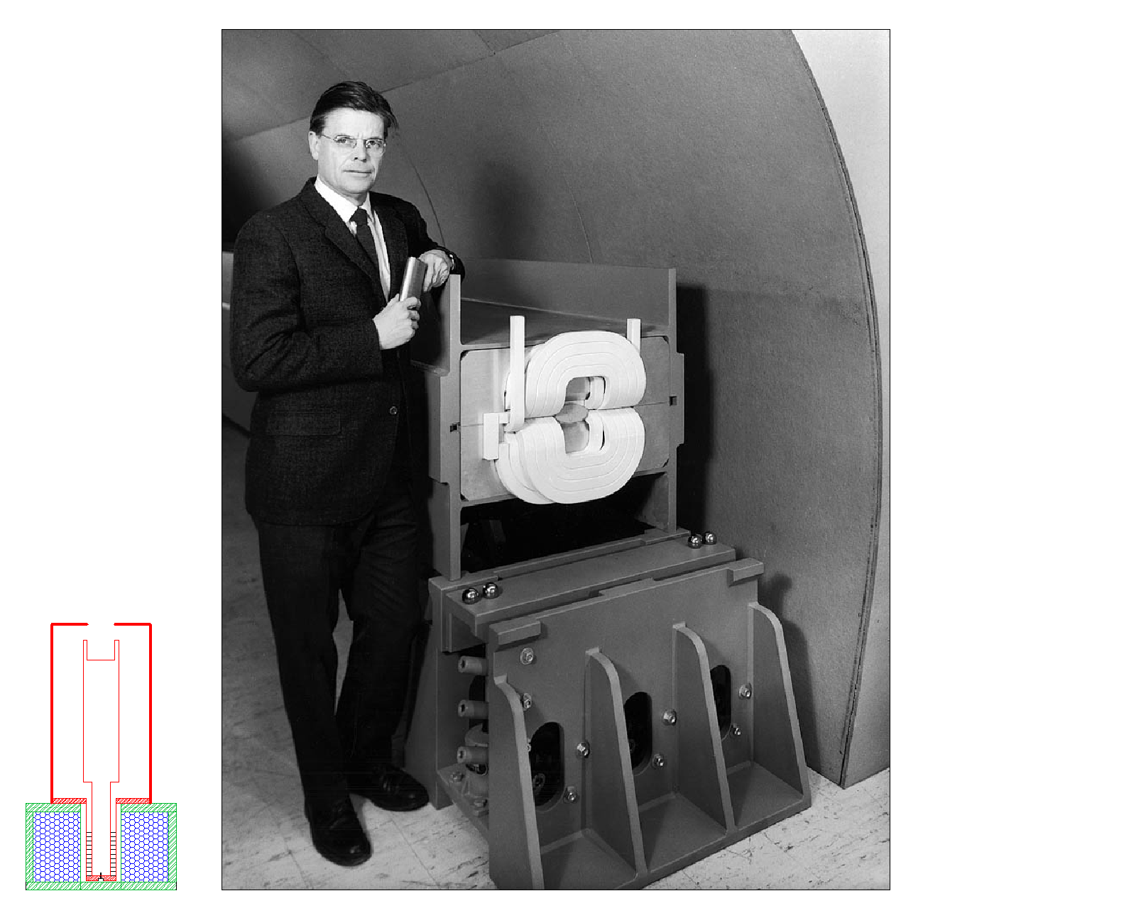
For scale, assuming Bob Wilson was 6 feet tall:

Slide 6
Issues (Kevin is working on)
Strategy
First measure fundamental, HOM’s, effect of (model) HOM coupler
Later – add input coupler (or make additional mock cavity)
What material for the center and outer conductors : copper? Aluminum? /tubing? Sheet metal?
How to attach various pieces (bolts? Brazing/welding/soldering? copper tape?)
How to fit the center conductor in the garnet and the garnet in the outer conduc tor minimizing any gaps (it changes the results)…shrink fit for inner?....
How to attach the HOM coupler/ how to model the HOM coupler?
The good part
No vacuum
Only low power

Slide 7
Effect of gaps for clearance in garnet part
No gaps => no gaps at all
With gaps => outer conductor (3.027”) is 0.027” bigger in diameter than ferrite OD;
inner conductor (1.818”) is 0.035” smaller in diameter than ferrite ID
We have in the past done a shrink fit on using one solid piece of ferrite for inner conductor
Outer conductor – wrap around and clamp?

Slide 8
r1 (cm) (d1 = 1.818”)
r2(cm) (d2 = 1.853”)
r3 (cm) (d3 = 3”)
r4 (cm) (d4=3.024”)
Region 2: ferrite; ε_{f} ~ 14
Regions 1 and 3:air, ε=1

Slide 9
Viewed as 3 cylindrical capacitors in series, where C (capacitance/length)
C1=2πε₀/ln(d2/d1) = 2.92 nF/m
C2=2πε_{f}ε₀/ln(d3/d2) = 1.62 nF/m
C3=2πε₀/ln(d4/d3) = 6.98 nF/m
Then Ctot = C1*C2*C3/(C1*C2+C1*C3+C2*C3) = 0.9 nF/m
Then defining Ctot = 2πε_{eff}ε₀/ln(d4/d1)
I can solve for an “effective epsilon” for the entire region
(between d4 and d1)
If I set ε_{f} = 14 and solve for ε_{eff,} I get ε_{eff} = 8.28
So we should pay attention to miminizing the gaps

Slide 10
Progress
We have a design
Ferrite is ordered
We are thinking about how to implement the design

Slide 11
Appendix Slides (not shown)

Slide 12
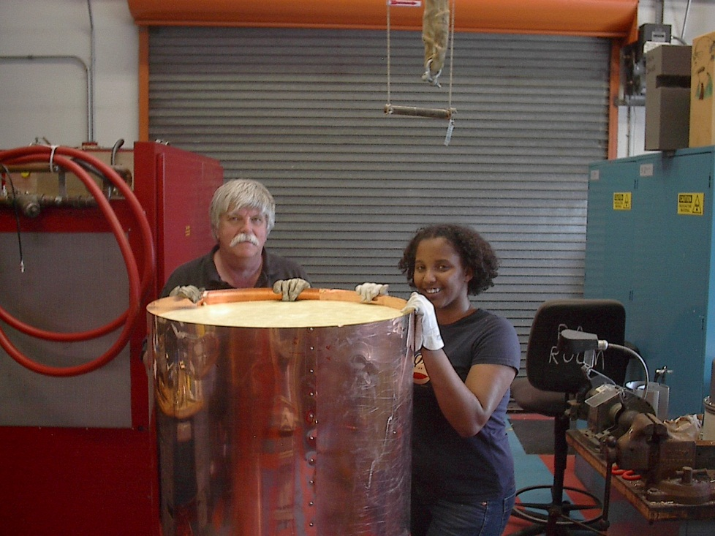
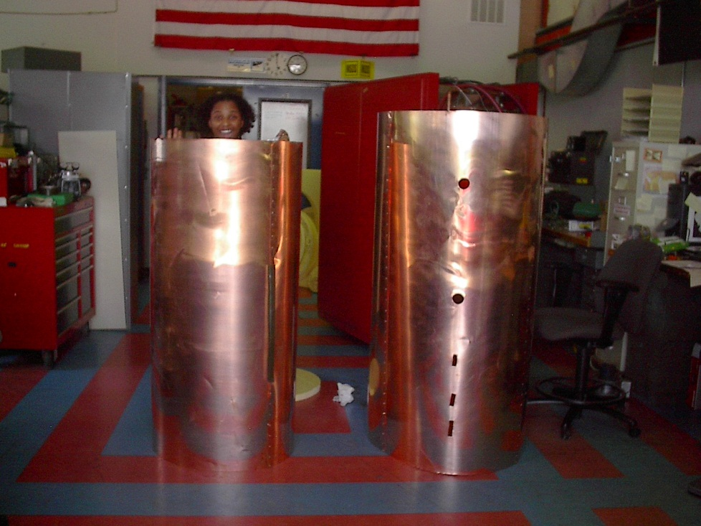
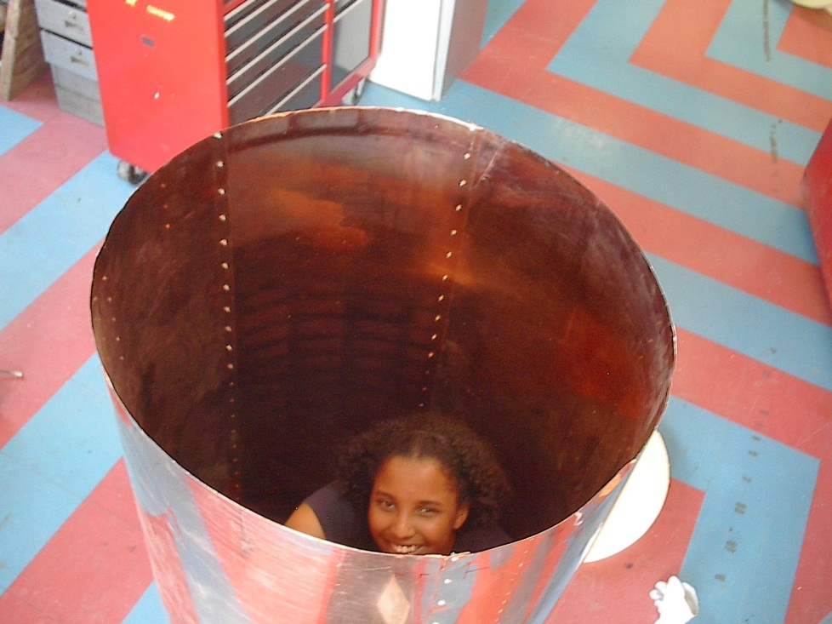
Examples of Other Model Cavities: RR Model Cavity
Sheet metal, connected with screws and nuts
Home insulation
Inner
conductor
Inner
conductor
outer
conductor
The inner and outer were connected with
a donut shaped piece of home insulation and a very large hose clamp
Seams along length of cavity (direction of current flow, does not decrease Q)
Gap end cover
Tabs bend out
Hose clamp
outer
insulation

Slide 13
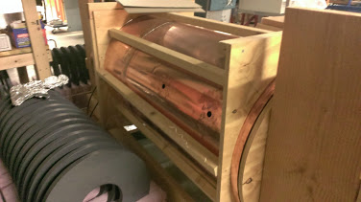
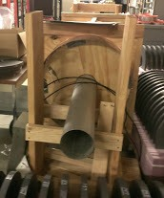
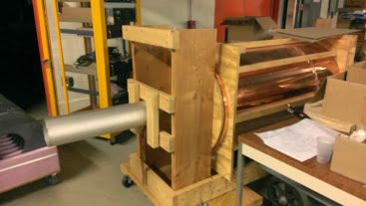
Examples of Other Model Cavities: Joe Dey’s
Made out of copper sheet metal
Supported by wood
Joints are soldered

Slide 14
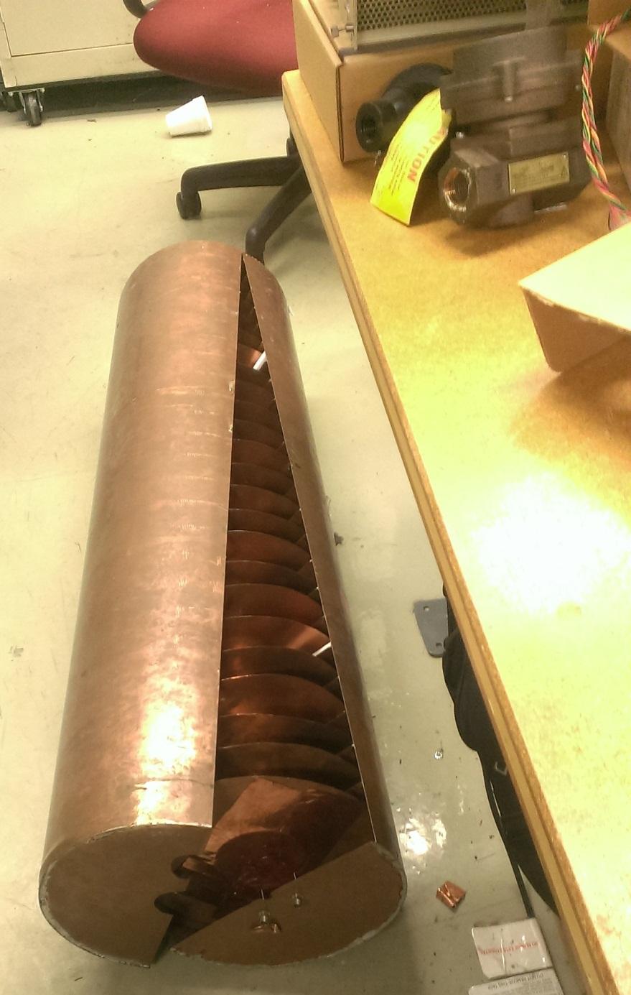
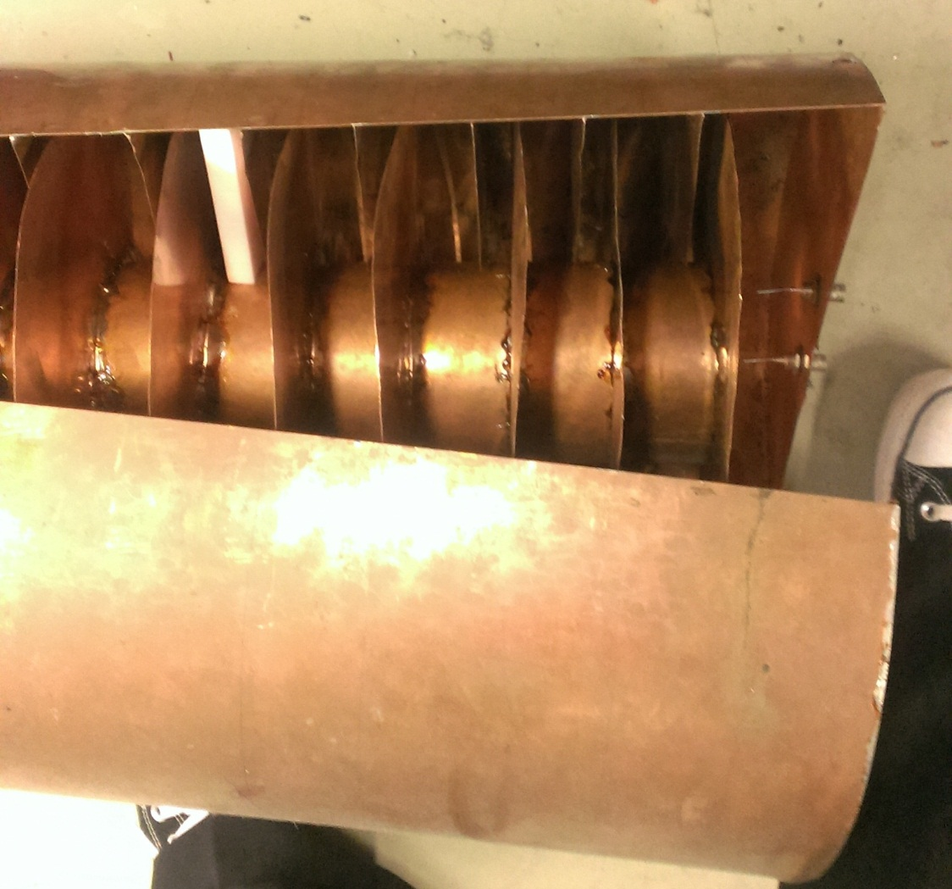
Examples of Other Model Cavities: Dave Wildman’s old cavity
Copper sheet metal
All soldered
Presumably some support was used while soldering

Slide 15
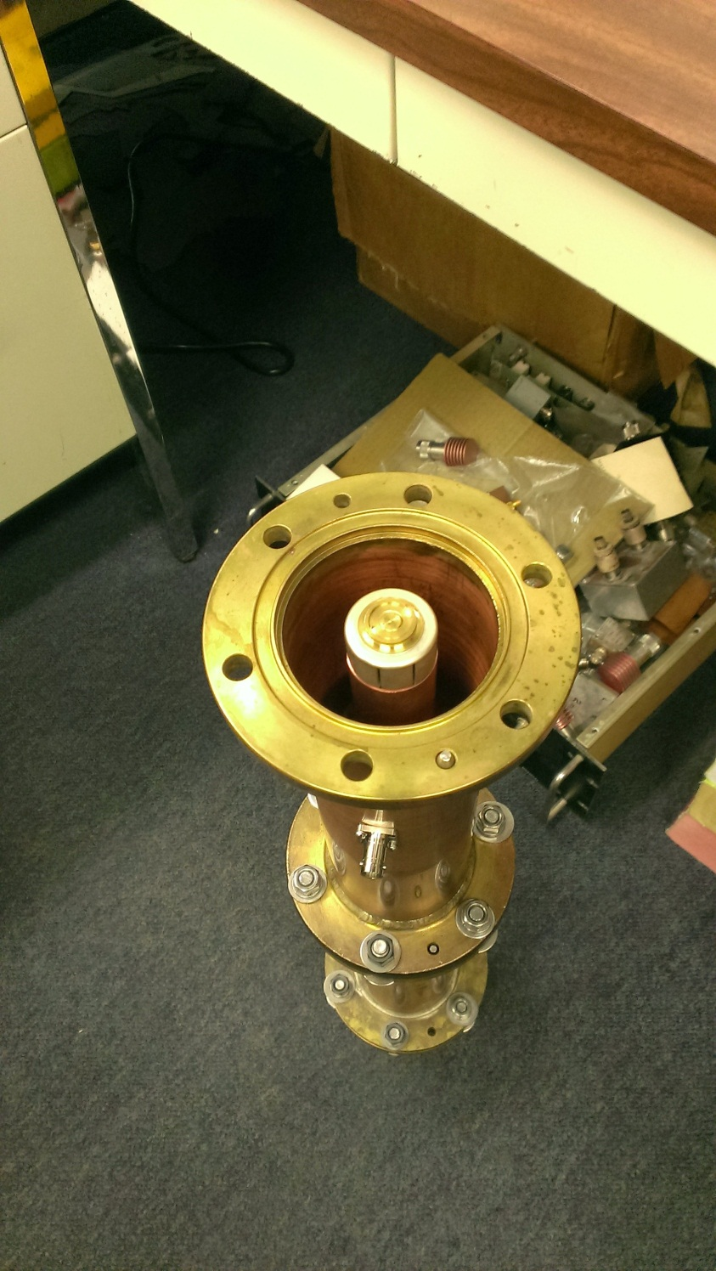
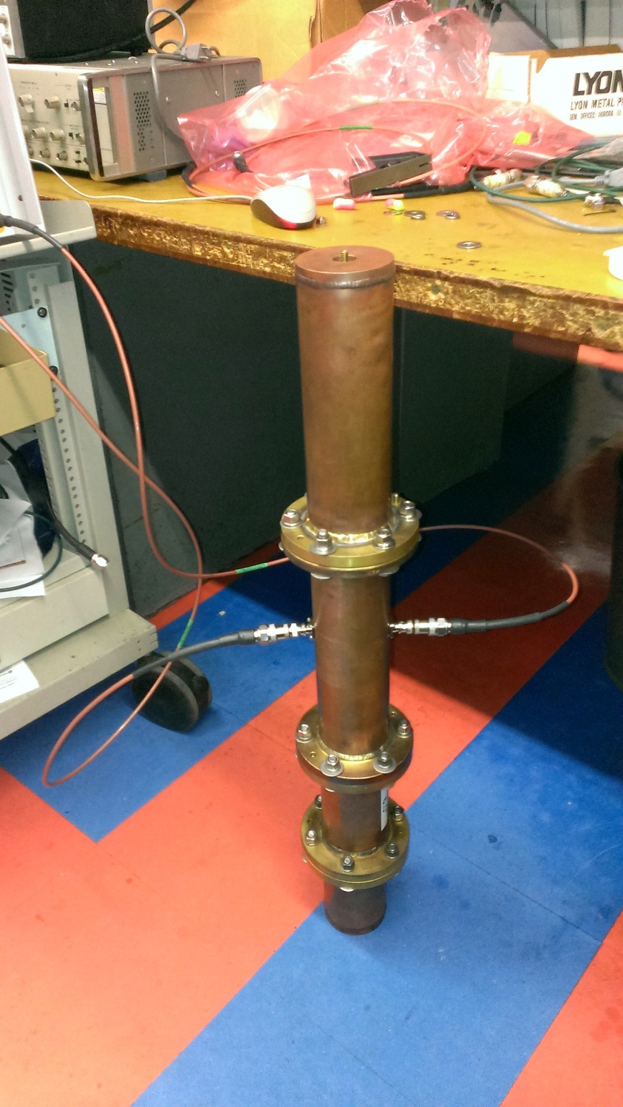
Examples of Other Model Cavities: Using standard coax hardline

