Slide 1
Simulation with experimental B(H).
February 17, 2015
G.Romanov

Slide 2
Plan from February 3, 2015
Measure ε of Al800 over the 70-120 MHz interval.*
Try to check and confirm that tanδ_e=0.0002 in the 70-120 MHz interval.
Measure static B(H) of Al800 – Done (Youri&Robyn).
Measure unloaded Q in the small solenoid set-up and compare with simulations to obtain ΔH.
Start thermal simulations with new garnet parameters.
In progress
(Sergei&Youri)
* The set-up model with gaps between garnet and walls was simulated. The simulations confirmed Robyn’s conclusion about impact of the gaps on intergral ε. Fortunately average ε ≈ 10 is practically constant over the 70-120 MHz interval, so the model without gaps still can be used. Sergey was asked to take the gaps into account.

Slide 3
Experimental B(H) for Al800.
Al800_exp2,3 – from Youri&Robyn

Slide 4
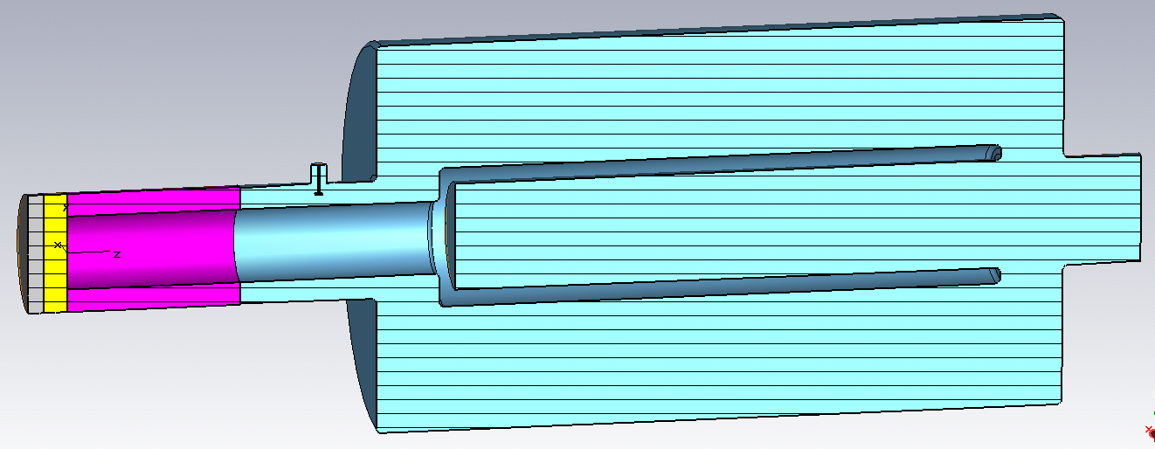
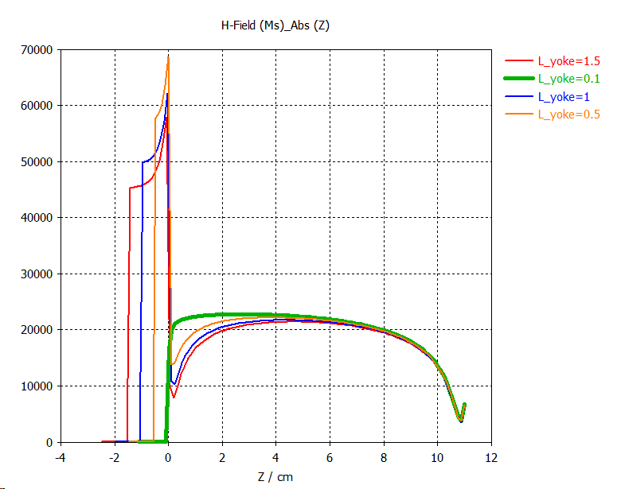
Cavity mock-up (Robyn’s design).
Solenoid yoke
Copper bottom
Bottom 1.5 cm
Bottom 0.1 cm

