Slide 1
PIP Update
March 25th 2015

Slide 2
Agenda
Summary Update
Current Activities
Updates (Ken Domann, Pat Sheahan)
Additional Meetings/Notes

Slide 3
Updates
Linac
SBK: Work at CPI continues –
LN:
Modulator: Buildup 54 cell modulator and testing of software continues
Utilities: completed – task closed
Booster
Beam Studies:
Cogging: Continues to make operational – working on syncing to Recycler and early notch
Booster optics software –Alex made some changes to ACNET software – need to test
Booster Longitudinal dampers – Damping mode 50 on $19. Waiting for Alexei to return…..
Booster BPMs – Peter testing of board -
RF:
Refurbished cavity work: Cavity RF 17 installed last week – back to 15 Hz cycling in east gallery
Next cavity just finished mill work, alignment fixtures done – being put on stand for John (eow)
New Tuners – (#2) new tuner completed and tested, # 3 almost done, #4 work just starting
Bias Supplies: Update today – but one swapped last week – breaker issue
Anode Supplies: Filling cabinet #1, Update last week by Ryan says April testing
Transformer: Gear ordered and shows an expected ship date of 5/26, the spare main breaker will be here next week
Perpendicular cavity: Measurements on mu look good – work on test cavity proceeding
Stations 20, 21 & 22: starting to ramp up activity on 20th upstairs – reviewed tunnel space
Rework of cavities 21 & 22: Working on plan – looking at options/floor space
New cavities: Dialogue with management still ongoing – working on design details
Shielding: TLMs testing continues (all Horizontals done next is verticals) Next week – ops/400KW
Absorber/Kicker: Completed for now – working on optimizing positions/reduction of losses

Slide 4
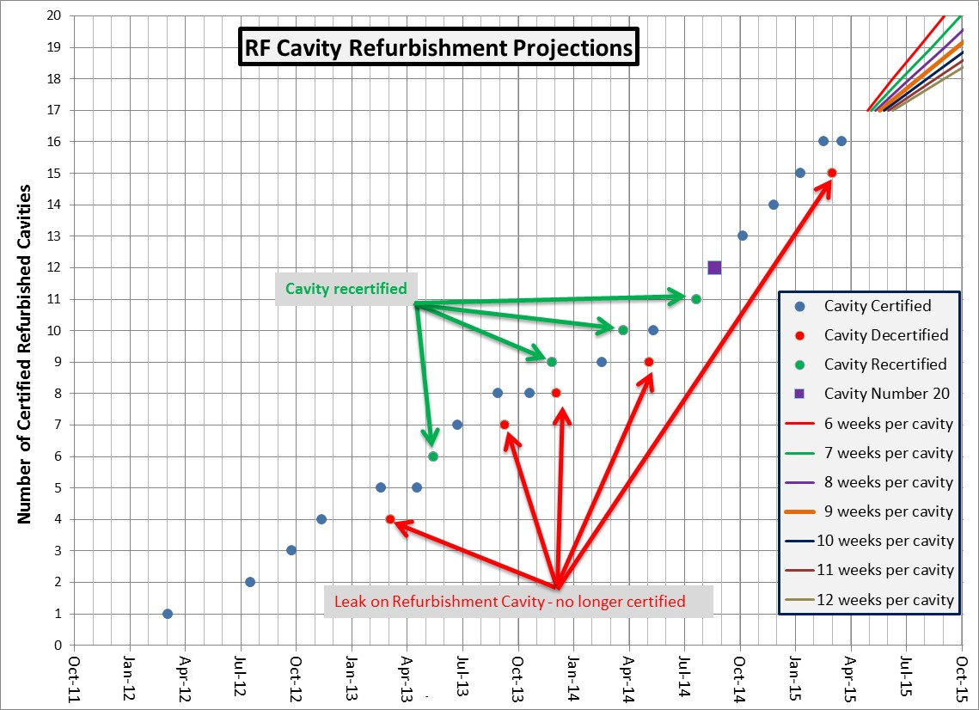
Install
Shutdown

Slide 5
Recent PIP Budget/News
FY15 Budget:
No updates
Need to discuss overhead rates and task updates with Ann
Update of RLS – Some Booster items remain
Mostly cavities related
Meetings to discuss transition PIP to PIP-II continue….next meeting on Monday
DOE REVIEW of PIP
Waiting for official document
Ann and company are going through dept. budgets
PIP PMG – not scheduled

Slide 6
Upcoming Talks
15 Hz East gallery – John
Laser Notcher (pre-install update) – Dave
Salah Chaurize – Notch system operations
Keith/Tony – TLM install and operations
New Cavities(plans)
Collimator – Status and plans (V. Kapin)
Install of Cavity 21 and 22 (plans)

