Slide 1
PIP Update
April 8th 2015

Slide 2
Agenda
Summary Update
Current Activities
Updates (Joe Compton - shutdown)
Additional Meetings/Notes

Slide 3
Updates
Linac
SBK: Work at CPI continues –
LN: Received back laser – working on implementing stay alive system, vendor working on interlocking power/pulsing
Modulator: Buildup 25 & 54 cell modulator and testing of software continues (shutdown testing?)
Utilities: completed – task closed
Booster
Beam Studies:
Cogging: Continues to make operational – working on syncing to Recycler and early notch
Booster optics software – Tan did another round of measurements – still down about 2%
Booster Longitudinal dampers – Alexei just back working on BPMs and Dampers, mode 2 tests
Booster BPMs – Peter ordered prototype board – making plans to remove clearing boxes
RF:
Refurbished cavity work: the 17 refurb station is in test stand – starting testing yesterday
15 Hz cycling continues in East gallery – so far so good…
Next cavity has a vacuum leak on one end (probably pie tin) being repaired
New Tuners – (#2) new tuner completed and tested, # 3 done, #4 work just starting
Bias Supplies: # 7 being worked on, one in gallery ready for shipping
Anode Supplies: Filling cabinet #1, April testing – trying to figure out schedule for 2nd one
Transformer: Gear ordered and shows an expected ship date of 5/26, the spare main breaker arrived
Perpendicular cavity: Measurements on mu look good – work on test cavity proceeding
Stations 20, 21 & 22: starting to ramp up activity on 20th upstairs – gallery space issues…
Rework of cavities 21 & 22: Working on plan – looking at options/floor space
New cavities: Dialogue with management still ongoing – working on design details
Shielding: TLMs testing completed – safety still wants one more L12 test?
Absorber/Kicker: Completed for now – working on optimizing positions/reduction of losses

Slide 4
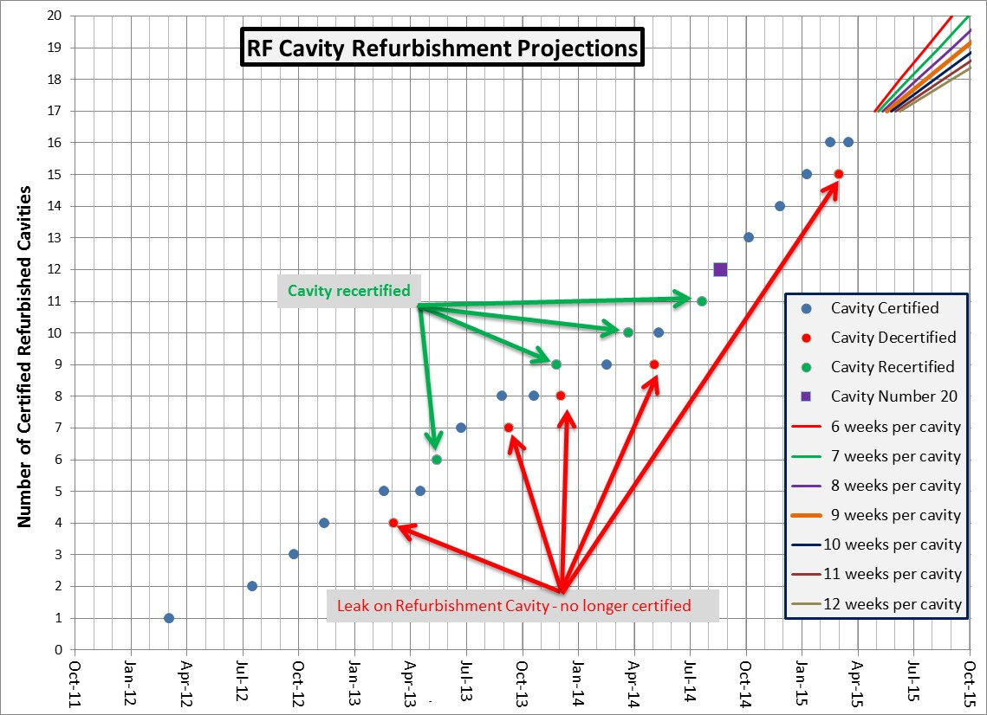
Cavity # 18
Install #17
April 21
Shutdown

Slide 5
Recent PIP Budget/News
FY15 Budget:
No updates
Discussions of task updates with Ann just about done!
Update of RLS – Some Booster items remain
Mostly cavities related
Meetings to discuss transition PIP to PIP-II continue….working towards completion/agreement spring
PIP – Sergei meeting Thursday
DOE REVIEW of PIP
Waiting for official document
Ann and company are going through dept. budgets
PIP PMG – May (FY15 Q3)

Slide 6
Upcoming Talks
15 Hz East gallery – John
Laser Notcher (pre-install update) – Dave
Salah Chaurize – Notch system operations
Keith/Tony – TLM install and operations
New Cavities(plans)
Collimator – Status and plans April 22nd (V. Kapin)
Install of Cavity 21 and 22 (plans)

