Slide 1
Booster SHC Modeling

Slide 2
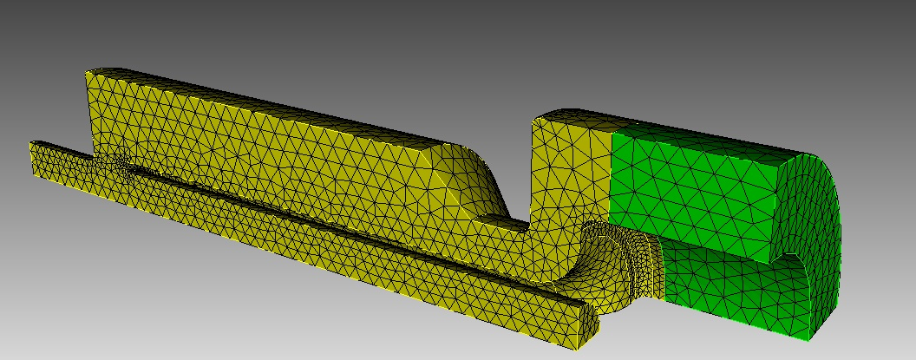
Quarter Model setup
As a first step check, a quarter model of the cavity is set up in Omega3P, based on the SAT file provided by Gennady.

Slide 3
Quarter Model Tuning
Ferrite material: average ξ=14.4, no ferrite heating loss .
From Gennady , “2nd harmonic Booster cavity status and plan, Apr 2nd ”
The frequency tuning agrees very well with Gennady’s results.

Slide 4
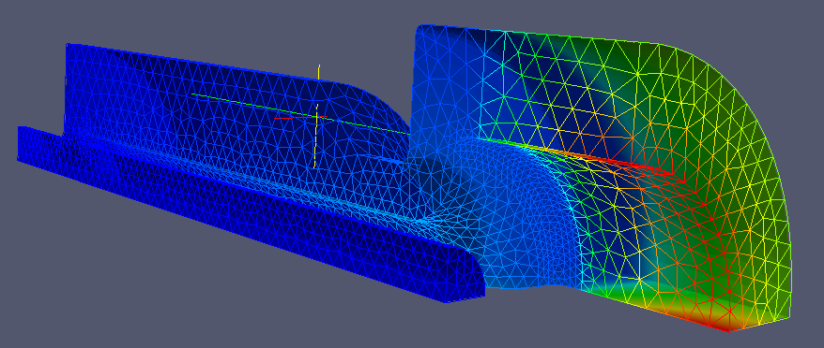
Thermal heating with constant u’’
Omega3P Simulation
Gennady’s results from “May212015_2nd_Harm”
B field Magnitude
F = 75.503 MHz
For V_peak = 100 KV:
P_ferrite_e = 8.11 kW
P_ferrite_m = 63.25 kW
P_ferrite = 71.36 kW
P_copper = 9.14 kW
The Omega3P simulation agrees well with Gennady’s results.

