Slide 1
The LHC in Context
& the Current Status
Chandra Bhat
Accelerator Division, Fermilab
January 12-16, 2015
CMSDAS, Fermilab
Abstract: Physics behind the CERN Accelerators and general aspects of circular accelerators is explained with an introduction to “collider luminosity“ as an introduction to the HEP graduate students. Current status of LHC operation for Run II and future upgrades for HLLHC is also outlined.

Slide 2
Important Collider Parameters
Collider Luminosity
  Instantaneous and
  Integrated Luminosity
Types of beam, & Collision Energy (CM Energy, √s )
Beam Parameters
  Number of Bunches
  Bunch Intensity
  Beam emittance (Transverse & Longitudinal emittance)
Lattice Parameters
  β* (Beta function after squeezing of the beam at IP)
Beam Crossing Angle

Slide 3
Luminosity Formula for a Collider
Instantaneous Luminosity
# of protons/bunch
for Beam-1 & Beam-2
Beam Revolution Frequency
Transverse Beam sizes
For Beam-1 & Beam-2
Correction term
# of Bunches/beam
Relativistic Factor
Beam Transverse
Emittance
β* @ interaction point
(Lattice parameter)

Slide 4
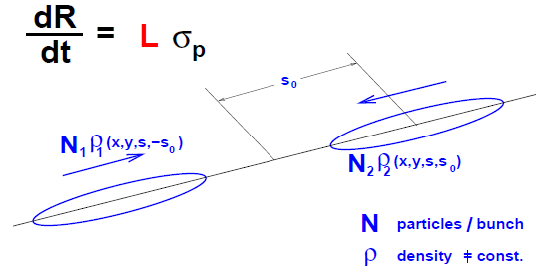
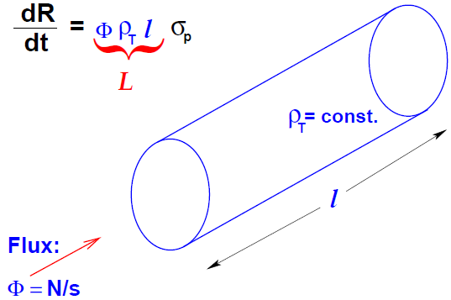
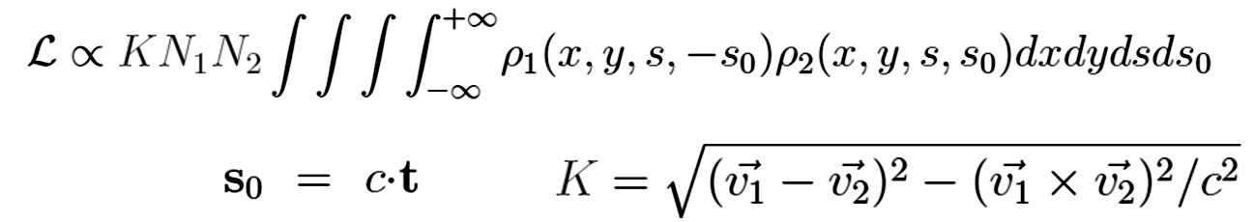
Luminosity
Luminosity relates the cross-section σ_{p} and event rate
  For Fixed Target case depends on
    Flux of Incident beam
    # of target nuclei/unit area
Goal of the Accelerator is to maximize the Event Rate
L
y
v₂=β₂c
L
L_{fix-Tgt}= Φ ρ_{T} l →
s
v₁=β₁c
x
  In the case of the Collider
    the target is also moving. Assuming bunched beam, the L per bunch crossing is,
Time variable
N₁ and N₂ ← number of particles /bunch
Kinematic factor

Slide 5
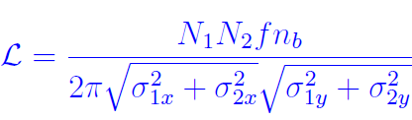


Collider Luminosity
Assume
  Head-on collision with magnitudes of velocities |v₁|=|v₂|
  Densities in all coordinates are uncorrelated:
    ρ(x,y,s,s0)= ρ_{x}(x)*ρ_{y} (y)* ρ_{s}(s±s₀) ; x≡ Horizontal, y≡ Vertical
  Density distribution function is Gaussian in each coordinate
  Transverse size: σ_{1x}# σ_{2x} and σ_{1y}# σ_{2y}, but bunch length σ_{1s}= σ_{2s}
  Then
σ ²_{x,y} =ε_{x,y} β*_{x,y}
; β*_{x,y} : Lattice beta-functions at interaction points &
ε_{x,y} : Transverse Emittance of the beam
As the # of bunches increase the cross talk between in-coming and out-going bunches (beam-beam interactions) becomes an issue.
Solution: Crossing angle

Slide 6
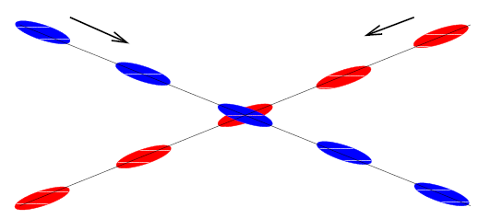



Collider Luminosity with Crossing Angle & other corrections; the case of LHC
x
θ= θ_{C}
Beam 1
Beam 2
Instantaneous Luminosity with other Corrections:
W → Beam offset
S → Crossing angle
→ Crossing angle and beam offset
H → Hour-glass factor from bunch length
Luminosity per Crossing
For the LHC
(n_{b})_{Max}= 2808 @25 ns bunch spacing,
N₁=N₂=1.15E11ppb, fo= 11.24kHz, β*_{x}= β*_{y}=0.55m,
θc=285μr, σ*_{x}= σ*_{y}=16.6μm, σ_{s}=7.5cm
L_{Head-on} =1.2x10³⁴cm⁻²s⁻¹
L_{S} =1.01x10³⁴cm⁻²s⁻¹
L_{S&H} =1.00x10³⁴cm⁻²s⁻¹
If N=N₁=N₂ L ∝ N² and linearly with n_{b} .
L also depends on beam filling pattern

Slide 7
Components of Accelerators
Magnets: Dipole (for bending), Quadrupole (for focusing), Sextupole, Octupole, Decapole, etc., ← These elements guide the beam, i.e., they control Transverse Beam dynamics
RF cavities ← They help to accelerate the beam, i.e., they control Longitudinal Beam Dynamics
Beam Diagnostics and other instrumentation ← They are essential constituents of any accelerator - help to monitor properties, behavior and control of the beam. Without beam diagnostics we are blind.
Example of beam diagnostics are
  Beam current monitors, Profile monitors, Loss monitors, Schottky noise monitors, quench protection systems, dampers, etc.

Slide 8
Accelerator Lattice
A single “quad” can provide focusing of charged particle beam only in one plane. Hence, two quadrupole magnets are needed to achieve overall focusing.
f_{F}
f_{D}
Optics
f_{F}= focal length of focusing quad
f_{D}= focal length of de-focusing quad
L = Distance between two quads
Focusing
Sextupole
L
A Lattice is formed by a series of magnetic elements which guide the charged particle beam from one point to another through a vacuum beam pipe.
Lattice may be for
  Beam transfer line
  Circular accelerator and Storage ring
  Linear accelerator
FODO Period
FODO Lattice:
A lattice comprising symmetric quadrupole triplets that can focus beam in both X and Y planes
1/2QF
QD
1/2QF
k(s)
Nomenclature
Symmetric FODO

Slide 9
Betatron Motion
The particles in a FODO lattice oscillate within an ENVELOPE in the transverse plane. The number of such oscillations around a ring is called Transverse Tune
  Horizontal tune (Q_{H} or ν_{H})
  Vertical tune (Q_{V} or ν_{V})
These oscillatory motion are governed by,
General solutions to the Hill’s equations are given as,
One can combine these two into one equation as,
ρ₀ is bending radius and
K(s) is focusing strength
or spring constant
“Hill’s equations”
Transverse Emittance Beta-function
phase advance
Envelope function
Tune →
ν_{H} = 64.28 at inj., = 64.31 at collision
ν_{V} = 59.31 at inj., = 59.32 at collision
for the LHC

Slide 10
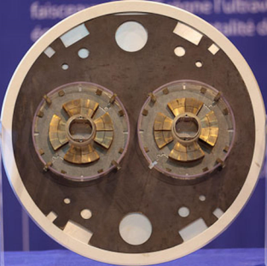
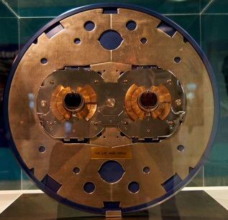

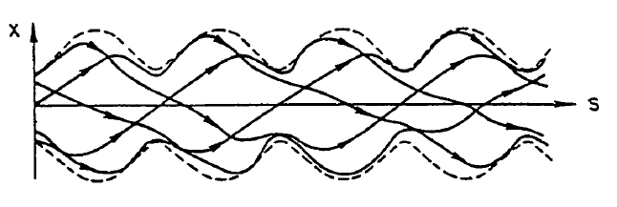
Aspects of Transverse Beam Dynamics
LHC SC Quad
IP. QuadMagnets
Beam Pipe
LHC SC Dipoles
Straight Section
FODO Lattice
IP
Envelope
Function=√Aβ(s)
Add Beam diagnostics:
Loss Monitors
Position Monitors
Profile monitors
Special Devices
Injection Devices
Extraction Devices
Beam Abort System
Scrapers
Bending Magnets
(Main Dipoles
with correctors)
Beam
Envelope
Function
=√Eβ(s)
Quadrupole Magnets
Trajectory of a particle on several successive revolutions
Close Orbit

Slide 11
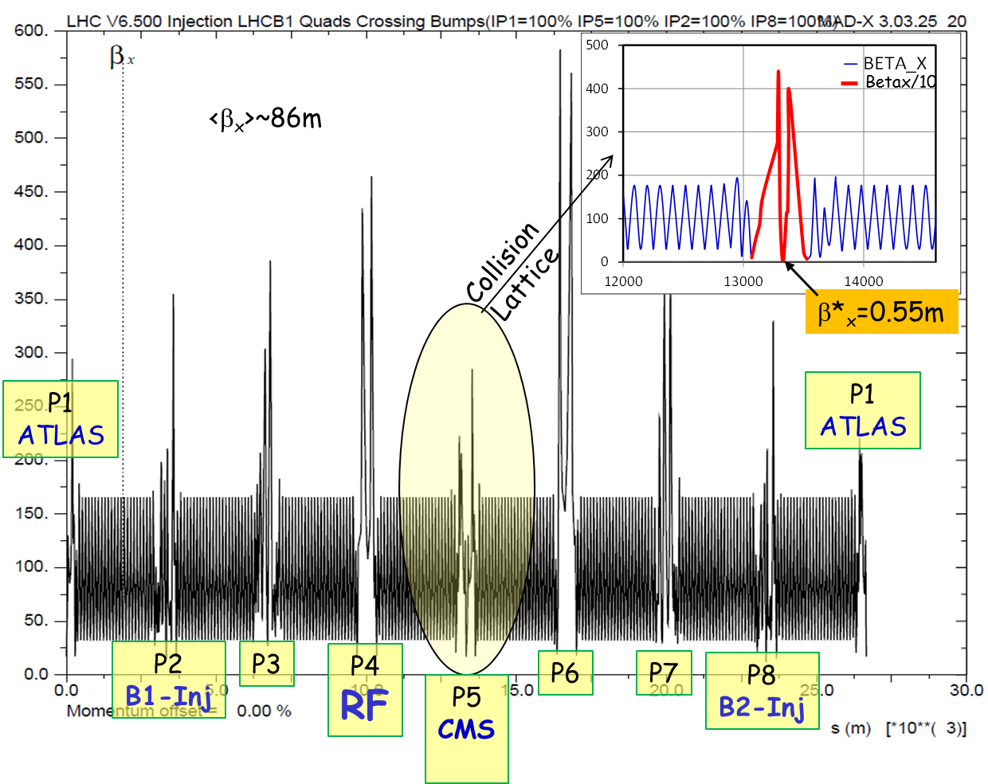
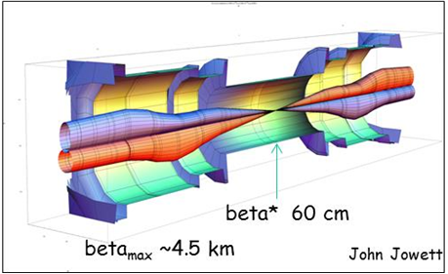
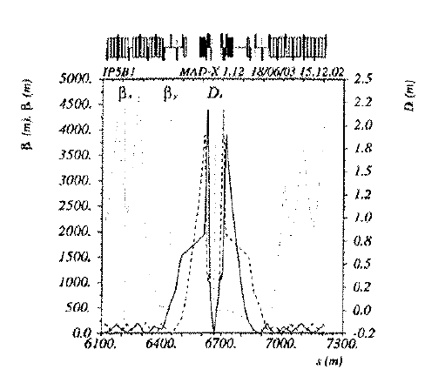
LHC β_{x}@Inj. & @Collision
β_{Max} ~4.5km
<β_{x,y}> ~86m
β* ~0.55m

Slide 12
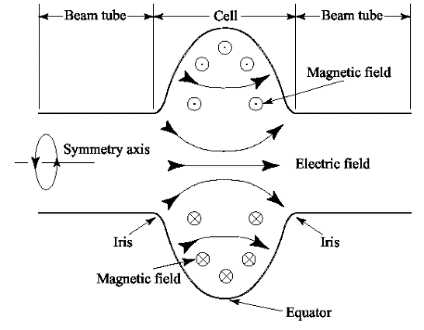
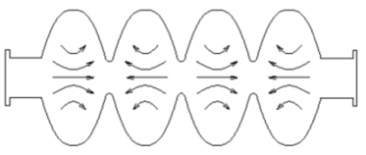
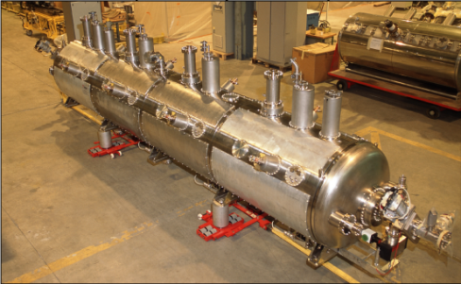
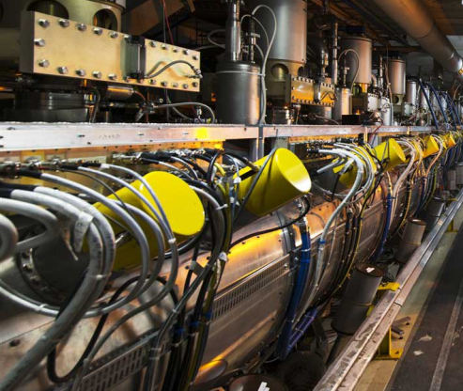
Components of Accelerators - RF
RF Cavity: A device used for
bunching, beam capture,
acceleration,
rf manipulation like bunch
  compression, rotation,
  shaping beam bunches,
  bunch splitting, coalescing
  multiple bunches,
  and many rf gymnastics.
Synchronous beam from
one accelerator to another
To keep up with the energy losses
during storing (loss ~7keV/turn)
in a collider like LHC,
and many more.
Single-Cell
SC cavity
TM010 mode
Multi-Cell SRF
LHC 400MHz 4-SRF cavity/cyro-module with 2MV/cavity
LHC 400MHz SRF in the LHC tunnel
at 4.5⁰K

Slide 13
What an RF system can do?
Aspects of Longitudinal Beam Dynamics
Coasting Beam with Energy E₀±ΔE
Bunch Compression
Closed Orbit
Beam Acceleration
Beam
Storage Ring
Beam Pipe &
the Beam
Ω
Ω
Bunched Beam
Phase-space Area of a Bunch is
Longitudinal Emittance
Measured in eVs
RF Cavity
Buckets of higher harmonic RF system
RF
Buckets
AC
RF Buckets
Sinusoidal
AC
Accelerating RF Buckets
and
Accelerating Beam Bunches
AC
Sinusoidal
AC
Vrf
RF Bucket
Boundary
Sinusoidal
Sinusoidal
Vrf
Vrf
Vrf
ΔE
Vrf
ΔE
ΔE
t
ΔE
t
t
ΔΕ
Beam
t
t
ω_{rf}= hω_{rev}
harmonic number h=2
t
ω_{rf}= hω_{rev}
harmonic number h=2
ω_{rf}= hω_{rev}
harmonic number h=1
ω_{rf}= hω_{rev}
harmonic number h=2
Accel. /turn=ΔE_{Acc}=V₀sin ϕ
Vrf
A contour of
constant Hamiltonian
h=35640 for the LHC, f_{rf}=400MHz (Vrf)_{peak}=16MV
Max. No. of Bunches =2808 @25nsec bunch spacing
Max. No. of Bunches (2012)=1383 @ 50 ns bunch spacing
Synchronous Particle
WCM Data
WCM Data
WCM Data
WCM Data

Slide 14
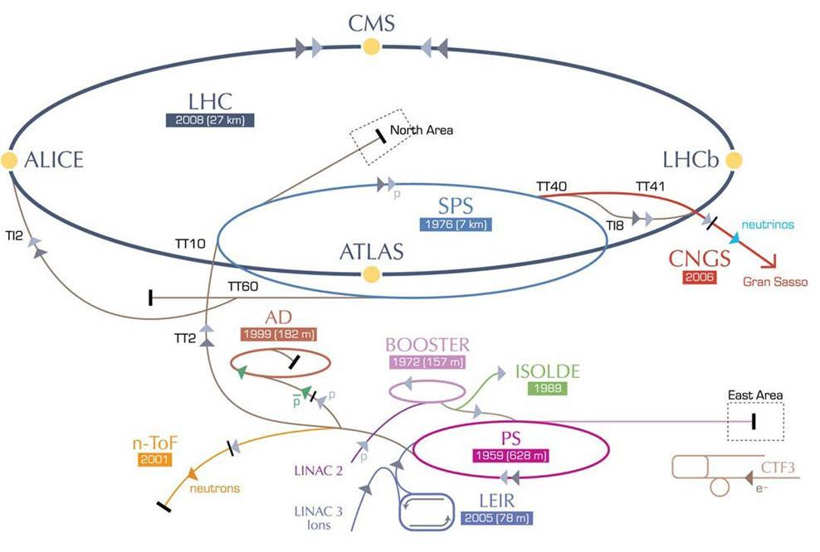
CERN Accelerators
LHC (Lum. upgrade) I worked on these
SPS (single bn. Instability) accelerators
PS (bn. Int. & e-cloud) during my sabbatical
at CERN
from 2010-2013
450-7000 GeV
LINAC-2 50MeV
PSB 1.4GeV
PS 26GeV
SPS 450GeV
LHC 7TeV
450 GeV
1bn x4
6bn(h=1?)
36bn (h=84?)
144bn(h=4620)
1380bn(h=35640)
450 GeV
26 GeV
50 MeV

Slide 15
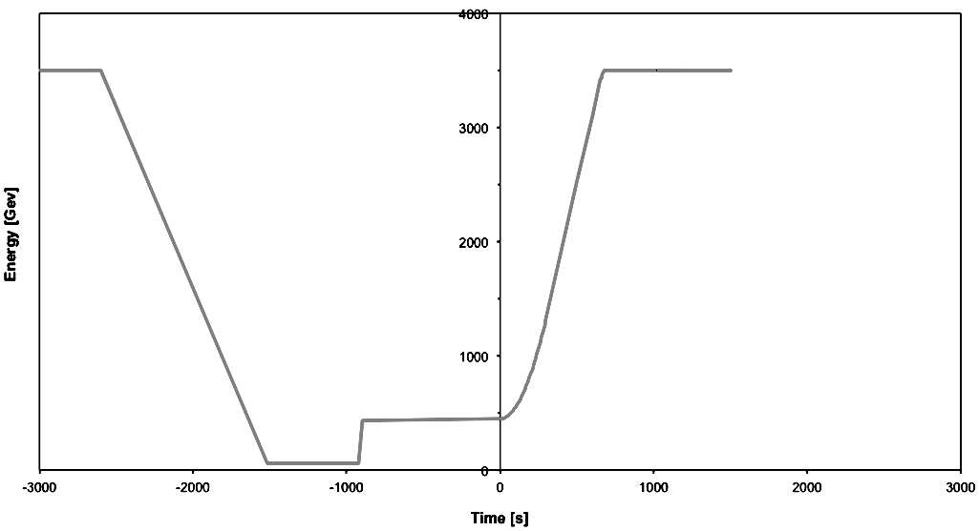
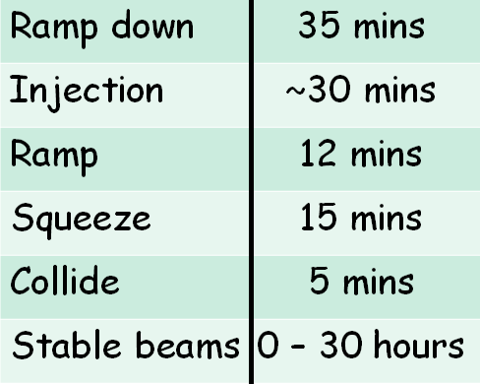
A Schematic of LHC Operational Cycle
Collide
Beam dump
3.5 TeV
Squeeze
Stable beams
Beam loss during
squeeze
12-SPS batch Injection
Ramp down/precycle
Ramp
450 GeV
Injection
LHC Turn around: 2-3 hours on a good day

Slide 16
PS Produces the Bunch-Filling Pattern for the LHC
25ns, 50 ns or 12.5 ns
C
  Octuple splitting for 12.5 ns if needed
LHC25
72 bunches
  Quadruple splitting for
  25 ns LHC fill
PS Acceleration 3.4 sec
LHC50
36 bunches
  Double splitting for
  50 ns LHC fill
1.4 GeV → 26 GeV acceleration
B
PSB to PS injection at 1.4 GeV and triple splitting at injection.
Bunch intensity was limited to <1.8E11ppb on LHCINDV prior to 2010
A
Six PSB Bunches at 1.4 GeV
During June-August 2010 lots of effort were made to produce high-intensity bunches in the PS with >3.5E11ppb with LE(4σ)< 0.29 eVs & ε_{x,y} <3 μm

Slide 17
High Intensity Bunches in 2010-12
Issues with high intensity bunch-trains:
  Prepare PS for acceleration,
  Transfer and acceleration in the SPS and LHC
    The SPS-Q23 lattice(old) was abandoned.
    A new SPS-Q18 lattice became operational.
High intensity single bunches were used to investigate
  SPS:Transverse Mode Coupling Instability (TMCI) and
  Single Bunch Longitudinal Instabilities (SBLI)←2010-11
  LHC: Test runs with high intensity bunches← 2010-12
    event pile-up & beam-beam tune shift (W. Herr et. al.)
    TMCI and SBLI (E. Shaposhnikova et. al.)
Ultimately, PS batch of 36 stable bunches with 50ns spacing & ~1.7E11ppb were used in the LHC for the HEP during 2011-12 operation.
LIU (Leader: Roland Garoby): A massive effort is being put to upgrade PS, SPS to handle high intensity beam.
Malika Meddahi

Slide 18
Peak performance through the years
 | Nominal | 2010 | 2011 | 2012
Energy [TeV] | 7 | 3.5 | 3.5 | 4
Bunch spacing [ns] | 25 | 150 | 50 | 50
No. of bunches | 2808 | 368 | 1380 | 1380
beta* [m] ATLAS and CMS | 0.55 | 3.5 | 1.0 | 0.6
Max bunch intensity [protons/bunch] | 1.15 x 10¹¹ | 1.2 x 10¹¹ | 1.45 x 10¹¹ | 1.7 x 10¹¹
Normalized emittance [mm.mrad] | 3.75 | ~2.0 | ~2.4 | ~2.5
Crossing Angle (urad) | 285(H&V) |  | ~100 (H&V)? | 145(H&V)
Peak luminosity[cm⁻²s⁻¹] | 1.0 x 10³⁴ | 2.1 x 10³² | 3.7 x 10³³ | 7.7 x 10³³
Ave. Pileup at Start | 26 | 8 | 17 | 38

Slide 19
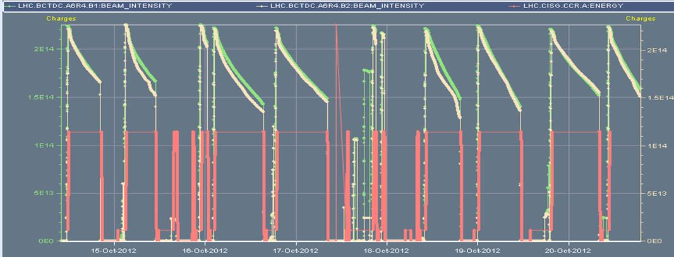
Typical LHC pp-store-Week
Eight Nice Fills (Mid Oct., 2012)
B1
B2
Fill # 3188, Store Length= 6:56 h,
L_{peak}=6.7x10³³cm⁻²s⁻¹, L_{Int}= 0.105fb⁻¹
Fill # 3192, Store Length= 10:39 h,
L_{peak}=6.8x10³³cm⁻²s⁻¹, L_{Int}= 0.154fb⁻¹
Fill # 3200, Store Length= 8:17 h,
L_{peak}=6.5x10³³cm⁻²s⁻¹, L_{Int}= 0.105fb⁻¹
Fill # 3194, Store Length= 12:34 h,
L_{peak}=6.5x10³³cm⁻²s⁻¹, L_{Int}= 0.167fb⁻¹
Fill # 3207, Store Length= 4:10 h,
L_{peak}=7.7x10³³cm⁻²s⁻¹, L_{Int}= 0.fb⁻¹
Fill # 3185, Store Length= 7:45 h,
L_{peak}=6.8x10³³cm⁻²s⁻¹, L_{Int}= 0.122fb⁻¹
Fill # 3203, Store Length= 11:42 h,
L_{peak}=7.1x10³³cm⁻²s⁻¹, L_{Int}= 0.175fb⁻¹
Fill # 3201, Store Length= 10:17 h,
L_{peak}=7.4x10³³cm⁻²s⁻¹, L_{Int}= 0.133fb⁻¹

Slide 20
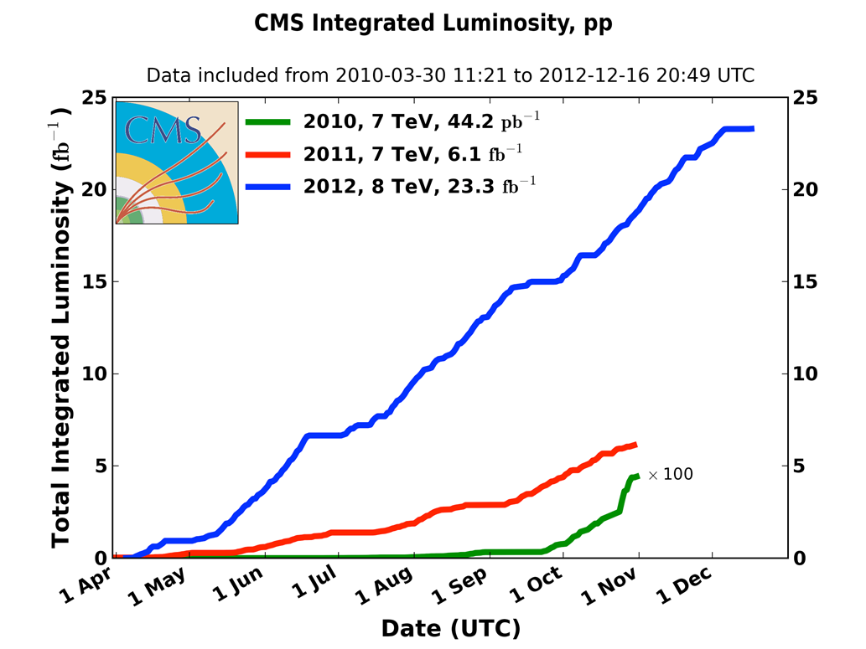
Summary of 2010-12
LHC – pp Luminosity Performances
2010: 0.04 fb⁻¹
  7 TeV CM
  Commissioning
2011: 6.1 fb⁻¹
  7 TeV CM
  Exploring the limits
2012: 23.3 fb⁻¹
  8 TeV CM
  Production
Higgs
Discovery
July 4th, 2012

Slide 21
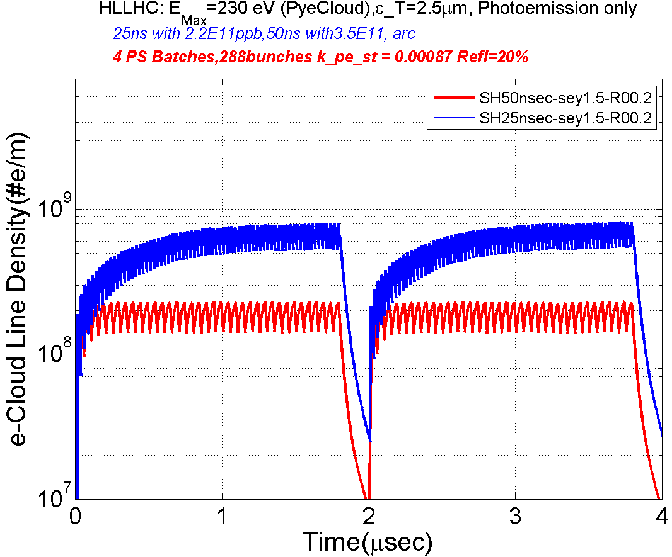
Main Challenges during Run I
2010-2013 the LHC was running with ≥ 50 ns bunch spacing for “Physics Runs”. However, was unable to run with nominal 25ns bunch spacing. Identified challenges were,
  Electron Cloud
  UFO (Unidentified objects) near injection regions ← Unintentional beam aborts
  Potential equipment damage
  Beam induced heating
  Collective effects and impedance
  Magnetic field perturbations & field quality
  Triplet aperture and beam-beam
E_{max}=239.5 eV
ε_{T} =2.5 μm
72x 2.2E11ppb(25ns)
36x 3.5E11ppb(50ns)

Slide 22
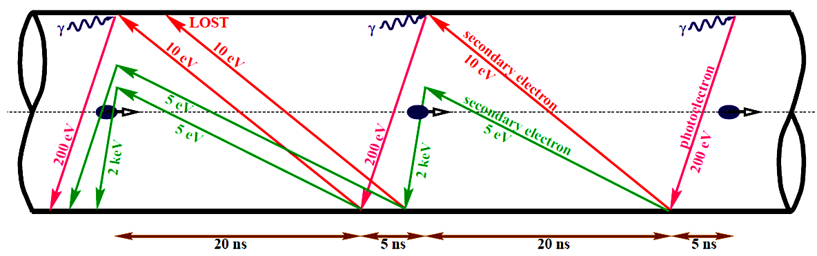
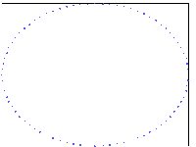
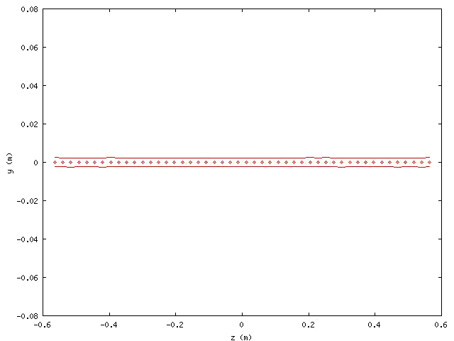
Buildup of Electron Cloud at the LHC & consequences
The critical energy of the photons at
7 TeV ~ 44 eV
Primary Source of electrons in the LHC
  At Injection (450 MeV) gas ionization
  At 7 TeV Synchrotron Radiation
Possible consequences:
  - instabilities, emittance growth, desorption ←bad vacuum
  - excessive energy deposition in the cold sectors

Slide 23
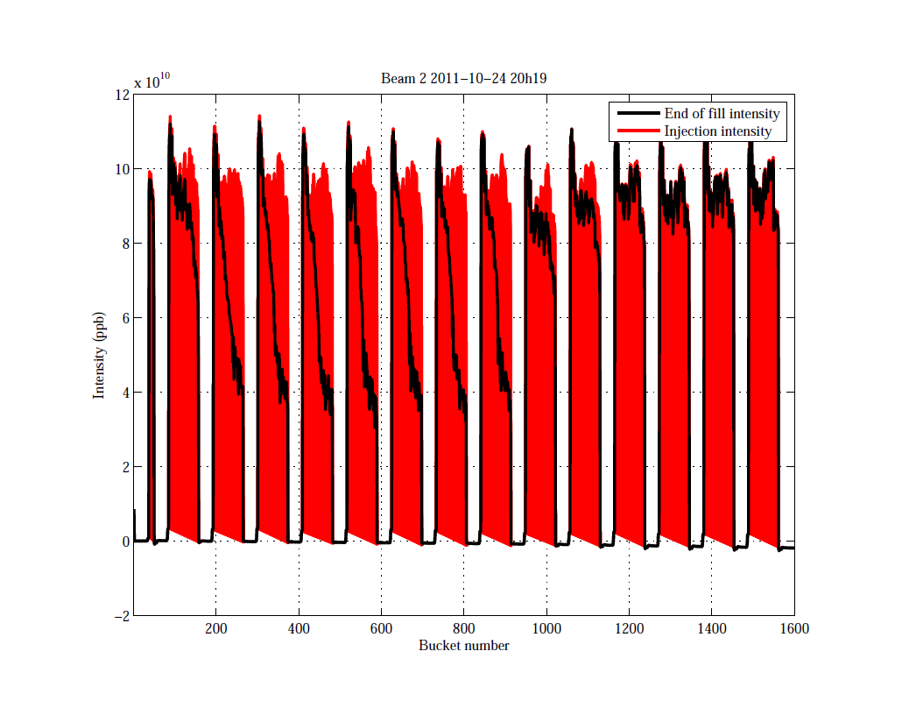
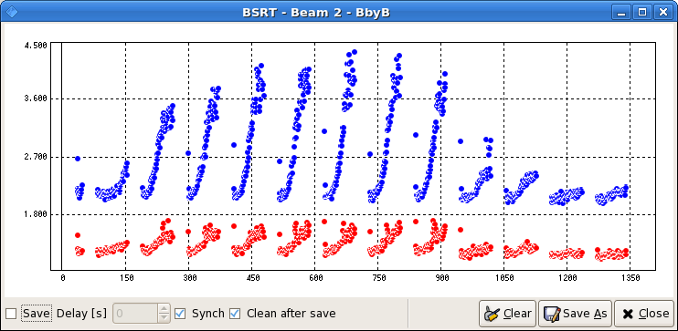
What e-cloud can do to the Beam?
Fill: 2249 (2011)
25 ns Bunch Spacing
Energy = 450 GeV
Time between Injection to End ~10 min
Dumped by BPM
1020 Bunches
Intensity
Bunch #
Injection Intensity
End of fill Intensity
Measured Emittance Growth
~33% Horizontal
~110% Vertical
Associated beam loss

Slide 24
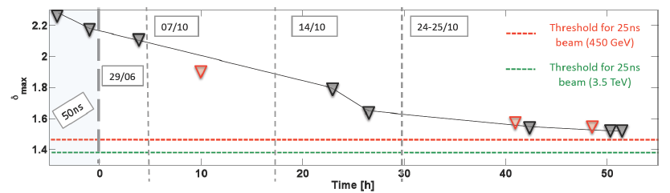
Mitigation of e-cloud in the LHC
Electron bombardment of a surface reduces secondary electron yield (SEY) of a material
An example of scrubbing 2011
First 1380 bunches in LHC
ε_{x,y} decreasing towards 1.1μm
N_{b} increasing towards1.45 x 10¹¹ ppb
21/02
13/03
05/04
12/04
28/06
18/07
30/09
30/10
Commissioning with beam
Scrubbing run 50ns
50ns beams
1.1x10¹¹ppb
Physics run 50ns
75ns physics run (nominal)
Observed Reduction of SEY by beam scrubbing
However, scrubbing with beam with 25 nsec bunch spacing alone probably is insufficient to fully suppress e-cloud
2011 Scrubbing
2012 Scrubbing
G. Iadarola, G. Rumolo

Slide 25
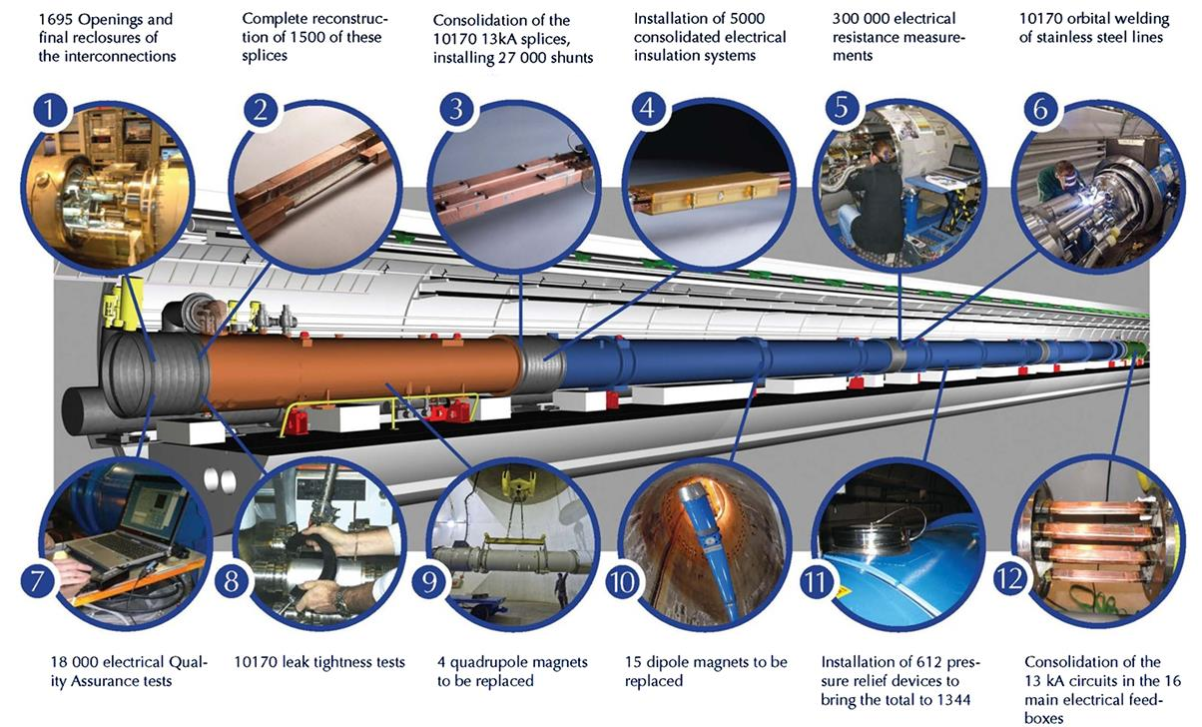
LHC: Coming up from a 2 years shutdown Main Repairs
A 13kA splice has a resistance of about 300 pΩ, which can be measured with a precision ~20pΩ. The acceptance criteria is 10 nΩ. Any splice does not meet this criteria is replaced/repaired.
The resistance acceptance criteria at the Cu - superconducting splice joints was 5 μΩ. Any joint does not meet this criteria is replaced or repaired.

Slide 26
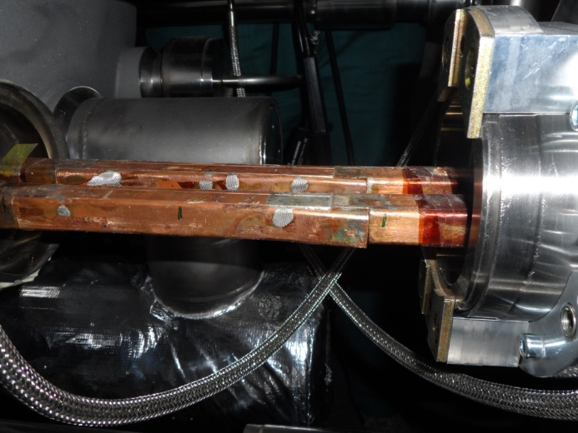
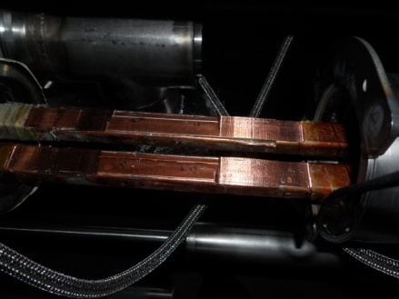
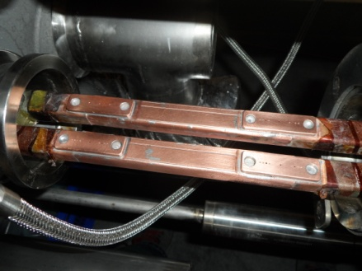
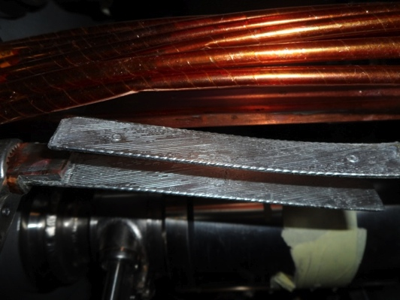
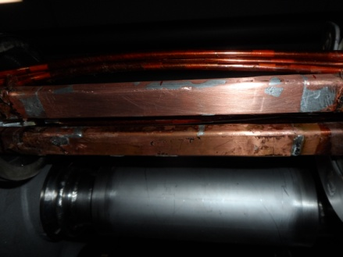
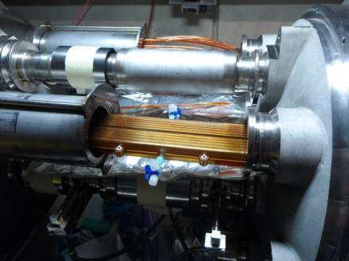
« Old Splice » « Machined Splice » « Consolidated Splice »
« Cables » « New Splice »
Total interconnects in the LHC:
  1,695 (10,170 high current splices)
Number of splices redone: ~3,000 (~ 30%)
Number of shunts applied: > 27,000
« Insulation box »
And a lot more besides…
(from Mike Lamont, 11/2014)

Slide 27
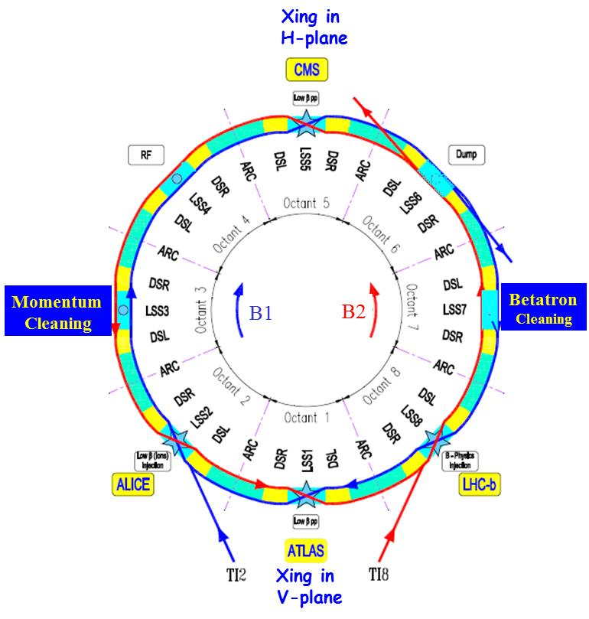
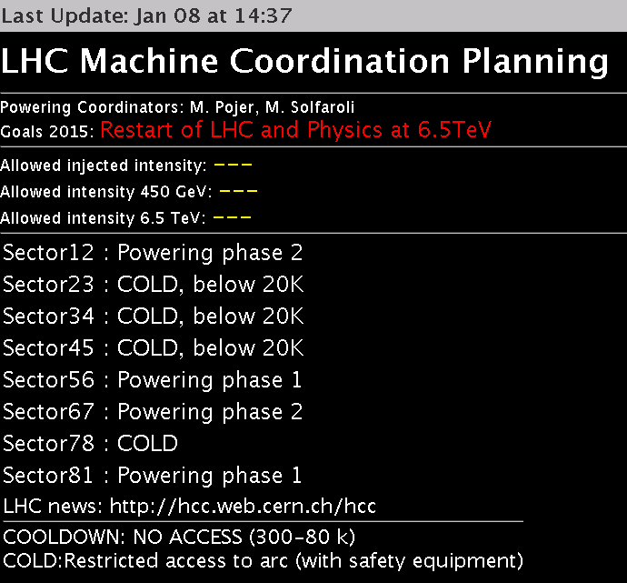
Current Status of the LHC
PS: Restarted in 3rd week of June 2014
SPS: Beam to SPS during 3rd week of September, 2014
LHC: All the sectors are completely repaired. The magnets have been "trained" and tested to full current only in 2 sectors (12 & 67), 56 and 81 are being trained, 4-more to go. (info from Bob Flora).
LHC Commissioning with beam is planned to start on week 11 of 2015 (i.e., 2nd week of March)
Beam for physics – Late Spring 2015?
45
56
34
67
1.9K
23
78
1.9K
12
81
1.9K
1.9K

Slide 28

LHC – 2015-2017
When the LHC is turned on this year, this will be a brand new machine.
Beam Energy: 6.5 TeV
Many Challenges are expected
  All magnet circuits are tested before and during installation. ← Need adjustments during operation
  Potential equipment damage in case of failures during operation. In case of failure the beam must never reach sensitive equipment!
  Requires good optics and orbit control! ← feedback loops
  May need Tighter Collimation than design!
  Design: 6σ for primary collimators & 7σ for secondary collimators
  Beam with 25 ns bunch spacing. Long range beam-beam effects will be larger than that observed in 2010-2012
  + All the problems encountered during Run 1.
    e-cloud, UFO and etc.
summary from Mike Lamont

Slide 29
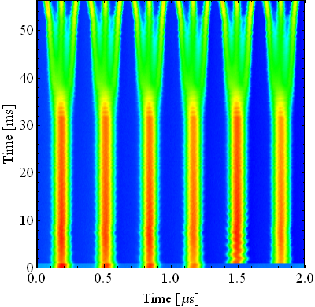
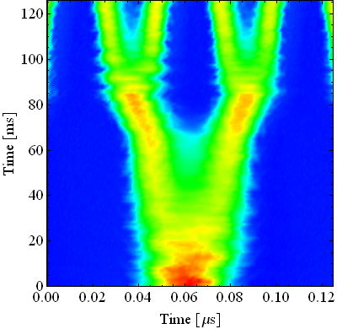
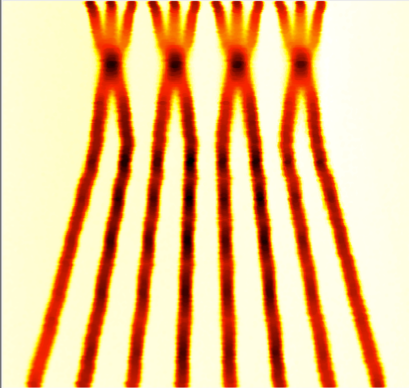
LHC Performance Goal 2015-…
 | LHC nominal 25ns | LHC 2012 50 ns | LHC2015 25ns | LHC2015 25ns (BCMS)
Beam Energy (TeV) | 7 | 4 | 6.5 | 6.5
# Bunches | 2808 | 1380 | 2748( or 2736) | 2508( or 2496)
p/bunch [10¹¹], I[Amp] | 1.15, 0.58 | 1.6,0.42 | 1.2,0.59 | 1.2, 0.54
γε_{x,y} [μm] | 3.75 | ~2.5 | 3.1 | 1.7
ε_{L} [eV.s] | 2.5 | 2.5 | 2.5 | 2.5
Effective beam size (μm) | 22 | 19 | 24 | 18
σ_{z} [cm] | 7.5 | 7.5 | 7.5 | 7.5
σ_{δp/p} [10⁻³] | 0.1 | 0.1 | 0.1 | 0.1
β∗ [cm] ,Xing Angle[μrad],b-b sep [σ] | 55 | 60,145,10 | 80,290,11 | 80,290,11
Ultimate in 2015 → |  |  | 40 | 40
Peak lumi [10³⁴] | 1.0 | 0.76 (peak) | 0.85 | 1.29
Lumi loss Factor/Geometric Factor | 0.84 | 0.96 | 0.87 | 0.79
T_{leveling} [h] @ 5E34 | No Leveling | No Leveling | No Leveling | No Leveling
#Pile up | 25 | 35(max) | 22 | 36
Max Stored Energy[MJ] | 362 | 140 | 342 | 311
PS: Bunch splitting schemes →

Slide 30
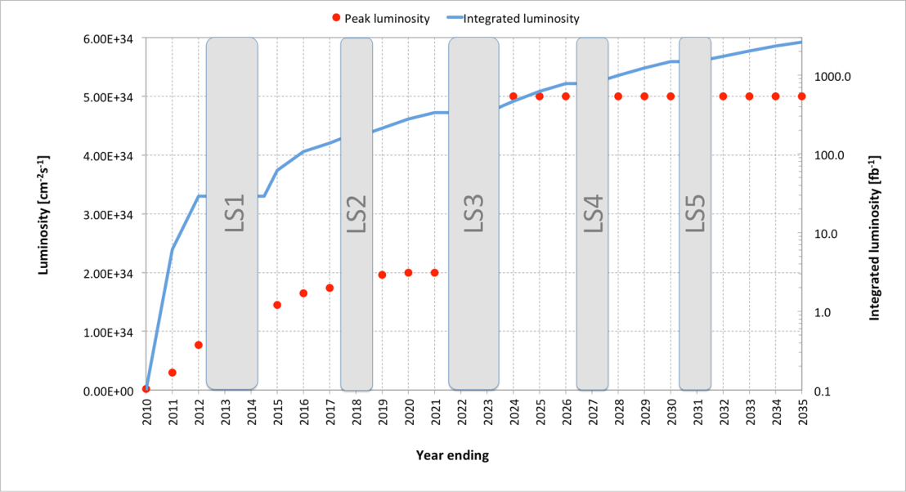
LHC for next 20 years
Very preliminary and very likely to change
☹_{peak} =7.7nb⁻¹/s
☹_{total} =30fb-1
Pileup(Max)~35
Bunch spacing=50ns
☹_{peak} =17nb⁻¹/s
☹_{total} =100-200fb-1
Pileup(Max)~42
Bunch spacing=25ns
☹_{peak} =20nb⁻¹/s
☹_{total} ~250fb-1
Pileup(Max)~42
Bunch spacing=25ns
HL-LHC era
Long Shutdown-1( )
Run 2
Run 3
☹_{peak} =50nb⁻¹/s
☹_{total} ~3000fb-1
Pileup(Max)~140
Bunch spacing=25ns
Run 1
30

Slide 31
HL-LHC Official Beam Parameters
Parameter | nominal | 25ns | 50ns
N | 1.15E+11 | 2.2E+11 | 3.5E+11
n_{b} | 2808 | 2808 | 1404
beam current [A] | 0.58 | 1.12 | 0.89
x-ing angle [μrad] | 300 | 590 | 590
beam separation [σ] | 10 | 12.5 | 11.4
β* [m] | 0.55 | 0.15 | 0.15
ε_{n} [μm] | 3.75 | 2.5 | 3.0
ε_{L} [eVs] | 2.5 | 2.5 | 2.5
energy spread | 1.20E-04 | 1.20E-04 | 1.20E-04
bunch length [m] | 7.50E-02 | 7.50E-02 | 7.50E-02
Piwinski parameter | 0.68 | 3.1 | 2.9
geom. reduction | 0.83 | 0.35 | 0.33
beam-beam / IP | 3.10E-03 | 3.9E-03 | 5.0E-03
Peak Luminosity | 1E10³⁴ | 7.4E10³⁴ | 8.5 10³⁴
Virtual Luminosity | 1.2E10³⁴ | 21E10³⁴ | 26 10³⁴
Events/Crossing | 26 | 210 | 475
(Leveled to 5x10³⁴ cm⁻² s⁻¹)
140
One can regain the lost Luminosity due to crossing angle by introducing Crab-cavity

Slide 32
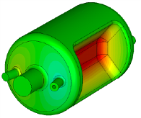
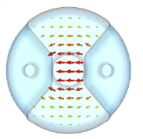
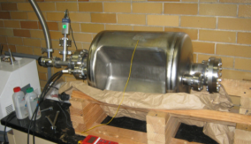
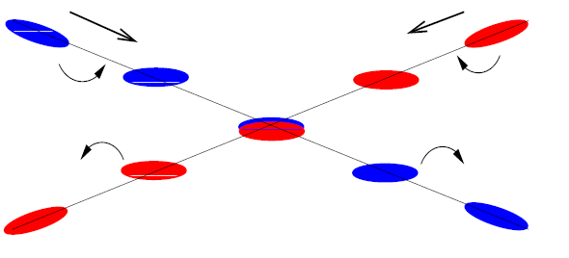
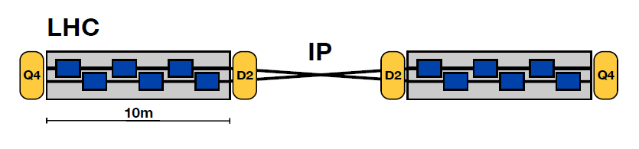

Collider Luminosity with Crab Crossing
Crab Cavity
Old Dominion University
Crab Crossing scheme
With transversely
Deflecting cavities
Crab Cavity
Crossing scheme
θc=θ
θ
Beam 1
Beam 2
Beam 1
Beam 2
Crab Cavity
Crab Cavity
Bob Palmer 1988
For the HL-LHC Beam parameters
Reduction due
Added gain in Luminosity by a factor √2 using crab-kissing
(flat bunches with
crab-cavity)
L_{H} =21x10³⁴cm⁻²s⁻¹
to Xing angle
L_{S&H} =7.4x10³⁴cm⁻²s⁻¹
Gain by
Crab-Xing
Luminosity Leveling 5x10³⁴cm⁻²s⁻¹ at pileup~140/collision
Changing the β* - Transverse offset
Manipulating the crossing angle - Use crab cavity to change the beam overlap

Slide 33
Acknowledgements
Frank Zimmerman, Oliver Bruning, Mike Lamont, E. Prebys
Elena Shaposhnikova, G. Rumolo, Roland Garoby, and
Gianluigi Arduini
PS Collaborators:
  Heiko Damerau, Steven Hancock, Edgar Mahner,
  Fritz Casper
SPS Collaborators
  T. Argyropoulos, J. Esteban Müller,T. Bohl, W. Hofle,
  E. Metral, G. Iadarola, B. Salvant, M. Taborelli,
  J. Tuckmantel, H. Timko
LARP and Fermi Research Alliance under U.S. DOE Contract.
Special thanks are due to Bob Flora

Slide 34
Summary
I have given you a simple overview of the physics of CERN accelerators and operating scenarios.
LHC started in 2008 with a glamorous start – but a disaster strikes!
  2008-10 LHC was fixed partially, learned a lot of lessons.
Restarted in 2010 and had a phenomenal run providing L_{intg}~30 fb⁻¹ to CMS and ATLAS collider detectors during 2010-12
  ← Discovery of the Higgs Boson in 2012
Further “consolidation” 2013-15: repaired and replaced all of the defective electrical connections (several thousands!) and many more.
Currently, testing of the accelerator components underway, to run the LHC with beam energy of 6.5TeV
Run 2 (2015-17):
  Run at CM energy of13TeV – may start with 50 ns bunch spacing?
  25 ns bunch spacing with~ 2736/2496 bunches, β*=80cm and going to β*=40cm (in 2015)
Contact: cbhat@fnal.gov

Slide 35
References
Practical Accelerator Physics,
http://www-ap.fnal.gov/users/cbhat/
Particle Accelerator Physics, H. Wiedemann (Springer, 1999)
An Introduction to Particle Physics High Energy Accelerators, D. Edwards and M. Syphers (John Wileyand Sons, Inc, 1993)
Accelerator Physics, S.Y. Lee (World Scientific, 1999)
Hand Book of Accelerator Physics and Engineering - Edt by A. Chao and M. Tinger , World Scientific (1999)
CAS CERN Accelerator, Accelerator Physics Courses
http://cas.web.cern.ch/cas/CAS%20Welcome/
Previous%20Schools.htm

Slide 36
Backup-Slides

Slide 37
Introduction: Terminology in Accelerator Physics
Units: I will try to stick to the MKS system.
Energy Units:
eV: It is the amount of kinetic energy gained by a single unbound electron when it passes through an electrostatic potential difference of one volt,
keV=10³*eV, MeV, GeV, TeV etc.
Momentum:
Measured in units of [MeV/c], [GeV/c], [TeV/c]
Beam Current: ; Unit of current = Amp
= 1 Coulomb/sec
  Beam Transport: Beam particles pass only once
  Circular Accelerator: Same particle goes through the same section f times/sec
1 eV
e-
At low energies Total energy >> KE
At high energies KE~ Total energy
1Volt
Charge passing through/unit time

Slide 38
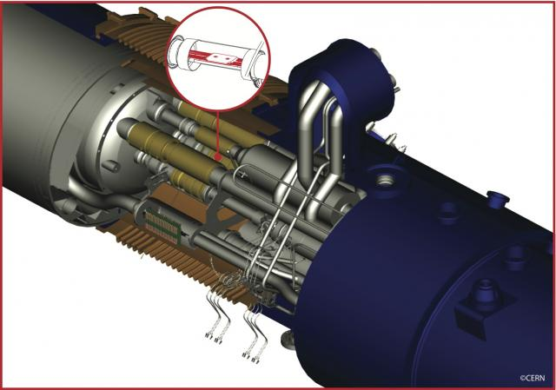
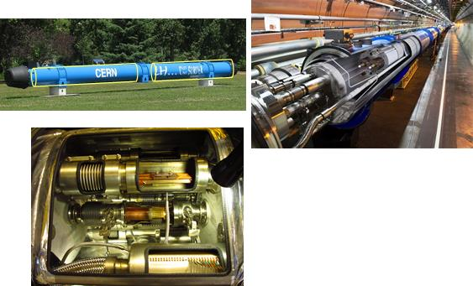
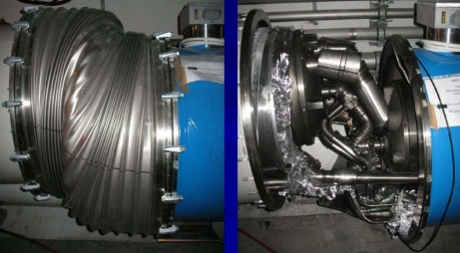
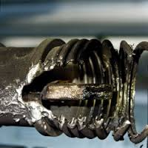
Some History of LHC Startup – Bright Startup
2008: Accelerator complete. Ring cold and under vacuum.
Sept. 10th 2008 by 14:59 hr
  First beam around the ring
Sept. 19th 2008 around noon: DISASTER while ramping Sect. 3-4 to 5.5TeV
2008–2009: 14 months of major repairs
  Replaced ~50 SC magnets in that sector
  Inspected all the sectors
  New Quench Protection System for online monitoring and protection of all joints.
However, uncertainties existed about the splice quality through out the 2010-2013 runs
  Because of this Risk
  ➔ decision: limit the beam energy to 3.5 TeV
  “This is HISTORY & we learned a lot
Public display of the
Dipole magnet
SC splices at the joints
Complex connections
between two dipoles
~4km of the LHC Ring was badly damaged

Slide 39
Crab Kissing Scheme
Using crab cavities to level luminosity and lower peak interaction density

Slide 40
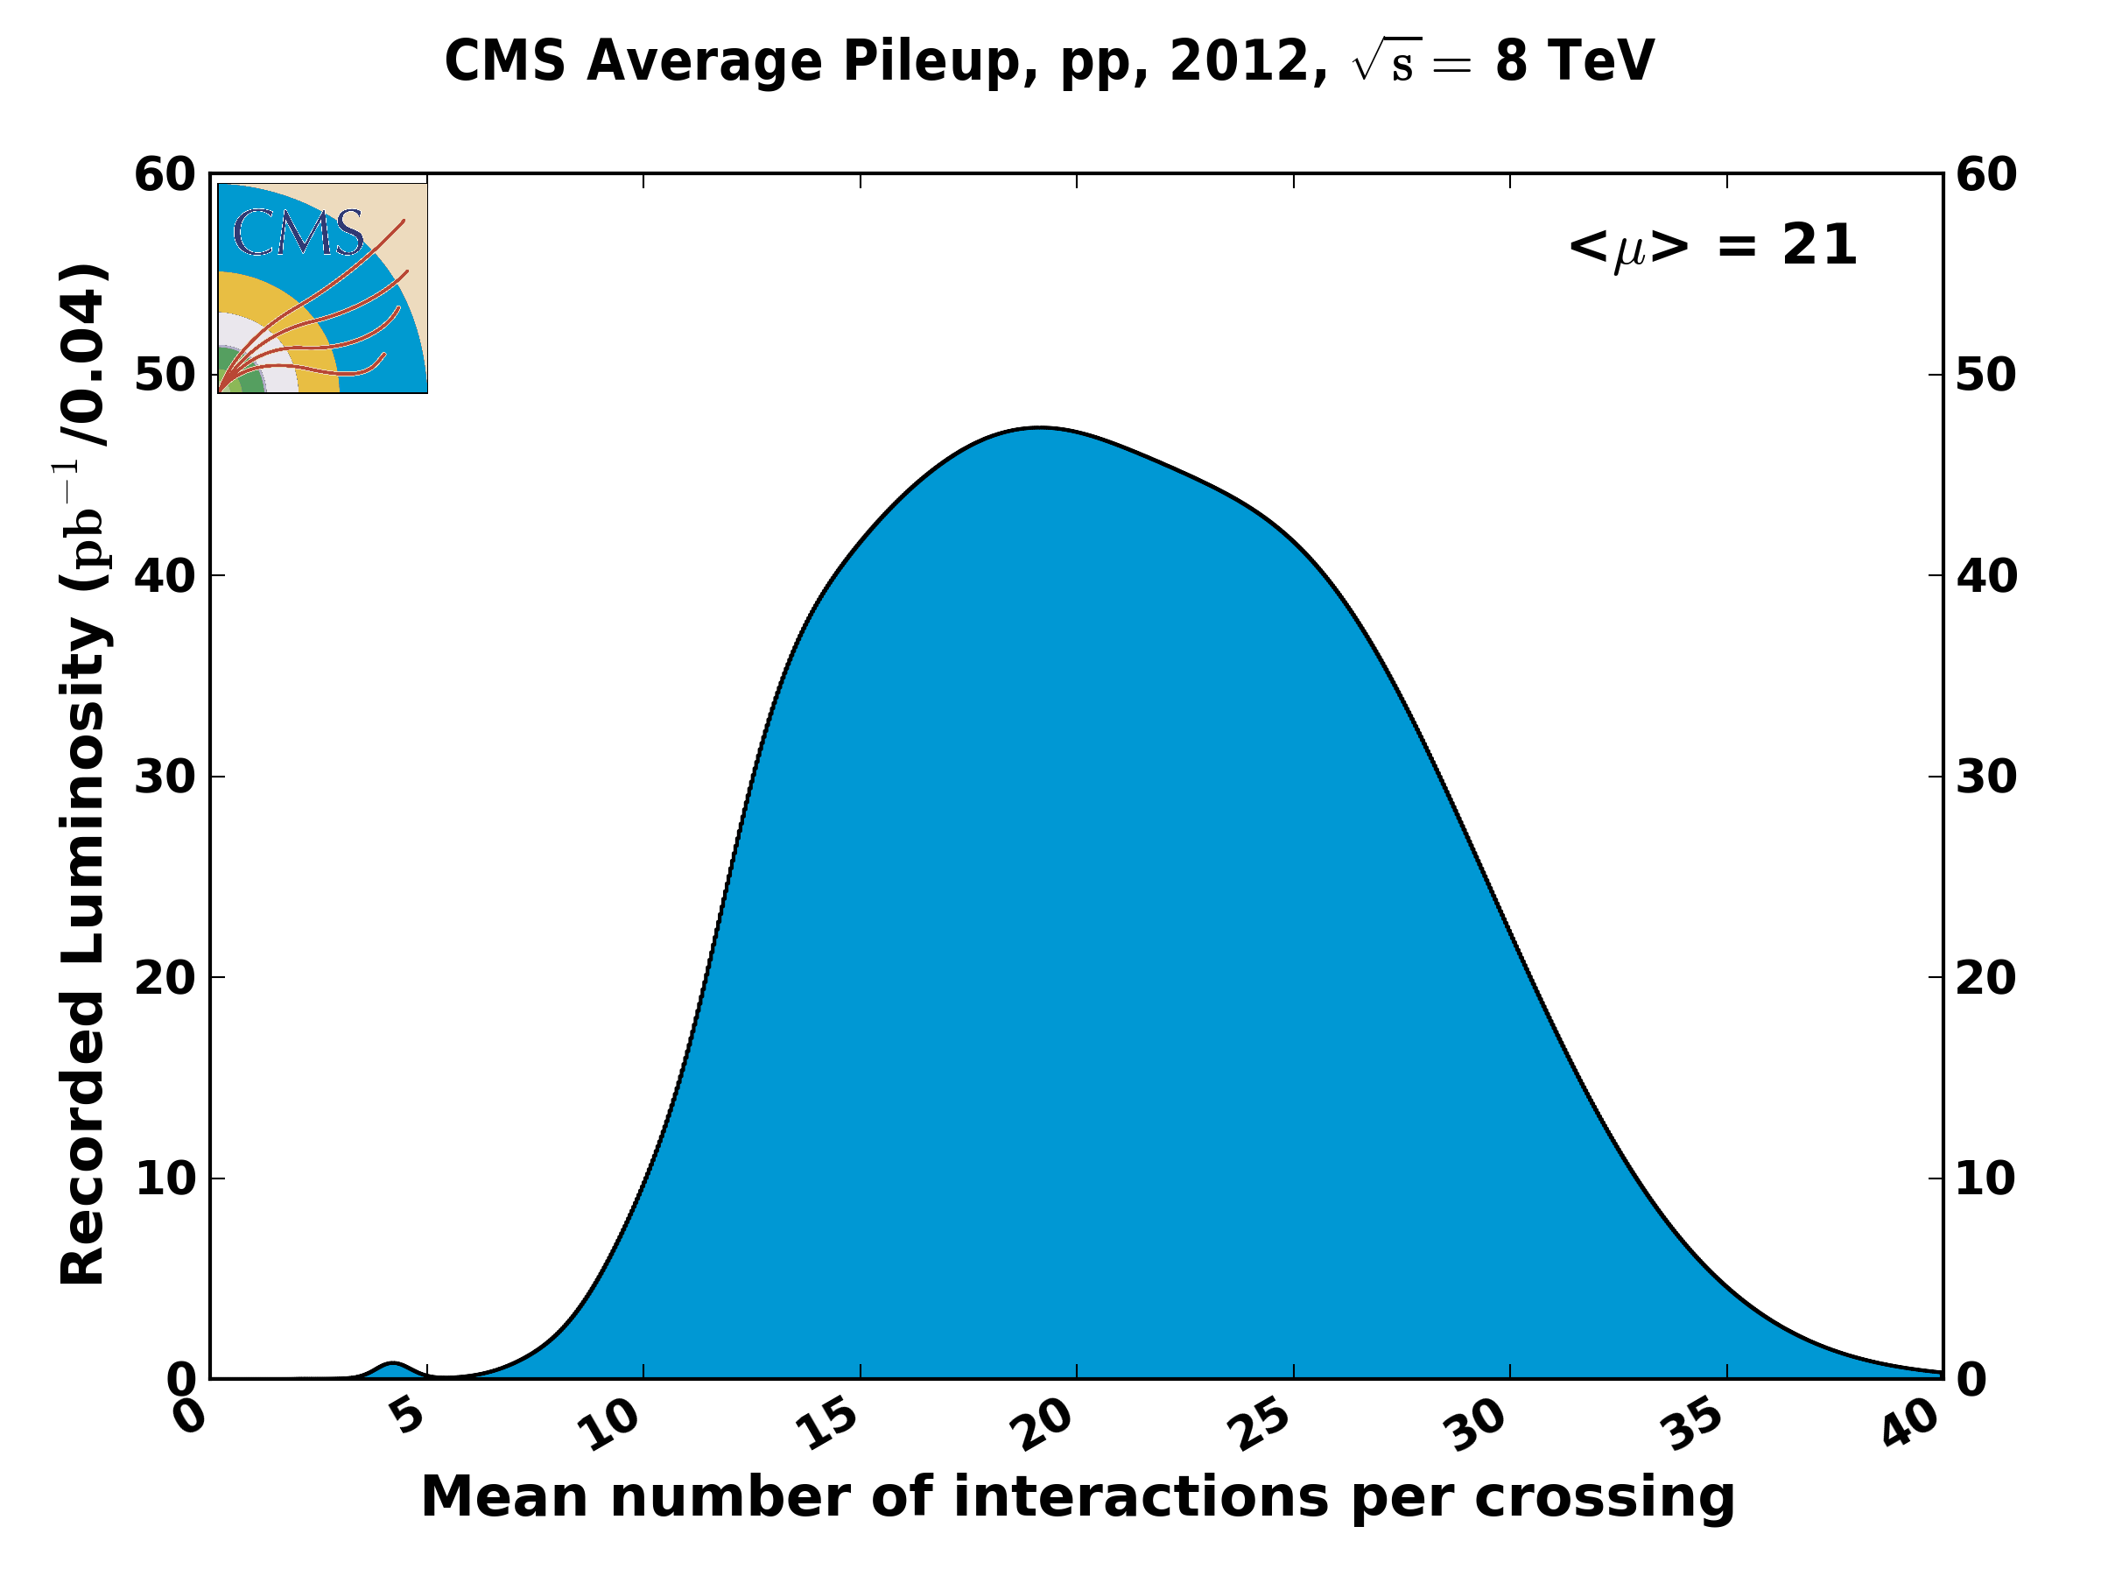
Pile-up or
# of Interactions/Bunch Crossing
For Example during the 2012 LHC run:
(Pileup) _{Max Lumi} = (7.7E33cm⁻²s⁻¹/ 1380 bunches/11245Hz)x(70mBarn)
= 34.7
CMS Ave. Pile-up, pp, 2012,
√s=8 TeV
Special Run with high intensity bunches had pile-up~75

Slide 41






Components of Accelerators
Magnets: Dipole (for bending), Quadrupole (for focusing), Sextupole, Octupole, Decapole, etc., ← Control Transverse Beam dynamics
RF cavities ← Control Longitudinal Beam Dynamics
Beam control and Monitoring Systems
Examples of LHC Magnets
1.9⁰K, Nb-Ti, 8.4Tesla (max),
14.3 m long, 56mm opening
LHC Dipole Magnet: A device used to bend the path of charged particles during beam transport.
Field-free region
& Beam
Ni-Ti, 1.9⁰K 223T/m
3.2 m long
56mm opening
Mag. Field Lines
LHC Quadrupole Magnet: A device used to focus charged particle beam during beam transport.
Monochromatic
beam

Slide 42


Components of Accelerators
Sextupole Magnet: Beam will have #0 (~10⁻⁴ for LHC). Beam needs chromatic corrections. Sextupole magnets are devices used for chromatic corrections.
Similarly, ring needs Octupole corrections. And other high-order corrections….

Slide 43

LHC 400MHz SC accelerating module
Cryo-module

Slide 44

LHC collimators (87 in number)
Fig. 1. An illustration of multi-stage cleaning in the transverse beam planes. Primary collimators intercept the protons that are lost from the beam core. The leakage from this single-stage cleaning would be well above the quench limit of superconducting magnets. Secondary collimators and absorbers are used in insertion regions IR3 and IR7 to intercept halo protons and hadronic showers produced by beam particles interacting with the collimator jaws during the multi-turn process. Additional tertiary collimators ensure further protection close to the experiments.

Slide 45
LHC Beta-function at Injection & Collision
β_{Max}~4.5km
β-function @ IR is after squeeze is β*

Slide 46







Hour-glass Effect (Back up slide)
Behavior of the lattice
β function abound
interaction points
in the LHC
Envelop of the
beam in the vicinity
of interaction point of the LHC
A short bunch
A long bunch
Significant effect on long bunches when β* is small: β* ~ σ_{s}

Slide 47

LHC Beam & Loss during Squeeze

Slide 48






Some issues in LHC 2011-12 operation
UFOs
20 dumps in 2012
time scale 50-200 µs
conditioning observed
worry about 6.5 TeV and 25 ns spacing
Radiation to electronics
concerted program of mitigation measures (shielding, relocation…)
premature dump rate down from 12/fb⁻¹ in 2011 to 3/fb⁻¹ in 2012
Beam induced heating
Local non-conformities (design, installation)
  injection protection devices
  sync. Light mirrors
  vacuum assemblies
T. Baer

Slide 49
Layout of the LHC
The LHC is a technological marvel
The Accelerator is 27 km around
Consequently, the commissioning and operation of this accelerator could be very challenging!
– a lot of safety measures should be taken.
~9000 magnetic elements
1720 Power converters
7568 Quench det. systems
1088 Beam position monitors
4000 Beam loss monitors
Design:
150 tonnes Helium, ~90 tonnes at 1.9 K
363 MJ/beam stored beam energy
2012 : 140 MJ/beam stored beam energy
@4TeV 450 MJ magnetic energy/sector
HL-LHC: ~700 MJ/beam stored beam energy
@7TeV ~800 MJ magnetic energy/sector

Slide 50

LHC Inner Triplet Quad-Magnets used in four IRs
Field Strength= 215-230 T/m Operate at 1.9⁰K
Beam size by
~100 times

