Slide 1
Cavity parameters used in CST, preliminary results with blocking capacitor and more thermal analyses
Gennady Romanov
2nd Harmonic cavity Meeting
1/VII-2015

Slide 2
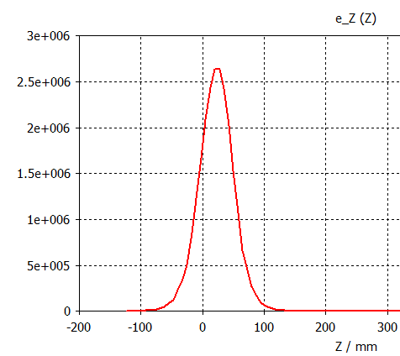
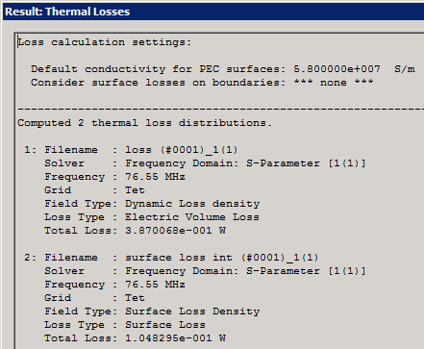
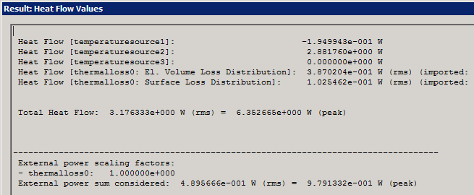
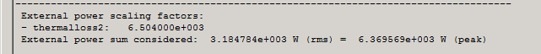
Definitions in CST
V/m
What are V_{eff}, P, R_{sh} in CST?
Voltage V_{eff}: CST integrates the electric field along the given voltage integration path (cavity axes typically). By definition V_{eff} takes into account time flight factor, but currently β = 1 is assumed (β - particle relative velocity).
Thermal losses P:
FD solver -> Thermal solver
Shunt impedance: R_{sh} = V_{eff}²/P

Slide 3
FD, EM and trans. model with garnet with averaged µ´ & µ´´
Tianhuan Luo, ThinPlate data
F = 75.503 MHz
For V_peak = 100 KV:
P_ferrite_e = 8.11 kW
P_ferrite_m = 63.25 kW
P_ferrite = 71.36 kW
P_copper = 9.14 kW
P_total = 80.5 kW
The Omega3P EM simu-lation agrees well with Gennady’s results.
tanδ_m | 4.67e-4 | 2.06e-4
R_sh, kΩ | 128 | 230 | CST EM
P , kW | 78 | 43.5
For garnet with fixed parameters FD solver and
EM solver (CST and Omega3P) deliver close results.
R_sh, kΩ | 124 | 205 | Omega3P
P , kW | 80.5 | 48.7
For f=76 MHz μʹ=3.5 => SteelPlug tanδ = 0.000206 (or tanδ = 0.0002145 from Tan’s approximation)
R_sh, kΩ | 78.5 | 152 | Transmit. model
P , kW | 127.4 | 65.8
Recalculating Tianhuan Luo results with SteelPlug tanδ = 0.000206
P_total=8.11+9.14+71.36*206/467=48.72 kW
Rsh = 100^2/48.72 = 205 kΩ

Slide 4
Uniform garnet vs non-linear garnet
Uniform garnet – transition model and CST eigenmode solver
Non-linear garnet – CST frequency domain with external bias
Losses in copper and dielectric losses:
Frequency domain solver with uniform garnet - 16.6 kW
Eigenmode solver with uniform garnet - 16.7 kW
Frequency domain with non-linear garnet at 106 MHz - 16.4 kW
Transition model at 106 MHz - 20 kW

Slide 5
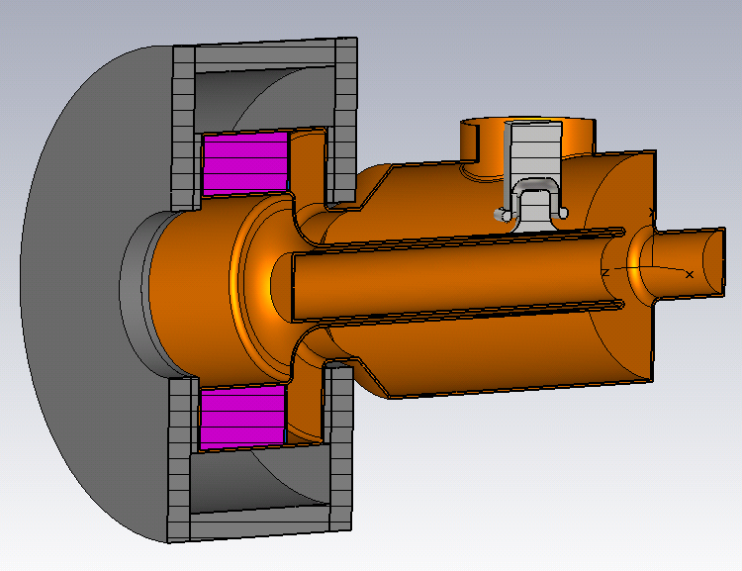
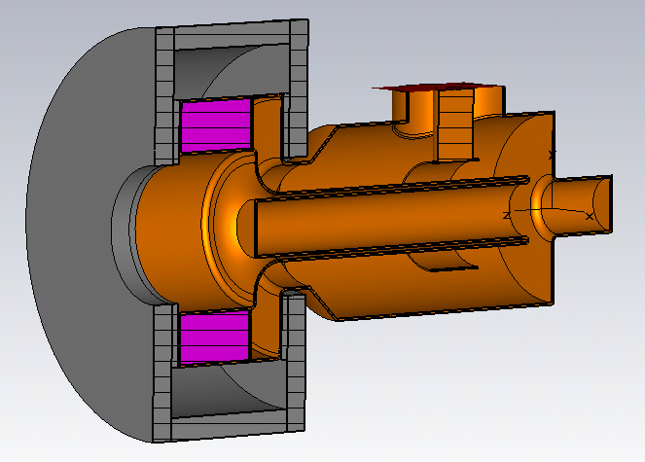
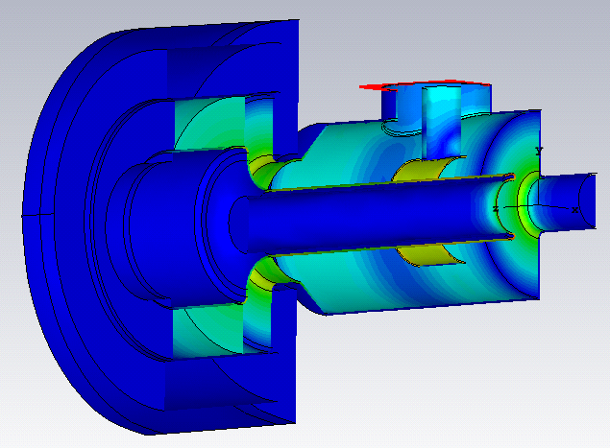
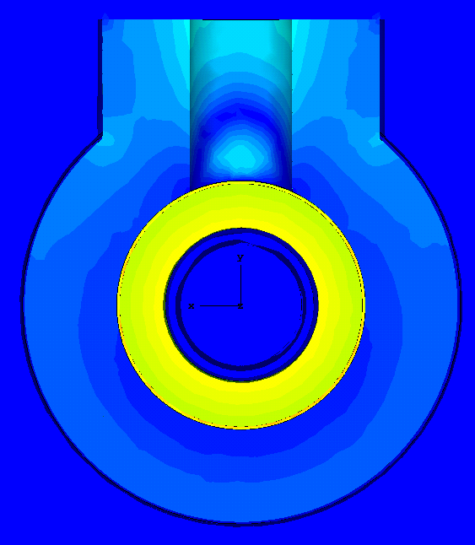
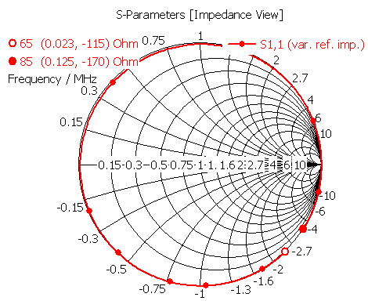
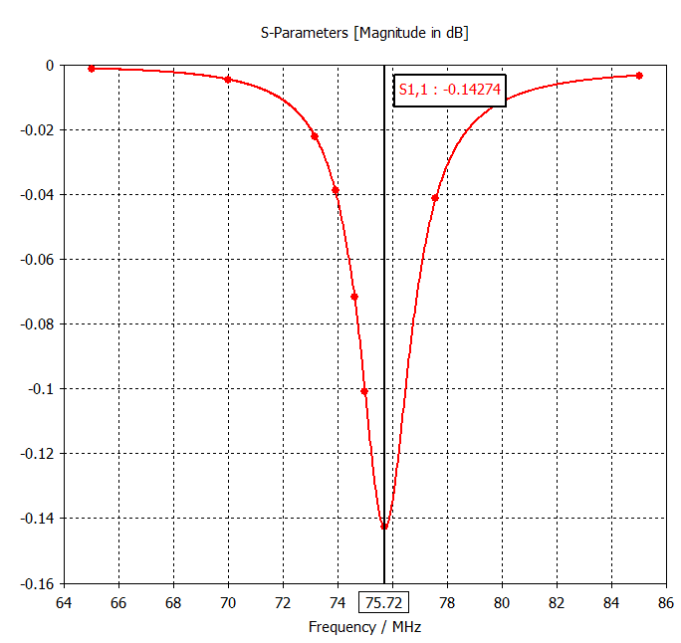
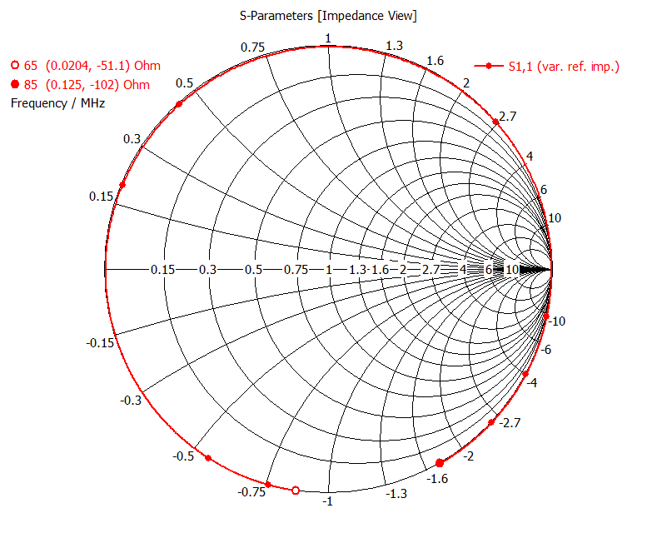
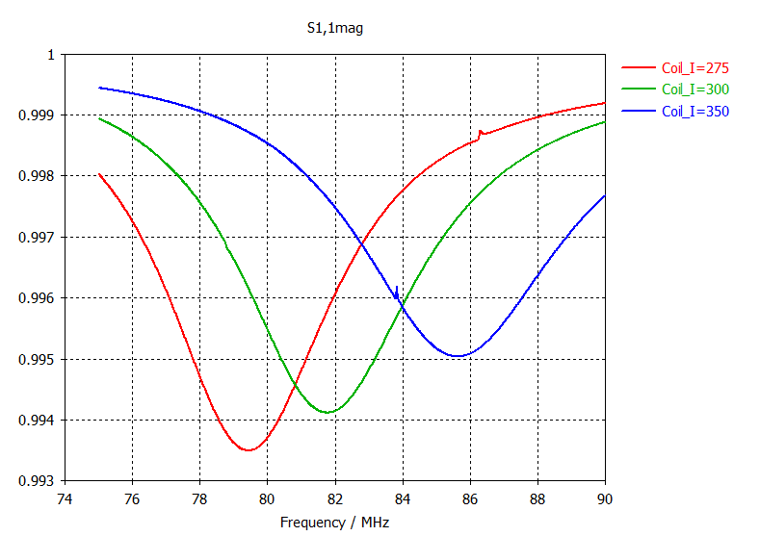
Power coupler or blocking capacitor
Scaled TRIUMF coupler
E surface field
Tan’s coax type blocking capacitor (L=80 mm, r = 70 mm)
Capacitance (10pF from trans. model)) is not convenient and sufficient requirement for designing. It is not even clear what is its definition in the 3D model.
Both are overcoupled. For higher frequency the reflection is increasing.

Slide 6
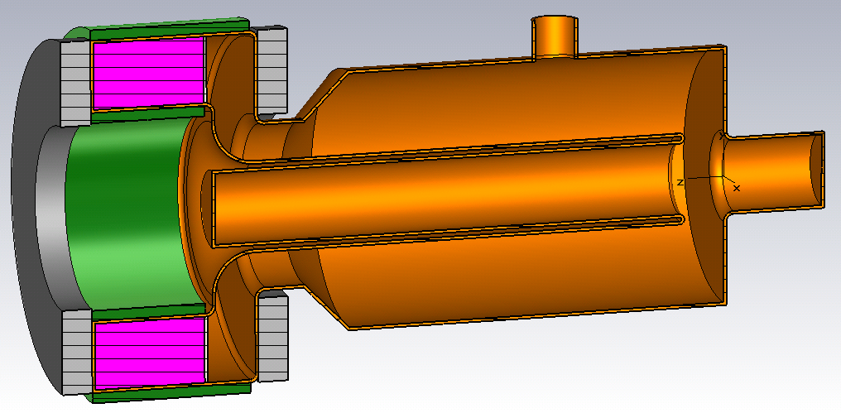
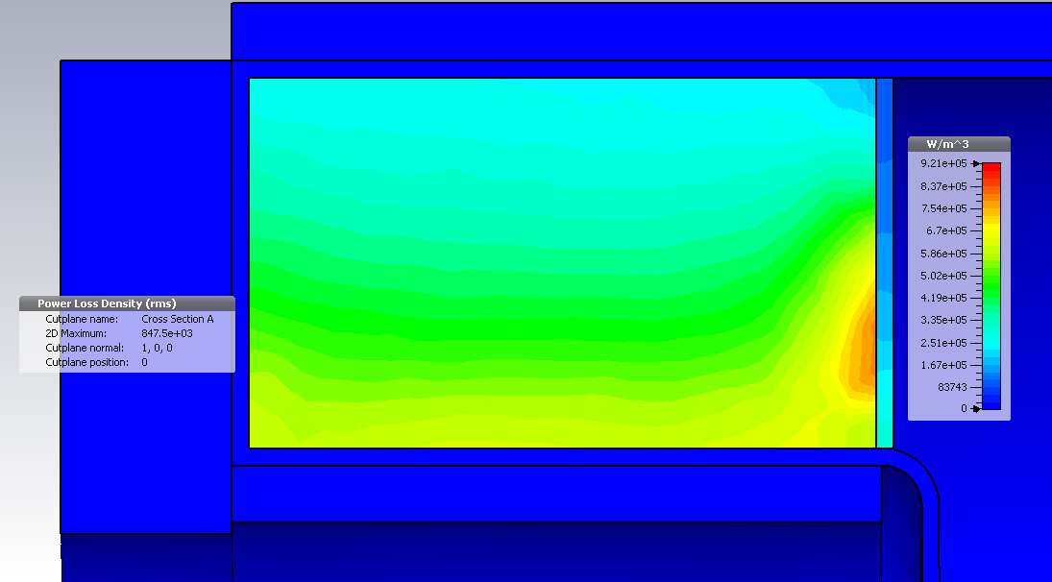
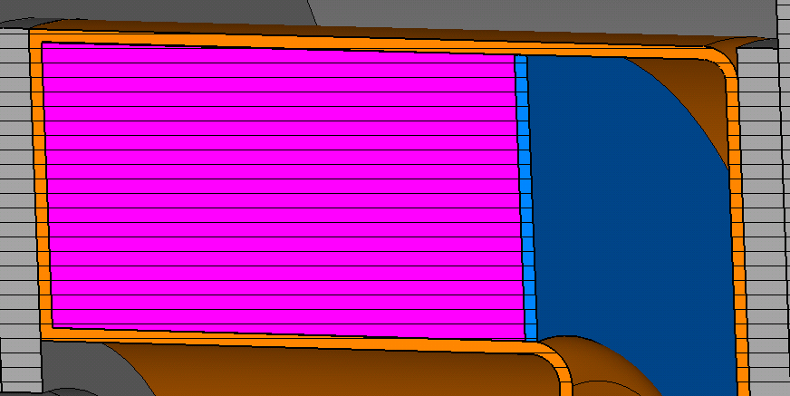
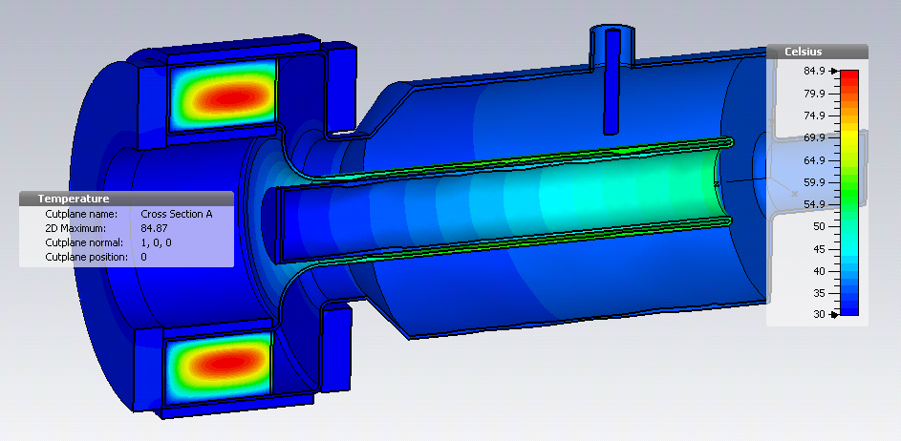
Thermal analyses with alumina cooling disk
Alumina 99.5%, 3 mm thickness
Imported distribution of thermal losses for f=76.55 MHz
Water jackets
Thermal conductivity
Al₂O₃ - 30 W/K/m
Al800 - 3.5 W/K/m
Simulation with thermal losses of P=3.2 kW and cooling water temperature of 30 °C,
old ramp.
T_max = 85°C
Temperature distribution
Additional alumina disks will reduce T_max

