Slide 1
Update on PA test stand, 200 kW Load, and Model Cavity
Robyn Madrak
Booster 2nd Harmonic Cavity Meeting
01 July 2015

Slide 2
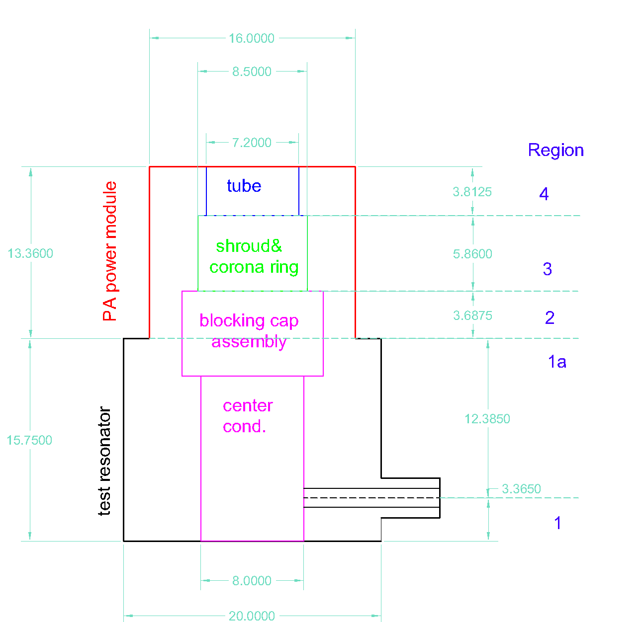
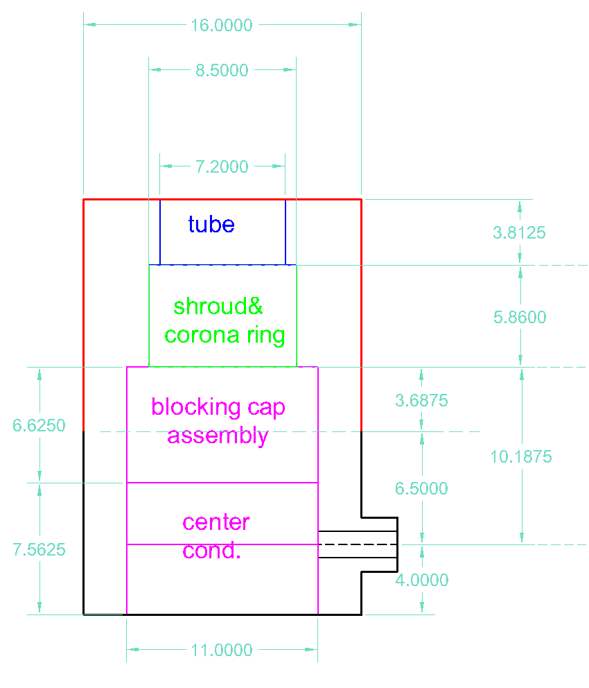
PA Test Stand 76 MHz Test
Existing resonator, 53 MHz
New resonator, 76 MHz
Existing PA and resonator, 53 MHz

Slide 3
From Matt Slabaugh (anode resonator)
Matt will be working on this with a ME intern
Target date for completion, end of Sept
200 kW load
attaches here;
Adjustable tap point

Slide 4
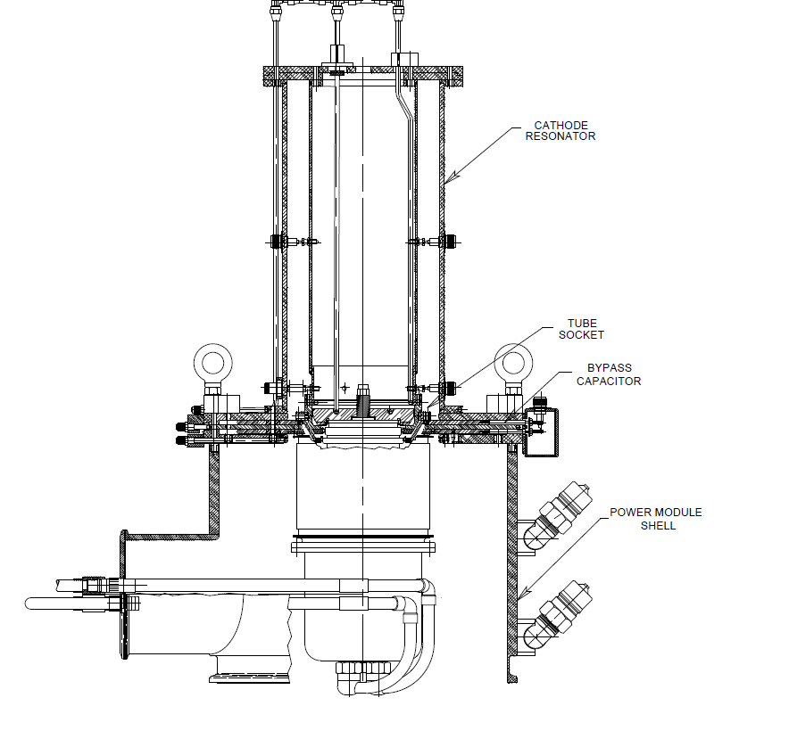
Other components for 76 MHz test
Modify prototype cathode resonator (shorter)
Stand
Modify choke for higher frequency operation (screens RF off of high voltage line to modulator) – Rene Padilla is working on this
200 kW load

Slide 5
200 kW / 50 Ohm load
Ralph let us cannibalize it from HINS (saves ~$13k)
Rating is for 200 kW with water cooling
Flange is 3⅛” :
  Peak power rating for this size line is > 200 kW
  Average power rating is ~50 kW (we do not need to and can not run CW anyway)

Slide 6
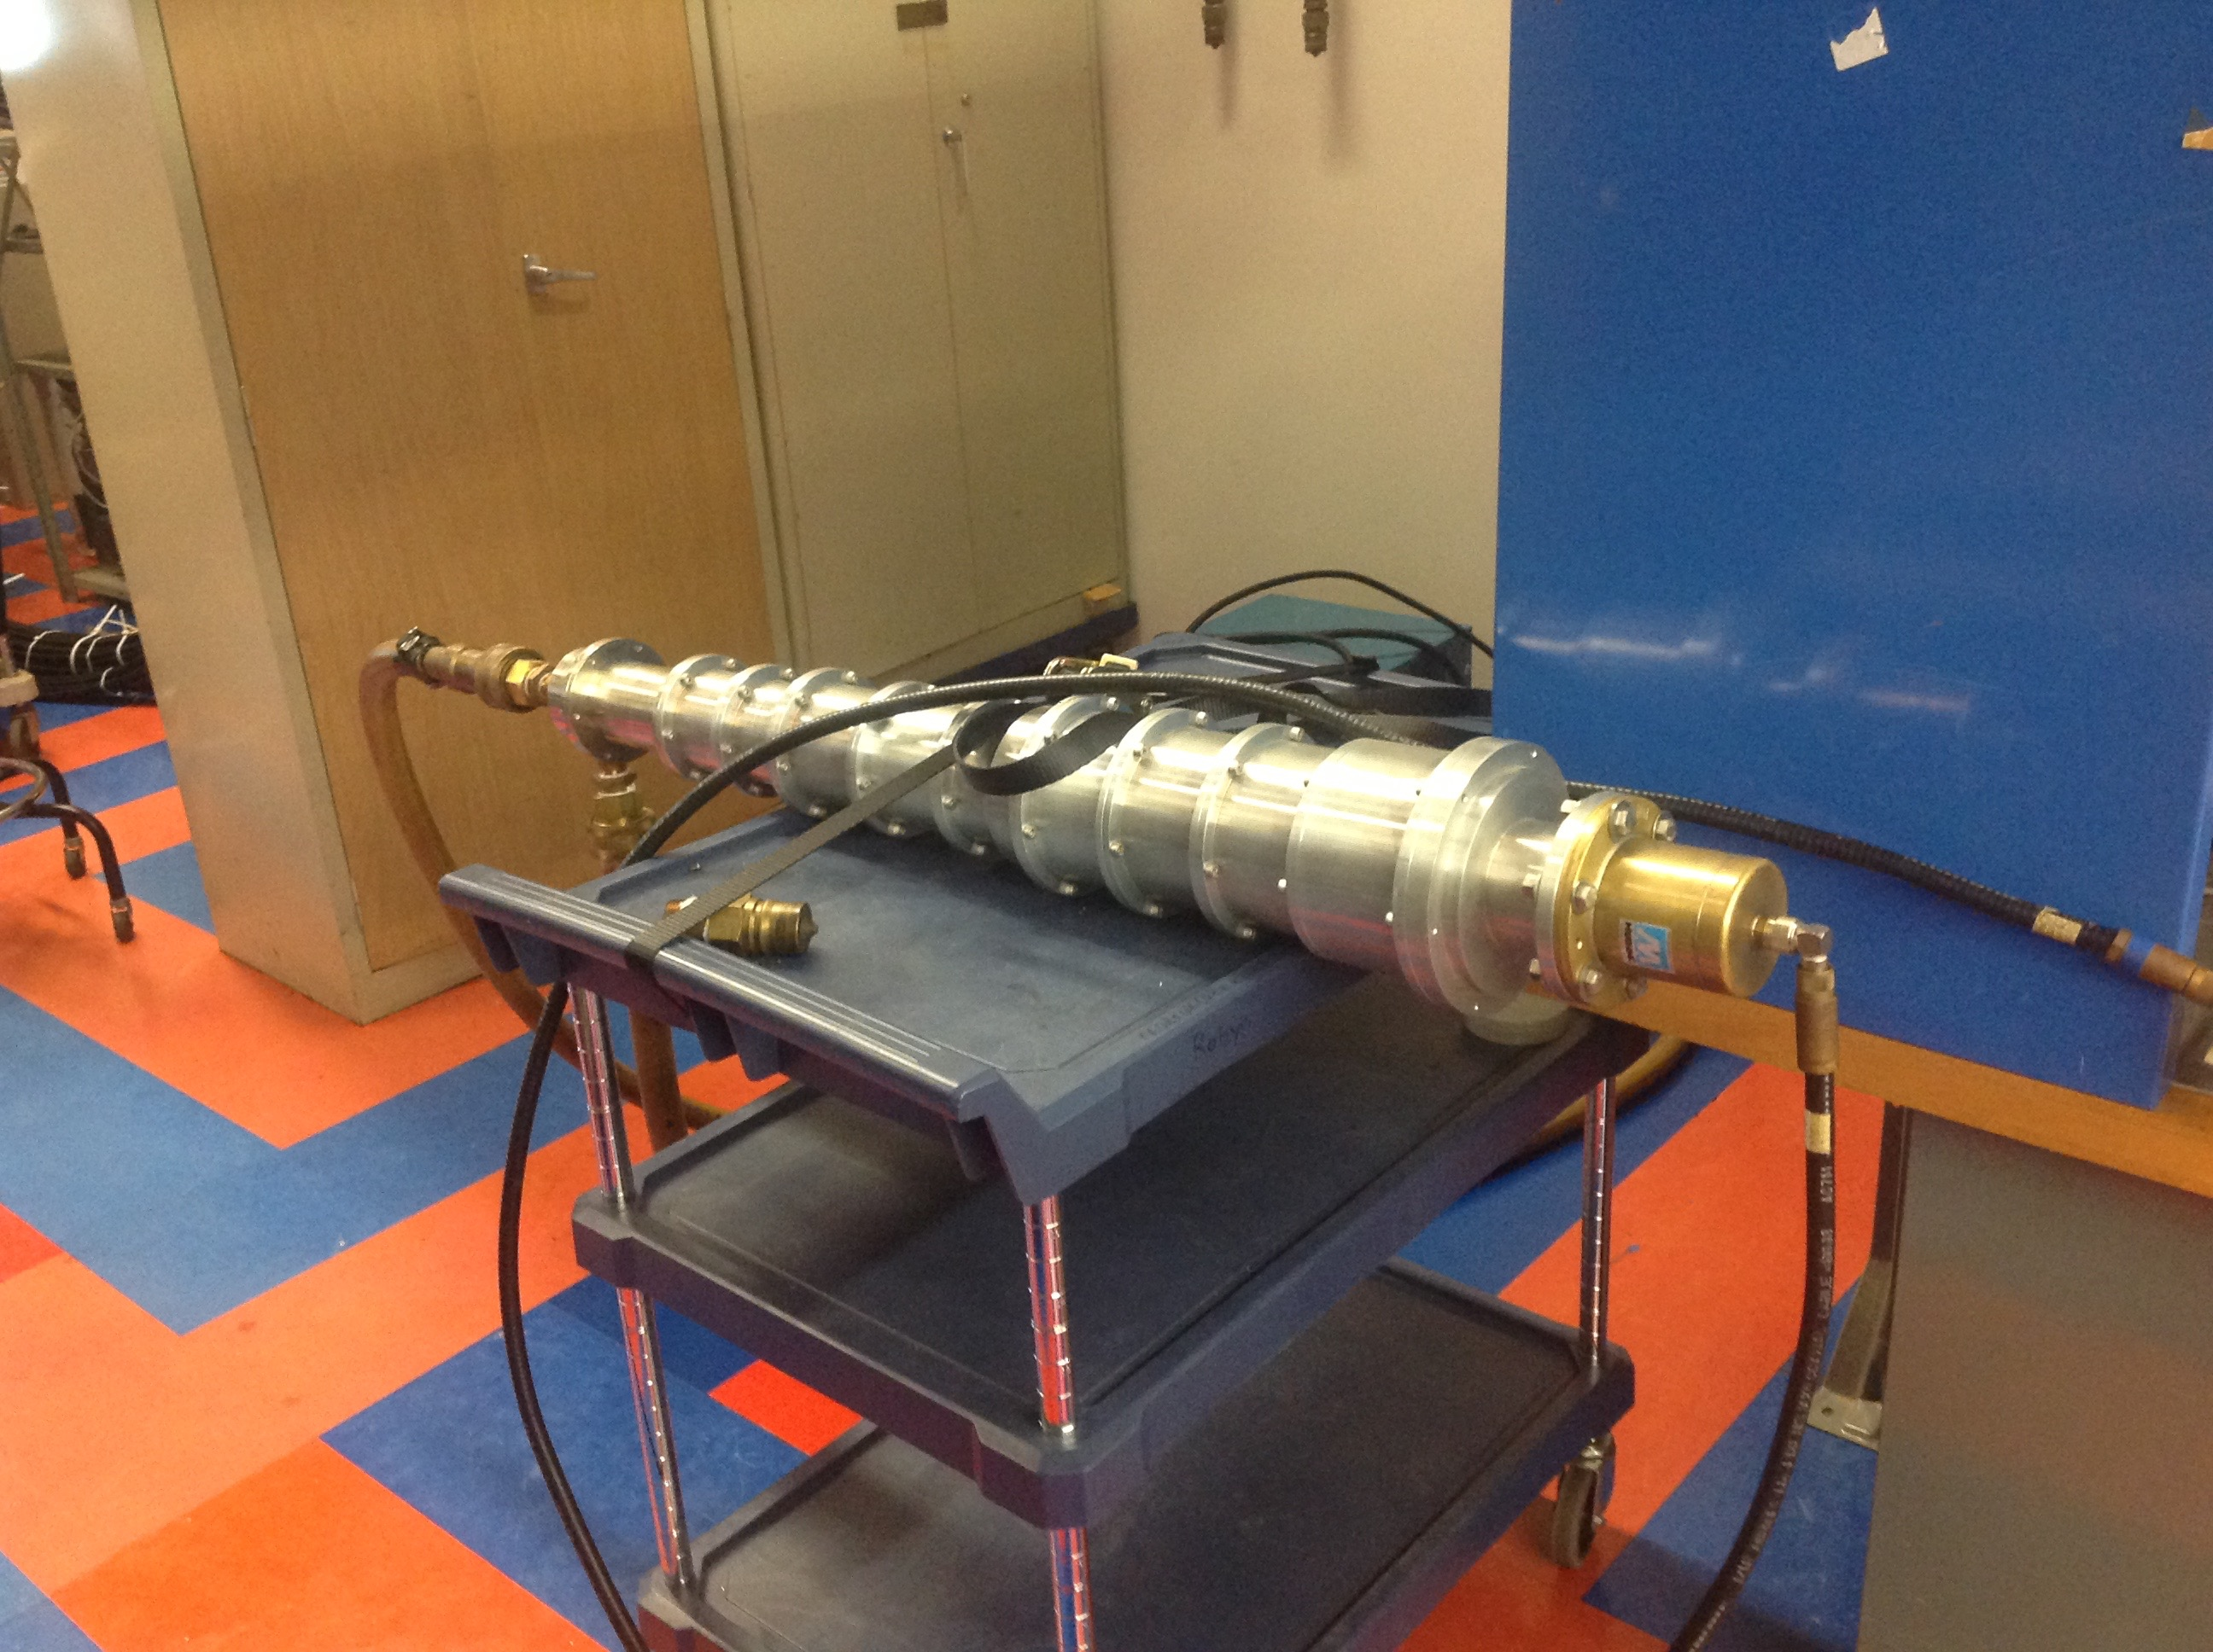
200 kW Water Cooled Load

Slide 7
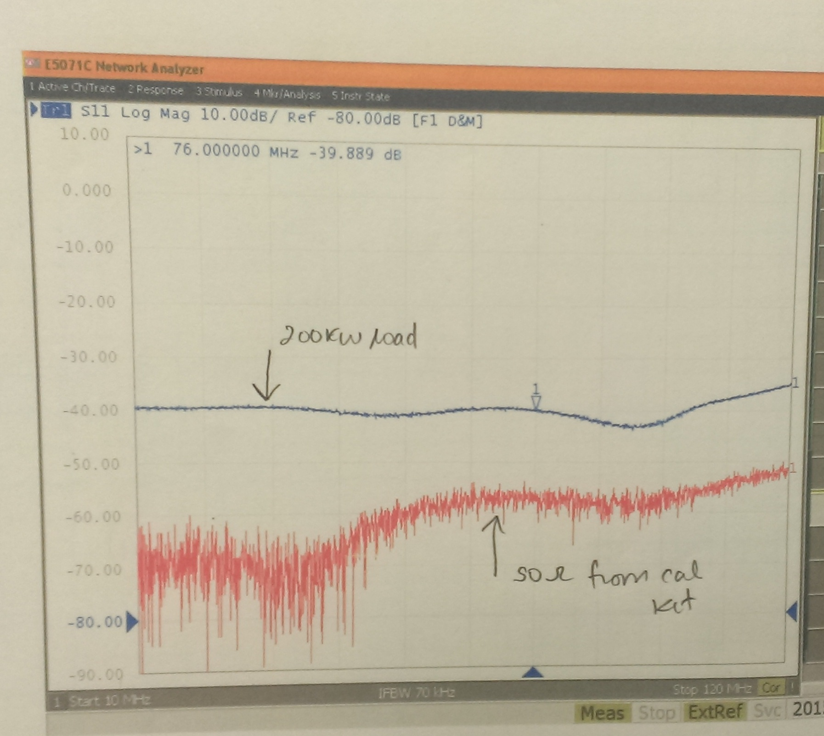
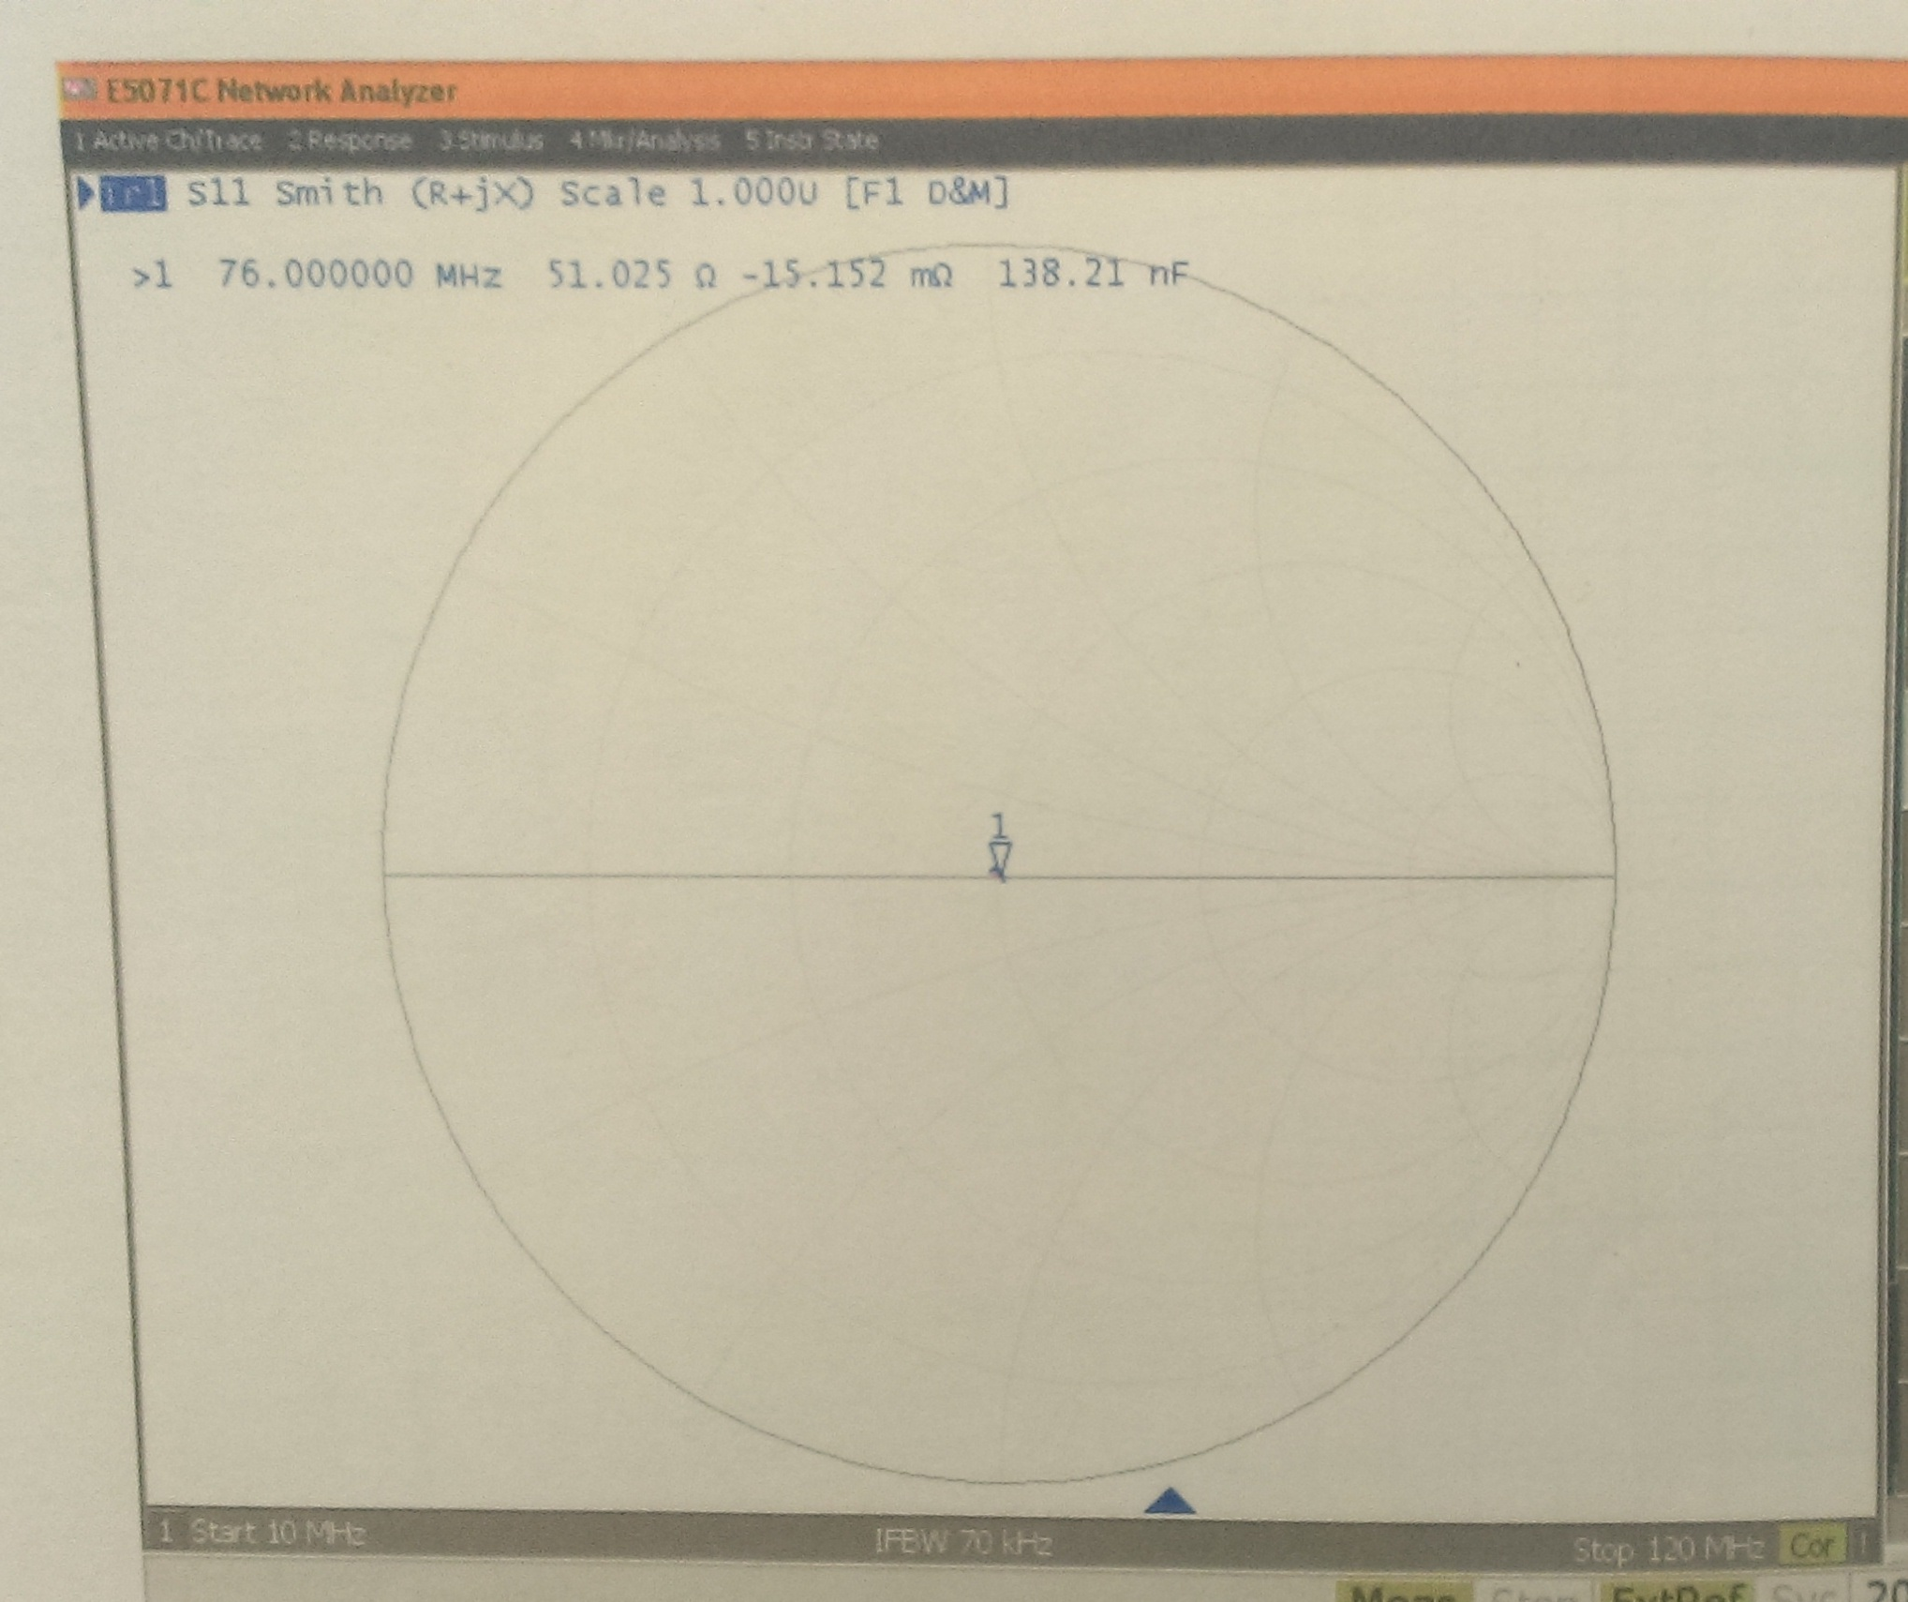
Low Power Test with water flowing
S11 Magnitude
10 dB
Smith Chart S11
51.025 Ω real
-15 mΩ imag
-40 dB

Slide 8
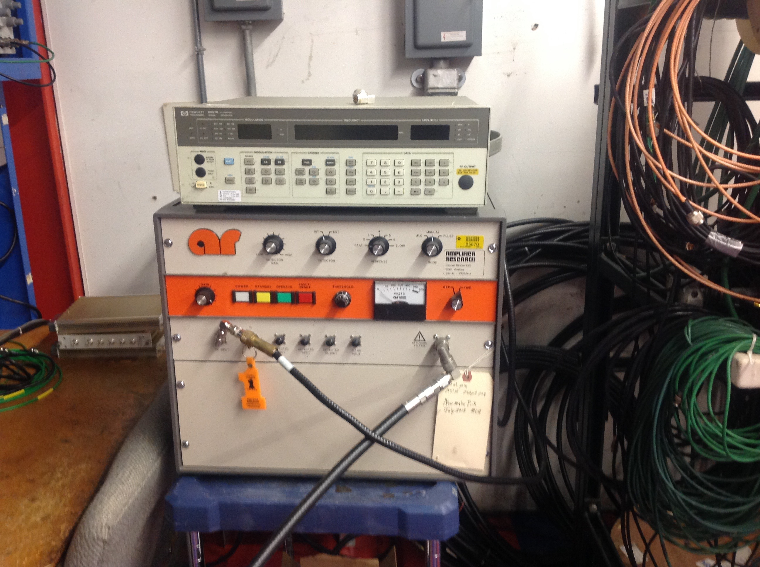
Power tested at 76 MHz to 500 W, again with water
Monitored FWD and REV power with directional coupler. Measured reflected power was ~-35 dB.

Slide 9
Measuring power on PA test stand
Currently, this is done by calorimetry, measuring ∆T between supply and return water from 200 kW load
There are extra PT100 temperature probes, readout chips, etc.
Maggie will build an electronics module to read out the temperatures, based on the existing design

Slide 10
Model Cavity
Parts are being worked on in the shop, possibly be done by the end of the week
Maggie has done Superfish comparisons of the new “Real” cavity design from Gennady, and the slightly modified mechanical design.
She has looked at Rsh and Q for the fundamental and higher order modes, for both low frequency (~76 MHz) and high frequency (~106 MHz)

Slide 11
Maggie Lankford – results for ~76 MHz and corresponding HOMs

Slide 12
Maggie Lankford – results for ~106 MHz and corresponding HOMs

Slide 13
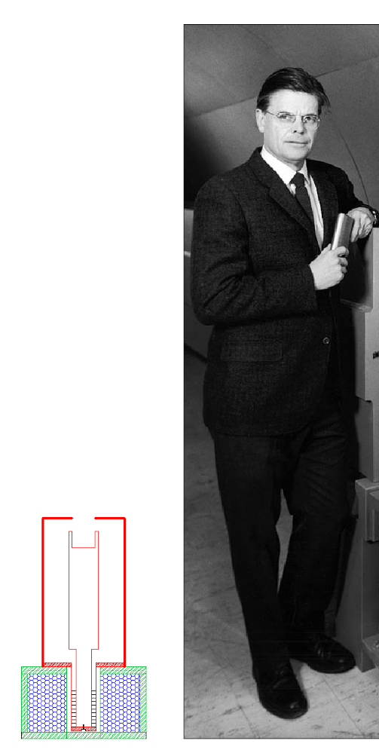
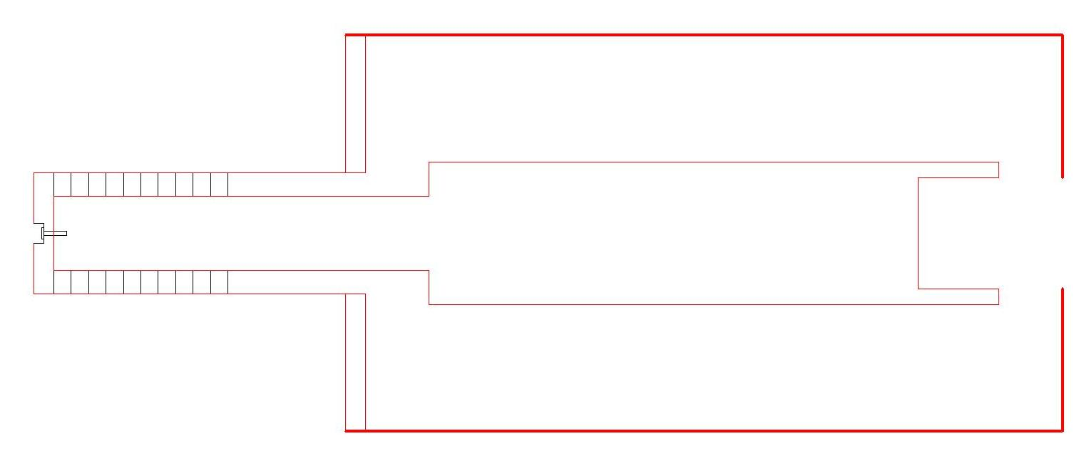
Stretched wire measurement of Rsh
Traditional :
Our plan:
wire
wire

Slide 14
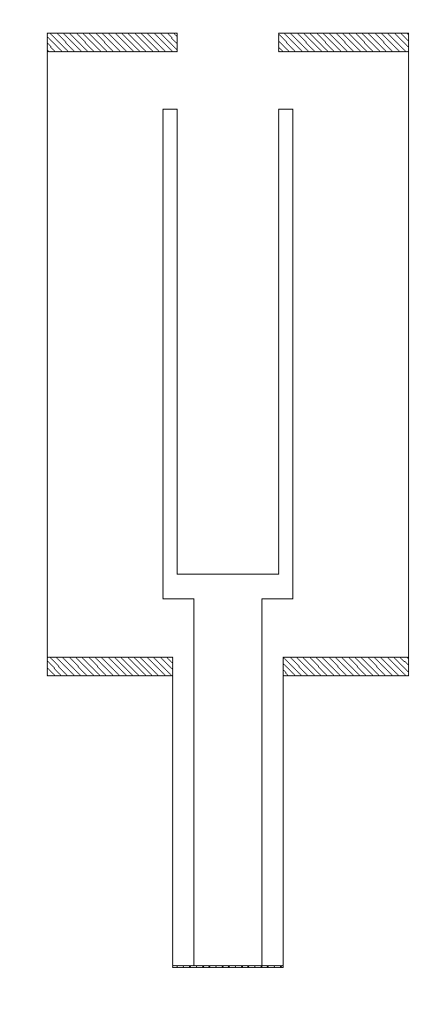
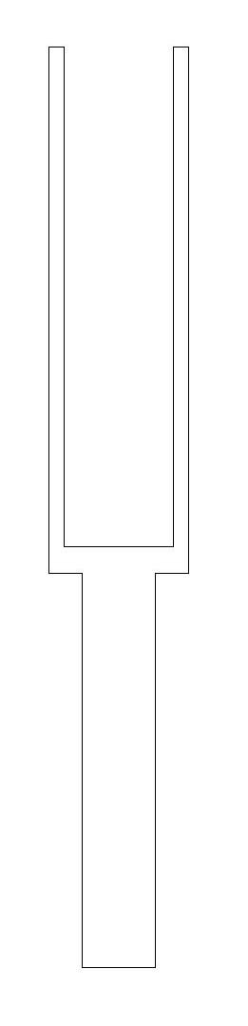
Measurement scheme
Reference to be subtracted:
Measurement:
wire
wire

Slide 16
Model
Rsh is included when the full measurement is done
Extra resistors are for matching
Rref + Rsh = Zterm*(S21-1)
  S21 is in ratio form = V1/V2
  Zterm = 110, 120 and 50 in parallel
  Rref = Reference meas without gap
  Rsh + Rref = measurement with gap
  If Q (and Rsh) is degraded by the presence of the wire, can correct for, since R/Q is preserved
Zt ~ 276 Ω (wire in beampipe)

Slide 17
Conclusion
High power load is good
Expect completed test station near the end of Sept.
Expect model cavity parts not long after the holiday
  Still have some assembly to do, hopefully measurements by mid-July

