Slide 1
PIP Update
September 2nd 2015

Slide 2
Agenda
Summary Update
Current Activities Update
Trevor Butler – Linac Modulators
Ken Domann – Financial/Controls Update
Additional Meetings/Notes

Slide 3
Linac
SBK: Work at CPI continues – welding complete – leak tight
LN: Progressing – Grumman module tested, optical box in machine shop, schedule of beam studies late fall…
Modulator: Update talk today
Booster
Beam Studies:
Booster optics software: No updates
Booster Longitudinal dampers: Task is done – moving into operations
Booster BPMs: No update today
Collimators: No update
Refurbished cavity: (New technicians)
Cavity #18: In test stand – running full power – thermal measurements underway, install next week
Cavity #19: Completed – waiting for HP testing to begin
Cavity #20: Done with mill work – will go on stand this week
15 Hz: Repair of bus work done – not sure of status?
New Tuners: Last set of Ferrites had some physical issues? Pat and John in contact with company…
Bias Supplies: #9 is upgraded but failed in HP testing, Next and last Bias is being worked on by EE tech (slow)
Anode Supplies: Lots of progress – update meeting later today – both are in and being wired (East testing soon)
Transformer: Installed last weekend (07.17) - Completed
Perpendicular bias cavity: work progressing – working on vacuum window and coupler
Stations 20, - Bus bar hung – need to connect joints…
Rework of cavities 21 & 22: no news
New cavities: Tom Kroc appointed as L3 manager – meetings – finalizing specs documentation
Shielding: Tony and Keith – working on documentation
Absorber/Kicker: Discussing insert removal and/or additional shielding – planning for removal later this shutdown

Slide 4
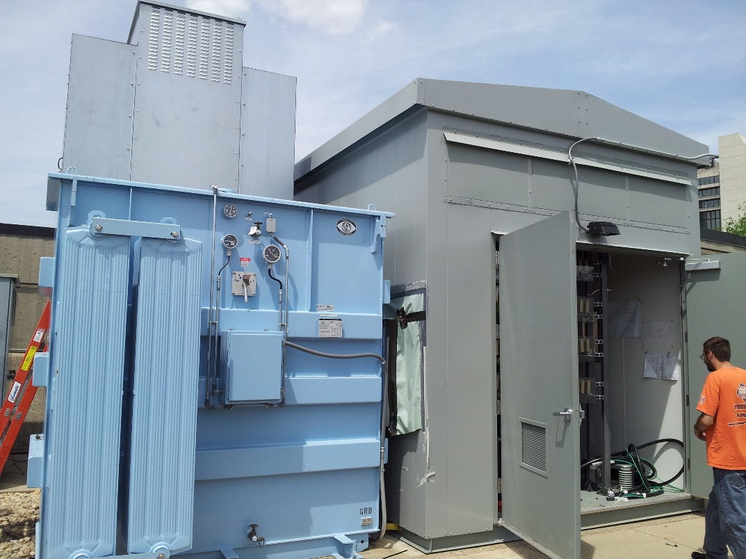
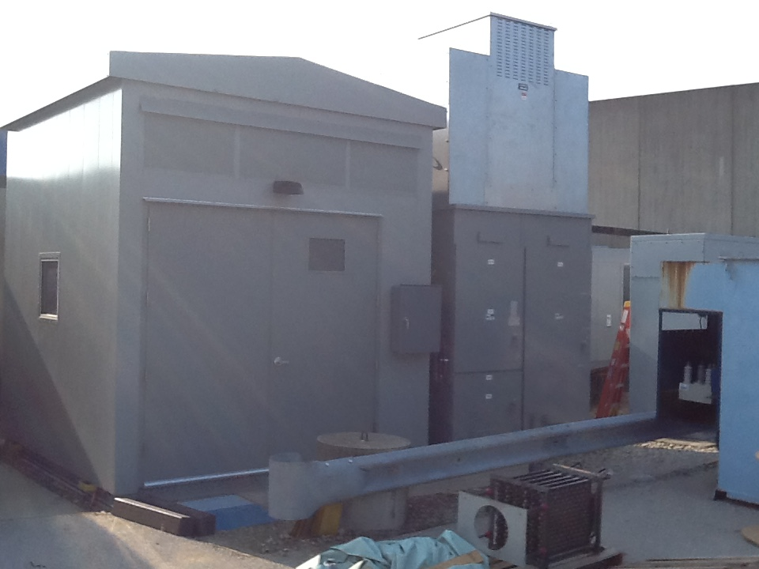
East anode assembled and wired:
Power testing starting next week
West anode just installed and now being wired (power testing to begin in three weeks)

Slide 5
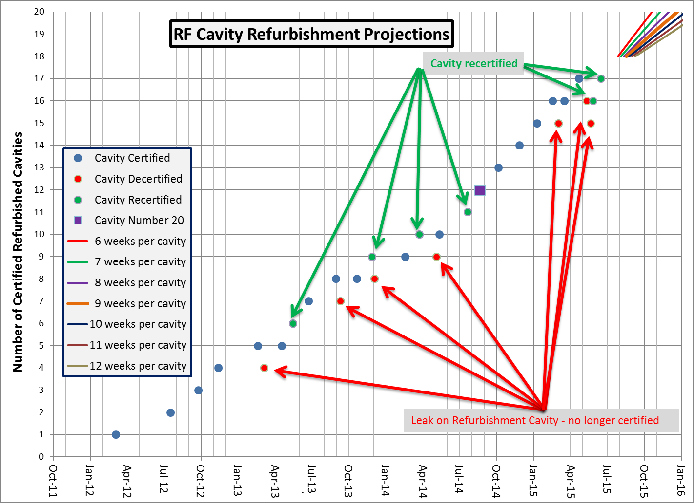
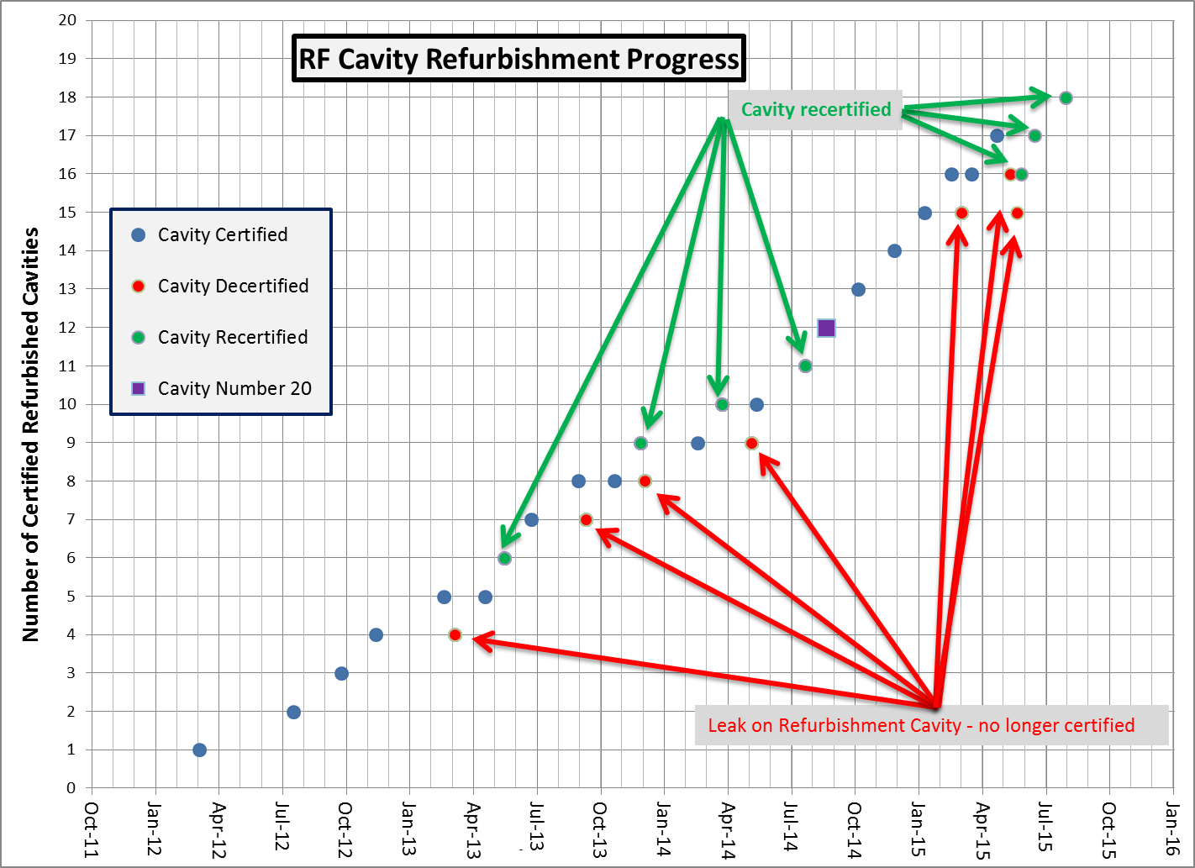
Booster Cavity Refurbishment
15 Hz:
The first time we tried 15 Hz system wide – two RF stations in west gallery failed.

Slide 6
Recent PIP Budget/News
Budget:
FY15 - Discussions of task updates/consolidation continues
Update of RLS
Replacement cavities schedule will be revised soon (T. Kroc)
Another revision by end of CY (starting fall (?))
Meetings to discuss transition PIP to PIP-II continue
Working on documentation and arranging of review as requested by Sergei/PIP-II
PIP PMG – Next PMG will be discussion of PIP/700 KW
PIP physics workshop – tentative Oct/2015
AAC re-review of 700 KW plan sept.11.
Full AAC review in Dec

Slide 7
Upcoming Talks
Keith/Tony – TLM install and operations
New Cavities (plans) Tom Kroc
Cavity testing results – simulations (Reid & Hassan)
Beam Physics Workshop discussion

