Slide 1
On coupler design - 2
Gennady Romanov
2nd Harmonic cavity Meeting
10/IX-2015

Slide 2
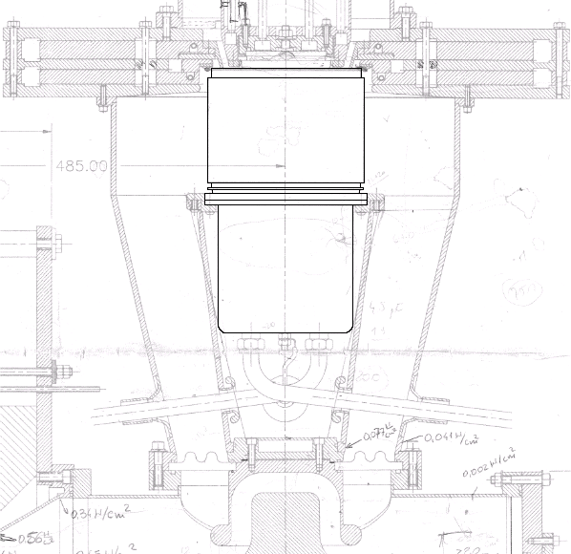
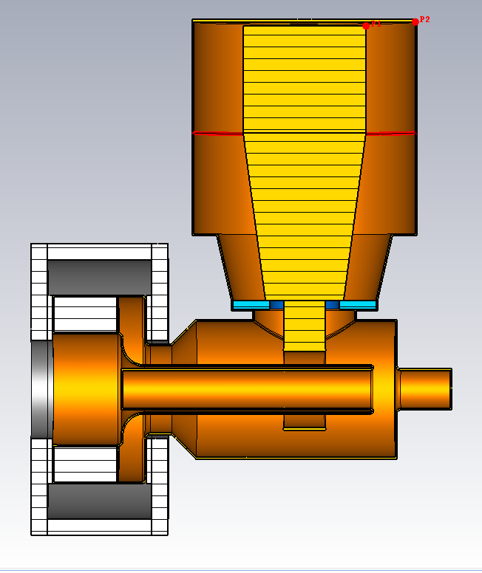
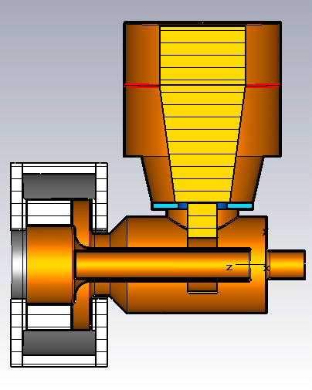

Replacement of the lumped capacitance with the gap
7.4 mm gap
Robyn’s model
7.4 mm gap
Gap C
7.4 mm gap
“Narrow”
f1=65.2 MHz
f2=105.3 MHz

Slide 3
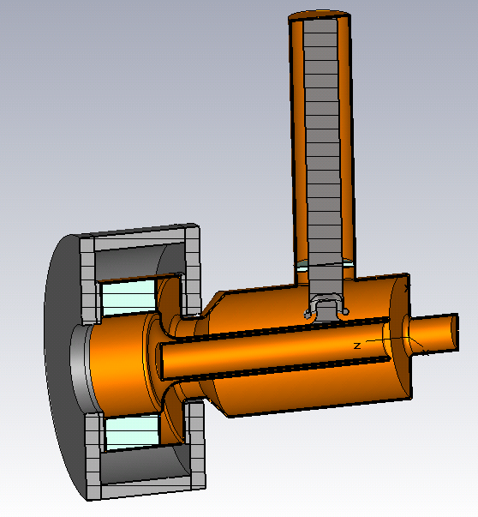
Basics of coupled cavities.
Tube_L
2ndHarm_FD_MyTube, TS4
Two coupled oscillators

Slide 4
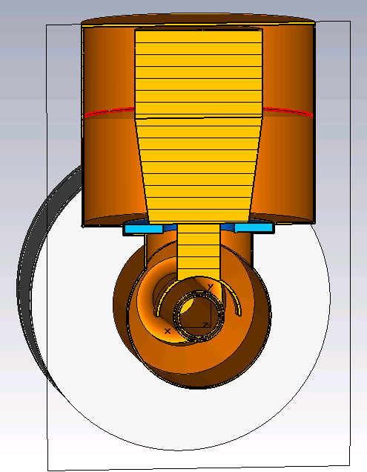
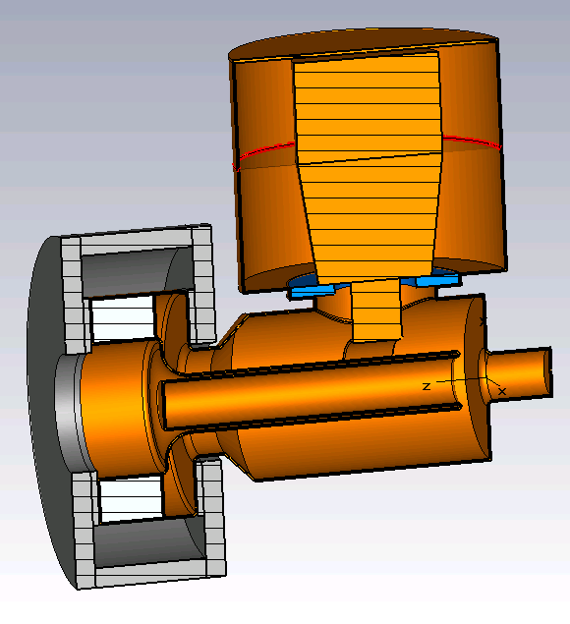
Restoring operating frequency and tuning range
1/3 of Tan’s blocking capacitor.
2/3 of the tube cavity

