Slide 1
Bias Magnet for the Booster’s 2-nd Harmonic Cavity
An attempt to evaluate the scope of work
based of the existing RF design of the cavity

Slide 2
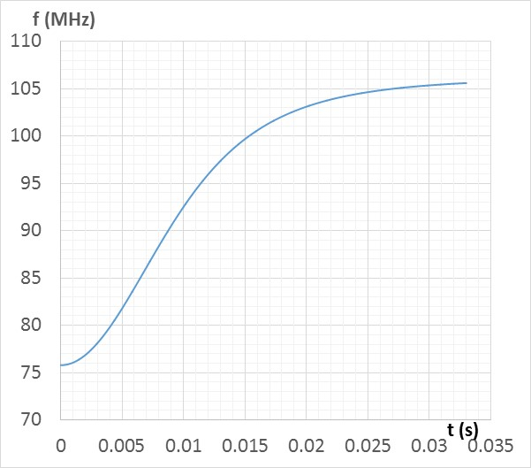
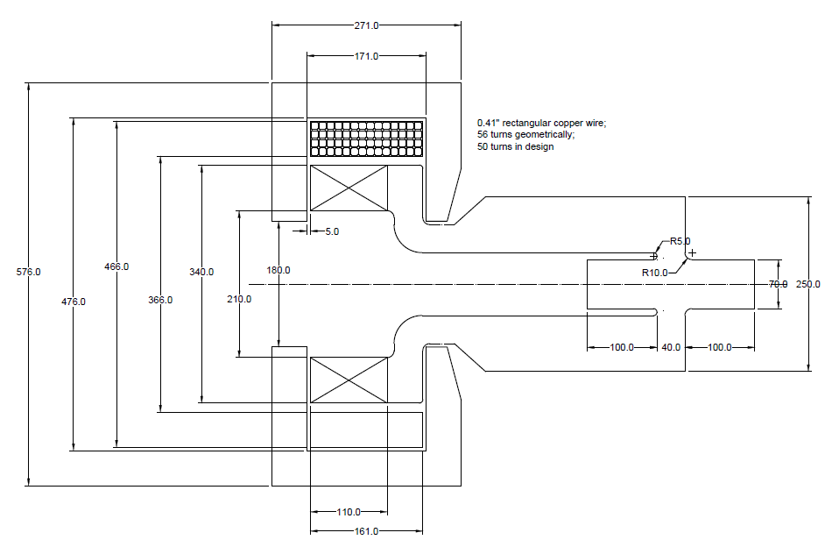
Geometry and Assumptions
Required change of Frequency vs Time:
Tan, July 17, 2015
First question is about a sale of the system → average power consumption must be found
Cavity geometry: G.R., July 2015

Slide 3
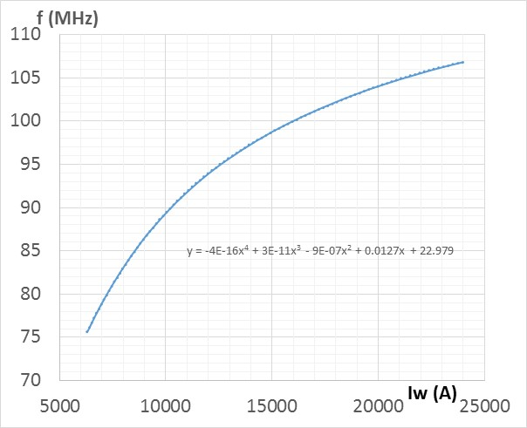
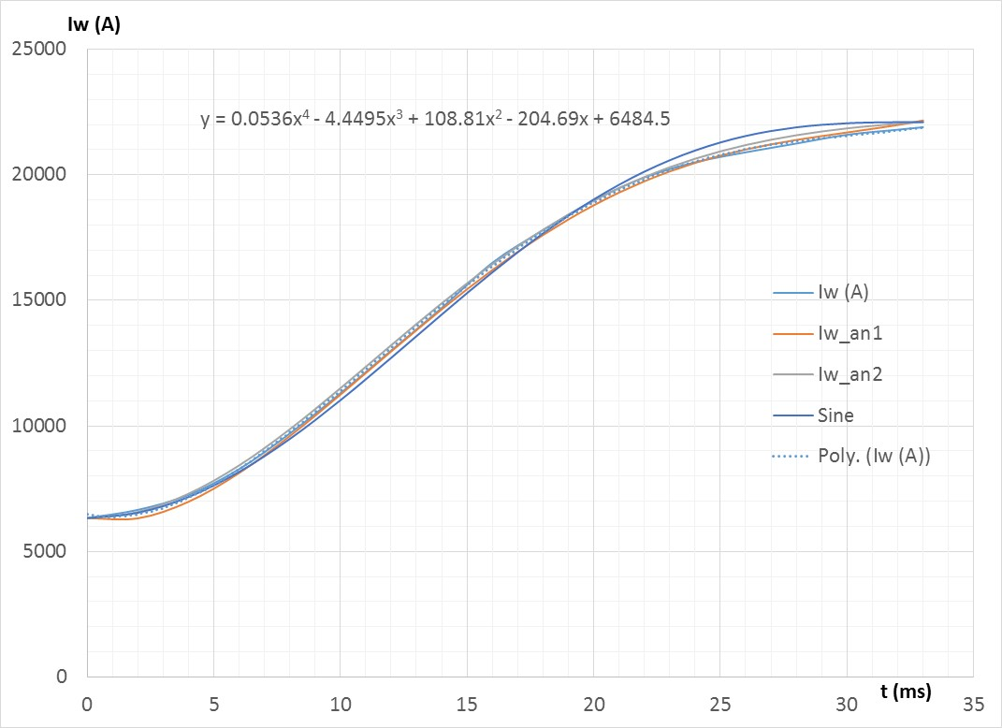
Frequency response and average power
Combining functions f(t) and f(I), we get the required current shape.
Results of modeling by G.R.
Having the function Iw(t) expressed analytically allows making analytical evaluation of power loss and generate other requirements needed for a power supply design.

Slide 4
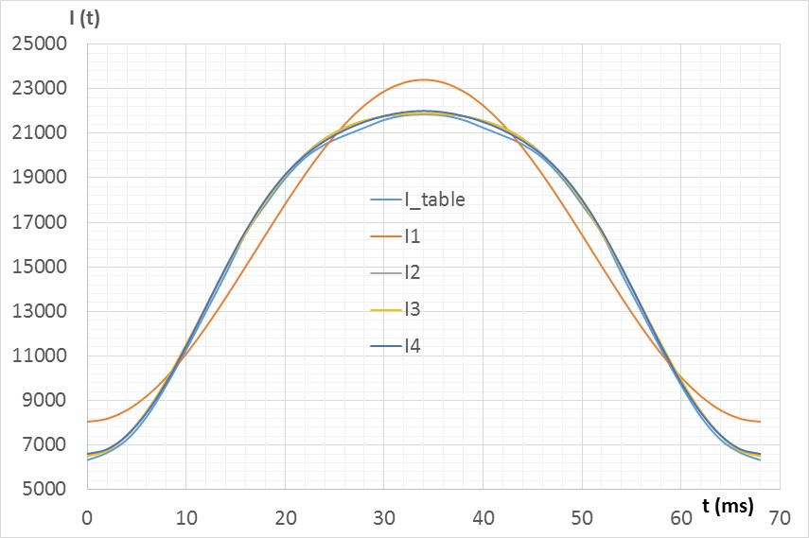
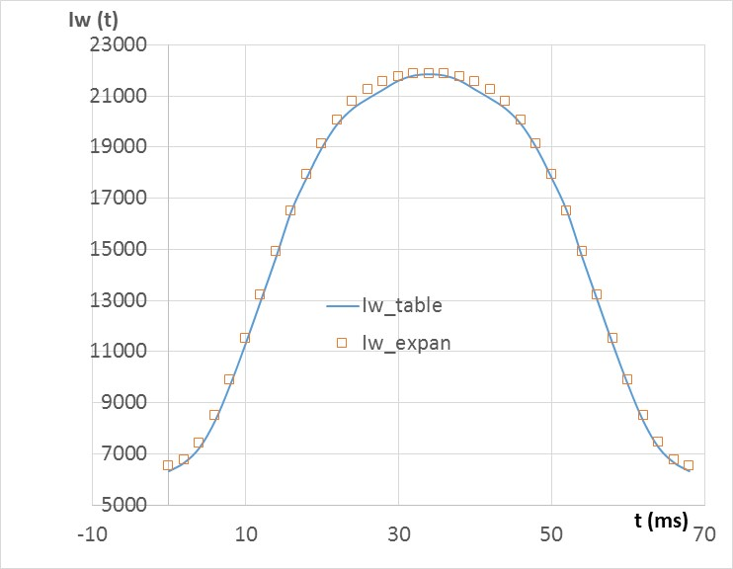
Harmonic Representation of the Current Cycle
The second order expansion reproduce the required current shape quite accurately.
Iw(t) = 15728 - 7676∙cos(2π∙t/T) - 1523∙cos(4π∙t/T)

Slide 5
Coil Design
0.41” (10.41 mm) rectangular copper wire with 0.229” (5.8 mm) hole for water cooling;
Copper cross-section 80 mm²; cooling hole cross-section 26.5 mm²;
Number of turns – 50 (conservative), 56 max;
Double-layer winding technique → required length of wire L_{wire} ≈ 80 m
Four reels of wire must be procured to avoid splices (90 feet reel)
Current range from I_{min} = 126.6 A to I_{max} = 440 A
Current shape: I(w) = I0 – I1∙cos(2π∙t/T) – I2∙cos(4π∙t/T
with I0 = 314.56 A, I1 = 153.52 A and I2 = 30.46 A
Wire resistance R = 0.019 Ohm
Power is found by integrating the losses through the cycle → W_{cycle} = 142.5 J;
f = 15 Hz → P = 2140 W

Slide 6
Coil Cooling
Two cooling loops assumed.
In the loop formed by the outer part of the coil, the power loss is ~1100 W. Assuming 10 ºC cooling water temperature rise, the required water flow is
Q [l/s] = 0.24∙P[kW]/ΔT[C] = 0.0264 [l/s] → 1.58 l/min → ~0.4 GPM.
Water velocity in the channel with the cross-section S = 26.6 mm² will be
v[m/s] = 1000∙Q[l/s]/S[mm²] ≈ 1 m/s, which seems OK.
This water flow will require the next pressure head:
h = v²∙L/2d^{1.33}
where h is measured in kG/cm², v is the velocity in m/s, d is the hole diameter in mm, and L is the length of the circuit in meters. For our parameters (L = 39 m)
h = 1²∙39/10.4 = 3.75 kG/cm² or ~53 PSI.
Volume of the coil is 10500 cm³ → weight is ~100 kG.
Power load is 2140/10500 = 0.2 W/cm³.

Slide 7
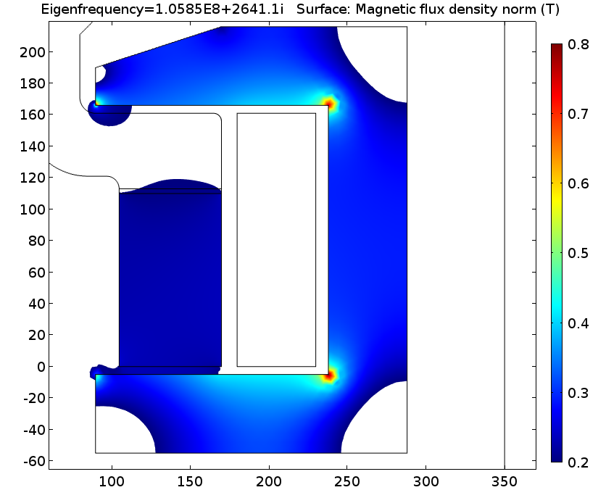
Flux Return. Inductance. Voltage
Central part of the flux return is made of low-frequency high permeability ferrite; peripheral part of the flux return is assembled using silicon steel plates.
Thickness of the yoke will be optimized to avoid saturation.
Shape of the poles will be optimized for better field uniformity in the garnet material
Expected inductance of the coil is ~2.5 mH at the maximum current and ~3.5 mH at the minimum current
Expected resistive voltage is ~9 V;
Inductive voltage is ~45 V.

Slide 8
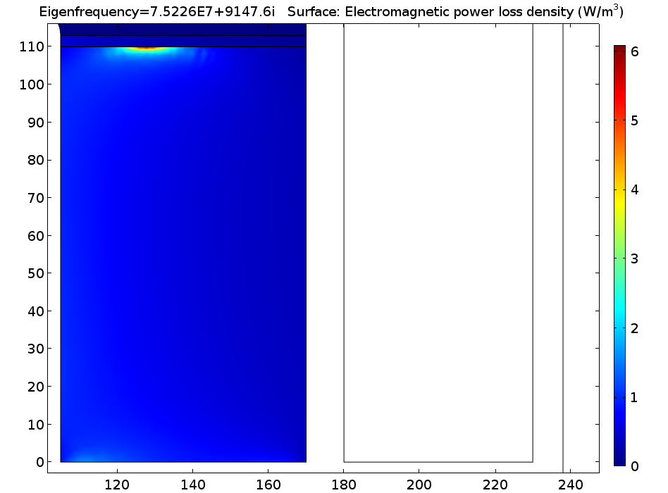
Power Loss in the Garnet Material
Running a 2D RF model gives frightening numbers for the power loss: at 125 A f = 75.22 MHz; Q = 3452;
ΔU = 20.5 V → power scaling factor to 100 kV is 23.8E6
Maximum power loss is ~50 W/cm³
Average power must be evaluated to have realistic understanding of the cooling problem
Power loss in the hot spot – 6.1 W/m³
ΔU = 33.27 V → power scaling factor to 100 kV is 9.03E6
So, the power density at the hot spot at 100 kV is 54.2 MW/m³ or 54.2 W/cm³
Total dissipated power in the garnet at 75. 225 MHz is 0.0038477*9.03E6 = 34765 W
Magnetic portion of the losses is 0.00305*9.03E6 = 27542 W
Stored energy in the cavity is 2*1.71E-8*9.03E6 = 0.31 J
Based on these numbers, quality factor associated with the losses in the garnet → Q_{AL800} ≈ 4150

Slide 9
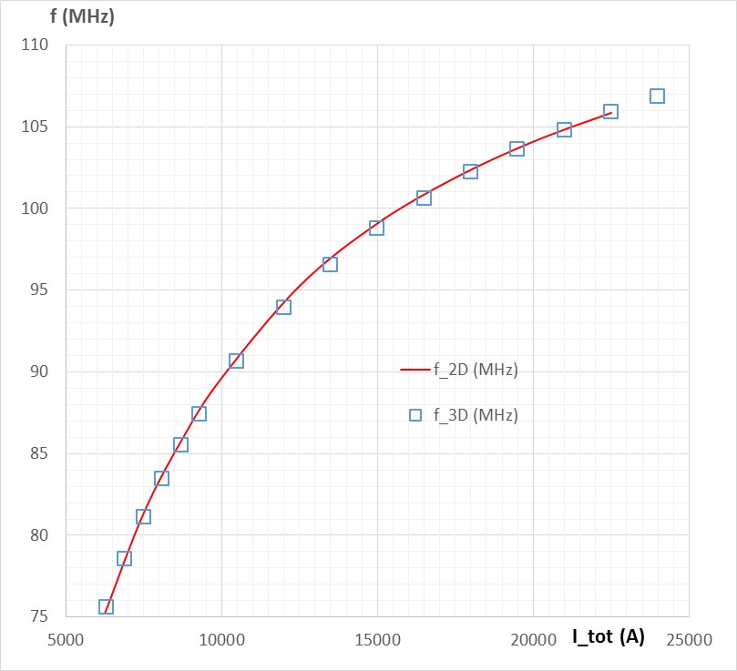
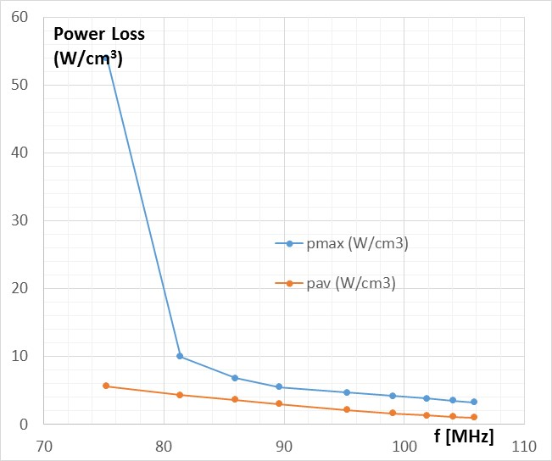
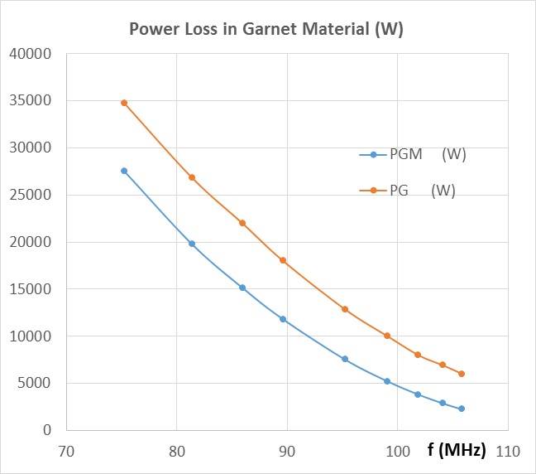
Power Loss in the AL-800 Material
Table below reflects results of 2D modeling of the cavity with different current settings in the coil
Power loss in AL800 material (magnetic and total)
Comparison with the 3D modeling by G.R.
Maximum and average power density

Slide 10
Average Power Loss in the AL-800 Material
Let’s find the average energy deposited in the garnet block during one cycle.
Current change is in accordance with the harmonic representation (as found earlier):
Iw(t) = 15728 - 7676∙cos(2π∙t/T) - 1523∙cos(4π∙t/T)
RF voltage power drops linearly from 100 kV at t = 0 to 0 at t = 23 ms.
U = U₀∙(1 – t/τ) when t < τ and 0 when t ≥ τ
This means that the power scaling factor also changes with time; additional, time dependent coefficient for the power scaling factor is
λ(t) = (1-t/τ)²
Procedure is detailed in the next sheet →

Slide 11
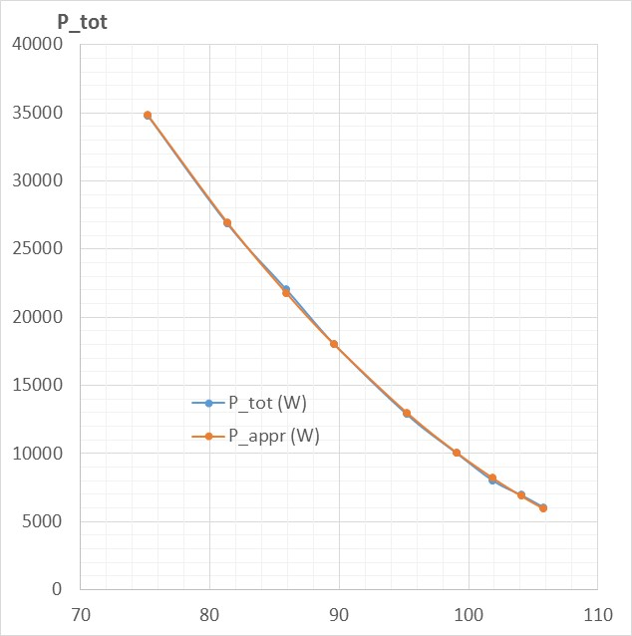
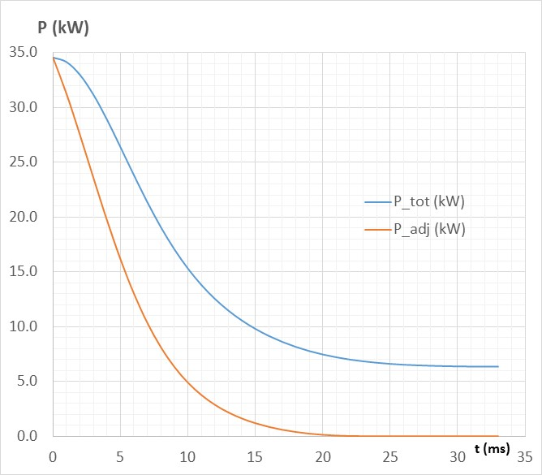
Average Power Loss in the AL-800 Material
The procedure is as following:
Use the expression for the current change:
Iw(t) = 15600 - 7676∙cos(2π∙t/T) - 1523∙cos(4π∙t/T).
Use expression for the frequency as a function of current:
f(I) = 22.5 + 12.7∙I – 0.868∙I² + 0.03∙I³ – 4.1∙10⁻⁴∙I⁴ (I is in kilo-Amperes)
Use expression for the power loss vs frequency (P in W, f in MHz):
P(f) = 215894 – 3447.8*f + 13.831*f²
Apply additional scaling factor and get adjusted (for the accelerating voltage) power loss.
Integrate the losses over time → 209.2 J per cycle→ 3140 W in the garnet (0.51 W/cm³ average power density)

Slide 12
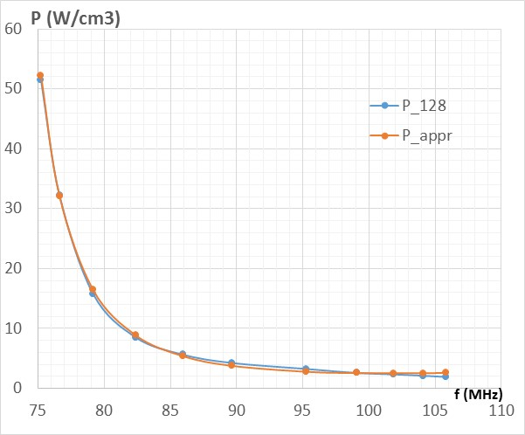
Maximum Power Loss Density in the AL-800 Material
Procedure:
1. Use the following expression for the current change:
Iw(t) = 15600 - 7676∙cos(2π∙t/T) - 1523∙cos(4π∙t/T).
2. Use expression for the frequency as a function of current:
f(I) = 22.5 + 12.7∙I – 0.868∙I² + 0.03∙I³ – 4.1∙10⁻⁴∙I⁴ (I is in kilo-Amperes)
3. Use expression for the power loss density vs frequency (p in kW/cm³, f in MHz):
p(f) = 1460/(f-70)² + 0.09*(f-90) (at R = 128 mm, Z = 110) →
4. Apply additional scaling factor for the accelerating voltage drop in time.
5. Integrate the power loss density over time in the hot spot R = 128 mm, Z = 110 mm → The accumulated heat per one cycle is 0.16 J/cm³ per cycle.
Average power density in the hot spot is 2.4 W/cm³.

Slide 13
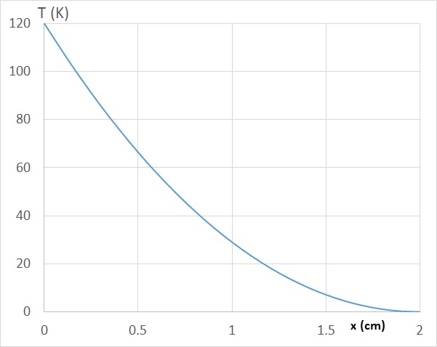
Temperature rise at the hot spot
Is the found maximum power loss density dangerous?
Let’s make simple evaluation.
Let’s consider a plate with thickness t. Let’s have coordinate x in the direction perpendicular to the plate with x = 0 at the surface where we will find the temperature rise relative to the other surface of the plate. Power deposition density is p(x). Thermal conductivity is k. Let’s assume
p(x) = p0*exp(-x/d)
Power flux in the direction towards x = 0 plane is
Q(x) = ∫p(x)dx with the limits from x = t to x = 0 →
Q(x) = -p0·d·[exp(-x/d) - exp(-t/d)] = k·dT/dx →
dT/dx = -p0·d/k·[exp(-x/d) - exp(-t/d)]
We assume here that the temperature derivative at x = t is zero →
ΔT(x) = d²·p0/k·[exp(-x/d) - exp(-t/d)] + p0·d/k·exp(-t/d)·(x-t)
or
ΔT(x) = d·p0/k·{[d·exp(-x/d) – (d – x + t)·exp(-t/d)]}
For x = 0 with t = 2 cm and d = 10 cm, and with k = 0.035 W/(m-K) and p0 = 2.4 W/m³ we have:
ΔT(0) = 685.7*(10 – 12*0.82) ≈ 120 K

Slide 14
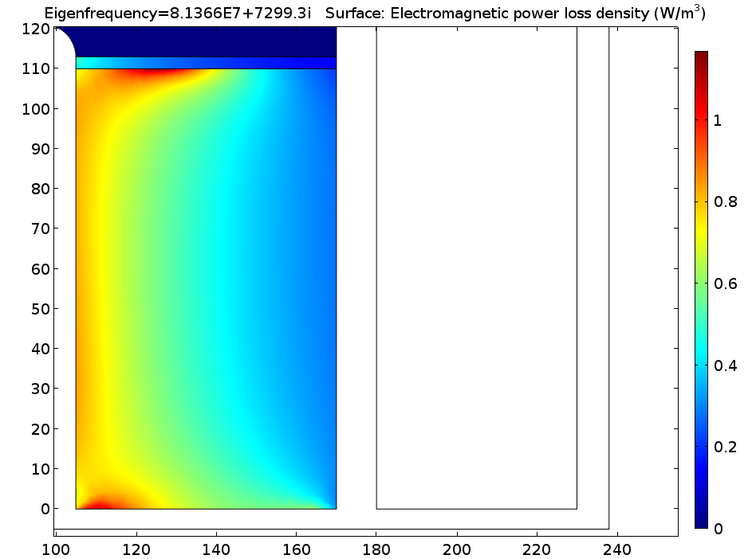
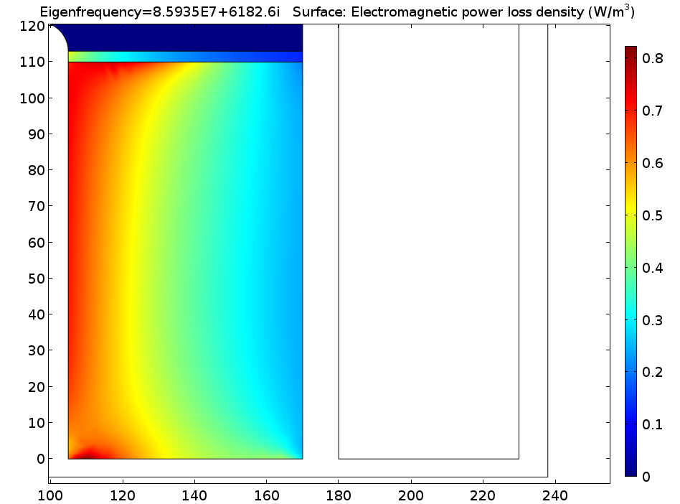
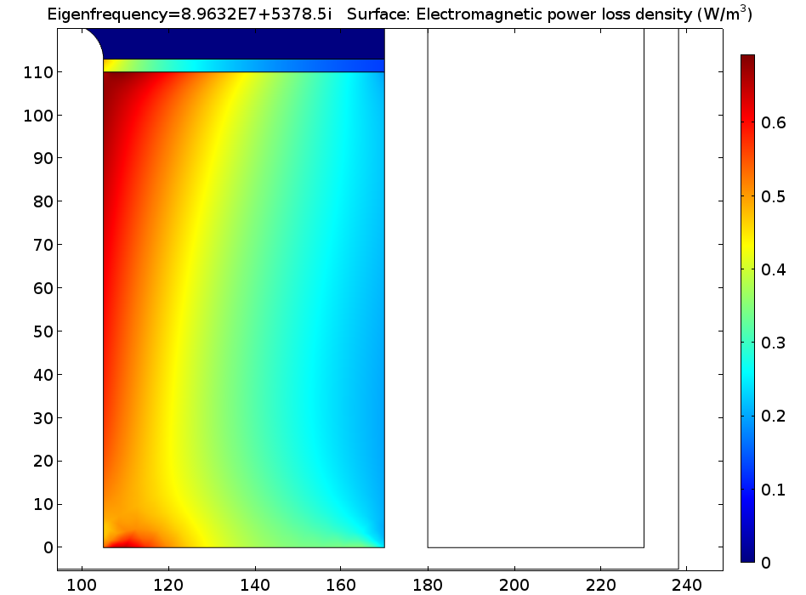
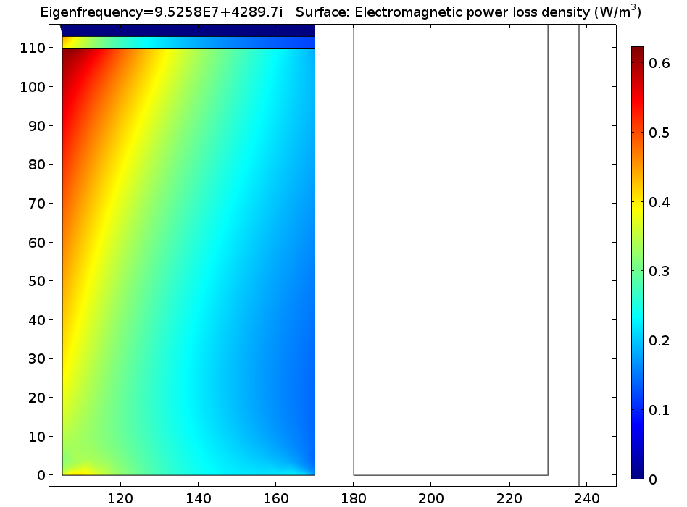
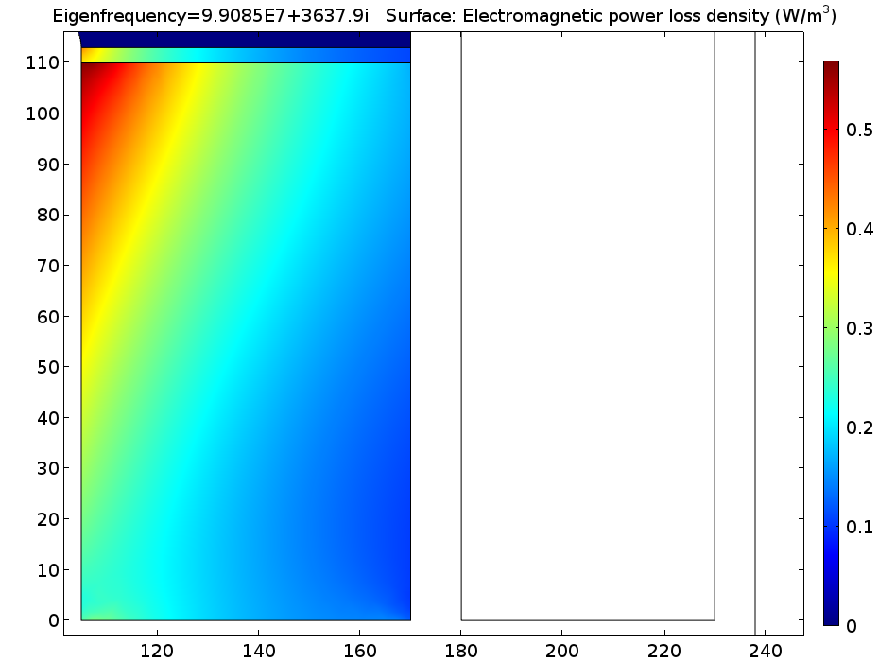
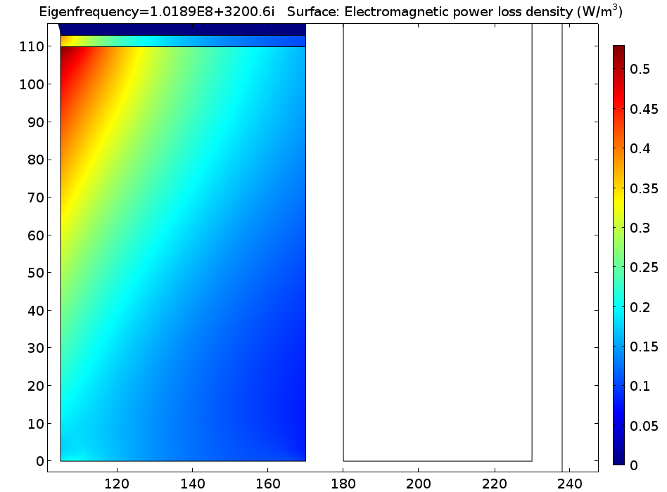
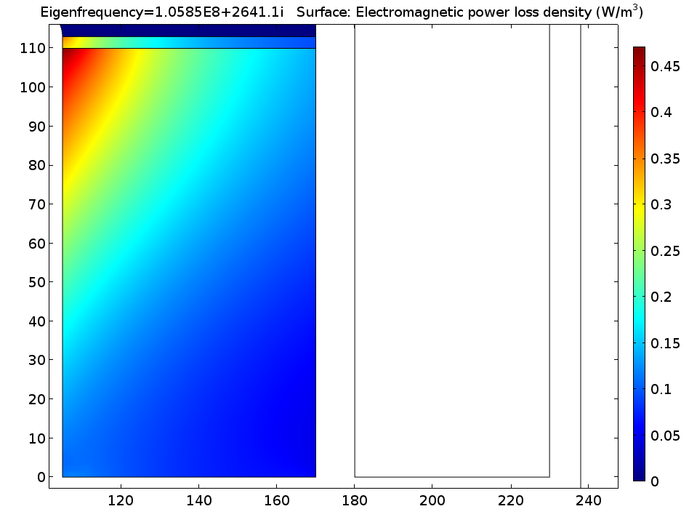
I = 125 A
I = 150 A
I = 175 A
I = 200 A
I = 250 A
I = 300 A
I = 350 A
I = 450 A

