Slide 1
Linac Laser Notcher
David Johnson, Todd Johnson, Matt Garner, Kevin Duel, Dave Slimmer
Workshop on Booster Performance and Enhancements
23-24 November 2015

Slide 2
Outline of talk
Motivation
Laser Notcher R&D Goals
Concept
Demonstration Experiment
System Description, Challenges, and Accomplishments
Status
Summary
Notes:
System Description, Challenges, and Accomplishments
started with a concept
little knowledge of technical details
little knowledge of available technology
and a closet for a laser room

Slide 3
Motivation
Motivation:
  Creating a notch in Booster beam for extraction removes approximately 3.5% of the Booster beam
  Currently, utilizing kickers in Booster ring to create notch between 400 and 700 MeV… accounts for ~30% of the losses in Booster.
  Several potential techniques for remedy:
    Install massive collimator style shielding in Booster ring to “catch” the beam removed by the notcher kicker(s) – does not remove the loss from the ring → materials in the tunnel are still activated.
    Move the notch creation out of the Booster tunnel to 750 keV line
      Electrostatic kicker - demonstrated by Robin Madrak – possible, but beam line real estate not available.
      Photoneutralization of H- ions using laser pulse. Demonstrated by Ray Tomlin, circa 2000.
Fall 2011 - PIP initiated a R&D program to develop a Notching System based upon Photoneutralization using Lasers.

Slide 4
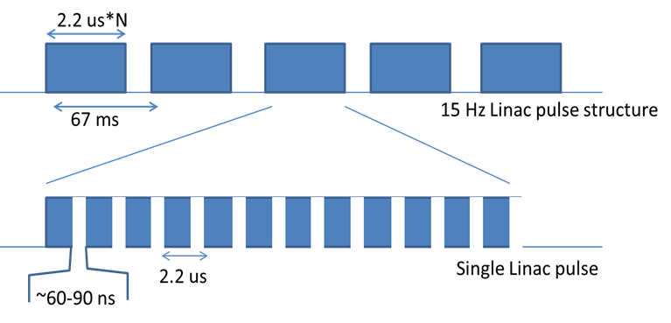
Goals of Laser Notcher R&D Program
Develop a laser system / optical cavity that:
  will fit into the highly constrained space in the 750 keV MEBT where component activation does not occur!
  will generate an arbitrary number of notches within a linac pulse
  will generate an arbitrary notch length for each notch
  will be capable of neutralization of 98% of the H- ions in each H- bunch
  create a system that is operationally robust

Slide 5
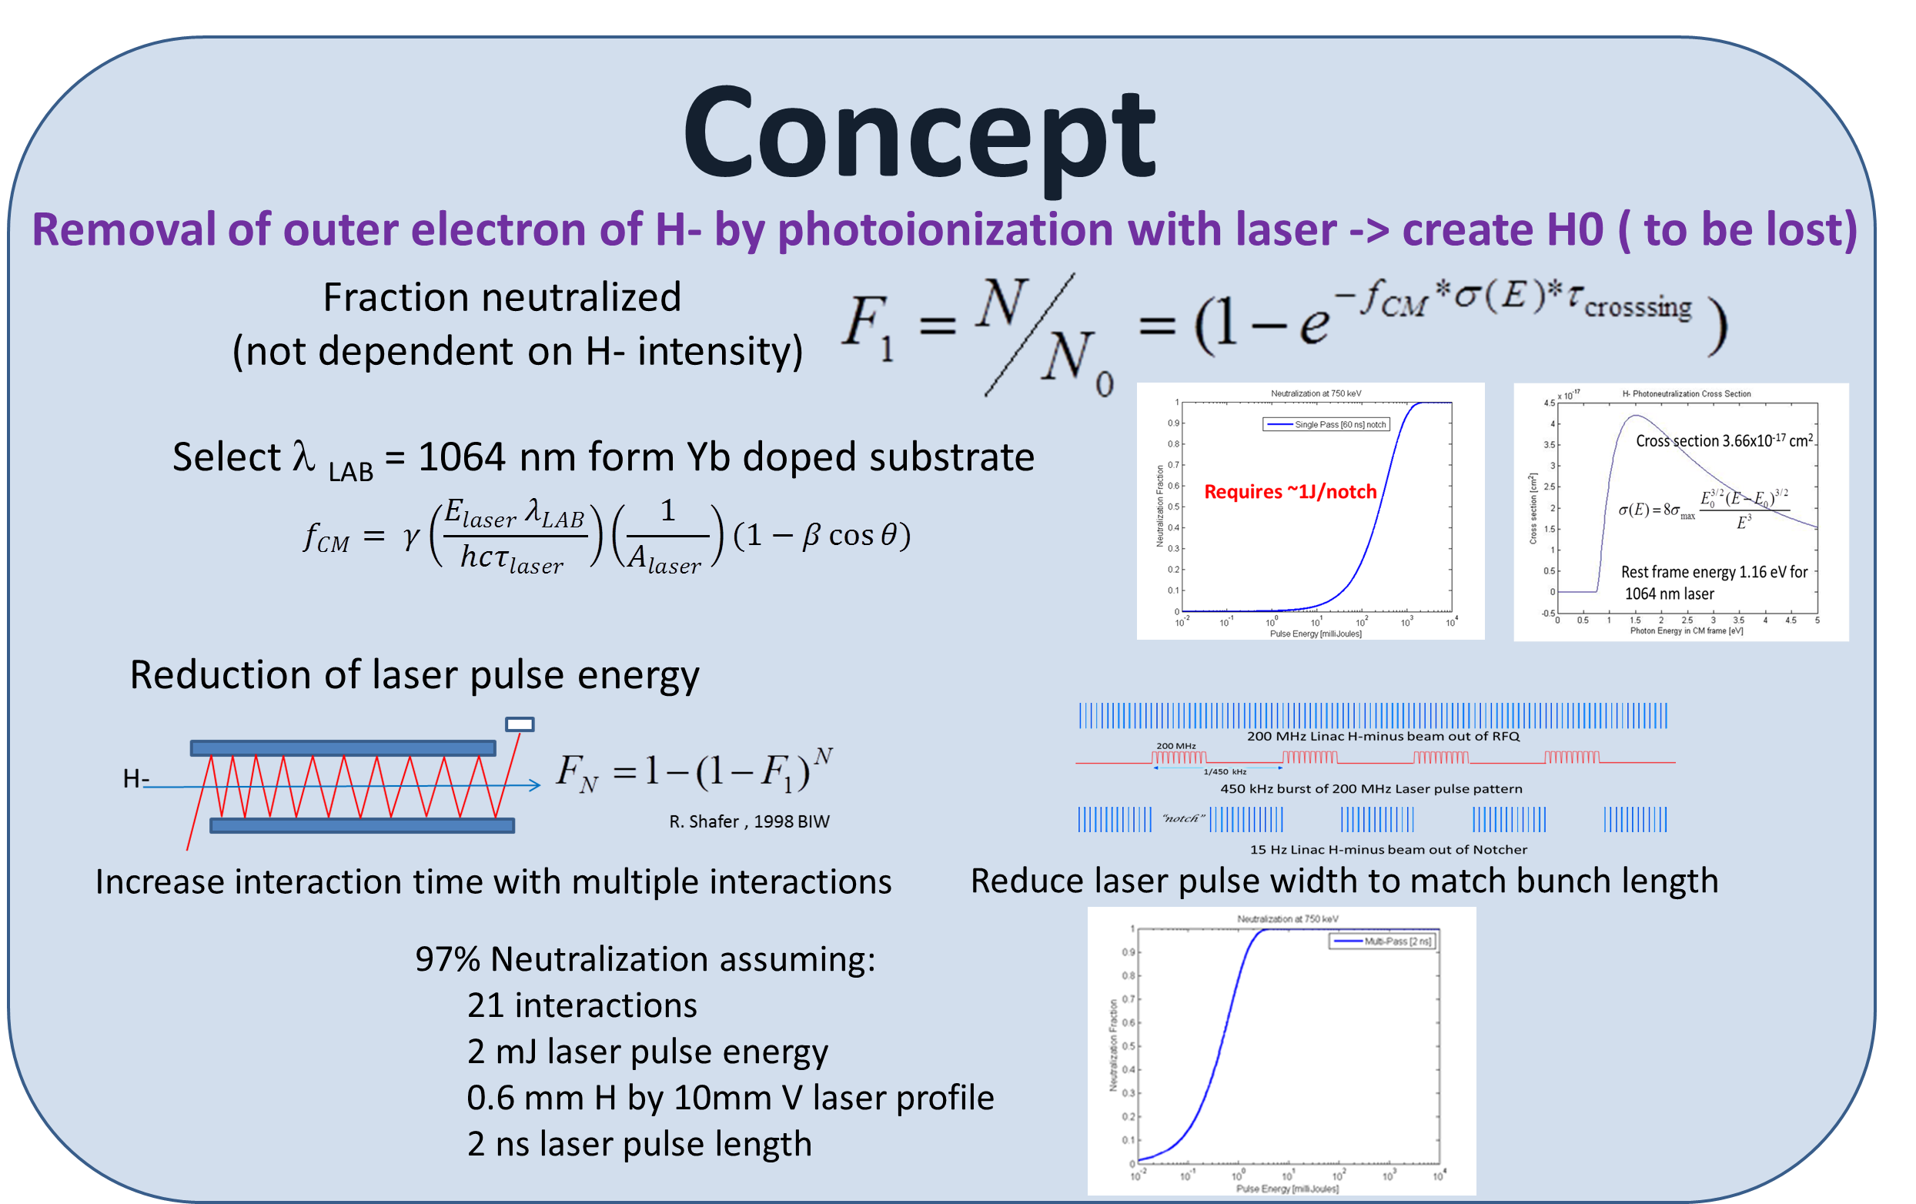
Concept of Laser Notching
Laser Beam
9.6 mm
1.1 mm

Slide 6
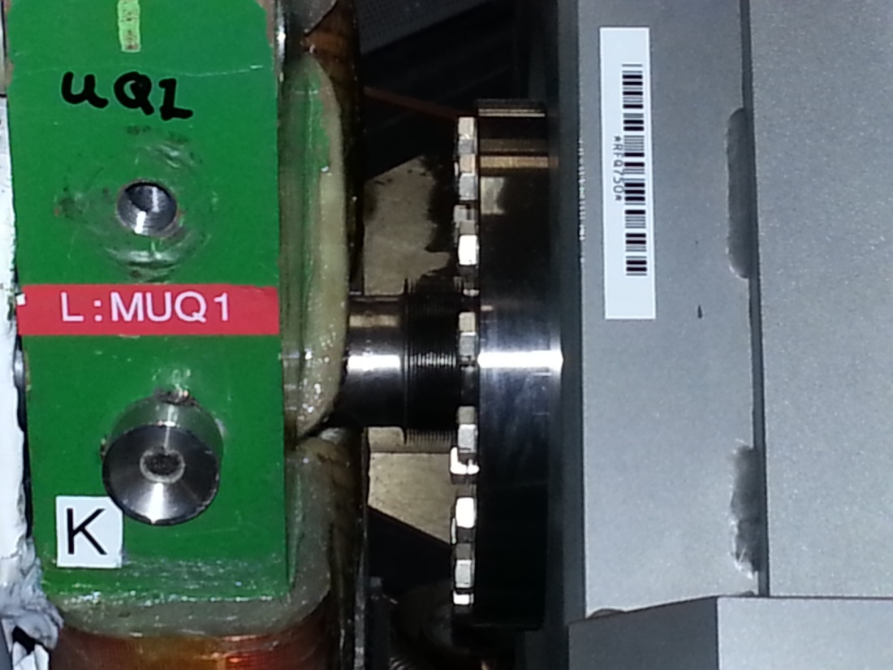
Where is it to be installed?
Must fit in this space

Slide 7
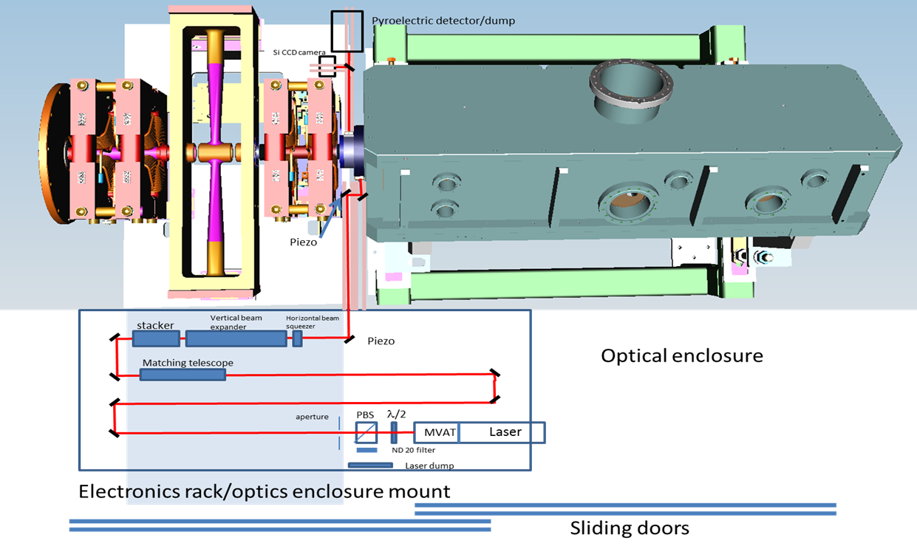
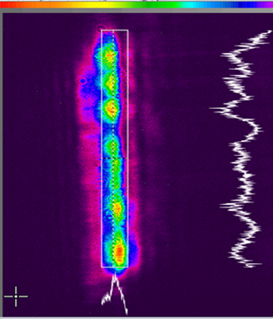
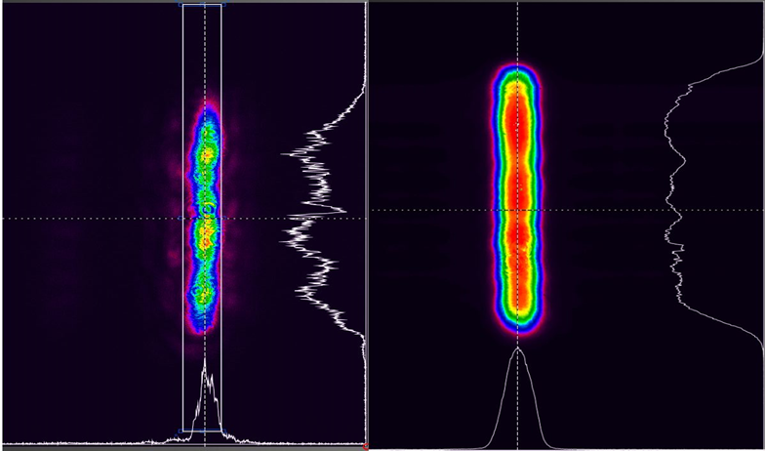
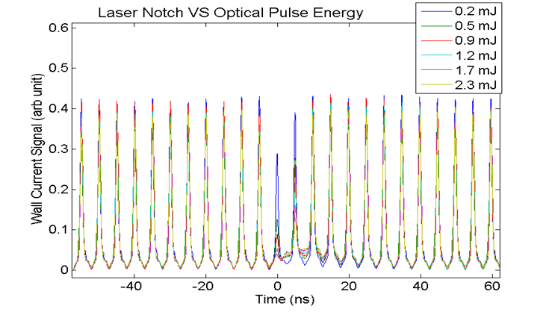
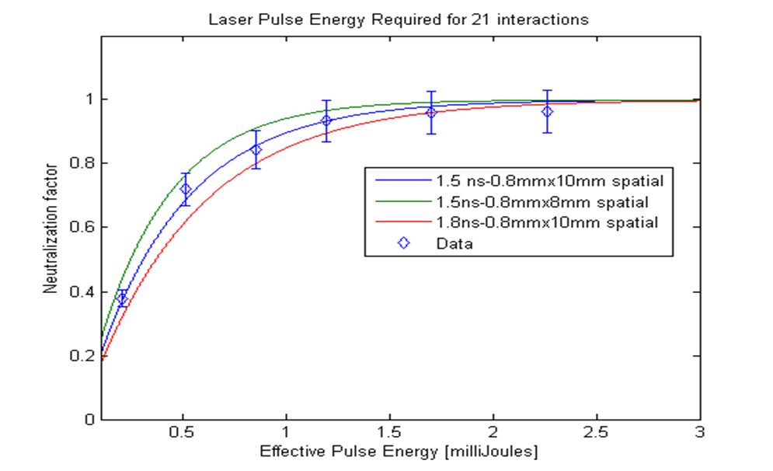
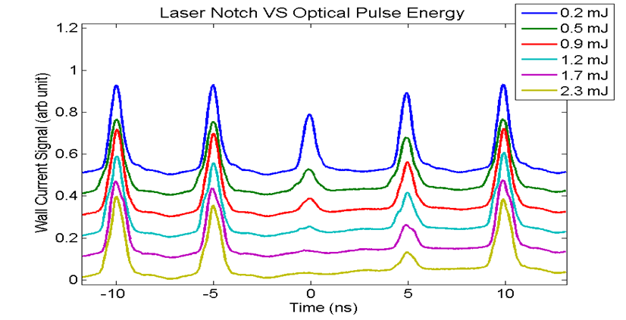
Demonstration Experiment ( January 2015 )
Profile in Experiment
Demo
Final System
Demonstration Experiment used Quantel 100 mJ Q-switched Nd:YAG laser with a 10 ns laser pulse @ 15 Hz
Todd Johnson
Matt Gardner
Vic Scarpine
Rick Tesarek
Andreas Saewert
Jamie Santucci
Fred Mach
PPD Machine Shop
Matt Quinn
Dave Baird
Ray Lewis
Ray Tomlin
Fernanda Garcia
Bill Pellico
Bob Zwaska

Slide 8
System Description -- Master Oscillator Power Amplifier(s)
Modulator
Determines average power
Seed
MDC Bias Control
Keep Alive Oscillator
VDRIVE
RF Amp
Trigger sync
from EL
<100 mW CW
DA12000 AWG
Fermi OPG
Fiber Amp 2
Ext. clock sync from RFQ
Fiber Amp 1
Fiber Pre-Amp
<P> =425 uW
Pump
Fiber Port
Optical Engines PCF FA
PriTel Yb FA
Measured peak
gain ~ 20 dB
<P> = 2W CW
<P> = 48 mW
Free Space
Northrup Grumman Amplifier Modules
Optical Cavity
Matching Optics
Beam Stacker
Transport Optics
RBA Amp
REA Amp
E ~ 2mJ/bunch
P ~ 1MW Peak
<P>@450 kHz ~ 10 kW
<P> @15Hz ~ 7 W
Measured Small signal gain
~ 25 dB both modules

Slide 9
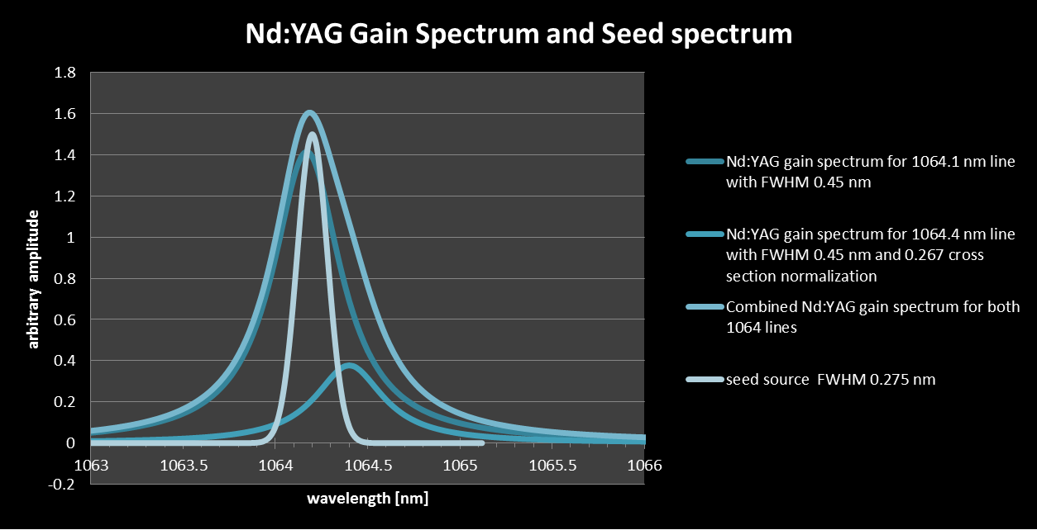
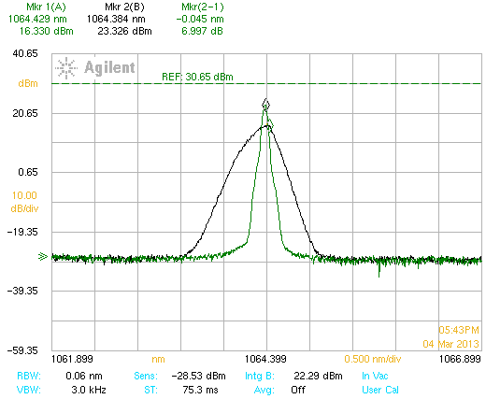
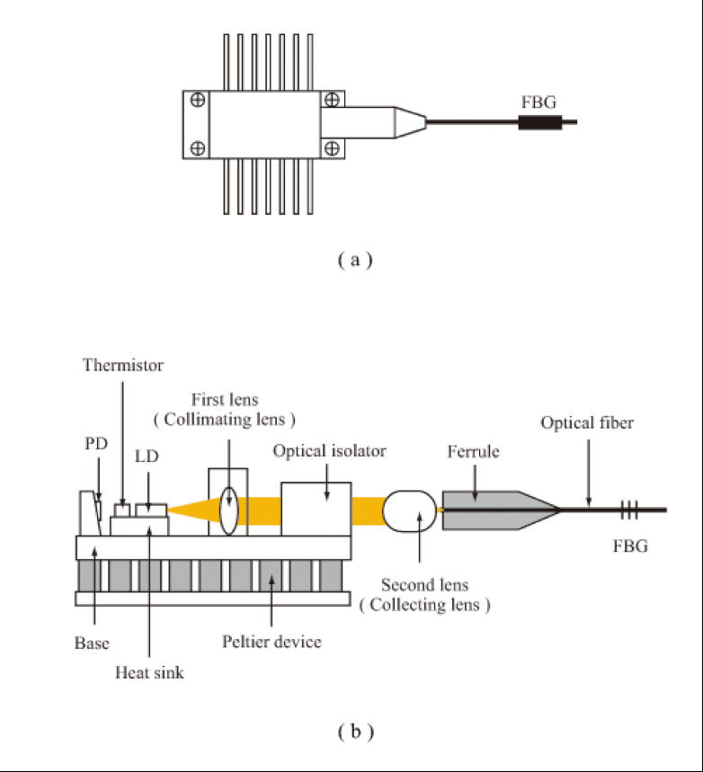
Seed Source Challenge
The requirements
  Wavelength and spectral bandwidth
    defined by the optical bandwidth of the
    Nd:YAG Diode Pumped Solid State
    (DPSS) amplifier modules (Grumman).
    λ₀ = 164.17 nm FWHM = 0.45 nm
    Spectral bandwidth can’t be too narrow due the generation of SBS in the power amplifier → want FWHM a few nm
  Stable output (power & bandwidth)
    Need 100 mW (max) average power into modulator
    Stay out of operation regime where we find “mode hopping”
  Linear polarized output
  CW (due to the CW nature of the 1st stage of fiber amplifier
  Compact (space limitations)
  Fiber coupled
Utilize a 14-pin broad bandwidth with a FBG to produce
the desired wavelength and bandwidth

Slide 10
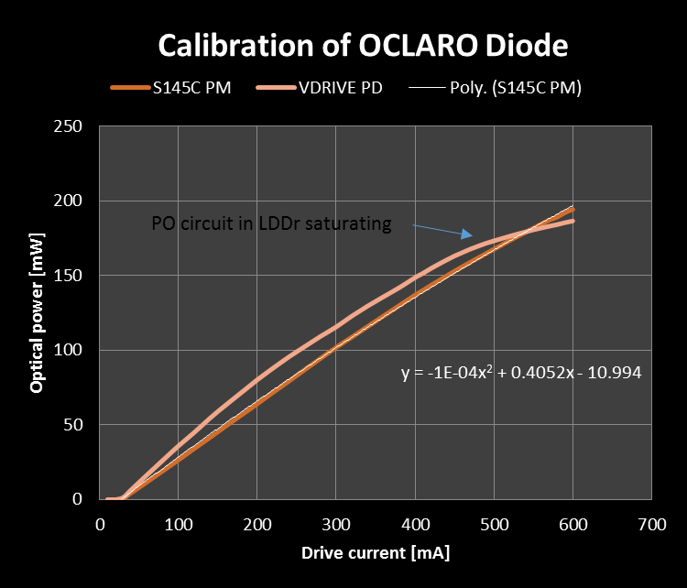
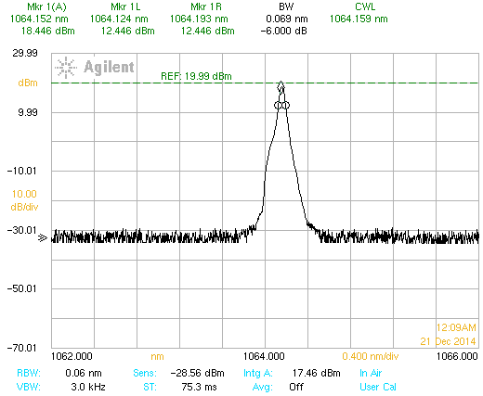
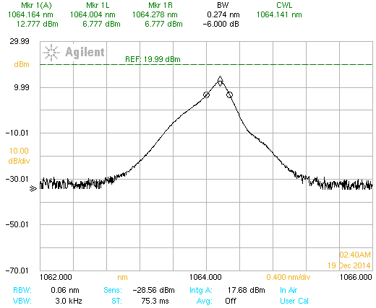
Seed Source Challenge
First seed source –
  Central wavelength slightly off the peak of the Nd:YAG gain spectrum
  Unstable at design temperature
Second seed source (OCLARO) → current operational source
  required a custom FBG to retrofit diode from manufacturer
  Chip has to run at 9ºC and 600 mA -> needed to find temp & current for stable operation
  Most laser diodes made overseas → Potential long lead times
Our current operational point
Max input to Modulator
OCLARO TEC 25º (6dB .07nm)
OCLARO TEC 9º
λ₀ = 164.16 nm -6dB = .274

Slide 11
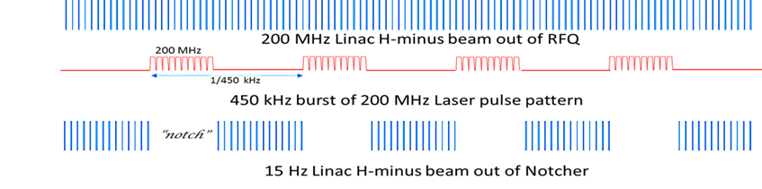
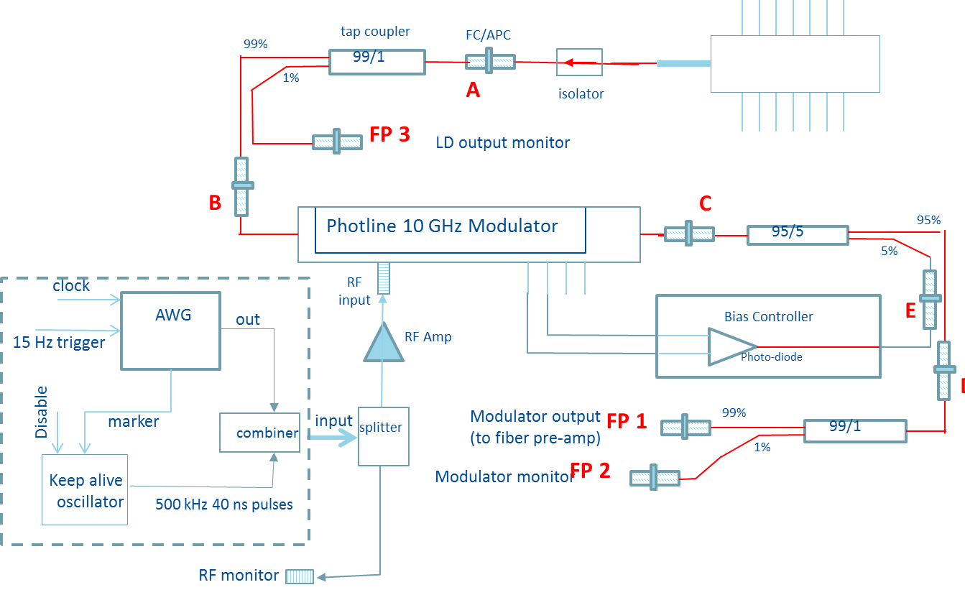
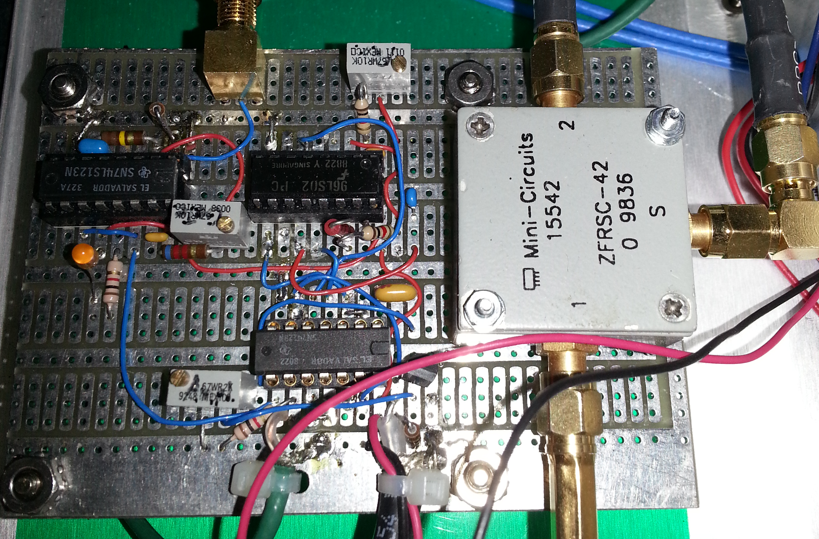
Optical Pattern Generator
This is the pattern of laser pulses we want to produce
Created by modulating a CW laser by a 10 GHz optical modulator.
We use a Fermi built 450 kHz gated oscillator circuit to generate 40 ns square wave pulses to provide a continuous seed signal to the first stage CW pumped fiber amplifier unless gated off by the AWG. *** (more on this later)
A 2 GHz arbitrary waveform generator is used
to create the 450 kHz bursts of 201.25 MHz
pulses (1.5-2.5 ns square wave)

Slide 12
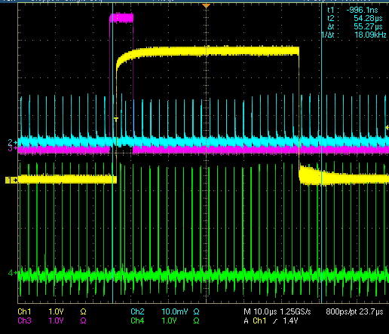
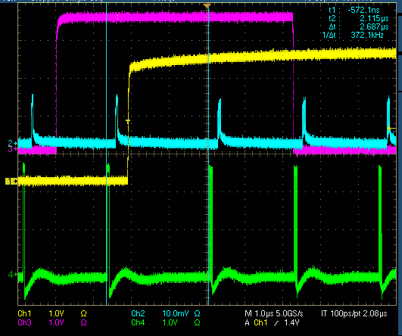
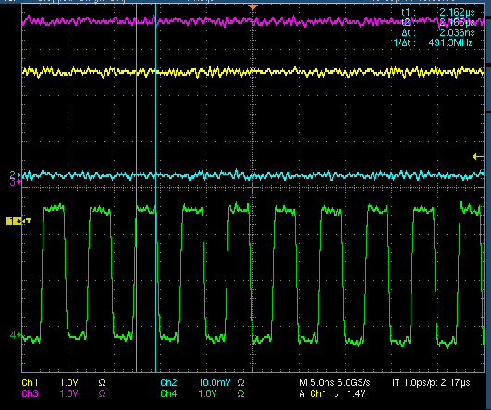
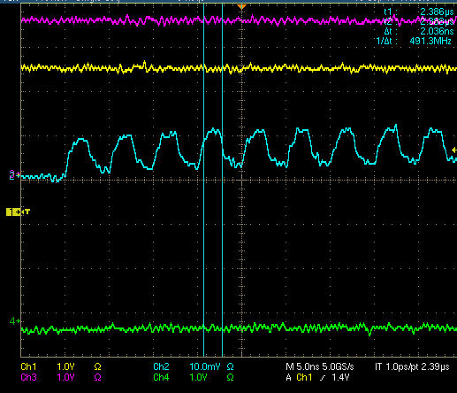
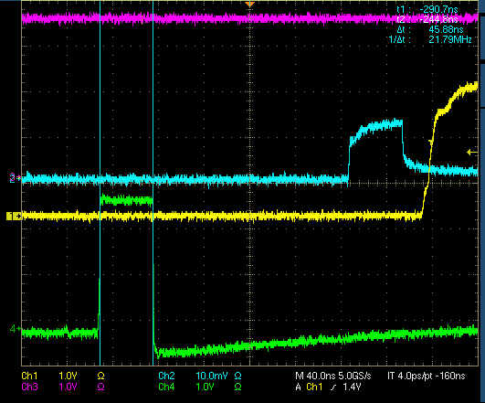
Optical Pattern Generator
Pictures show the output of the RF monitor , the trigger for the AWG,
the trigger for the Optical Engines fiber amplifier, and the output of PriTel amplifier
with 1% sampled by a free space photodiode.
Notch
KA
KA
10 us/div
1 us/div
5 ns/div
Green: RF Amplifier
Cyan: Photodiode
Yellow: Notch trigger
Magenta: Pulsed FA trigger
5 ns/div
40 ns/div

Slide 13
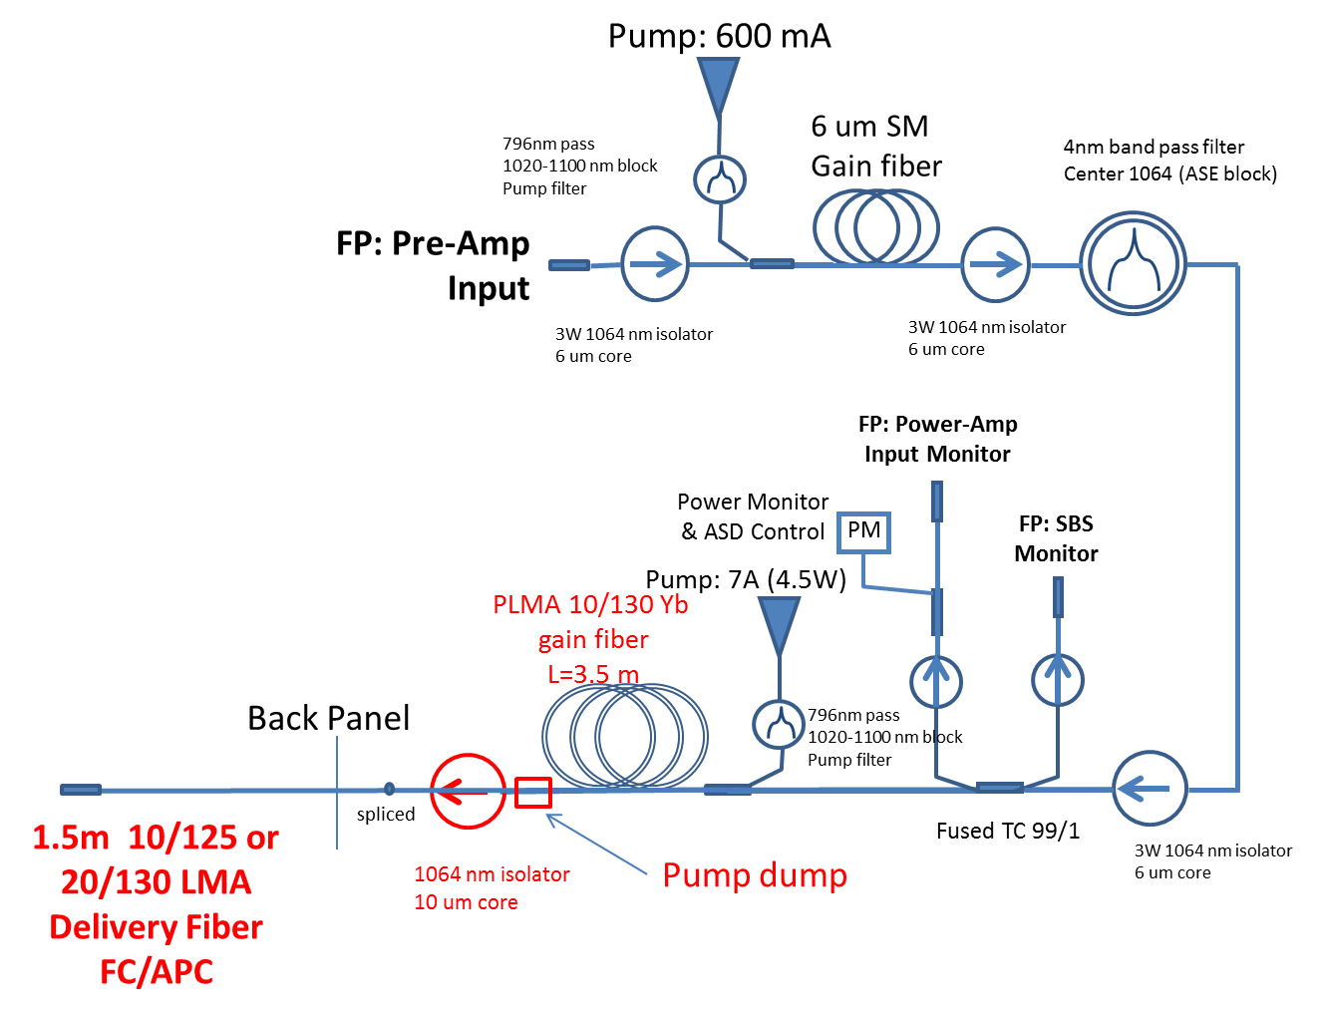
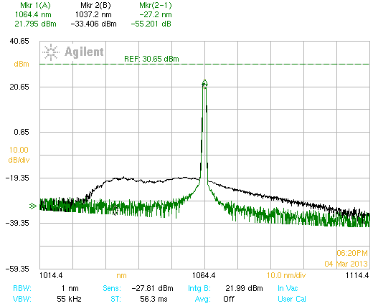
Fiber Amplifiers
We utilize three fiber amplifiers
  First two stages CW
    Packaged in a single unit
  Third stage uses a pulsed fiber amplifier at 10 Hz
A number of challenges have presented themselves during the development of the fiber stage.
Present a few & their resolutions
PriTel (CW pumped)
~ 230 nJ pulse energy
92 W peak power
1.9 W average power
976 nm pumps
99%
MFA
splice
splice
40/200 PM un-doped
PCF delivery fiber
~0.5 m
99/1
1%
40/200 PM Yb doped
PCF Fiber
~1.5m
Input
(from pre-amp)
976 nm
pumps
6+1 pump
combiner
Output
To Free space Amplifier
Optical Engines
(Pulsed pumped)
~10 uJ pulse energy
50 kW peak power
17 mW average power
Input Detection/
Monitor circuit
Input
Monitor

Slide 14
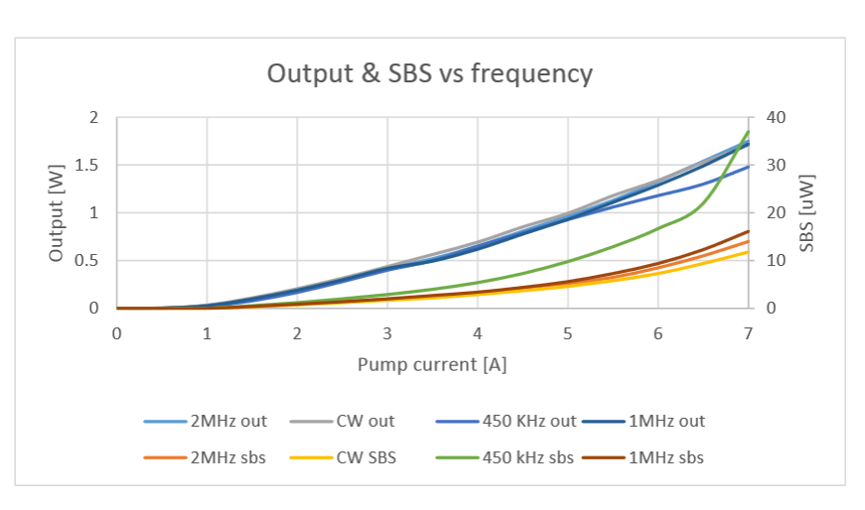
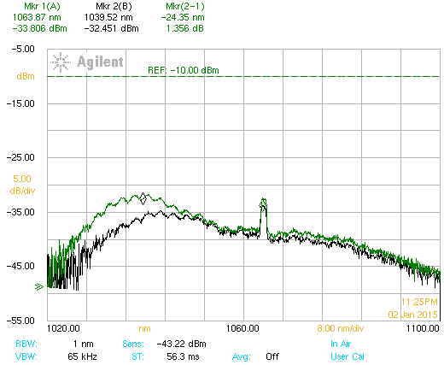
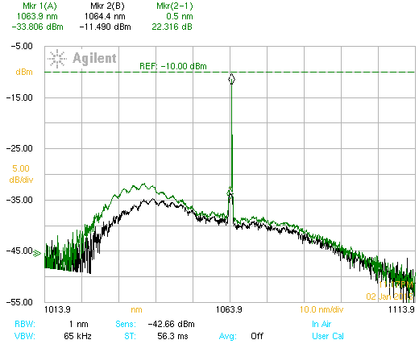
Challenges with CW fiber amplifiers
Low seed power and to much pump current
  Auto “q-switching” → send large amplitude pulses in both directions
  Consequences “burn” fiber connectors and burn out pump diodes
  Monitor input power to power amp → install auto shutdown
Bandwidth of seed too small
  Generate SBS ( a backward laser pulse which robs power from signal)
  Threshold ~ gain fiber MFD, 1/length, and seed BW
  Dependent on PRF
  Optical Spectrum Analyzer → SBS monitor
  Can take out pump diodes
6 amps
7 amps

Slide 15
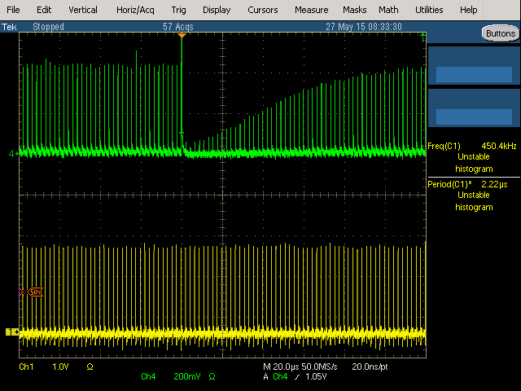
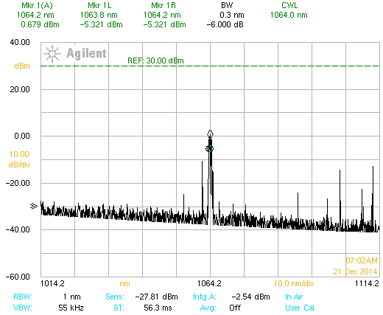
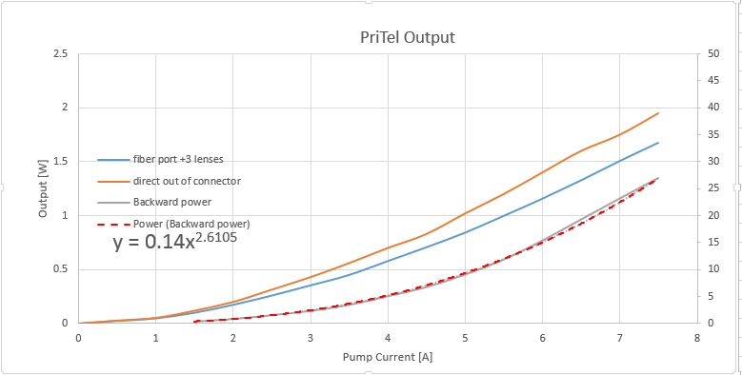
CW fiber amplifier
Example of auto q-switching ( can also be PRF and pulse width dependent)
Output after modifications
  We believe we have stable Operation
  Modifications include
    Added “auto shutdown” circuit
    New pump diode-> match absorption λ
    Change gain fiber SM 6 um-> LMA 10 um,
    Reduce gain fiber length 7->4.3 m
    Added a pump stripper
    Added BP filter to pump diodes

Slide 16
Working with large average powers in fibers (1)
Modulator
Determines average power
Seed
MDC Bias Control
Osc. Keep Alive
VDRIVE
RF Amp
100 mW CW
Trigger sync
to RFQ
DA12000 AWG
Fermi OPG
Fiber Amp 2
Ext. clock sync to RFQ
Fiber Amp 1
Fiber Pre-Amp
<P> =425 uW
Pump
Fiber Port
Optical Engines PCF FA
PriTel Yb FA
Measured peak
gain ~ 20 dB
Power density @ interface
using 10 um MFD at PriTel full
2W power is 25 kW/mm²
Burned connectors
<P> = 2W CW
<P> = 48 mW
Free Space
RBA Amp
REA Amp
Matching Optics
Beam Stacker
Transport Optics
Measured Small signal gain
~ 25 dB both modules
Notes:
10 sec…. Point out interface between amplifiers and the powers we’re talking about

Slide 17
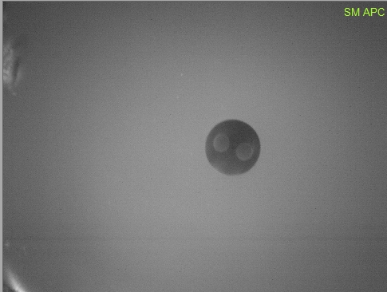
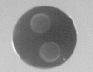
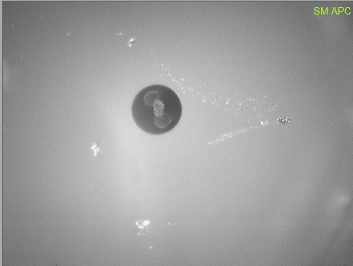
Working with large average powers in fibers (2)
Stress rods
10 um core
125 um
Burned
FC/APC connectors (Angled Physical contact) spring loaded - standard fiber adapter
Fiber geometry at connector
  Expanded core SM fiber (July 10, 2015)
  LMA w/10um core (Sept 18, 2015)
Pictures from 400 um video inspection scope
10um delivery fiber

Slide 18
Working with large average powers in fibers (3)
Fiber Damage -Two phenomena
  bulk fiber damage threshold usually associated with peak powers in ps and fs pulses with the threshold in the 10’s GW/cm2,
  End facet damage – usually due to average power and heating of the silica at the glass-air interface.
    End facet surface irregularities or polish
    In fiber to fiber connections mis-alignment can cause heating
    Dust particles (absorb energy & raise temp)
End facet damage threshold
  There seems to be no agreed upon number – NO hard fast number
    Coastal connections -> clean interface 25 kW/mm² (comfortable fluence)
    -> “dirty” interface 5 kW/mm²
    Diamond -> 1 micron dust particle on core 3 kW/mm² (for power solutions)
  How to raise threshold
    Expanded core connector OR larger core fiber → 1st & 2nd failures
    GRIN fiber end-cap connector
    Free space coupling (using end-capped fiber) Options remaining
    Eliminate interface -> fusion splice

Slide 19

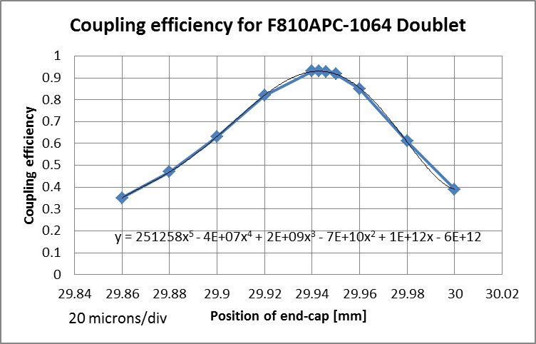
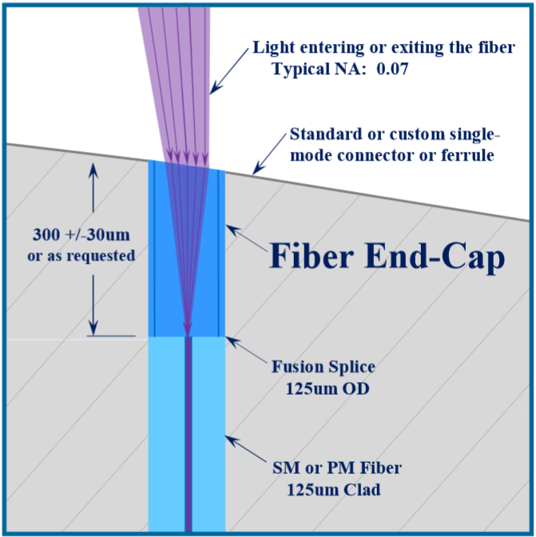
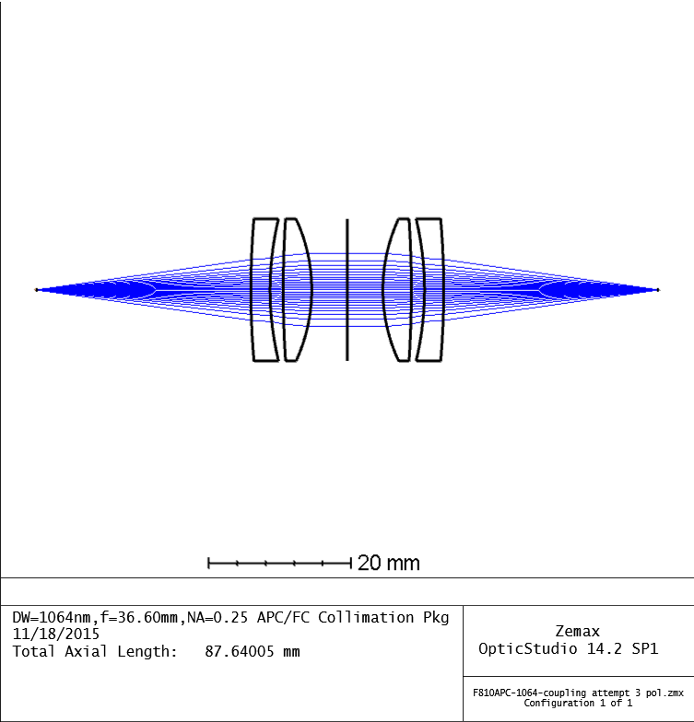
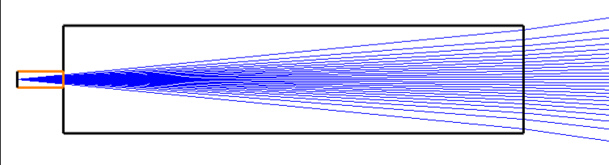

How to couple high power in fiber
GRIN fiber end-cap connector
Free-space w/end-cap
Eliminate interface -> fusion splicing the two amplifiers together -> we don’t have capability… must contract out
splice
GRIN fiber
Can handle > 3W@ interface
Have only made w/SM fiber
Requires R&D
Long lead time
SM fiber
GRIN fiber
SM fiber
connector 1
connector 2
Coupling eff 0.92 (-.4 dB loss)

Slide 20
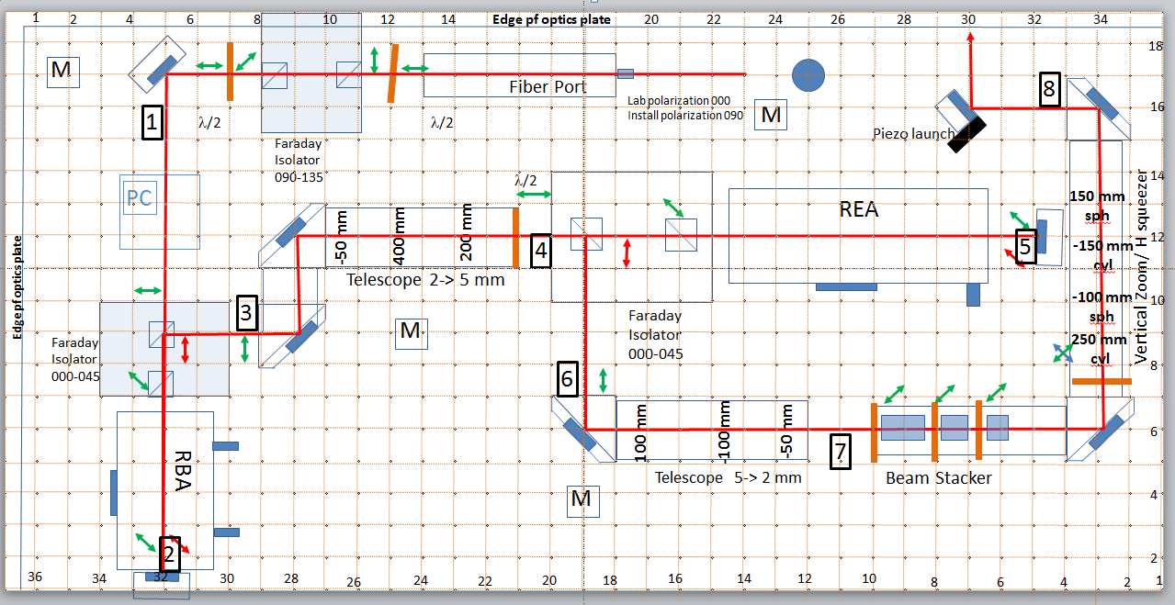
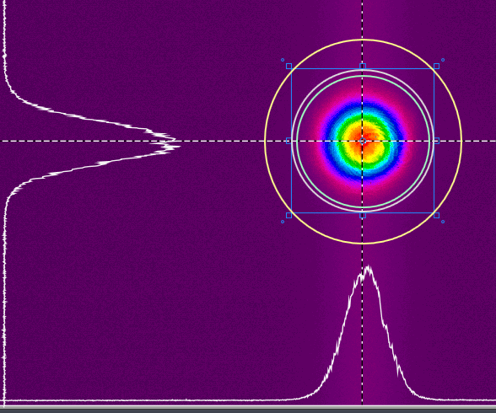
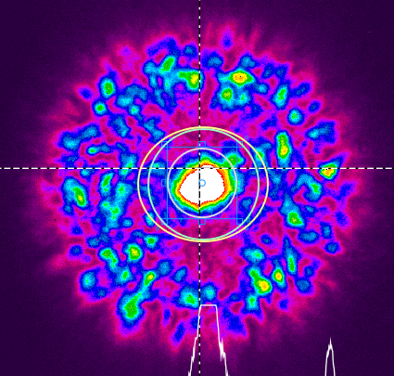
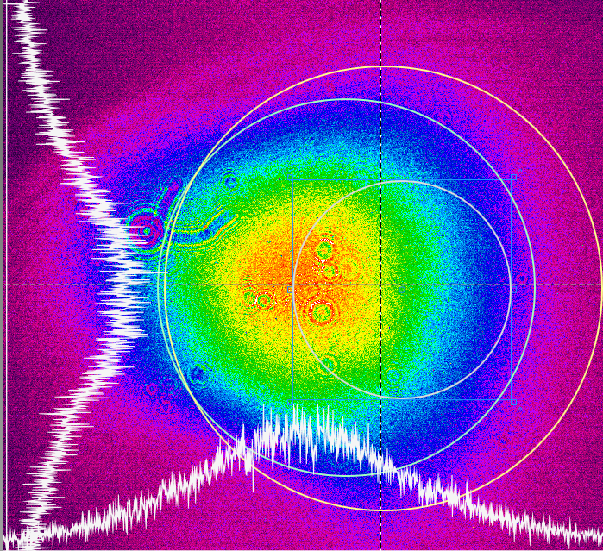
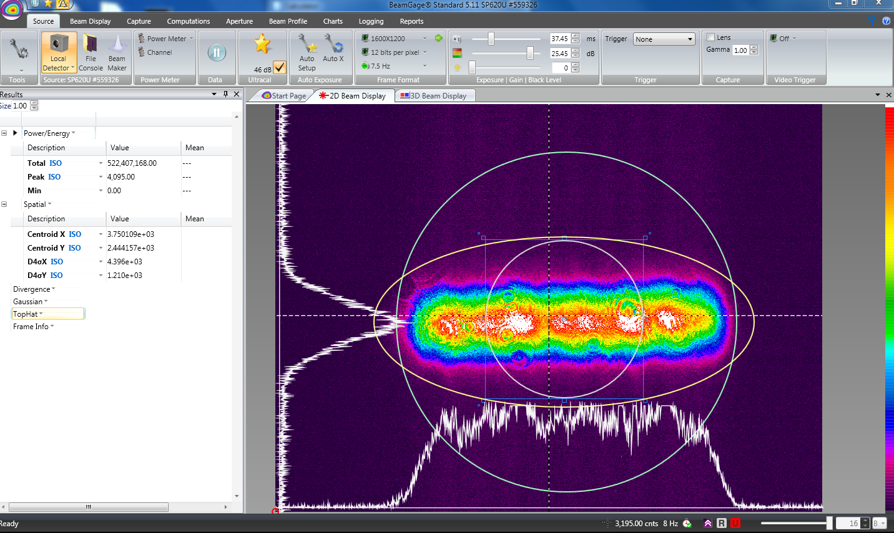
Free Space Amplifier and Beam Shaping
Optical Board layout and beam profiles during preliminary alignment

Slide 21
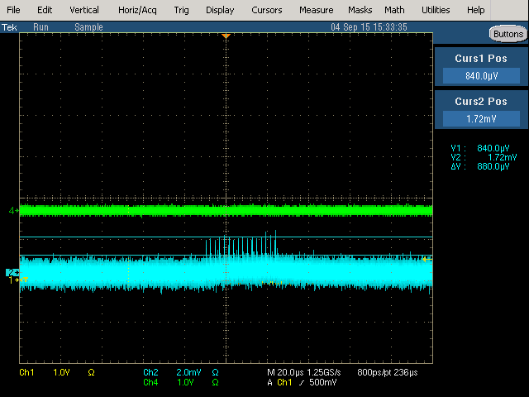
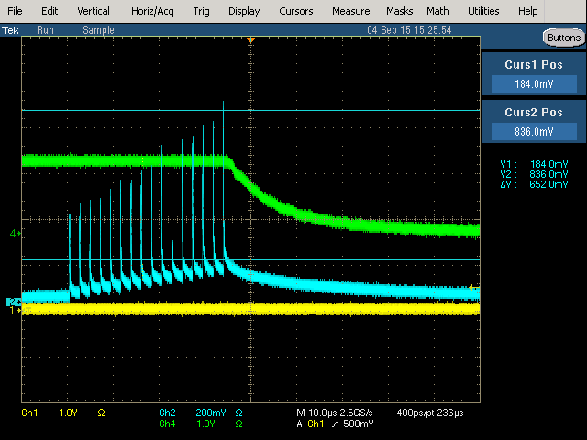
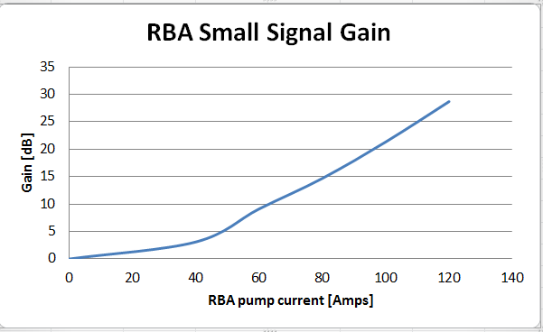
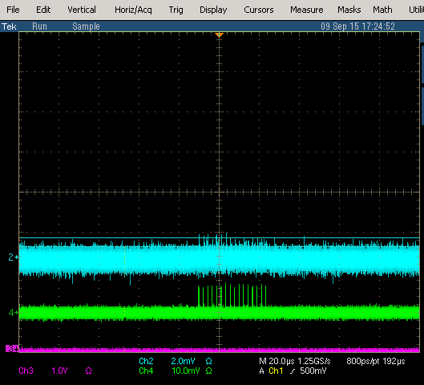
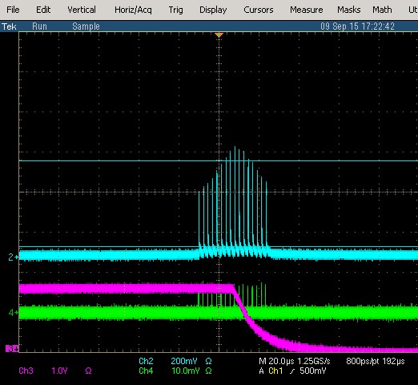
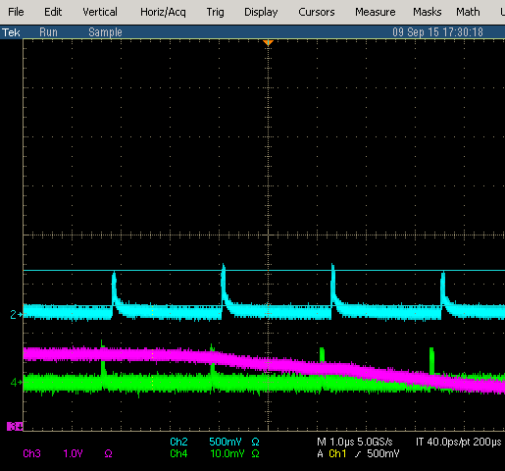
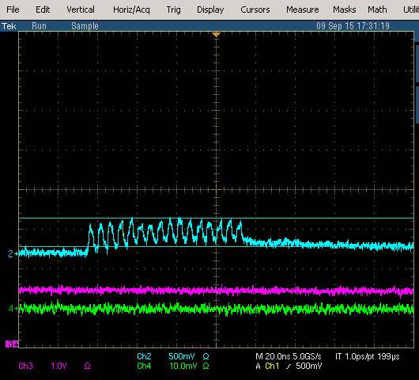
Free Space Amplifier(s)
Two amplifier modules (double pass) REA and RBA
RBA SSG measurement
REA SSG measurement
652 mV
880 uV
120 A
360 mV
Notch
Bunch
440 uV
Zero current
130 Amp
SSG ~ 30 dB for REA

Slide 22


Beam Shaping Optics
Due to
  restricted horizontal aperture in optical cavity
  Large vertical H- beam size
  And desire to neutralize “all” ions in the bunch (long & trans.)
  We chose to generate a temporally and spatially uniform (roof-top)
Refractive beam shaping optics
  Made a nice roof top profile over a short distance
  Couldn’t transport roof-top profile required
  distance
Developed new technique for generating & transporting roof-top profile (i.e. the Beam Stacker)

Slide 23






Beam Stacker
Vary beam input sigma

Slide 24

Transport of roof-top profile
Comparison of transport of roof-top profile from Beam Stacker (left) and Pi Shaper (right)

Slide 25

Optical Cavity

Slide 26








Optical Cavity
First cavity installed Oct 2014
test laser to monitor change in reflectivity
No significant change noted due to beam
Used for Demonstration Experiment
RFQ Flange
Version 1 Cavity
removed
Last 4 months of mirror monitor
Cavity replaced July 2015 with upgraded design
Adjustable
Mirror
Installed
Fixed mirror
From back
US (RFQ side)
DS (quad side)

Slide 27





Setting up Optical Cavity in the lab

Slide 28
Laser Instrumentation
Optical BPM
  Primary use for steering laser into Optical cavity
  Used in conjunction with a pair of piezoelectric controlled mirrors
Fast photodiode detectors
  Free Space (EOT-3000) 2.1 GHz bandwidth
  Monitor pulse structure in the free space section
Video monitors
  Monitor profile of laser profile entering optical cavity
  Monitoring profile of laser on dump exiting optical cavity
  Need to integrate these into transport & dump enclosures
Photodiode monitor (slow)
  Monitor the laser power in CW section of the laser system
  Have circuits and design & most components (need to build)

Slide 29





Optical BPM
Video monitoring of IR on OBPM
Nonlinearities due to piezo
Stability few microns
OBPM boards

Slide 30




Laser Path and Piezo mirror control
cavity
OBPM
piezo

Slide 31

Electronics Rack
Lambda Supply for RBA
RBA Controller
Lambda Supply for REA
REA Controller
Linac Laser Notcher Safety Interface Chassis
PriTel (fiber pre-amp and power amp)
Optical Pattern Generator
Photodiode Monitor Chassis (future)
Expansion chassis (AWG, KA, DAQ, Freq, Mult)
Computer
UPS

Slide 32


Software (1)
Laser Notcher System controlled by LabView on a dedicated PC
Communicate with over a dozen individual modules through COM ports or USB, each with different protocol.
Coordinates and controls:
  Optical Pattern Generation
  All amplifiers & equipment
  All timing
  Laser steering
  Diagnostics
Front Panel
OBPM and Mirror Control

Slide 33



Software (2)
COM PORT Settings
Triggers for Pulsed Amp & Data Acq.
DAQ Configuration

Slide 34
Status (1)
Optical Pulse Generation
  Seed source/ Keep Alive/ Modulator – operational
  AWG software – running on test version –convert to operational
Fiber amplifiers
  PriTel
    communications – operational
    Preamp - operational
    Power amp – operational after delivery fiber modification
      LMA gain fiber and pump diodes optimized
      Gain measured to be ~14 dB
      Delivery fiber replacement- settled on fused connection – parts to be ordered
  Optical Engines
    Measured gain to 14 dB
    Had to learn how to handle PCF fiber
    Currently at manufacturer waiting for input fiber
Solid State Amplifiers
  Tests of chiller and module controllers complete
  Small signal gain measured
  Ready to re-install and align on optics board for power tests

Slide 35
Status (2)
Mechanical
  Optics Box complete and optics board installed
    currently installed on optics table in lab
    Chiller connections installed
    Need to install
      Grumman power connections
      BPM, video, photodiode, and interlock feedthroughs
  Alignment plate complete
  Prints for transport and dump enclosure and support structure in shop
  Electronics rack
    Clean up wiring
    Install patch panel
    relocate wheels to adjust elevation of laser
MEBT installation
  CDC module installed
  All control, network, and safety cables pulled
  Chiller tubing and manifold support installed
  New floor plate(s) installed

Slide 36
Status (3)
Optics board
  Verify alignment of all components (alignment mode)
  Characterize the 2 -5 and 5-2 mm telescopes
  Install Grumman modules and align
  Optimize beam stacker
  Optimize final vertical telescope and horizontal squeezer
  Install photodiode monitors
Optical BPM’s
  Finalize mounting in transport enclosure
  Install cylindrical lenses and OD filters
  Test with final profile
Peizo mirrors
  Calibrate motions with OBPM positions
Software
  All major devices have been integrated into LabView Control panel
  Optimizing/debugging code
Safety
  SOP signed, safety sign-off for operation

Slide 37
Summary
Presented motivation and goals of the project
Took a whirl wind tour of the laser system and some of the challenges we faced and the resolutions obtained.
We are able to generate and amplify the required uniform temporal pulses to match bunch spacing& length out of RFQ
We have designed and demonstrated neutralization enhancement by a compact zig-zag optical cavity
Several new techniques developed
  Beam stacker
  Optical BPM
We have a very nice design for the transport & dump enc.
We have developed the software required to integrate all the components into an operational system
We have created a mobile Laser Notcher on wheels

