Slide 1
Booster lattice measurement and correction with LOCO
C.Y. Tan & K. Seiya
Booster workshop
23 Nov 2015

Slide 2
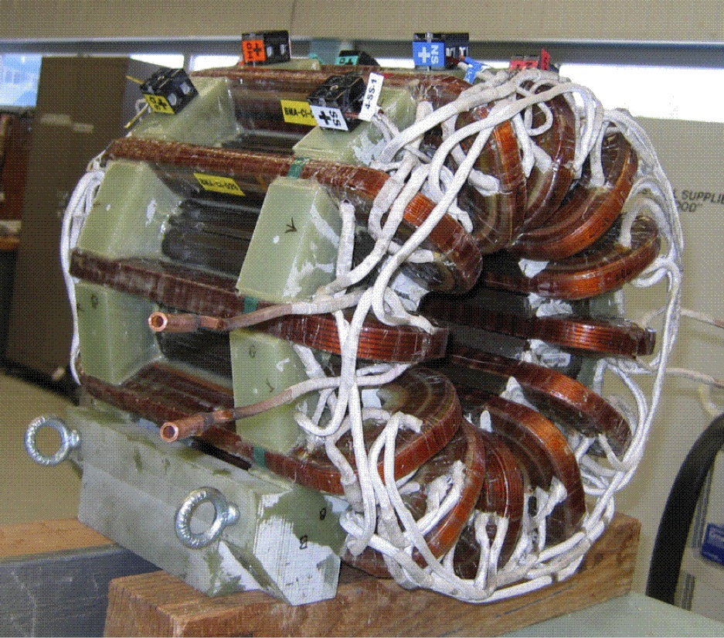
Introduction
People involved
  C.Y. Tan, K. Triplett & K. Seiya
Motivation
  To measure and correct the Booster lattice
Goal
  Control the Booster lattice
    Set good working points
Use corrector quad and skew quad packages that were installed in 2009
  Corrector package contains horz vert dipole, normal and skew quads, normal and skew sextupoles.
  Corrector package in between every 24 long and 24 short straight sections (FOFDOOD), i.e. 48 corrector packages.
  Each magnet about 10 ft (~3 m long)
  1 FOFDOOD cell is 19.76 m long.

Slide 3
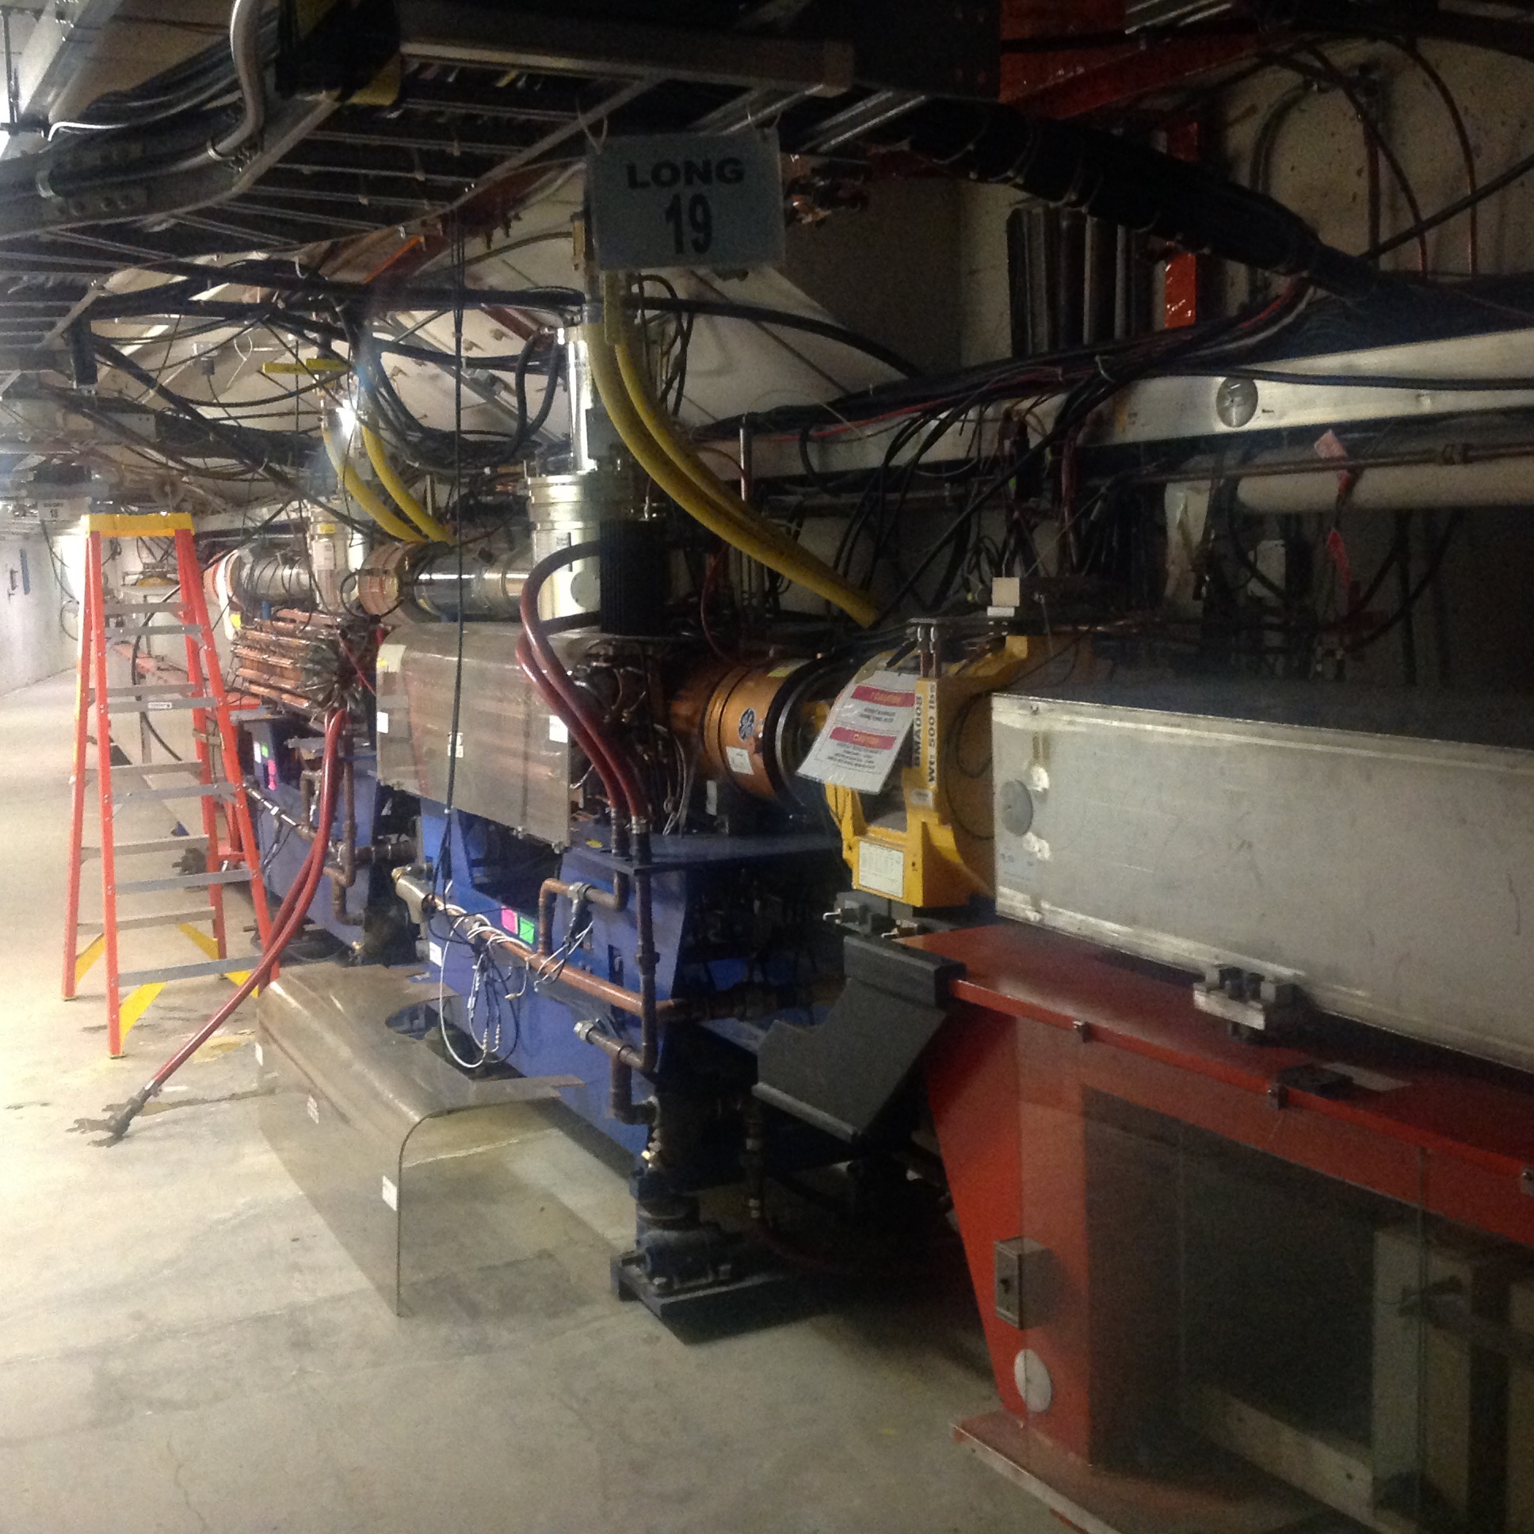
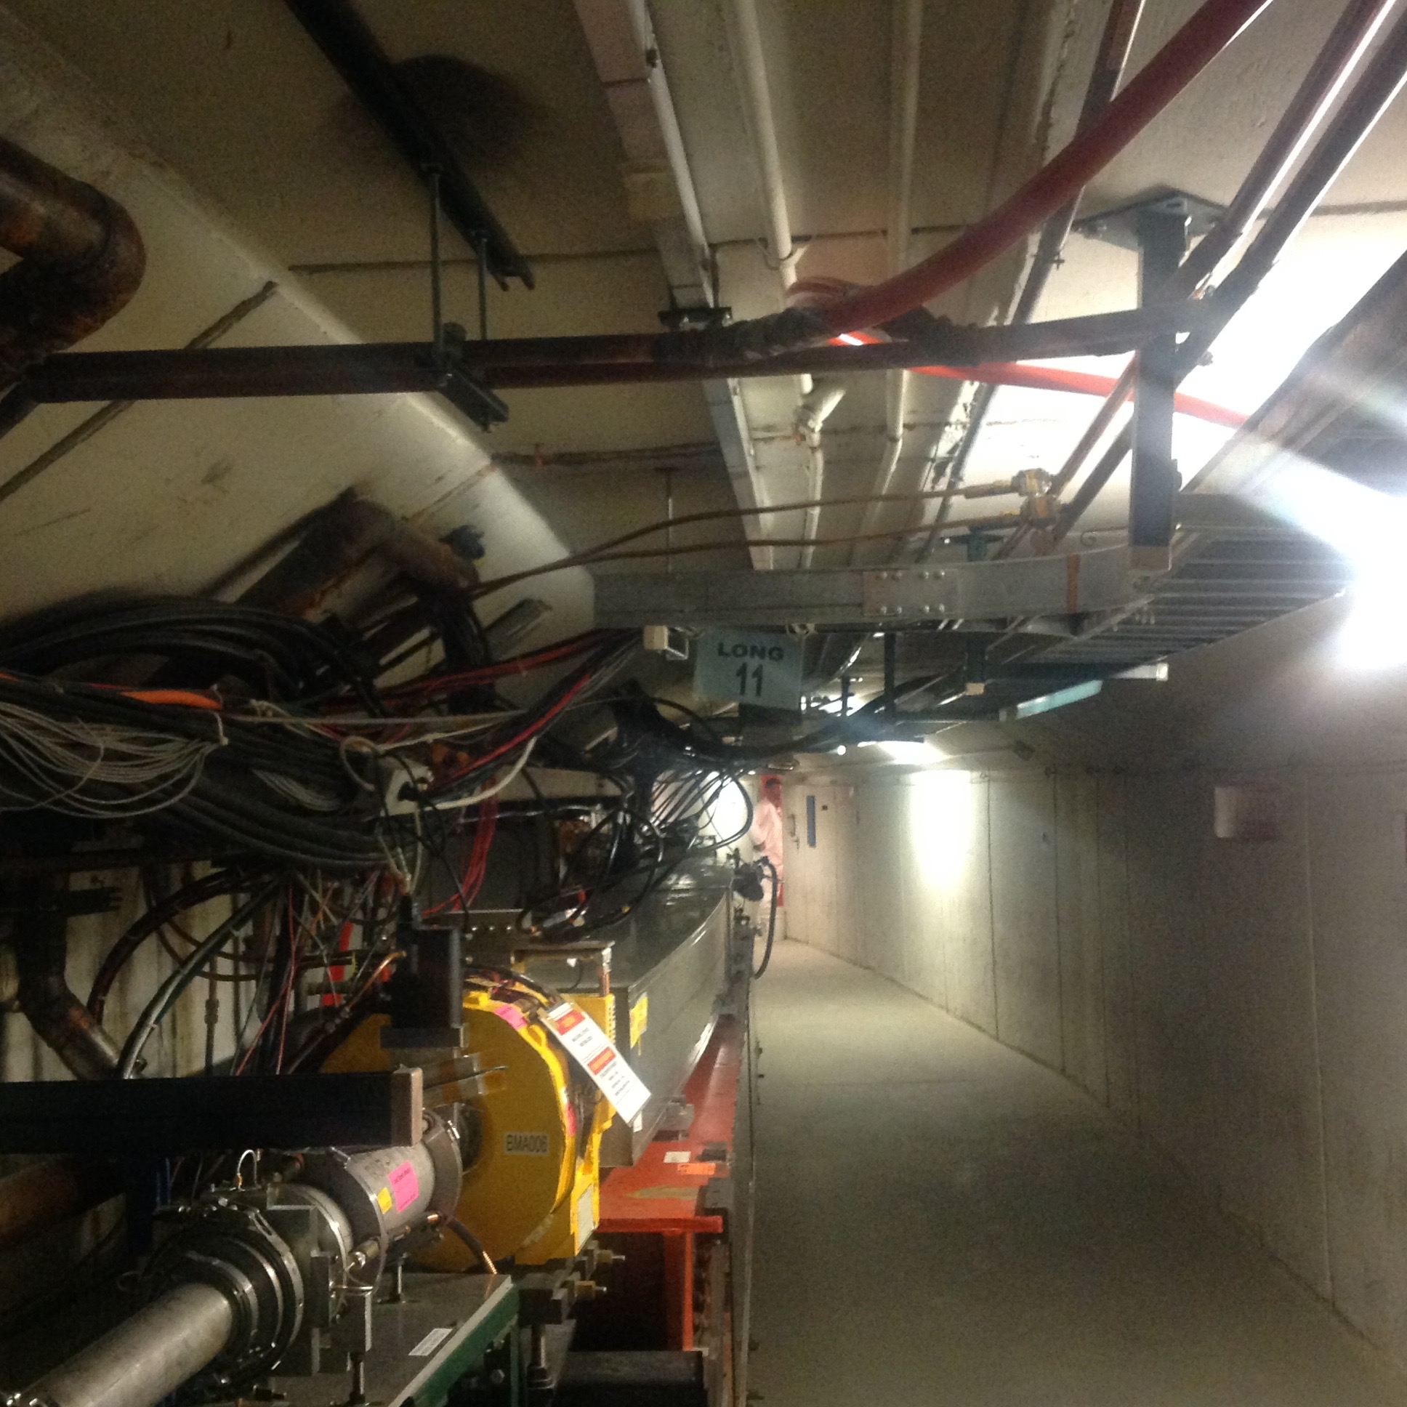
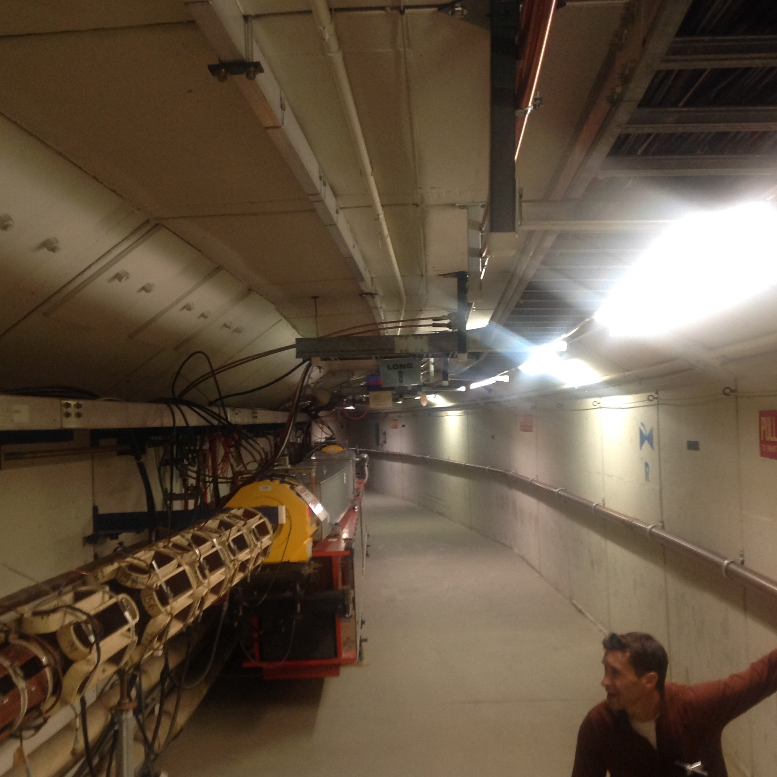
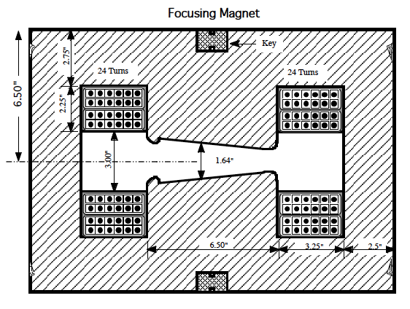
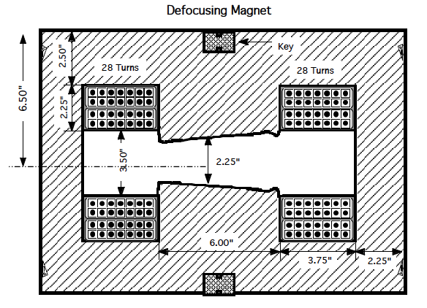
Booster

Slide 4
What is LOCO?
LOCO stands for Linear Optics from Closed Orbit
  This method was invented at NSLS for correcting optics in the light source.
  M. McAteer and A. Petrenko started this whole business in 2012
    Programs are a collection of ACL scripts, TCL scrips, Mathematica programs, Octave programs and Elegant Lattice files.
  I started working on this around March 2013
    Cleaned up code. Moved everything to C++. Parallelized the code to make it MPI compliant.
    Moved lattice to MADX (now official lattice of Booster) from Elegant.
The idea
  Measure the closed orbit with all the bpms when a 1 bump is introduced. Kicks must be small!
  Every dipole corrector is used sequentially and every BPM is used to measure beam position
    The collection of slopes dx/dkick is called the orbit response of the beam. IMO, this is the brilliance of this method.
  From the orbit response, the Twiss parameters and other parameters like corrector quad strengths, bpm calibrations, rolls can be calculated.

Slide 5

What is LOCO? (cont’d)
From these Twiss parameters, the “measured lattice” can be calculated.
  The solution comes from a non-square matrix equation:
  This solution that generates the “measured” lattice is probably not what we want
  Corrections are calculated from the measurement and loaded into the corrector quads QL and QS.
  LOCO is used to measure the lattice again and hopefully the optics get closer to the ideal.
Quad strengths, rolls etc.
orbit response error between model and measurement
slope of orbit response as a function of quad stregnths, rolls, etc

Slide 6
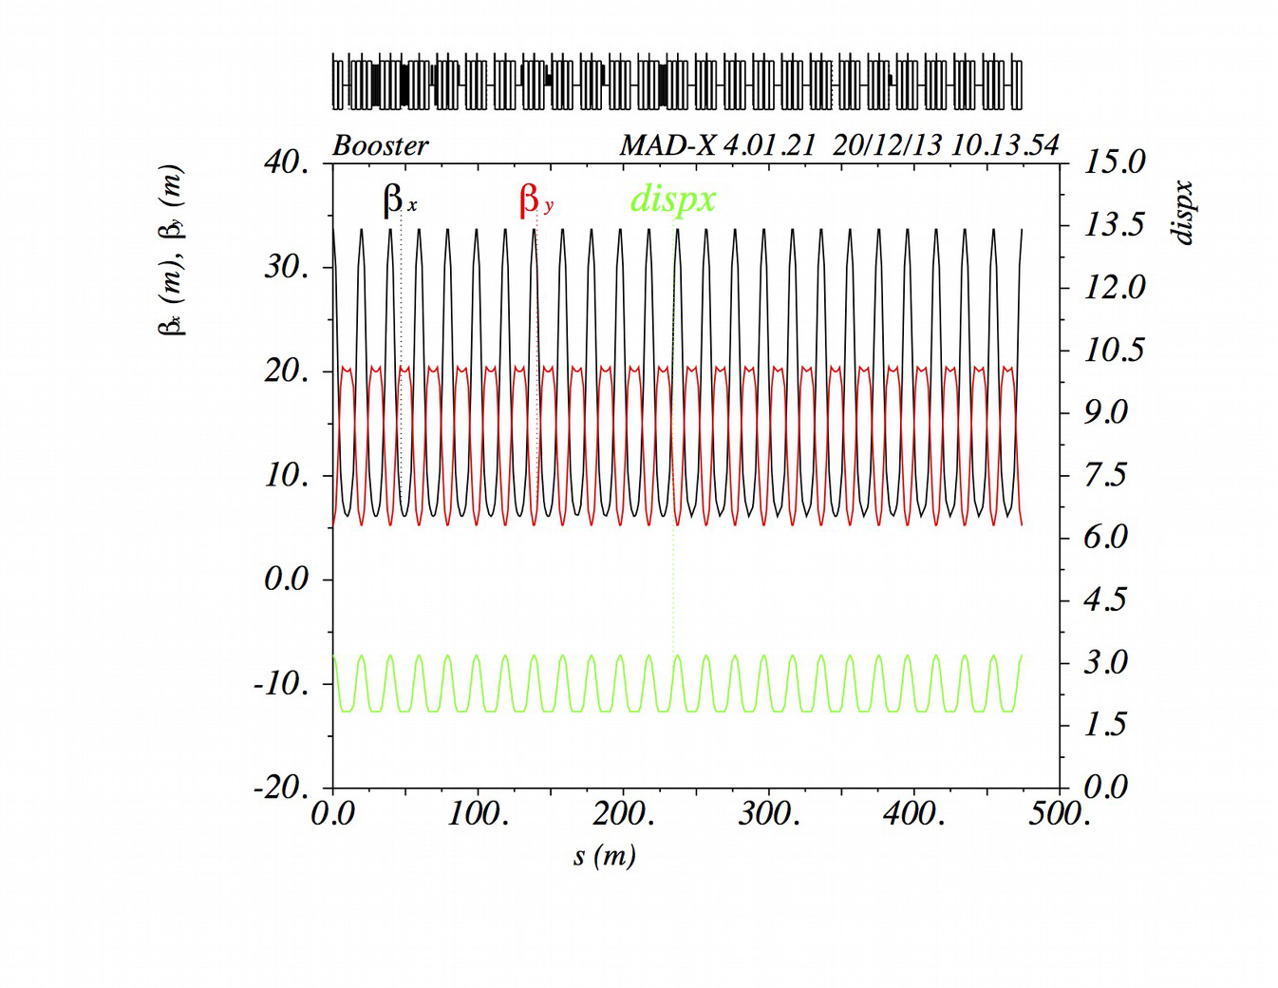
Ideal Booster lattice
Ideal lattice is when QL and QS have zero current.
However, in real Booster, QL and QS are not zero.
Pseudo quads (QLerr, QSerr) are introduced that sit on top of every QL and QS and LOCO uses these quds to find the errors in the lattice.
In the perfect Universe, (QL-QLerr) = 0 and (QS-Qserr)=0
LOCO depends critically that the “reference” or “ideal” lattice is indeed correct. If not, the result is garbage.

Slide 7
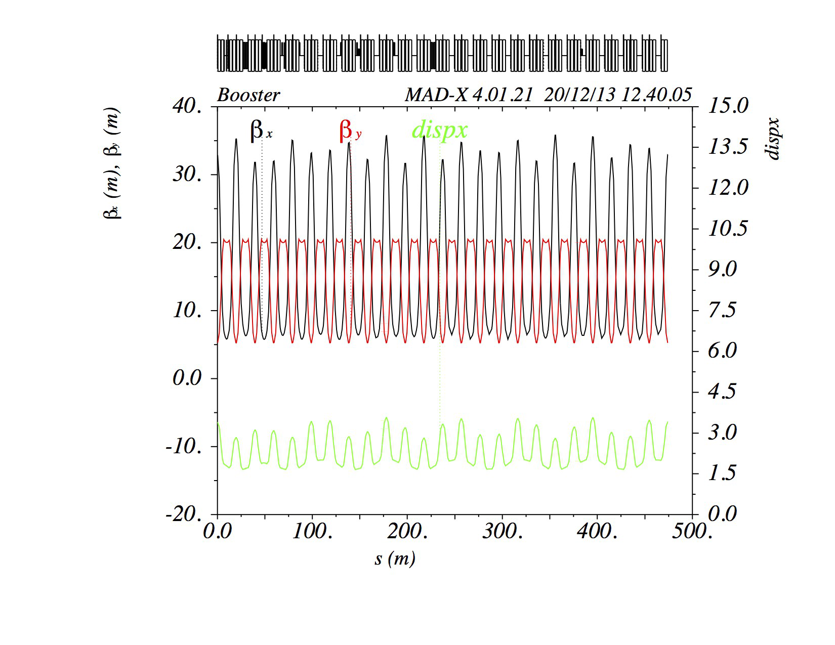
Extraction dogleg introduces lattice distortions
After fitting to get QSerr and QLerr, we will get a distorted lattice and not the ideal lattice in real life because of the effects of the dogleg.
Therefore, once we get the QSerr and QLerr, we fix this distortion by hand with a subset of quads in the dogleg region.
Note: This effect is greatest a injection but diminishes as the beam energy increases.

Slide 8

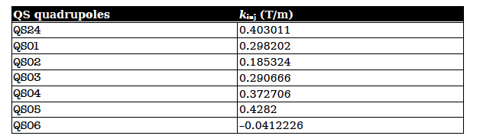
The correction
Not perfect but good enough
Lower the strength of these quads as the momentum increases using inverse proportionality.
This method was suggested by V. Lebedev.
Corrections are all in the horizontal plane.

Slide 9
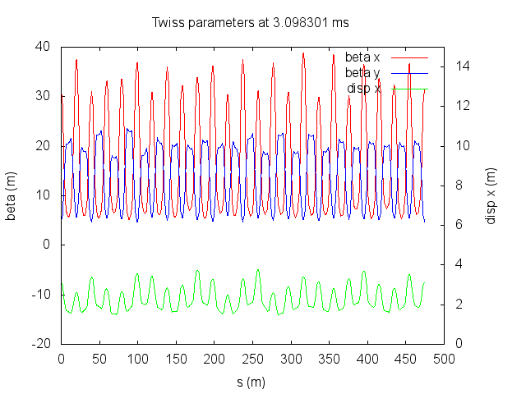
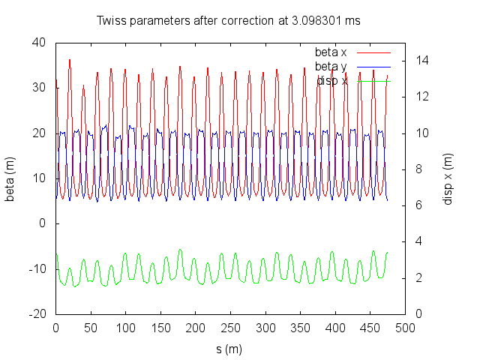
Measurement and correction
Measured before
Measured after
Booster is divided into 32 break points and at each break point, orbits are measured 6 times to get a good mean and standard deviation of the orbit. There are 96 dipole correctors, and for each dipole three 1 bumps are applied. Orbits are measured from 96 bpms.
It takes about 2 hours to collect the data.
LOCO is applied for each break point and by inverting a Jacobian of 4.3e6 elements! Results of 32 break points take 15 minutes on 30 processors using parallel processing.

Slide 10
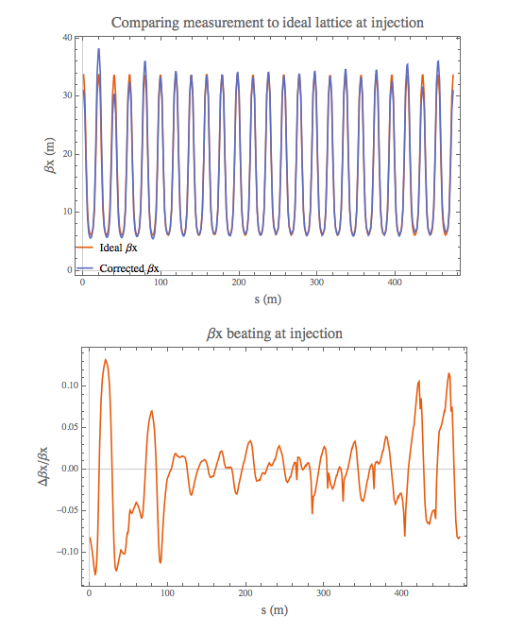
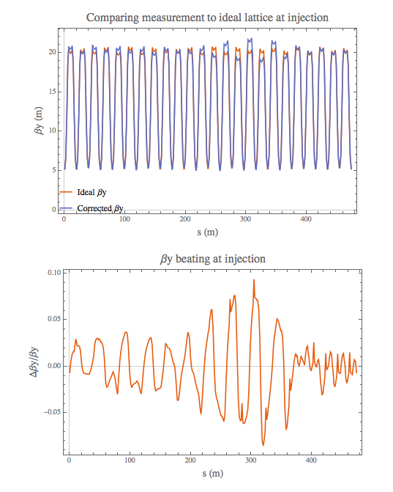
At injection

Slide 11
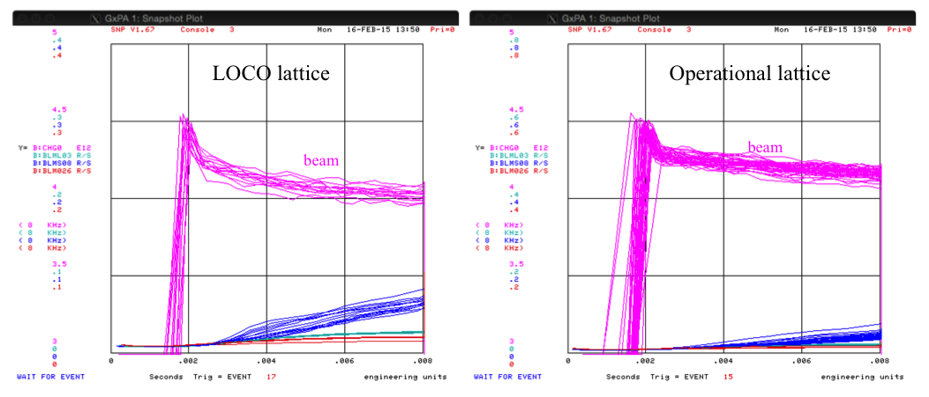
Does it work?
After an enormous effort in tuning Booster with the new lattice, we could *never* fix the initial drop in intensity. There is always a 2% difference between LOCO and operational lattices.
Why????

Slide 12
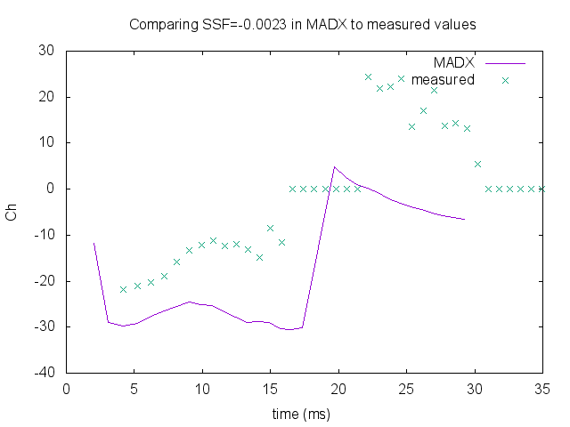
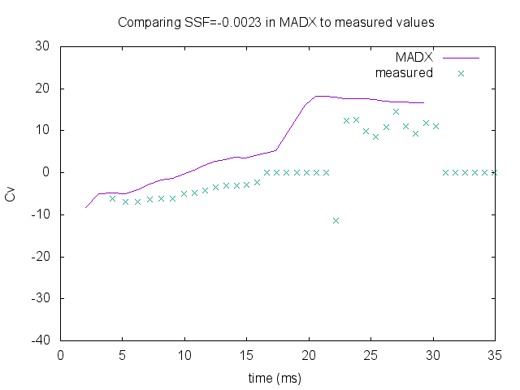
Indication of problems
We found that using the calibration values of the sextupoles in the MADX lattice file to calculate the chromaticity does *not* match the measured values by a lot!
A lot of tracking down old magnet measurements of the gradient magnets to see what the problem is.

Slide 13
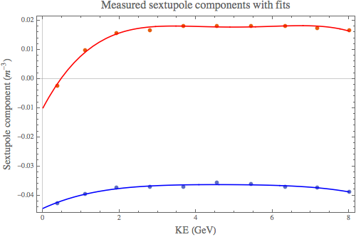
MADX calibrations are wrong!
MADX lattice file originally parametrized as constants:
ssf = -0.0023 m⁻³ and ssd = -0.0426 m⁻³.
Clearly incorrect!
Reparametrized as function of ke:
ssf= -0.00992918 + 0.024842 x - 0.00796048 x² + 0.00108966 x³ -
0.0000539123 x⁴
ssd=-0.0444353 + 0.00605359 x - 0.00172891 x² + 0.000228775 x³ -
0.0000120267 x⁴
Measured sextupole components from “Fermilab Booster Magnets Sextupole Components”, A. Drozhdin, J. DiMarco, R. Tomlin, October 31, 2003.

Slide 14
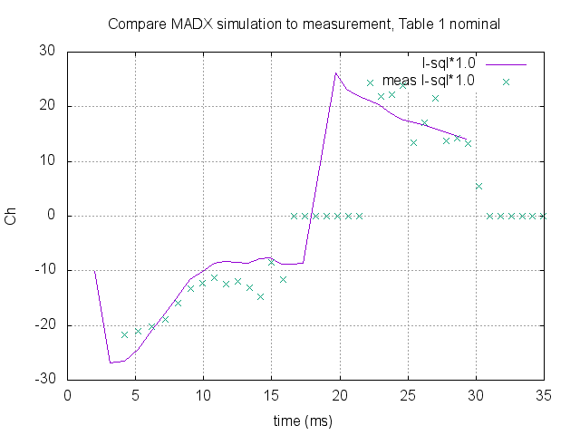
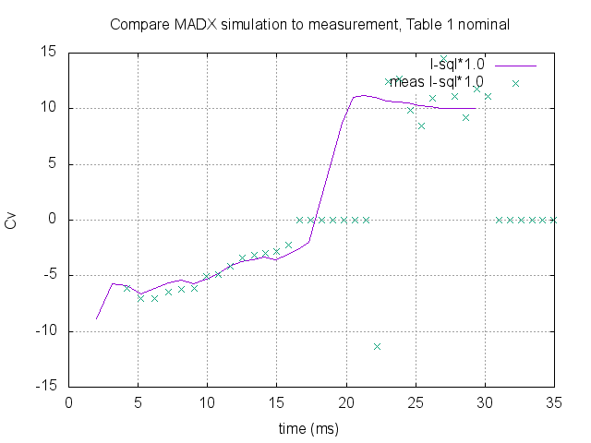
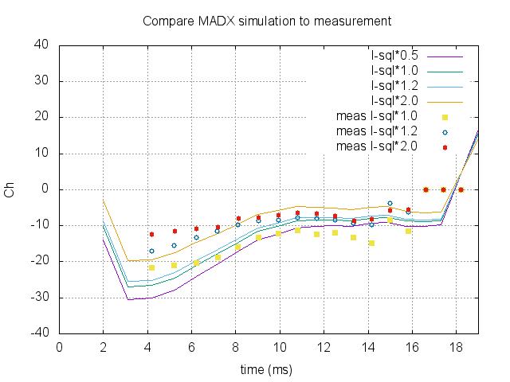
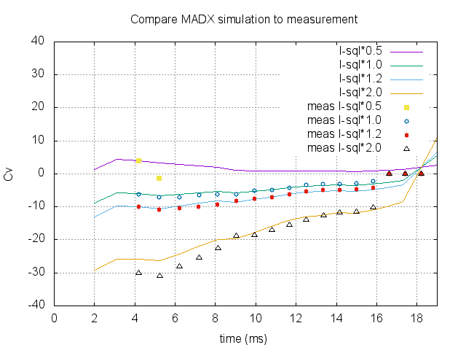
Results with new sextupole calibrations
Results clearly a lot better, especially vert chroms. However, not perfect in horz. Measurement error?

Slide 15
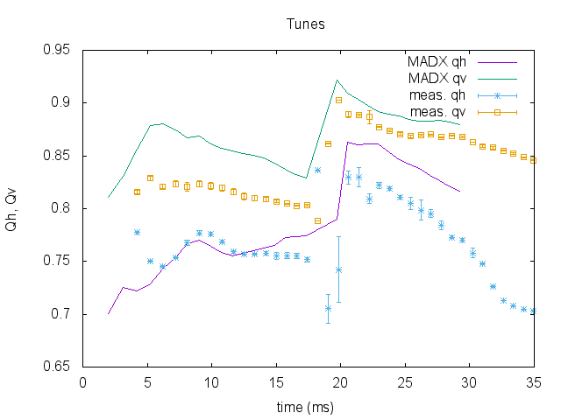
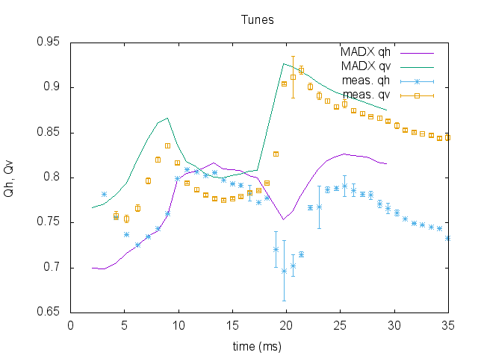
What about quad calibrations?
Again, it looks like we have a similar problem, bad tune prediction.
Again, K1 in MADX file uses one value in the gradient magnets.
D: -0.0577069 m⁻²
F: 0.0542195 m⁻²

Slide 16
Measured K1 values
hysteresis
~0.3%
~0.5%
Notice that the spread is very small, but …

Slide 17
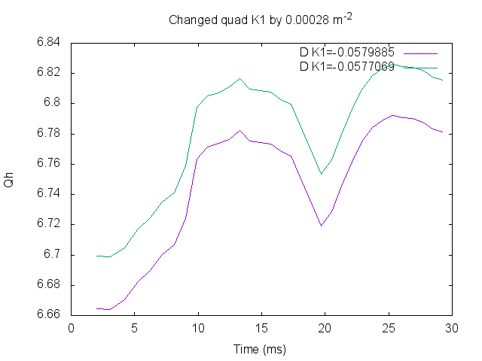
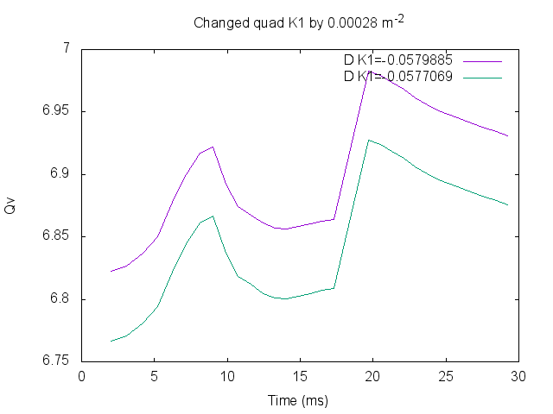
Small change to K1 values have a huge effect on tunes
0.05
0.04
Dramatic changes in tune by just a 0.5% change in K1 strength!

Slide 18
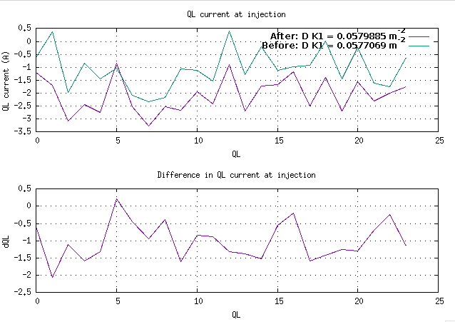
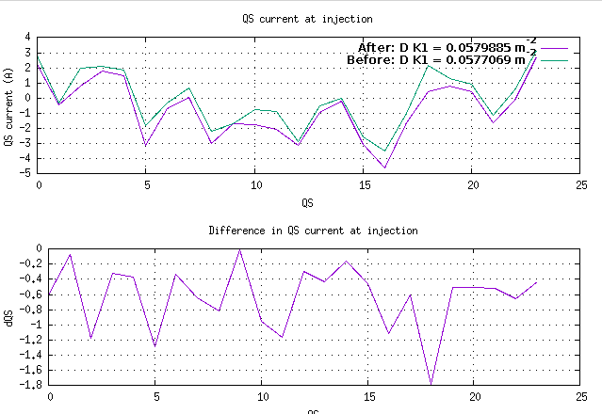
Effect on QL and QS
There are large effects in QL and QS currents with a 0.5% change in D K1. (Note vertical scales are different in both graphs) Can change between ~0 A to 2 A.

Slide 19
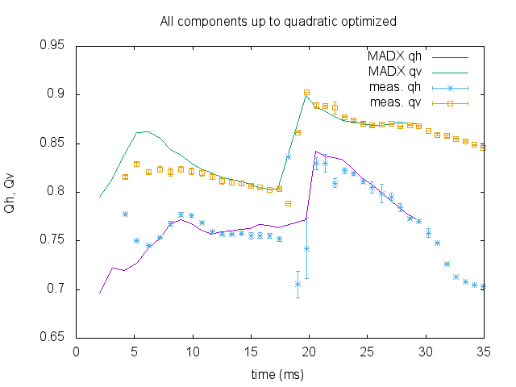
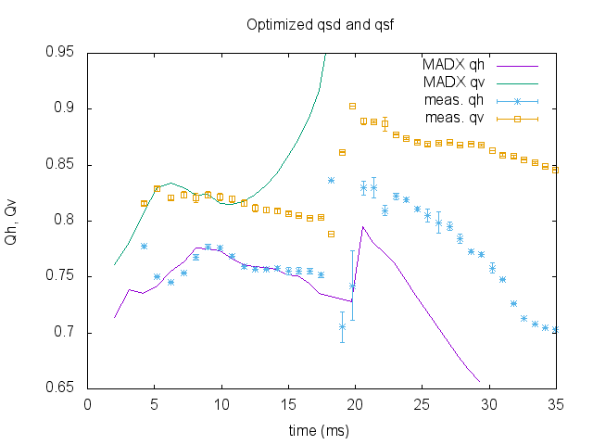
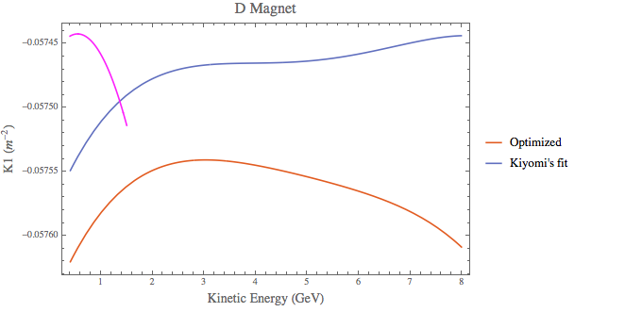
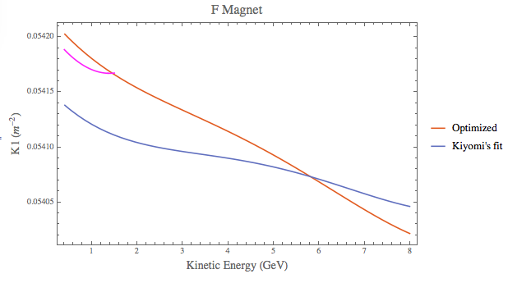
First pass at fitting measurements to K1 calibrations
Doesn’t fit well
Discontinuous between the two fits. The fits do not predict the tunes very well below 1 GeV.
rescaled, measured k1 values

Slide 20
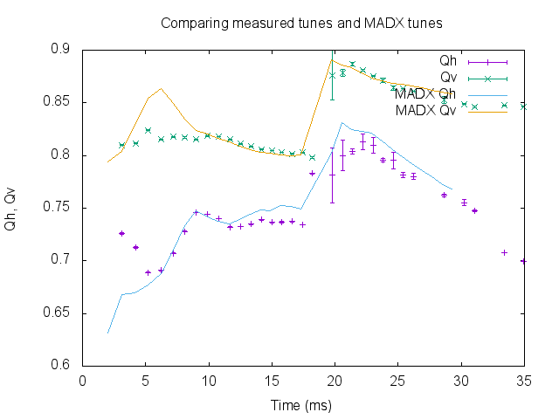
Other observations
K1 fits can predict tunes quite well above 1 GeV!
Data taken on 13 Nov 2015 using K1 fits from 24 June 2015.
Radial position of the beam is moving and thus dp/p is not zero. Chromaticity shifting tunes?

Slide 21
Conclusion
More work to figure out if better handle of K1 values help with getting new lattice to have the same or better transmission efficiency than the uncorrected, HEP lattice.
  Low energy K1 values where the concern is.
    Temporarily fudge it?
LOCO solution is *not* unique because the problem is clearly over-constrained. Is there a better solution for the minima.
Investigation continues …

