Slide 1
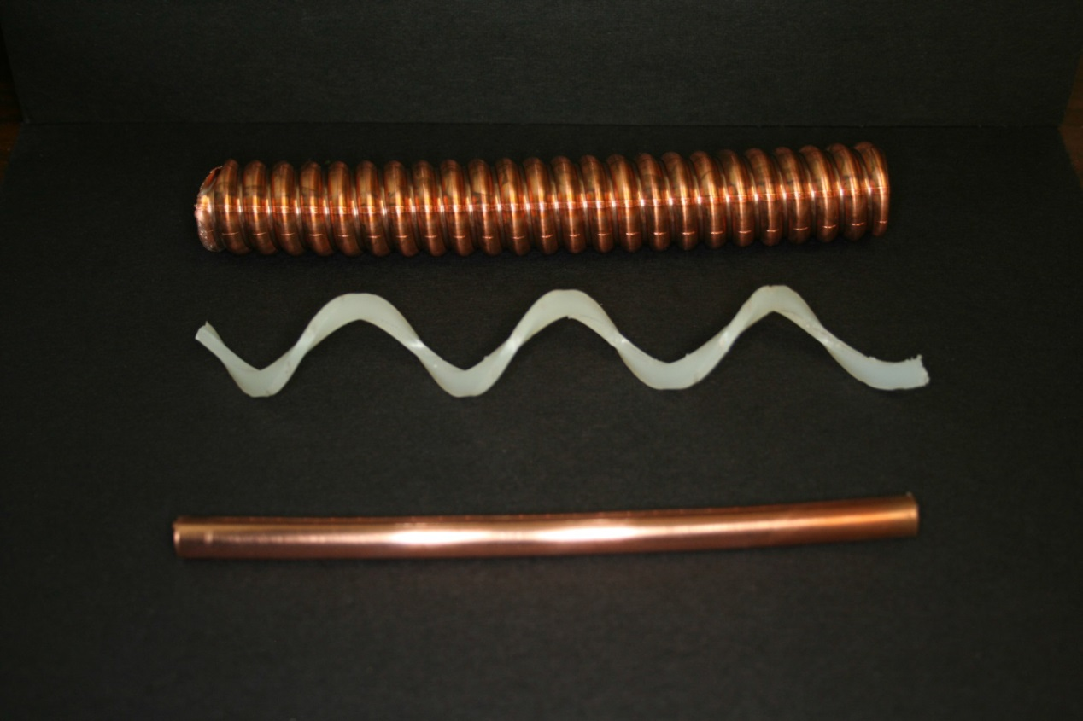
Booster Losses, TLMs and limits
K. Gollwitzer, A. Leveling
Workshop on Booster Performance and Enhancements
11/23-24/15

Slide 2
TLM status at Booster
Total Loss Monitors have been installed at Booster
Purpose is to eventually replace chipmunk array (48)
Driven by the possibility of creating injection losses virtually anywhere in the Booster
High strength correctors
8 detectors
200’ long
Each detector covers 3 periods
Response in units nC/min
TLMs are actively measuring losses since early in 2015
System approved for use as a credited safety system in June 2015
System interlocks inactive at this time
Awaiting completion of shielding assessment process

Slide 3
TLM characteristics
Simple ion chamber with electrometer
No energy resolution
No beam loss position information
No machine timing signals
Records integrated charge over a fixed period of 60 seconds
TLM system trips when 15 minute allowable charge limit is exceeded
Time weighted average charge limits cannot be exceeded, e.g., by manual resets
See beams doc.db 4679-v1 for development history

Slide 4
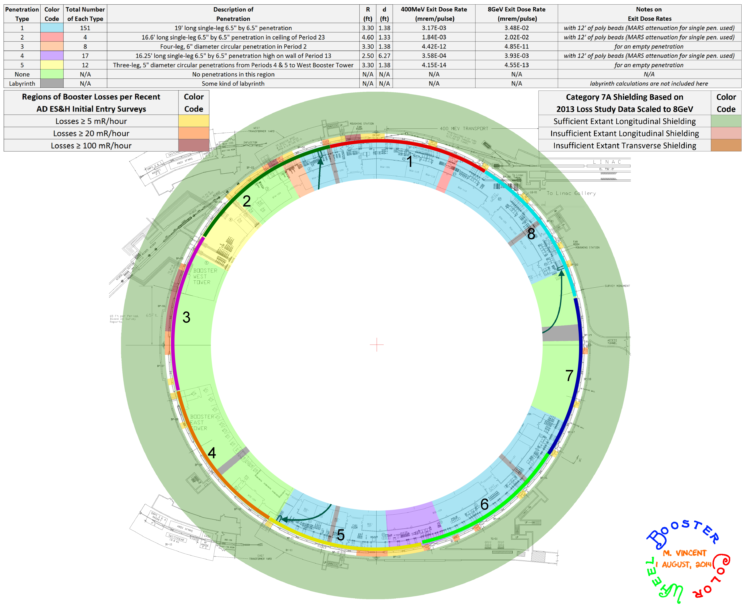
TLM system layout
8 detector systems each cover 3 periods
TLM #1, periods 23, 24,1
TLM #2 periods 2,3,4
TLM #3 periods 5,6,7
TLM #4 periods 8,9,10
TLM #5 periods 11,12,13
TLM #6 periods 14,15,16
TLM #7 periods 17,18,19
TLM #8 periods 20,21,22

Slide 5
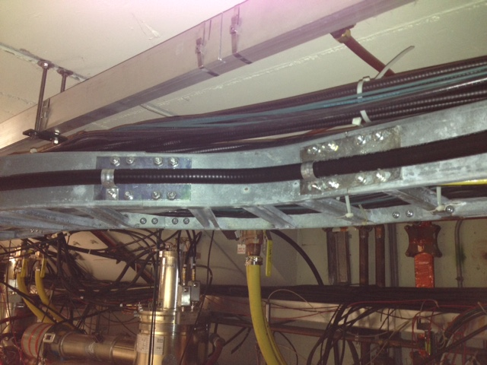
Detector cables are routed along cable tray

Slide 6
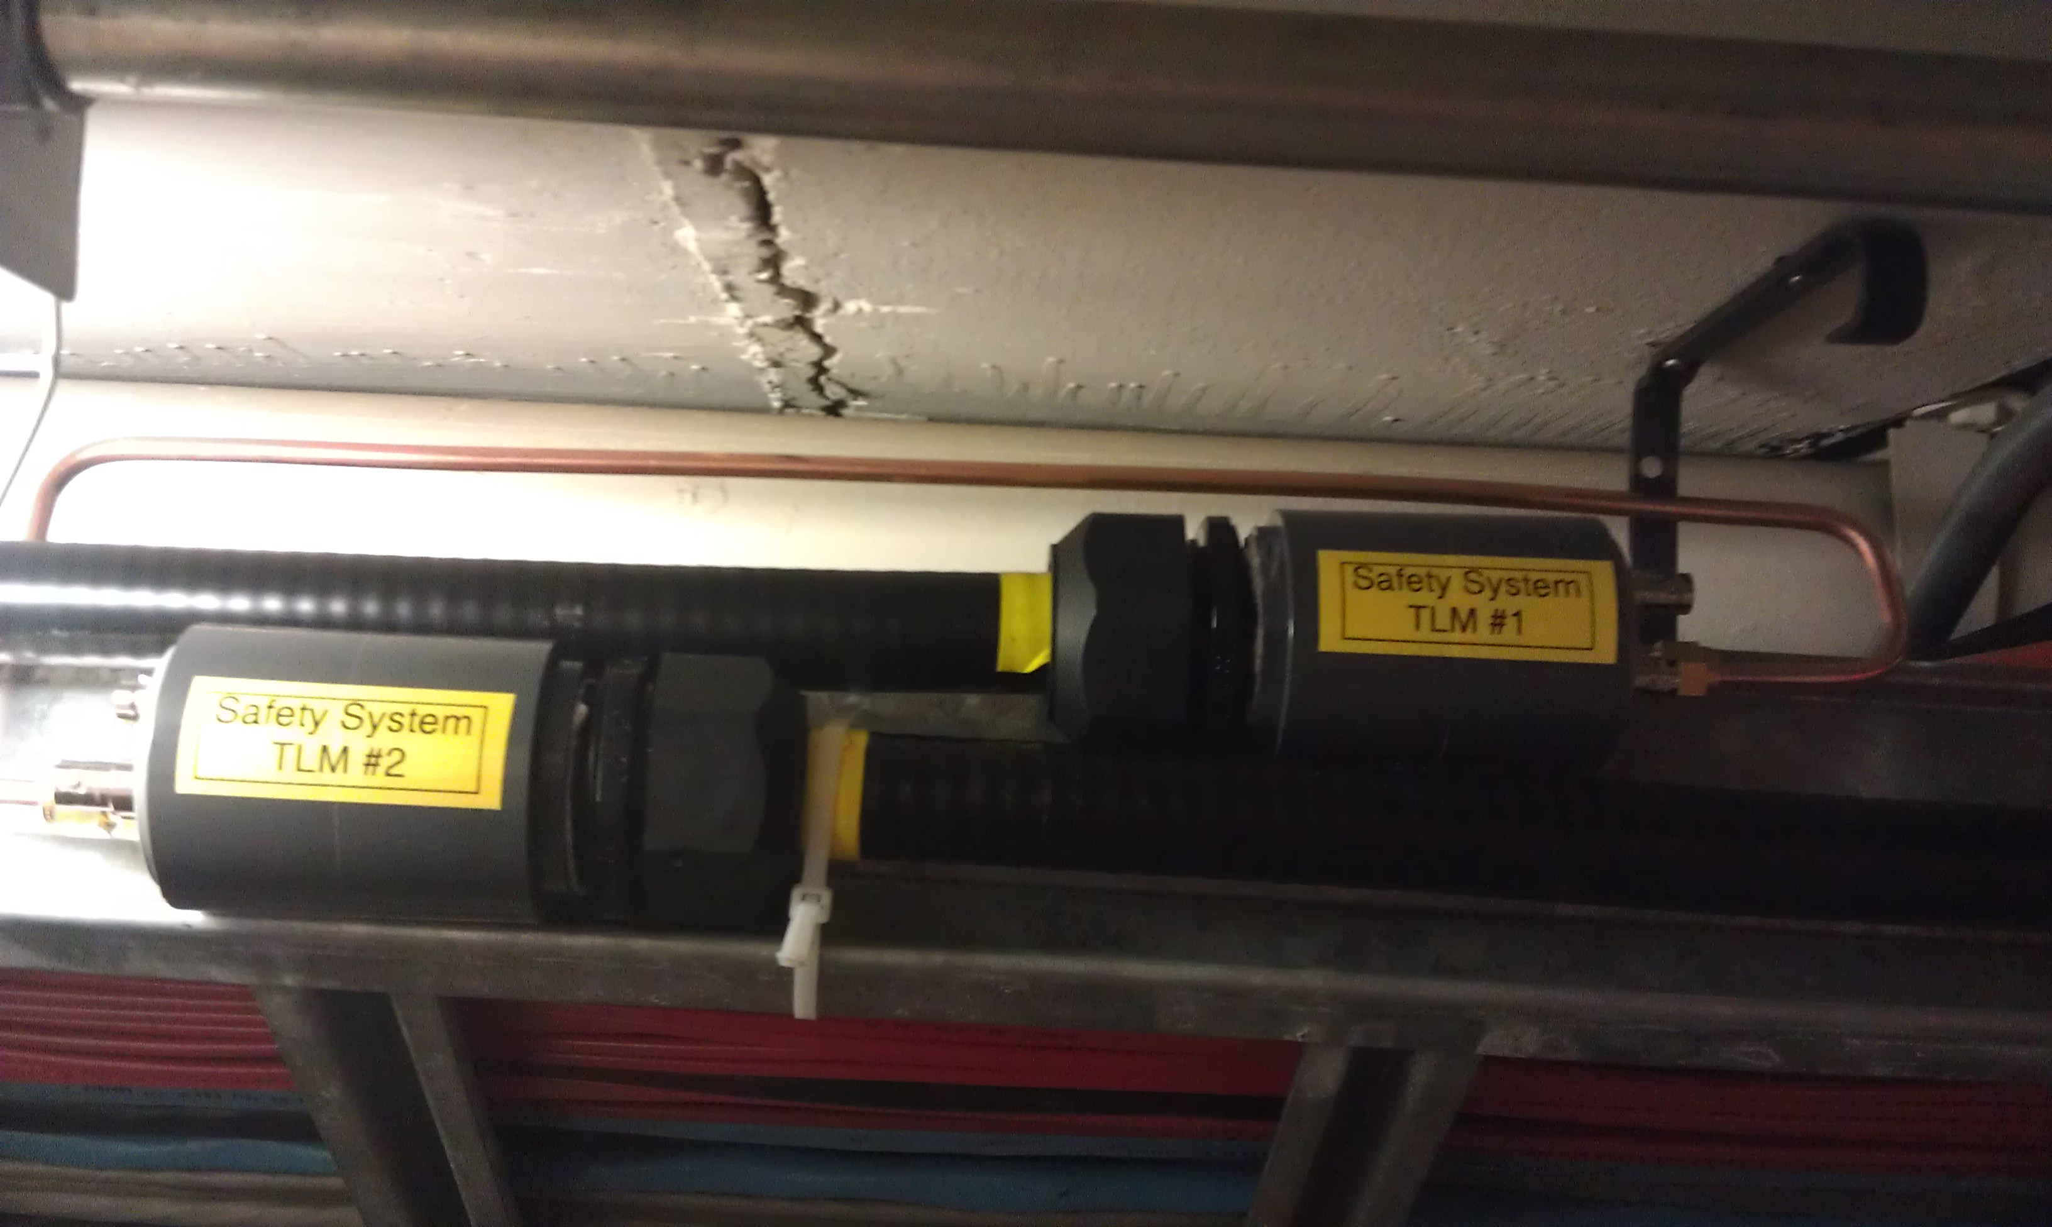
Detector cables overlap where ends meet
Detector gas line jumper

Slide 7
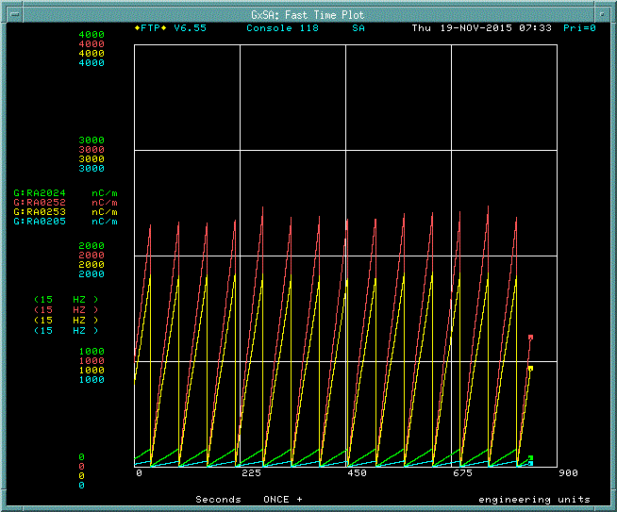
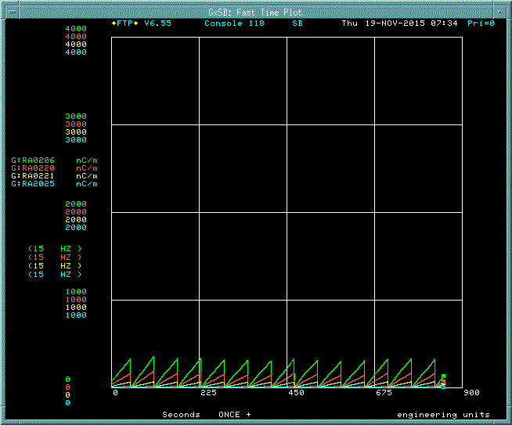
TLM responses are also ACNET devices
Detectors are listed on D106/Booster subpage/ page 20
Data logger records 1 minute integrated counts
TLMs #1 through #4
TLMs #5 through #8

Slide 8
How are TLM trip limits established?
The TLM response must be correlated with:
Chipmunk response to known beam loss conditions
or with Monte Carlo simulation techniques
March 2015 we completed a massive study set
192 low energy loss cases @ 400 MeV
5 cases with high field losses
Beam doc.db 4914-v1

Slide 9
400 MeV beam loss normalized to 2.7E17 protons/hr
1 mrem/min on shield berm @ short 11

Slide 10
8 GeV beam loss normalized to 2.7E17 protons/hour
20 mrem/min @ short 4 (buried detector)

Slide 11
8 GeV beam loss normalized to 2.7E17 protons/hour
10 mrem/min @ long 4 (buried detector)

Slide 12
TLM beam loss trip level setting
Trip level will be set based upon correlations with chipmunk response for single point beam loss at 400 MeV
Probable range of trip setting will be 3,000 to 3,500 nC/min
For simplicity, use the same trip level for all 8 systems

Slide 13
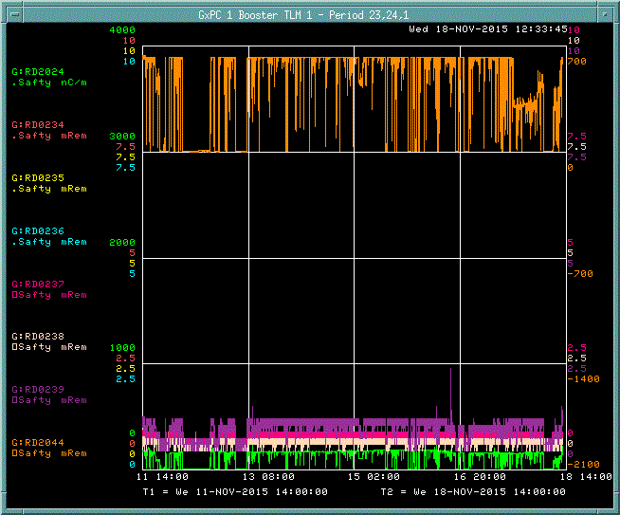
TLM #1 one week response
TLM #1
TLM trip level
Booster chute
chipmunk

Slide 14
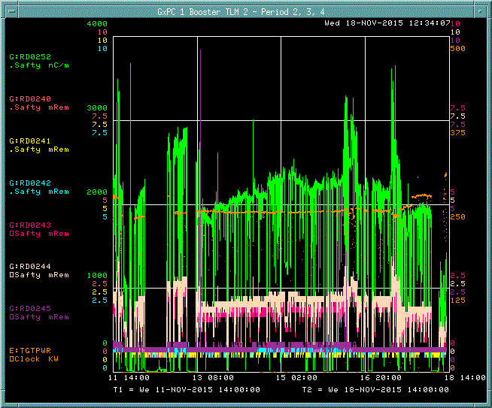
TLM #2 one week response
TLM #2
TLM trip level
NuMI target
power

Slide 15
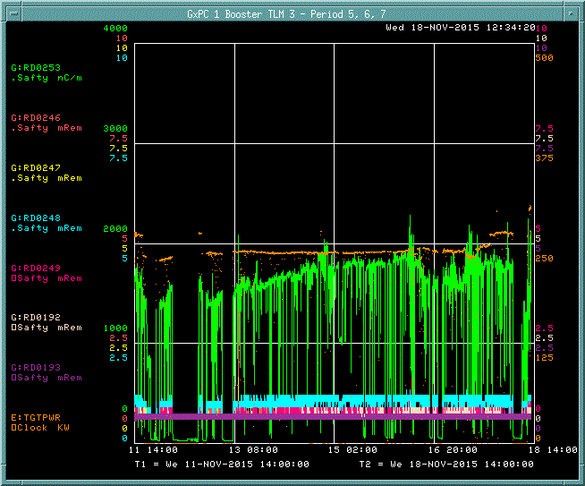
TLM #3 one week response
TLM #3
TLM trip level
NuMI target
power

Slide 16
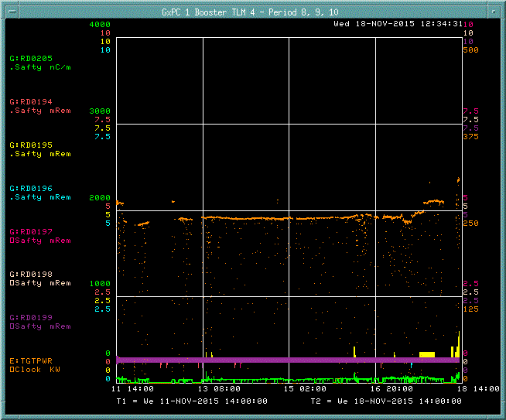
TLM #4 one week response
TLM #4
TLM trip level
NuMI target
power

Slide 17
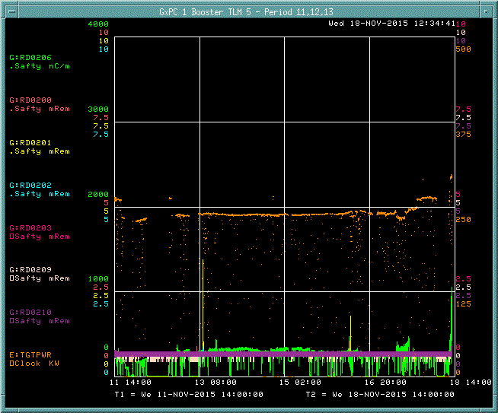
TLM #5 one week response
TLM #5
TLM trip level
NuMI target
power

Slide 18
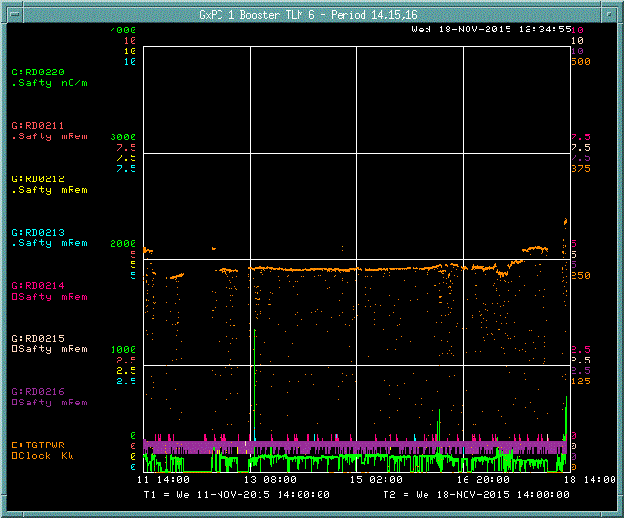
TLM #6 one week response
TLM #6
TLM trip level
NuMI target
power

Slide 19
TLM #7 one week response
TLM #7
TLM trip level
NuMI target
power

Slide 20
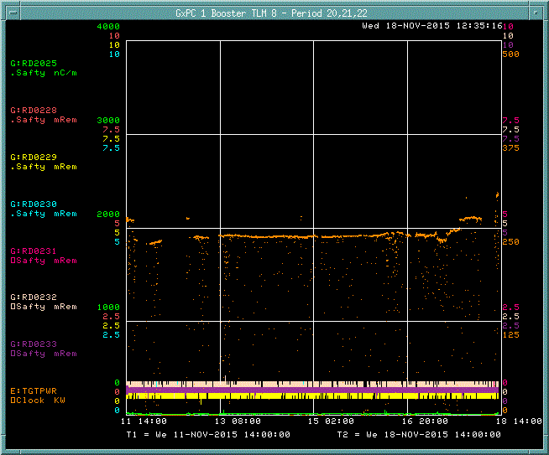
TLM #8 one week response
TLM #8
TLM trip level
NuMI target
power

Slide 21
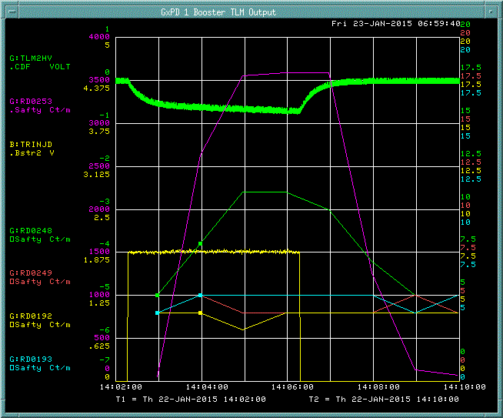
Excessive charge circuit prevents exceeding TLM system dynamic range
Excessive charge circuit monitors voltage of the electrometer integrating capacitor
Excessive charge
TLM #3
Beam intensity
L6 chipmunk
Excessive charge trip level
HS5 corrector ramped to -39 amps at injection causes 400 MeV beam to be stopped in < 1 turn. 1.88E12 protons delivered at 2 Hz for 4 minutes (8.74E14 total protons). A total of 14,935 nC was collected and reported by the TLM system. A rad trip would have eventually occurred in 12 minutes.

Slide 22
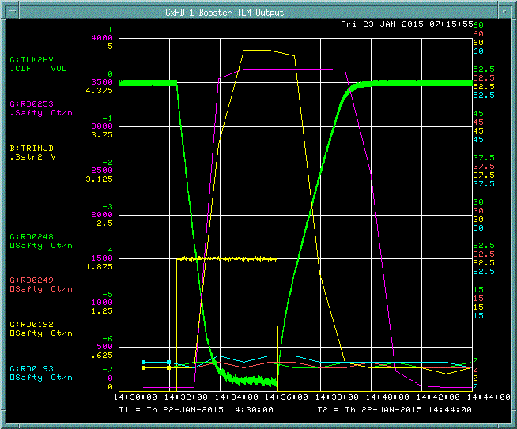
Excessive charge circuit prevents exceeding TLM system dynamic range
Excessive charge
TLM #3
Beam intensity
Excessive charge trip level
L7 chipmunk
HL6 corrector ramped to -39 amps at injection causes 400 MeV beam to be stopped in < 1 turn. 1.88E12 protons delivered at 2 Hz for 4 minutes (8.74E14 total protons). A total of 24,609 nC was collected and reported by the TLM system, just 25% of the total charge that was produced. The excessive charge protection circuit would have stopped beam delivery about 42 seconds after initiation of beam loss. All charge produced would have been collected and recorded.

Slide 23
TLM electrometer internal fault trips inhibit beam
TLM chassis loses power
Motherboard subsystem voltages go out of tolerance
Detector is disconnected from electrometer
Detector bias voltage not sensed
System heartbeat is lost (provided by 83 pA leakage current)
Detector bias voltage falls outside tolerance
Detector gas flow is lost, (nominally 25 cc/min)
One gas system covers the entire Booster
Excessive charge collection
NOTE: Argon/CO₂ TLM supply bottle pressure is on ACNET and provides early warning (weeks) of gas bottle supply condition

Slide 24
TLM detector options for Booster
Since TLM trip levels are based upon 400 MeV beam loss at a single point
Detector cables can be sub-divided to gain operating margin
e.g., TLM #2 could be cut into 3 sections
TLM#2a – Period 2
TLM#2b – Period 3
TLM#2c – Period 4
Additional equipment and cables would be required
Two electrometers
Two rad cards
Two heartbeat resistors
Six RG 58 cables
4 detector end caps
The same trip level could be used
This option is only useful if losses are somewhat distributed among at least 2 periods

Slide 25
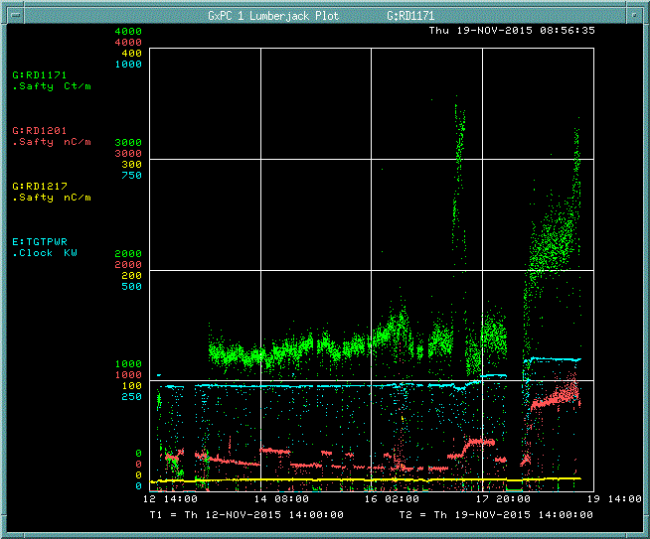
MI and NuMI TLMs one week response
125’ detector at MI 30
142’ detector at MI 52
800’ detector at NuMI
NuMI target power

