Slide 1


Beam Injection and Capture
Chandra Bhat
Fermilab
Acknowledgements
W. Pellico, B. Chase, S. Chaurize,
C. Drennan, F. Garcia, B. Hendrick, J. Nelson*, K. Seiya,
T. Sullivan, C. Y. Tan, K. Triplett, M.-J. Yang
and
MCR Operation Group
“Workshop on Booster Performance and Enhancements”
Fermi National Accelerator Laboratory
November 23-24, 2014

Slide 2
ABSTRACT
The Fermilab Booster is going to play very significant role for nearly next two decades in view of recent accelerator upgrade proposal, PIP-II. In this context, it is extremely important to measure and understand as found properties of the Booster from beam injection to the extraction. In this talk we present results from a recent measurement on momentum acceptance and beam energy spread for multi-turn beam in the Booster. We also discuss results from the early beam injection scheme that has a high potential to increase the beam intensity output from the Booster even before the PIP-II era and also help mitigate beam losses from the Booster.

Slide 3
The Proton Improvement PlP
Goal
The Proton Improvement Plan, when executed, should enable Linac/Booster operation capable of
  delivering 2.25E17 protons/hour (at 15 Hz) safely to the ongoing neutrino programs “next decade or two”.
The Proton Improvement Plan-II Strategy
  Deliver ≥ 1.2MW beam power to the LBNF. PIP-II still uses current Booster
Booster would play a very significant for next two decades
“Yes, Booster is in its Forties. Still it has lot more juice”
  Revisit: Injection, Acceleration, Tran. Xing, Extraction &
S. Henderson,
Proton Source Retreat,
Dec. 7-8, 2010
S. Holmes,
P5/BNL,
Dec 16, 2013

Slide 4
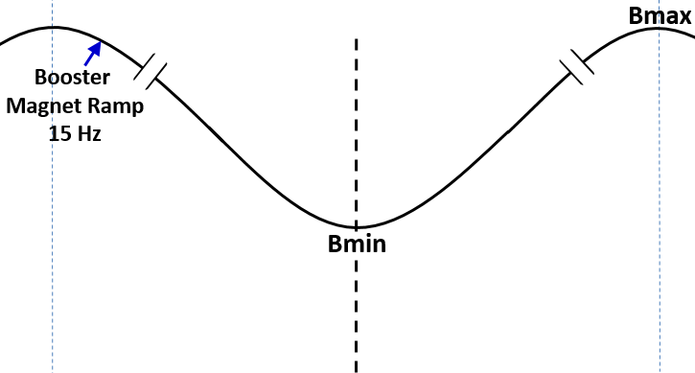
(Schematic)
Beam Injection in the Booster
Current Scheme (CIS)
Begin Inj.
LINAC
Beam
Booster
Booster
Synchrotron
≈ 40μs
injection
Capture & Acceleration using
37-52 MHz RF system in ≈360μs
~60μs-200 μs debunching
Issues: A limited time for Beam Capture & Acceleration. RF manipulations are non-adiabatic ← ~50% emittance dilution, ~7-8% beam loss and large RF power

Slide 5
Beam Injection and Capture
Needs a good understanding of
  Properties of the beam from the LINAC
    Beam Energy Spread, ΔE (full)
    H and V Transverse Emittances
  Acceptance at Injection
    Momentum Acceptance
    Transverse Acceptance
  Beam capture and Acceleration
    Current Operation
    Future Plans – “Early Injection Scheme”

Slide 6
Measurement of Beam Energy Spread
H⁻ beam of 0-40µsec from the LINAC is injected into the Booster
(Booster revolution period To ~ 2.216µsec).
We have measured the ΔE of the beam
  Downstream of the LINAC
    Using the magnetic spectrometer
    Using the multi-wire data from 400 MeV transfer line and fitting to the known lattice
  Partial turn beam in the Booster
  Multi-turn circulating beam in the Booster by creating a notch

Slide 7
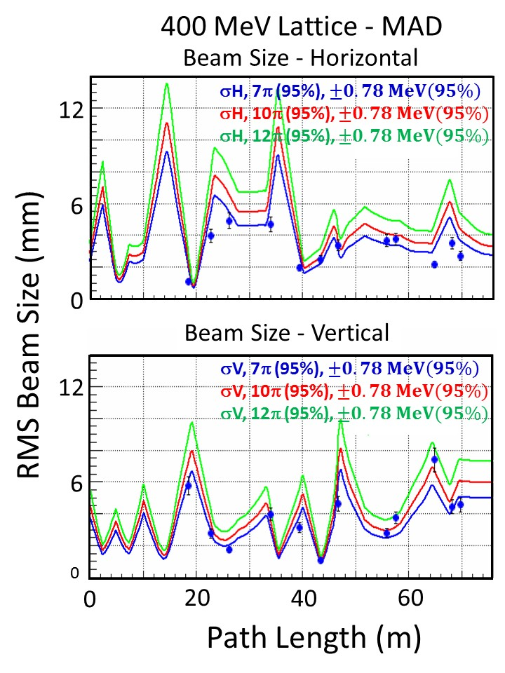
Multi-wire data with MAD overlay
Data is consistent with
ΔE(full) = 1.56 MeV
εH = 7 π-mm-mr
εV = 7 π-mm-mr
But, this measurement does not give info. on multi-turn beam in the Booster.

Slide 8
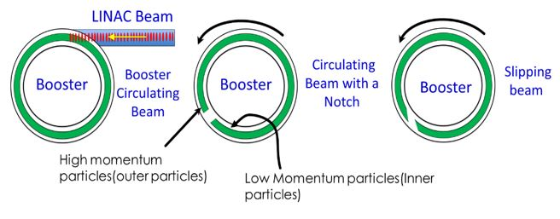
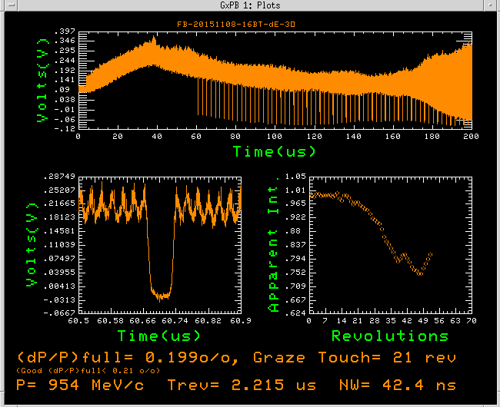
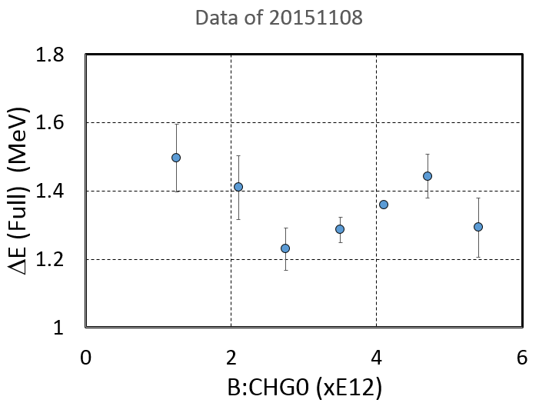
ΔE at Injection on Multi-turn Beam
Wnotch = Width of the Notch
Tgraze = Time for grazing touch
B96
WCM data
Principle of Measurement
(schematic of WCM data)
<ΔE>(full) = 1.36±0.11 MeV
<dP/P>(full)=0.20 ±0.02 %
Beam before
a Notch
At Notch formation
After some Revolutions
High and Low meet
Some more Revolutions later
D
D
D
D’
Notch at
formation
A1
A2
A1
A2
A1
A2
A1’
A2’
A=A1+A2
A=A1+A2
A=A1+A2
A>A1’+A2’

Slide 9
Measurement of
Momentum Acceptance
P
Total Momentum
Acceptance
RF OFF
A
Central Momentum
ΔE
Beam Momentum @Inj
Beam
Bmin ∝ B:VIMIN
B
t
A
Beam loss at injection – small loss at the beginning & total loss later
B
Beam loss at injection – Continuous loss

Slide 10
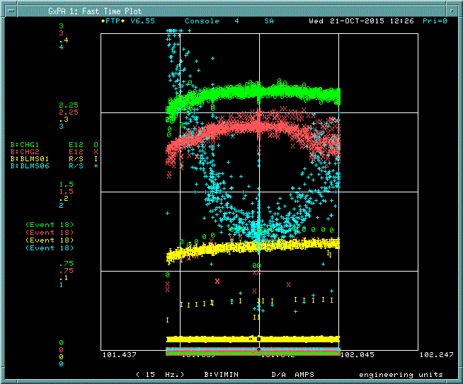
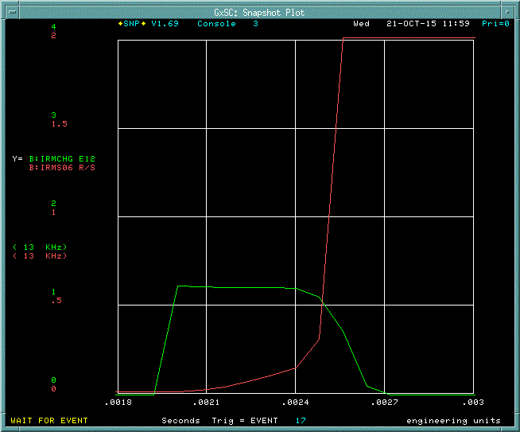
Measurement of
Momentum Acceptance (cont.)
Standard Aperture Scan
Beam at B:VIMIN=101.842 AMP
B
Beam Intensity
Monitors
A
LOSS Monitors
Energy Acceptance of the Booster = ΔE(Δ(Bmin)) + ΔE(full)_{Beam}
= 4 MeV (±0.4 MeV)+1.36MeV (±0.11 MeV)
= 5.4 MeV (±0.4 MeV)

Slide 11
(Schematic)
Beam Capture and Acceleration
Current Operation
Begin Inj.
Vrf
≈ 40μs
injection
Capture & Acceleration using
37-52 MHz RF system in ≈360μs
~60μs-200 μs debunching
Vrf≈0
Vrf≈0
Paraphase Angle
Chandra Bhat

Slide 12
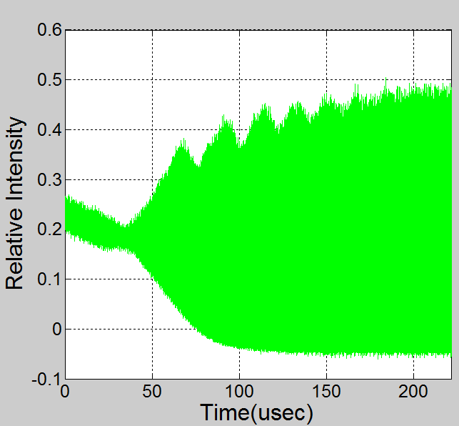
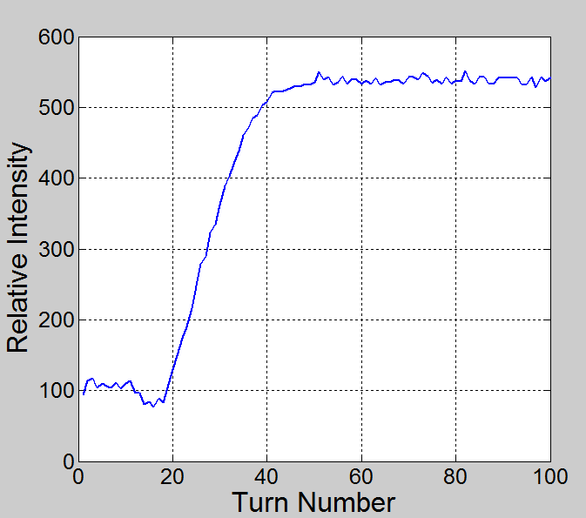
Beam Capture in the Current Operation
Paraphase “ON”
Beam Feedback “ON”
B:TFBON=2130 µs
Accel. Gate “ON”
B:VAPLON=2090 µs
B:VXTPPP=2050 µs
Represents “start” and “end” points of beam capture
WCM Data of 20151107 with 4.5E12p/Booster pulse
Starts Beam Capture
Ends Beam Capture
Beam capture is carried out in ~30 turns (~70 µsec) in the current operation. This is mainly because the beam injection is done close to Bmin and there is not enough time to finish capture before acceleration commences.

Slide 13
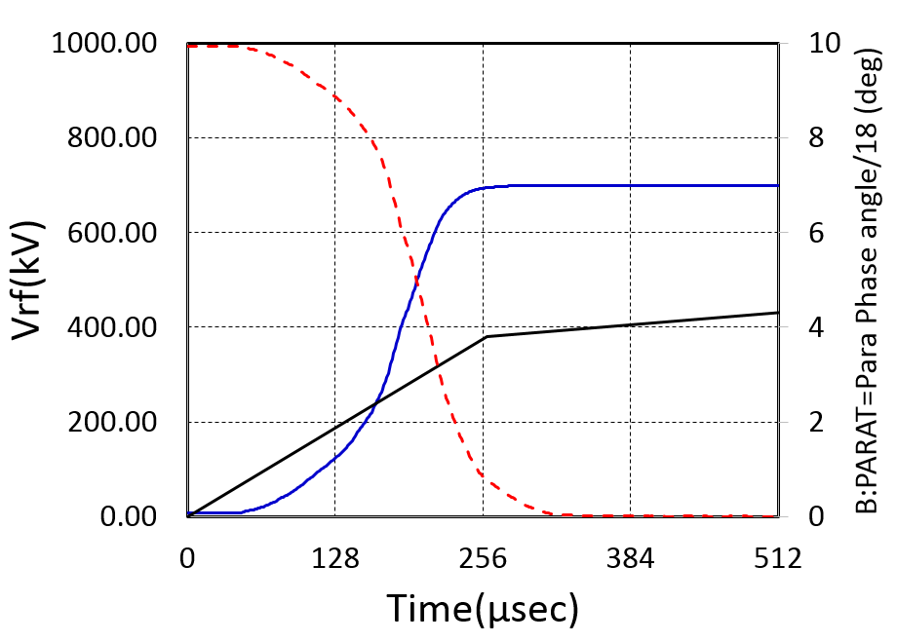
Current Operation
RF Voltage during Capture
Bucket Area
= 0.096 eVs
Vrf
(Operational)
B:PARAT
(Operational)
Vrf
(adiabatic)
Bucket Area
= 0.070 eVs
Bunch Area=0.04 eVs
by simulation

Slide 14
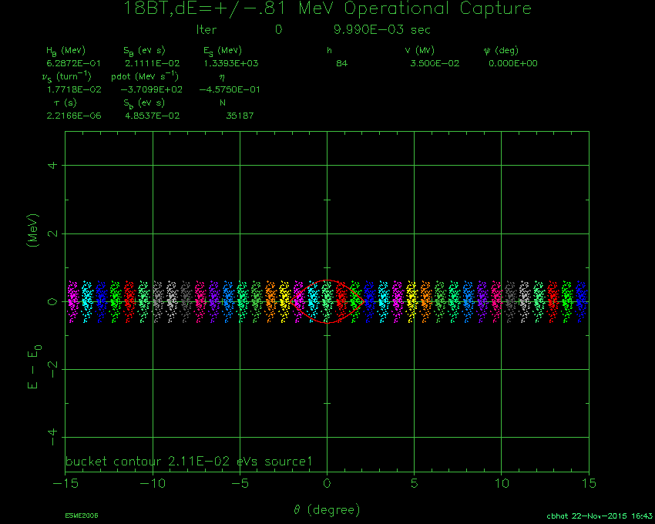
Simulation (ESME): Phase-Space Evolution during Beam Capture - 14 BT Beam
Operational Beam: injection at ~0 us before BDOT=0
Injection at -35μs w.r.t. BDOT=0.0
ε_{L} at the end of beam capture = 0.06 eVs (~60% dilution)
with ~5% beam loss

Slide 15
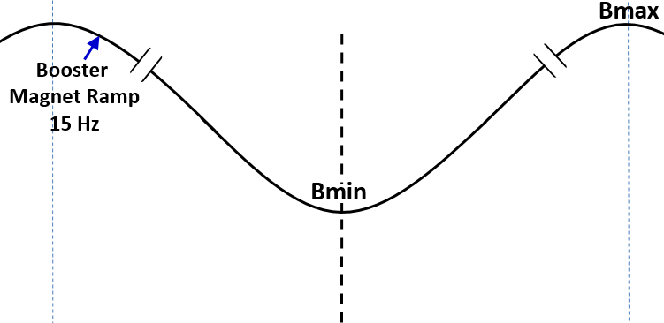
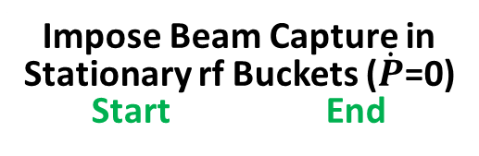
Schematic of the
Early Injection in the Booster
with a pseudo front-porch
Impose Beam Capture in
Stationary rf Buckets ($\dot{P}$=0)
Start End
Begin Inj.
Change in
Es <0.24MeV
≈ 40μs
injection
Beam Acceleration using
37-52 MHz RF system
150μs
capture for >260μs (no debunching)
1/15Hz ≈ 0.0666 s
pseudo front-porch in the Booster
Energy Acceptance > 4MeV
Beam ΔE ≈ 1.3MeV
f_{sy} = 8kHz-27kHz @ Vrf=0.035-0.4MV
C. M. Bhat, IPAC2015

Slide 16
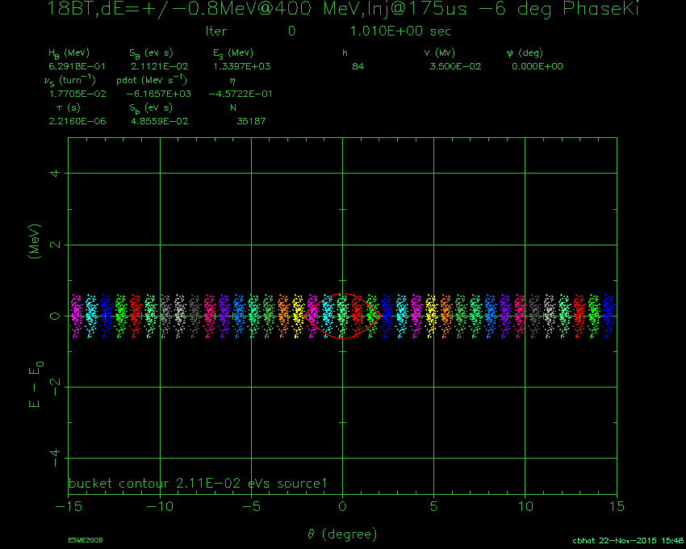
Simulation (ESME): Phase-Space Evolution during Beam Capture - 14 BT Beam
Early Injection: injection at 175us before BDOT=0
Injection at -175μs w.r.t. BDOT=0.0
ε_{L} at the end of beam capture = 0.040 eVs (~ 6% delution)
no particle losses

Slide 17
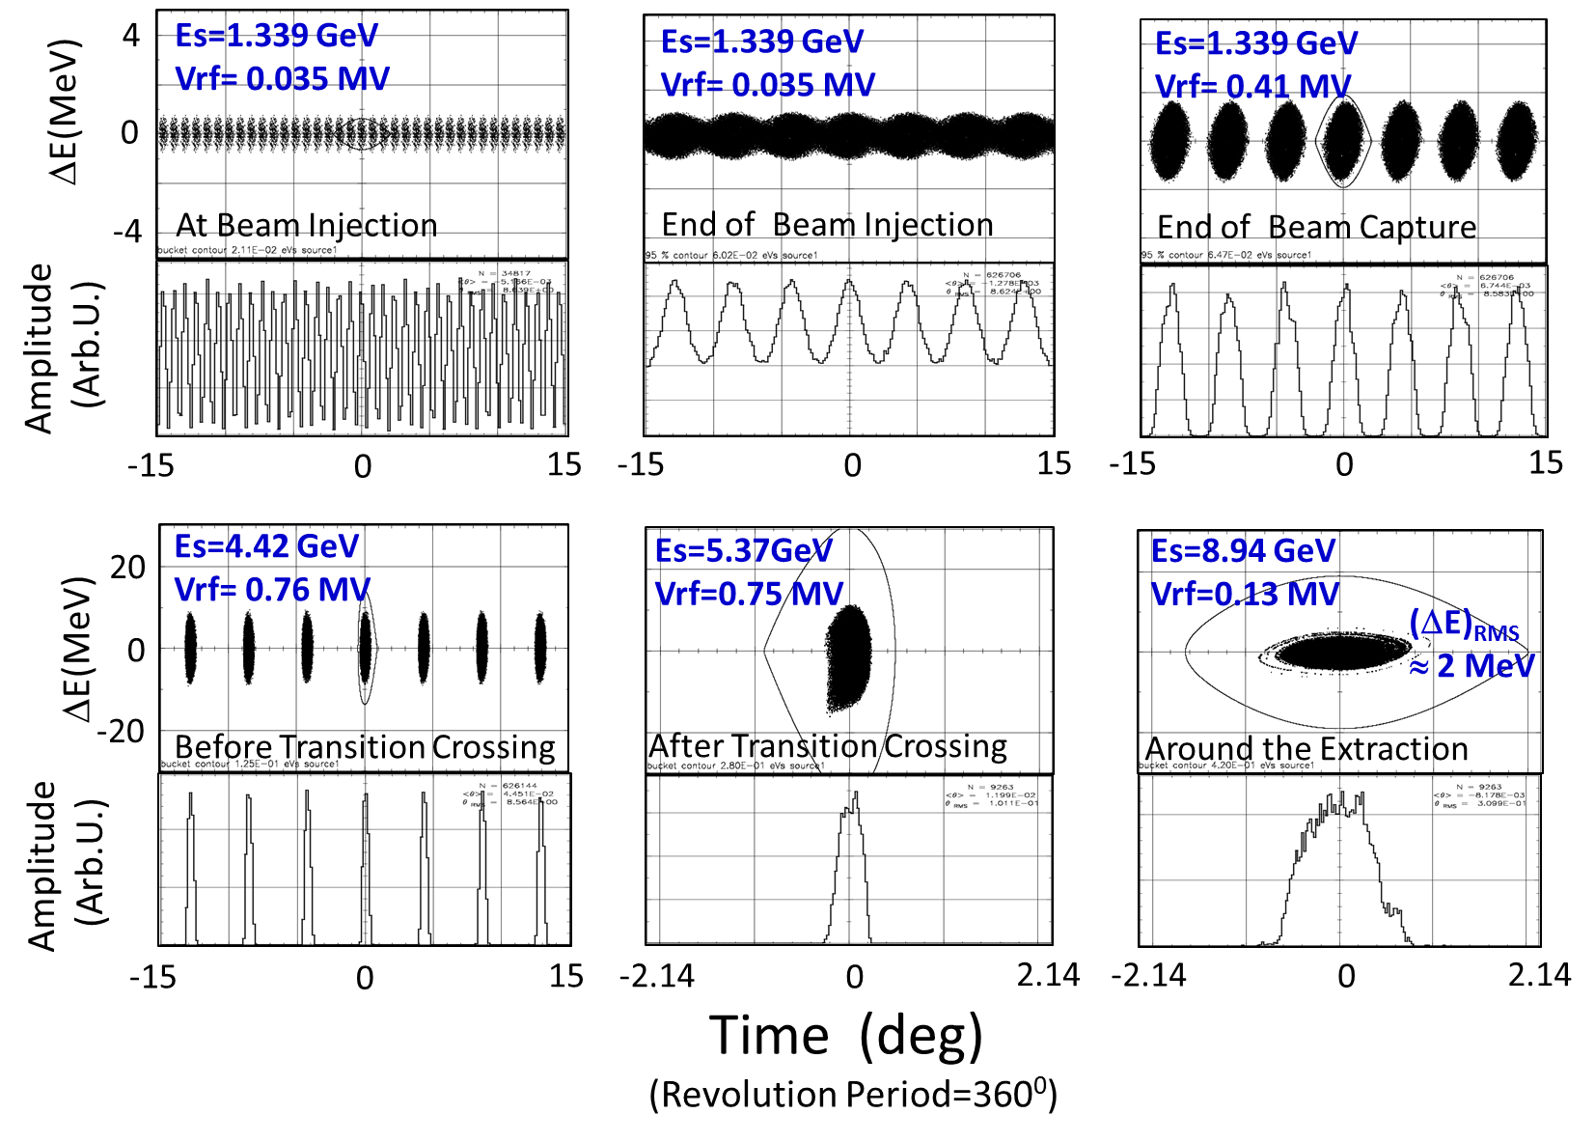
Beam simulations from
Injection→ Extraction
with 12E10p/bunch

Slide 18
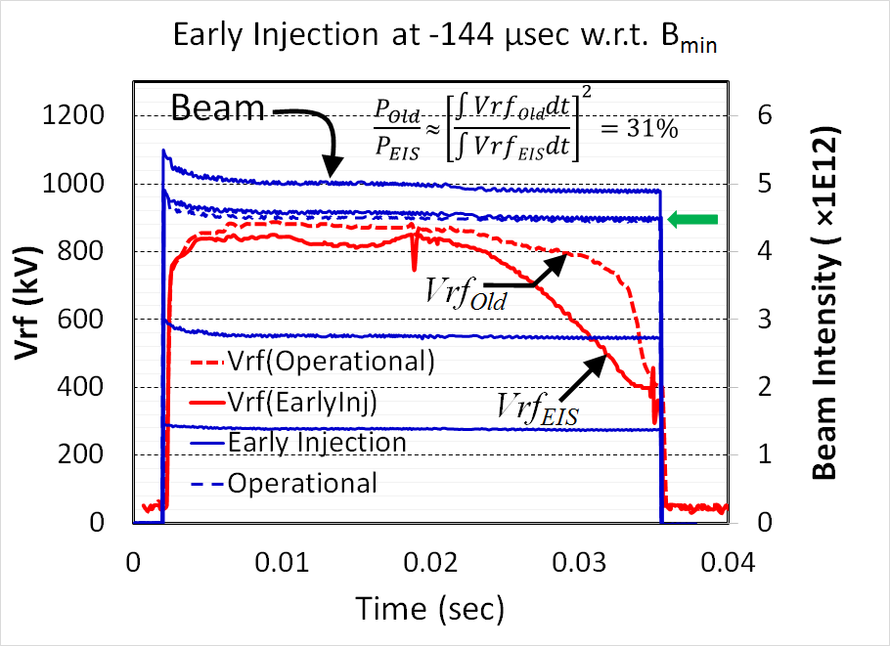
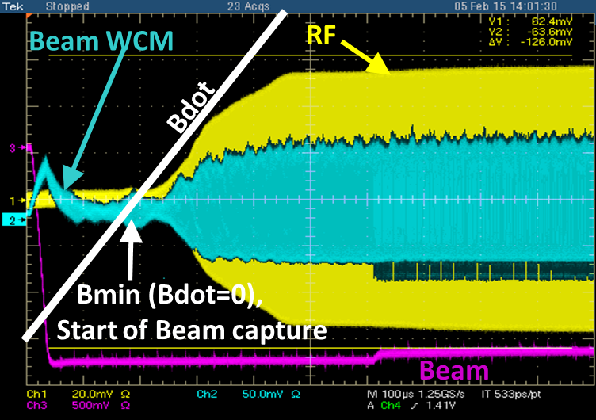
Beam Experiments
New Radial-position, Paraphase and Simulated Vrf curves are used
Transition crossing ← Needed additional tuning
(Preliminary)

Slide 19
Future Plans
Beam capture soon after the completion of the beam injection,
A better frequency synchronization between the LLRF and real frequency,
Implement phase corrections/jump at transition crossing. This gives better match between bunch and the RF bucket,
Fast bunch rotation← Gives lower beam energy spread at extraction. Hence, is better for slip-stacking in RR.
Make it Operational by next shutdown
We have done first attempt
LLRF is ready. Waiting for beam time
Module is ready to go into BLLRF
Not applied on the EIS

Slide 20
Summary
Are learning a lot about the Booster in recent years: Identified several issues related to beam injection , beam capture, Tran Crossing & etc.... Come out with a new injection scheme, EIS, for the Booster.
If EIS is implemented then the implications are
Higher brightness beam to the downstream machines
One can increase the Booster beam power at extraction, because more number of Booster turns can be accommodated
Booster can be run with ≈20% less RF power per cycle ← This is a great bonus.

Slide 21
Backup Slides

Slide 22
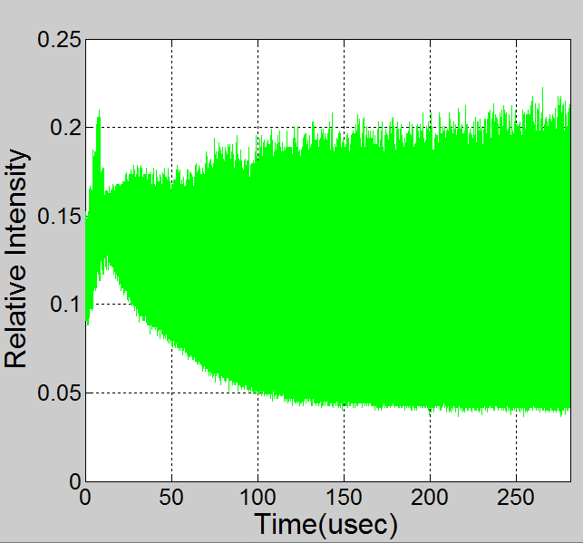
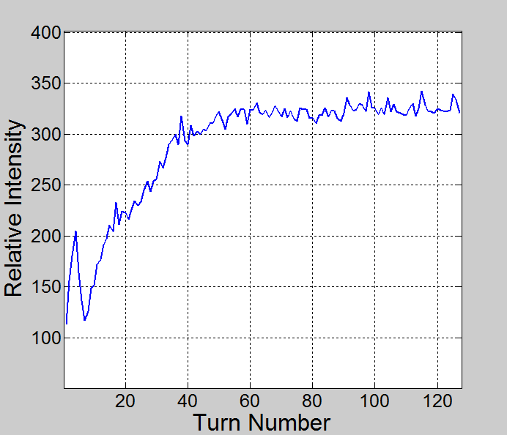
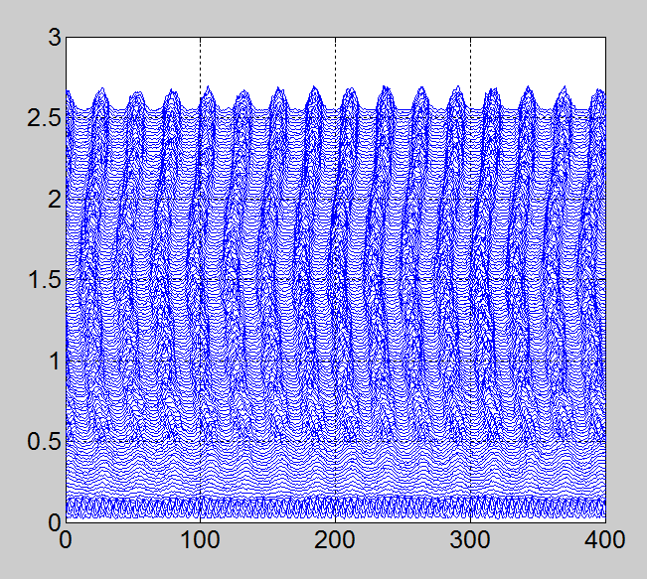
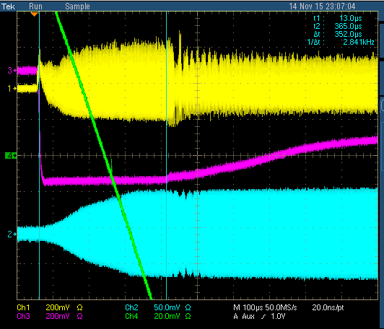
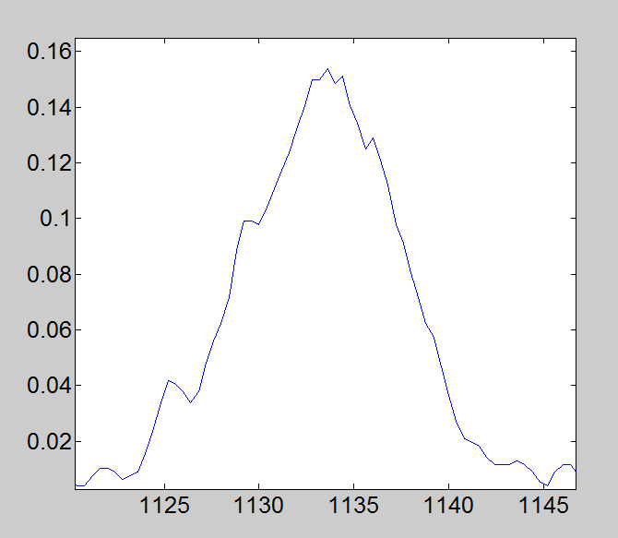
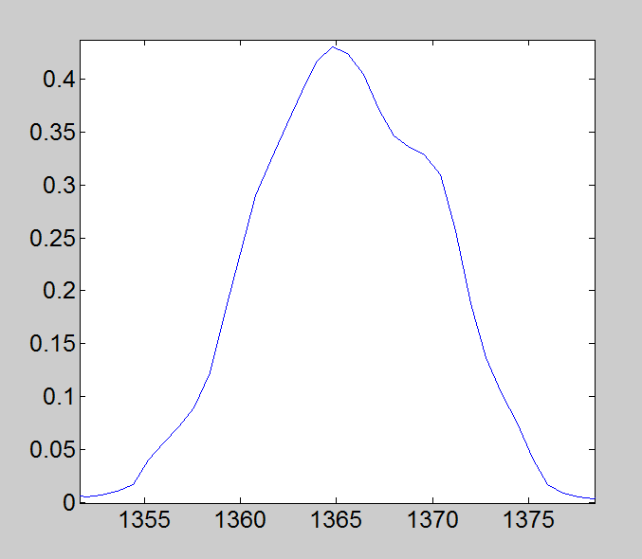
Early Capture – Measurements
(Preliminary)
WCM
Mountain Range
For Capture
Relative Beam
WCM
Single Bunch
@ the end of capture
Single Bunch
@ the end of capture
Beam
EIS
FWHM ≈10 nsec
FW ≈18 nsec
Vrf=0.72kV
Oper.
FWHM ≈13 nsec
FW ≈21 nsec
Vrf=0.72kV
RF
Bdot

Slide 23
IPM Data on the EIS and a comparison with Operational cycle
(Nothing Unusual)
Average of H and V beam sizes
during the first 500 turns
Average of H and V beam sizes
during the entire beam cycle

Slide 24
PIP parameters with EIS
Expected by adopting Early Injection Scheme
Parameter | PIP | PIP-II (After 2022)
Injection Energy (KE) (GeV) | 0.4 | 0.8
Extraction Energy KE (GeV) | 8 | 8
Injection Intensity (p/pulse) | 4.52E12 (x ~1.4) | 6.63E12
Extraction Intensity (p/pulse) | 4.3E12 (~6E12) | 6.44E12
Number of Booster Turns | 13 (18) | 300
Efficiency (%) | 95 (≥97) | 97
Booster repetition rate (Hz) | 15 | 20
Booster Beam Power at Extraction (kW) | 94 (~130) | 184
MI batches | 12 every 1.33 sec | 12 every 1.2 sec
NOvA beam power (kW) | 700 (~950) | 1200
Rate availability for other users (Hz) | 5 | 8
Booster flux capability (protons/hr) | ~ 2.3E17 (3.2E17) | ~ 3.5E17

