Slide 1
Status of work on the HOM coupler.
Gennady Romanov
2nd Harmonic cavity meeting
February 25, 2016

Slide 2
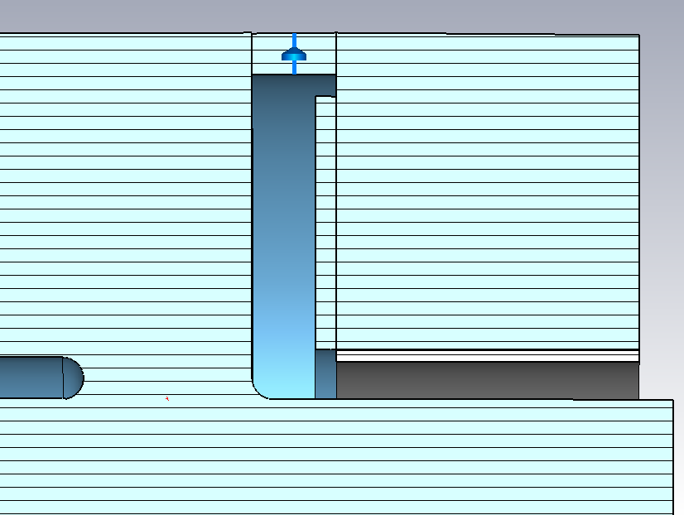
Starting point
Load gap increased from 0.25 cm to 1 cm.
All diameters are made equal.
Wall thickness of the drift tube is 1 cm instead of 0.2 cm.
μ = 3.5, F= 70.85 MHz, F_HOM1=167.8 MHz
SuperFish model
Operating: Z11= 84658 Ω without HOM cavity, Z11= 60094 Ω with HOM cavity
Drop = - 29% (SuperFish original: -27%)
R_{equiv.} = 7.96e5 Ω with HOM cavity
HOM1: Z11=248651 Ω without HOM cavity, Z11= 10105 Ω with HOM cavity
Drop = -96% (SuperFish original: -93%)
R_{equiv.} = 868 Ω with HOM cavity

Slide 3
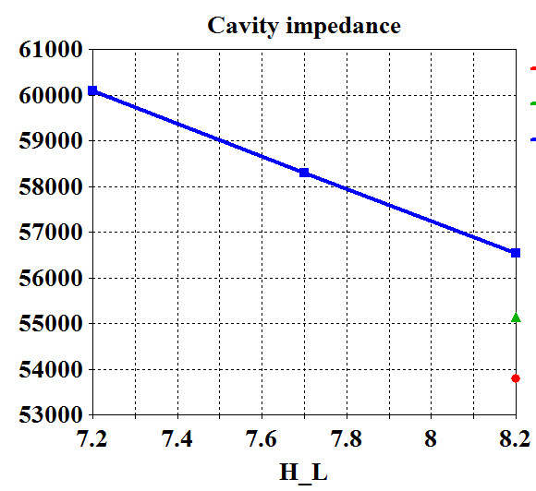
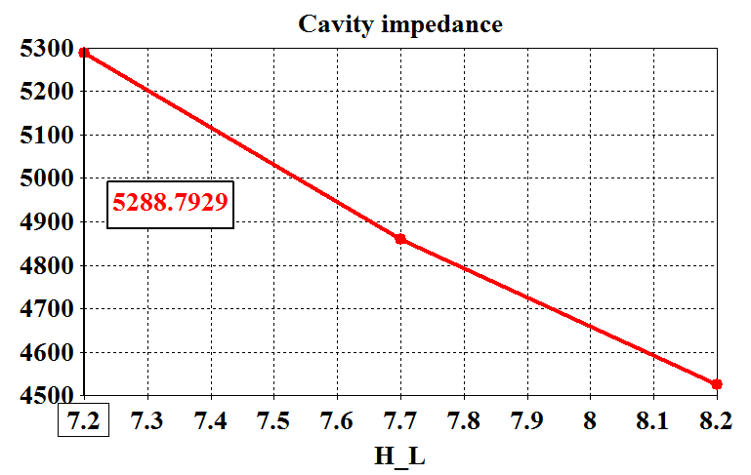
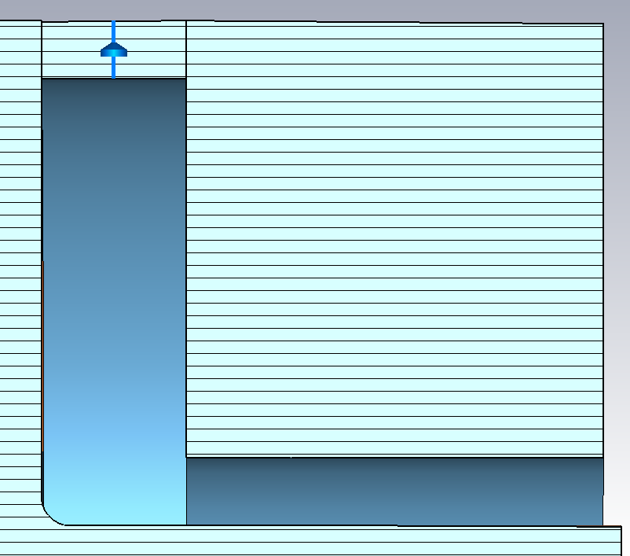
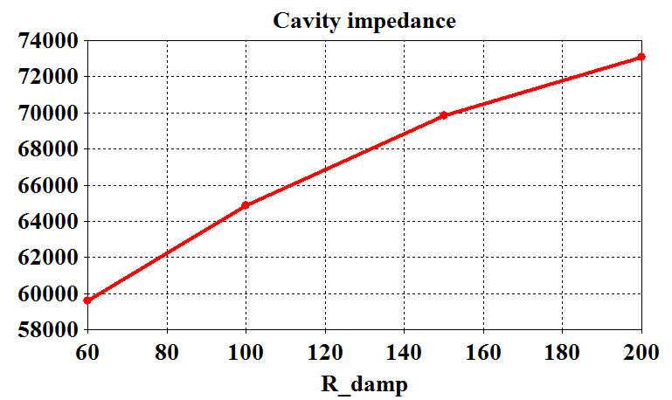
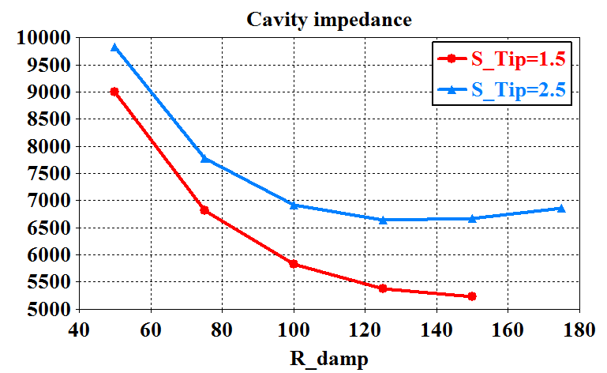
Optimization
d_slot
S_L
H_L
All tuning curves are almost linear. Signs are the same for operating mode and HOM1, only exception is R_damp
H_R_in
Parameters for HOM cavity optimization:
H_L – cavity length
H_R_in – inner radius
S_L – coupling gap length
d_slot – coupling gap width
R_damp - Damping resistor.

Slide 4
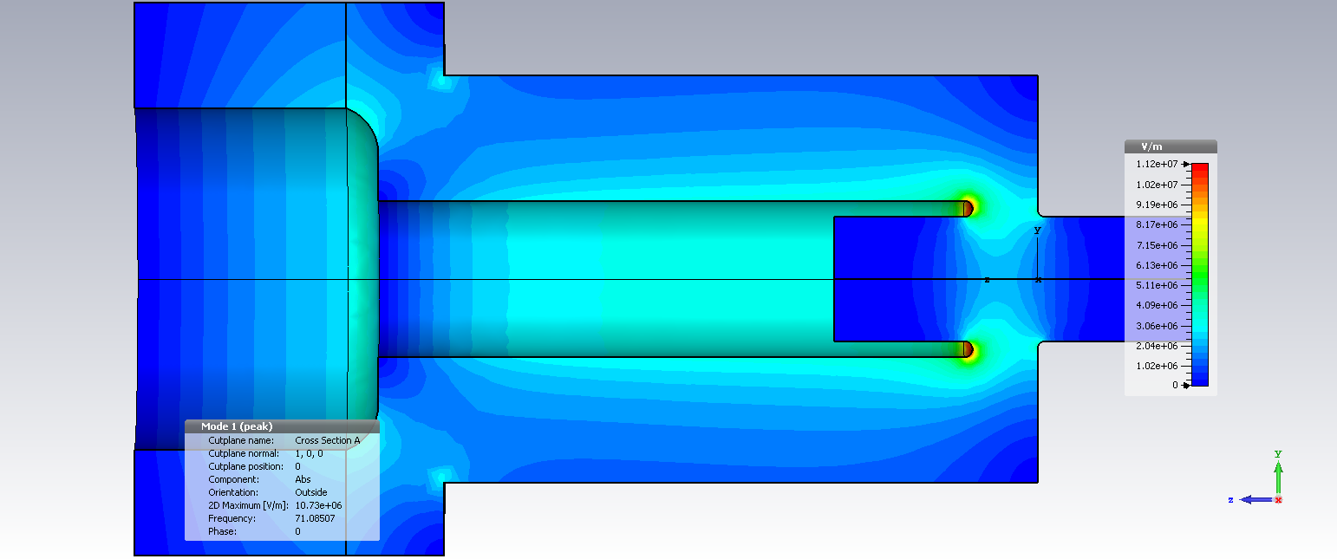
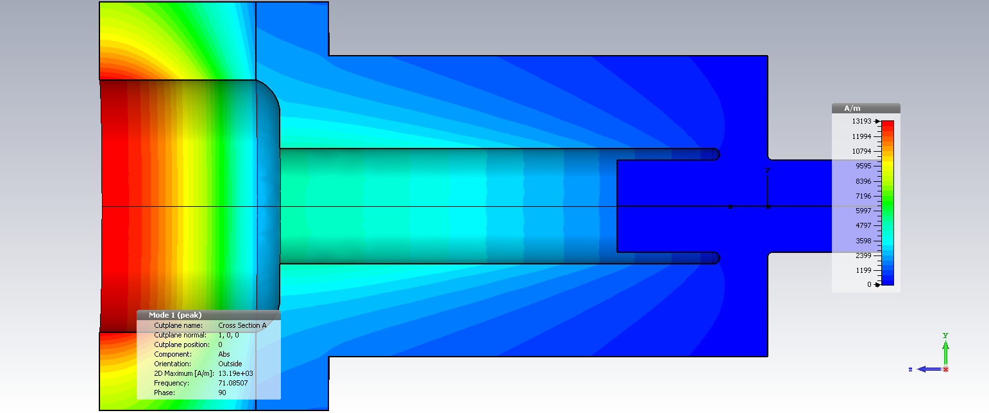
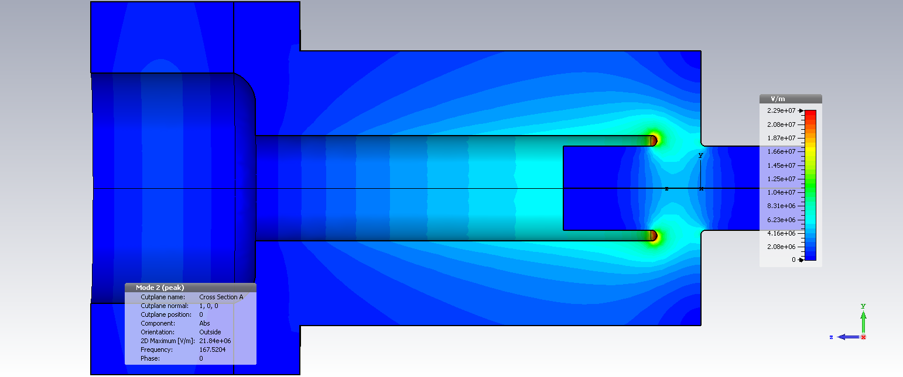
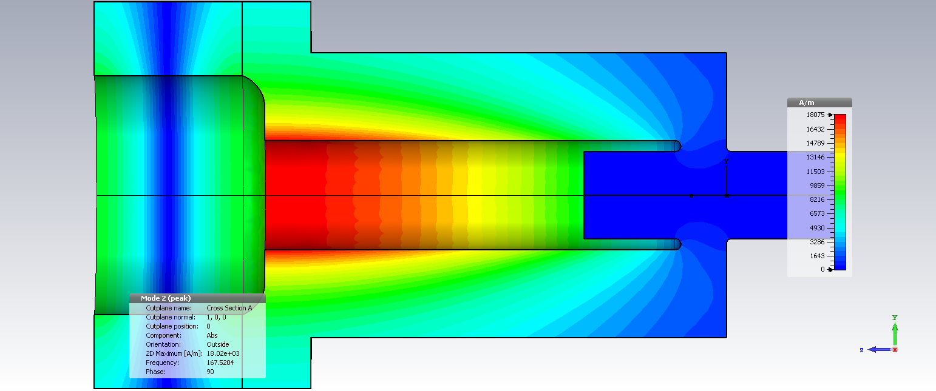
First results and further steps
Damping of operating mode: -29% => -12%; Damping of HOM1: -96%=>97%.
Requirements?
Try to tune the cavity to move HOM1 up and increase F-F_HOM1. Now difference is 96 MHz at low frequency end and 75 MHz at high frequency end.
Scan μ and find dependence of impedances on frequency.
Operating mode
<=E H=>
It’s possible to tune operating mode and HOM1 independently
HOM1
<=E H=>

