Slide 1
Windows of 2nd Harmonic Cavity (Part II)
Ding Sun
2nd Harmonic Cavity Meeting
03/10/2015

Slide 2
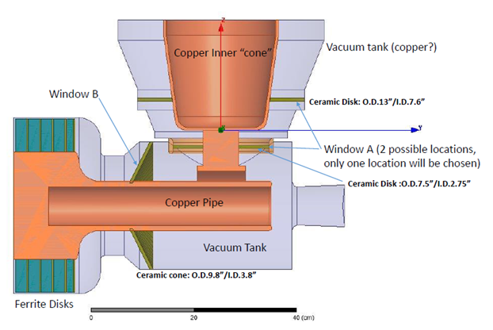
Update on windows
Two windows: input window (A) and inside window (B)
Focus on input window first.
Brazing of large ceramic disk (O.D. 13 “) to copper ring: doable
Cost (ceramic disks and brazing): ~ $10760 for two units of 13” window and $9570 for two units of 7.5” window.
But related engineering issues need to be fully addressed before proceeding.

Slide 3
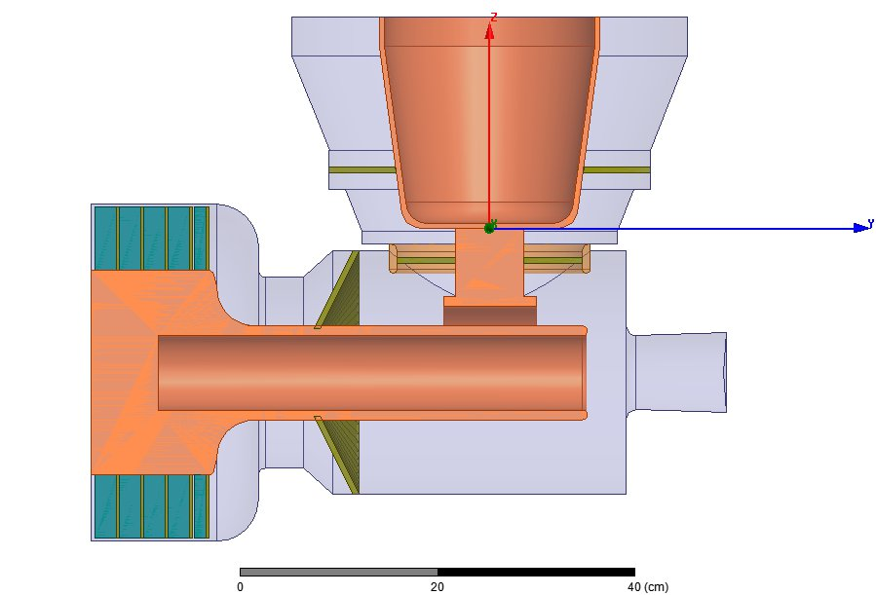
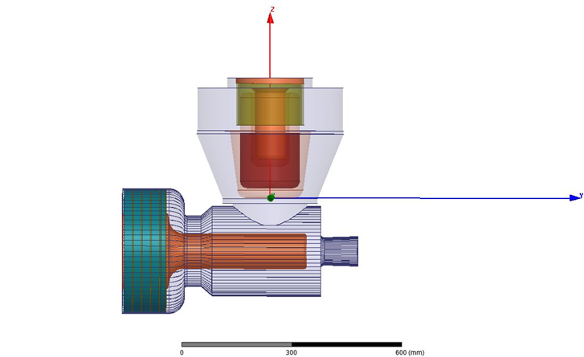
Input window (option 1)
Lower current density. Window cooling would be easier. But more engineering work:
(1) joining window with two parts of outer tank
(2) anode cooling water tube penetration has to be above the window -> water tubes has to be bent vertically in tight space
Assembly procedure (some steps are exchangeable):
braze alumina disk & copper rings (inner and outer)
Weld inner copper ring to inner conductor
then weld outer copper ring to outer tank (two parts)
install PA tube/coupler
(e) join ver. and hor. outer tanks (flange or weld? also depending on how to install window B)
Window cooling:
Inner: cooled at the flat bottom of the ver. hollow inner cond.
Outer: cooling tube at outer ring area.
Risk: stress on ceramic due to imperfect alignment etc.
~0.5” space?
~1” space

Slide 4
Input window (option 2)
Joining to outer tank is easier. But it is at higher current density area (closer to coupling area).
Assembly procedure (some steps are exchangeable):
(a) braze alumina disk with a short solid inner conductor and outer copper ring
(b) weld outer copper ring to transition “neck” (the part joining ver. and hor. outer tanks)
(c) weld “neck” to hor. outer tank
(d) join ver. hollow inner conductor and solid inner conductor of window assembly
(e) join coupler and solid inner conductor of window assembly (this step may be performed before step (c) if necessary)
(f) join ver. and hor. outer tanks (depending on how to install window B. flange or weld? Is there enough space for flange?)
(g) install PA tube and cooling water tube
Window cooling:
Inner: cooled at the flat bottom of the ver. hollow inner cond.
Outer: cooled at outer cooling channel (between copper ring and ver. “neck”) or just cool the “neck” from outside.
Risk: stress on ceramic due to imperfect alignment etc. Bending force may be larger.
Note: this window may see beam and radiation.

Slide 5
Inside window and related issues
There is no good location for this window.
The straight section of the hor. outer tank in this window area has been changed from ~ 10 cm to 6 cm: (i) closer to the vertical “neck” --- affect the decision on large top flange (if it is desired) and welding procedure (ii) closer to the horizontal “neck”.
Option A: similar to the current booster cavity (some steps are exchangeable):
(a) braze alumina disk with a thin copper tube
(b) glue…(whole inner conductor with outer conductor plus hor. neck?)
(c) insert glued inner conductor into the tube (in step(a)), weld outer tank with outer ring of window and weld inner conductor and tube at the gap end.
Option B:
(a) braze alumina disk with whole inner conductor (?) and a outer ring
(b) Glue ferrite/”fat” outer conductor with brazed inner conductor
(c) weld glued assembly to hor. neck (hor. neck has to be two halves, can the dia. of hor. neck be larger than inner conductor? )
(d) weld to hor. outer tank.
Option C:
Braze alumina disk with a straight section of inner conductor and outer ring, weld “neck” to outer ring, weld left side of straight inner conductor to the glued “fat” inner conductor? (or join them mechanically?), weld “fat” outer and “neck”.
Note: radiation from coupling area?

