Slide 1
NMG Visit and Mechanical Assembly Update
Kevin Duel
Booster 2nd Harmonic Cavity
7 April 2016

Slide 2
NMG Visit
Overall a very positive visit
Spoke with machinist
Excited about the challenge/opportunity
Our tolerances call out +/- .005 – they can typically achieve better than +/- .002
Have achieved even better tolerances in the past for special projects
Chipping mostly occurs during handling
Apply Teflon tape to work surfaces
We should reconsider having them perform gluing
Explained how pieces are chucked and supported
For OD and ID, often glue on additional ferrite to grab onto which is later surface ground off
Ensures piece will not be supported by alumina
Making angular cuts to form ring without gaps will be the most difficult
Might need to make final piece a “keystone”

Slide 3
NMG Visit
Parts are inspected by QC department to verify specs are met
Packaging/shipping
They will design and provide packaging for shipping back and forth
Can use “shock sticker” if desired
Will strap box to pallet

Slide 4
NMG Visit
Cannon used to pressurize powder with water and form into pre-fired shape

Slide 5
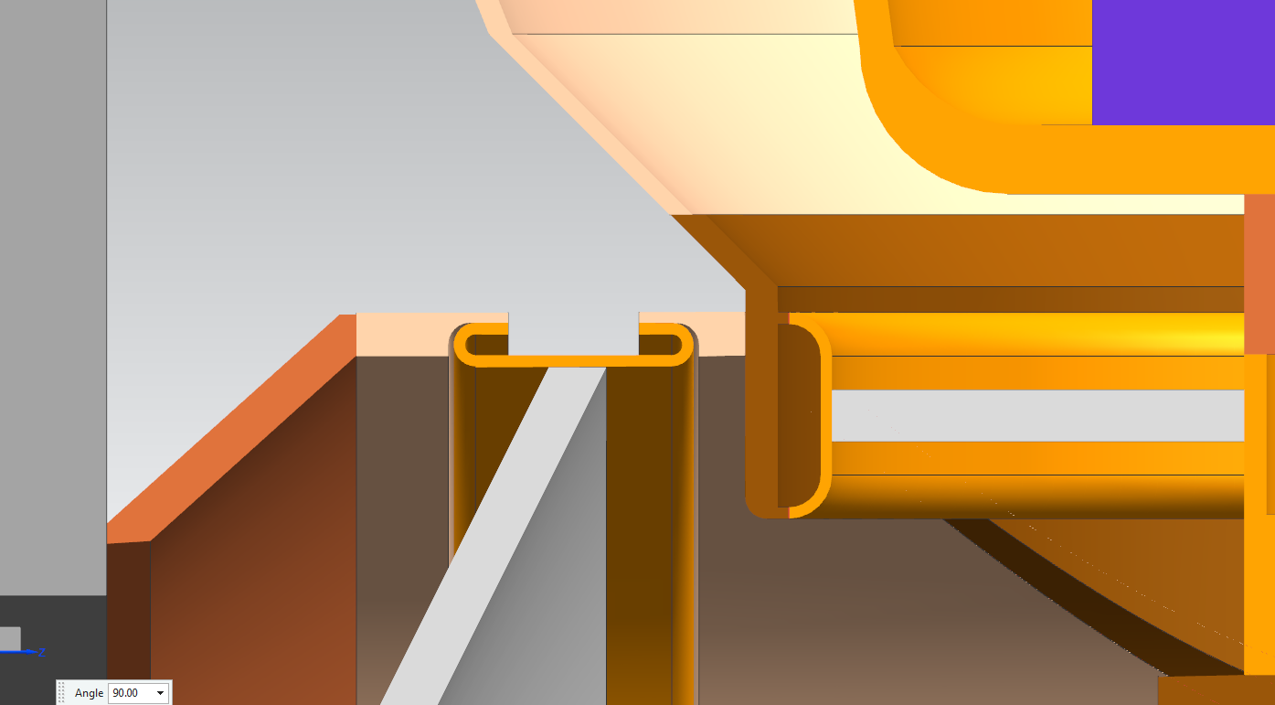
Mechanical Assembly Update

Slide 6
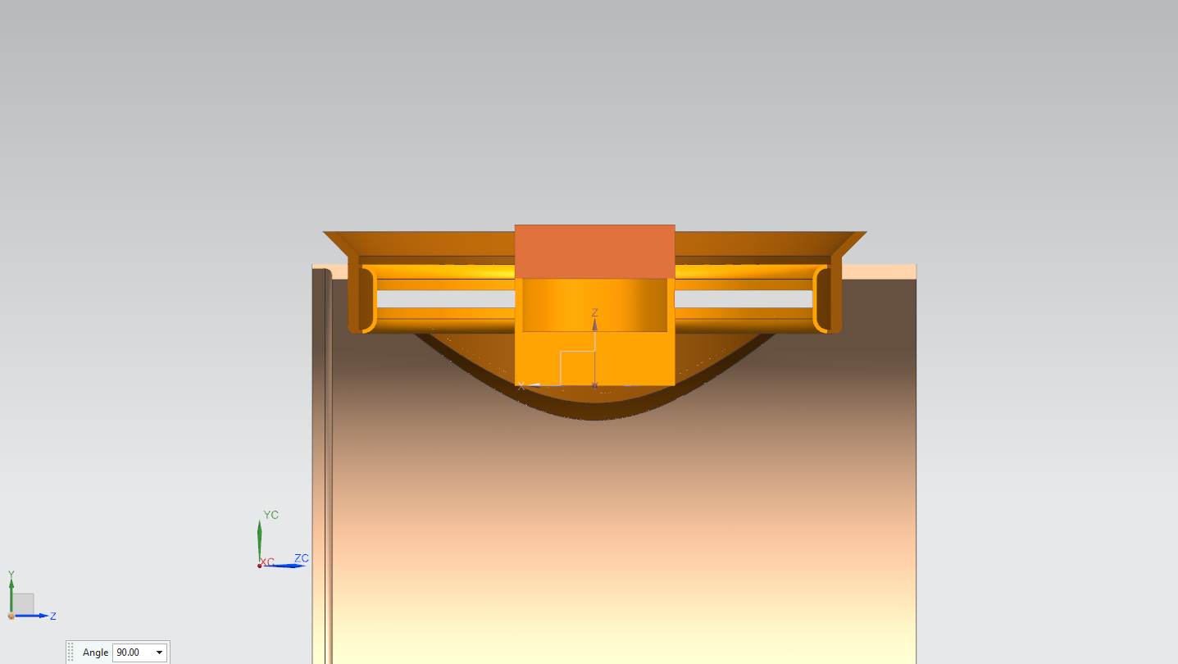
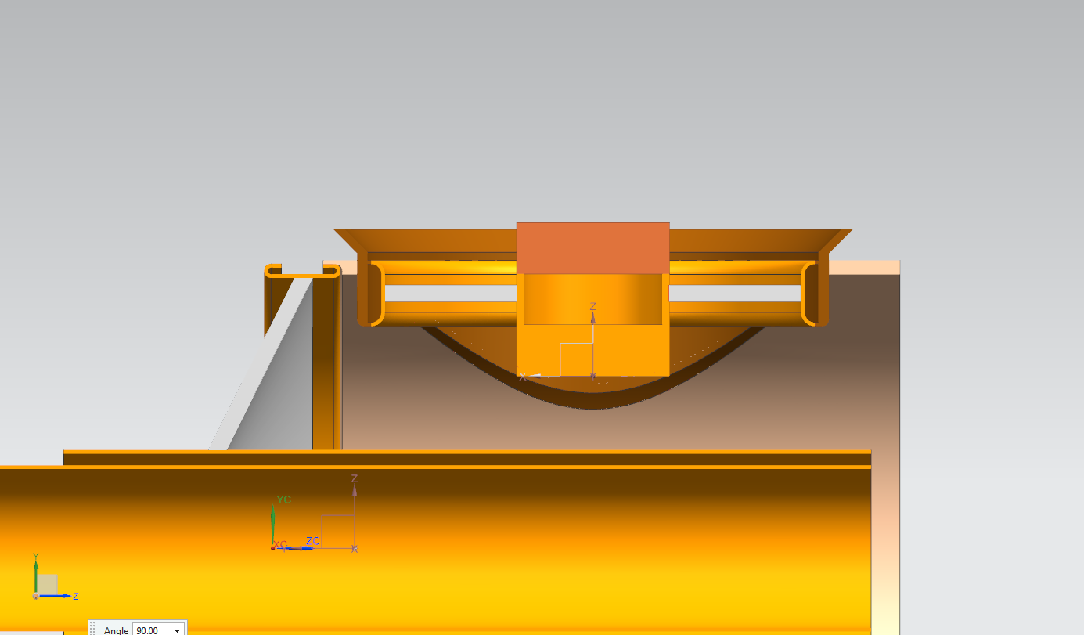
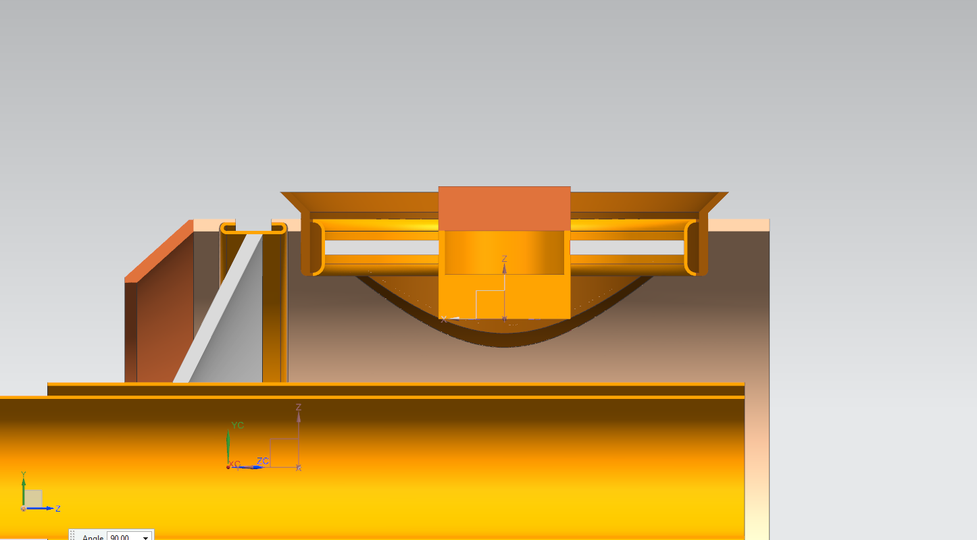
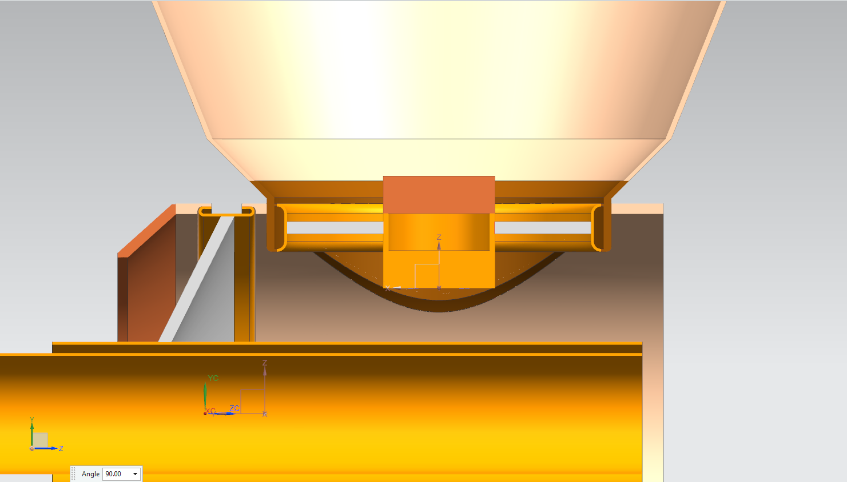
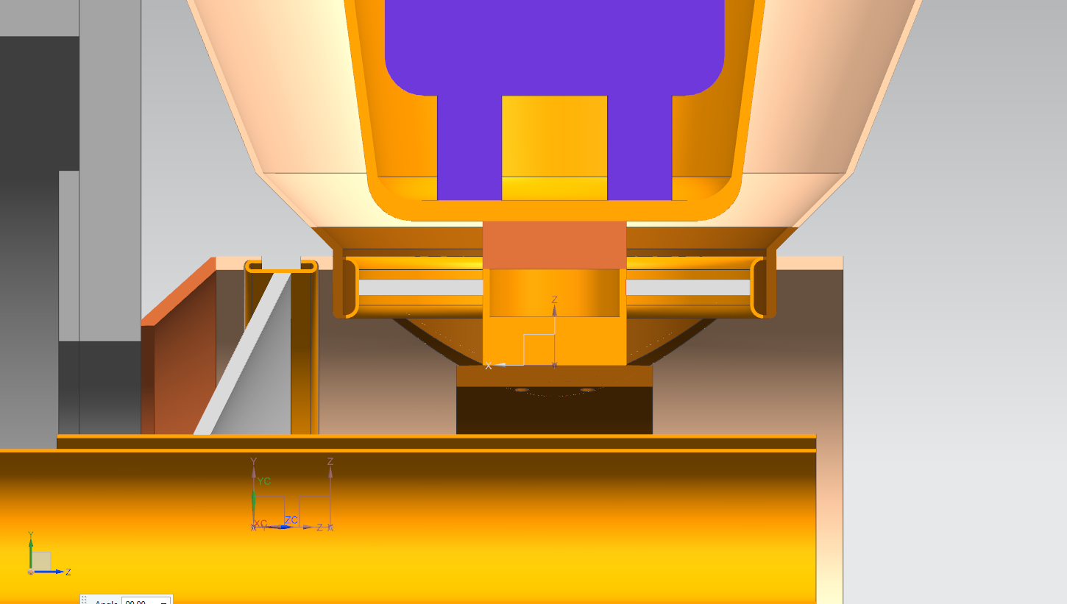
Mechanical Assembly Update

