Slide 1

LHC Beam Instrumentation
Challenges
Manfred Wendt – CERN
with a lot of help and many contributions from the colleagues of the CERN BI and OP groups!

Slide 2
Contents
Overview and General Challenges
LHC Introduction
Summary of LHC Run 1
Beam Instrumentation R&D during LHC Run 2
HL-LHC Challenges
Summary

Slide 3
Large Ring Colliders
Collider | Years of Operation | Circumference [km] | Beam type | Beam Energy [GeV] | Luminosity [cm⁻²s⁻¹]
Tevatron | 1983-2011 | 6.3 | p-͞p | 980-980 | 4e32
LEP | 1989-2000 | 27 | e⁺-e⁻ | 104.5-104.5 | 2.1e31
HERA* | 1992-2007 | 6.3 | p-e | 920-27.5 | 5.1e31
LHC | 2008-… | 27 | p-p / Pb⁸²⁺ | 6500-6500** | 5e33**
* achieved >50% longitudinal spin polarization of the e-beam
** 2015 data
Common technologies
  Superconductive RF and/or magnets
Common goals
  Highest energy of the colliding beams
  High integrated luminosity
  High spin polarization (leptons)
  Low investment and operational cost

Slide 4
Beam Characterization
Intensity
  Beam & bunch currents, beam lifetime, abort gap
Orbit and position
  BPMs with turn-by-turn and high rez orbit measurement capabilities
  Orbit FB systems
  Single bunch BPMs for technical interlocks (machine protection)
  Hi-Rez BPMs integrated in the collimator jaws
Beam loss detection
  Key element of the machine protection system (MPS)
Tune and instabilities
  No/minimum beam excitation, SB tunes
  Tune FB
Beam profile (emittance) and halo
  Non/minimum invasive methods
Chromaticity

Slide 5
General Challenges
Large physical size of the collider
  # of components, reliability, costs
    E.g. replace copper cable by optical fibers
  Radiation effects on electronics
Superconductivity
  RF feedthroughs, cables, cold beam pickups & BLMs
HOM & wakefield effects
  RF heating of beam monitors and components
  Impedance budget, instabilities
High brilliance, high power beams
  Non-invasive monitoring of all relevant machine parameters!
Monitoring / damping of beam instabilities
  Head-tail, e-cloud, etc.
Be prepared for changes!
  Beam formatting , e.g. bunch intensity, bunch spacing, etc.
  Beam energy
  Beam optics and layout near the IP
Machine protection!
  High damage potential of high intensity, high brightness beams.

Slide 6
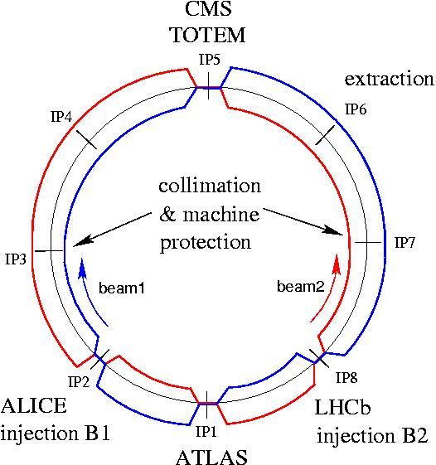






LHC Layout
8 arcs (sectors), ~3 km each
8 long straight sections (700 m each)
circumference 26.7 km
beams cross in 4 points
2-in-1 magnet design with separate vacuum chambers → p-p collisions
Nominal bunch spacing 25 ns
~8000 super-conducting magnets.
up to 8.3 T dipole field.
1600 electrical circuits.
Following a severe powering incident in September 2008 a few days after startup with beam, the energy had to be limited to 4 TeV.
Full energy recovered end 2014 after a 1 ½ year stop for consolidation.

Slide 7
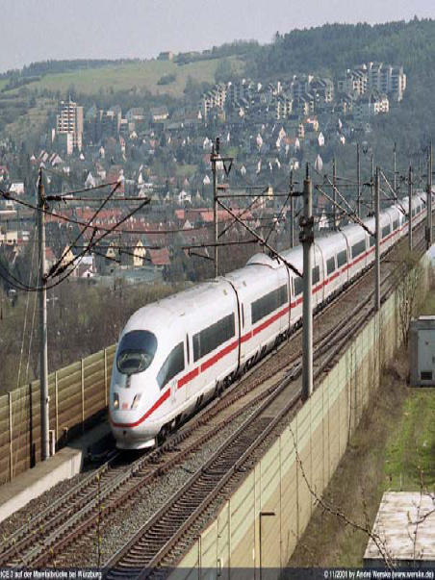
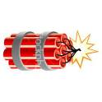
Damage Potential of the LHC Beam
One LHC beam = 360 MJ =
Beam momentum
Particle type
  Proton – ions – electrons – photons
Energy store in the beam
  1 MJ can heat and melt 1.5 kg copper
  1 MJ = energy stored on 0.25 kg TNT
Beam power
Beam size
Time structure of the beam
The kinetic energy of a 200 m long train, travelling at a speed of 155 km/h.
90 kg of TNT
Different accelerators (colliders, linacs, hadron - lepton) cannot always be compared directly!
MPS challenges can be quite different !

Slide 8
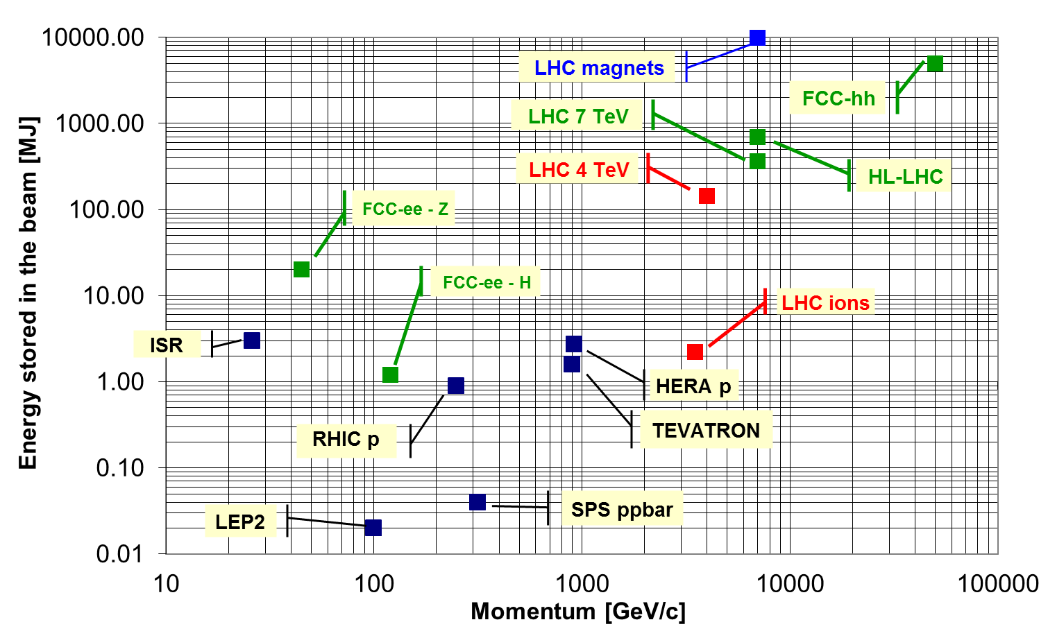
Stored Energy in Colliders
LHC Run 2: ~330 MJ @ 6.5 TeV

Slide 9
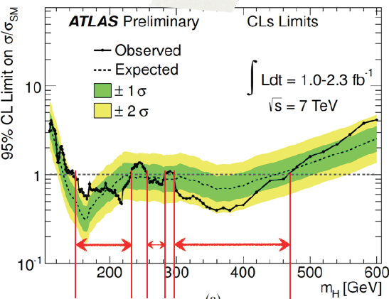

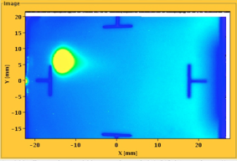
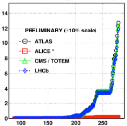
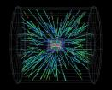




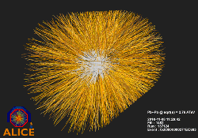
LHC Run 1 – Timeline
August 2008
First injection test
14 February, 2013
Start of Long Shutdown 1 (LS1)
November 29, 2009
Beam back
August, 2011
2.3e33, 2.6 fb⁻¹
1380 bunches
September 10, 2008
First beams around
June 28 2011
1380 bunches
1380
October 14, 2010
Goal reached 1e32 248 bunches
20 Jan, 2013
First Proton-Lead Collisions
2008
2009
2010
2011
2012
2013
November 2010
First lead ion run
September 19, 2008
Disaster
Accidental release of 600 MJ stored energy in one sector of LHC dipole magnets
April 5, 2012
First collisions at 4 TeV
March 30, 2010
First collisions at 3.5 TeV
4 July, 2012
Higgs Discovery

Slide 10
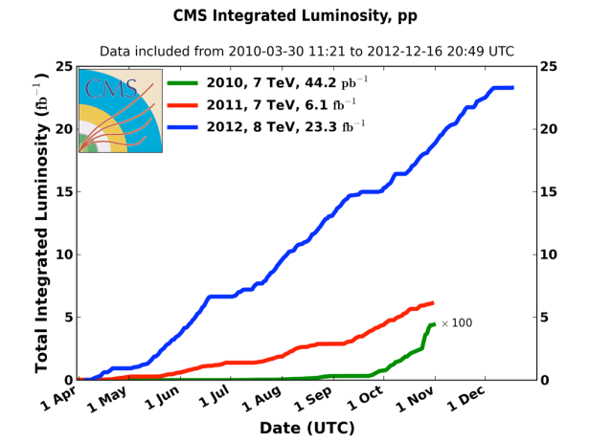
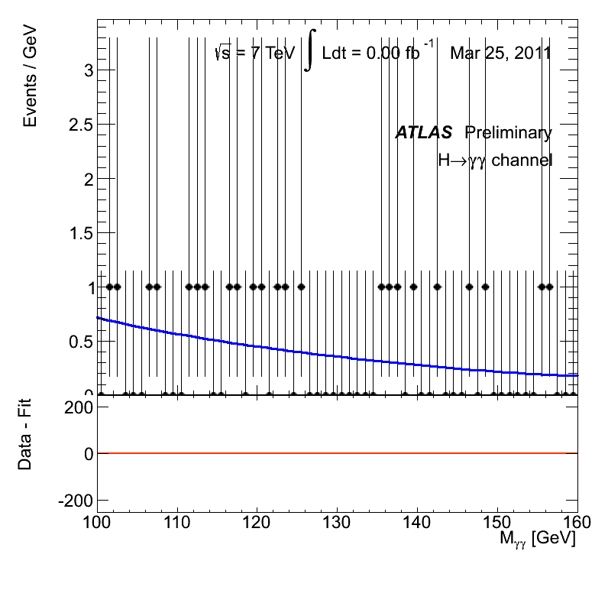
LHC Run 1 Integrated Luminosity
2010: 0.04 fb⁻¹
  7 TeV CoM energy
  Commissioning
2011: 6.1 fb⁻¹
  7 TeV CoM energy
  Exploring the limits
2012: 23.3 fb⁻¹
  8 TeV CoM energy
  Production

Slide 11
LHC Run 2 Challenges
Operating at higher energy
  Significantly reduced quench thresholds
    Maintaining collimation hierarchy
    Dealing with Unidentified Falling Objects (UFOs)
Running with 25ns bunch spacing
  Dealing with electron cloud instabilities
    Also running with doublet bunches for scrubbing
  RF heating issues
  Understanding & curing instabilities
    Early detection of instabilities
Coping with high brightness beams
  Measurement of small beam sizes

Slide 12
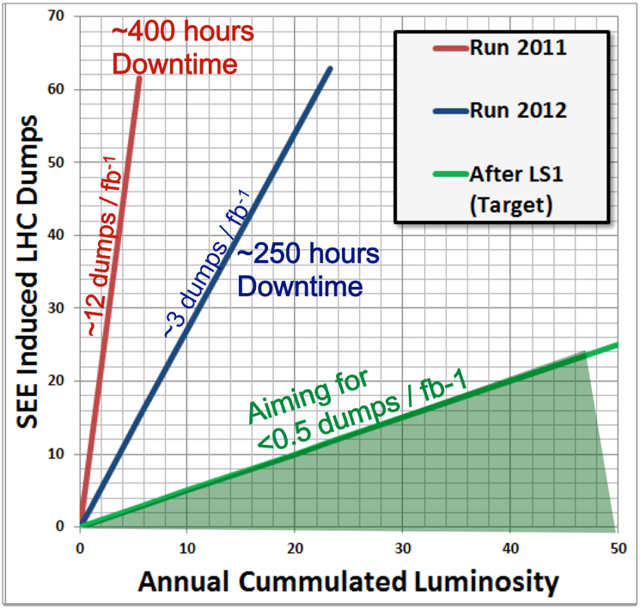
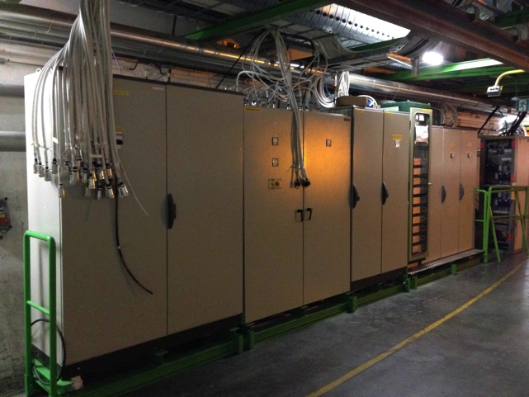
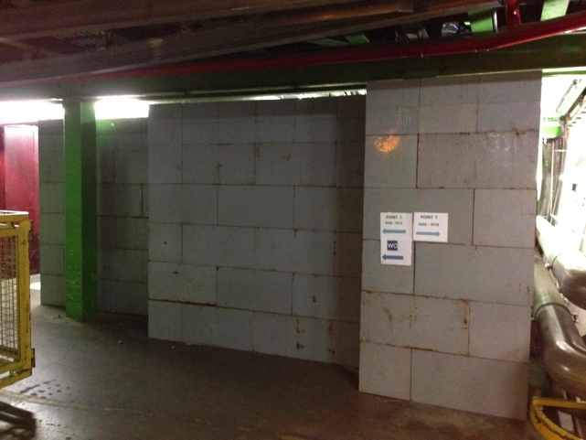
Minimizing Radiation to Electronics
Major effort - 70 weeks and combined effort of ~150 persons
Main activities around high luminosity experiments and collimation regions
Relocation & Shielding
Equipment Upgrades
Monitoring
Testing & Facilities

Slide 13
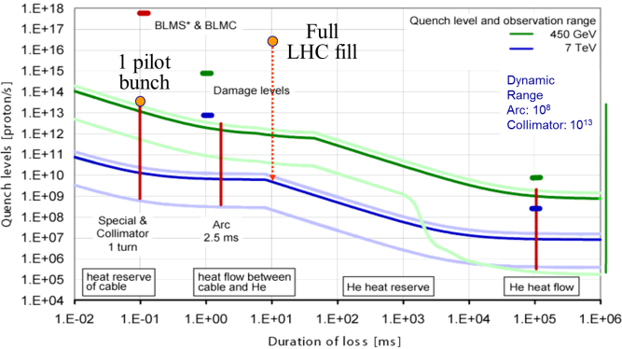
Running at High Energy
Significantly reduced quench and damage thresholds
  Pilot bunch of 5×10⁹ close to damage level at 7 TeV
  Loss of 3×10⁻⁷ of nominal beam over 10ms can create a quench at 7 TeV

Slide 14

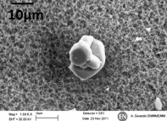
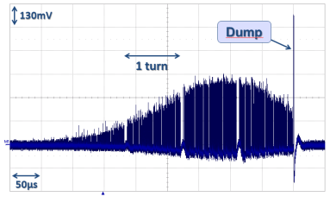
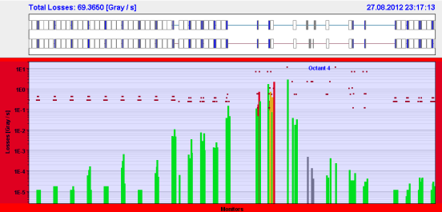
Running at Higher Energy: UFOs
Dealing with Unidentified Falling Objects (UFOs)
In 2012:
  20 beam dumps due to (Un)identified Falling Objects
    14 dumps at 4 TeV, 3 during ramp, 3 at 450 GeV
  ~17,000 candidate UFOs below BLM thresholds
At 6.5…7 TeV quench thresholds are significantly lower hence more dumps can occur
B1
B2
200m
Pt. 4
UFO location
Diamond BLM in IR7

Slide 15
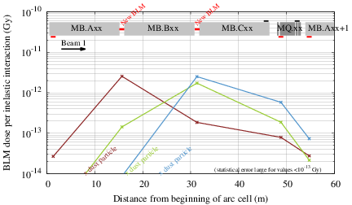
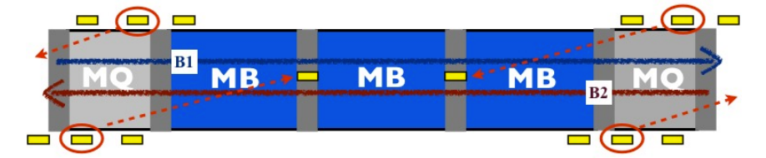
BLM Relocation for UFO Detection
BLM system designed to protect from beam losses at maximum-beta locations (quadrupoles)
During Run 1 there were 3 BLMs per beam per quadrupole
Middle BLM moved to main dipole interconnect in order to protect efficiently from UFO losses
  Gain a factor 30 in sensitivity

Slide 16
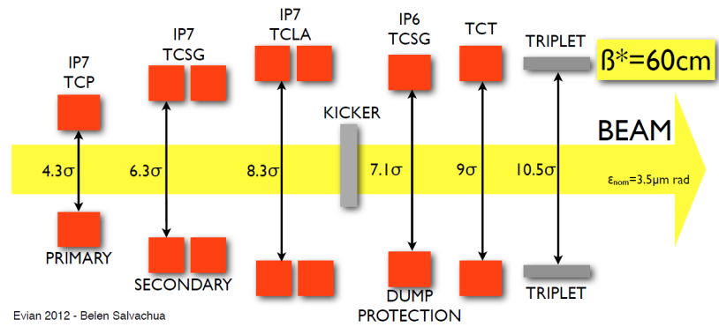
Collimation at the LHC
Multi-stage collimation system with ~100 moveable devices
Hierarchy between cleaning stages must be preserved
To date – no quench with stored beam energies up to 330 MJ

Slide 17


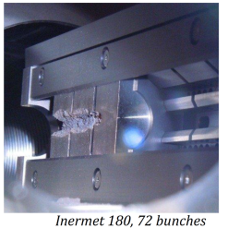
How Tight is Tight?
Norway
Iberian
peninsula
Intermediate settings (2011):
~3.1 mm gap
at primary collimator
Tight settings (2012):
~2.2 mm gap at
primary collimator

Slide 18
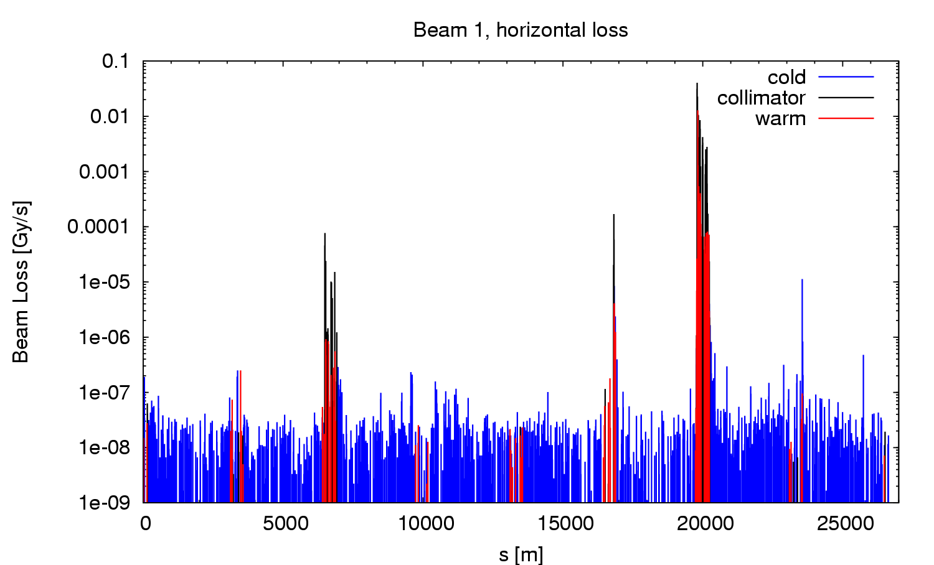
Collimation Verification with BLMs
BLM system used both for setting-up and qualifying
Beam cleaning efficiencies ≥ 99.98% ~ as designed
Loss at primary collimator
Collimation
Momentum Cleaning
Collimation
Betatron Cleaning
Beam Dump Protection
Peak leakage
to SC magnets
Measurement offset – ensures acquisition chain is alive

Slide 19
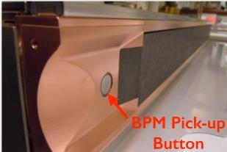
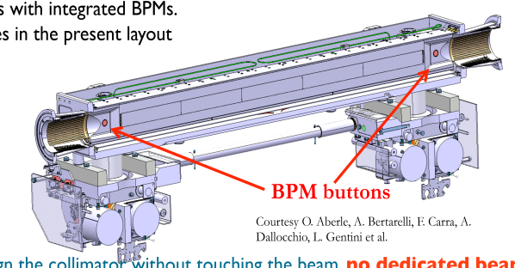
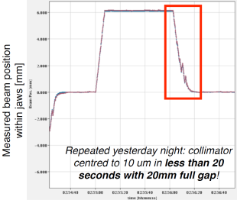
New: Collimators with Embedded BPMs
18 tertiary collimators now equipped with BPM buttons
Readout via high resolution Diode Orbit electronics
  Compensated diode peak detectors - resolution <100nm for centred beams
Allows fast, parallel alignment
  <20 s for all BPM collimators without touching the beam
  2 orders of magnitude faster than BLM method

Slide 20
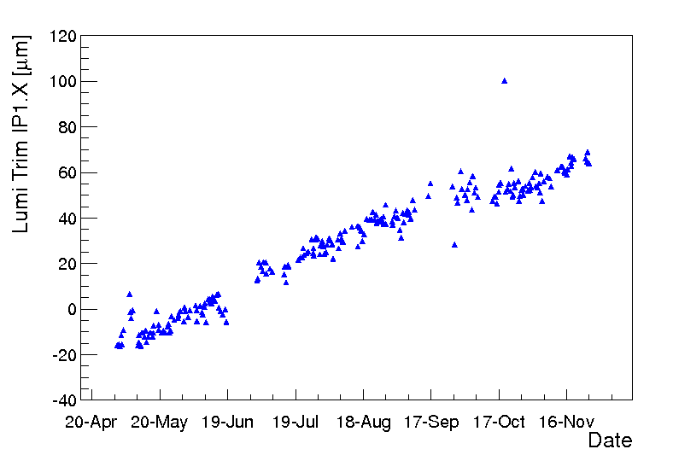
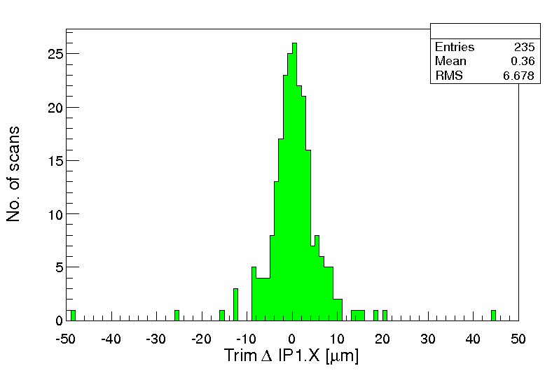
Beam Orbit Stability
Important for collimation and collision process
LHC does not work without orbit feedback
Main limitations
  Temperature dependence of electronics
  Linearity and directivity of stripline couplers near the interaction points
2012 data
Orbit correction at IP to bring beams head-on
Slow drift over the year →not corrected by feedback
80 μm
7 μm rms
Fill to fill difference is very small

Slide 21
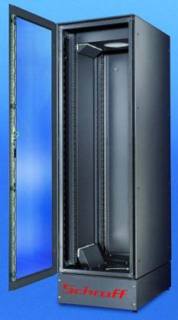
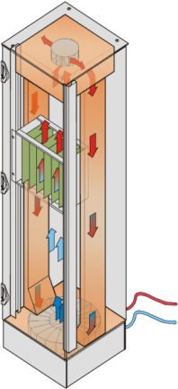
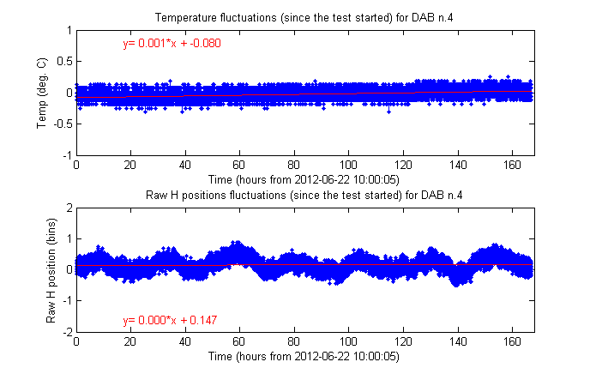
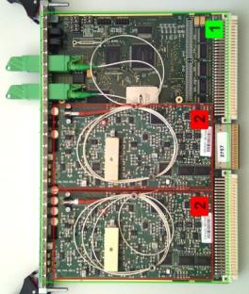
Beam Orbit Stability (cont.)
Improvements Foreseen
  Thermalized racks
  Maintains temperature
  within ±0.2°C
  Prototype successfully
  tested in 2012 – installed during LS1.
1 bin ~ 30um

Slide 22
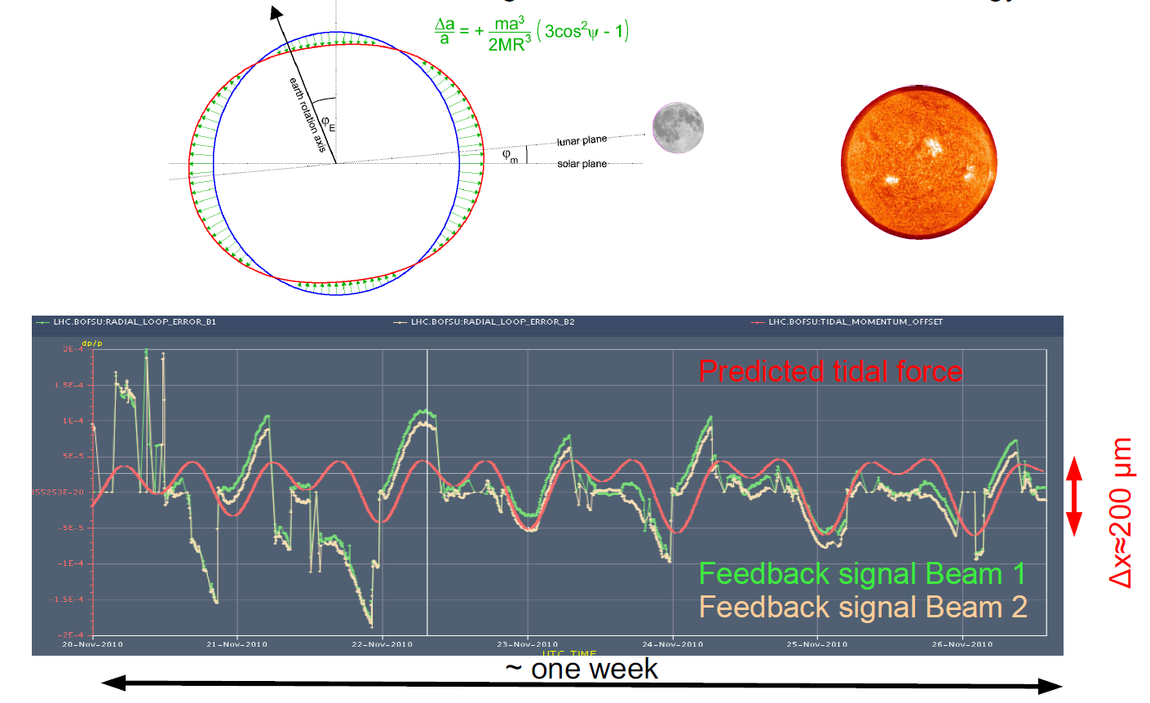
Beam Orbit Stability (cont.)
Earth Tides dominate during Physics

Slide 23
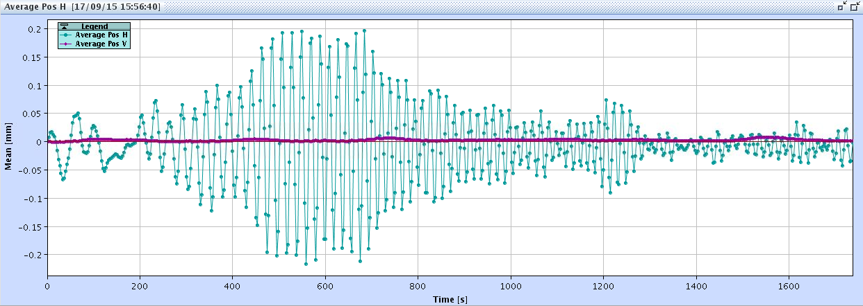
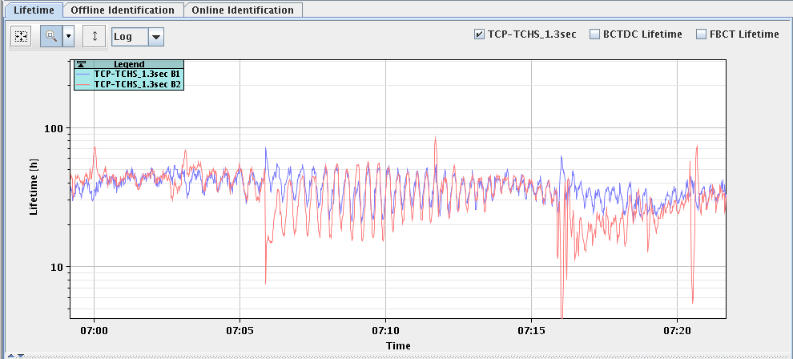
Beam Orbit Stability (cont.)
LHC radial orbit change on Sept. 16, 2015 between 01:45 and 02:15 (23:45-00:15 UTC), being at injection energy. Radial amplitudes are large, ~200 μm.
  Earthquake in Chile
  Observed roughly 1 hour after the 8.3 magnitude quake, which fits with a simple estimate based on a distance of 12,000 km at a speed of 4 km/s
Oscillation period is ~25 sec

Slide 24
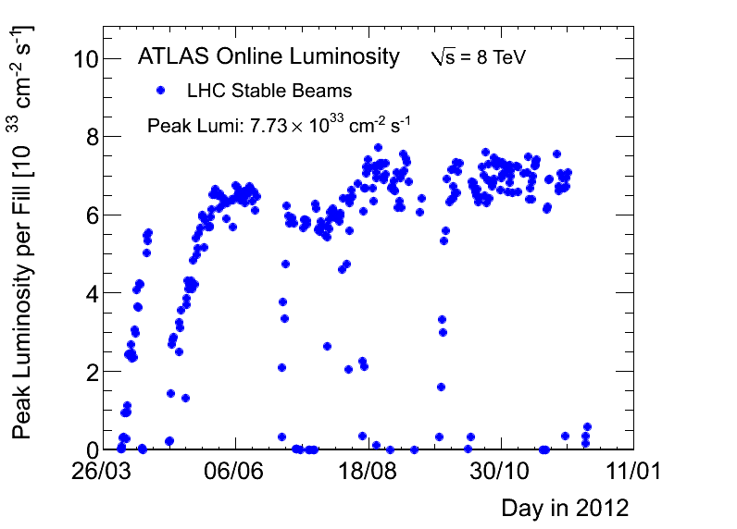
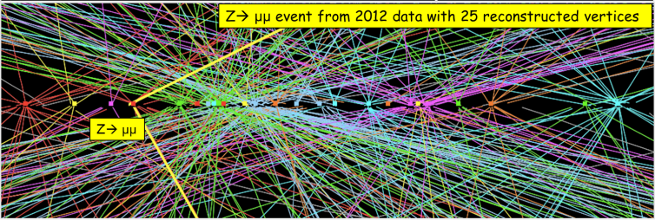
Running with 25 ns Bunch Spacing
During Run 1 ran at 50ns bunch spacing with near ultimate bunch intensities and small emittances
  Achieved a peak luminosity of nearly 8×10³³ cm⁻²s⁻¹
Close to design luminosity of 10³⁴ cm⁻²s⁻¹
Why change?
Experiments inefficient with large number of collisions per crossing
Moving to 25ns spacing
  increases total intensity while significantly lowering pile-up

Slide 25
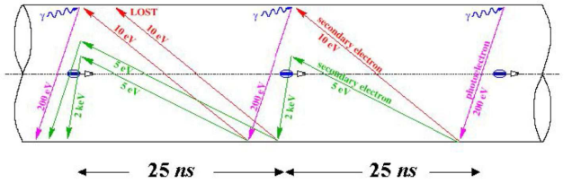
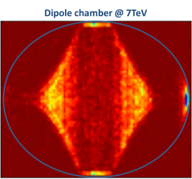
25 ns Bunch Spacing & E-Cloud
When an accelerator is operated with close bunch spacing an Electron Cloud can develop in the beam chamber due to Secondary Emission from the chamber wall
Consequences
Impact on beam quality
  induced instabilities, particle loss, emittance growth
  Dynamic pressure rise
  Heat load (for cryogenic sections)
For LHC these are much worse for 25ns beams
Scrubbing efficiency

Slide 26
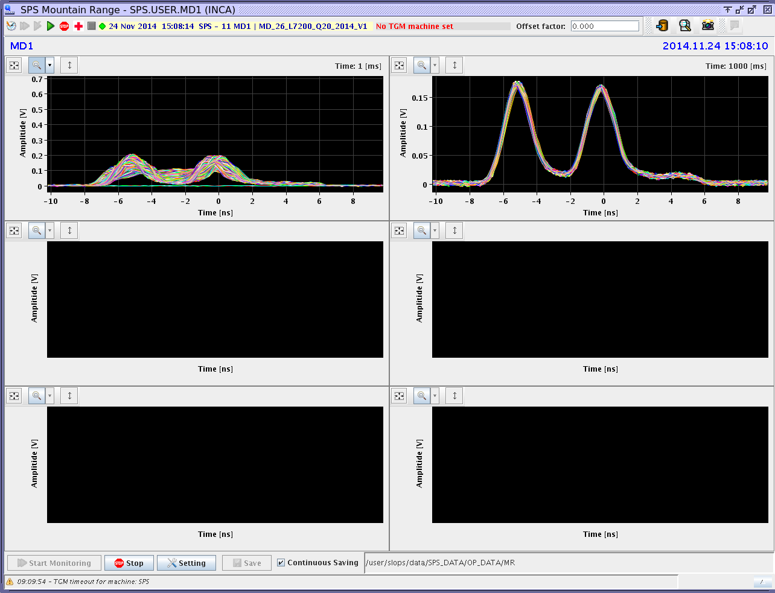
Doublet Bunches & Interlock BPMs
Eight BPMs near the dump extraction line are part of the LHC technical interlock
  A few mm orbit window threshold, accompanied with # of turns and time interval, triggers the beam dump.
The BPM read-out electronics was not designed to cope with 6 ns / 25 ns doublet bunches
  False beam dumps, perhaps even unsafe operation!
  Bad orbit and wrong FB values for all other BPMs
Looking into new BPM signals processing schemas
  1.2 GHz broadband analog section
  4 GSPS 12-bit ADC based DDC
6 ns

Slide 27
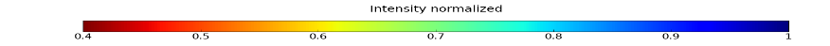
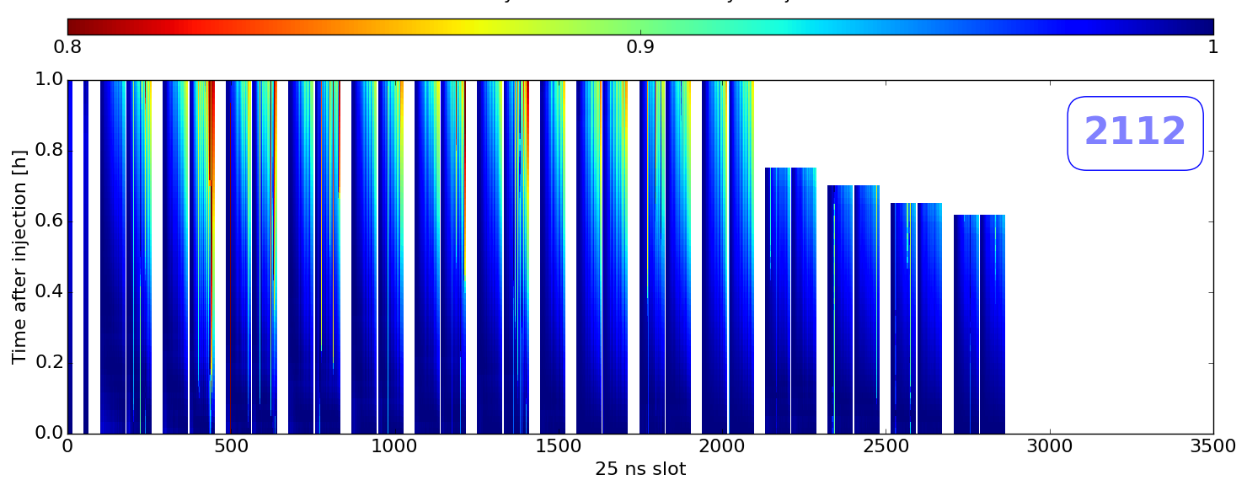
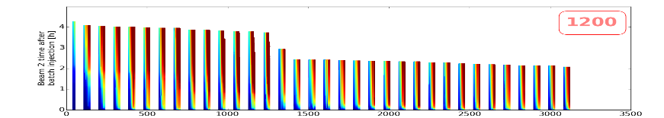
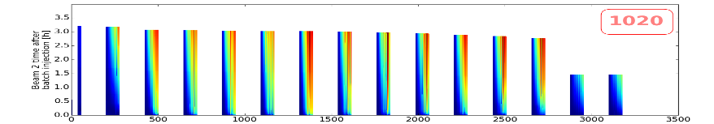
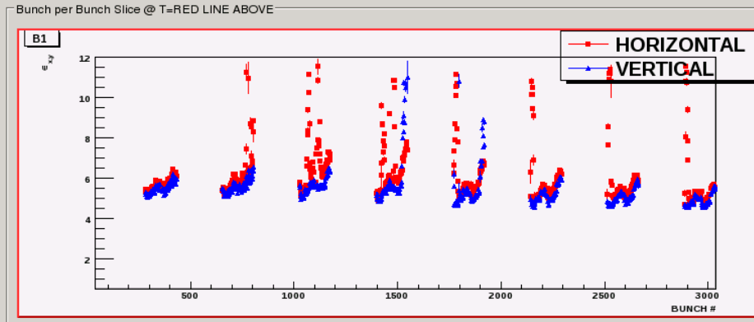
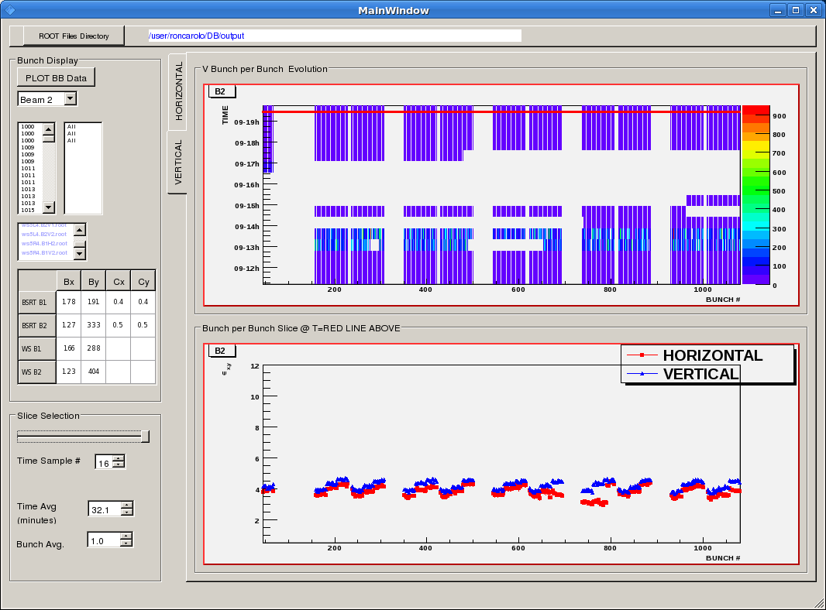
25 ns – Measuring Instabilities
Bunch-by-bunch measurements
Fast Beam Current Transformer
  Relative bunch intensities
Synchrotron Light Monitor
  Relative bunch size
  Gated camera allows profile of all bunches to be captured in a few minutes
Tue 29 June
Fri 3 July
LHC Synchrotron Light Diagnostics
Emittance
Bunch number
Emittance
Bunch number
Emittance blow-up before & after scrubbing

Slide 28
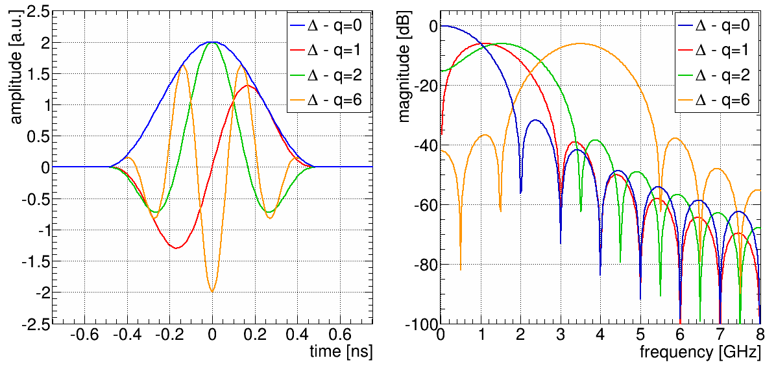
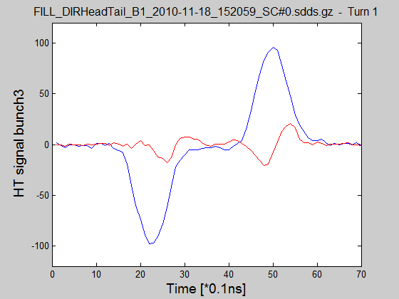
25 ns – Detecting Instabilities
Intra-bunch measurements
Head-Tail monitor
  Resolution limited to ~100μm due to orbit offsets & limited ADC resolution
Multiband Instability Monitor – currently being developed
  16 bands @ Δf_{b} = 400 MHz
  Use filter bank followed by direct diode detection for high sensitivity
  Can infer mode of oscillation and be used to trigger other systems

Slide 29
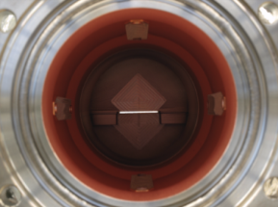
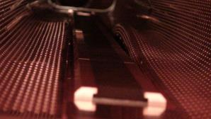



Coping with High Brightness Beams
Beam induced RF Heating
Observed on many systems in Run 1
Largely improved for Run 2
Heating of ATLAS ALFA Detector
Deformation of Beam screen around injection protection jaw
Deformation of bellow support spring
Overheated and broken ferrite absorbers (BSRT).
Injection Kicker heating

Slide 30




Synchrotron Light Extraction Mirror
Metallic mirror holder + Silicon bulk mirror
Mirror heating clearly correlated to
  beam intensity
  beam spectrum
  bunch length
Metallic holder
Silicon bulk mirror
Beam
SR
Failure of mirror holder + blistering of mirror coating
deformed
clips
blistered
SR mirror
Complete Re-design
EM Simulations
Lab Measurements

Slide 31




Synchrotron Light Extraction Mirror
E-field of a dominant resonating mode at 650 MHz.
(Q = 1263 / Rsh = 25841 Ohm)
Longitudinal wake impedance of BSRT
with and without Ferrite damping
Mirror front
B-field of the beam in Time Domain.
Red = Hot (bigger current density) : Blue = Cold
Mirror Back

Slide 32



Sync Light Mirror (cont.)
OLD Extraction Mirror
NEW Extraction Mirror
Solution for Run II with low RF ‘footprint’ and shielded cavities

Slide 33


The High Brightness, Small Beam Size Measurement Challenge: Sync Light (cont.)
Interferometry
Non-diffraction limited & widely used in e⁻ machines for very small beam sizes
New project in collaboration with KEK, SLAC & CELLS-ALBA
Injection
7 TeV
Simulated interference fringes & resulting Line Spread Function
Interference fringes for different emittances & predicted visibility as function of emittance

Slide 34

1st Results of the Interferometer
Tested with one beam
Initial measurements in 2015 look promising…
Cross-calibration with the wire-scanner not yet performed
If successful, interferometers will be deployed for both beams

Slide 35


The High Brightness, Small Beam Size Measurement Challenge: Wire Scanner
Wire Scanners - Operational limits after LS1
Limit defined by wire sublimation process
At 450 GeV limit at 2.7×10¹³ protons
  One injected SPS batch of 144 bunches @ 50ns OK
  One injected SPS batch of 288 bunches @ 25ns NOT OK
At 6.5 TeV limit at 2.7×10¹² protons
  ~20 bunches
Issue for calibration of all other beam size measurement devices

Slide 36


2015: Going into Run 2…
2015: Stress level in the control room (as observed by Mike Lamont)
More stress with
unidentified lying objects…

Slide 37


Irritation with Schottky Signals?!
Hum…
1st 13 TeV stable beams – 8:30 meeting

Slide 38

More fun with Schottky Signals…

Slide 39

End of a stressful 2015

Slide 40
Into 2016: Excellent start, but then…
66 kV bushing
18 kV cable termination
after being shorted to ground by a weasel

Slide 41

Beyond Run 2: The Next 10 Years
Run 2
Run 3
6.5 to 7 TeV
Peak luminosity 1.7x10³⁴cm⁻²s⁻¹
7 TeV
Peak luminosity 2.0x10³⁴cm⁻²s⁻¹
LHC Injector Upgrade:
Connection of new LINAC4
Major upgrades to many systems
  RF, BI, injection/extraction,…
Experimental Upgrade:
ALICE & LHCb
High Luminosity LHC Upgrade:
Peak luminosity 5×10³⁴ cm⁻²s⁻¹
3000 fb⁻¹ in ~10 years
Replacement of Triplet Quads
Addition of crab cavities
Cryogenic upgrade
Major Experimental Upgrade

Slide 42

High Luminosity LHC Goals
Prepare LHC for operation beyond 2025
Achieve a total integrated luminosity of 3000 fb⁻¹ by 2035
  Ten times the luminosity reach of first 10 years of LHC operation
  Integrated luminosity of 250 fb⁻¹ per year
  (levelled luminosity of 5x10³⁴ cm⁻² s⁻¹)
Parameters compared to nominal LHC
  2x current (bunch & total), 3x smaller β*, 2/3 emittance

Slide 43






Critical Zones around Atlas & CMS
ATLAS
CMS
Installation of new equipment in an area of 1.2 km
  New triplets using Nb₃Sn technology
  Addition of crab cavities & new D1, D2, Q4 & correctors
  11 T Nb₃Sn dipoles to allow additional collimators in the dispersion suppressor
Elimination of technical bottlenecks
  Cryogenic system upgrade
  Relocation of power converters – use of high temperature superconducting links
Need for new beam instrumentation
to further improve machine operations and beam quality

Slide 44

Beam Loss Monitoring for HL-LHC
Essential for safe & reliable operation of LHC
  Prevents damage to accelerator components
  Avoids quenches & associated time-consuming cryo recovery
Existing system
  Meets needs of the HL-LHC in arc regions
    ~3000 ionisation chambers
    Radiation tolerant front-end electronics
New requirements for high luminosity interaction points
  Cryogenic beam loss monitors for triplet magnets
  Radiation Hard front-end electronics

Slide 45



“Cryogenic” Beam Loss Monitors
HL-LHC triplets are running close to the quench limit due to luminosity
Current BLM thresholds are 3x below quench level
  Not applicable for HL-LHC triplet
To improve the sensitivity of BLMs: from the outside to the inside of the cryostats – avoid shielding from iron yokes
  BLMs in cryogenic environment (LHe, silicon, diamonds).
  CryoBLMs promise 2-3 times better separation for debris & losses
Diamond BLM detector,
courtesy of E. Griesmayer

Slide 46




Beam Position Monitors for HL-LHC
Beam Position Monitoring System
  All ~500 BPMs per beam have bunch-by-bunch acquisition
    No performance increase required for the arc BPMs
    Renovation of the electronics foreseen for LS 3 (2023-2025)
New BPMs required for HL-LHC interaction regions
  Stripline BPMs with high directivity
  Distinguish position signals between both beams
    in the same vacuum chamber
  Remaining cross talk of beam signals
    Time separation by optimizing BPM location
    Signal separation by improved pickup design
    Signal entangling by advanced signal processing
Towards collision point

Slide 47


Directional Stripline Coupler BPM
Current BPMs suffer for limited directivity (~27 dB @ 70 MHz)
  Leads to position errors 10-100 μm
New designs being pursued to improve this
  7-10 dB improvement demonstrated in simulation
  Next step to turn this into a mechanical design with all the constraints of a cryogenic BPM
Additional contraints
  Integration of tungsten shielding
  Required to maintain uniform cold bore aperture to limit energy deposition in magnet coils

Slide 48

Non-Invasive Beam Size Measurement
The Beam Gas Vertex Detector
Beam Profile
Beam Trajectories
Based on concept used by LHCb vertex detector

Slide 49


The LHC Beam Gas Vertex Detector
Prototype installed on one beam during LS1
    Detectors based on scintillating fibers read out with SiPMs
LHCb (CERN)
EPFL (CH)
Aachen (DE)

Slide 50




Gas Jet Techniques
Gas sheet & luminescence (University of Liverpool/UK & CERN)
  Being considered for hollow electron lens diagnostics
Beam
Gas jet scanner – alternative to wire-scanner
  Use atomic sieve to focus neutral gas atoms
    Quantum inteference
  Modify scan speed for core or halo measurements
20μm

Slide 51




Beam Halo Mitigation: Hollow E-Lens
Halo cleaning by electron lens demonstrated at Tevatron.
  Soft scrapper
  No material damage
  Tunable strength – diffusion speed
Beam population
Diffusion speed
p
p
Such a lend is considered as option for HL-LHC
(CERN_LARP collaboration).
Stancari et al., Phys. Rev. Let. 107, 084802

Slide 52




Coronagraph for Halo Diagnostics
Diffraction creates fringes surrounding the central beam image
Intensity of fringes range 10⁻² to 10⁻³ of the peak intensity
Masks used for observation of weal halo at 10⁻⁵
  Need to find out how to reduce the effect of the diffraction fringes
Apply coronagraph technology developed for astronomy

Slide 53

Coronagraph for Halo Diagnostics
Demonstrated at the KEK Photon Factory
  Achieved 6x10⁻⁷ ratio background to peak intensity
  ~50 μm spatial resolution
Main challenge
  Avoid noise from imperfections or dust on objective lens
Preliminary estimation for HL-LHC
  Feasible reduction of diffraction
  background to 10⁻⁶ in the region
  of interest
  Image halo to a few mm
  surrounding the beam core with
  0.1-0.2 mm spatial resolution
R&D collaboration with KEK
Courtesy of Toshiyuki Mitsuhashi

Slide 54

Additional Intra-Bunch Diagnostics
Already important for understanding instabilities
  Electron cloud, impedance, beam-beam, ….
Will also be essential for crab cavity diagnostics
  Understanding their effects on the beam
Two methods being investigated
  Streak cameras looking at synchrotron radiation
    Will require new light extraction line to be built
    Light transport to radiation free area
  High resolution electromagnetic pick-ups

Slide 55



Electro-Optical BPMs
Traditional electromagnetic BPMs are already installed in the LHC
  Higher time resolution requires more bandwidth: >10 GHz
    R&D on beam pickups based on electro-optical crystals
    First tests started at the CERN SPS
      In collaboration with the Royal Holloway University of London and the Daresbury Laboratory

Slide 56
Summary
The LHC was build with a comprehensive suite of beam diagnostic devices
  These instruments play an important role for safe & reliable day-to-day beam operation
HL-LHC will push the performance of the LHC even further
  …and requires deep and better understanding of all beam related phenomena
Beam observation can only be delivered by beam instrumentation devices
  Upgrade of many exsisting BI systems
  Development of new beam diagnostics to address specific needs has already started...

Slide 57

THANK YOU!
Please spread the word
and sign up!

Slide 58
Backup Material

Slide 59
Modern Machine Protection System : P³
Protect the machine
  Highest priority is to avoid damage of the accelerator.
Protect the beam
  Complex protection systems may reduce the accelerator availability, an aspect that must be taken into account at the design phase.
  Trade-off between protection and operation.
    Availability (targets): ~99% light sources, ~95% spallation sources like SNS, ESS, LHC so far modest 35%.
Provide the evidence
  Clear (post-mortem) diagnostics must be provided when:
    the protection systems stop operation,
    something goes wrong (failure, damage, but also ‘near miss’).
Machine protection is not limited to designing a fast interlock !
Machine protection must be closely integrated into the machine design !

Slide 60

High Power Hadron Accelerators
Planned projects: 1-10 MW range
IFMIF
LIPAc
10 MW
0.1 MW
1 MW
ILC ~ 20 MW
Courtesy M. Lindroos

Slide 61



Release of 600 MJ at LHC
The 2008 LHC accident happened during test runs without beam.
A magnet interconnect was defect and the circuit opened. An electrical arc provoked a He pressure wave damaging ~600 m of LHC, polluting the beam vacuum over more than 2 km.
Collateral damage from the helium pressure wave dominates !
Arcing in the interconnection
Magnet displacement
53 magnets to repair, 14 months downtime
Over-pressure
J. Wenninger for LHC, PAC09

Slide 62

2008 – What happened?
Theory: A resistive joint of about 220 nΩ with bad electrical and thermal contacts with the stabilizer
No electrical contact between wedge and U-profile with the bus on at least 1 side of the joint
No bonding at joint with the U-profile and the wedge
Loss of clamping pressure on the joint and between joint and stabilizer
Degradation of transverse contact between superconducting cable and stabilizer
Interruption of longitudinal electrical continuity in stabilizer
Problem: this is where the evidence used to be

Slide 63
LHC Long Shutdown 1
Primary aim
Consolidation to allow running at high energy
Three main tasks
Superconducting magnet and circuit consolidation
Reducing effect of radiation on electronics
Full maintenance of all equipment,
including majority of beam instrumentation

Slide 64






Splice Consolidation Process
Old splices
10170 splices
Machined splices
Consolidated splices including shunts
> 27000 shunts
30% of the splices
Initially estimated at 15%
~ 3000
Unsoldering of splice and superconducting cables
Reconstruction and soldering of splice and superconducting cables
Consolidated and insulated splices

Slide 65

LS1 2013/14: SC-Wire Consolidation

Slide 66

The High Brightness, Small Beam Size Measurement Challenge: Sync Light
New extraction mirror design
Wave-front distortion measurements (Shack-Hartman mask method) with and without beam
During Run1 :
imaging accuracy compromised by extraction mirror heating and coating blistering
→light scattering, image blurring
Problem
Proposed Solution
@ 6.5-7 TeV when imaging in the UV (e.g. 250nm):
contribution from diffraction (~250μm) > beam size (180μm)
Imaging a narrow band in the near UV to reduce diffraction
Interferometry (not diffraction limited)
250nm focusing lenses
UV sensitive CCD camera photocathode
New optical line (in parallel to imaging, after splitting)
Line Spread Function (LSF) @ 7 TeV
Size at image plane
(Mag 0.25)

Slide 67


The High Brightness, Small Beam Size Measurement Challenge: IPM (cont.)
Outlook for proton beam size measurements
At injection: emittance OK - agreement with wire scanner
Unphysical behavior during ramp and squeeze.
  Explanation: profile distortion due to beam space-charge
  Confirmed by simulations.
Distorted profile cannot easily be fitted
Solution: increase of magnetic field to 1 T (not foreseen for the moment)

Slide 68



Monitoring 2 Beams in a Single Pipe
Beam monitoring, e.g. beam position / orbit measurement of both beams (e⁺, e⁻) in a single beam pipe
  Few beam bunches: time discrimination
  Many beam bunches: difficult!
    BPM pickups with directivity
    Advanced BPM signal processing
    including beam arrival time
Gaussian bunch:
  n=1E10, σ=25mm, v=c₀
d_{pipe}: 25 mm
l_{strip}: 200 mm

Slide 69



BPM Long-Term Drift Compensation
Libera crossbar switching technique
  <100 nm stability over 14 hours
courtesy P. Leban
courtesy N. Eddy
Calibration tone technique (only in narrowband
operation)
ATF (KEK)

Slide 70



BPM Wake-Potential & Impedance
The longitudinal coupling impedance of the button pickup is based on the transfer impedance and scales with
  The slot between button and pipe
  acts as resonator, thus gives
  additional impedance effects, also
  contributes at low frequencies
  Thickness and shape of the
  button have significant
  influence on the coupling impedance
The BPM system performance
  Often is not anymore limited by the read-out electronics
  Has an impact on the machine impedance budget and instabilities!
Large # of BPMS:
There is no free lunch !

Slide 71




Laser Wire
For H⁻ & e-beams
  Non-invasive beam profile and emittance monitor
  Demonstrated resolution in the μm regime
  Also used for beam polarization measurement
Needs further R&D for
turn-key instrument
  Reliable (fiber) laser system
  Multi-station light distribution system and optical components

Slide 72


The High Brightness, Small Beam Size Measurement Challenge: IPM
Layout
Gas injection (Ne)
Electron collection with 0.2 T guide magnets and MCP signal amplification
Optical readout from phosphor screen with Rad-hard camera
Results
Worked well for Pb ions (what it was designed for)
Gave distorted images for protons at high energy

Slide 73

“Cryogenic” BLMs
To improve the sensitivity of BLMs: from the outside to the inside of the cryostats – avoid shielding from iron yokes
  BLMs in cryogenic environment (LHe, silicon, diamonds).
  First tests in the LHC in 2015.
Similar ideas at FRIB and IFMIF for high sensitivity halo monitors
Diamond BLM detector,
courtesy of E. Griesmayer

Slide 74


Cryogenic Beam Loss Monitors
HL-LHC triplets are running close to the quench limit due to luminosity
Current BLM thresholds are 3x below quench level
  Not applicable for HL-LHC triplet
  Need additional precise measurements
CryoBLMs promise 2-3 times better separation for debris & losses
Standard BLM
BLM Threshold
Cryo-BLM
BLM
Threshold

Slide 75


Cryogenic BLMs (cont.)
Two types of detectors tested under irradiation at cold (2K) up to several MGy
  Single crystal chemical vapor deposition (CVD) diamond
  p⁺-n-n⁺ silicon
Charge collection efficiency degrades 15x in both under irradiation to 20 MGy
High leakage current of Si if irradiated at warm, but disappears when irradiated at cold!
Now testing both detectors in LHC under operational conditions
1 MGy

Slide 76

Scrubbing Runs in 2015
50 ns
25 ns

