Slide 1
Laser Notcher July Commissioning and Shutdown Plans
David Johnson & Todd Johnson
August 10, 2016

Slide 2
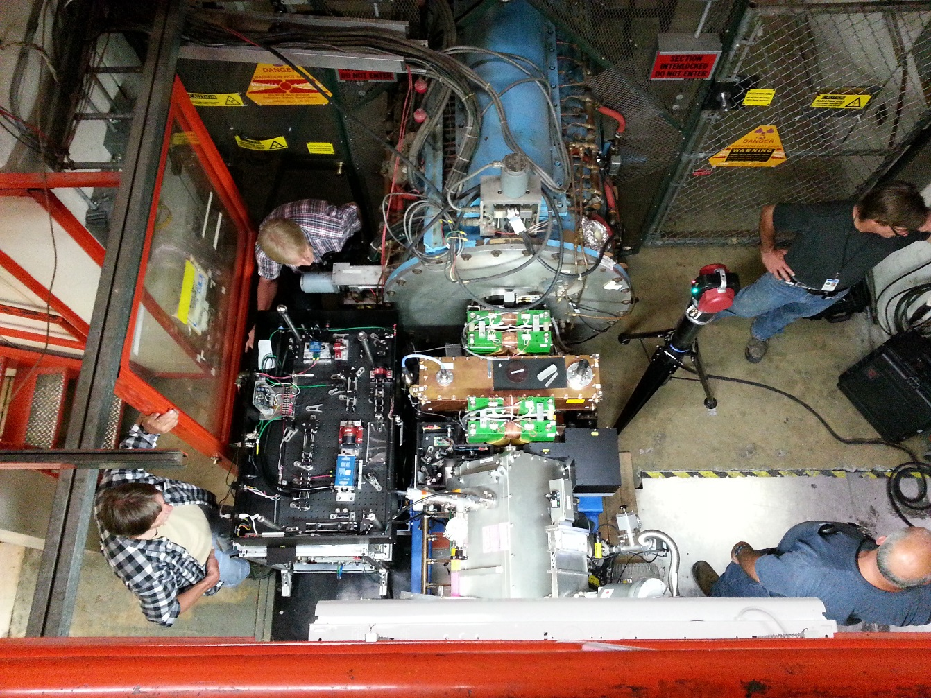
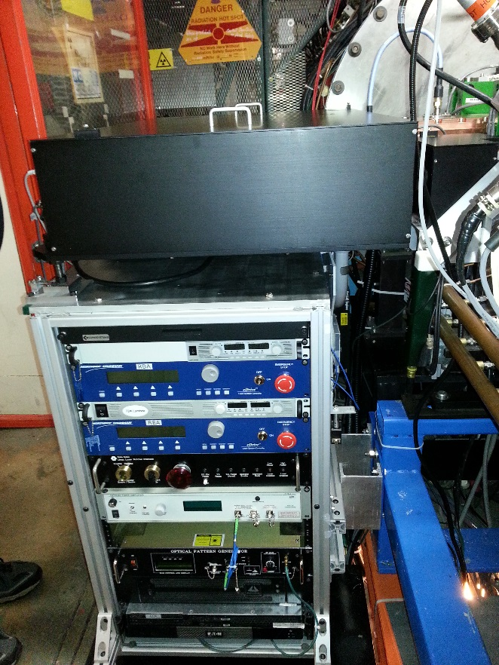
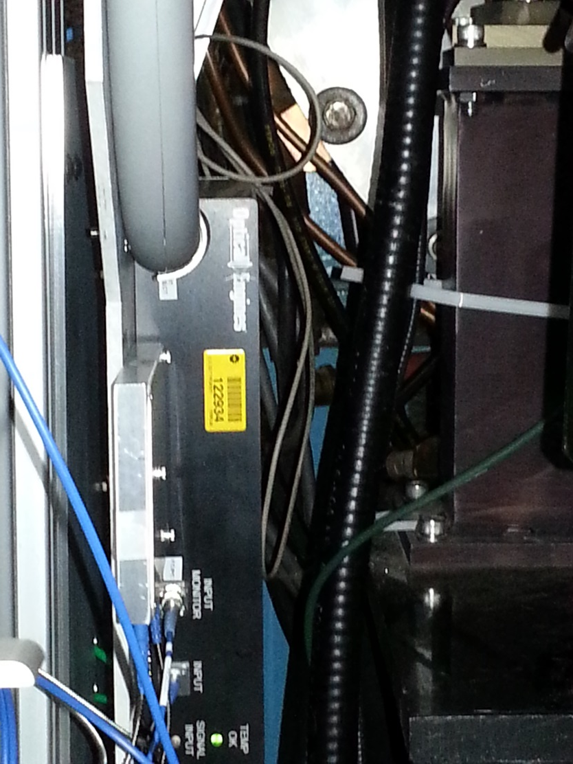
Timeline (1)
July 6th installation & alignment of the transport and dump enclosure
July 12th Finished installation & alignment of the optics box

Slide 4
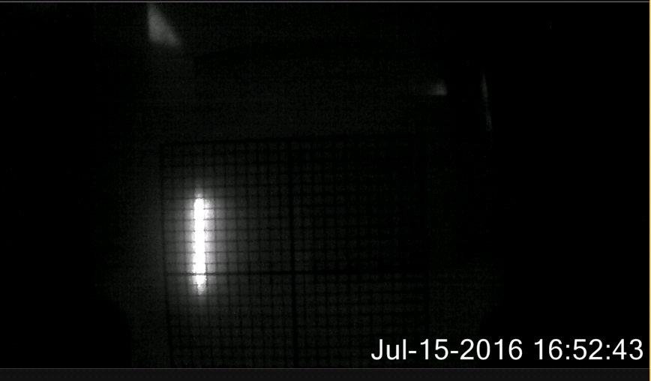
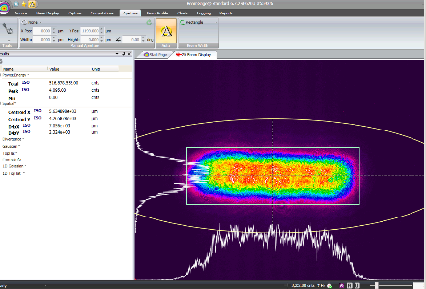
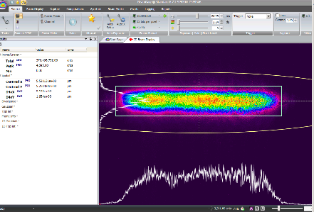
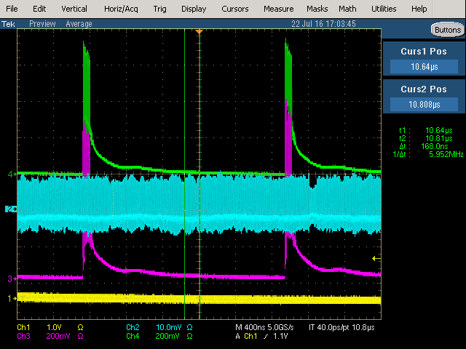
Timeline (2)
July 15th (Friday noon)Permission to Operate from ORC (we’re the first project in AD to fall under the new Operational Readiness Clearance)
July 15th By the end of the day we had a laser profile in the dump.
July 19th (Tues.) Continued to optimize transmission thru cavity
July 22nd (Friday) demonstrated first notches in Linac pulse
  Before adjusting notch timing (starting and separation between notches)
Scanned the delay after the Notch trigger
Adjusted separation of between notch pulses
  Both of these were added to the waveform calculation section
  Thanks to Bobby Santucci & Dave Slimmer
  This resulted in much greater efficiency in notch generation
Optics Box
Dump
About 75% transmission
See next slide

Slide 5
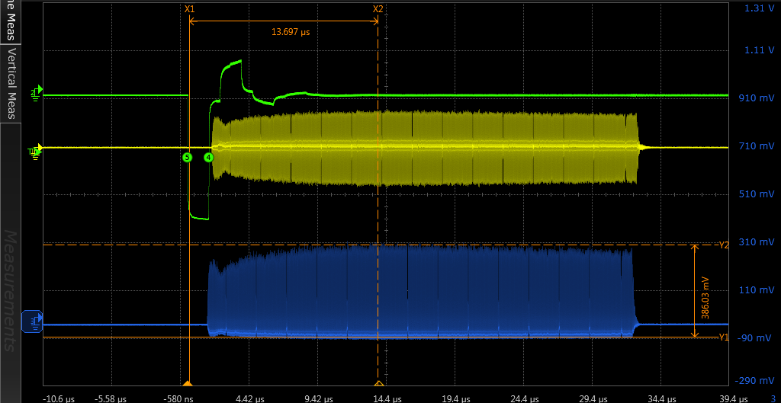
Observations of multiple notches created in Linac Pulse
Linac Griffin Det.
Notch
trigger
Linac WCM
Notches in Linac pulse with ~200 mJ total laser energy in the Dump

Slide 6
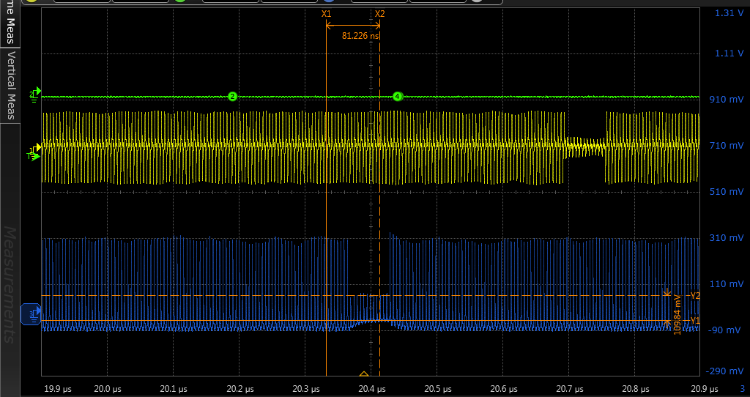
Zoom in on 9th Notch
Neutralization efficiency estimated from signal heights of notched bunches to the unaffected bunches (both detectors give similar results).

Slide 7
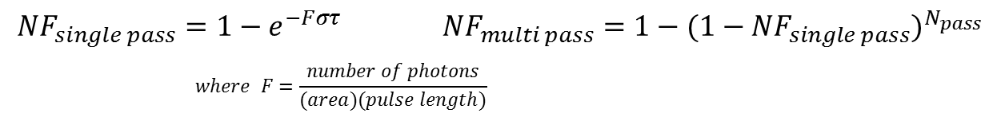
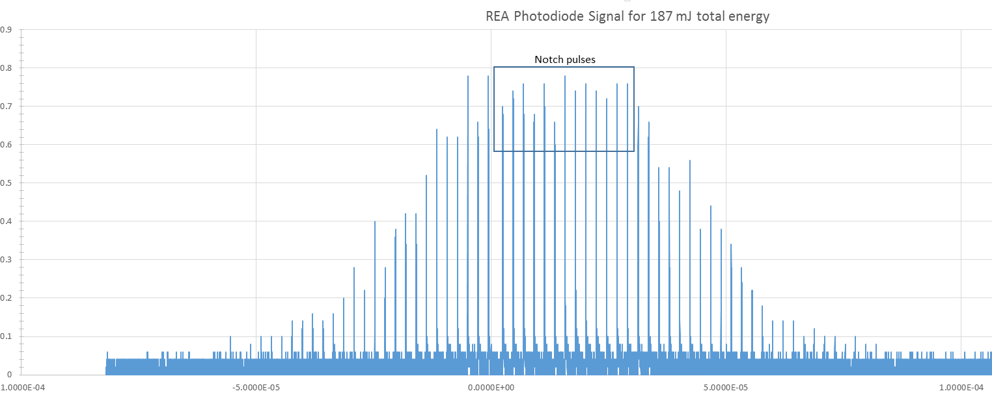
Estimate neutralization based upon laser parameters
Take neutralization data as a function of pulse energy
Recall
The parameters of interest are laser pulse energy, pulse length, transverse laser dimensions thru the cavity, and the number of interactions in cavity
Laser pulse energy
Laser pulse length
  Set to 2 ns in waveform tables
Transverse laser dimensions
(next slide)
Notch Pulses
About 39% of total energy seen in dump
participates in neutralization process
These pulses do not interact with Linac pulse
Only add to total power to free space optics
May be removed w/ Pockels cell after OEA…

Slide 8
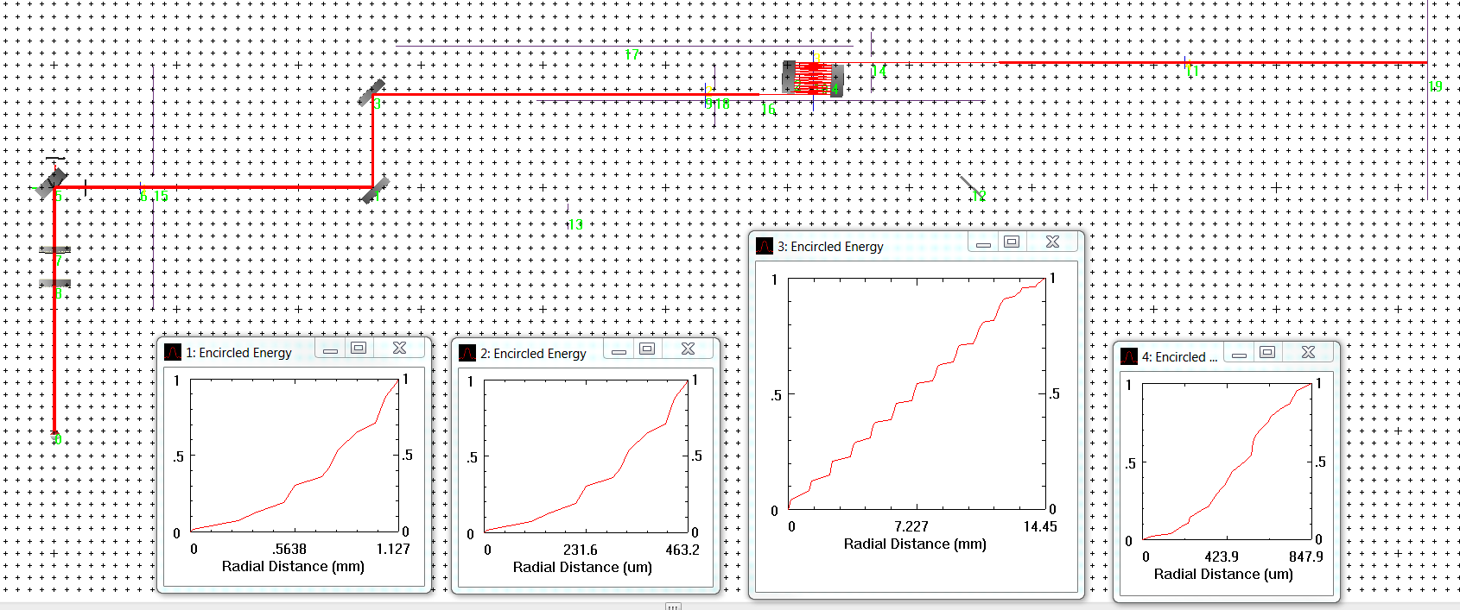
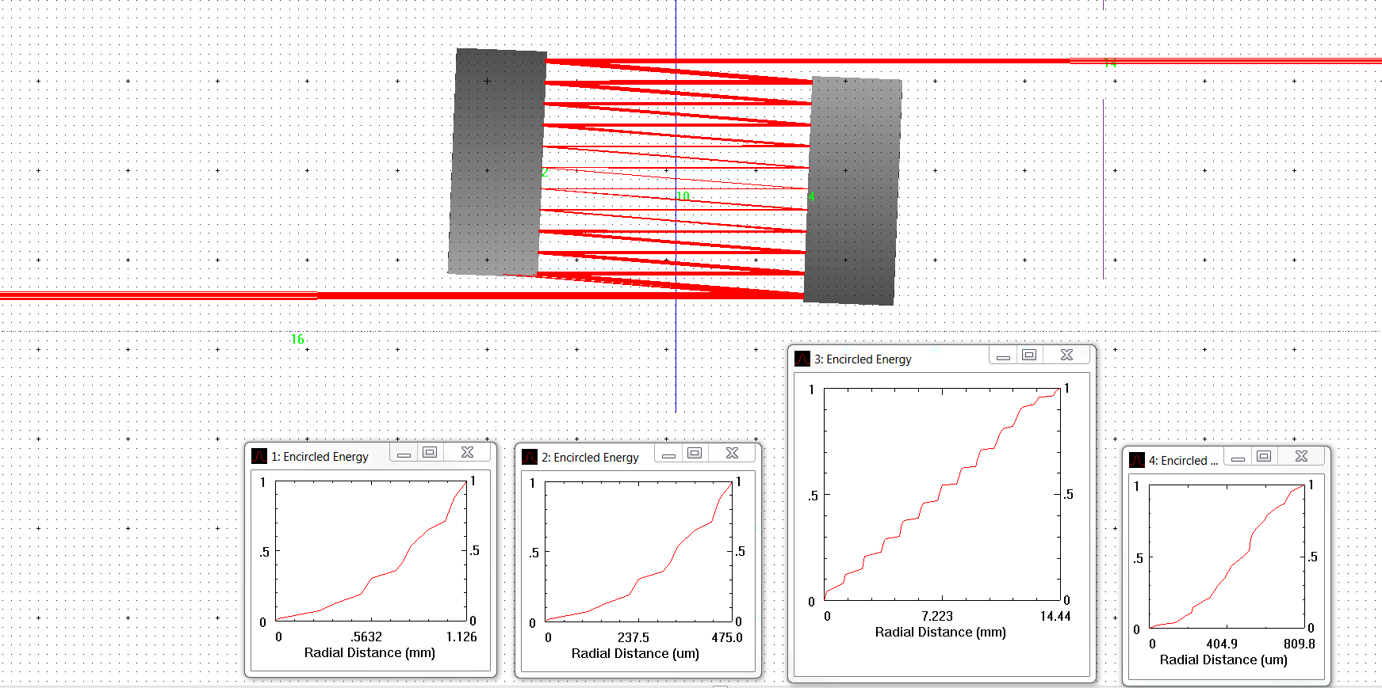
Laser Path and horizontal size thru cavity
23 interactions
Match profile Optics Box
Match profile Dump

Slide 9
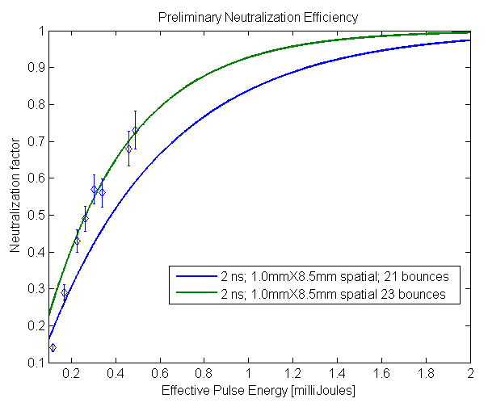
Preliminary Neutralization efficiency
Vary laser pulse energy
Compare with estimation
Design goal is 2 mJ/pulse

Slide 10
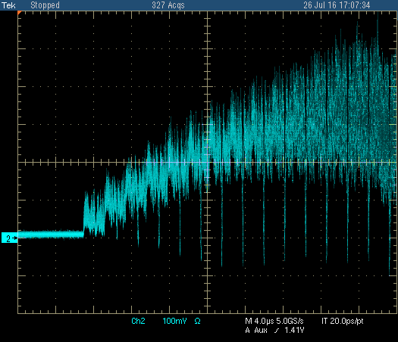
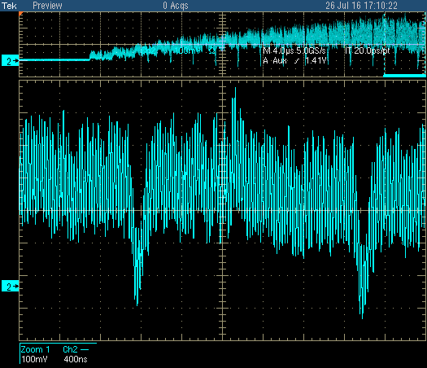
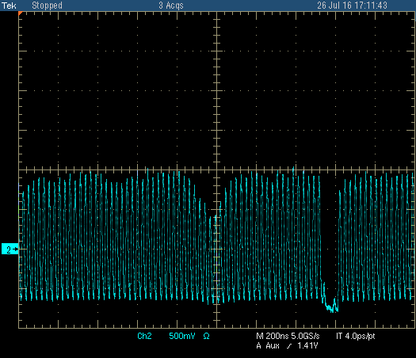
Booster Injection
Once we started seeing notches in the Linac pulse we looked to see them in Booster
  Look at the phase detector (or WCM)
  Clearly if we have ~70% in Linac, we need to learn how to keep this in Booster
Booster Notch
Linac Notch
~30%
Injection
1st & 2nd turn after injection
Sometime after Booster Notch creation

Slide 11
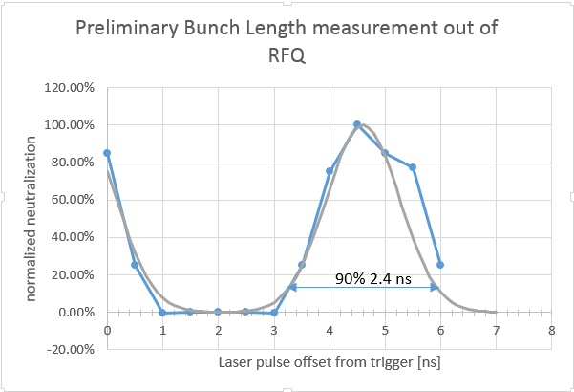
Bunch length of ions exiting the RFQ
Adjust the notch delay in the table in 500 ps steps and measure the neutralization
2 ns laser pulse

Slide 12

Lessons learned/issues
Temperature inside the rack
  Used several thermocouples to measure the temperature inside the electronics rack over a period of several hours
  Found temperatures in excess of 95 degrees.
    This impacts the wavelength shift for pump diodes
  Tried t use a fan on the front of the rack, but didn’t make any difference
Reduction of total energy over time
  Believe this is due to temperature in rack impacting pump diodes (more on this later)
Transmission efficiency through the cavity
  No direct measurements for laser path inside cavity and the number of bounces
  Only have indirect measurement by looking at input and output trajectory
  Need to have better measurement techniques of trajectories
RBA/REA solid state e-Drive controller trips on water flow
  Believe this was associated to induced noise in the water flow interlock circuit
  Tried cores, but didn’t help much
  Installed 0.1 uf cap across signal lines in DB9 connector – eliminated all trips
Communication issues
  Communication with devices hangs -> many times related to poor quality USB hub
Instrumentation issues
  The scope we are using to take data by the notcher
    Hangs up frequently, particularly when trying to save data, requires a power cycle
    This has added much time and frustration during commissioning

Slide 13
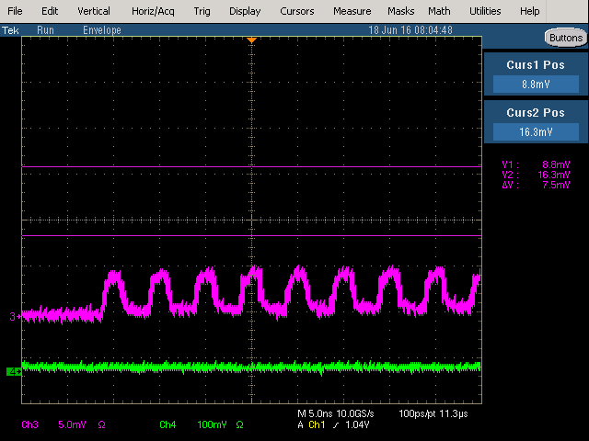
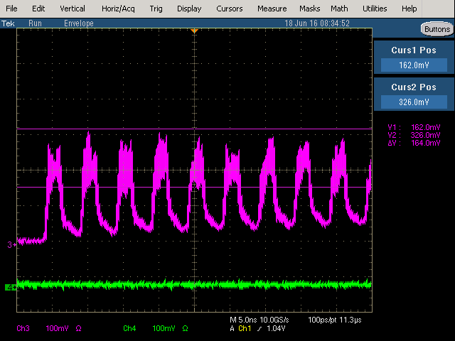
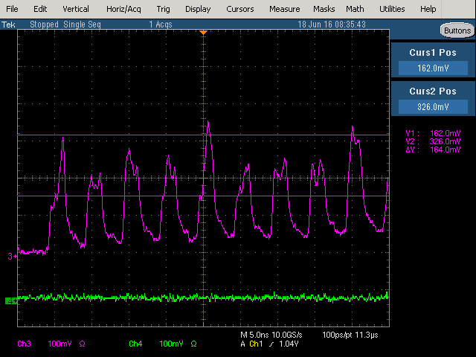
Known issues going into the commissioning period (1)
Instability in the RBA/REA amplifiers
  What are we seeing:
  High frequency component to pulsed output of the DPSS amplifiers
  Have discussed this issue with Jinhao, laser physicists at Grumman and Coherent, and others to isolate the cause and develop a remediation plan.
  The current candidate is “some sort of feedback” and based on time scale it indicates a fairly short “parasitic laser cavity (oscillator)” is present in the system.
envelope mode
single sample
OEA only at nominal pump
OEA and RBA at nominal pump
OEA and RBA at nominal pump

Slide 14
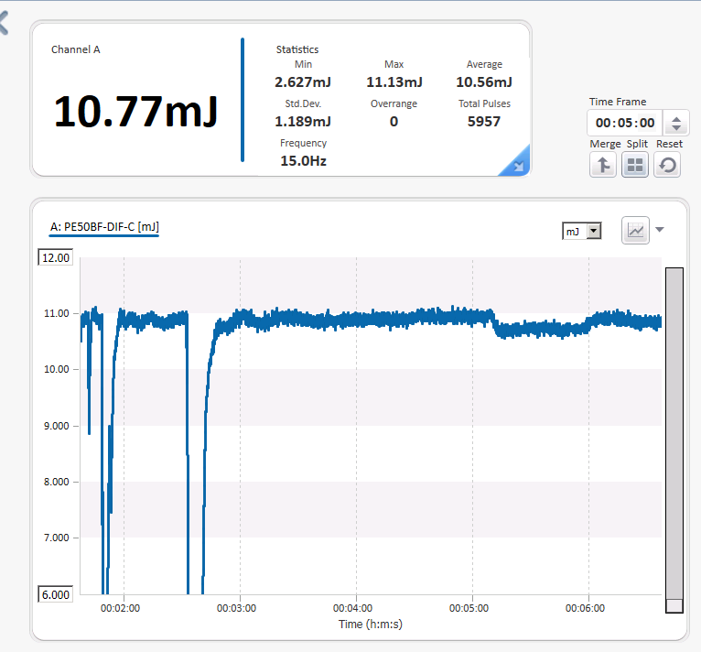
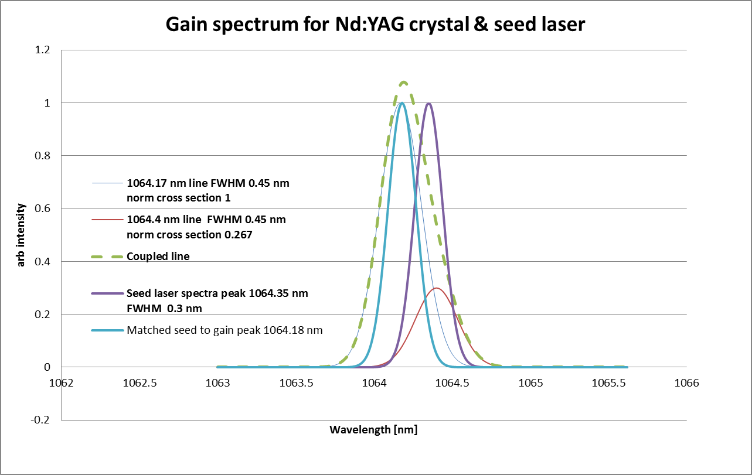
Known issues going into the commissioning period (2)
FBG temperature of the seed source
  This determines the central wavelength of the laser seed into the complete system. We have tested (in a crude way ) the wavelength shift and output pulse energy from the RBA module
  Fixed the FBG to an Al mass in Styrofoam insulator & used canned air to cool FBG
  As we hit the FBG with the liquid
    the RBA output dropped like a rock.
    The center wavelength moved from 1064.35 nm to 1063.9 nm
    As FBG warmed up & CW came to 1064.15 nm output was maximum
    Next small dip is me warming the fiber with my fingers to 1064.25 saw ~10% drop
  Did not try to warm the FBG
  Install a TEC on the FBG (potentially)

Slide 15
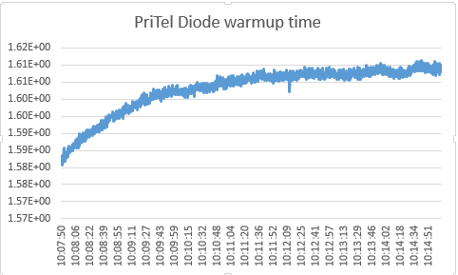
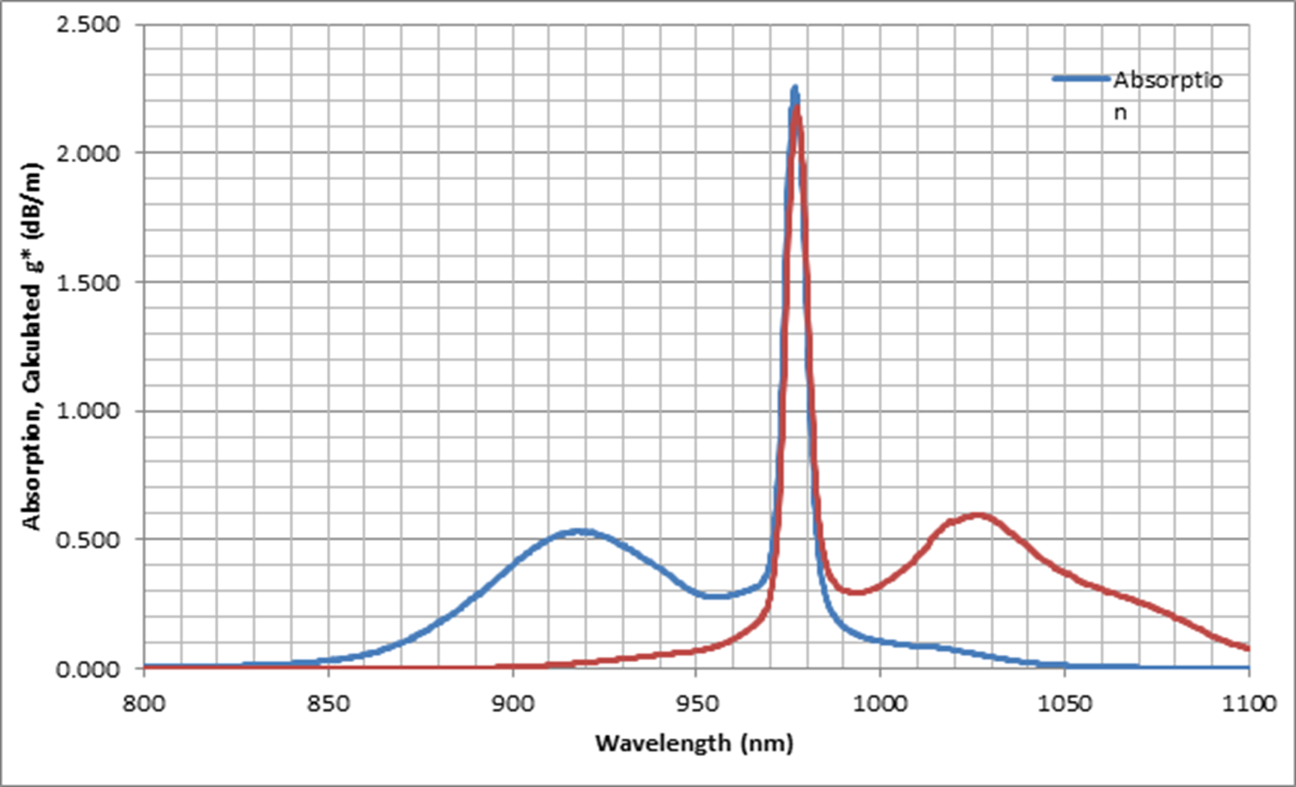
Known issues going into the commissioning period (3)
Temperature stability of fiber amp pump diodes
  Typically high power pump diodes do not have built in TEC
  Typically installed an large heat sync with forced air cooling
  Wavelength of diode shifts with temperature
  We want to have some additional air flow/cooling to make sure the
Here is about 2% effect

Slide 16
Known issues going into the commissioning period (4)
Output isolator of PriTel 2W amplifier limiting output power and hence input to Optical Engines pulsed amplifier
  The current output isolator is the original isolator with the PM Single mode fiber pig tails.
  This was not changed with the installation of the LMA fiber and LMA delivery fiber.
  Splice losses increase with the splice of fibers with different MFD
  The output of the LMA gain fiber was measured to be ~3W at 7.5A, with the current pump stripper, isolator, and delivery fiber the power to the OEA is about 1.7 W.
  Based upon the predicted loss in fusion splicing be fibers with dissimilar MFD, we expect an increase in average power (pulse energy) into the OEA of about 60%

Slide 17
Known issues going into the commissioning period (5)
Instrumentation
  Photodiode monitor
    Used to monitor seed diode, modulator output, PriTel 2W amplifier input, Reverse power in PriTel 2W amplifier, and input into Optical Engines pulsed amplifier
    Design is complete
    Have most (if not all components)
    Need to lay out boards, make boards and stull, and install in enclosure
  Integrating spheres
    Used to monitor output power of the OEA, RBA and REA.
    Gated
    Fermi design
  Oscilloscope
    We need a scope that does not crash when trying to save images

Slide 18
Study Plans
In Linac (est. thru Aug 12th)
  Additional alignment studies
  Optimization of transmission thru cavity
    Do we need to pull cavity for alignment tests?
  Determine filters for BPM (high intensity)
In Lab ( est. Aug 15th – Oct 15th )
  Move electronics rack, chiller, manifold into lab and re-set up
  Resolve instability in RBA/REA
  Increase seed power – replace output isolator
  Integrate new instrumentation
  Continue to test/optimize software and procedures
  Develop procedures for operation
  Add Pockels cell between fiber port and RBA
  Replace additional Plano-convex/concave telescope lenses with meniscus lenses to reduce abberation

Slide 19
Projects during shutdown
Once we move laser system into lab need to test interlocks before we run
Provide for rack cooling (ORC)
  Discussion with Dan Bollinger about the addition of cooling tube to cool the rack
Design, build, install electronics rack front door (to accommodate external cooling)
Design , build and install a water shield for Optical Engines Amplifier (at least)
Replace output isolator on 2W amplifier
Add grommet for power cord thru side wall (ORC)
Re-terminate Burndy connectors (ORC)
Install T&H sensor in Linac and connect to network (Mike Kucera)
Build & test photodiode monitor unit
Build & test integrating spheres
Replace consumer USB hubs with industrial hub (ordered) and mount
Install Pockels cell between fiber port and RBA

Slide 20
Conclusions/Take Away
We successfully demonstrated “for the first time anywhere” the ability to neutralize multiple sections (at the Booster revolution period) of a 200 MHz H- ion bunch structure out of the RFQ utilizing a burst mode fiber/solid state MOPA laser system combined with an optical zig-zag interaction cavity.
Although the laser system was not at design intensity (0.5 mJ/pulse) we demonstrated ~70% neutralization in the Linac pulse train.
The fiber and free space amplifiers worked as expected at the time.
We learned a great deal about operation of the laser system in the Linac environment and developed a good list of modifications and improvements.
We have a lot of work to accomplish during the shutdown and could use additional manpower to accomplish the tasks at hand.
We need to have a better scope to aid in commissioning
Although we saw survival of the notch ms after injection, it is clear that we need to address the survival of the notch in Booster when we turn back on.

