Slide 1
Garnet test setup. Cavity mechanical design, 1st round.
Gennady Romanov
2nd Harmonic cavity meeting
September 15, 2016

Slide 2
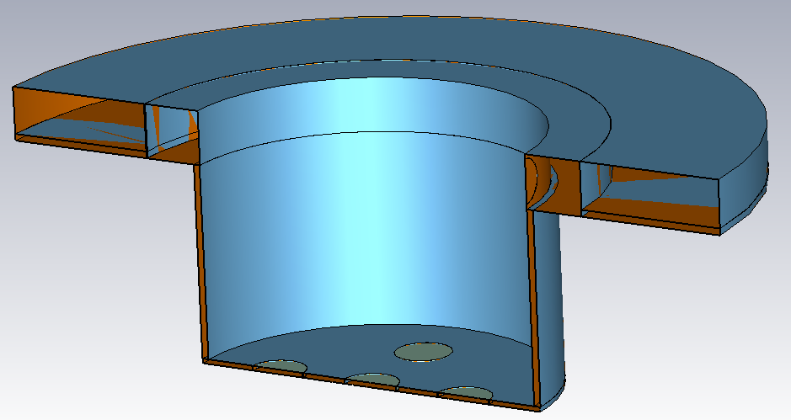
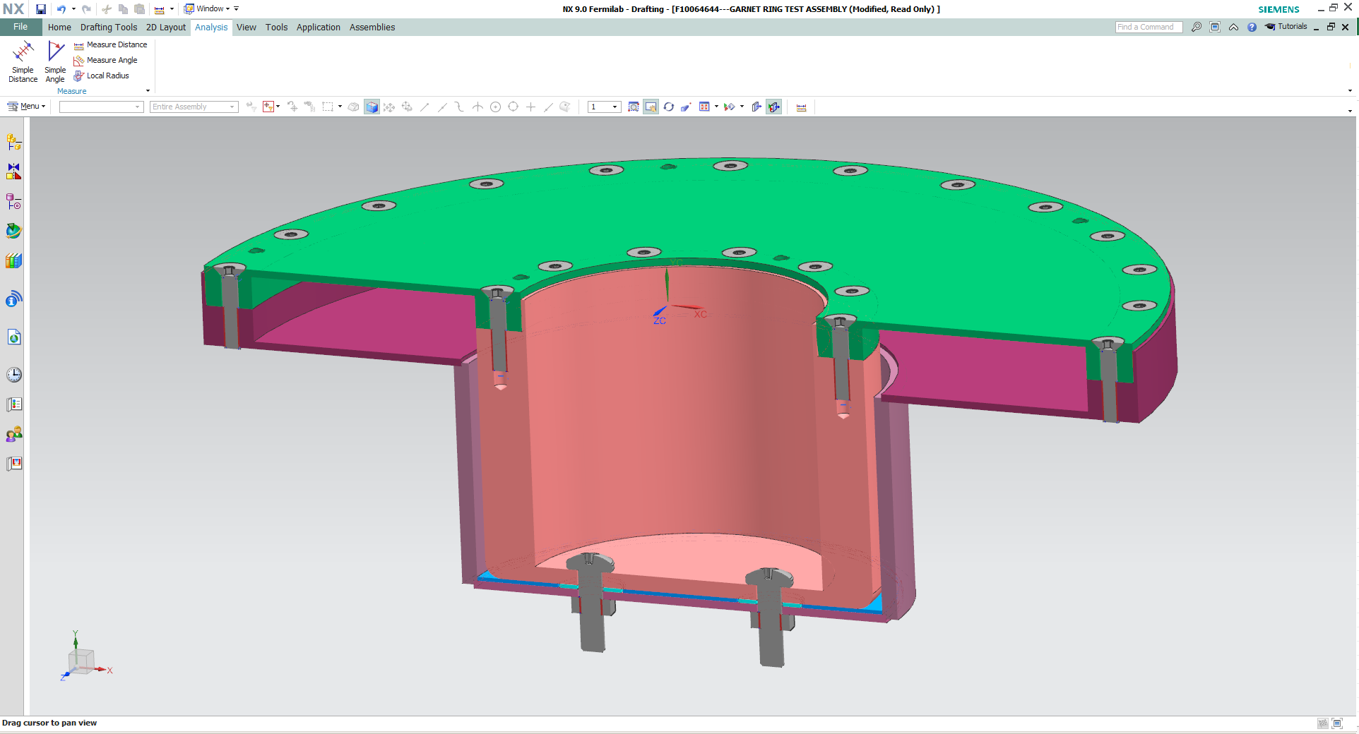
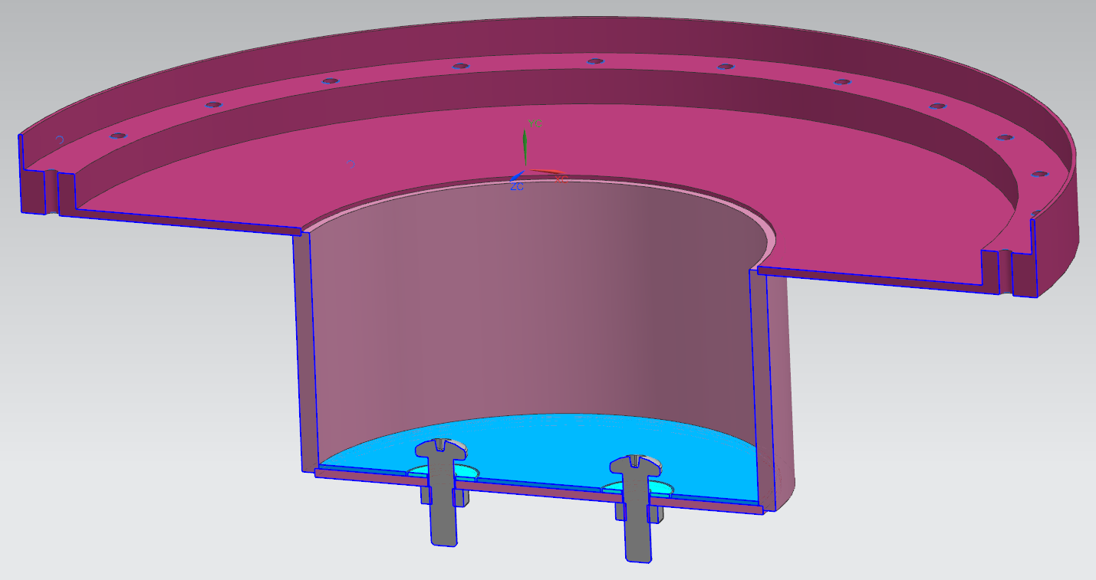
From RF design to mechanical design
24 mm=>24.5 mm
3 mm=>3.556mm
Teflon
Alumina
2 mm=>1.556mm
Reference frequency of cavity without garnet 137.2 => 124.9 MHz

Slide 3
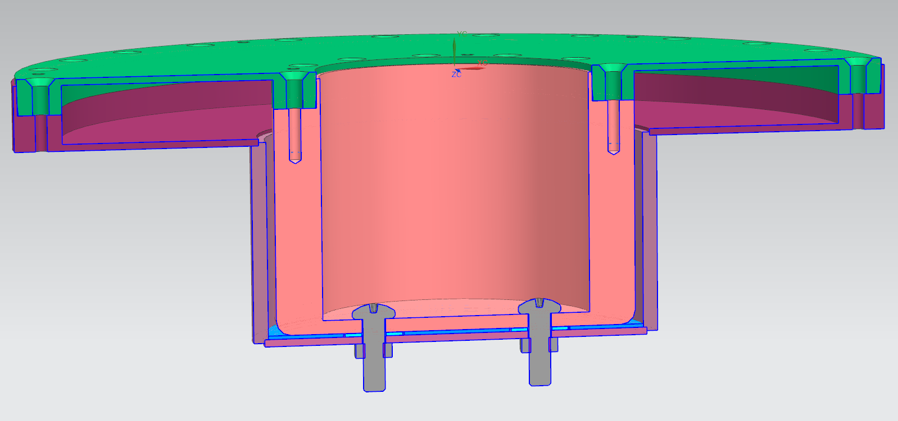
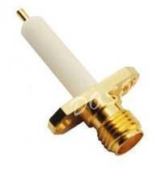
Additions
Loop?
Signal in/out
Antenna?
20 mm
What would be a suggested feedthrough?
Something like that?
May be some shielding should be provided

