Slide 1
Next attempt on tanδ measurement for Stycast
Robyn Madrak
2nd Harmonic Cavity Meeting
15 Sept 2016

Slide 2
Approach
In the previous attempt, we tried to extract tanδ for the Stycast 2850FT with Catalyst 9 by adding thin layers (0. 1mm) to the garnet test setup
  This had various uncertainties mostly due to the garnet, however it was close to what will be reality in the cavity
Next attempt: take garnet out of the picture. Make a sturdy quarter wave cavity out of 3-1/8” transmission line.
  Make a 2” thick ring of epoxy to fit in side of the line
  Measure Q with and without the epoxy: from this extract tanδ

Slide 3
Model
epoxy
Flange on outer cond.
teflon
There is a “bullet” connector in the center conductor for every flange (not shown)
Short
(with screw)

Slide 4
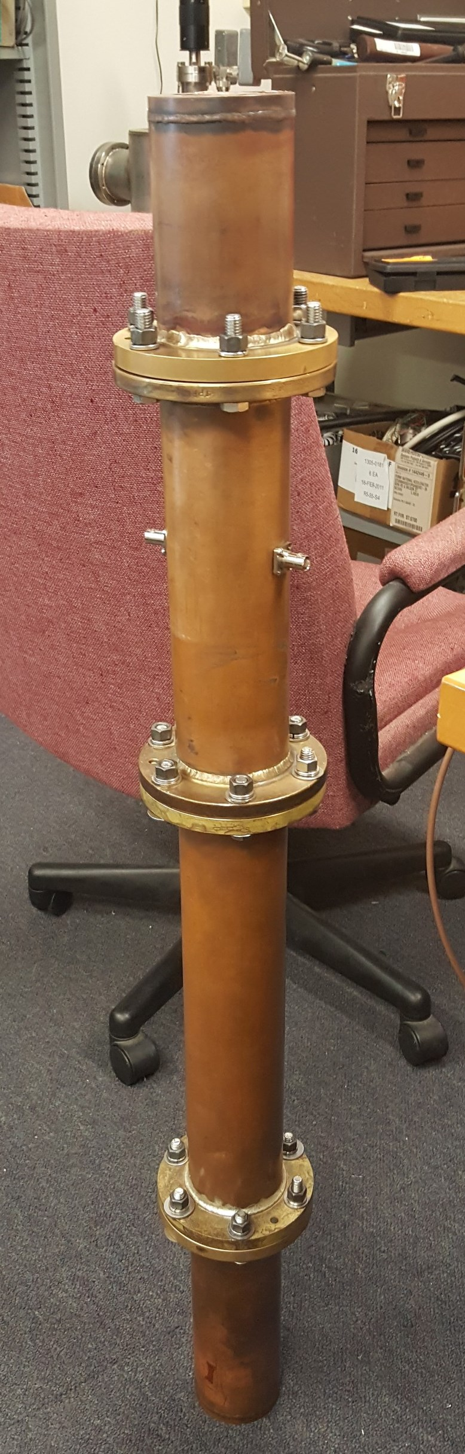
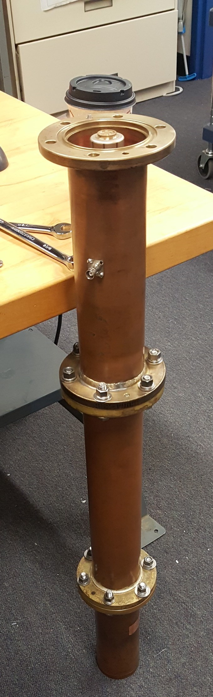
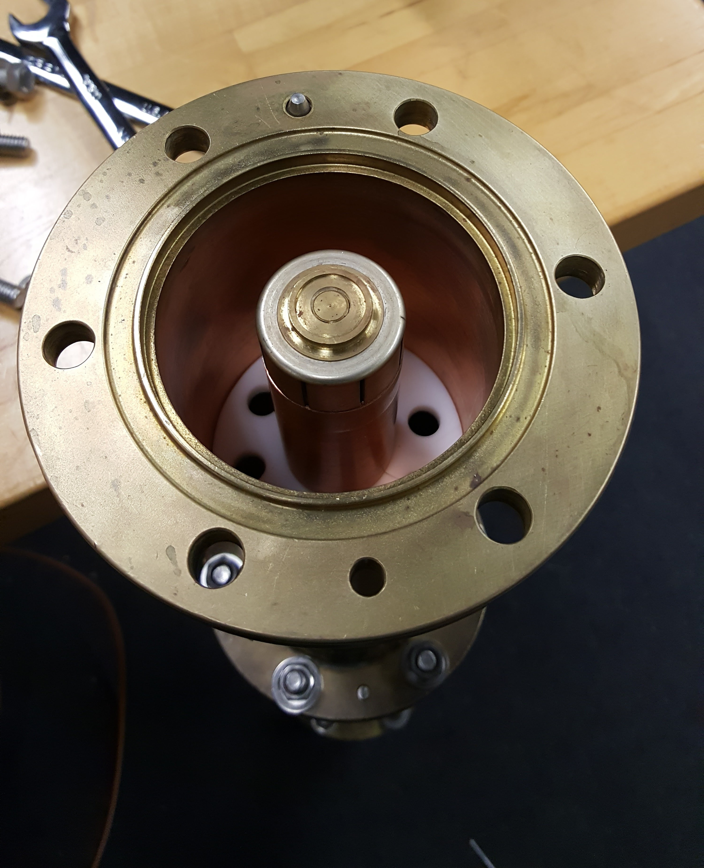
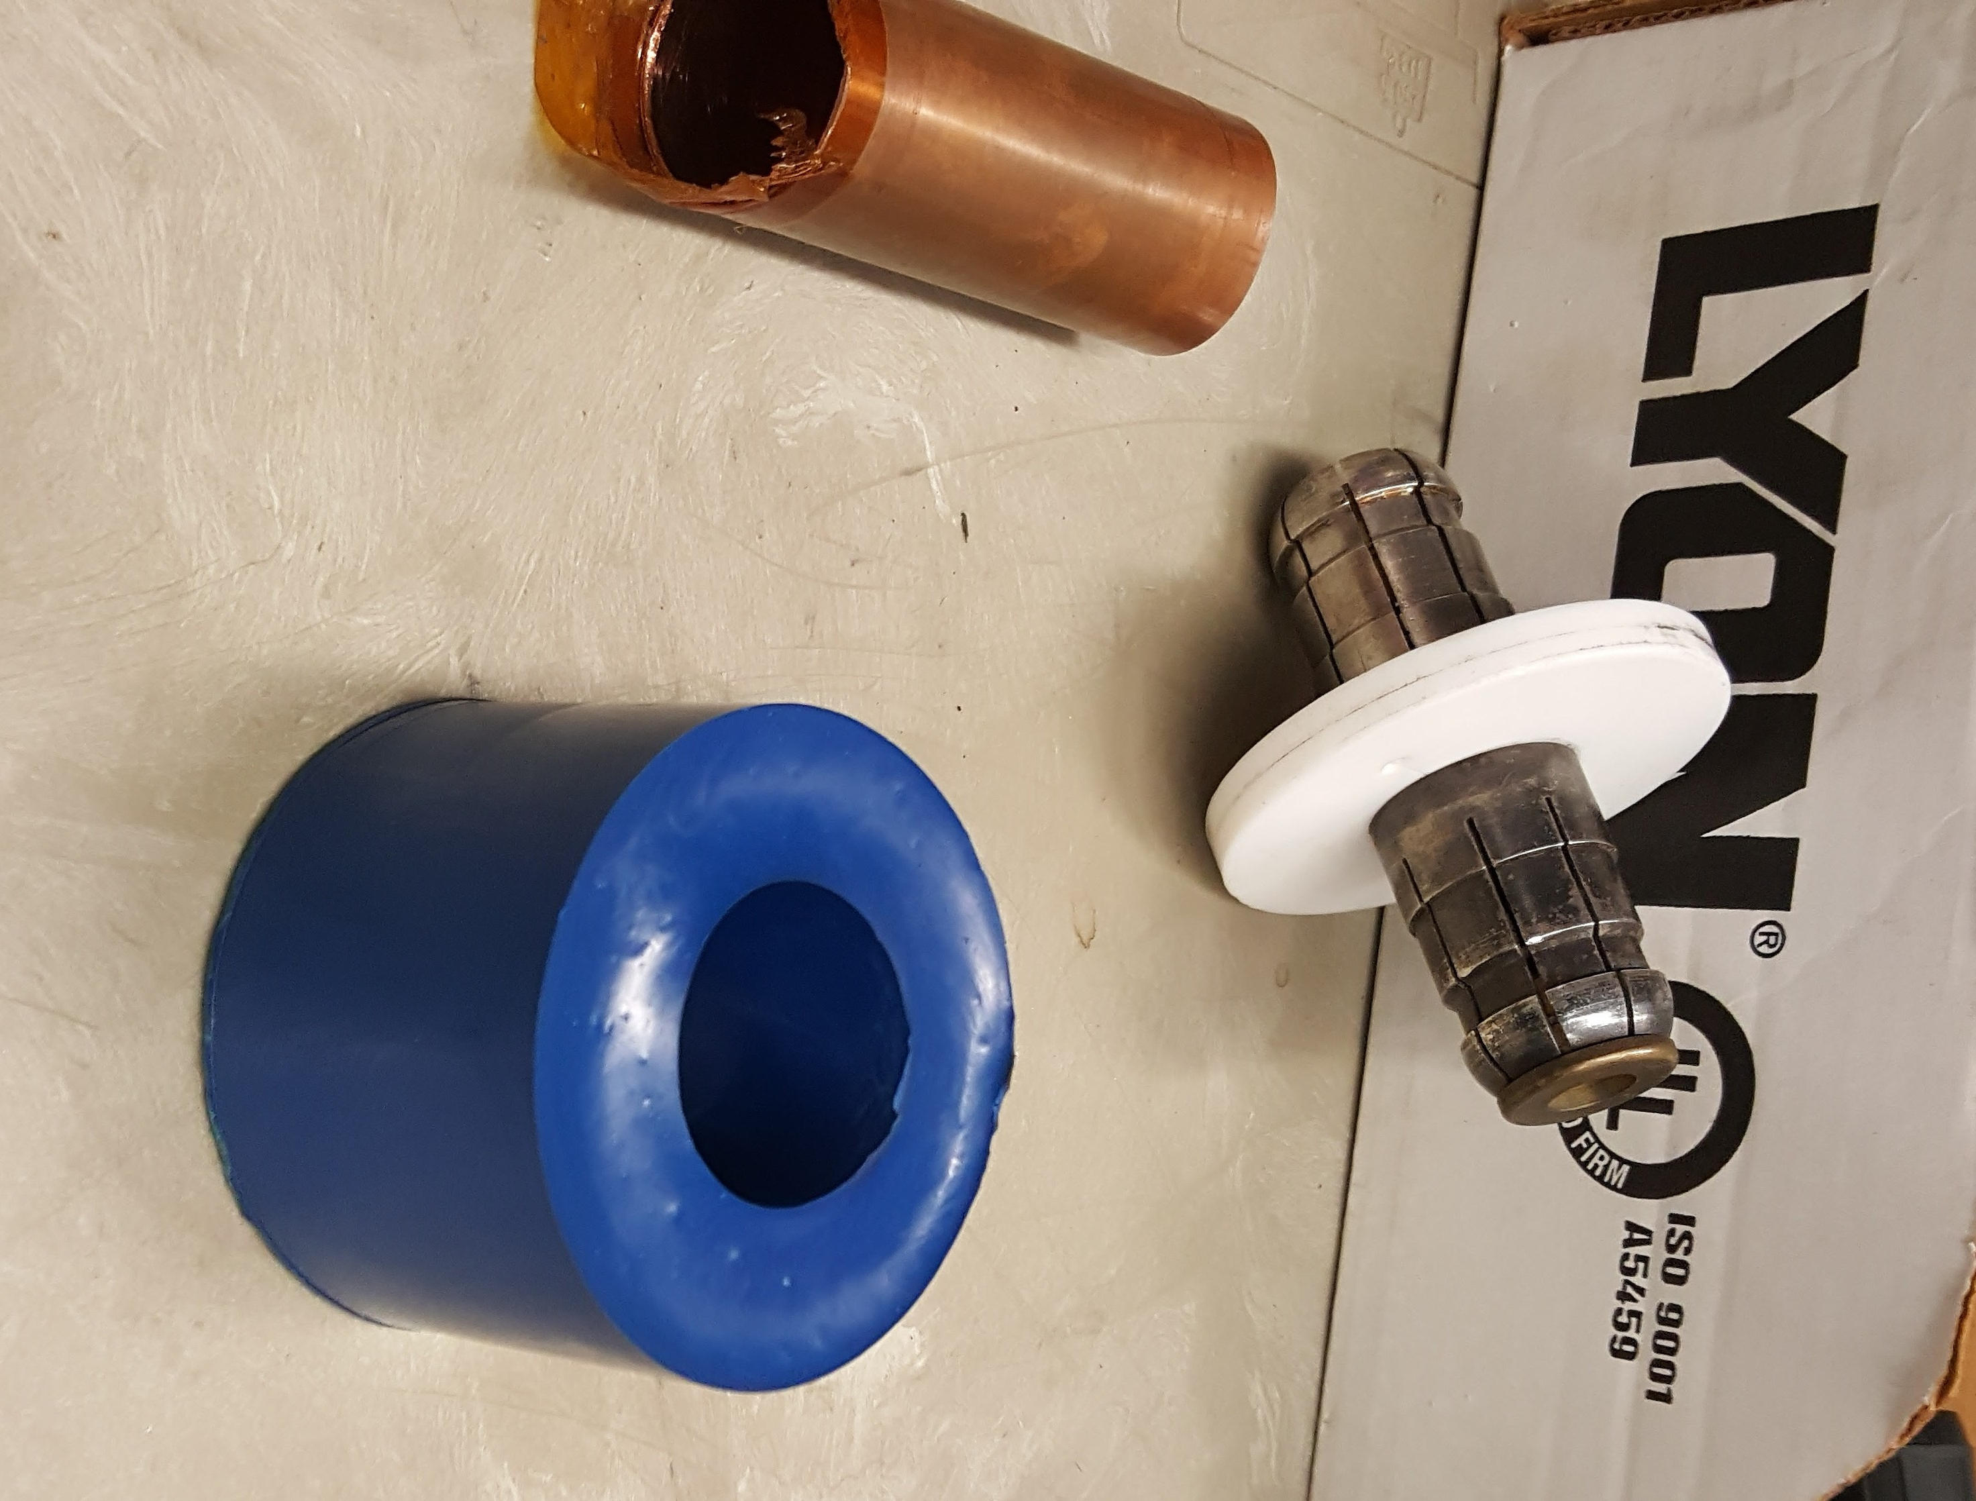
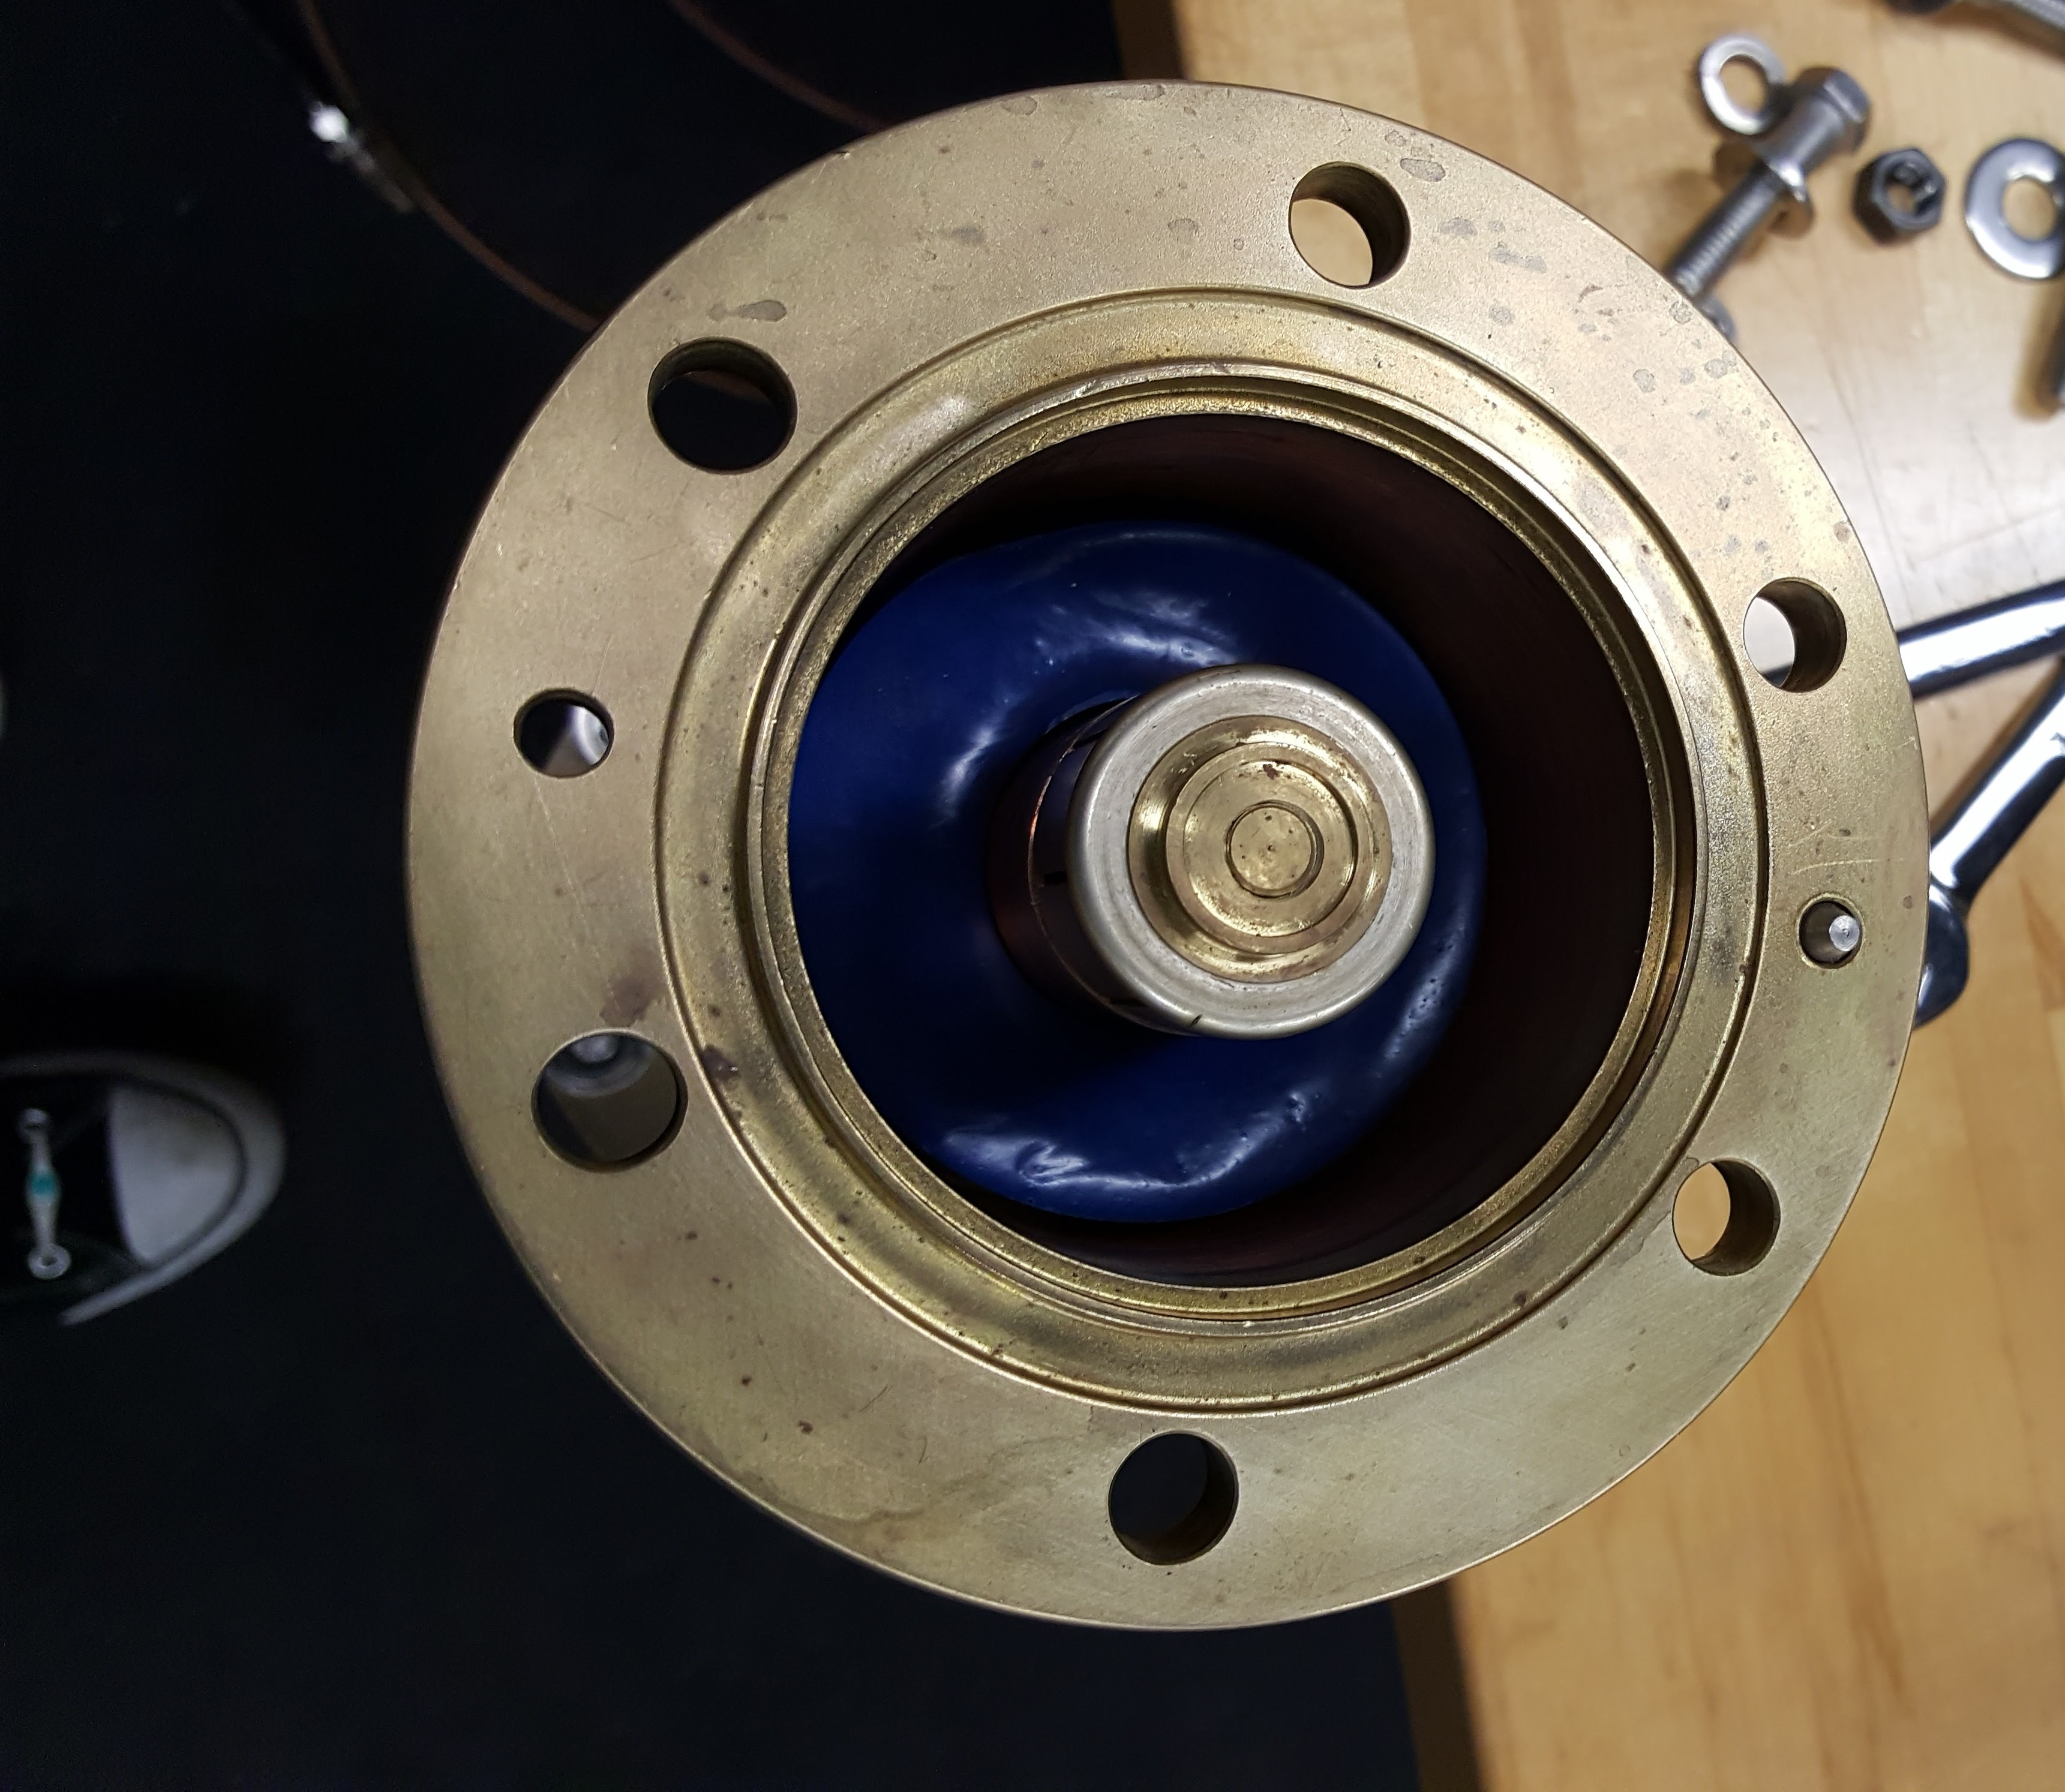
Pictures
View from the top
with and without epoxy
Whole fixture
Top removed
on open end
Cured epoxy ring
And connector “bullet”

Slide 5
Procedure
Measure Q with no epoxy
  Q(meas) =1628, Q(sim) = 2342
  This measurement was extremely repeatable, to < 0.3%
Adjust resistive losses in simulation until Q(sim) ~ Q(meas)
Measure Q with epoxy. Do a back-of-the-envelope calculation: tanδ =0.017
  See last slides for details
Put epoxy in simulation using calculated tanδ = 0.017
  Q(meas) = 235, Q(sim)=230
Evaluate sensitivity. If tanδ = 0.03 in sim, Q(sim) = 138
Used two approaches for adjusting resistive losses: uniform and at joints only
Used two different gaps in data and sim; same results
  Large gap: 3.8”, small gap ~0.5”

Slide 6
Discussion
Stycast data sheet say tanδ = 0.03
Last measurement says tanδ = 0.02 (0.017)
Previous result was around 0.1
…

Slide 7
Back of the envelope (1)

Slide 8
Back of the envelope (2)
Here β = 2 π/λ

Slide 9
Back of the envelope (3)

