Slide 1
PIP – General Update Sept 28th 2016
Shutdown continues – still looking at week 10 -11 beam startup
Budget
  FY17 has now started
    Labor on FY17
    M&S PO’s pulled are being released – not sure how backed up
Labor –
  Need to update
    Looking back at FY16 estimates and finding out which tasks were on target and which missed
      Understand why and how to fix

Slide 2
Sunday Monday Tuesday Wednesday Thursday Friday Saturday
Sept 18 | Sept 19 | Sept 20 | SEPT 21 | SEPT 22 | SEPT 23 | SEPT 24
 |  |  |  | Wrap new tunnel longitudinal bus bars for BRF 21 & 22 | Wrap new tunnel longitudinal bus bars for BRF 21 & 22 | Install BWG diagonal cable tray for BRF 21 & 22 cables.
 | Successful bus drop | Installed damper pick-up, L11 | Initial bus move for BRF17&18 | Initial bus move for BRF17&18 |  | East Gallery damper power connection
 |  |  | Pre-cut cables for BRF 21 & 22 | Pre-cut cables for BRF 21 & 22
SEPT 25 | SEPT 26 | SEPT 27 | SEPT 28 | SEPT 29 | SEPT 30 | Oct 1
 |  | T&M Electricians Pull HV cables for BRF 21 & 22
 | Janitors (2 days) Delayed for as long as possible | Electricians (T&M) re-install 480v utilities for BRF 18. |  | Water techs connect up BMA LCW S20&21 | Move and connect BPM rack in corner
 | Start re-installing FBS upstairs bus bars for BRF 17 & 18 | Continue re-installing FBS upstairs bus bars for BRF 17 & 18 | Start fabrication of BRF17&18 tunnel bus bar cross connections | Continue fabrication of BRF17&18 tunnel bus bar cross connections | Start fabrication of BRF21&22 tunnel bus bar cross connections
 | Start installation of longitudinal FBS tunnel bus bars for BRF 21 & 22 | Continue installation of longitudinal FBS tunnel bus bars for BRF 21 & 22 | Cable pulls for BRF 21 & 22 and IPM---------→
Oct 2 | Oct 3 | Oct 4 | Oct 5 | Oct 6 | Oct 7 | Oct 8
 | Continue fabrication of BRF21&22 tunnel bus bar cross connections
 | Seal penetrations & Fill -------------→ |  | Walk-throughs
 | Tunnel Clean-up |  | BRF start-up | Turn on power supplies ------------→
 |  |  | S&S Tunnel
Oct 9 | Oct 10 | Oct 11 | Oct 12 | Oct 13 | Oct 14 | Oct 15
 | Beam --------------------------------------------------------------------------------------------------------------------------------------→

Slide 3
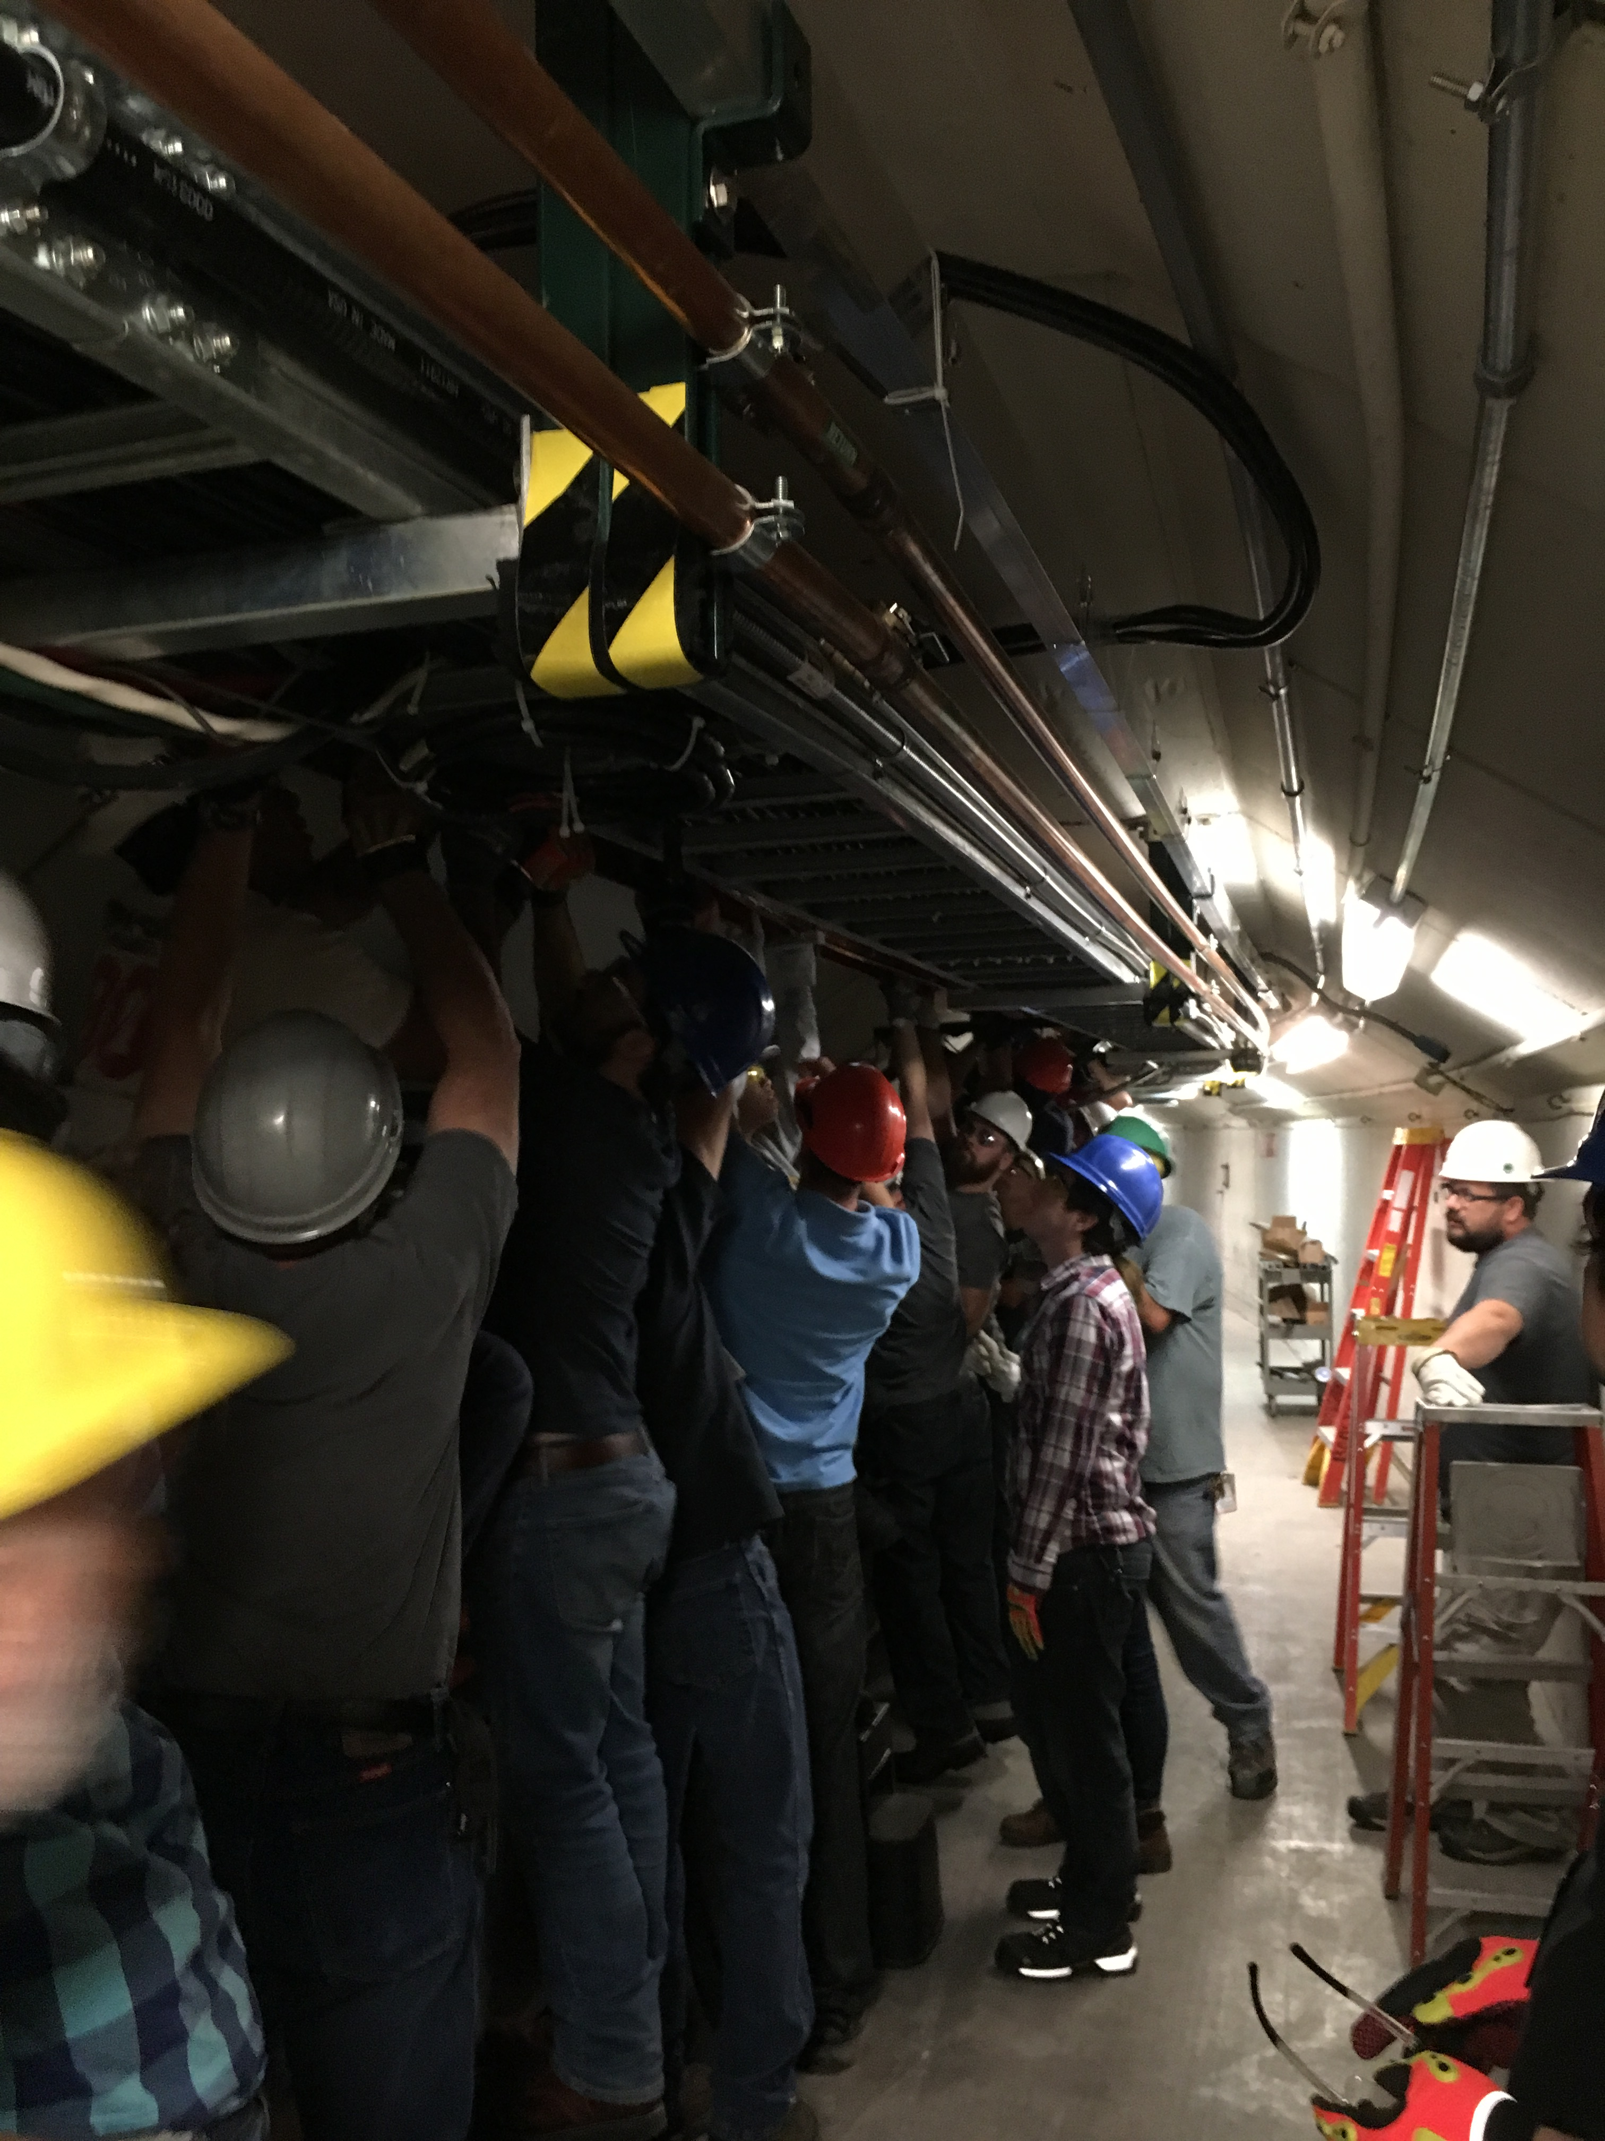

Slide 4
Should be done this year
Should be done before AAC review in Dec!
5 Tasks remaining 2017

Slide 5
Laser Notcher Status for PIP Meeting 9-14-2016 – Dave J.
Add TEC to seed diode FBG - design underway
Replace LMA isolator – isolator order placed/ labor not – work install Oct
Fiber amplifier Optimization – consultant – specs/requirement/deliverable in process – M&S not determined
Replace tap coupler in OEA with 2x2 to monitor Rev power – orders placed install Oct
Cure high freq instability in Grumman modules – investigation on hold – time required ? Cost expect none
Create N2 atmosphere in optics box – design complete – parts not ordered yet
Add Pockels cell to FSA – parts on order delivery expected Nov 4 – installation time and tuning 2 wks(?)
Miscellaneous optics - not purchased yet
Replace wheels on rack/add anti-vibration feet/add protective front panel(door)/water shield OE
Stiffen steel floor plate – nothing done yet waiting on Kevin to address
Add cooling to electronics rack – preliminary ideas w/Dan & Tom
Construct photodiode monitor module – design complete
Construct integrating spheres - components on hand
Build 2 new vacuum flanges & 1 optical cavity – prints complete/ drawings submitted to shop – REQs in process
Total costs for above items ~ $36 K
Approved REQ’s/PO’s $9.1 K
Need to install Vacuum flange before start up
Improvements/upgrades not ready until after start up
NO SPARE COMPONENS INCLUDED

Slide 6
Marx Modulator (Matt Gardner)
54 Cell prototype Testing
  Final assembly of system has been completed but took longer than anticipated.
  Additional time was needed to debug the temporary control system.
  Filter installation was completed in the extra time.
  Marx has been run up to 200V per cell
  FPGA card is in hand as of Monday
LRF5 preparation
  7835 Anode connection is being modified to take power directly from the Marx
  Old Modulator is being modified to be able to output power through RG-220 to use the same connection as the Marx.
Testing Schedule
  Spark testing – begins today ( 1 week )
  CPS measurements ( 1 week )
  ZOV cell tests ( 2 week )
  Full Power testing and thermal scans ( 1 week )
  Move to Linac( 2 weeks )
  FPGA card testing( 2 weeks )
  7835 testing( 2+ weeks )

Slide 7
2nd Harmonic Updates (CY Tan)
Glue for garnet pieces
  Instructions to be sent to garnet vendor this week.
  Measured loss tangent of glue (stycast) is ambiguous
    With thin layer ~0.1mm between garnets, tanδ ~0.1 @85-- 122 MHz (bad)
    With ring of glue only, tanδ ~ 0.02 @ 66 MHz (vendor 0.028 @1 MHz
    Investigation continues …
Cathode resonator
  A stub antenna has been designed so that the VSWR=4 at 76 MHz to 106 MHz. This means reflected power is 36%. Should have enough overhead to have 100 kV in the gap.
Tomco SS amplifier
  Combiner has been shipped back to vendor (13 Sep)
  Replacement combiner coming soon.
76 MHz Y567 test
  Finally got jumper (25 Aug). Will test after shutdown.
106 MHz Y567 test
  Pieces on hand. Waiting for end of shutdown for welding.
Garnet ring test
  TD finializing design of ring test cavity.
Bias solenoid design
  TD finalizing design.
Stuff bought before end of fiscal year
  Bulk supply for bias supply ($9k)
  RF windows ($47k)
  Y567 ($22k)
Stuff coming
  2 sets of garnet rings
  test stand ferrite pieces for witness piece tests.

Slide 8
Ferrites/New Tuners (Pat Sheahan) Booster BPMs Peter
Task will be closed out after we receive and test spare ferrites
Physical measurements and low power testing of the 30 new ferrites should only take two or three days. I will move the power amp back into place and preform the full power test on 4 or 5 of the ferrites, which will likely take a week since the system has been powered up in so many months. Right now we are storing the spares in the old anode supply room on the F0 side, but we will probably need to find a better long term storage area. Unfortunately I have not heard back from National as to an updated delivery date. As per their history, I would not be surprised if they are at least two or three weeks late on the delivery date. Given an on-time delivery, I should be able to wrap everything up by the end of October, and worse case, hopefully before the end of the year. Pat will let us know as soon as he has actual delivery date.
BPMs
Booster timing board done going out or id. Transition board tested in Booster redesign being implemented starting Thursday, then layout.

