Slide 1
Heating of the ceramic windows. HOM in the cavity of latest design.
Gennady Romanov
2nd Harmonic cavity meeting
October 27, 2016

Slide 2
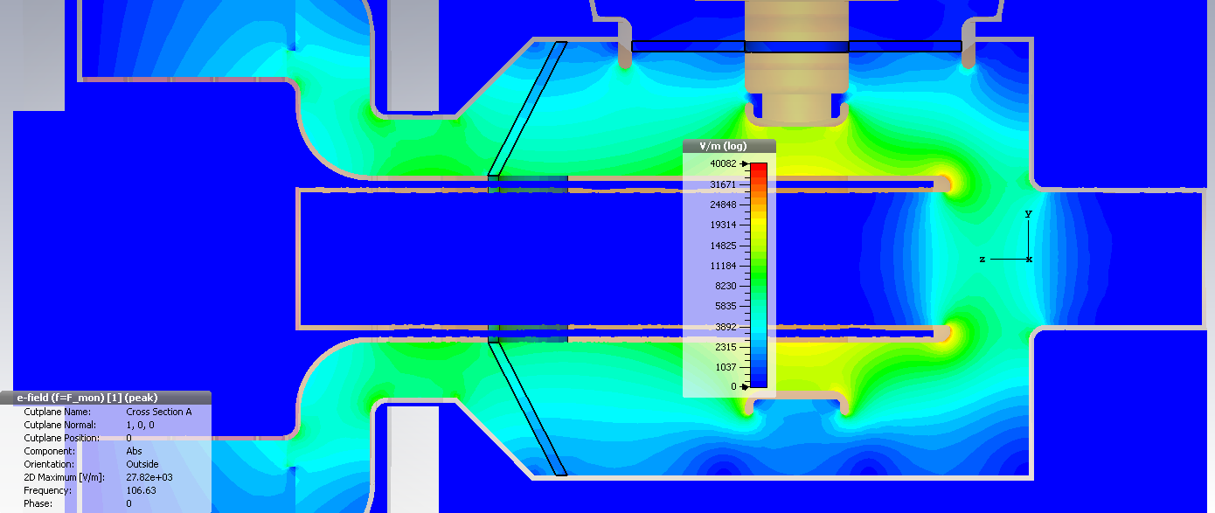
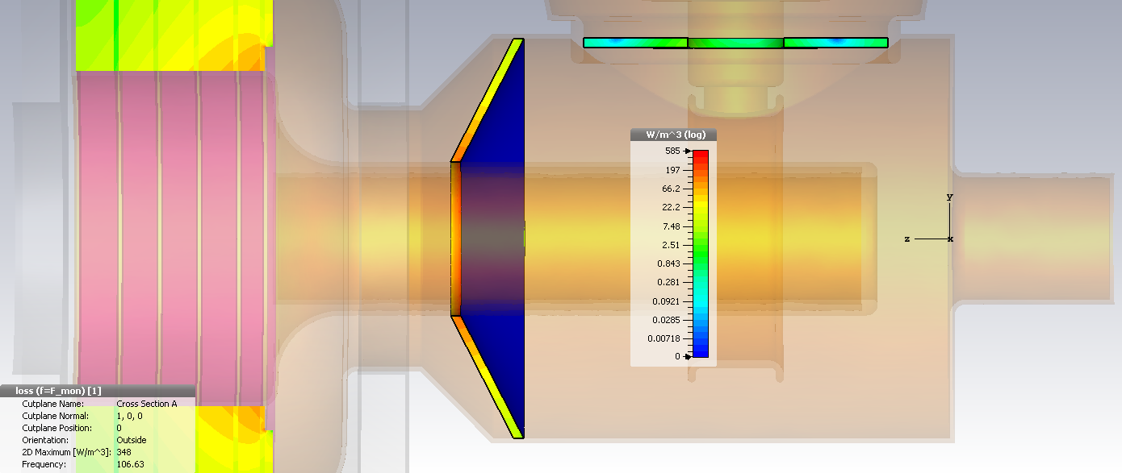
Thermal losses in the ceramic windows
Assumptions:
Acc. Voltage = 100 kV
3 ms injection: I=140 A, F= 75.96 MHz, constant losses
+ 3 ms extraction: I=700, F=106.63 MHz, constant losses
tanδ_{E} = 0.0001
Repetition rate 15 Hz
Thermal losses:
Flat window: thermal losses of 0.25 W
Conical window: thermal losses 46.5 W
RF electric field
Distributions at coil I = 700 A, F = 106.63 MHz
RF dielectric losses

Slide 3
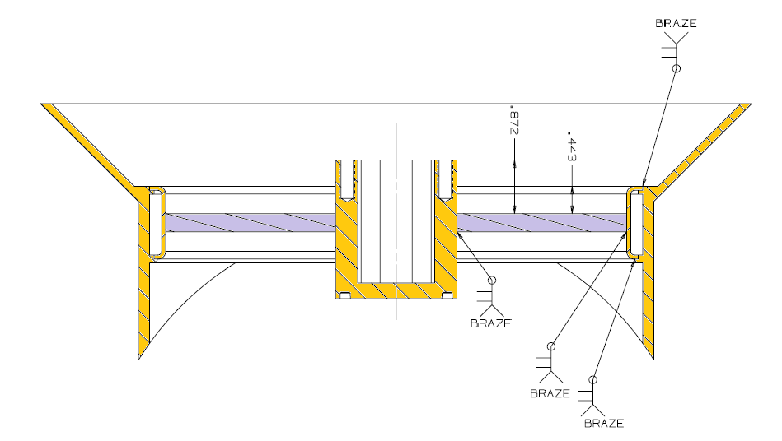
Mechanical design of windows
Real cooling channels are not defined yet.
Assumption: temperature of the copper walls is uniform and equals to 30˚C.

Slide 4
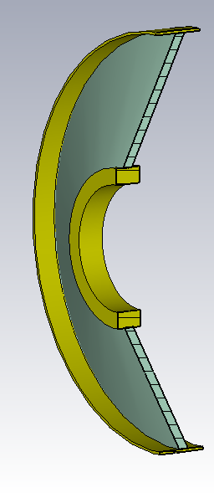
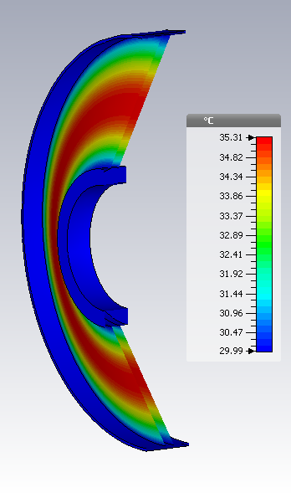
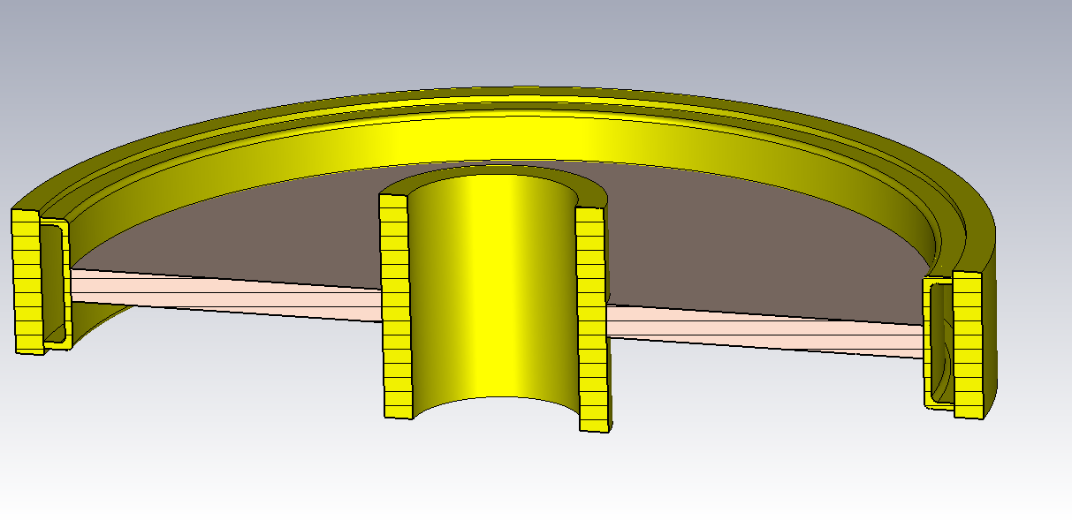
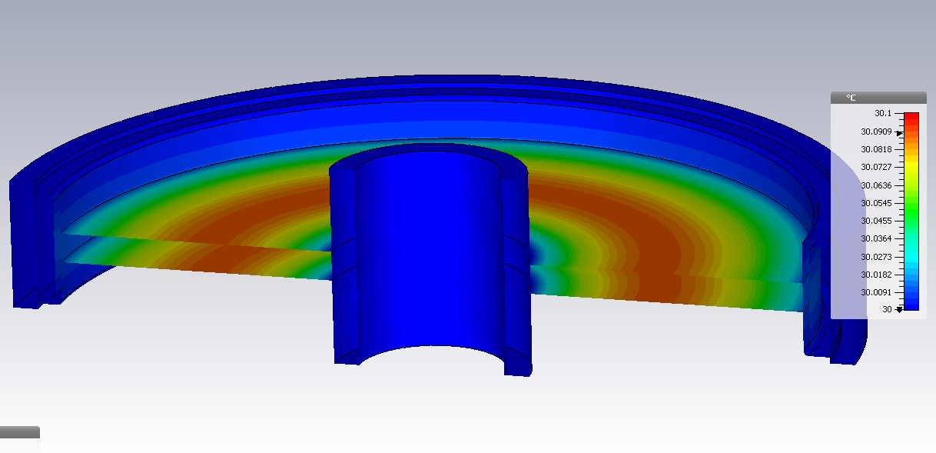
Thermal simulations
Δt = 5.3˚C
Δt = 0.1˚C
The thermal losses in the windows were assumed uniformly distributed.

Slide 5
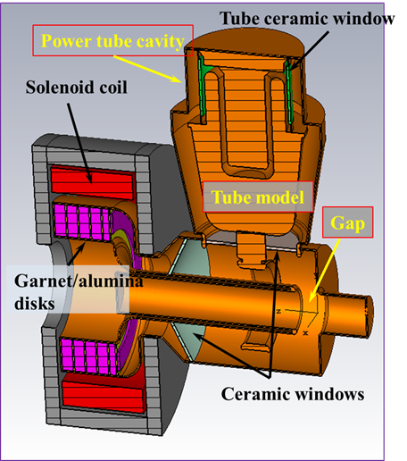
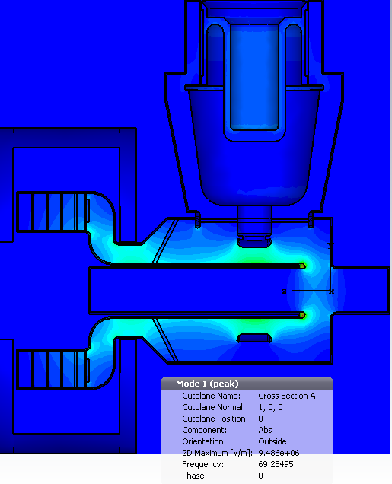
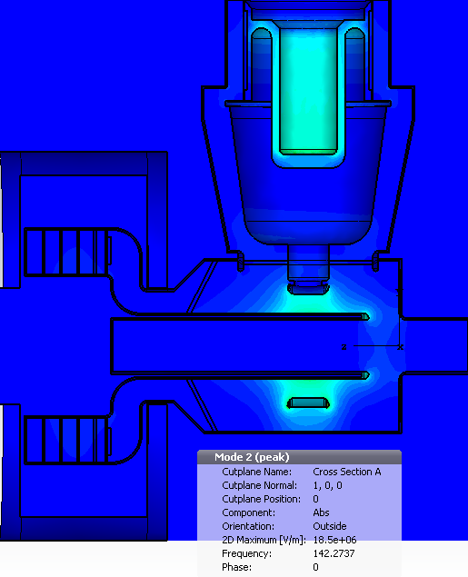
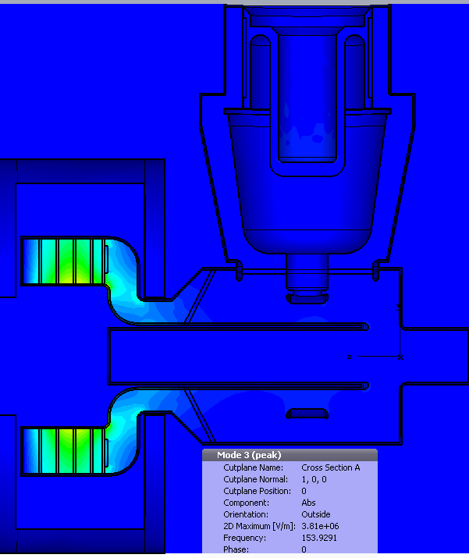
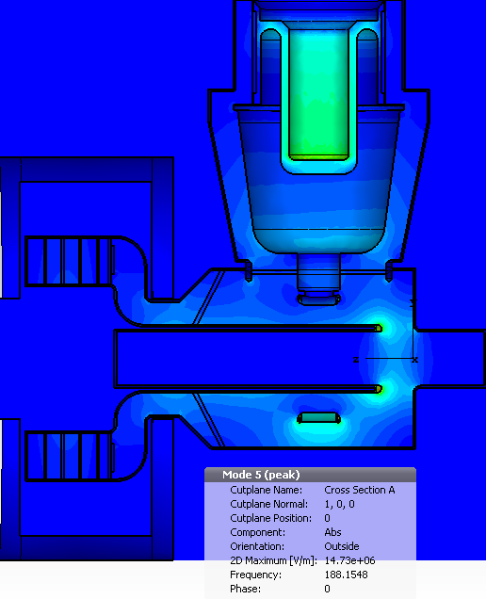
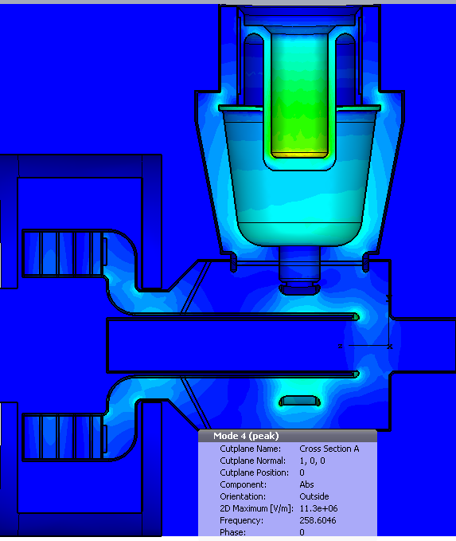
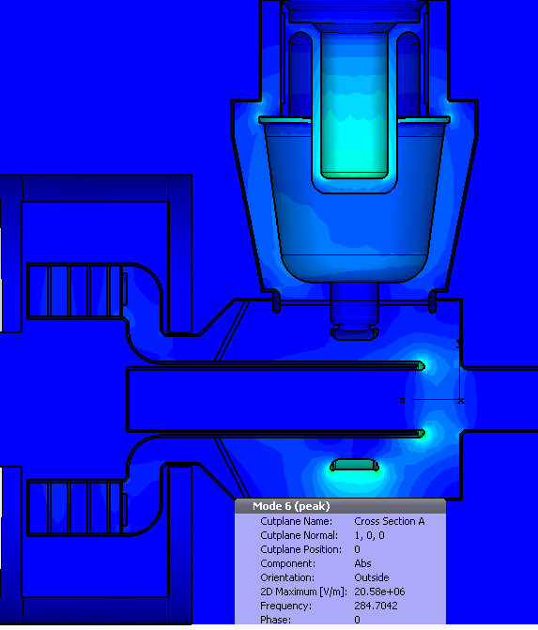
HOM in the latest cavity version
Operating mode,
F = 69.25 MHz
F = 142.26 MHz
F = 154 MHz
Uniform garnet, μ = 4
F = 188.14 MHz
F = 258.42 MHz
F = 284.7 MHz

Slide 6
HOMs in different models
R/Q for operating mode is almost the same in all three models.
HOMs associated with the tuner are almost the same.
HOMs associated with the tube cavity got higher frequency.
The tube cavity provides additional damping for HOMs.

Slide 7
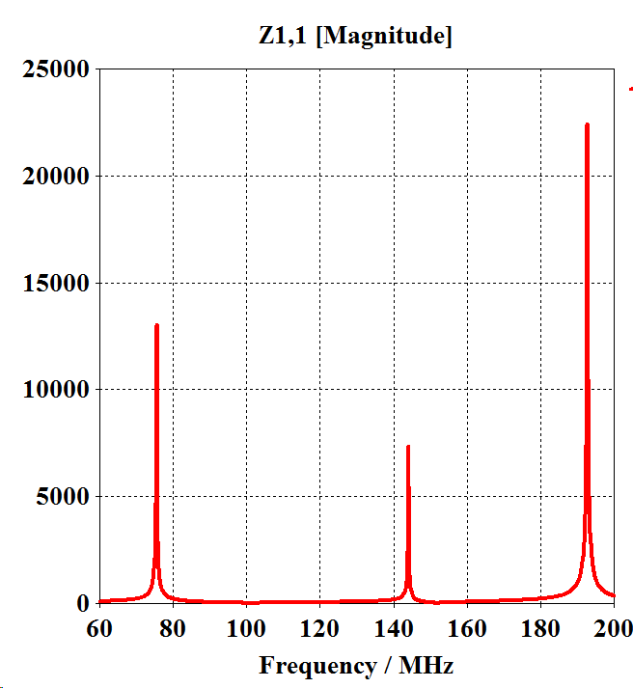
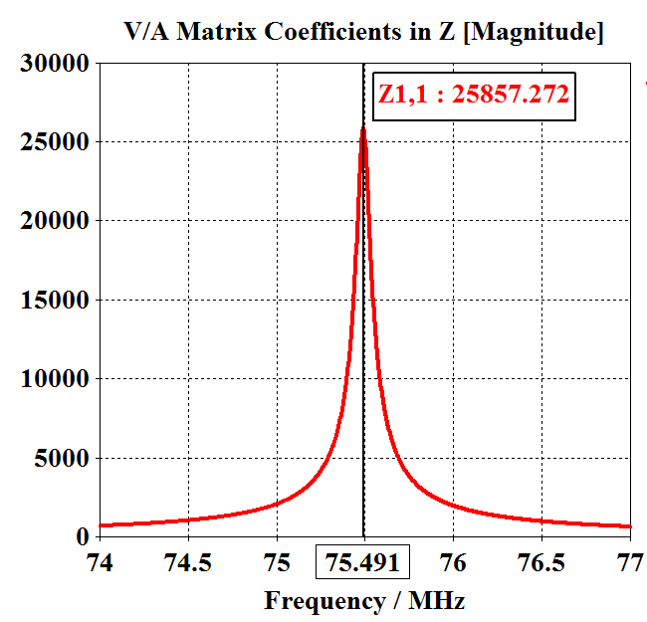
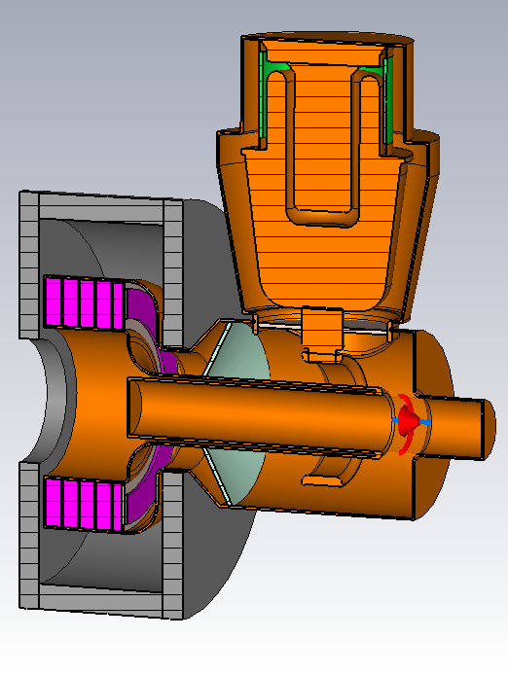
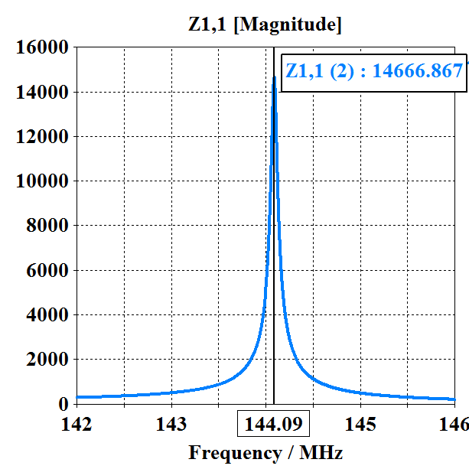
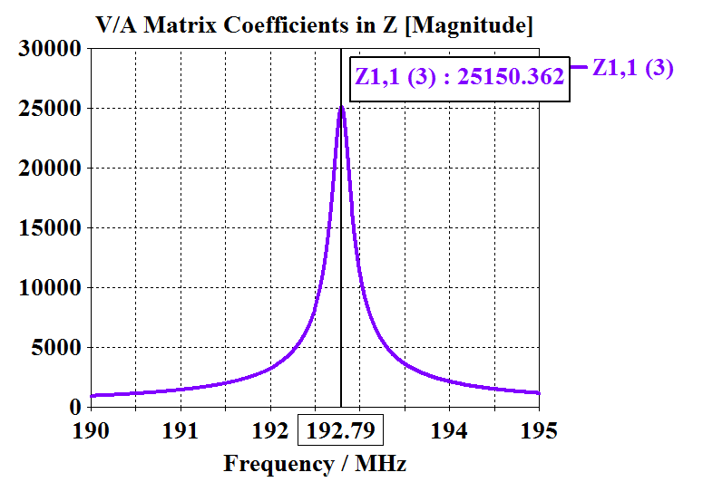
Imitation of beam.
Frequency domain,
I_bias = 140 A
The nearest HOMs that the “beam” sees
(ignore the peak values)
Discrete port

Slide 8
Next
Look at the dipole modes.
Connect the damper to the cavity
New optimization of damper with tube cavity (apparently).

