Slide 1
Vector Modulator PS as Booster Bias Supply
Matt Kufer
10-27-16

Slide 2
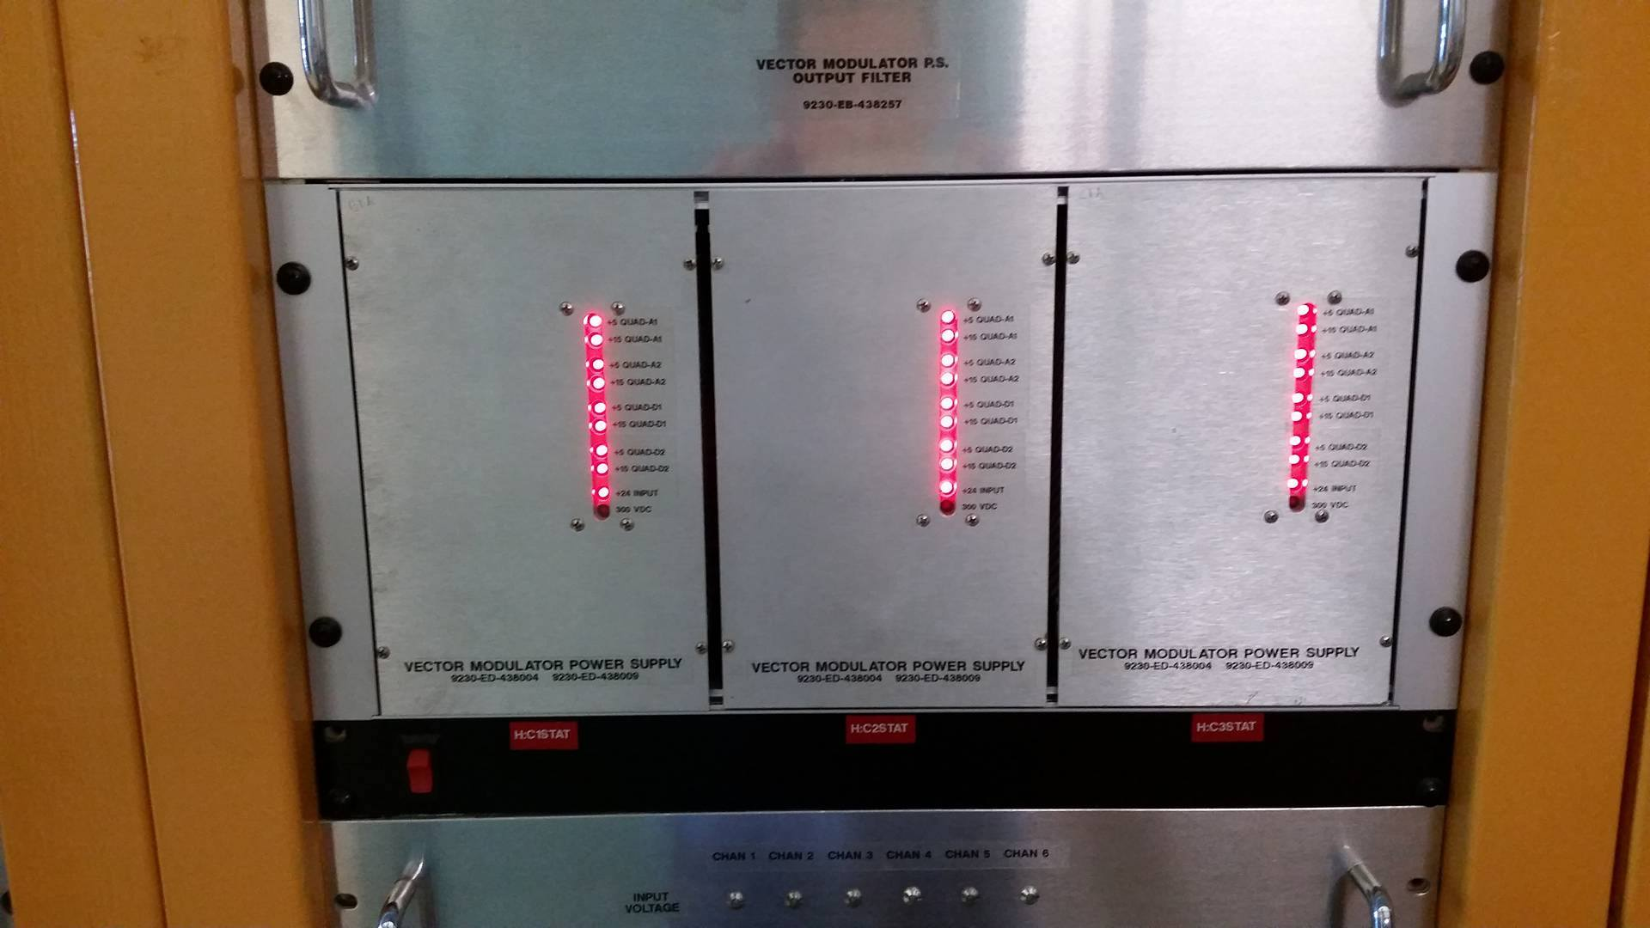

Slide 3
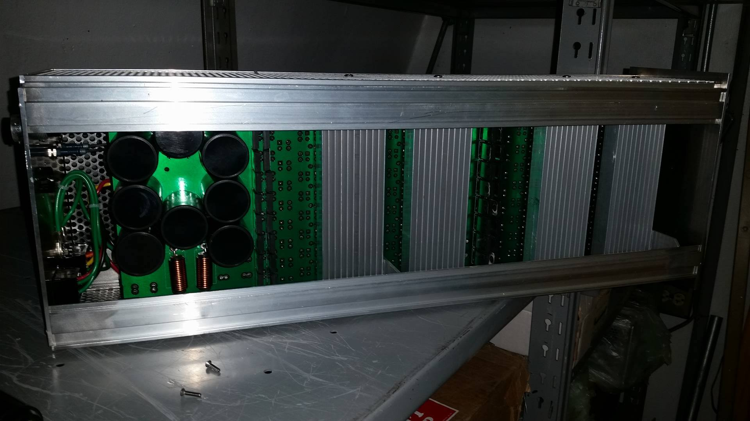

Slide 4
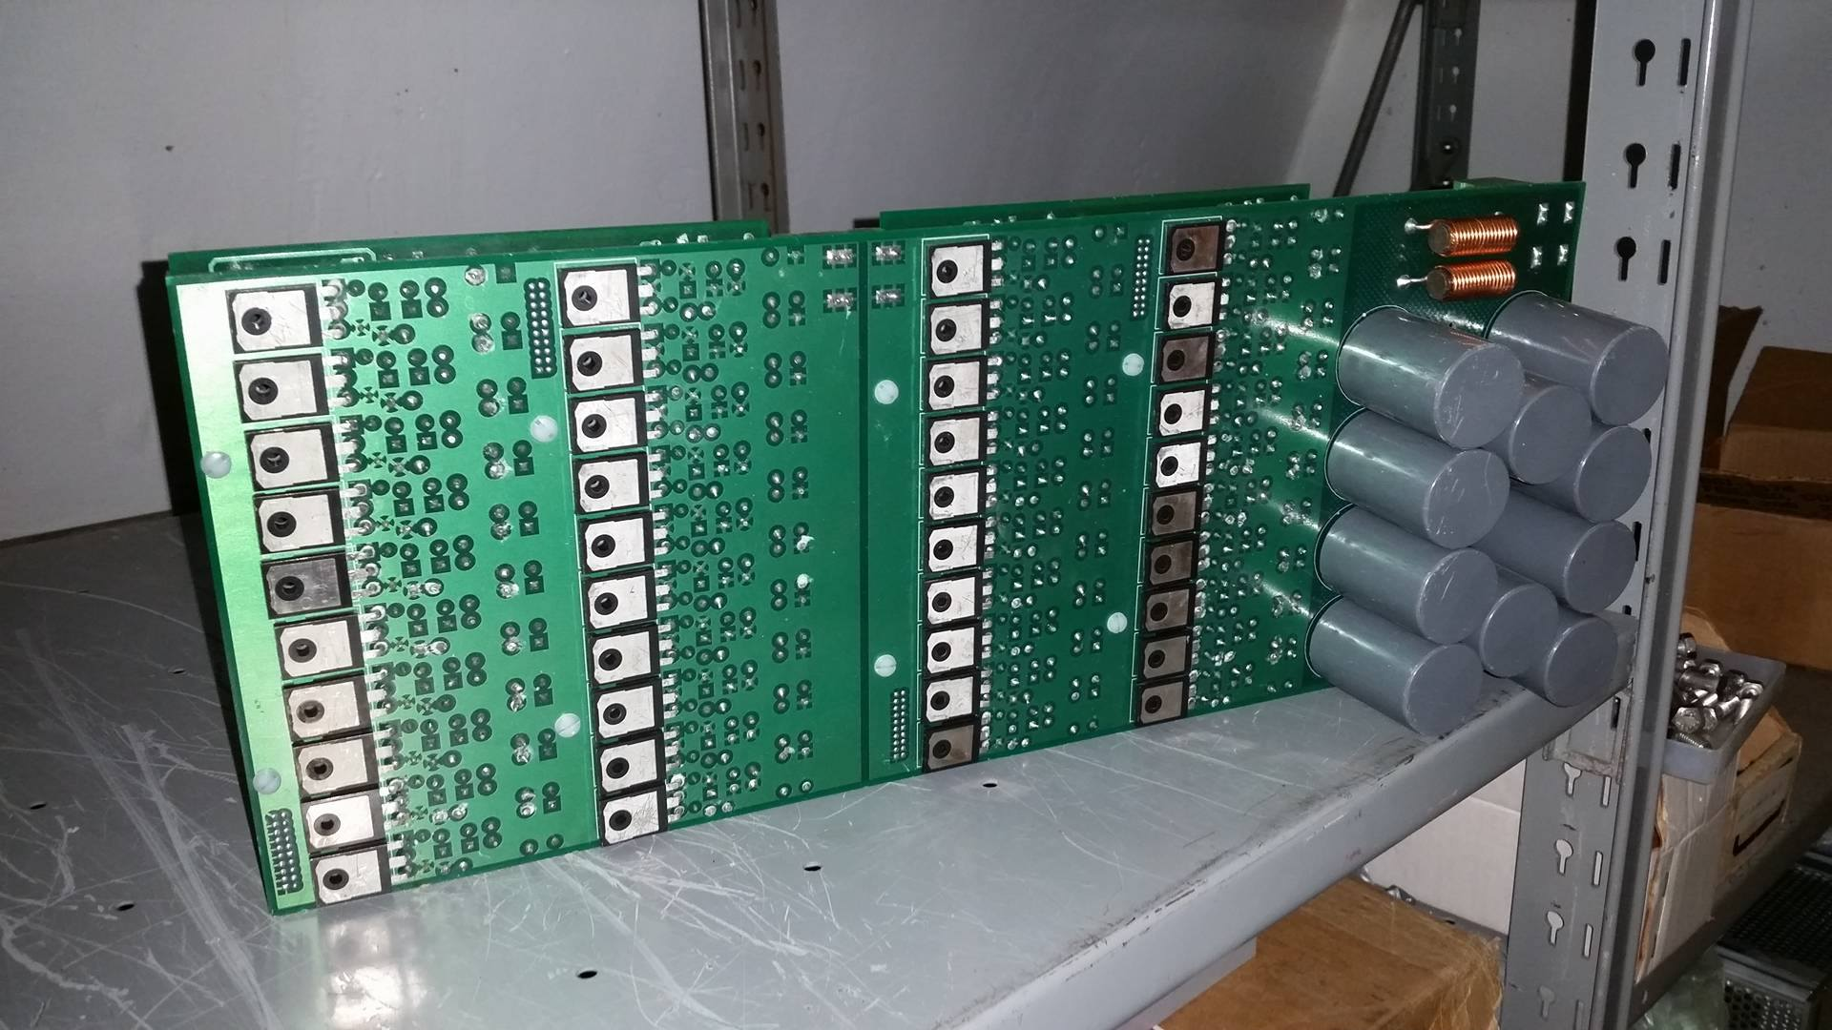

Slide 5
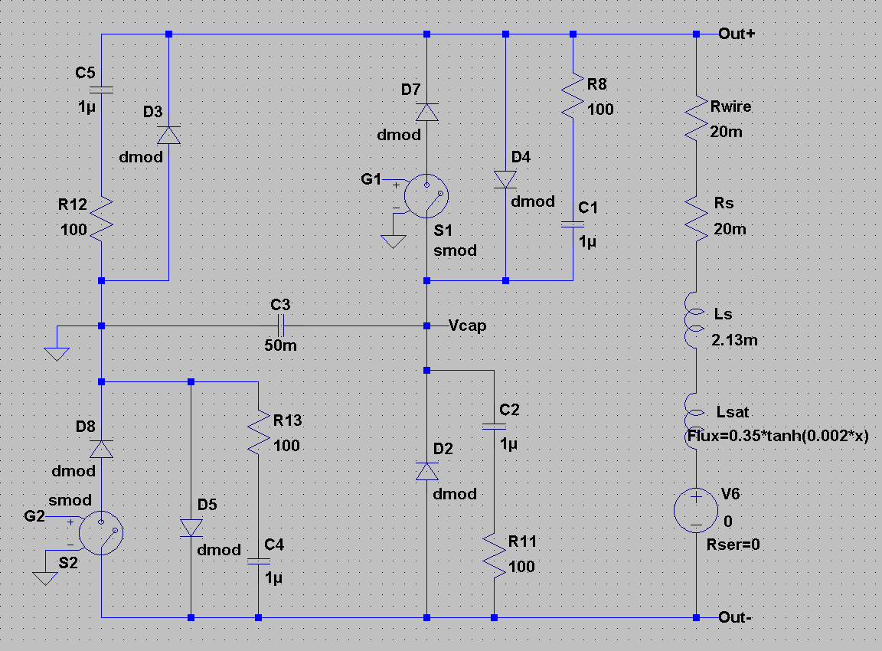

Slide 6
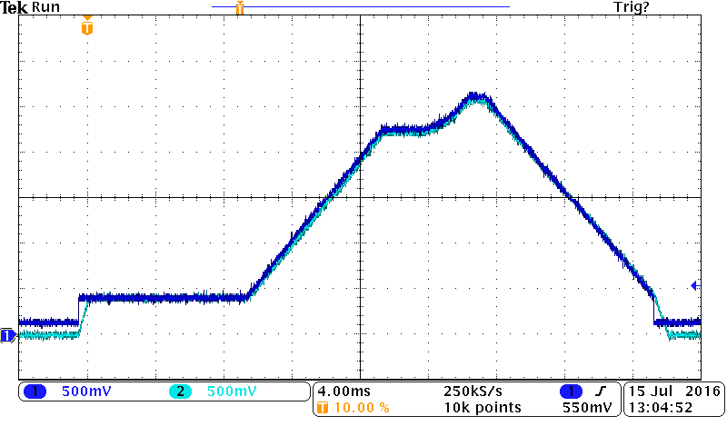
50 A/V

Slide 7
