Slide 1
Linac Laser Notcher Free-Space optics
Todd Johnson
Laser Notcher External Review
14-15 November 2016

Slide 3
Beam sizes through the Free Space system

Slide 4
Jay Doster simulations for two-pass amplification in RBA & REA
modules for 16 notch pulses and 16 pulses/notch assuming 4.7 uJ/pulse.
--- Simulations don’t take into account pre-distortion of pulses…
--- Both modules operate at 130 A (nominal) pulsed at 15 Hz (max pulse 250 us)
--- RBA stores about 40 mJ and each pulse will extract 200-600 uJ
---REA operates in nearly ‘steady state’ .
The amount of energy stored due to diode pumps between each pulse
is equal to the energy extracted each pulse

Slide 5
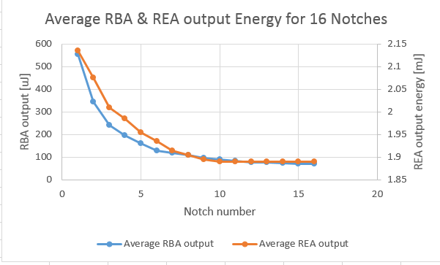
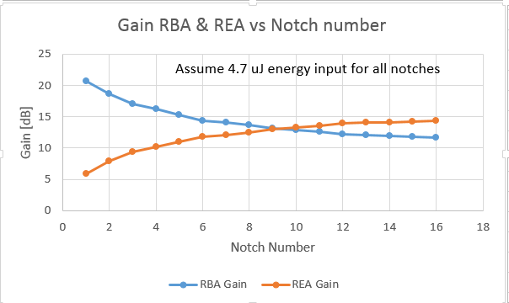

Slide 6
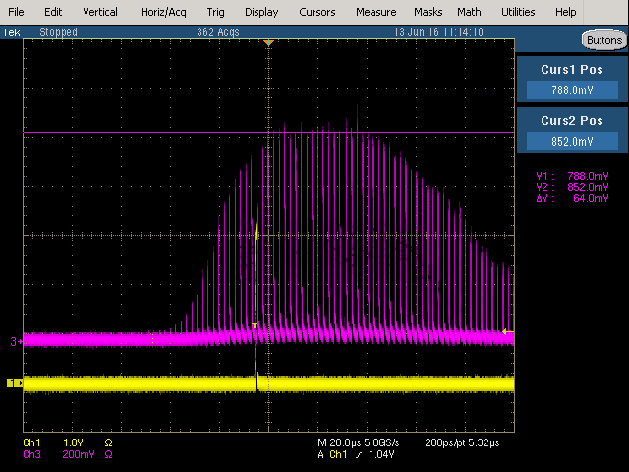
Example of timing adjustment for RBA & REA
Set up timing for RBA and REA according to Jay’s simulations.
Shifted REA a little earlier which flattened out notch pulses

Slide 7
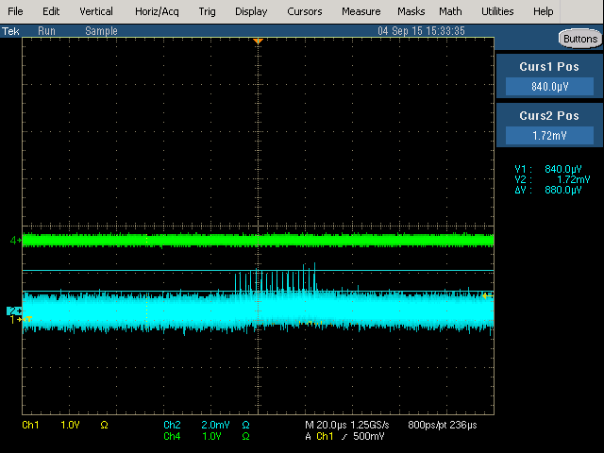
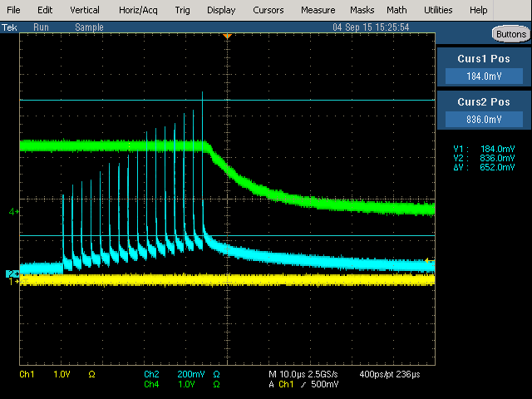
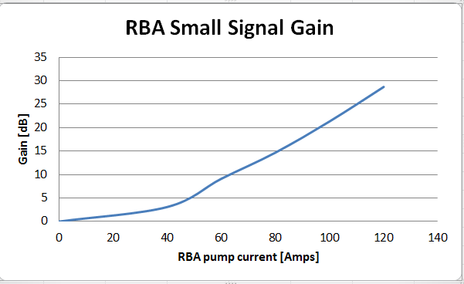
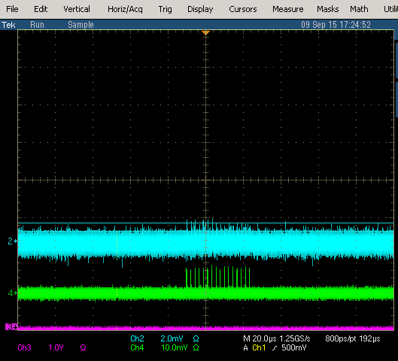
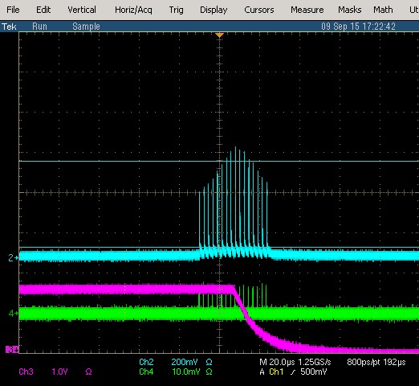
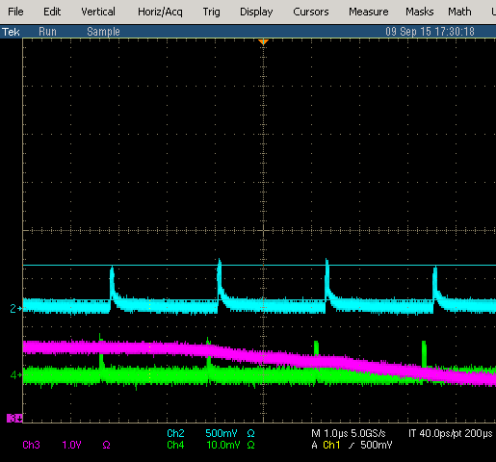
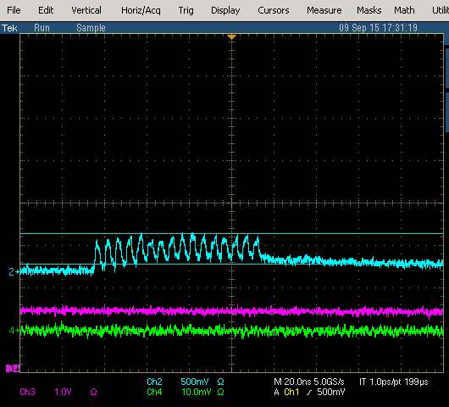
Free Space Amplifier(s)
Two amplifier modules (double pass) REA and RBA
RBA SSG measurement
REA SSG measurement
652 mV
880 uV
120 A
360 mV
Notch
Bunch
440 uV
Zero current
130 Amp
SSG ~ 30 dB for REA

Slide 8
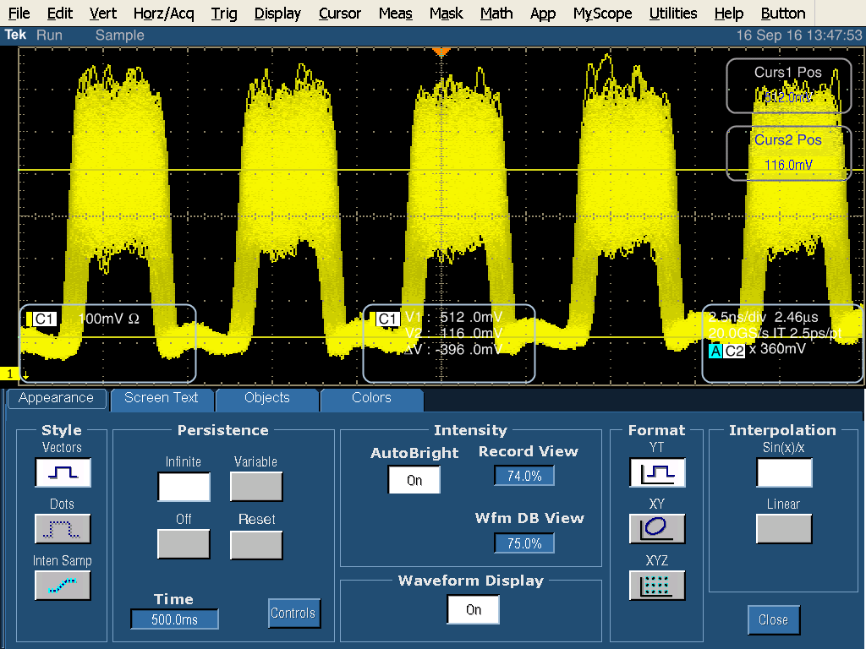
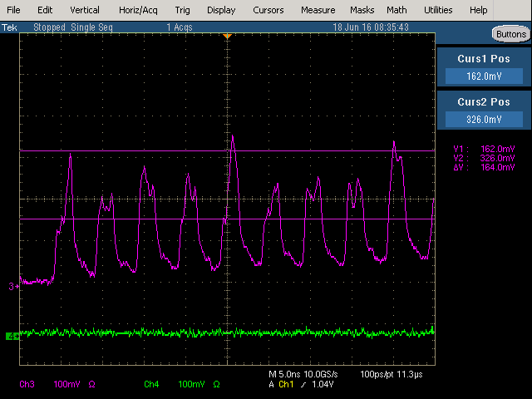
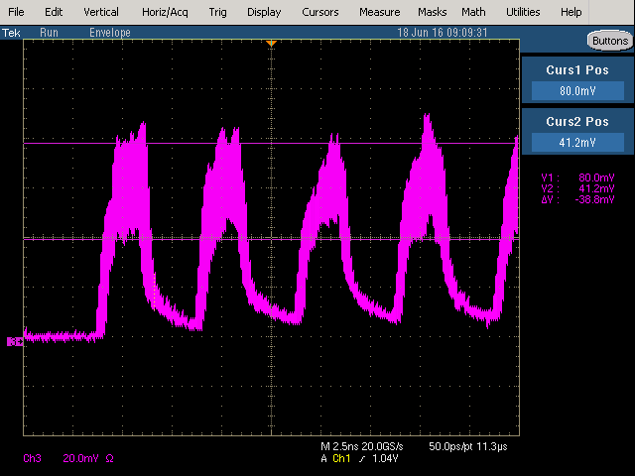
High Frequency Instability in Grumman modules
RBA 0A
RBA 130A

