Slide 1
HOM in the cavity with HOM damper.
Gennady Romanov
2nd Harmonic cavity meeting
November 16, 2016

Slide 2
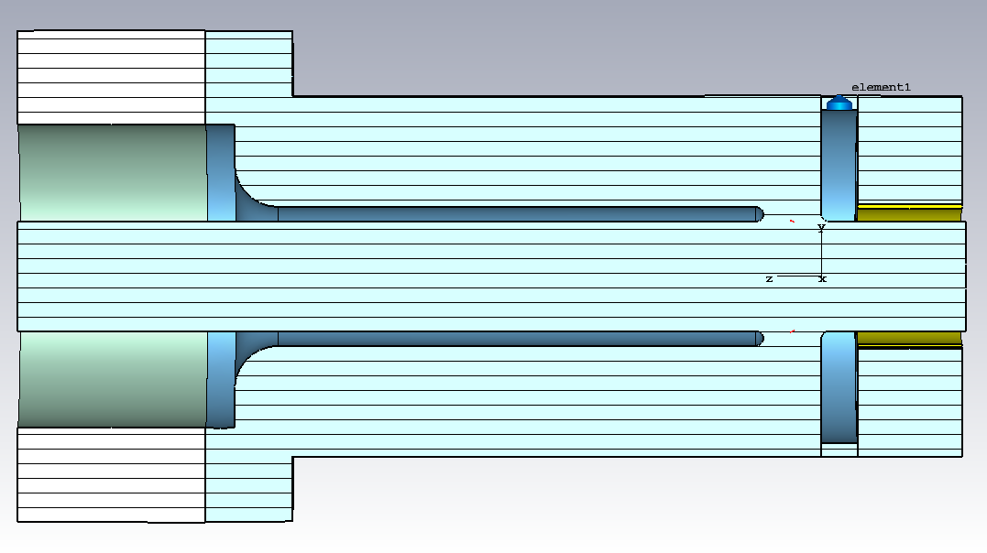
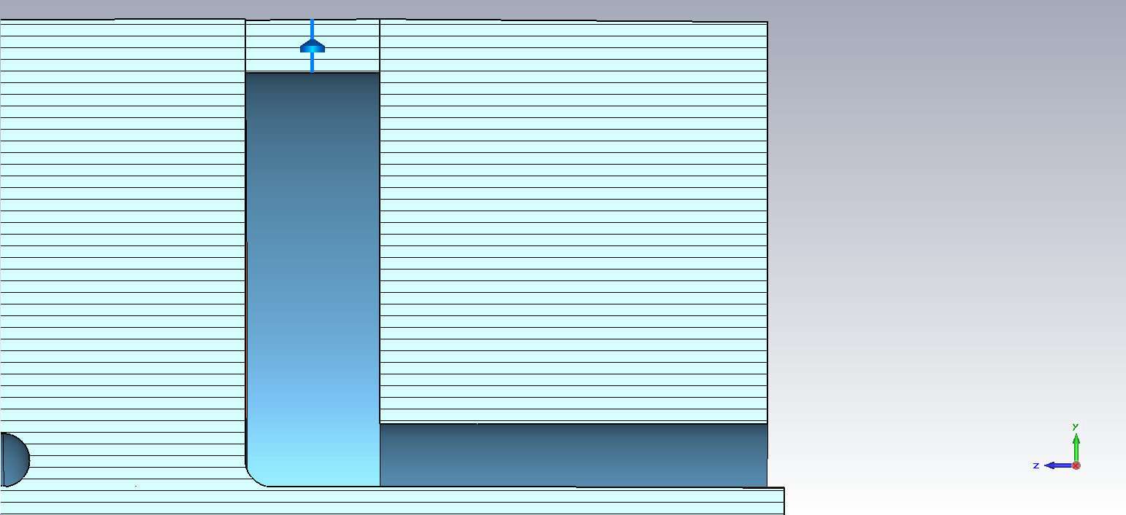
The damping cavity from 2D to 3D
S_R_out
H_R_out
H_R_in
S_Tip
S_R_in
The damping cavity is as designed in the model without tetrode.
d_slot
S_L
S_L
Optimized parameters for HOM cavity:
H_L – cavity length (7.2 cm)
H_R_in – inner radius (5 cm)
S_L – coupling gap length (2.5 cm)
d_slot – coupling gap width (1 cm)
R_damp - Damping resistor (4x87.5 Ohm).
S_R_in=S_R_out - d_slot (11.5 cm)
S_R_out = 12.5 cm = H_R_out
S_Tip = 0
H_L
H_R_in

Slide 3
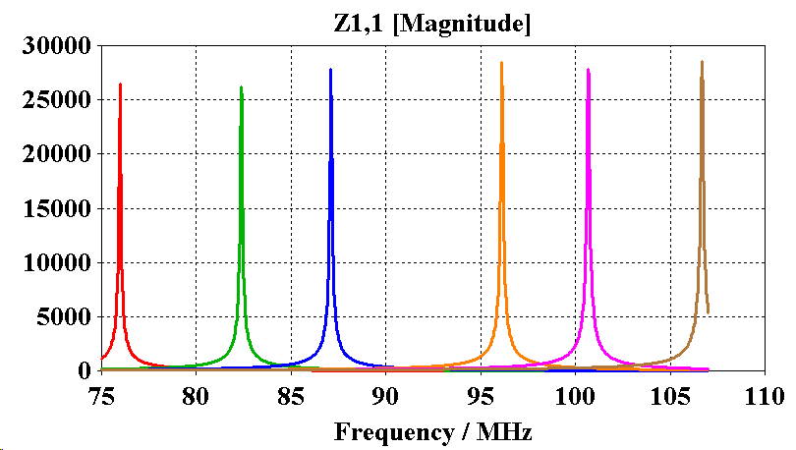
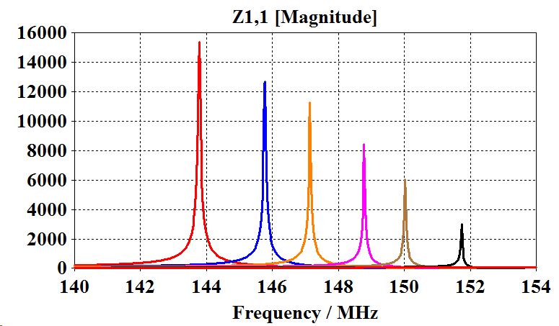
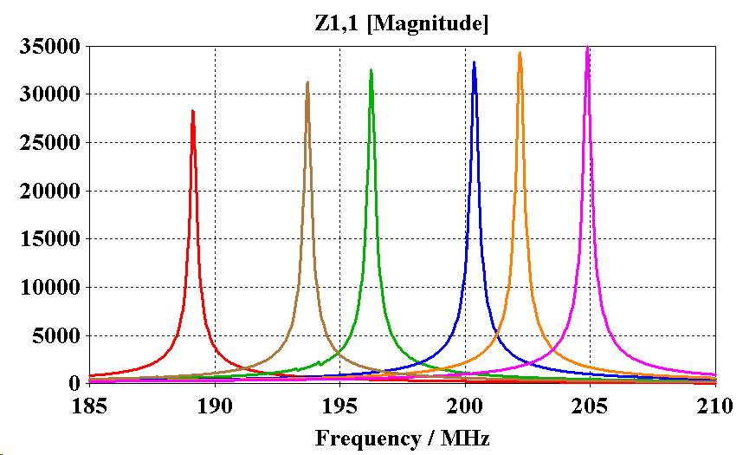
The cavity with HOM damper, but without damping resistors
Operating mode
HOM_2
HOM_1

Slide 4
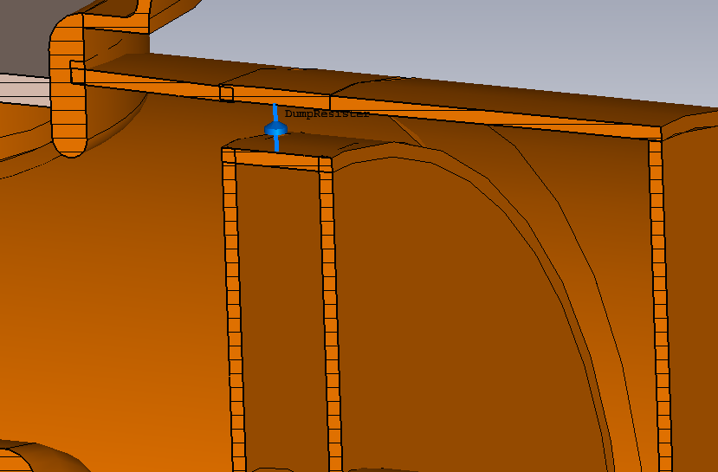
Damping resistor

Slide 5
Kevin’s requests
R=13 mm
OK, radius can be even slightly bigger
Conditionally OK (look again after all mechanical details are implemented)

