Slide 1
Eddy Current Effects in the Tuner of the 2-nd Harmonic Booster Cavity
Main results of the tuner study by 3D modeling

Slide 2
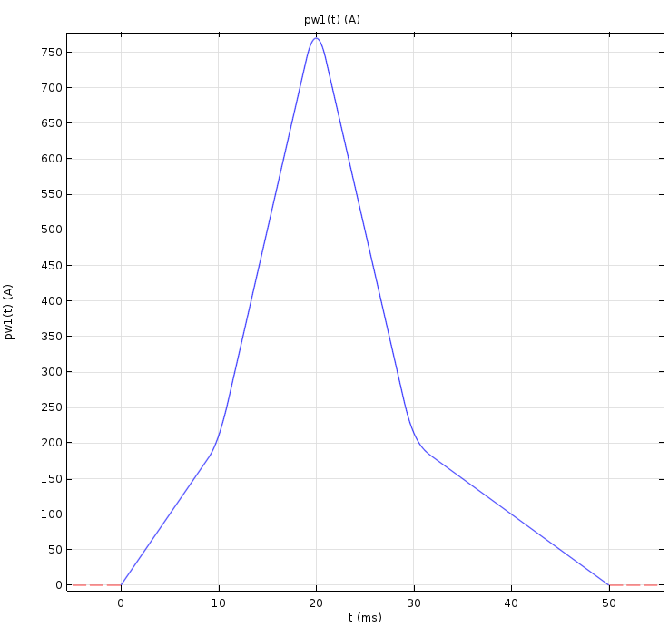
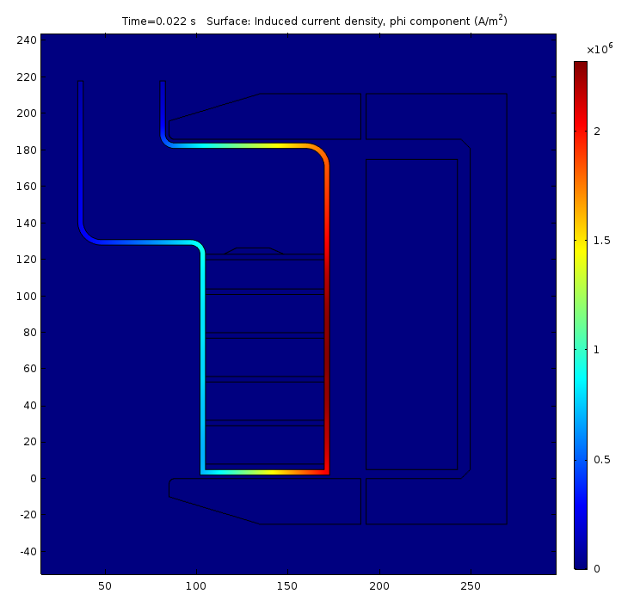
2D analysis results refresher
Geometry
Current Ramp (simplified)
N = 50
d(Iw)/dt|_{max} = 3000 A/ms
d(Iw)/dt|_{set} = 1000 A/ms
I_start ≈ 170 A
Shell thickness t = 3 mm
Copper coating 25 µm
Eddy current at the start corresponds to ~10% of the excitation current
Additional thermal loss is ~1200 W, that is ~40% of the loss in the garnet.

Slide 3
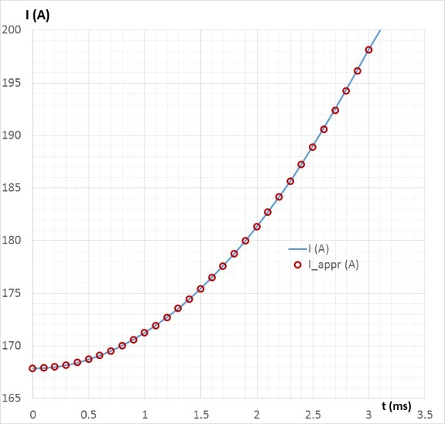
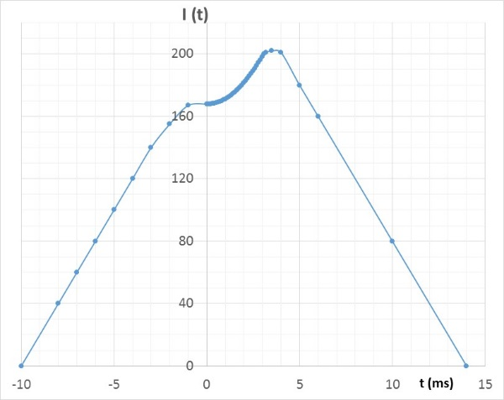
3D study setting
From the point of view of keeping the anomalous RF power loss in the garnet material of the tuner under control, the most challenging part of the accelerating cycle is injection, where the magnetic field is the closest to the gyromagnetic resonance condition. Only this part of the cycle was studied.
The current rise rate at this stage reaches its maximum value for the active part of the cycle, so results will apply to the whole cycle.
At the injection, the current rise is described by the following expression (N = 50):
I(t) [A] = 167.855 + 3.36∙t² [ms]
Example of the bias current shape is a pulsed power supply is used (not an wide-band power source of an amplifier type)

Slide 4
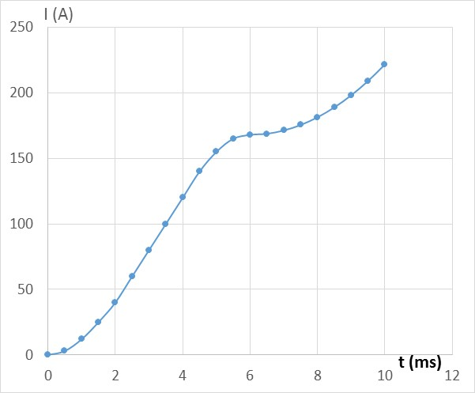
Current rise setting
Current rise during the setting part of the current pulse makes its impact of the magnetic field in the tuner due to eddy currents it generated in the shell. The initial current rise rate of the power supply (from the beginning of the cycle at t = -10 s in the figure to the beginning of the injection period at t = 0) must be chosen to make this impact tolerable. The maximum current rise rate d(Iw)/dt = 1000 A/ms.
2D study was made with d(Iw)/dt|_{set} = 1000 A/ms, but during the active part of the pulse d(Iw)/dt|_{max} = 3000 A/ms.
The initial proposal for the power supply by Matt Kufer assumes the setting current rose rate d(Iw)/dt = 4500 A/ms
Starting point:
d(Iw)/dt|_{set} = 2200 A/ms

Slide 5
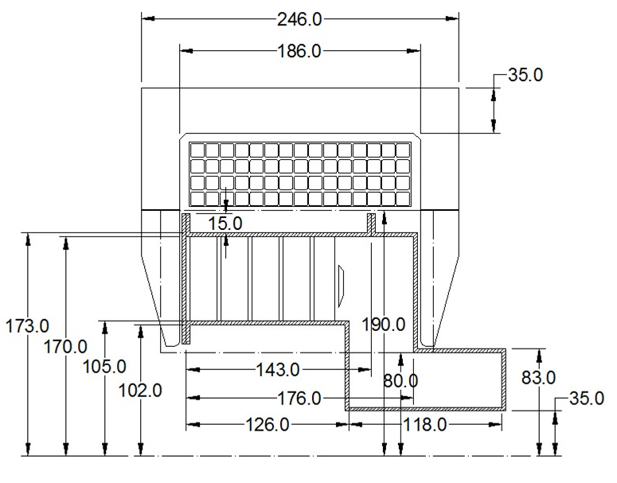
Modeling time line
Transparent (high resistance material) shield
Stainless steel cylindrical shield (t = 3 mm) (for comparison with the 2D case)
Shield made of four insulated sectors
Partially slotted shield
Effect of the current rise rate
Impact of copper coating
Expanded slots
Ultimate slots
Sampling points:
Point #1 Z = 8 mm, R = 110 mm
Point #2 Z = 8 mm, R = 165 mm
Point #3 Z = 120 mm, R = 110 mm
Point #4 Z = 120 mm, R = 165 mm
Point #5 Z = 8 mm R = 110 mm @ 45⁰
Point #6 Z = 8 mm R = 140 mm @ 45⁰
Point #7 Z = 8 mm R = 165 mm @ 45⁰
Point #8 Z = 120 mm R = 110 mm @ 45⁰
Point #9 Z = 120 mm R = 140 mm @ 45⁰
Point #10 Z = 120 mm R = 165 mm @ 45⁰
t_start = 6 ms

Slide 6
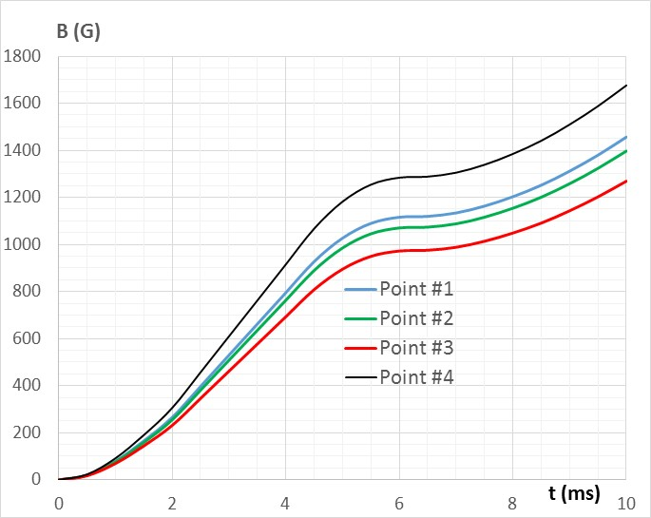
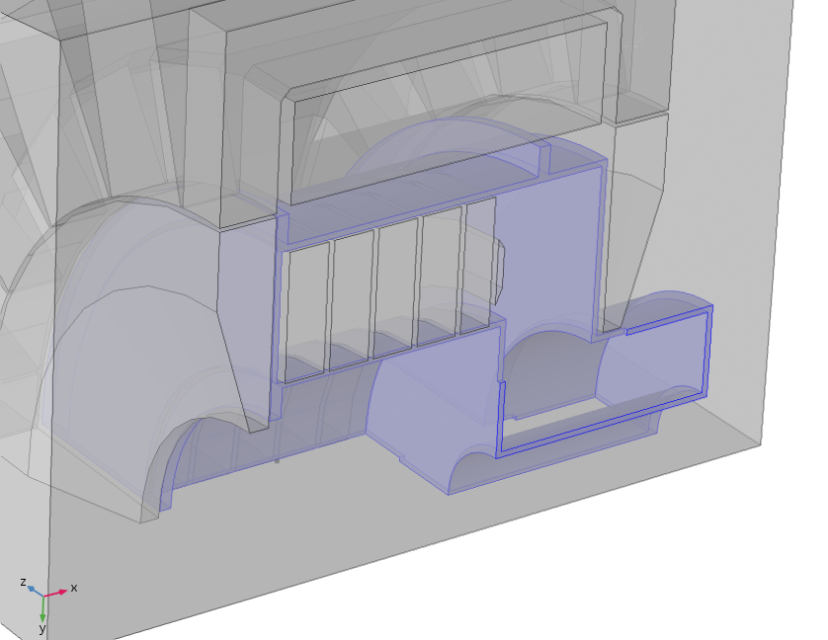
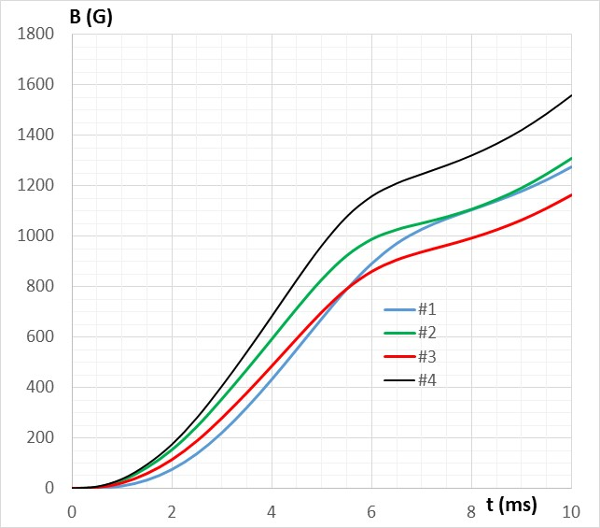
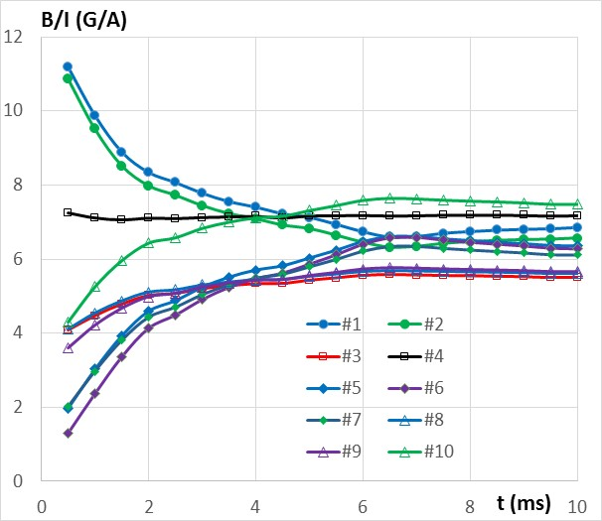
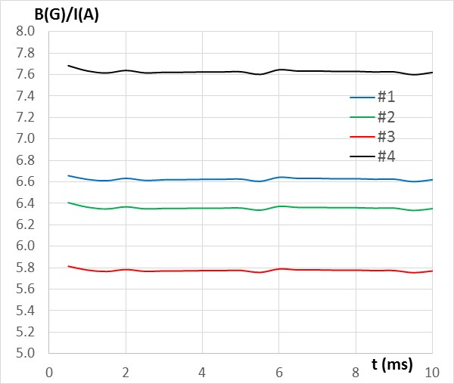
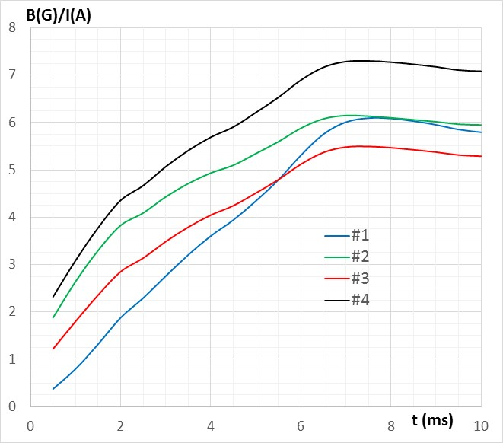
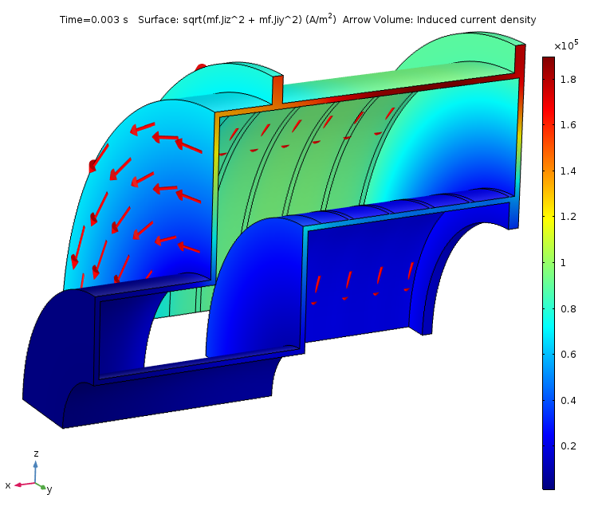
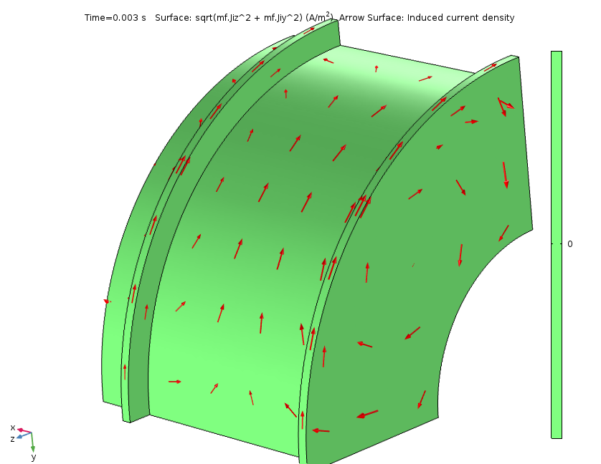
Transfer Functions at the Sampling Points
Transparent Shield
Axially Symmetric Stainless Steel
Four-Segment Shield

Slide 7
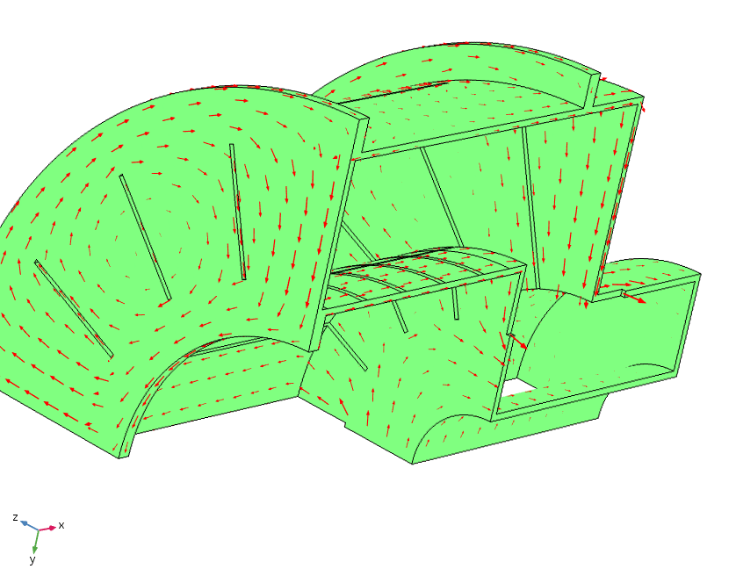
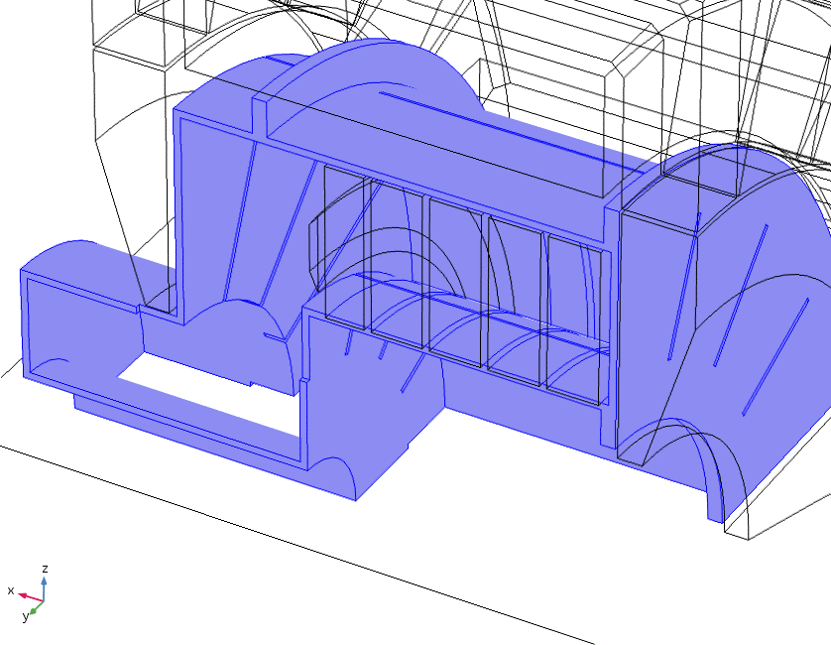
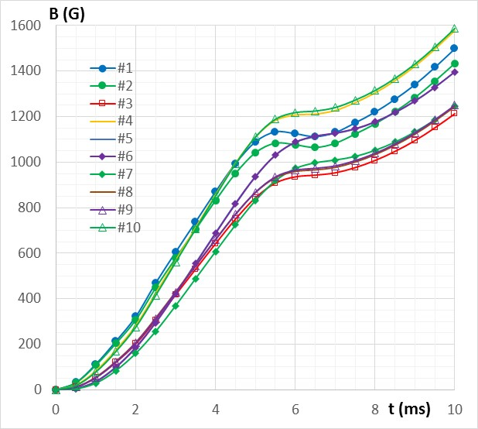
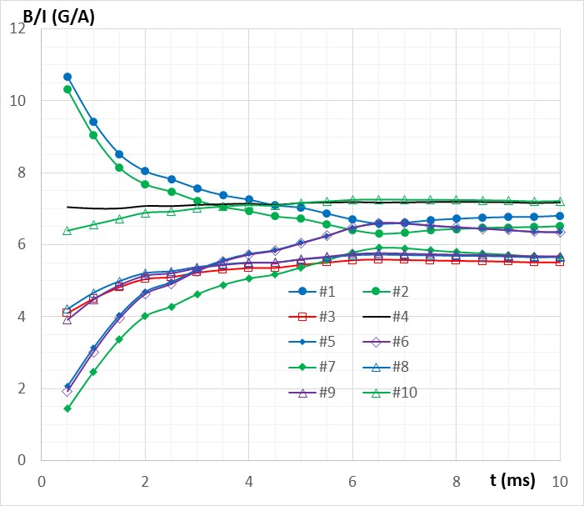
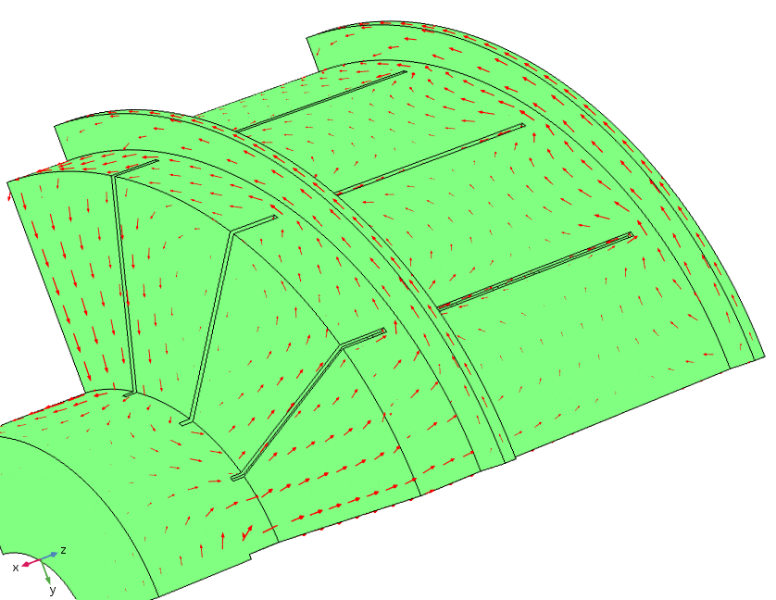
Transfer Functions at the Sampling Points
Partial Slots

Slide 8
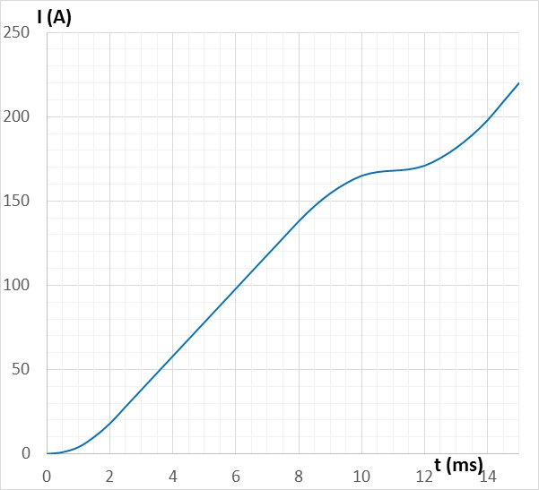
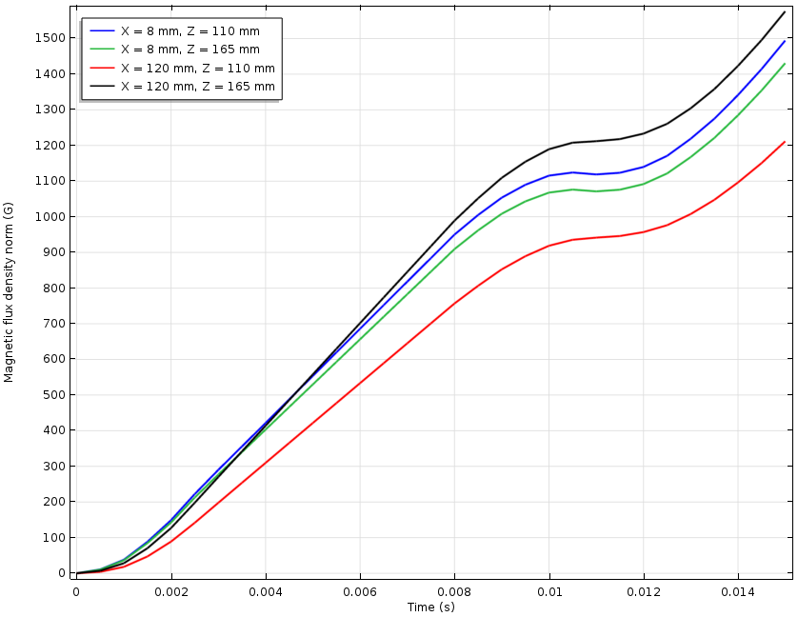
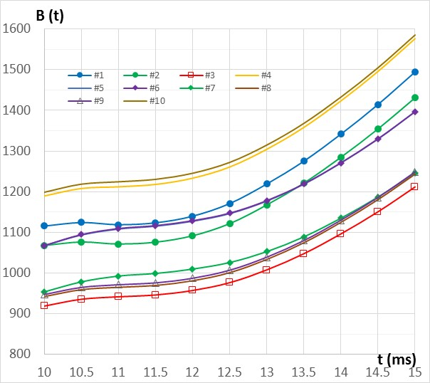
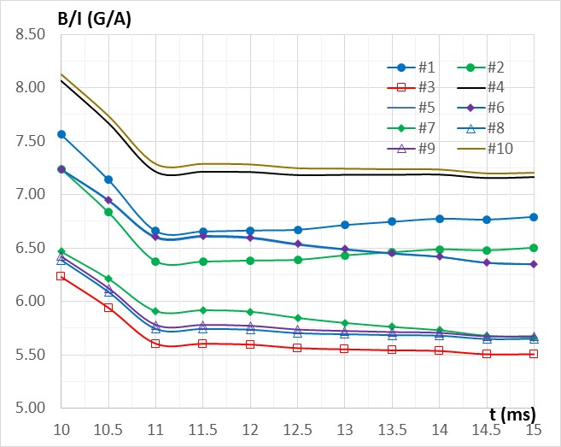
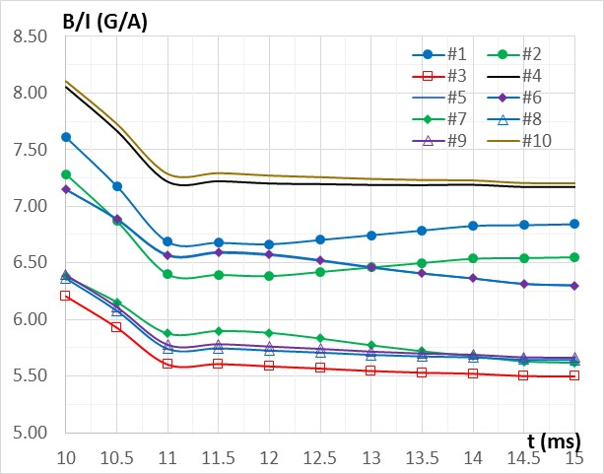
Current Rise Rate Effect
d(Iw)/dt|_{max} = 1000 A/ms
t_start = 11 ms
Ideal case
3 mm, no coating
3 mm, Cu coating

Slide 9
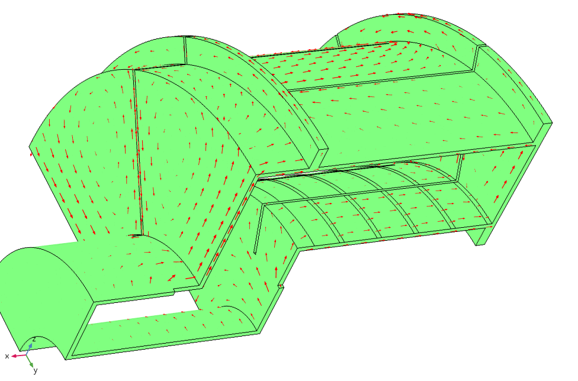
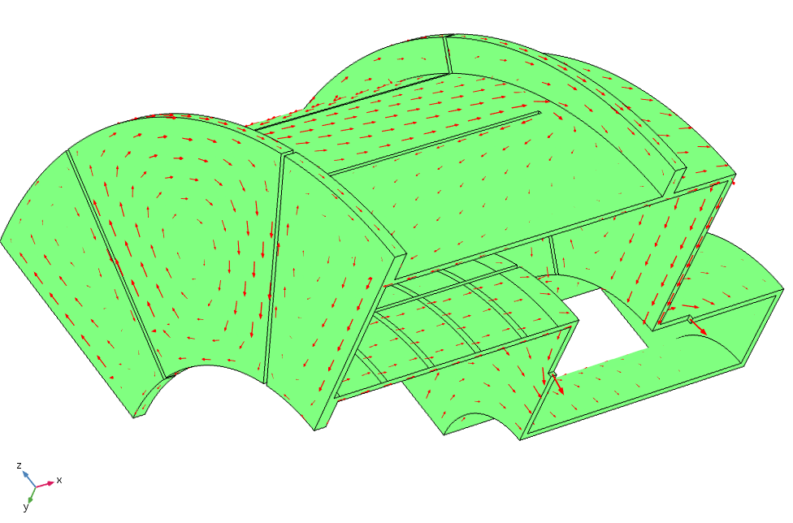
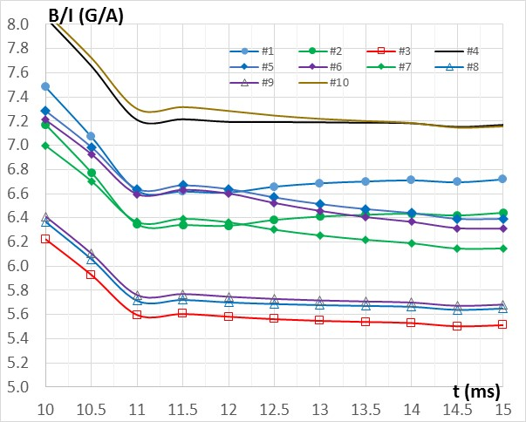
Aggressive slotting
Extended slots
Limited slots
Although there is some effect of restricting the eddy currents this way, it is not strong. Practically, no big difference exists between this case with the extended slots and the case with limited cutting just on the cylindrical surface.

Slide 10
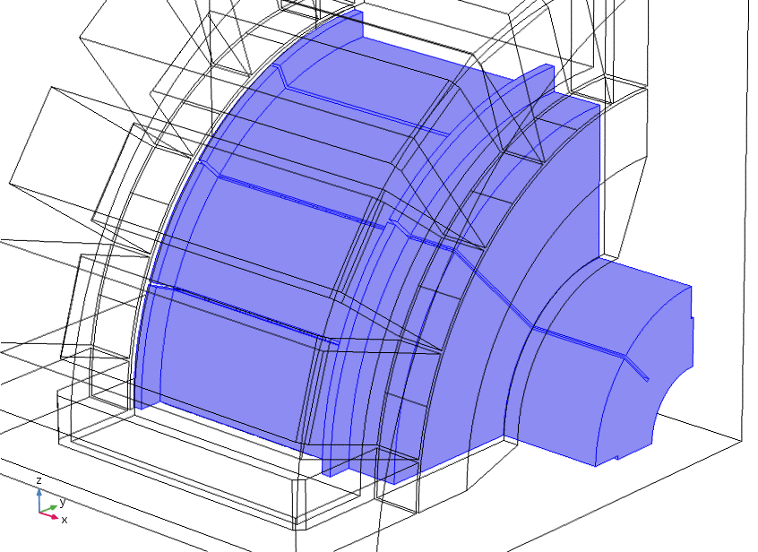
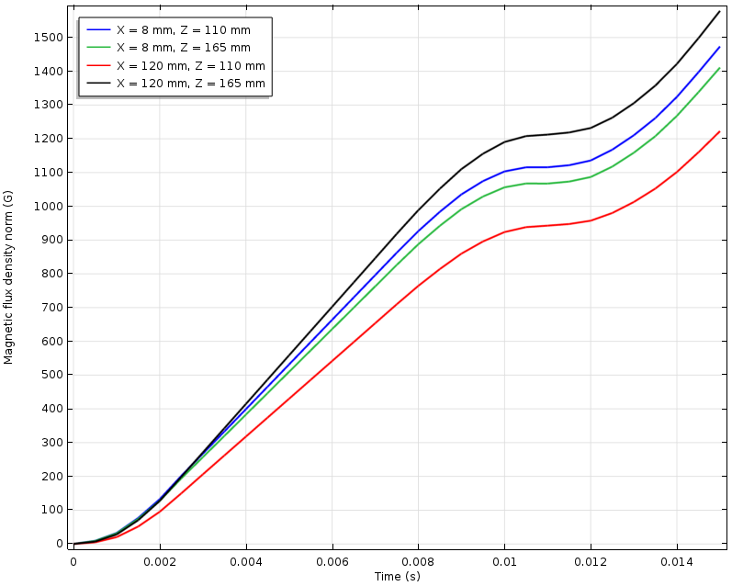
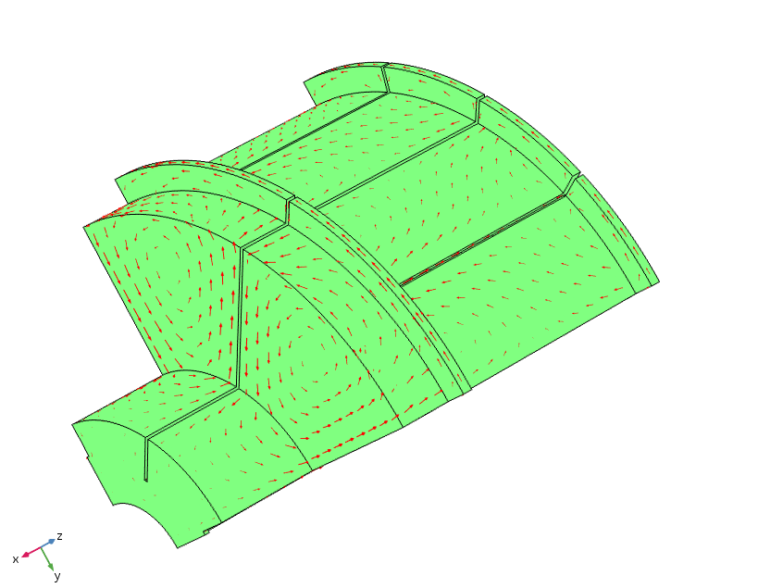
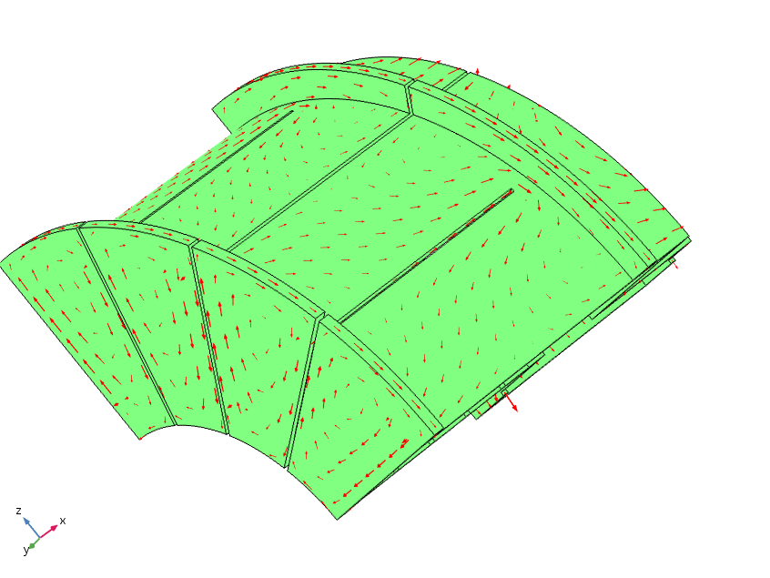
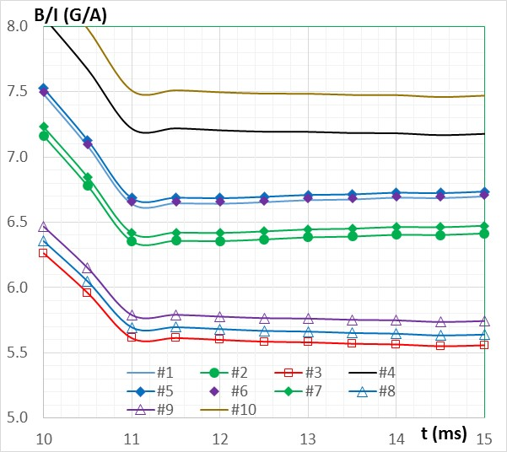
Ultimate Slotting
The cut at 45° degrees goes through all flanges. This means that two cooling circuits will be used on one quarter, not one.
This cut also extended to the pipe to limit this way of the eddy current closing.

Slide 11
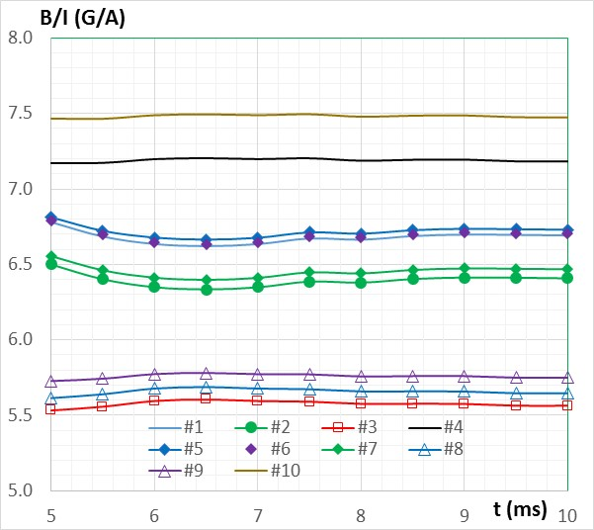
How the current rise rate makes things different?
Did it become even better with the faster rise?
Need to investigate

Slide 12
Next:
Iterate on the shell design.
Finalize the bias coil current shape.
Having in mind severe effect of the setting current rise rate, do we have the right approach to the power supply choice?

