Slide 1
Analysis of different design options for the RF shell design
2-nd Harmonic Booster Cavity Meeting

Slide 2
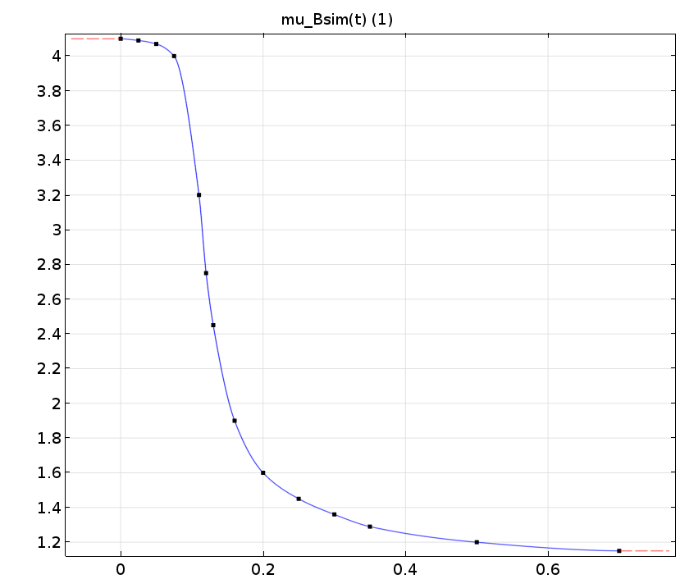
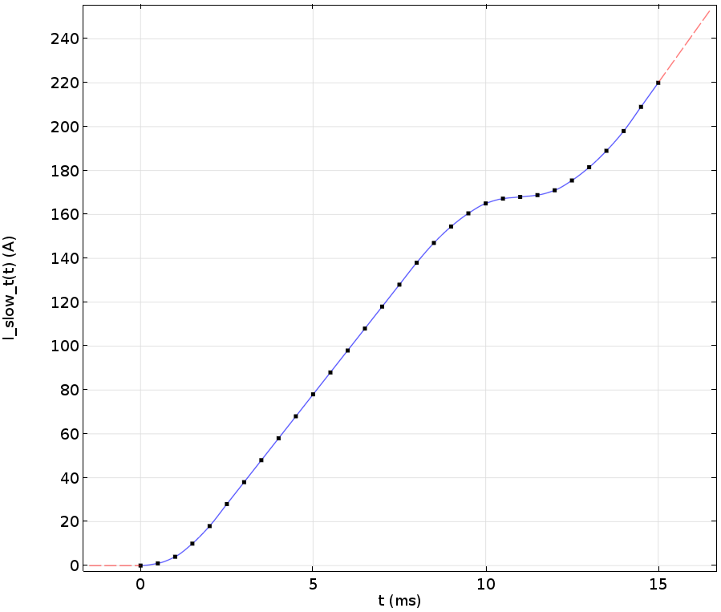
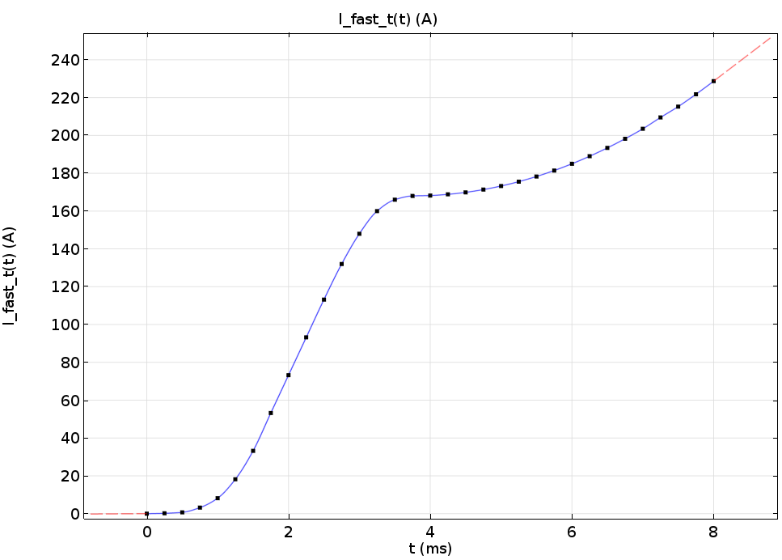
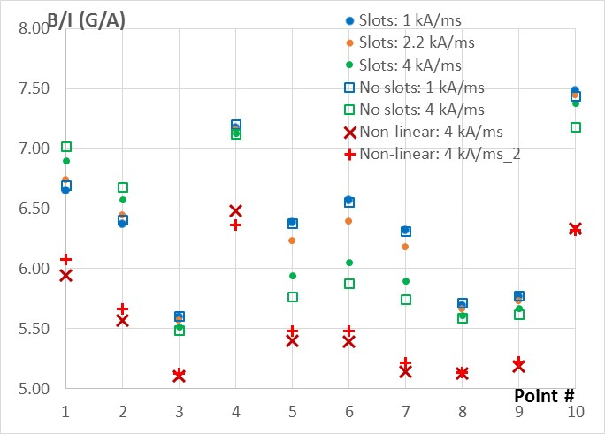
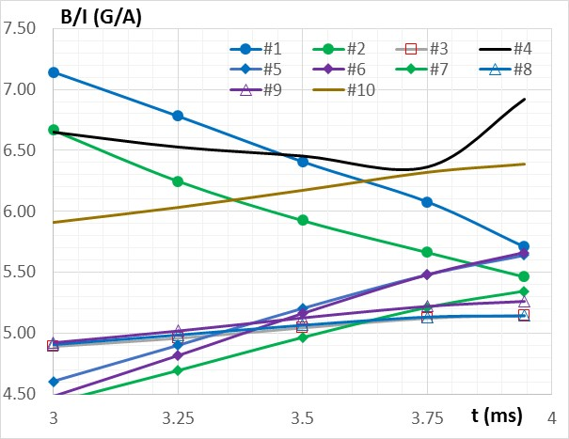
Summary of the previously made study on the impact of slots in the shell
dIw/dt|_{max} = 1 kA/ms
dIw/dt|_{max} = 4 kA/ms
“No slots” case really meant no slots in the cylinder part of the shell, assuming that it was important to have slots in the ends.
The following study attempted to clarify this.

Slide 3
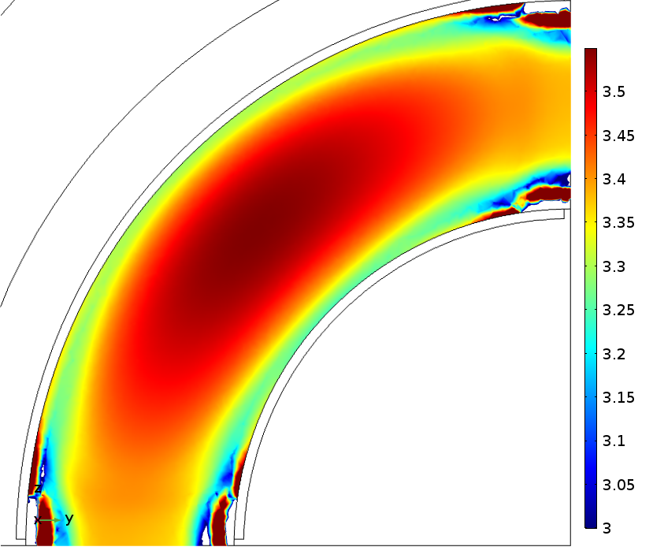
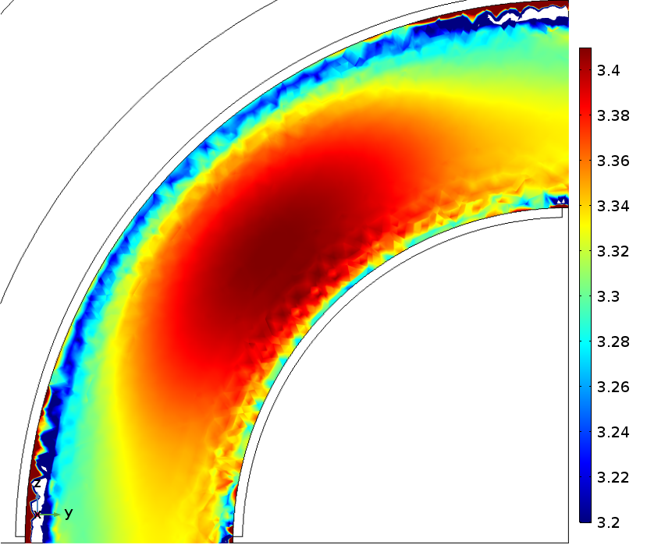
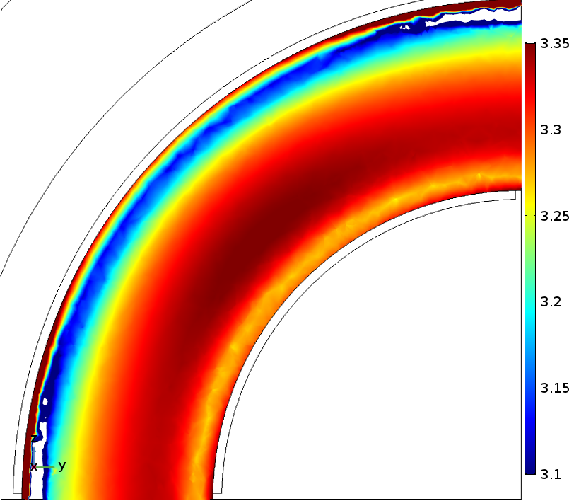
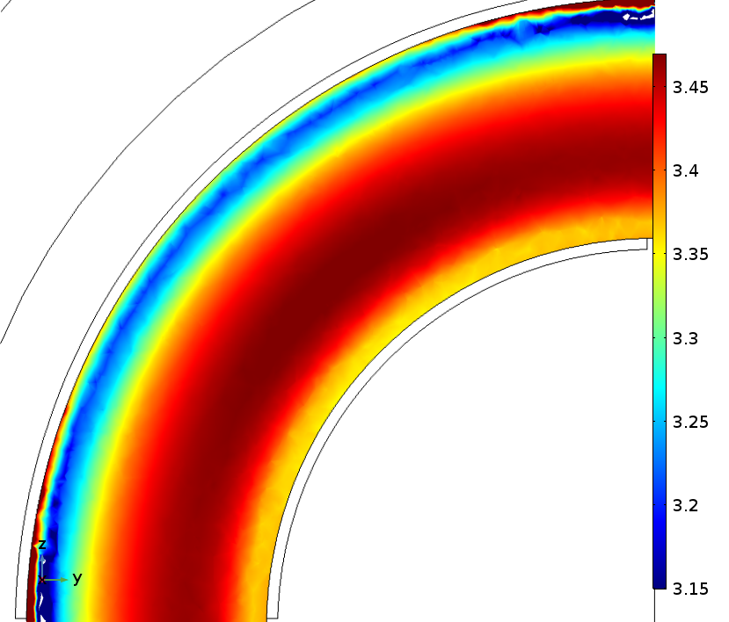
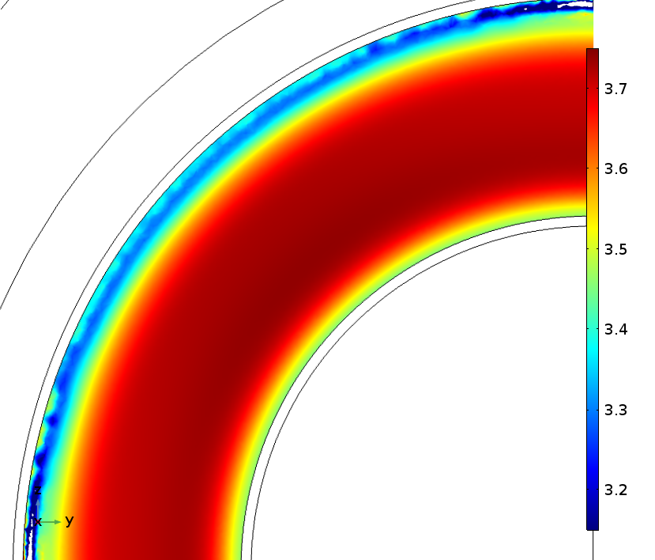
Range of permeability in the garnet at injection
X = 19.5 mm;
µ_{av} = 3.43
X = 34.5 mm; µ_{av} = 3.31
X = 66.5 mm;
µ_{av} = 3.30
X = 90.5 mm;
µ_{av} = 3.41
X = 112 mm;
µ_{av} = 3.63
X = 125 mm;
µ_{av} = 3.81
Average permeability of the whole tuner at injection is 3.41

Slide 4
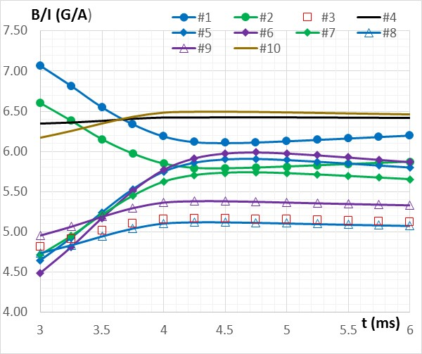
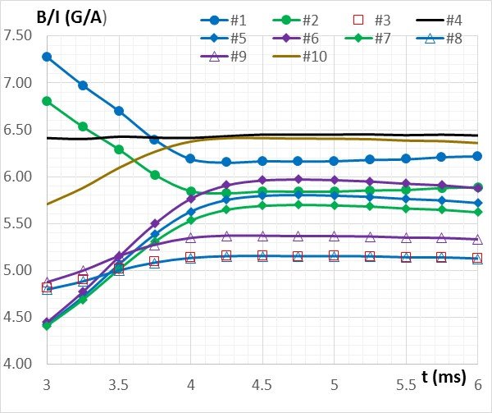
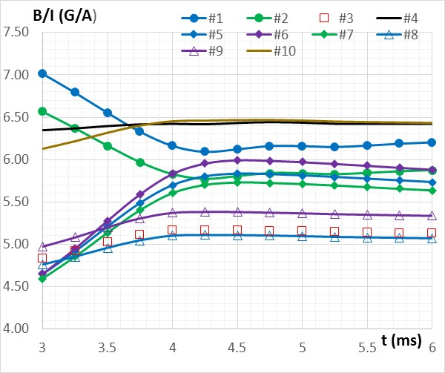
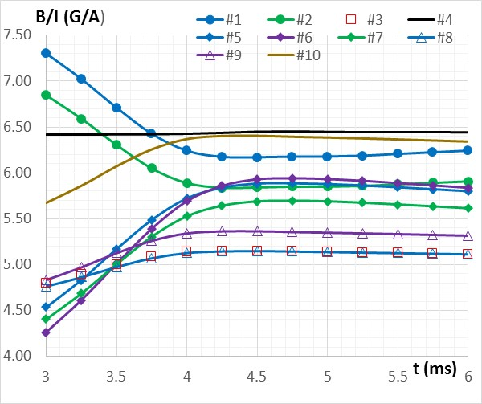
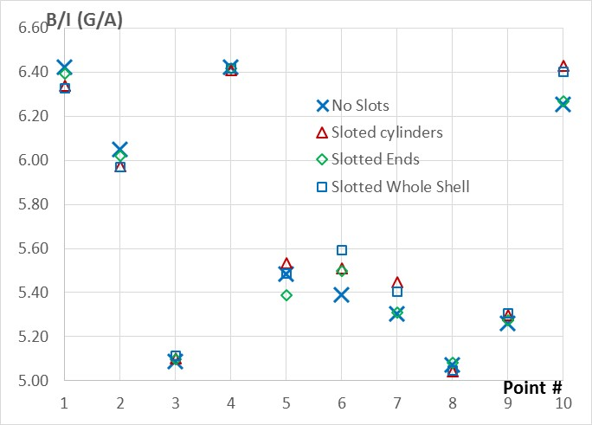
Comparison of design options with different slot patterns
Slots only in the cylinders
Slots only in the ends
Slots in the ends and in the cylinders
No slots at all
µ = 3.75;
d(Iw)/dt = 4 kA/ms
t_inj = 3.75 ms

Slide 5
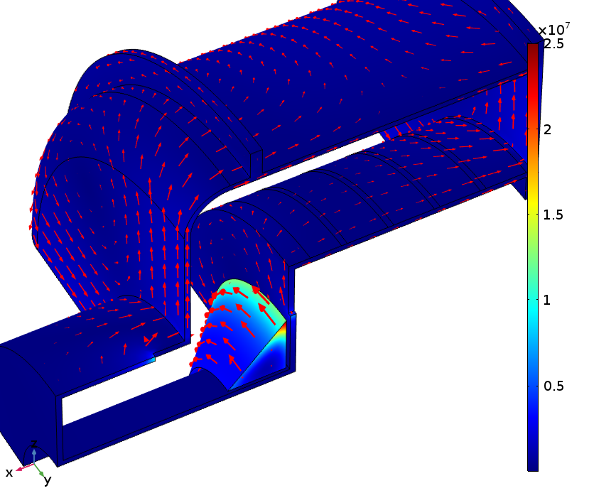
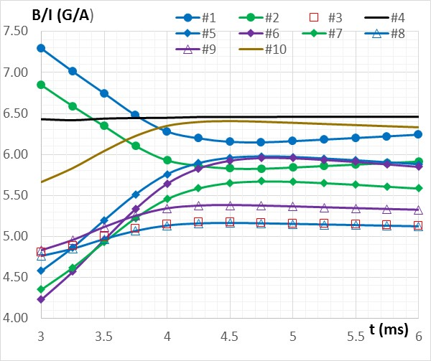
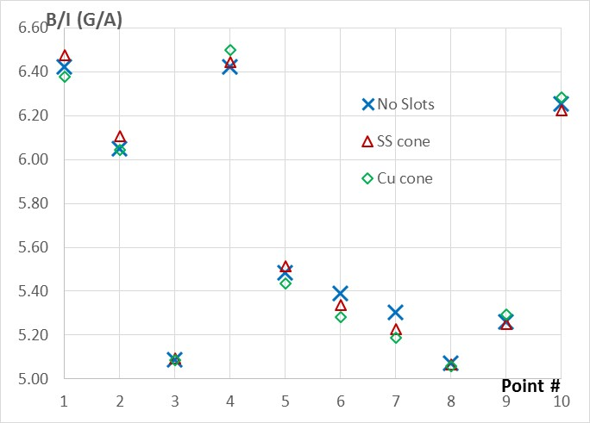
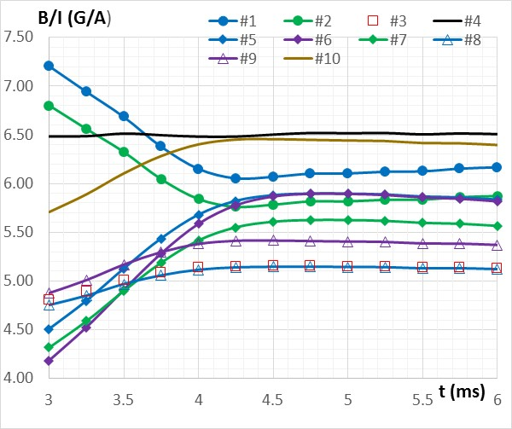
Impact of the added material near the beam pipe
Stainless Steel
Copper

Slide 6
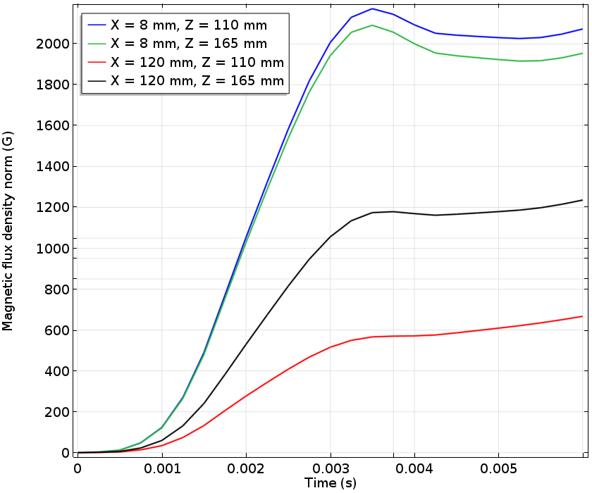
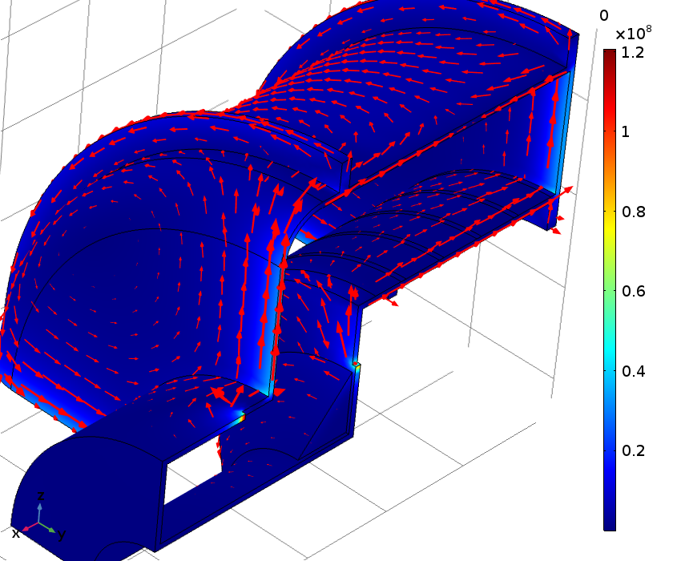
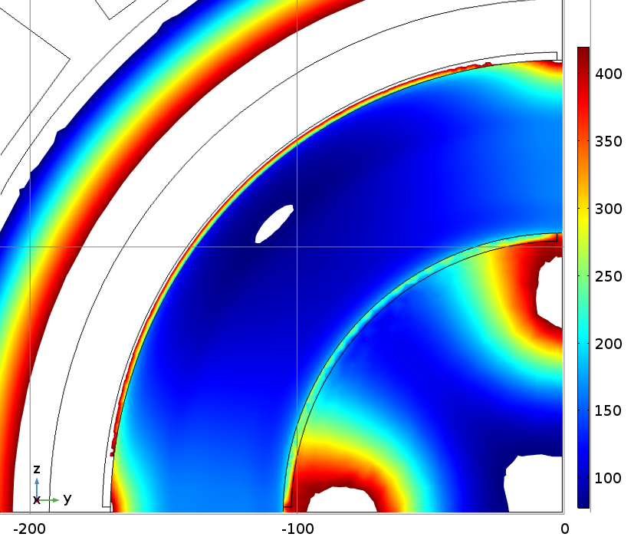
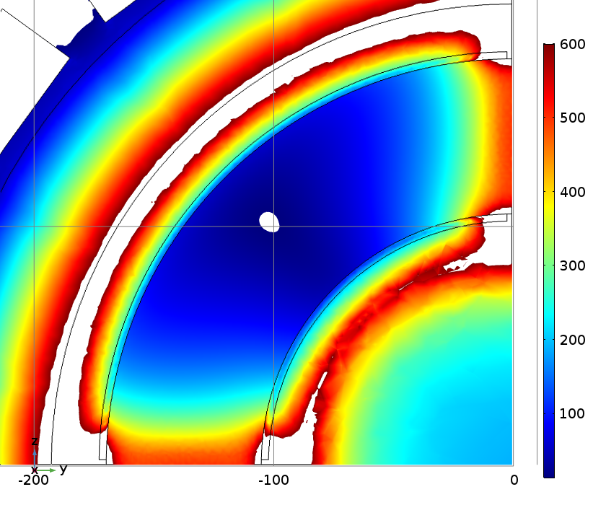
Are there any design restrictions?
What if to make the shell of copper, while having the “four quarters” design structure?
No slots in the shell
Too big spread of the field in the garnet blocks.
The field is below the resonance
X = 118 mm (min 75 Oe) X = 10 mm (min 15 Oe)

Slide 7
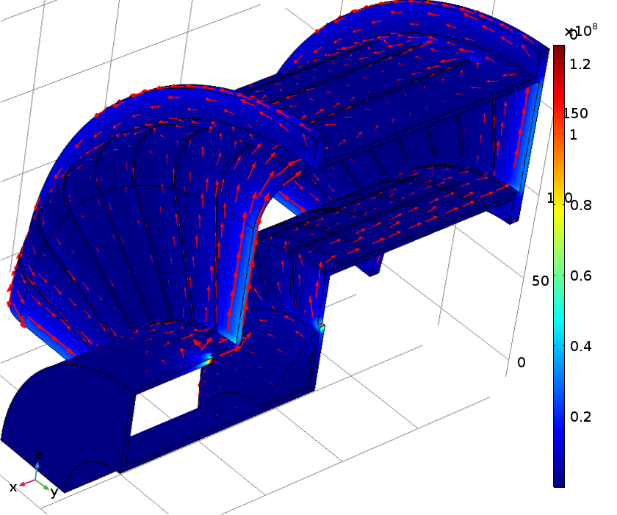
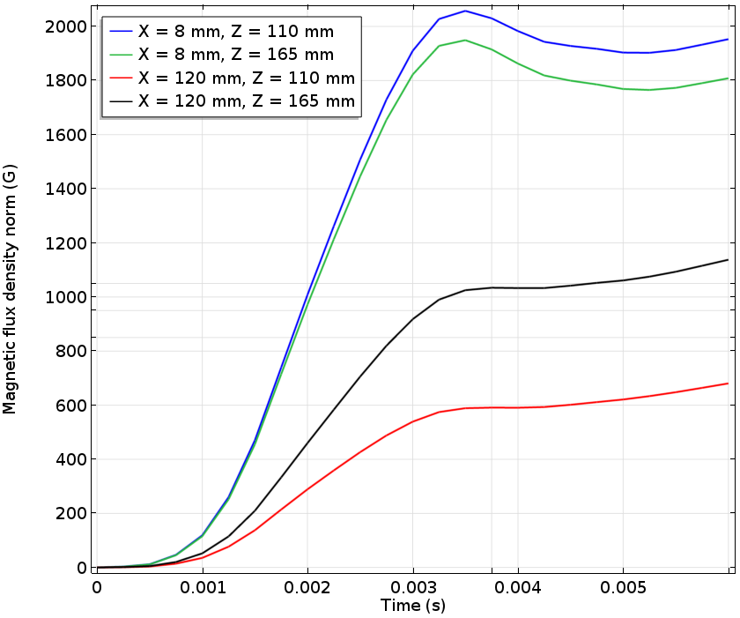
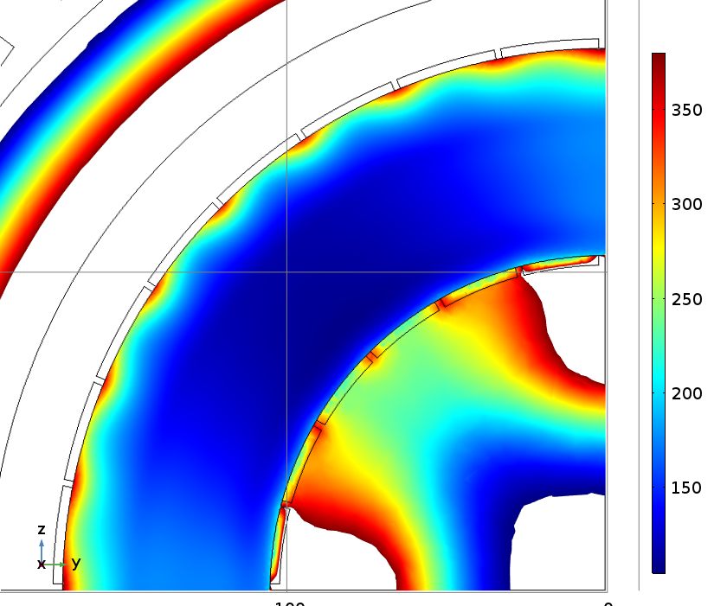
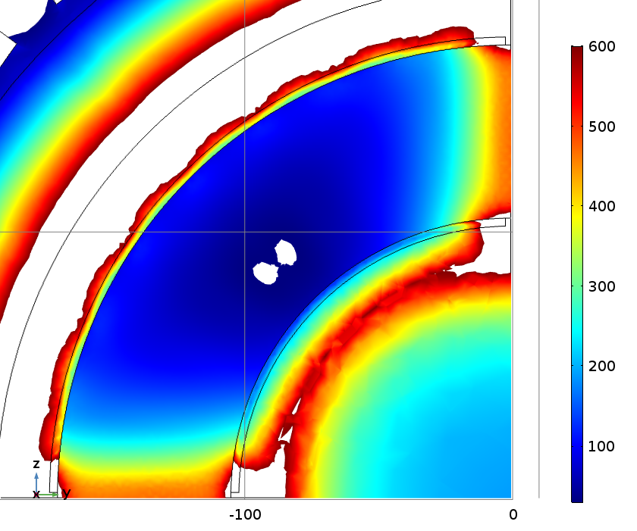
Small step back
Fully slotted shell
Still big spread of the field in the garnet blocks.
Dangerously close to the resonance condition
X = 118 mm (min 105 Oe) X = 10 mm (min 30 Oe)

Slide 8
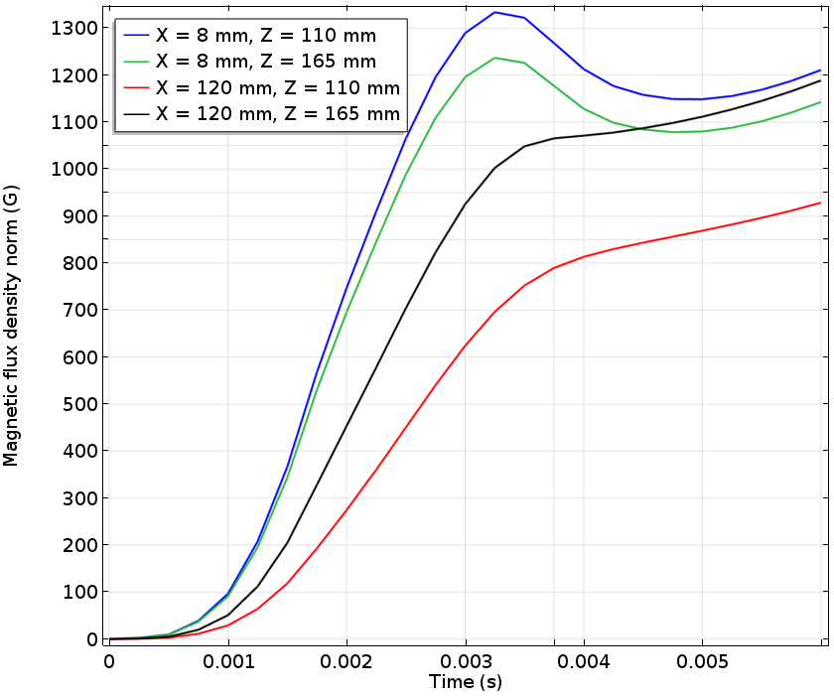
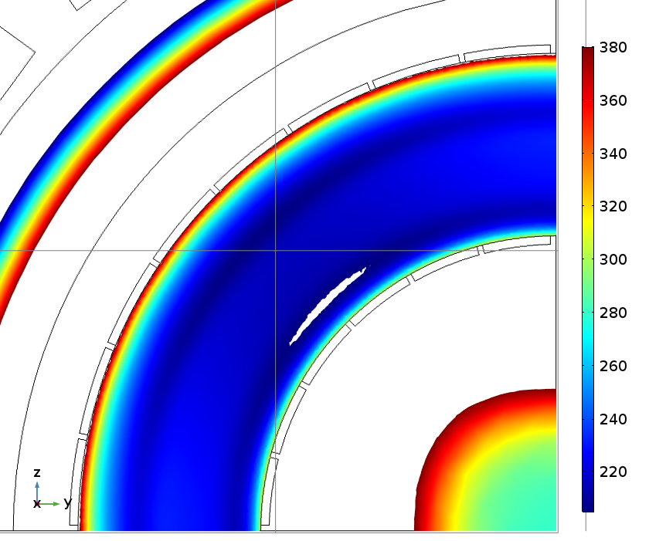
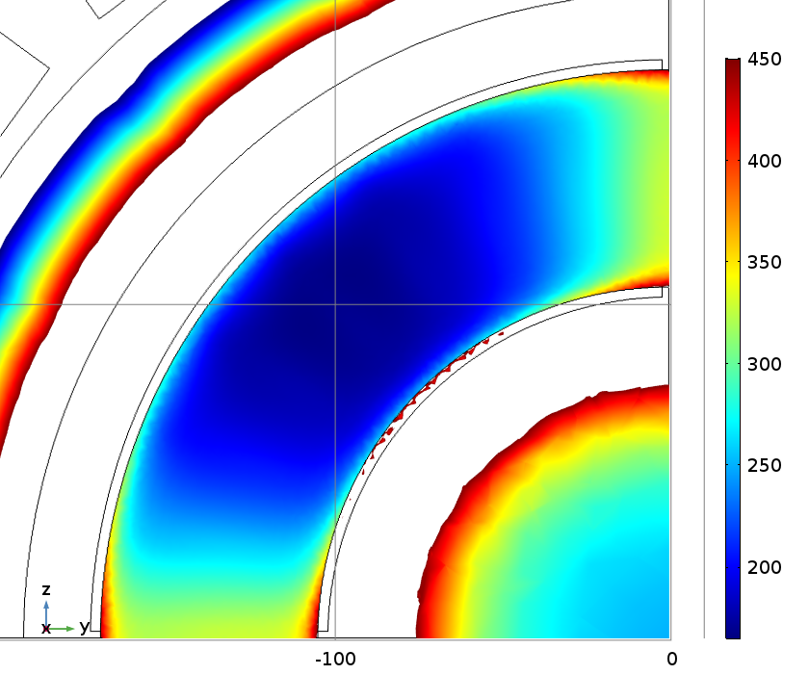
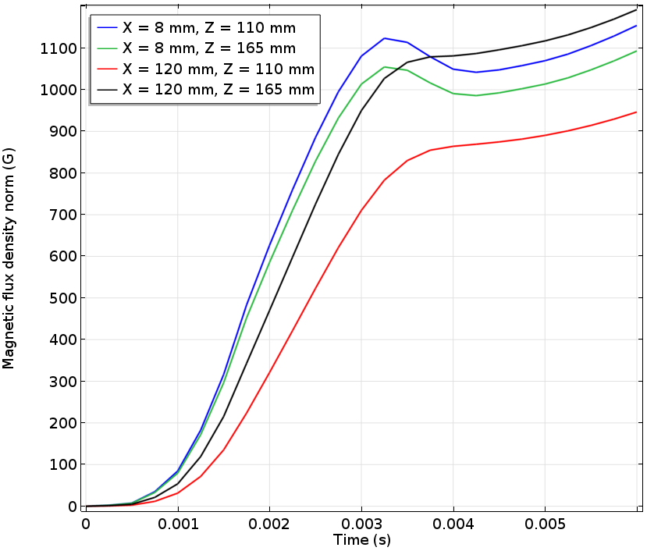
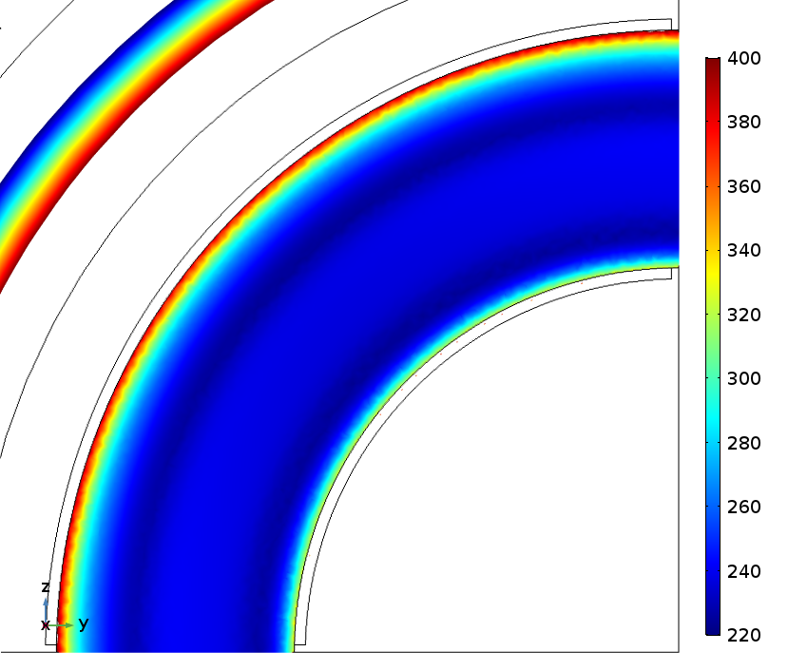
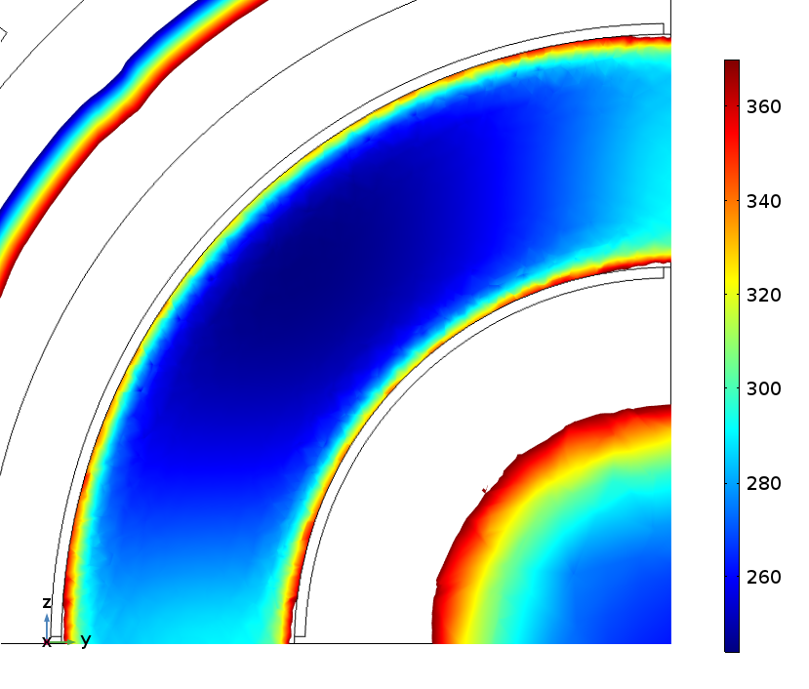
0.3 mm copper plating
Effective wall material conductivity is 5.8*10⁶ Sim/m
X = 118 mm (min 205 Oe) X = 10 mm (min 165 Oe)
Effective wall material conductivity is 1.8*10⁶ Sim/m
X = 118 mm (min 220 Oe) X = 10 mm (min 245 Oe)

