Slide 1
PA test simulations.
Gennady Romanov, Robyn Madrak.
2nd Harmonic cavity meeting
February 2, 2017

Slide 2
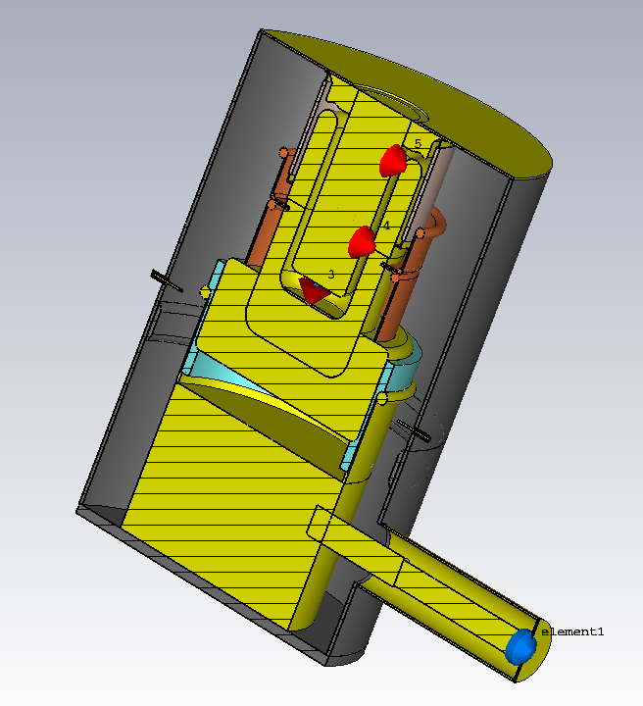
New model (Robyn, 2/2/2017)
Gennady and I measured dimensions of real (cut apart) tetrodes and Gennady made a model of this in CST
I took this model and inserted it into the test station model
Data:
f0 = 71.7 MHz, Zanode = 1.3 – 1.4 k
CST:
f0 = 70.016 MHz, Zanode = 1.5 – 1.6 k
The more simplistic model also did not agree with data, but gave a higher f0
What would be the effect on the real cavity? Presumably maximum shift of ~ 2 MHz but probably less
Would effect be absorbable by tuning to lower f, or would we wind up with the garnet being too lossy?

Slide 3
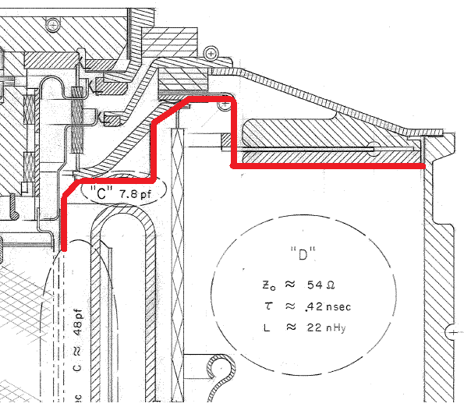
Minor corrections
Removed
Added
Gap removed, resistor placed between electrodes

Slide 4
Result of corrections
L
The corrections increased frequency up to 70.9 MHz, still not enough.
The frequency is very sensitives to the port length, so it was decided to
check the waterload.

Slide 5
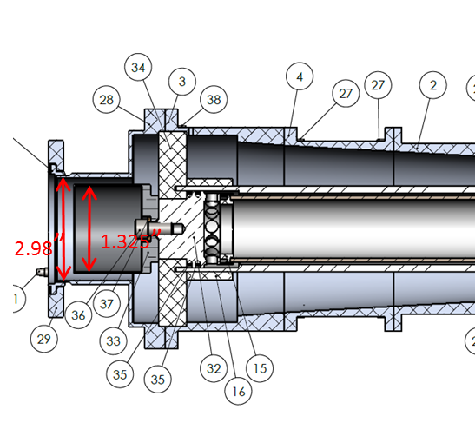
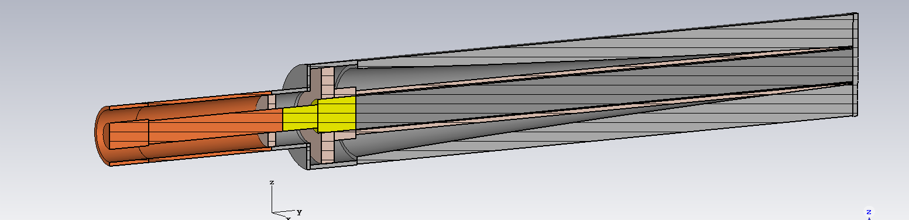
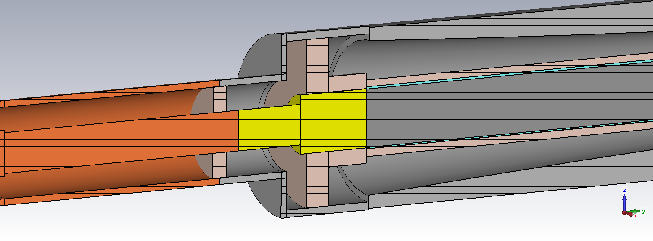
Waterload
Line imp. 41 Ohms (D=2.976”, d = 1.325”)
Water

Slide 6
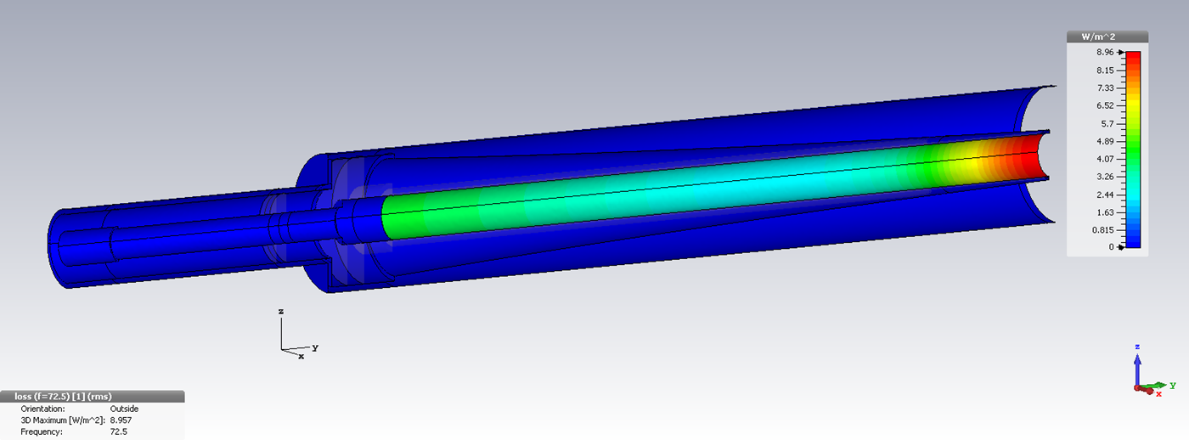
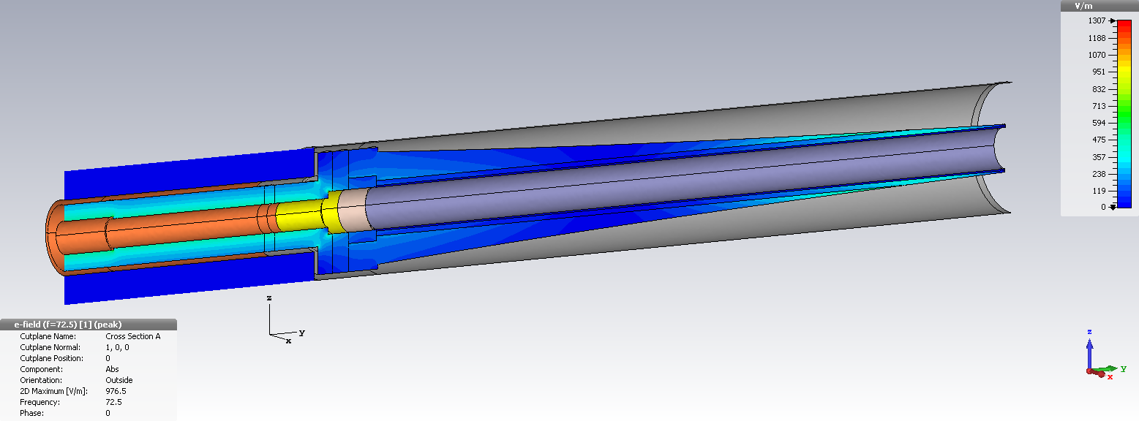
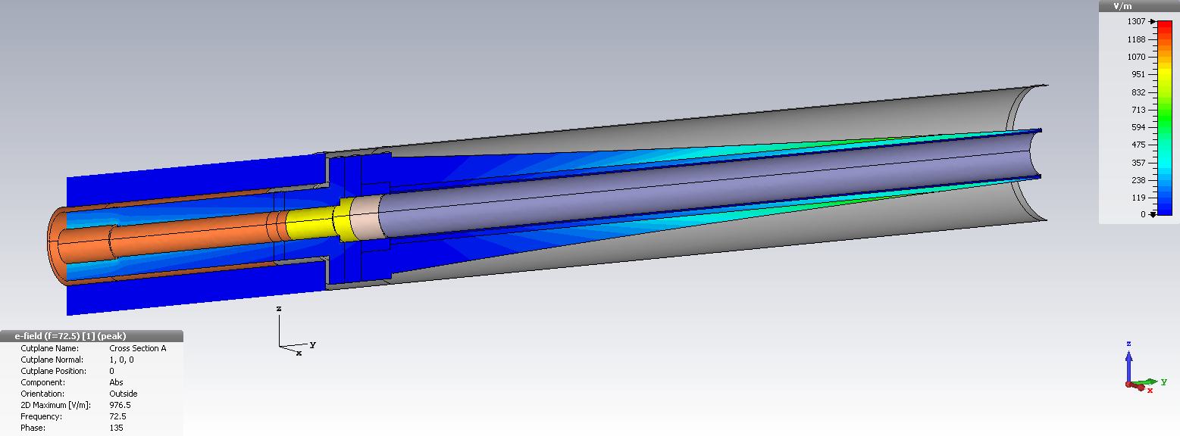
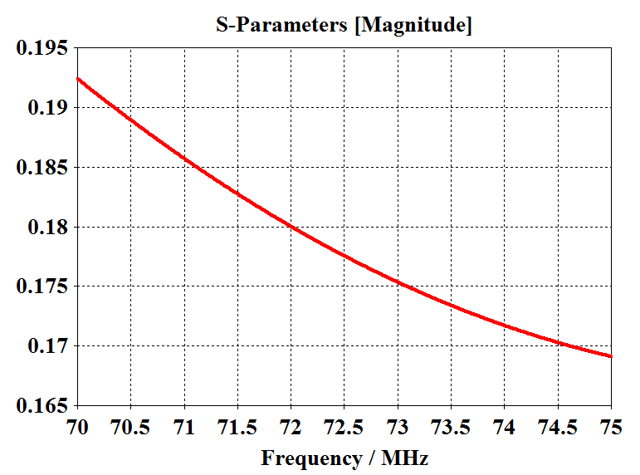
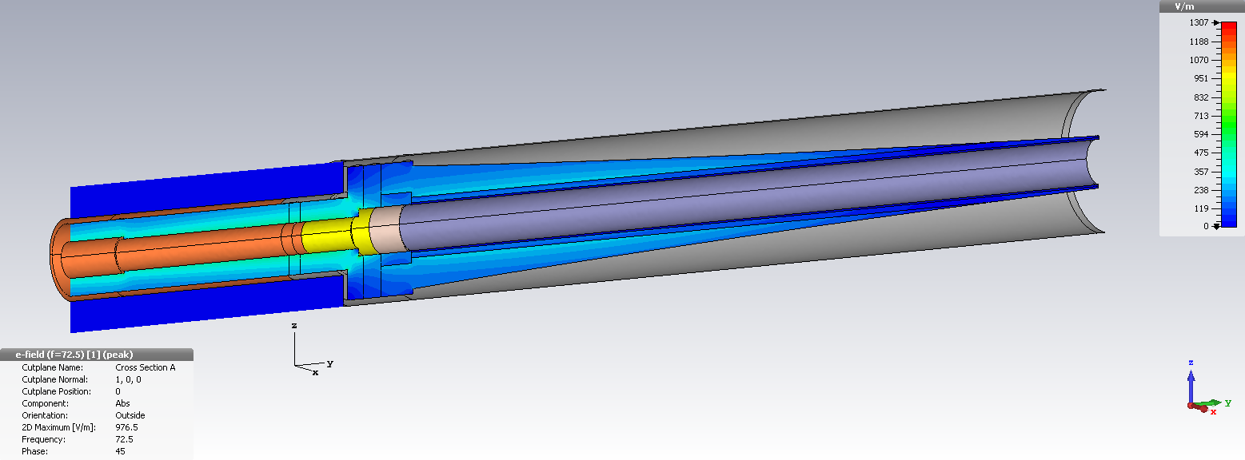
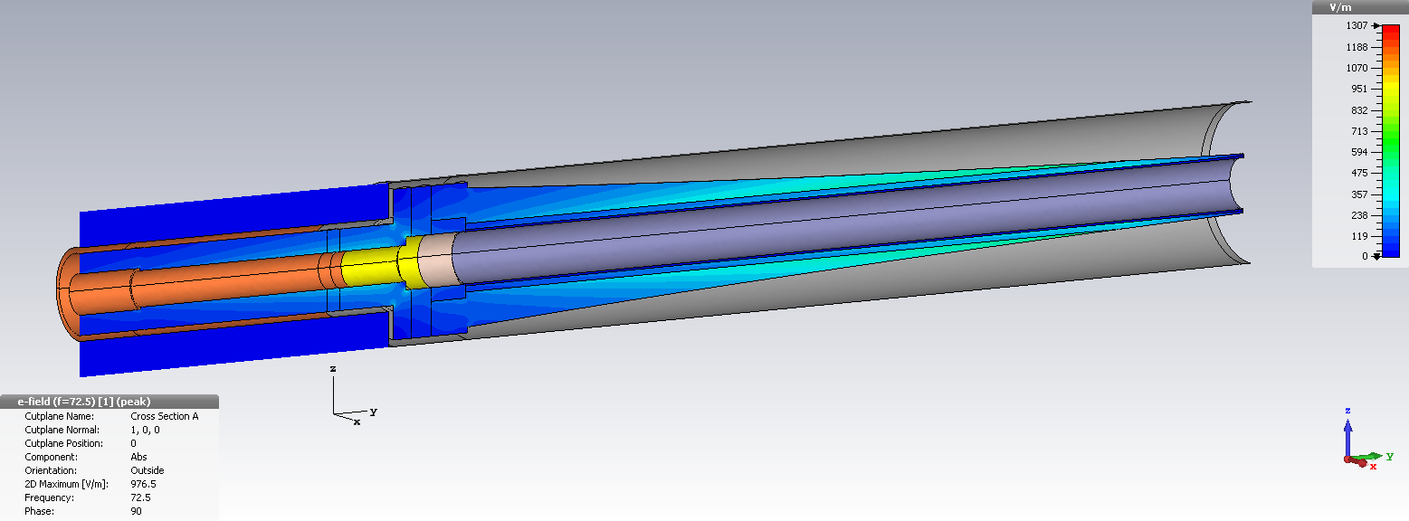
Waterload simulations
The parameters of resistor were unknown.
Electric field, TW
Distribution of losses in the resistor
0°
45°
1.6 S/m
90°
135°

Slide 7
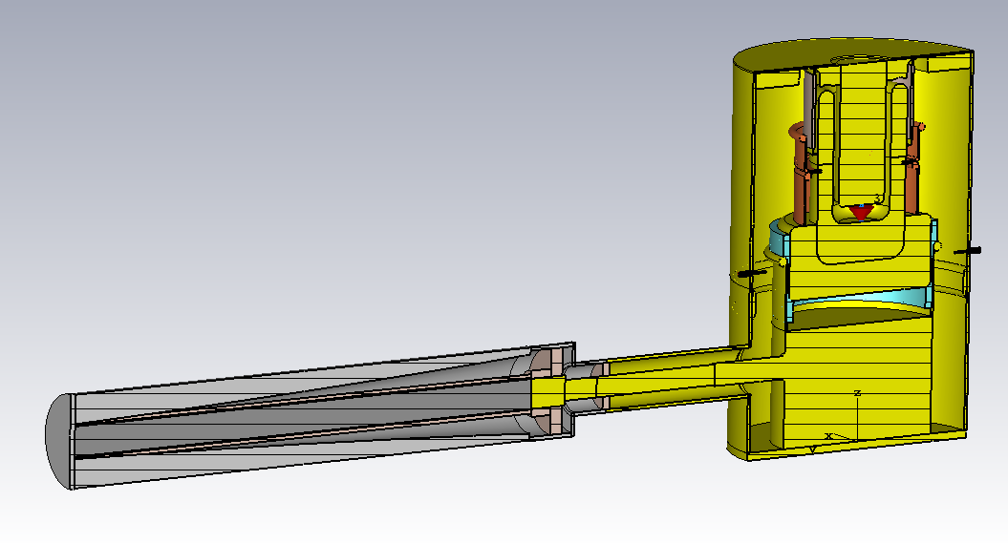
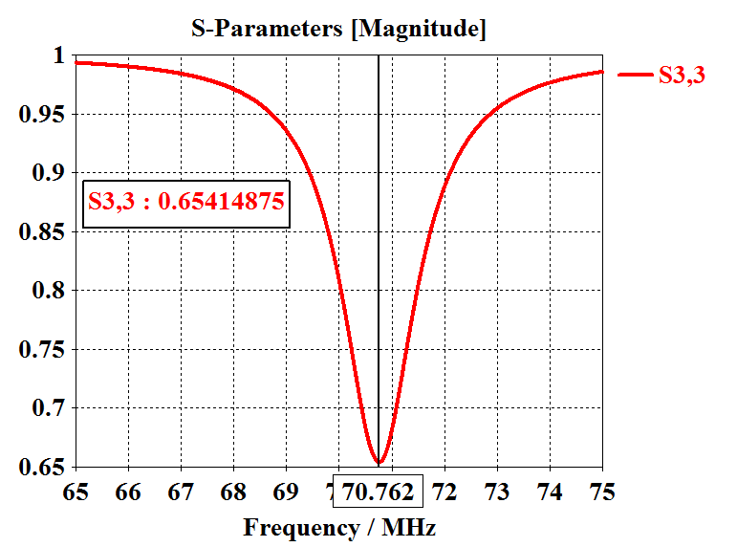
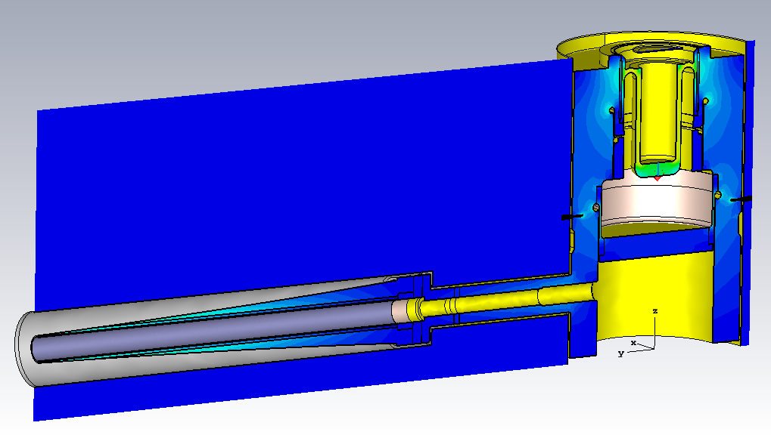
PA model with waterload
No changes.
It has to be something else

