Slide 1
Heating of the Tuner’s Shell by Eddy Currents
This study aims to understand to which extent eddy current heating can impact the shell design (four-quadrant approach)

Slide 2
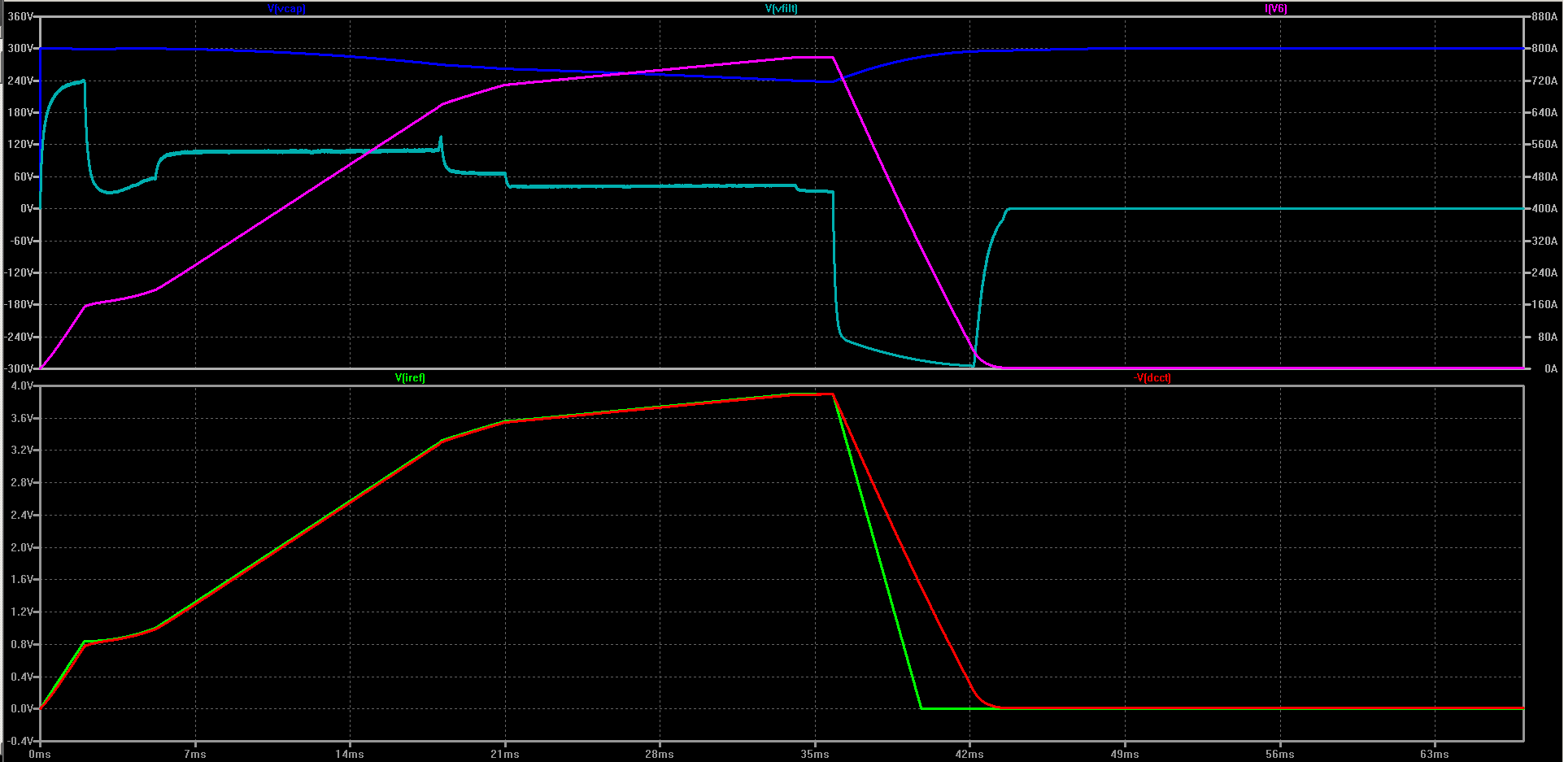
Current pulse Fourier decomposition
Suggested current pulse shape
Simplified current pulse shape
Fourier transformation of the current pulse can be presented in the following form:
I(t) = I₀/2 + I₁_c·cos(2πt/T) + I₁_s·sin(2πt/T) + … + I_{n}_c·cos(2πt·n/T) + I_{n}_s·sin(2πt·n/T)
The coefficients I_{k}_c and I_{k}_s can be calculated using the following expressions:
I_{k}_c = 2/T∙∫I(t)∙cos(2πk∙t/T)∙dt,
I_{k}_s = 2/T∙∫I(t)∙sin(2πk∙t/T)∙dt

Slide 3
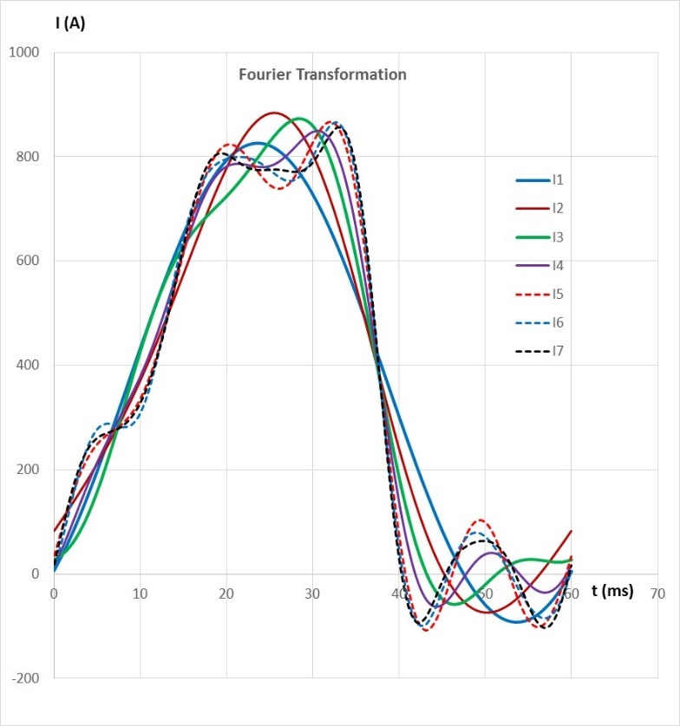
Current pulse Fourier decomposition
Spectral content of the simplified current pulse
The amplitudes of the main harmonics :
I1 = 460 A 15 Hz
I2 = 81 A 30 Hz
I3 = 77 A 45 Hz
I4 = 61 A 60 Hz
I5 = 38 A 75 Hz
I6 = 28 A 90 Hz
I7 = 19 A 105 Hz
Parameters of the study:
- Frequency (harmonic number)
- Harmonic amplitude
- Permeability of the garnet
- Material of the shell
- Geometry of the shell

Slide 4
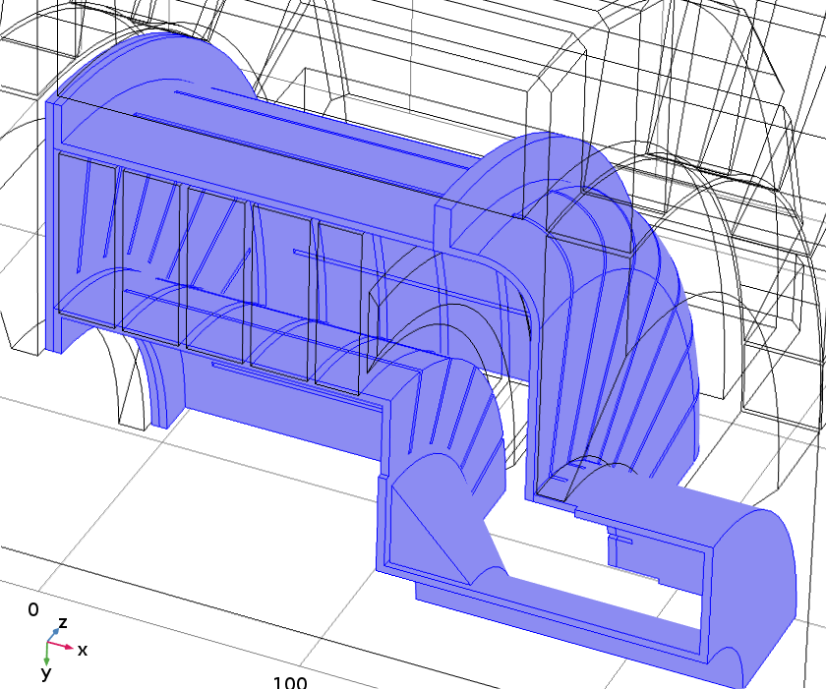
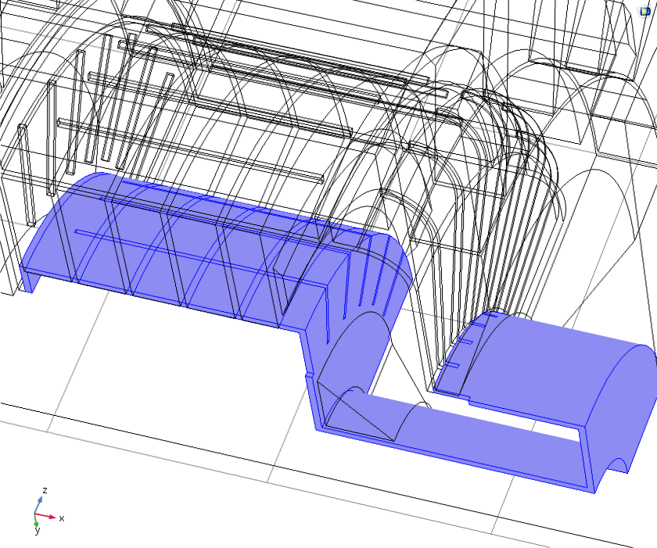
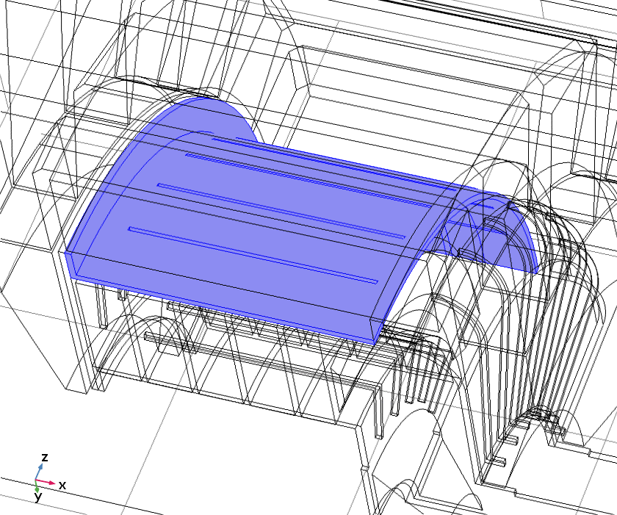
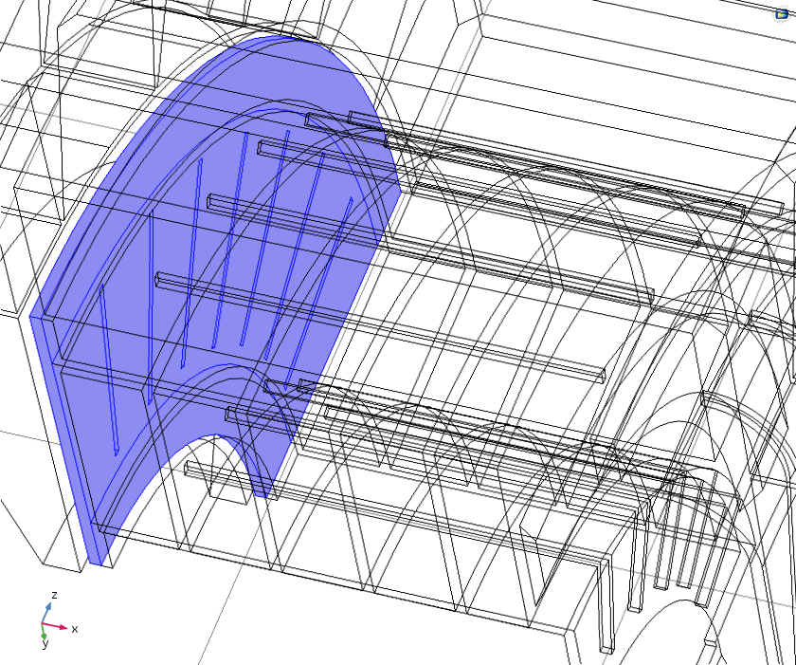
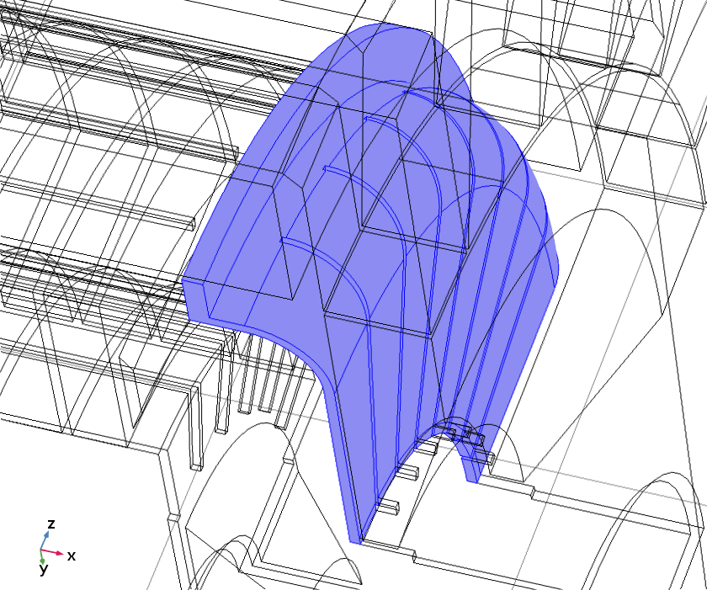
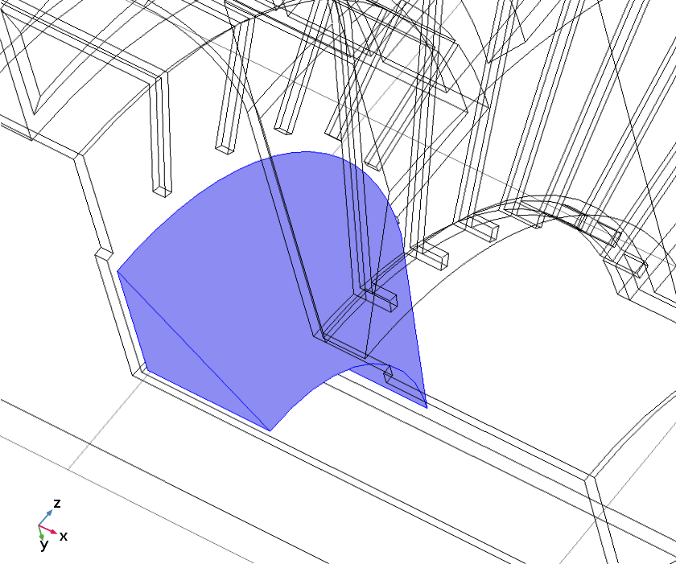
Parts of the tuner’s shell
Whole Shell
Inner Shell
Outer Shell
End Flange
Gap Wall
Insert

Slide 5
Power loss depends on the frequency and the current
# freq. Current perm. material design code
15 Hz, I1 = 500 A, µ = 3.5, copper, all slots “15, 500, 3.5, c, a”
30 Hz, I1 = 250 A, µ = 3.5, copper, all slots “30, 250, 3.5, c, a”
60 Hz, I1 = 250 A, µ = 3.5, copper, all slots “60, 250, 3.5, c, a”
Logic tells that the losses should increase proportionally to the frequency. They also must be quadratic to the current. Some field re-distribution can modify this scaling, but not dramatically. Results of the case modeling support this statement. Shown is power loss (in Watts per quadrant) in parts of the shell:
Parameter set → 15, 500, 3.5, c, a 30, 250, 3.5, c, a 60, 250, 3.5, c, a
Inner Shell 335 174.5 292
Outer Shell 264 127 228
End Flange 441 198 294
Gap Wall 594 344.5 607
Insert 42 12 11
Whole Shell 1675 856 1432
This allows using Fourier decomposition to evaluate expected power loss generated by the changing bias magnetic field.

Slide 6
Power Loss for the Shell Made of Copper
Parameters | 15 Hz | 30 Hz | 45 Hz | 60 Hz | 75 Hz | 90 Hz | 105 Hz
I_{k} (A) | 460 | 81 | 77 | 61 | 38 | 28 | 19 | Total: | Increase %
Inner Shell | 335 | 21 | 28 | 23 | 11 | 7 | 4 | 429 | 28.1
Outer Shell | 264 | 16 | 22 | 18 | 9 | 6 | 3 | 338 | 28.0
End Flange | 441 | 27 | 37 | 31 | 15 | 10 | 5 | 566 | 28.3
Gap Wall | 594 | 36 | 50 | 42 | 20 | 13 | 7 | 762 | 28.3
Insert | 42 | 3 | 4 | 3 | 1.5 | 1 | 0.5 | 55 | 31.0
Whole Shell | 1675 | 104 | 140 | 117 | 57 | 37 | 20 | 2150 | 28.4
The following scaling was used to generate this table:
I1 = 460 A 15 Hz 1
I2 = 81 A 30 Hz (81/460)²*2 = 0.062
I3 = 77 A 45 Hz (77/460)²*3 = 0.084
I4 = 61 A 60 Hz (61/460)²*4 = 0.070
I5 = 38 A 75 Hz (38/460)²*5 = 0.034
I6 = 28 A 90 Hz (28/460)²*6 = 0.022
I7 = 19 A 105 Hz (19/460)²*7 = 0.012
Higher harmonics contribute just under 30% to the total power loss in all elements of the shell.
We can take this into account by scaling the lowest harmonic up by ~15% → 460*1.15 → 530 A

Slide 7
Power Loss for the Shell Made of Stainless Steel
Power losses generated by eddy currents in the copper shell are prohibitively high → only stainless steel can be considered as the material for the shell.
Case studies for the stainless steel shell:
# freq. Current perm. material design code
15 Hz, I1 = 530 A, µ = 3.5, st. steel, all slots “15, 530, 3.5, ss, a”
15 Hz, I1 = 530 A, µ = 3.5, st. steel, no slots “15, 530, 3.5, ss, n”
15 Hz, I1 = 530 A, µ = 50, st. steel, all slots “15, 530, 50, ss, n”
15 Hz, I1 = 530 A, µ = 3.5, 0.3 mm Cu no slots “15, 530, 3.5, cp, n”
Parameters | 15, 500, 3.5, c, a | 15, 530, 3.5, ss, a | 15, 530, 3.5, ss, n | 15, 530, 50, ss, n | 15, 530, 3.5, cp, n
Inner Shell | 335 | 20.5 | 27 | 45 | 96
Outer Shell | 264 | 17.5 | 28 | 71 | 99
End Flange | 441 | 30 | 38 | 83 | 136
Gap Wall | 594 | 31 | 39 | 63 | 138
Insert | 42 | 4.5 | 4.5 | 5 | 16
Whole Shell | 1675 | 103 | 136 | 268 | 484

Slide 8
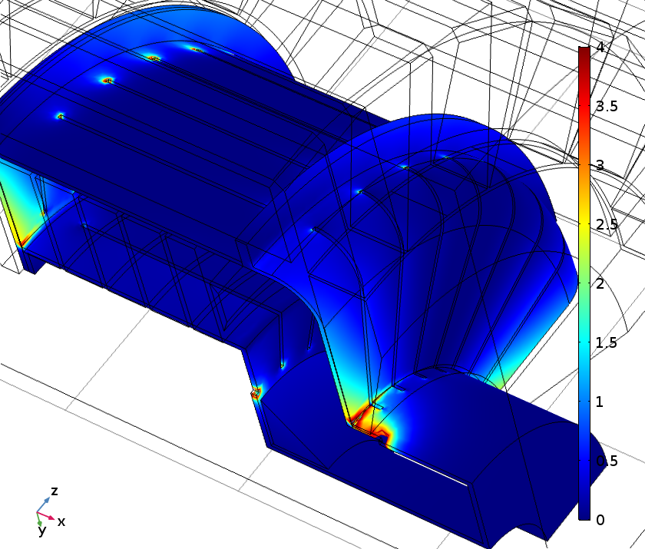
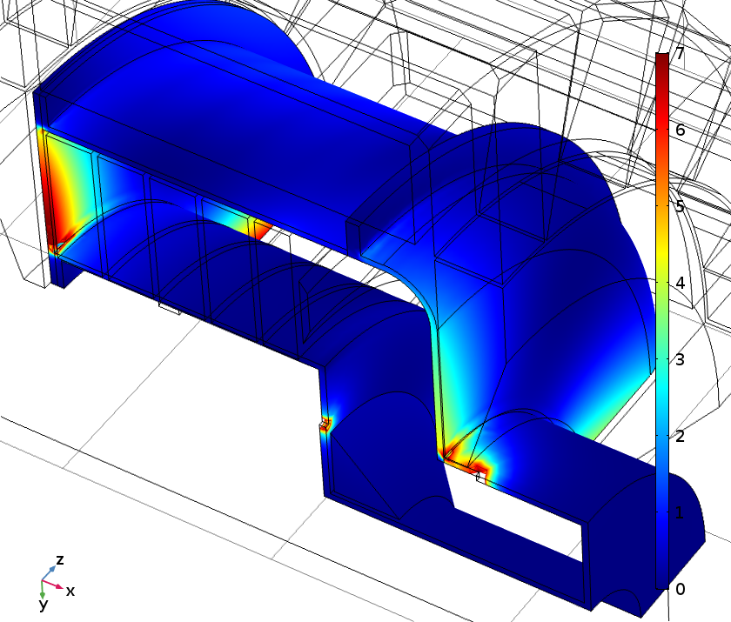
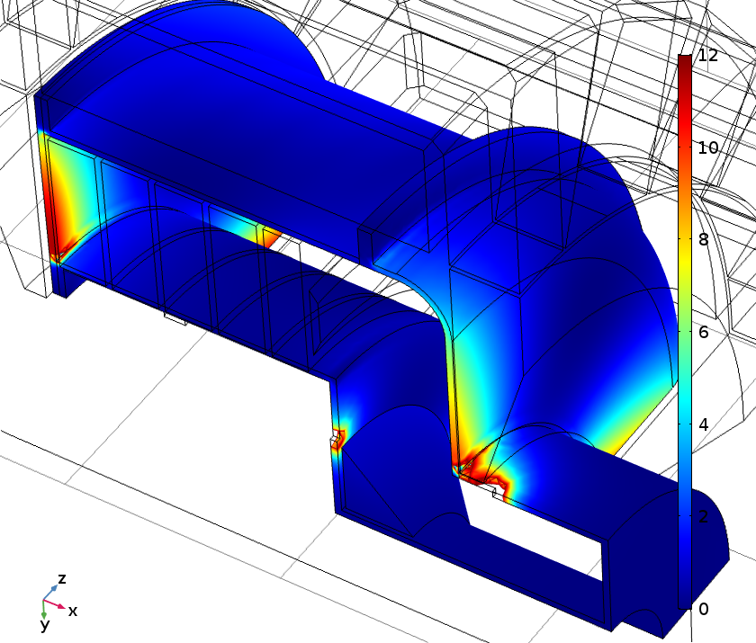
Ends Cooling ?
“15, 530, 3.5, ss, a”
“15, 530, 50, ss, n”
“15, 530, 3.5, cp, n”
End cooling must be evaluated.
Can uncut inner shell cylinder be considered ?
Other issues?

