Slide 1
Booster lattice measurements
C.Y. Tan, K. Seiya & A. Petrenko
23 Feb 2017

Slide 2
Some reminders
Kiyomi and I worked on the MADX model for a very long time.
  It took a lot of effort to get to where we are today.
There was no obvious way to confirm way to confirm the model
  During DC studies, orbit response method gave strange results, i.e. some missing scale factor although shape of beta functions look similar to MADX model.
  tune response, (dQ/dK ∝ β) for some reason didn’t work.
Alexey Petrenko (CERN) came to visit us for 3 months starting from Jan 2017.
  He assured us that the tune response method works and we should try it again.

Slide 3
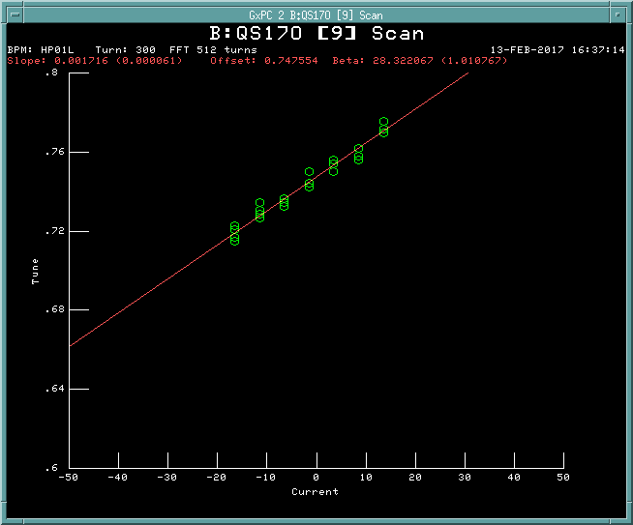
Tune response method to check MADX model (and eventually to pin down LOCO results)
The tune response method is model independent. The formula that relates β to tune response is:
  Bill Marsh has written a program that allows us to scan the tunes as a function of QS and QL currents. Therefore, we can measure the β functions at these locations.
We can also use these measurements to compare them to our MADX model.
  No cheating!
  Read in quad, sext, etc. currents and just load into MADX model.
Note: Tune response does not take into account calibration errors of quads.
Measurements done at ~1.2 -- 1.5e12 protons.
Is this low current enough?
MADX model is zero current model.

Slide 4
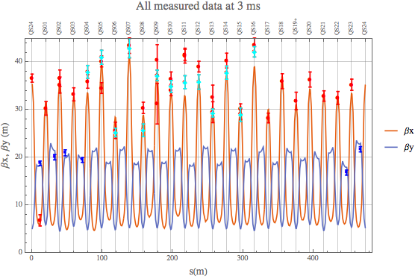
Measurements done on 13 and 14 Feb 2017
The model uses the currents read directly from the power supplies in Booster. Errorbars are ±1σ.

Slide 5
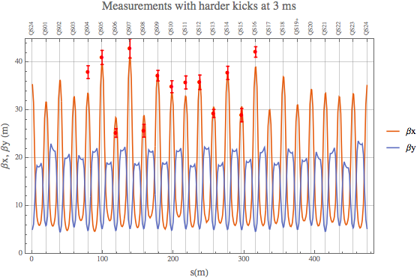
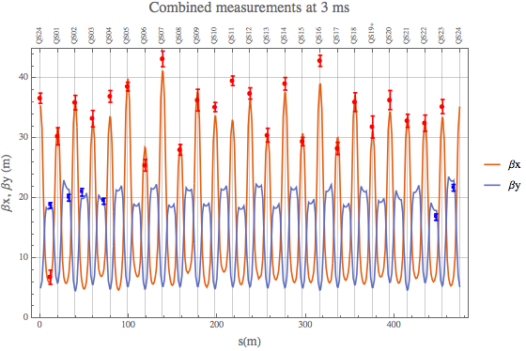
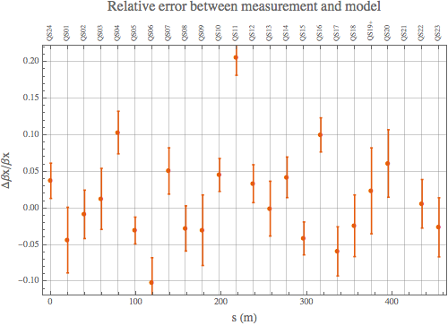
Different views of the measurements
The relative errors are < 10% except at one point QS11. This location and QS14, QS16 needs to be investigated.
These results look really good! Therefore, we can make a flat lattice using the MADX model with confidence!

Slide 6
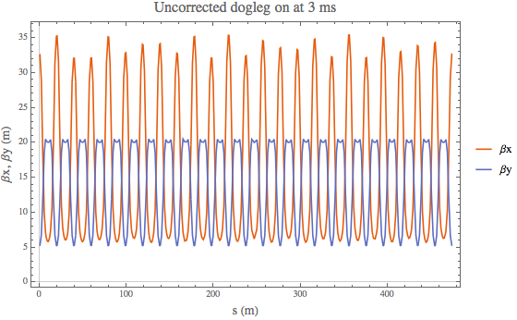
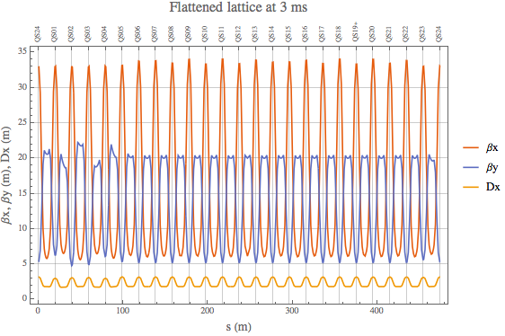
New “flat” lattice
Make a new lattice that is flat in both beta’s and dispersion.
  It’ll be a compromise.
  Using 17 quads to correct the beta functions due to the dogleg.
    QS23,24,01,02,03,04,05,06,07
    QL23,34,01,02,03,04,05,06.
Previous “flat” lattices did not pay attention to flatness of dispersion
  Alex Macridin’s simulations say that dispersion is important.
Flattening βx, makes βy worse.

Slide 7
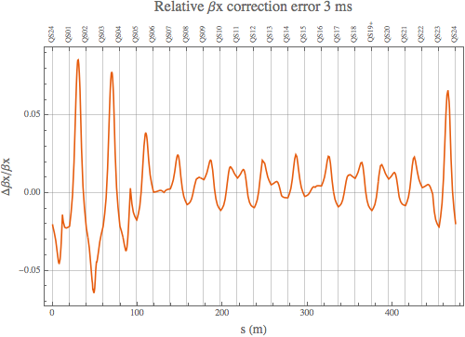
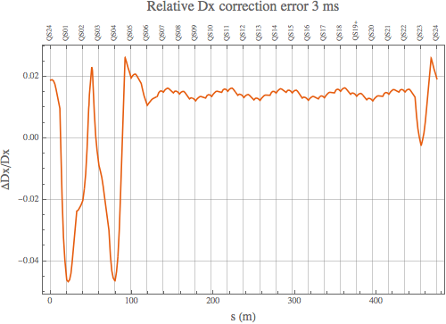
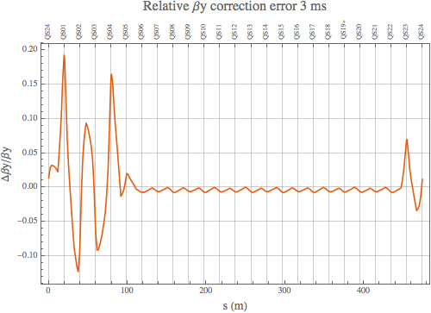
Relative errors compared to ideal lattice
Location of min βx’s
Location of min βy’s
Relative error is better than 5% for βx, and 10% for βy. Dispersion better than 5%.

Slide 8
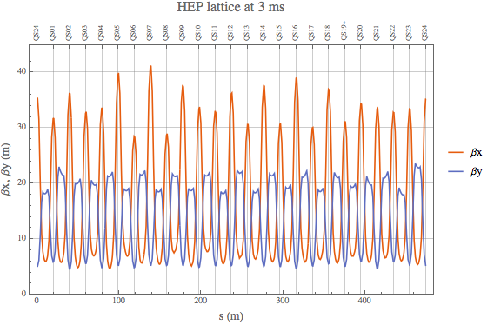
Flat lattice not the panacea?
Orbump
Collimators
???
???
RF
RF
RF
Maybe some locations must have smaller β’s because of some sort of aperture restriction rather than space charge?

Slide 9
So now what?
Plan is to load the “flat” lattice into Booster
  Earlier measurements with tune response show that with the earlier “flat” lattice, the lattice is indeed flat!
  Check to see if lifetime improves at low current with “flat” lattice.
  If not, check apertures!
In the meantime, the simulation and theory guys will have to tell us whether a 5% error in flatness at low intensity is good enough for high intensity or not
  Space charge amplifies the beta beatings, is the 5% “flat” lattice good enough, so that harmonic corrections can correct for the space charge distortion?
However, if it is good enough
  Then LOCO comes into play.
  The real life lattice is only ~10% close to the model. So LOCO can correct the real life lattice to the “flat” lattice at low intensity.
  And then we can use harmonic corrections to flatten the lattice again for high intensity.

Slide 10
LOCO applied to Booster (Reminder)
We used to have a chicken and the egg problem.
  Without a good known lattice, LOCO does *not* have a unique solution and is highly dependent on fitting stepsize and singular value cutoff.
Previously, what I did was to measure the orbit response using the as-found HEP lattice (with a bad MADX model)
  This is bad because I don’t have a “known” starting point or a good model because LOCO is model dependent.
  This makes things a lot more difficult to pin down the correct lattice or even know I was doing ☺
Now, since we have confirmed that the MADX model is close
  Use tune response method to pin down LOCO solution
  Calculate the fix for the real life lattice with the LOCO solution.

Slide 11
In the process of checking LOCO
We can use the MADX model (with some mangling) to compare the measured orbit response to the model.
  which again shows that the MADX model is very good.
Alexey wrote two very nice programs to do this.
  Compare_ORM_vs_Model
  Orbit response viewer
    The above uses data collected on 22 Nov 2016 and has a “flat” lattice (but with non flat dispersion)
    The “as loaded” currents from Booster for a “flat” lattice calculated using MADX.
  The measurements show that the ORM and the measurements are very close!

Slide 12
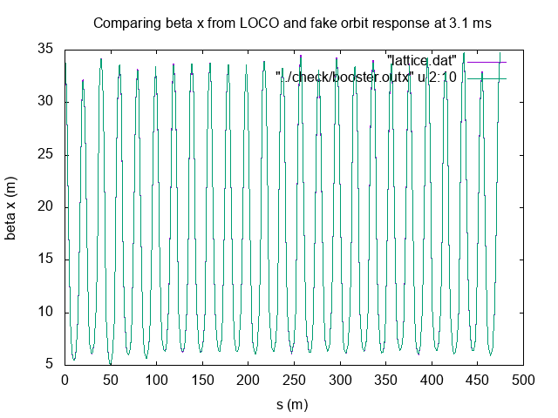
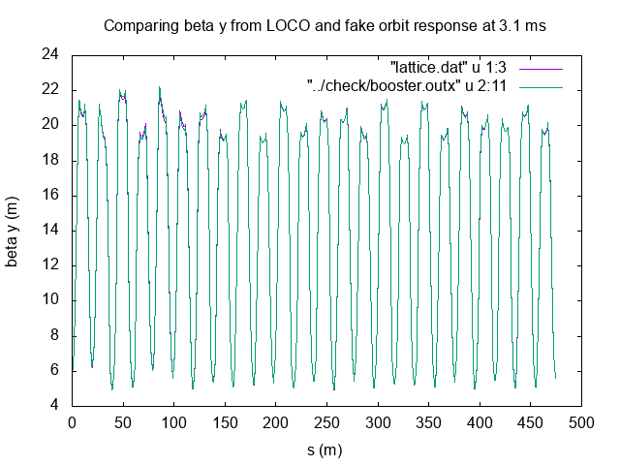
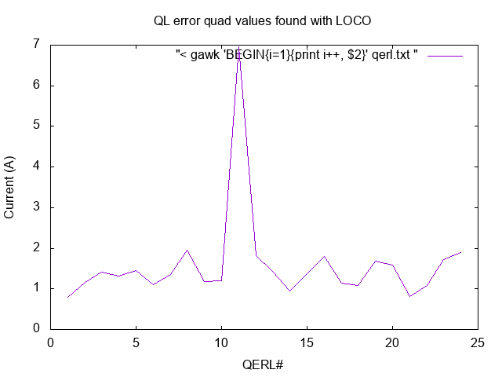
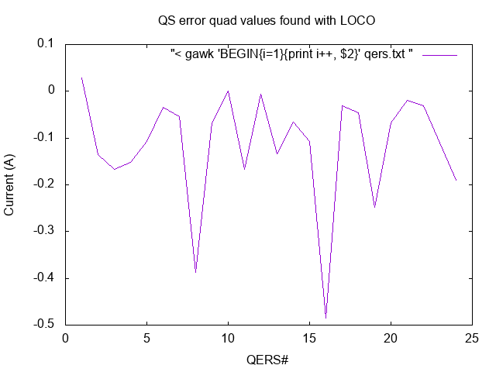
Other LOCO checks
Using fake data, LOCO was found to re-create the fake lattice given the fake orbit response.
Fake data had +4 A at QL11.
Notice that lattice matches. LOCO also finds that QL11 has a large error BUT it has a larger value (+7 A) than was input. Also assumed 15 bad bpms like in practice.
Again, LOCO finds a solution, but is it the “right” solution?

Slide 13
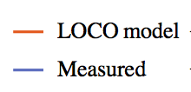
Why do I say I have LOCO multiple solutions
So, all three solutions are fit the bpm response quite well. But the last 2 solutions fit the rpos data better. It’s difficult to distinguish between these 2 solutions

Slide 14
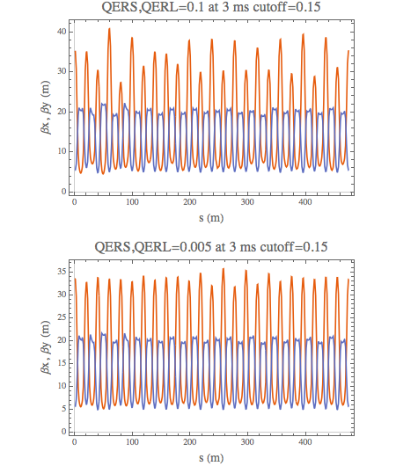
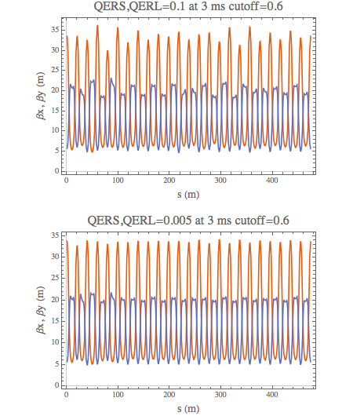
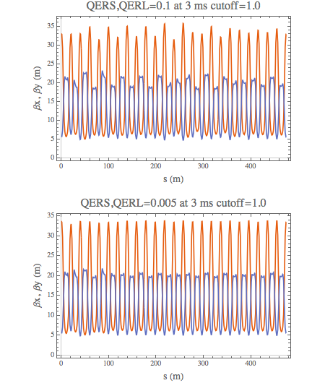
Perhaps it’s from singular values cutoff
I still have multiple solutions

Slide 15
Comparing fits for different singular value cutoffs and fitting step size
Step size = 0.1 A
Step size = 0.005 A
cutoff =0.15

Slide 16
Comparing fits for different singular value cutoffs and fitting step size
Step size = 0.1 A
Step size = 0.005 A
cutoff =0.6
Clearly worse than cutoff=0.15

Slide 17
Comparing fits for different singular value cutoffs and fitting step size
Step size = 0.1 A
Step size = 0.005 A
cutoff =1.0
and slightly worse than cutoff=0.6
The previous slides demonstrate the need to pin down the LOCO solution with an independent method.

Slide 18
Plan (one more time) and conclusion
Load new “flat” lattice in Booster
  Check with tune response method that lattice is flat.
  IMPORTANT: See whether beam lifetime is better with flat lattice for different current settings
    Intuitively, the “garbage” lattice now in Booster cannot be better than a flat lattice at low current!
    If we cannot see any lifetime improvements for low currents, maybe aperture is the limiting factor and not space charge
      This is the reason for the as found Booster lattice!
Since Booster lattice is now more or less modeled well with MADX
  The simulations guys will have to see if the “flat” lattice helps with high intensity with harmonic tuning
    Does intensity distort the “flat” lattice so much that it is hopeless even with harmonic tuning?
    If the 5% “flat” lattice helps with harmonic tuning, we have to make sure that the real world lattice comes as close as possible to the 5% “flat” lattice – here is where LOCO helps to get the real world lattice close to the model “flat” lattice.
Of course, if it is aperture, then this whole flat lattice business will have to be looked at from a different perspective.

Slide 19
Spare slides

Slide 20
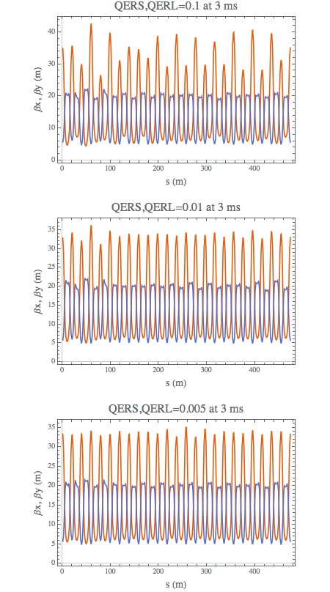
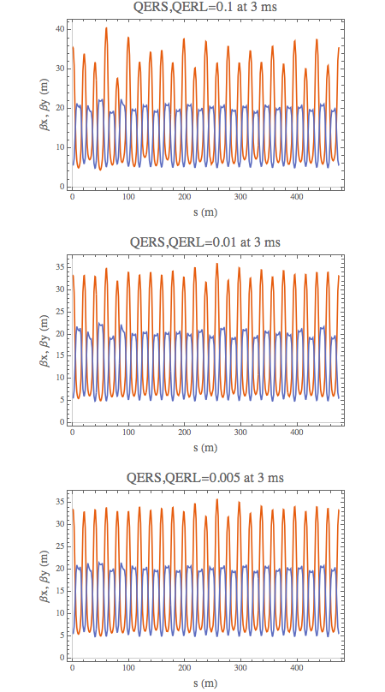
Comparison between 15 bad bpms and 3 bad bpms
15 bad bpms
3 bad bpms
Still converges to different solutions depending on error parameter step size.

Slide 21
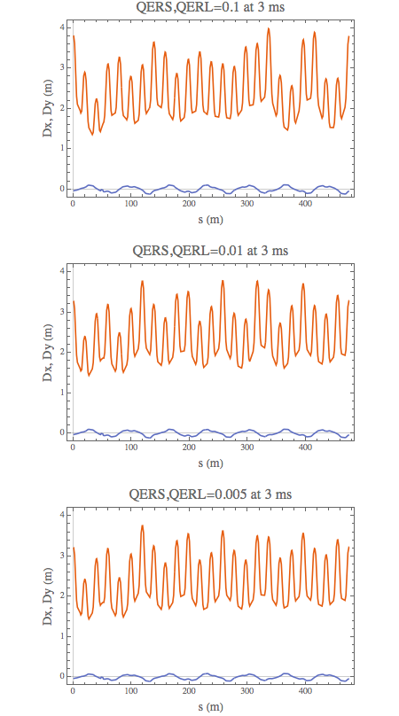
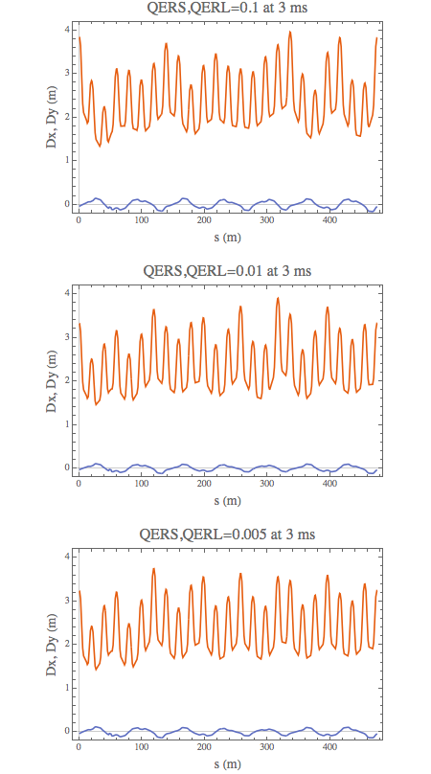
Comparison between 15 bad bpms and 3 bad bpms (cont’d)
15 bad bpms
3 bad bpms

Slide 22
Other problems
LOCO relies on RPOS response data. But RPOS is not calibrated. LOCO finds non-convergent lattice if RPOS is wrong.
  Therefore, I have used fake data as a guide as to what the RPOS calibration should be and then rescaled the data so that the the RPOS response is close to what the model predicts.
Corrections found from LOCO and break points don’t match and creates problems.
  See next slide

Slide 23
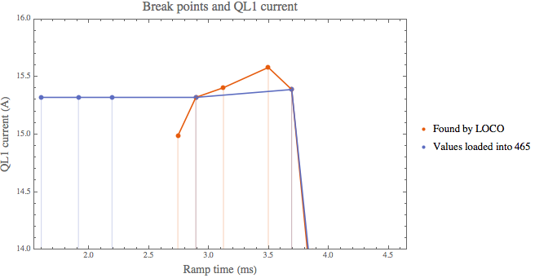
Fixing Booster lattice
Once LOCO lattice is determined, the lattice fix can be applied.
  However, 465 card break points don’t match.
  Need more break points?

