Slide 1
Garnet Witness Sample Testing
John Kuharik
Booster 2nd Harmonic Cavity Meeting
March 16, 2017

Slide 2
Calculations for B, H, Mu, with and without Air Gap Correction
Calculation parameters:
nprim = 183 turns on the excitation coil (183turns/0.0179m)*(0.016m)=163 turns
nsec = 80 turns on the measurement coil
A = 0.000249 m² Area of the garnet sample
A_{coil} = 0.000269 m² Area of the measurement coil
L = 0.01603 m Length of sample. In a solenoid field calculation, L = length of solenoid. Because of the ferrite box, we use L=sample length.
R = 3.92 ohm primary resistor.
Oefact = 0.01256637 factor for conversion from A/m to Oersted.
Gaussf = 10000 factor for conversion from Tesla to Gauss.
Vrp = Voltage across the primary side resistor
Vs = Measurement signal voltage

Slide 3
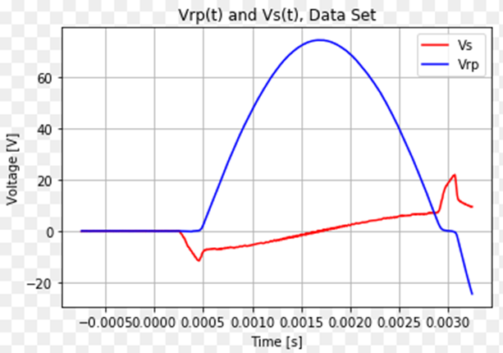
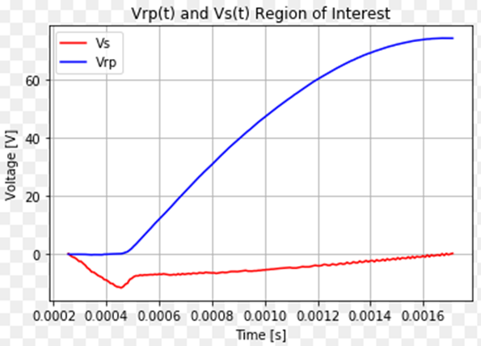
Data Processing
Read raw data from file and select region of interest t= 0.000256 ->0.00172s

Slide 4
Calculate scope DC offset in data files
Take the mean of each signal in the pre-pulse region and subtract from the whole signals.
In this case, pre-pulse interval is t= -0.0005s to t=0.000255s, and the offsets are:
Vs offset correction: -0.00664906
Vrp offset correction: 0.00660004

Slide 5
Calculate H in the region of interest
$$H=\frac{V_{rp}N_{prim}}{RL}×{Oe}_{fact}$$

Slide 6
Calculate dB from Faraday’s Law
$$Vs=−N\frac{dφ}{dt} where φ=dBA$$
$$dB=\frac{−V_{s}}{N_{sec}A_{sample}}$$
If we take into account the air gap between measurement coil and sample:
$$Vs=−\left[N\frac{dφ_{sample}}{dt}+N\frac{dφ_{air}}{dt}\right]$$
$\frac{dB_{sample}}{dt}= −\frac{V}{N_{sec}A_{sample}}−\frac{A_{air}}{A_{sample}}\frac{dB_{air}}{dt}$

Slide 7
Calculate B
With no air gap correction:
$$B_{j}= −\frac{1}{N_{sec}A_{sample}}\int_{0}^{j}{V_{s}dt}= −\frac{1}{N_{sec}A_{sample}}\sum_{i=0}^{j}{\frac{V_{s i}+V_{s i+1}}{2}\left(t_{i+1}−t_{i}\right)}$$
With the air gap correction:
$$B_{j}= −\frac{1}{N_{sec}A_{sample}}\sum_{i=0}^{j}{\left[\frac{V_{s i}+V_{s i+1}}{2}\left(t_{i+1}−t_{i}\right)\right]}−\frac{A_{air}H_{j} μ_{0}}{A_{sample}{Oe}_{fact}}$$
Multiply B by Gaussf = 10,000 to get B in Gauss.

Slide 8
Plot B(H) and B_{corrected}(H)
Calculate Mu and Mu_{corrected}:
$Mu=\frac{B}{H}$ ${Mu}_{corrected}=\frac{B_{corrected}}{H}$

Slide 9
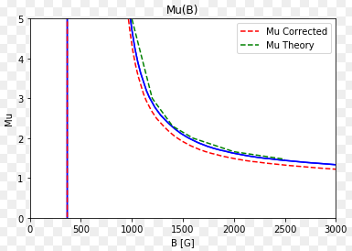
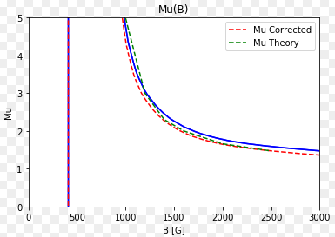
Compare results to theory
N=183 turns
N=163 turns

Slide 10
Interpolate and Consolidate Data for Multiple Runs
Five runs at 19 amps processed as described above. H and B for each run interpolated and Mu calculated (without the air gap correction). The average measurement with standard error is shown below along side the theory prediction.
This is with N=183 turns

