Slide 1
Mechanical Update
Kevin Duel
Booster 2nd Harmonic Cavity
30 March 2017

Slide 2
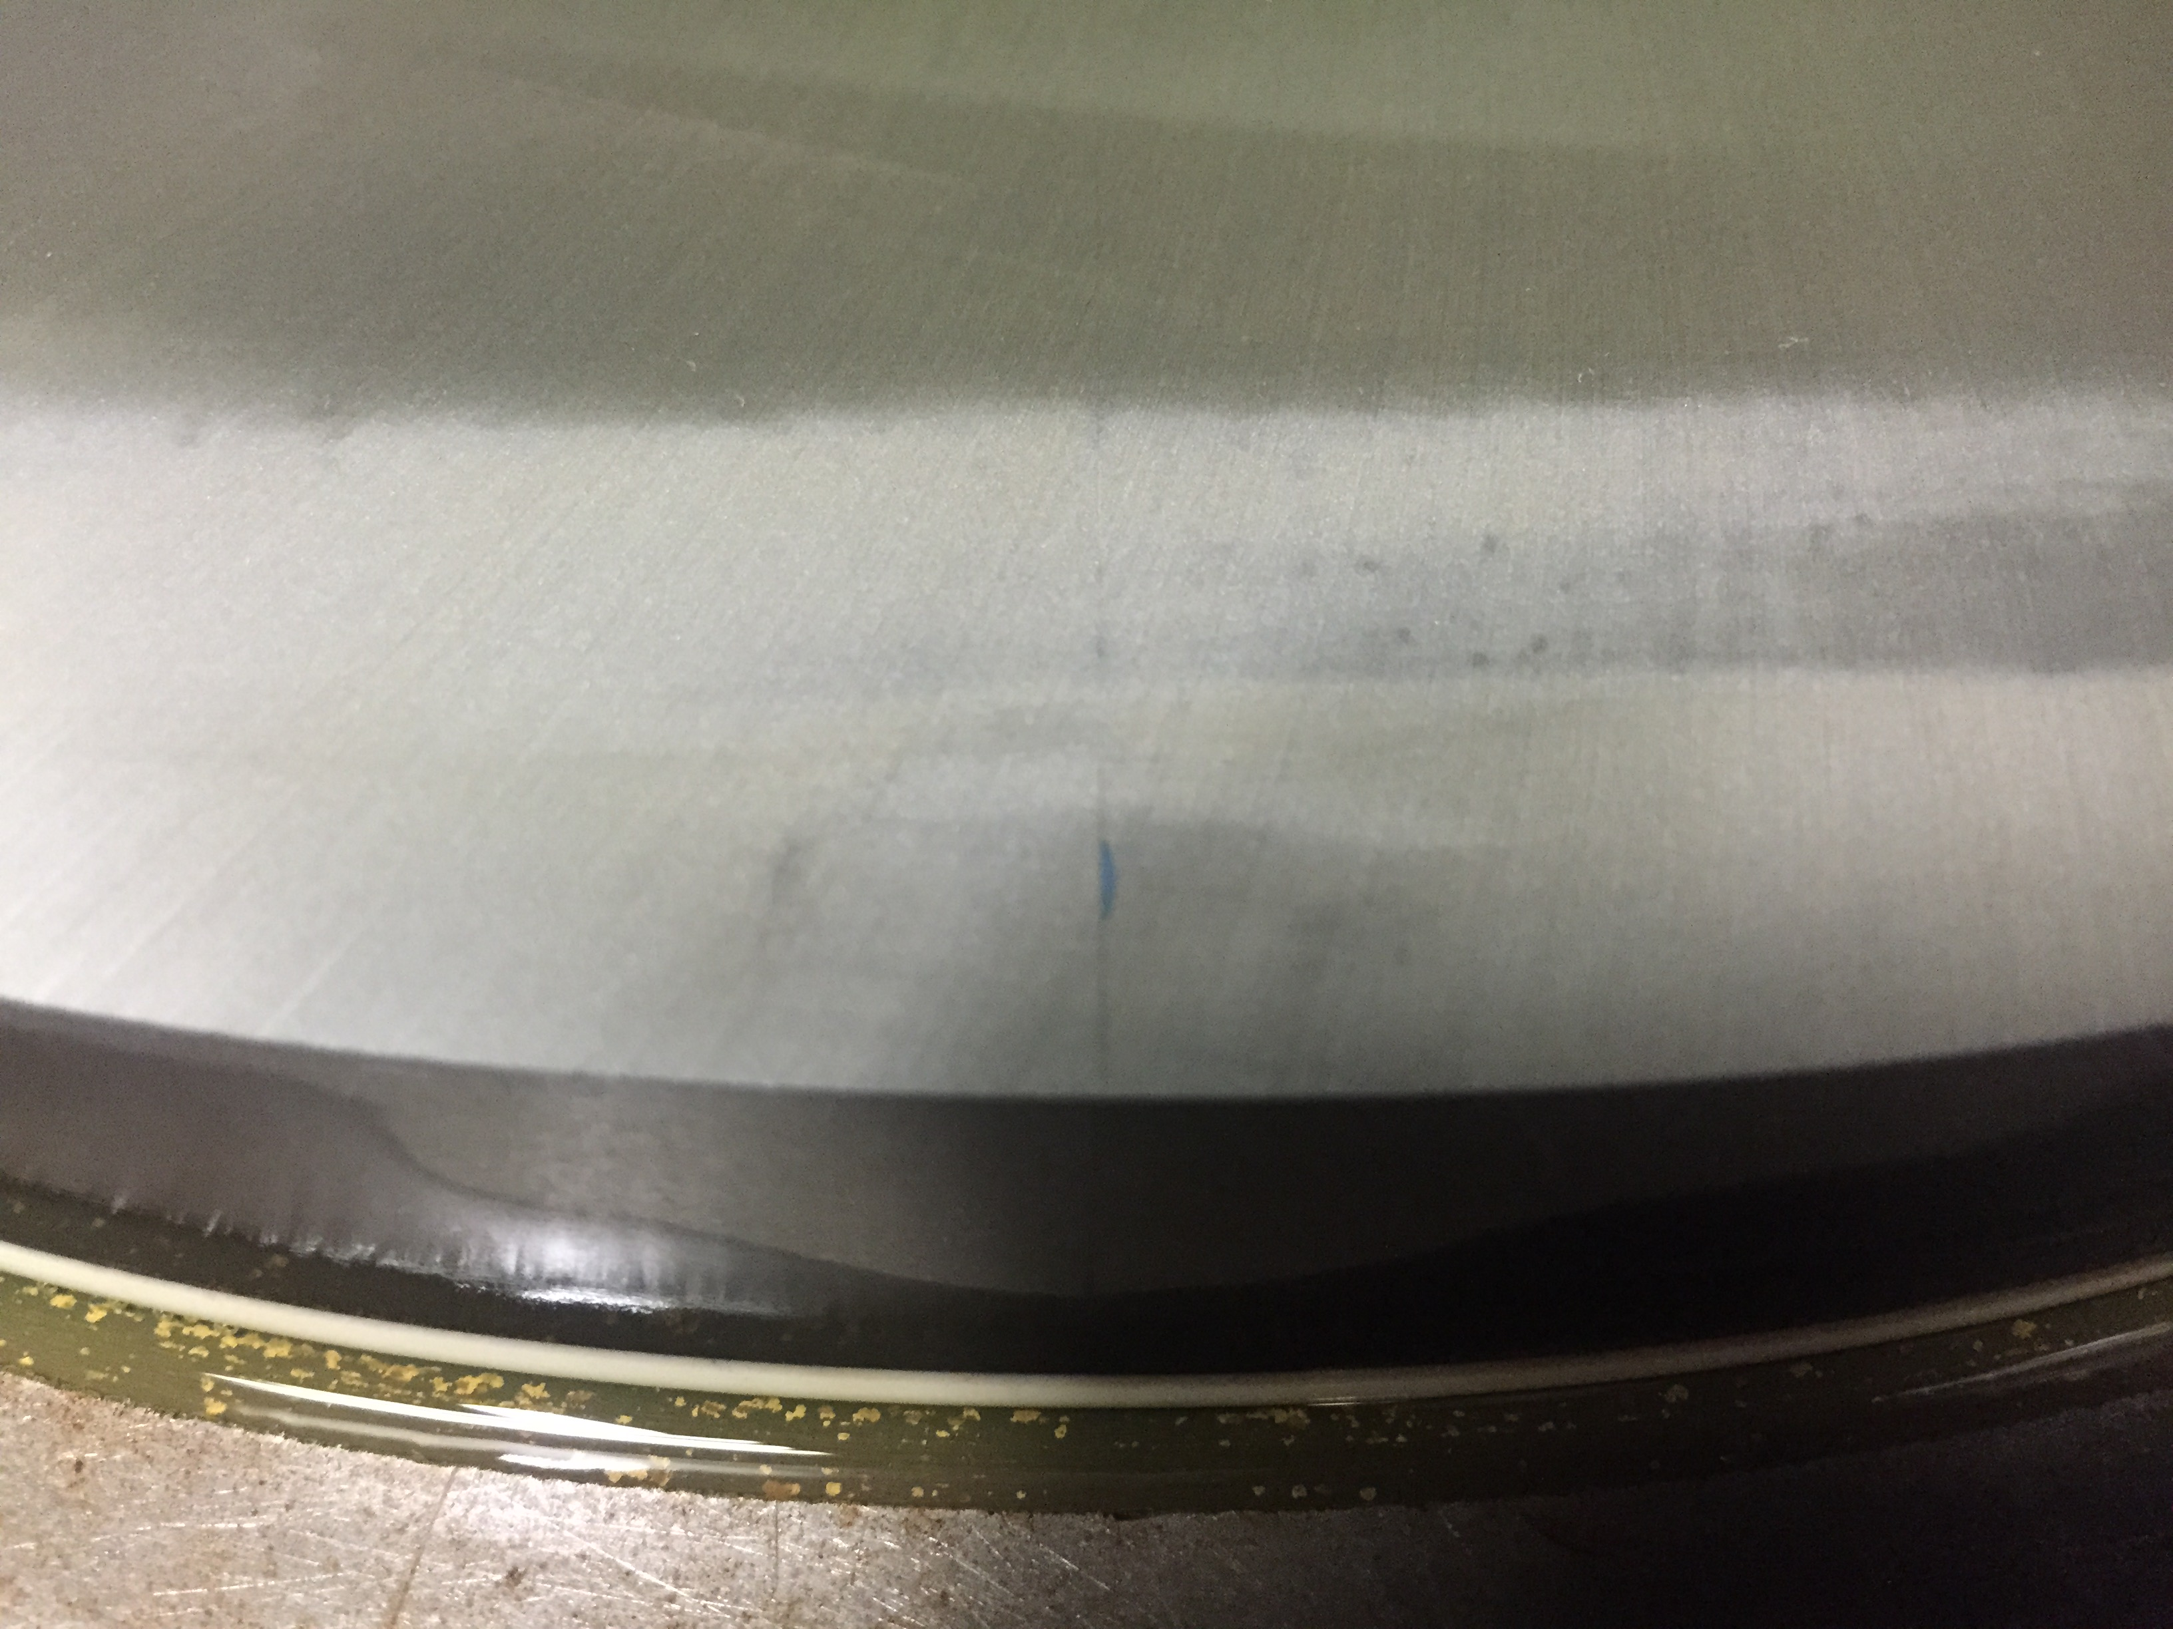
2nd Ring Assembly Chip Discovered
.020-.025” deep
Likely created while clamping sectors together for gluing
Was not exposed until after .010” of surface grinding
Decided to grind chip away
Removed extra .015” off garnet flat surface
Drawing spec is .827 +/- .005
Final thickness is now .812
Assembly shipped yesterday

Slide 3
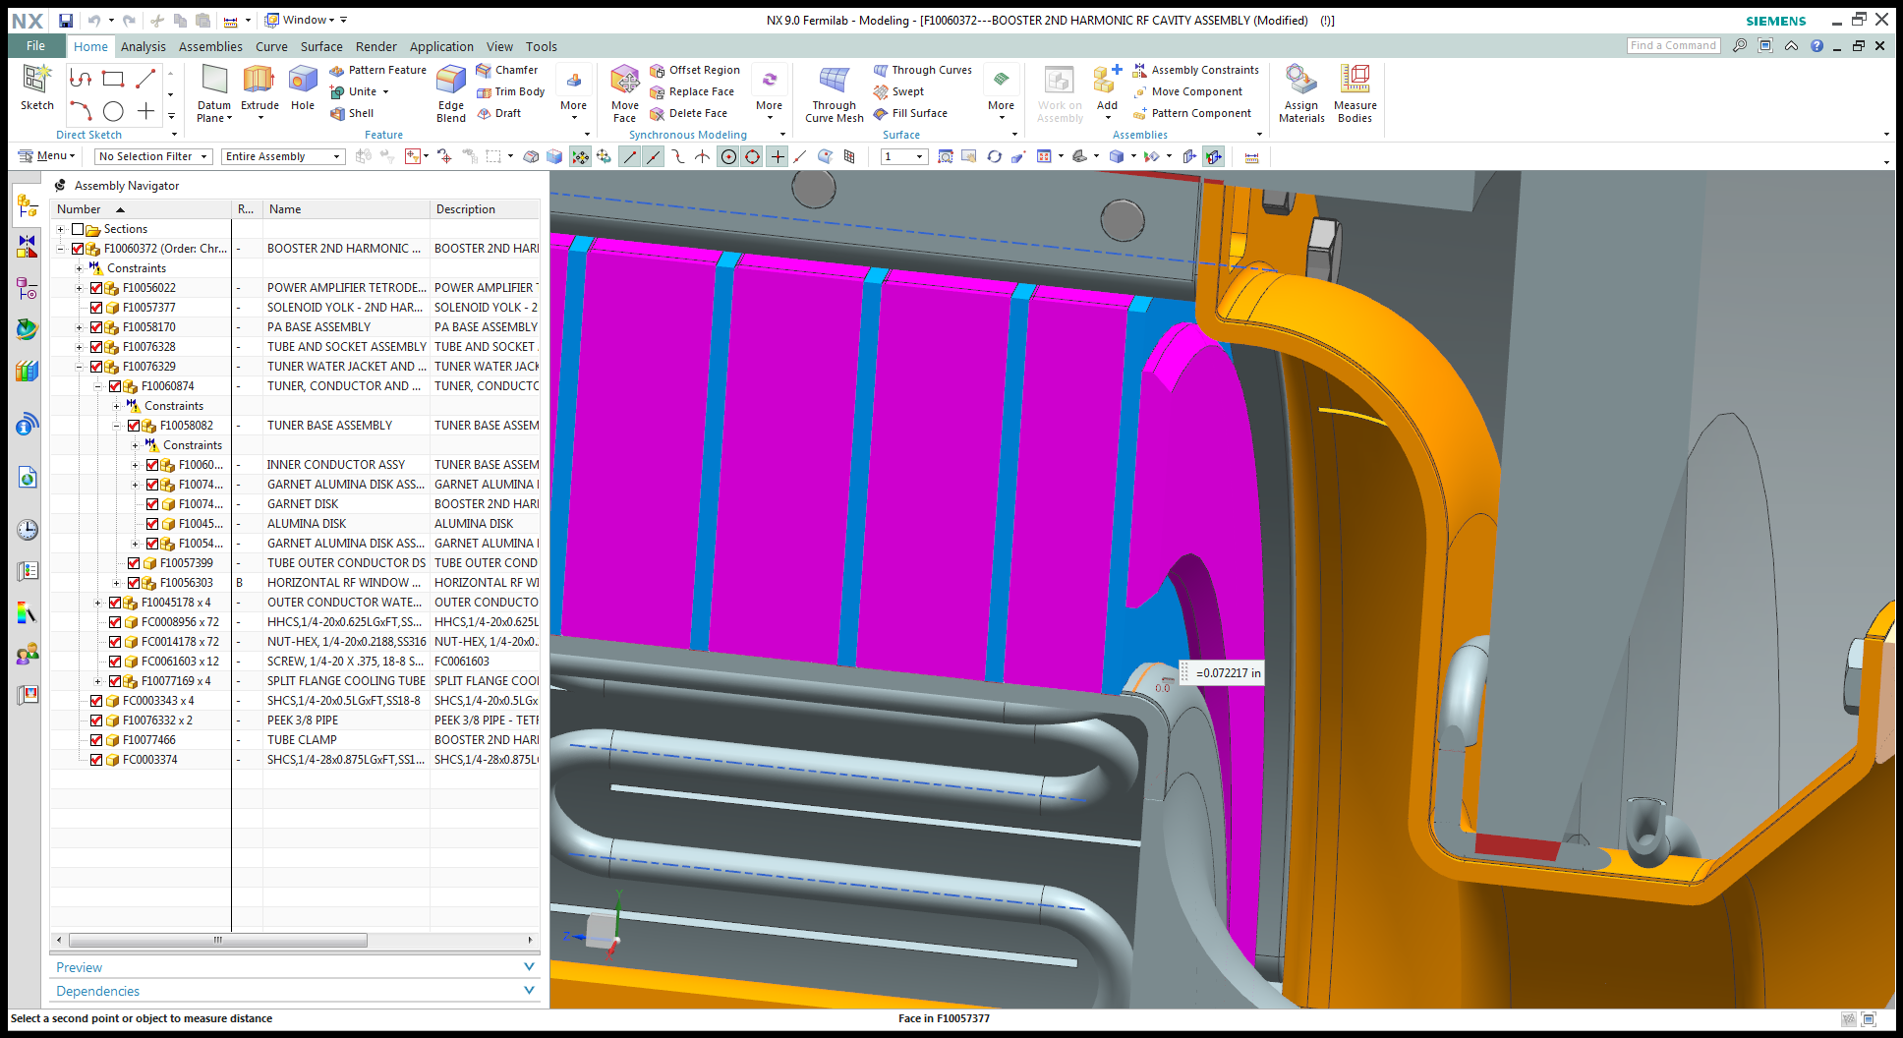
Clearance to radius beginning
Reduced radius from .315” to .25”

Slide 4
Shroud Clamp Access Hole
Hole is at bend in shell
Need to design cap/cover

Slide 5
Overall with Sasha’s Solenoid

