Slide 1
New CST model.
Gennady Romanov
2nd Harmonic cavity meeting
April 13, 2017

Slide 2
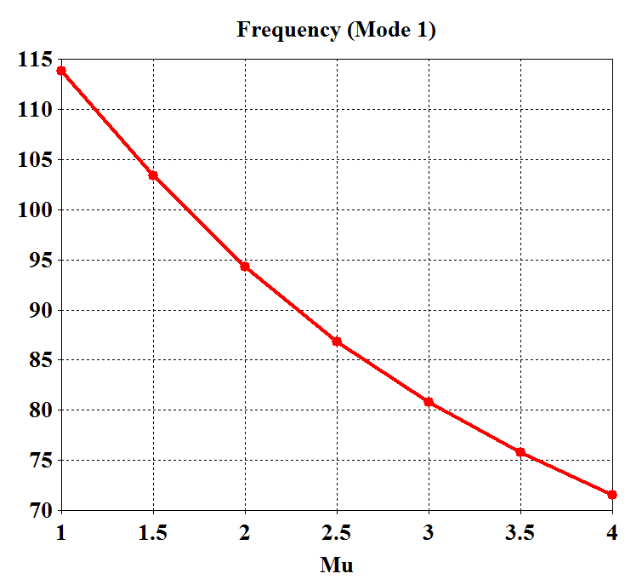
New model
3D solid model along with 2D drawings were used.
Every part except coupling ring has been re-built manually.
Meshing performs smoothly without errors and warnings.
Tuning range with uniform garnet is OK.
Next: simulations with AC and DC coils

Slide 3
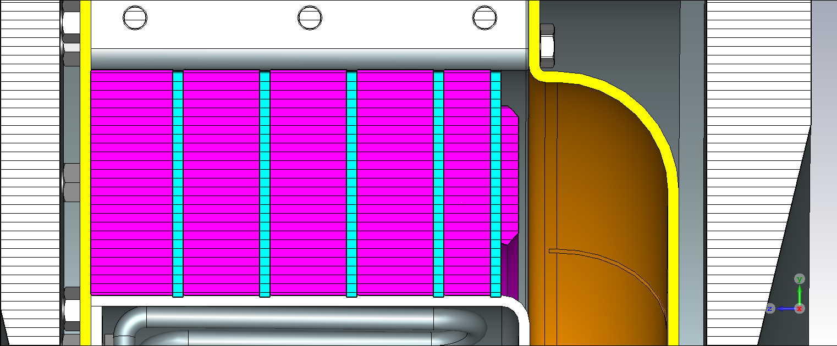
Remark
In the mechanical solid model: Outer shell R=6.688”
Inner shell R=4.1339”
Garnet outer R = 6.6929”
Inner R= 4.1338”
In the 2D drawings:
Garnet outer R = 6.693” accepted in
inner R= 4.134” CST model

