Slide 1
RF parameters table update .
Gennady Romanov
2nd Harmonic cavity meeting
May 25, 2017

Slide 2
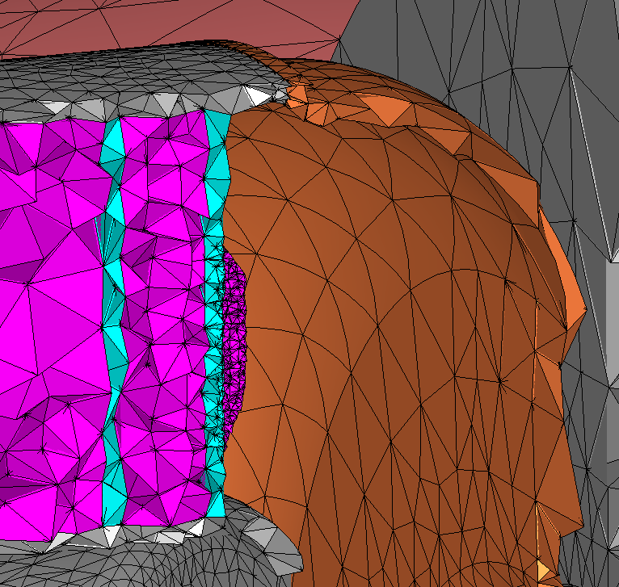
The model
0.8-1 M tetrahedrons
Three models, three datasets, two meshes.
Direct solver – often reaches operating memory limit.
Iterative solver – longer simulation.
1-2 M tetrahedrons

Slide 3
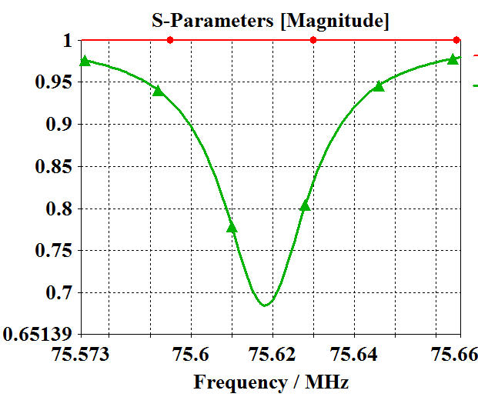
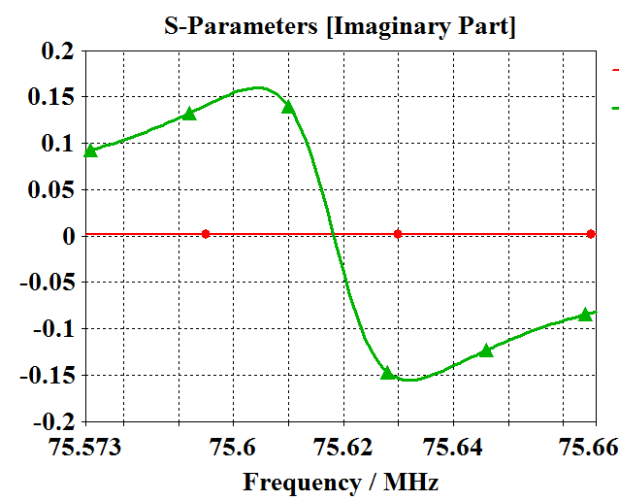
Q factor problem in FD
FD has a macro that calculates loaded Q_{macro} , using S11(f) curve. It’s not very accurate, but reliable

Slide 4
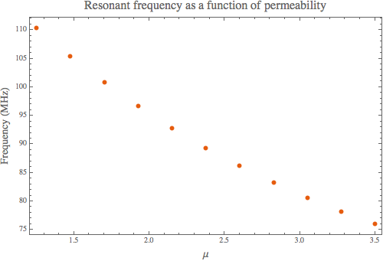
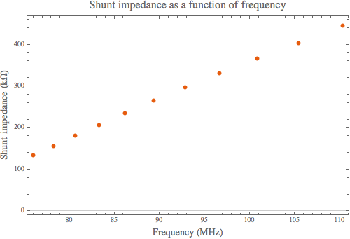
Tuning curve and shunt impedance
|H|

Slide 5
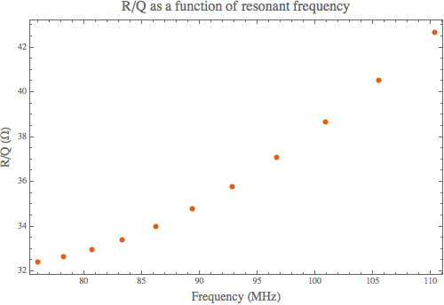
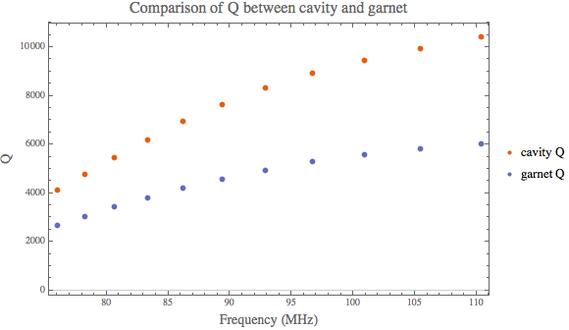
R_{sh}/Q and Q
?

Slide 6
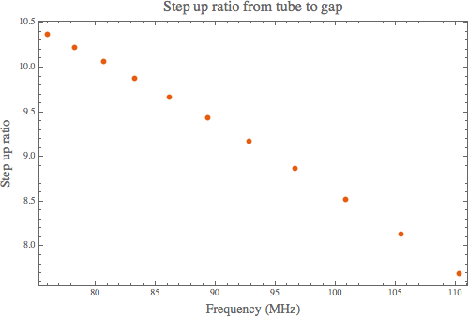
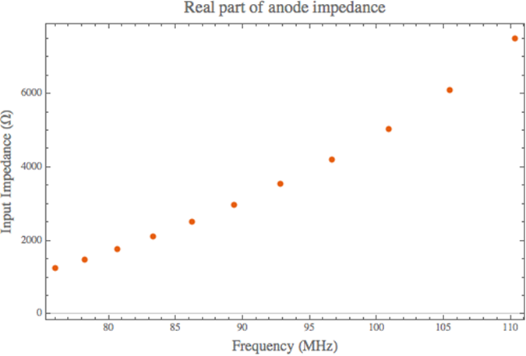
Step up ratio and Z11

Slide 7
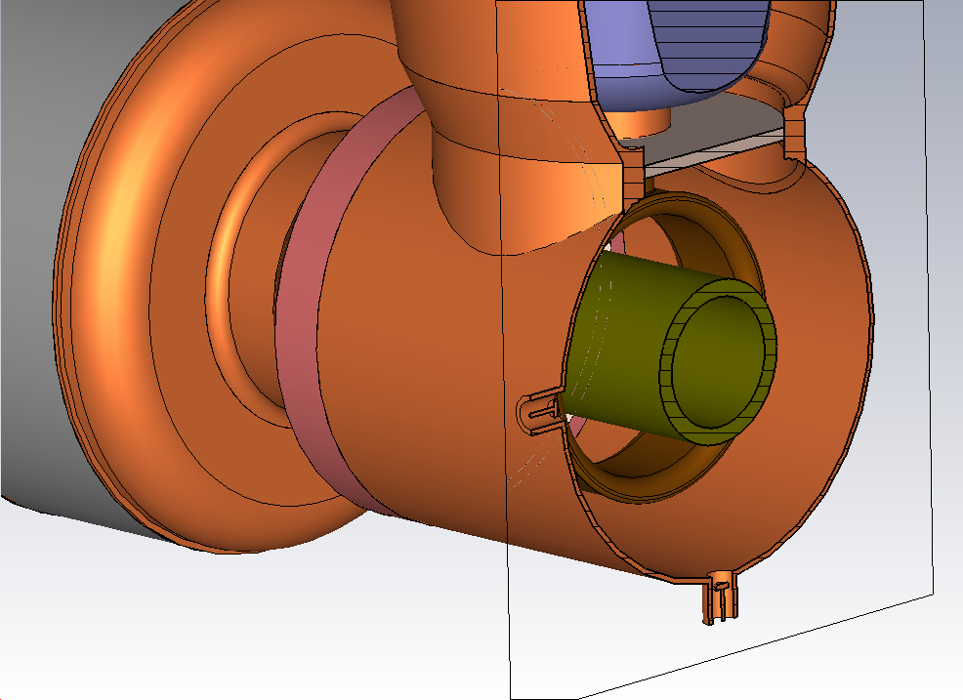
Pick up electrodes
0.4”
1.66”
0.1”
No field disturbance, no frequency shift. To evaluate coupling the exact dimensions are needed.

