Slide 1
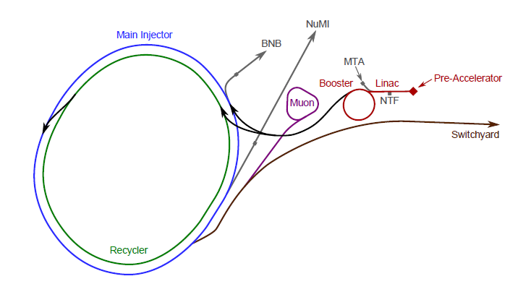
Nova Test Beam Accelerator and Spectrometer Considerations Michael Backfish 6 14 2017

Slide 2
“Switchyard”

Slide 3
MI Bunch Structure

Slide 4
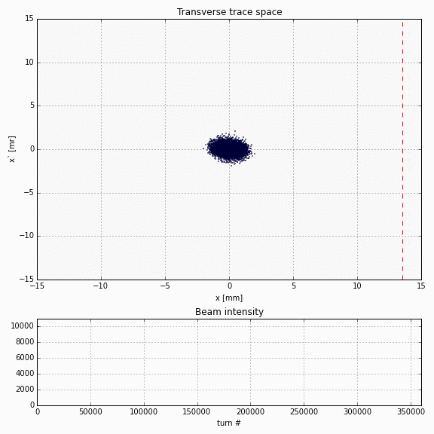

Slide 5
Variations Within the Spill
53.1 MHz RF for 4 second spill allows 212,400,000 RF buckets
The maximum intensities that we currently run to Meson Center
result in about 1E7 Secondary Particles
On average this is .05 Particles per bucket
In practice FTBF staff claims to rarely detect more than one track
per bucket in the FTBF chambers
There are often longer time frame variations in the spill as illustrated
by the image to the left

Slide 6
120 GeV Primary Beam Target and Shielding
Copper Target
Just under 20 cm long
Just under .5 cm wide by .5 cm tall

Slide 7
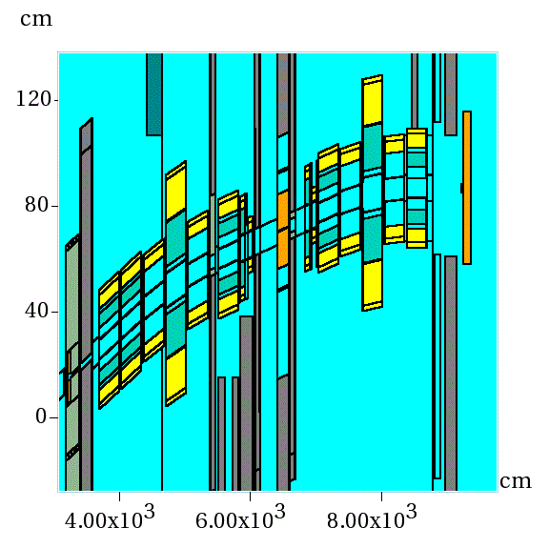
Secondary Beamline ($≈$4 to 80 GeV) Vertical Momentum Selection accomplished with CV (Vertical Collimator)
D3
Q5
D4
Q6
Q4
CV
Q3
Q2
D2
D1
Vertical
Q1-2
Q1-1
Longitudinal
Notes:
575 Amps is the limit of MC6D….low end is limited by lack of vacuum in the second half of the line. Scattering

Slide 8
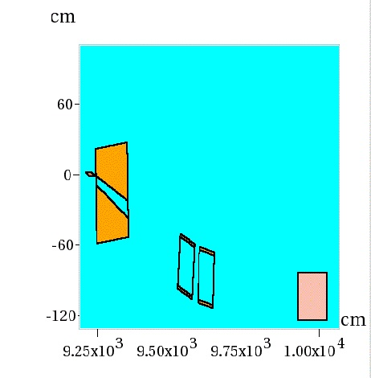
Lariat Tertiary
MCAN at 100 Amps Selects 616 MeV Particles
Field rolls off near 100 amps 588 MeV Particles
Collimator
MCAN at 50 Amps Selects 308 MeV Particles
Target
13$°$
MC7AN
TPC

Slide 9
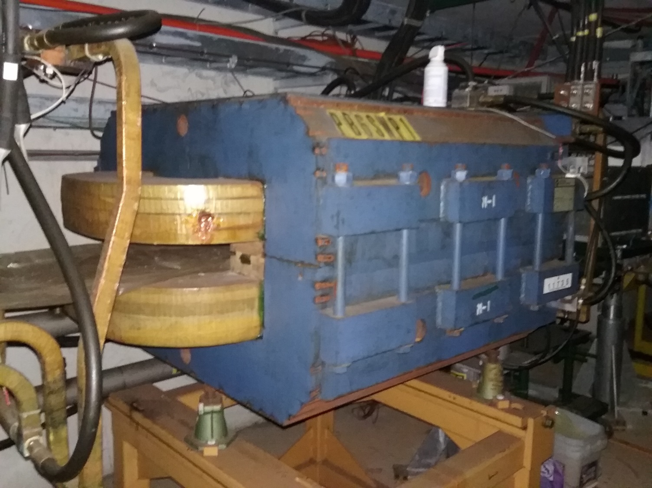
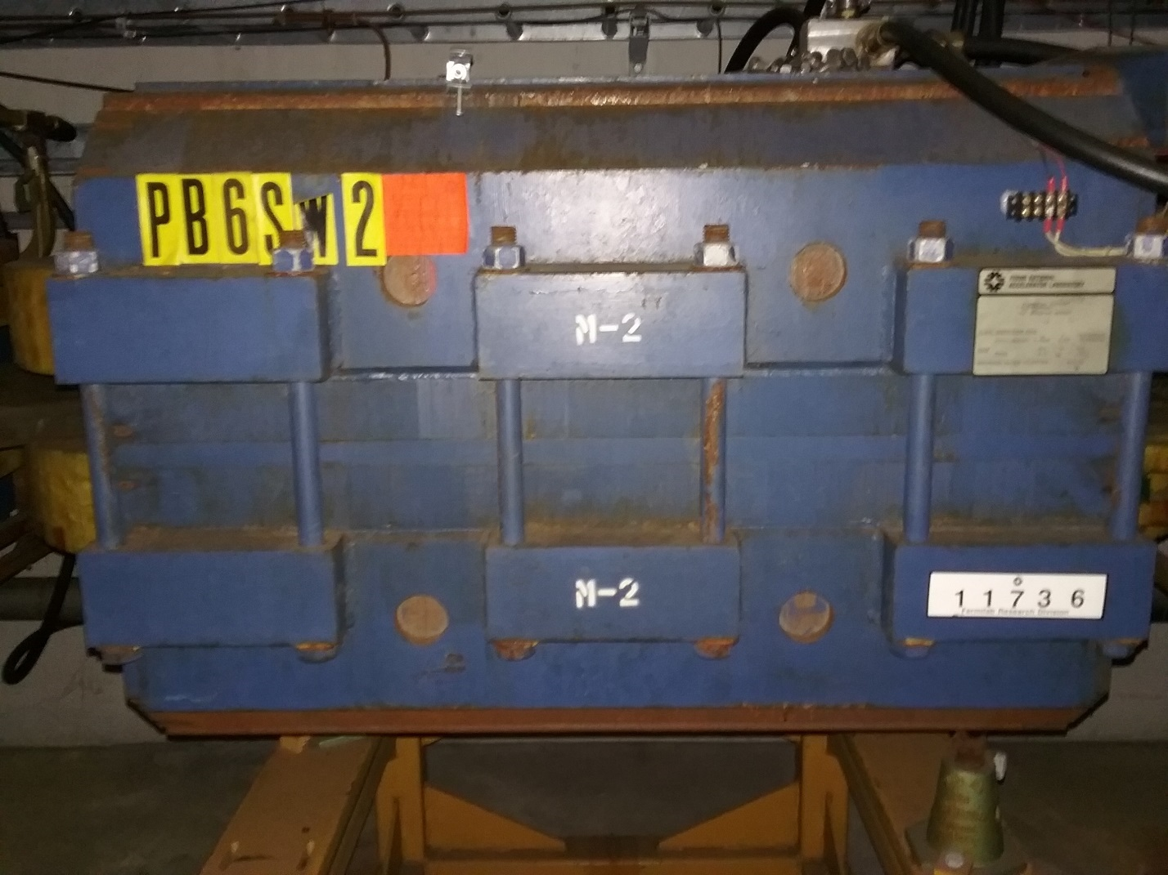
Wideband 42” Sweeping Dipoles

Slide 10
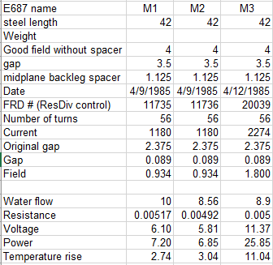
Former Wideband Sweeping Dipole Specifications
Field Length is length of steel plus ½ Gap at Each (42 in+3.5 in) or 1.1557 Meters
Brho=(10/3) P (With Momentum in GeV/C and B and Brho in Tesla Meters
Brho=BL/deltaTheta (where deltaTheta is the angle and BL is integrated field in Tesla Metes
P=(3/10)BL/deltaTheta (with momentum in GeV/C)
16 Degree is .279253 Radian
Momentum on central axis is 2.235 GeV

Slide 11
G4 Beamline Model

Slide 12
Momentum of 2.05 GeV/C Plus or Minus .1 GeV/C

Slide 13
FTBF Wire Chambers
128 wires 1 mm apart for X and Y planes
dP/P = Dtheta/Theta
A chamber 1.1 meter downstream of the magnet offers an angle distinction of .0324 Degrees
For a 16 degree angle Dtheta/theta is .002 or .2% Momentum Resolution

Slide 14
Dave Harding’s Magnetic Field Measurement Recommendations
“Simplest is probably integral Bdl (measured with a rotating coil) as a function of x and current. That gets you the field integral on a straight line, not on a curved trajectory. A 3-D point-by-point map takes much longer, so you wouldn't get as many currents. You can also think about exploring the hysteresis curves to help develop a current changing procedure.”

Slide 15
Path Forward
This is just one idea of a solution
Establish whether the floor can hold the weight
Have technical division test the magnets in situ for inductance
If this is the correct plan forward then the magnets should be sent to Technical Division for detailed testing

Slide 16
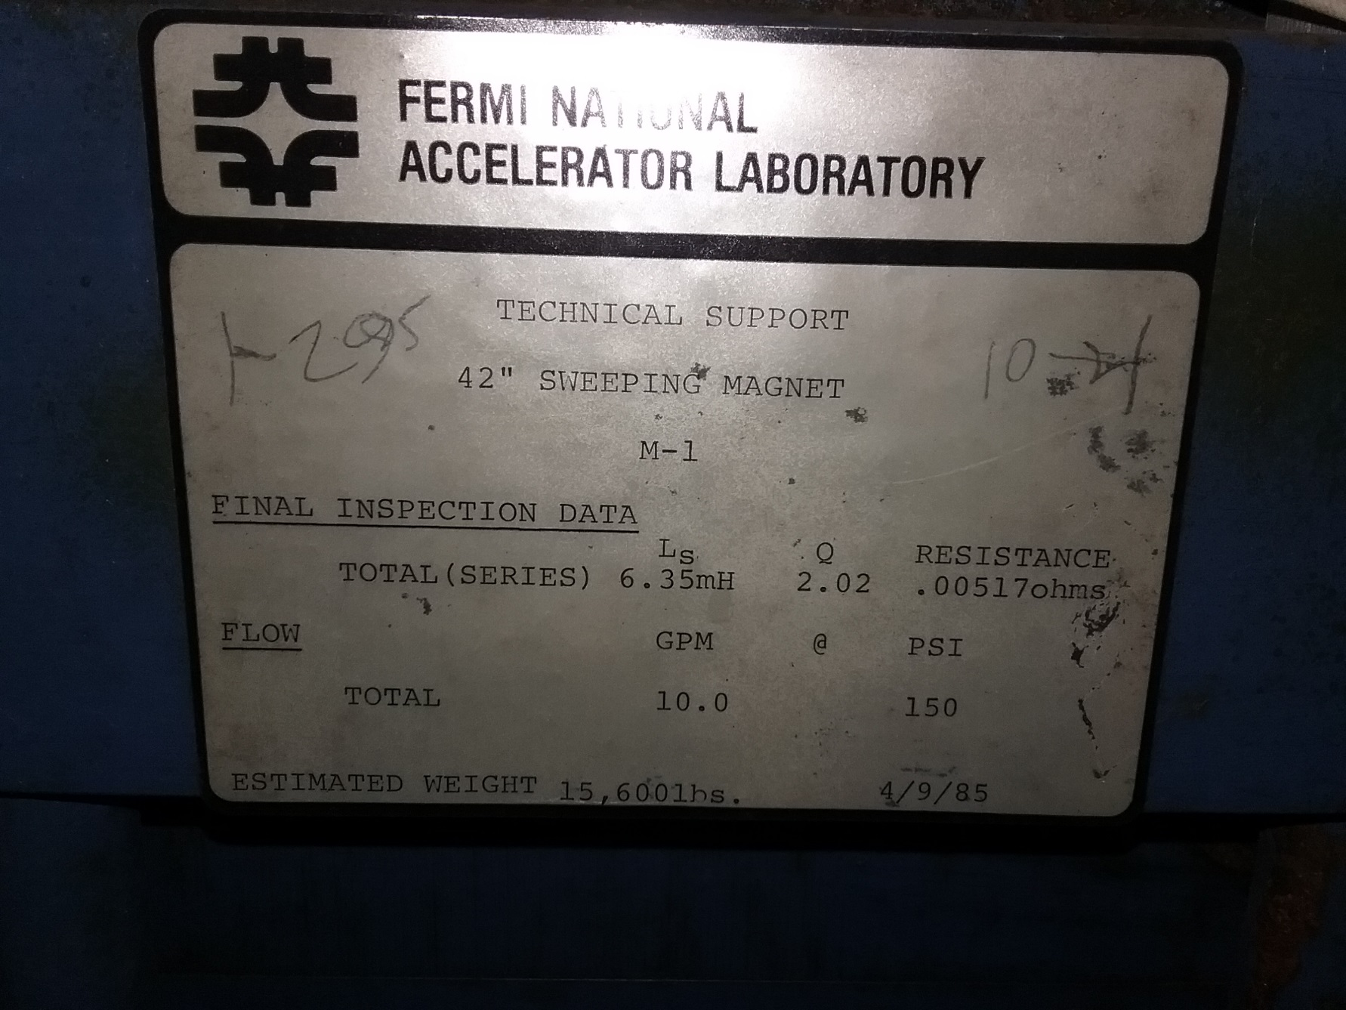
More Magnet Information Including Weight of 15,600 Lbs

Slide 17
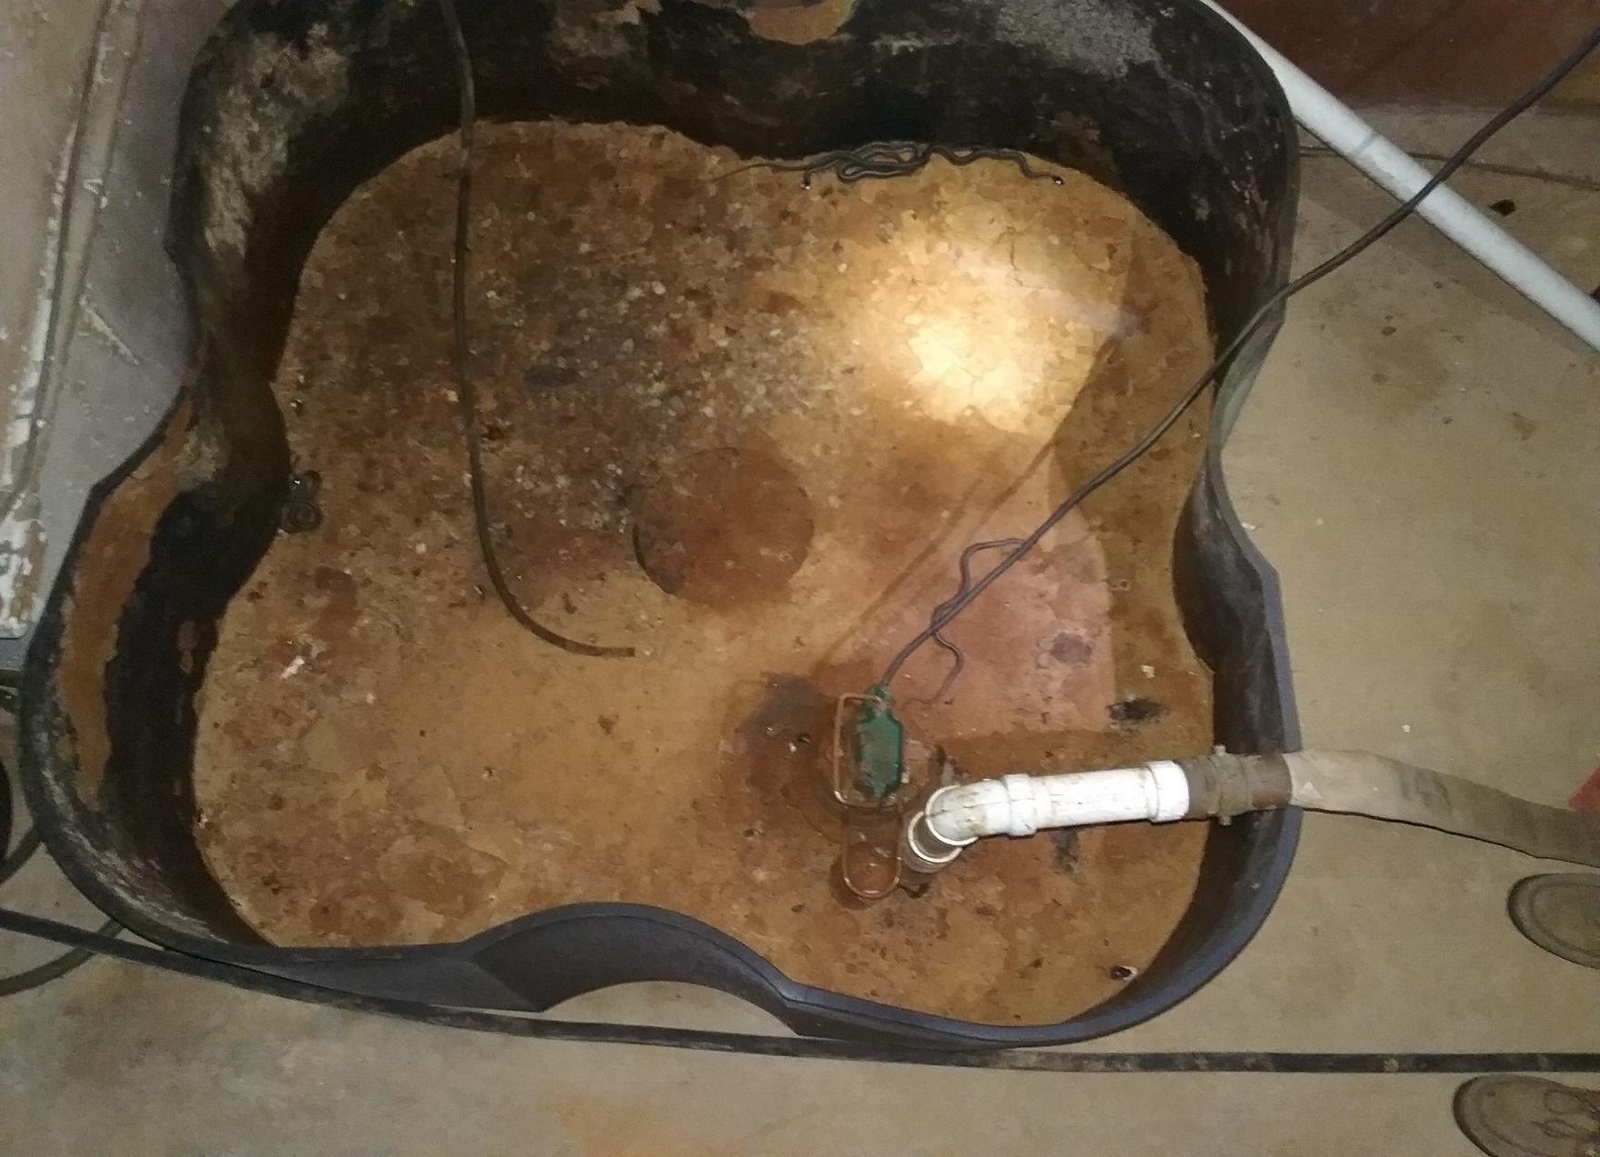
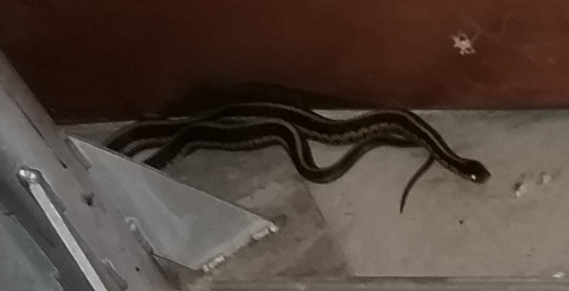
The Magnets are in PB6 Protected by Snakes We Saw At Least 8, but NO mice
1
2
3
5
4

