Slide 1
Miscellaneous.
Gennady Romanov
2nd Harmonic cavity meeting
June 8, 2017

Slide 2
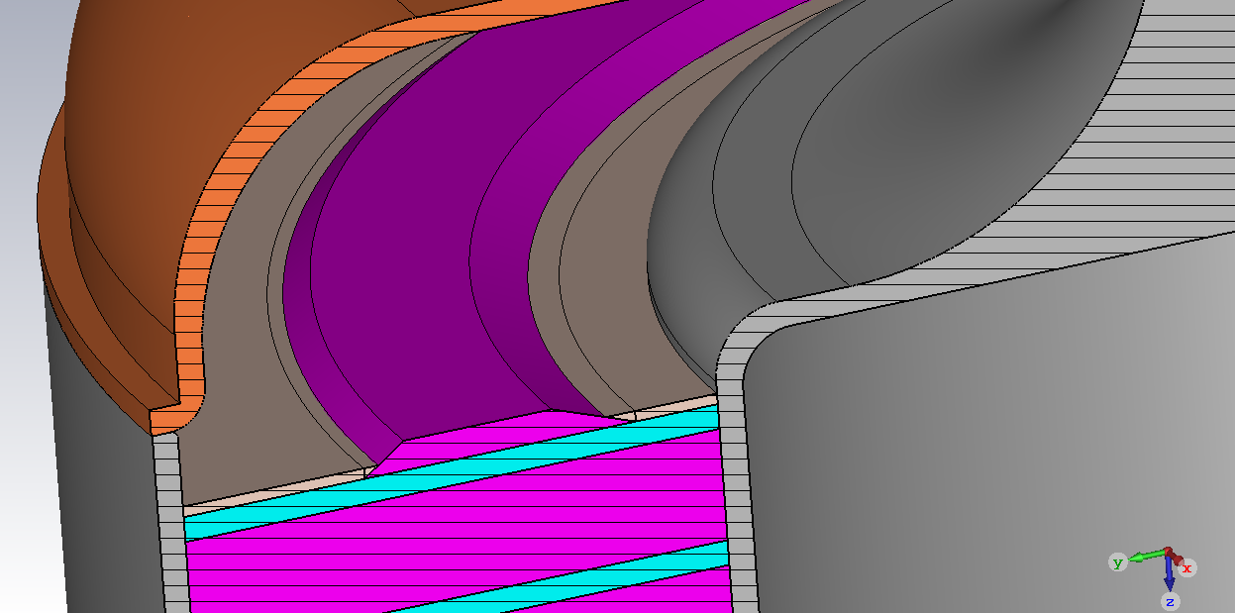
Angular recess
The shim with tiny rectangular edges is slightly recessed in the main alumina substrate. Then the shim edges are covered with additional alumina disks
Requires two “recess” alumina disks with angular edges.
Obviously a good tight connection between parts without air pockets is hard to make
The best recess design, but the most complicated
The most practical recess (if we decide to make a recess at all). Depth is 0.02” .
The model sent to Kevin.

Slide 3
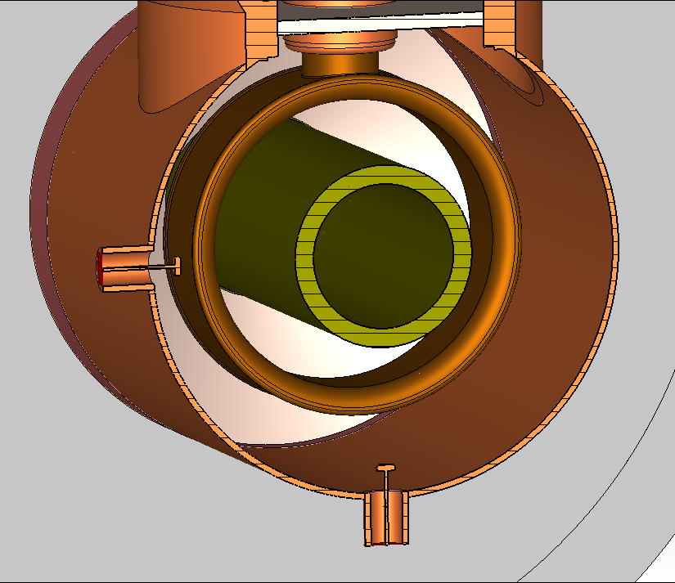
Unloaded Q
Discrete port in the tetrode,
reflection method. S11 is interpreted as a scalar?
Two probes
Transmission method.
Two probes, discrete port removed, transmission method
The final table of the cavity RF parameters will be posted in our share point folder after revision.

Slide 4
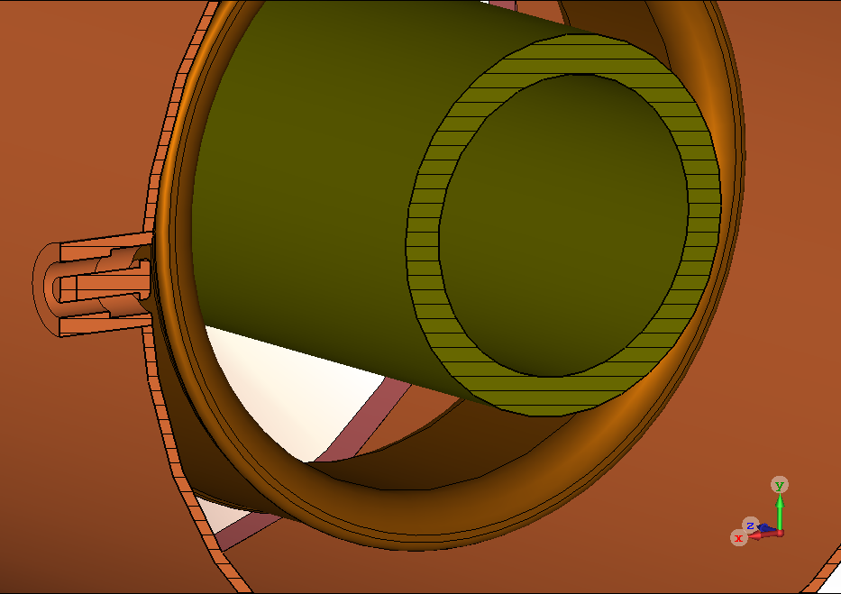
MDC probe
MDC Type-N, up to 1 GHz,
500 V dc, 3 A
1300 V/m
0.55”
0.25”
10 V
0.68”

Slide 5
Slots
Barely noticeable degradation with perfectly aligned slots

