Slide 1
Mechanical Update
Kevin Duel
Booster 2nd Harmonic Cavity
7 July 2017

Slide 2
Garnet Ring Orders
Still waiting for PO to be issued - waiting for “RFP” from 3 vendors now due to the price. RFP closes July 12th.

Slide 3
RF Spring

Slide 4
RF Spring

Slide 5
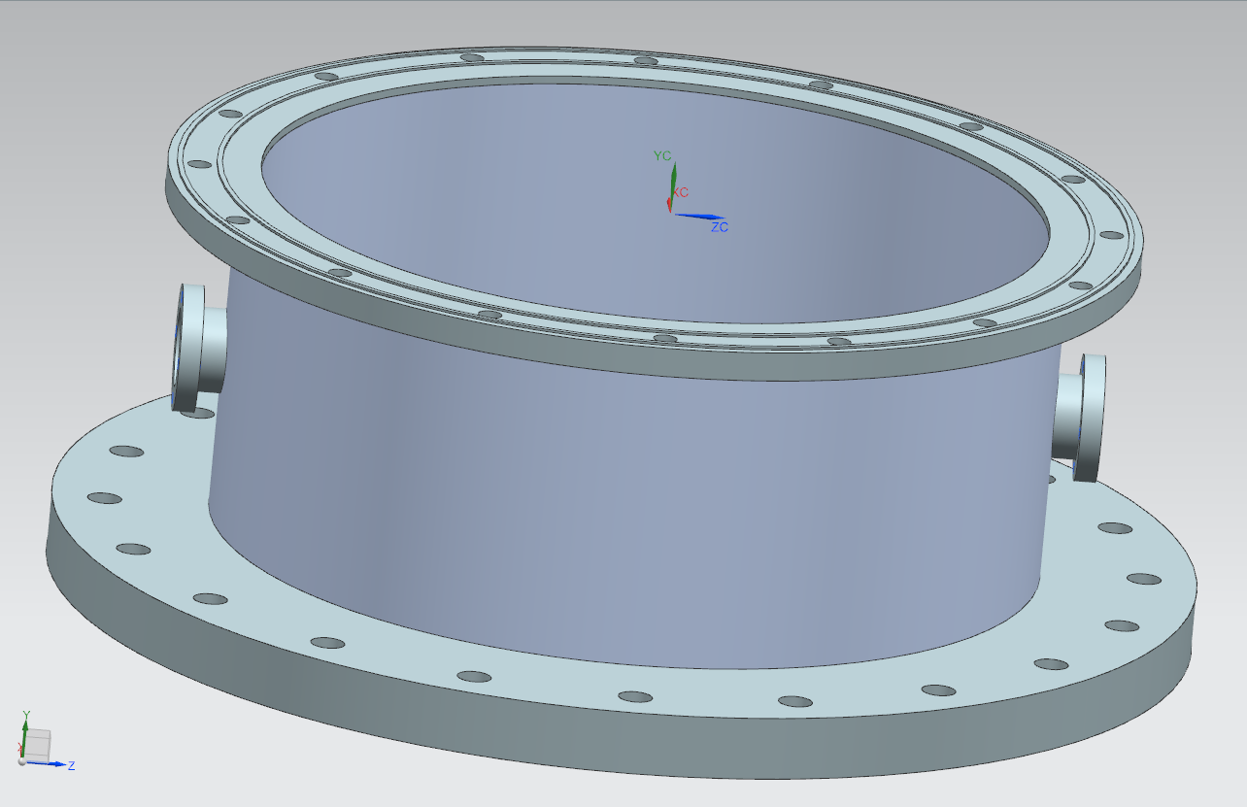
PA Outer Shell
RF Lip

Slide 6
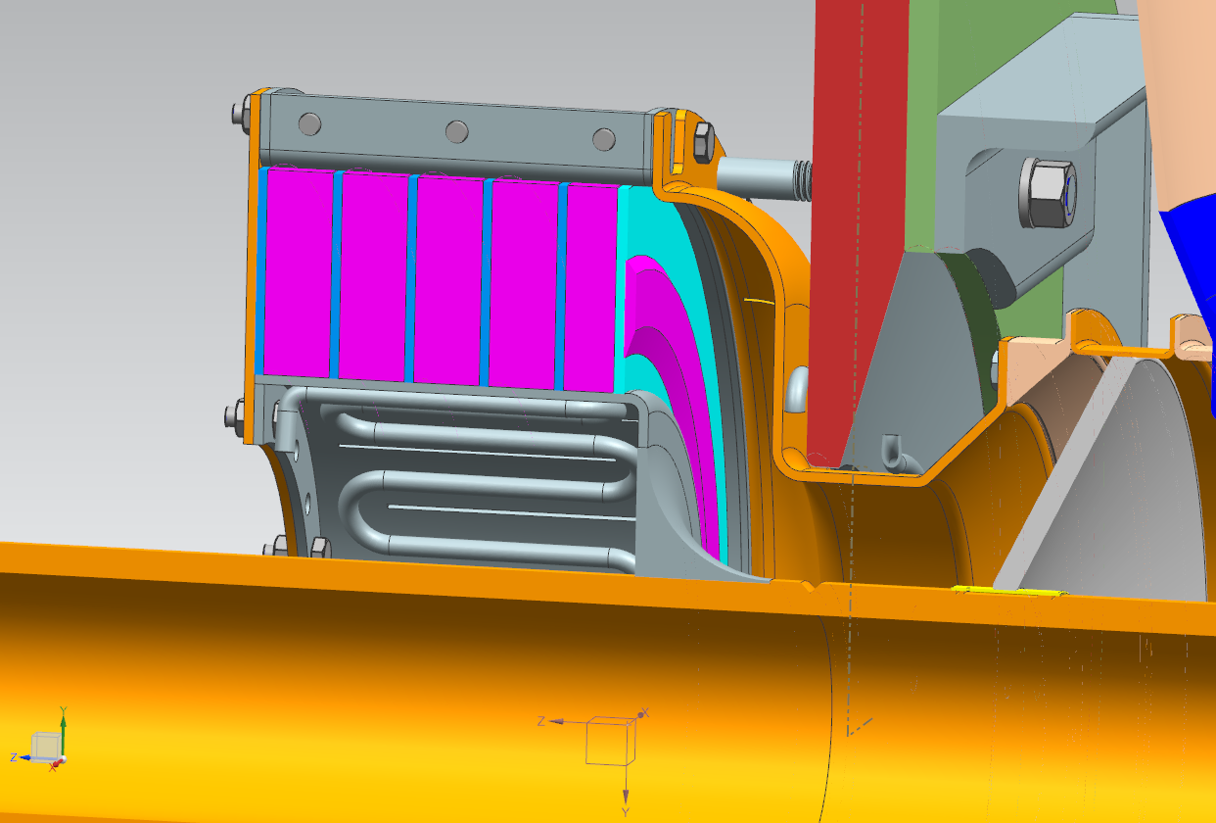
Garnet and Alumina Shim
Drawings sent to NMG
Waiting for response

Slide 7
Solenoid Coil – Tuner Jacket Interference
Coil ID increased to provide clearance with tuner jacket

Slide 8
PA Shell Air Flow Holes

Slide 9
RF Probes Location?

