Slide 1
Y567B PA test at 106 MHz
Robyn Madrak
Booster 2nd Harmonic Cavity Meeting
20 Jul 2017

Slide 2
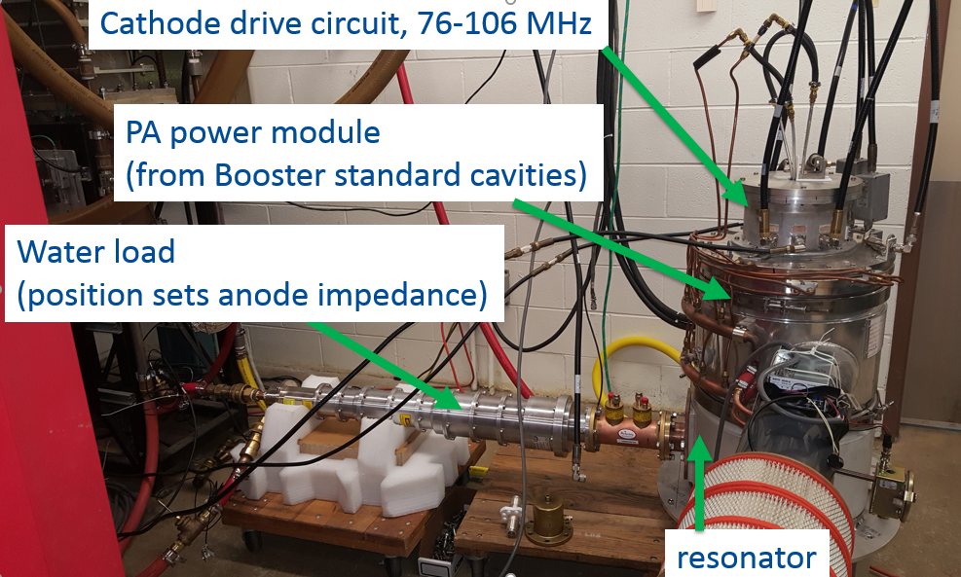
Previously
Already tested at 76 MHz, got to ~ 150 kW (Need ~50 kW)

Slide 3
106 MHz test
New cathode resonator with a better response at 106 MHz (and a sufficient response at 76 MHz)
Anode resonator is 3λ/4, since λ/4 was not possible at this frequency (too small)

Slide 4
Procedure
As was done last time, several data points were taken at varying DC anode voltages
The drive power from the Tomco was set to that which produced 300 mA screen current
The duty cycle was 50% which ~40 ms wide pulses
Measured quantities: Anode DC voltage and current, output (load) power, dissipated anode power, cathode and anode response, forward and reflected drive power, reflected drive power at cathode

Slide 5
Output power and anode power
At 106 MHz, only need 28 kW for 100 kV in gap
For extraction may only need 30 kV

Slide 6
Comparison
76 MHz
106 MHz

Slide 7
Drive power (out of 8 kW max from Tomco)

Slide 8
Fraction of power reflected: low power meas was ~62%

Slide 9
Plans
Though we have low level measurements, we need to high power test at 76 MHz with the new cathode resonator
The tube loading is not present during low power testing and thus the impedance seen by the drive is different
Not expected to be a problem, but must be verified
The tetrode itself produces more power than we require and both frequencies.

