Slide 1
Understanding Loss Coefficient
Based in the latest results of measurements of the garnet ring assembly in the test setup

Slide 2
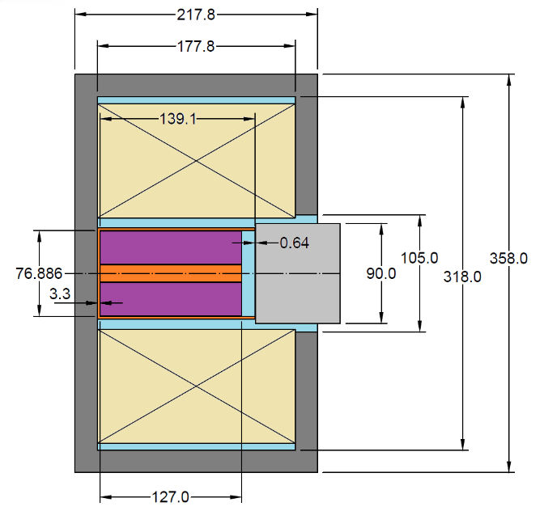
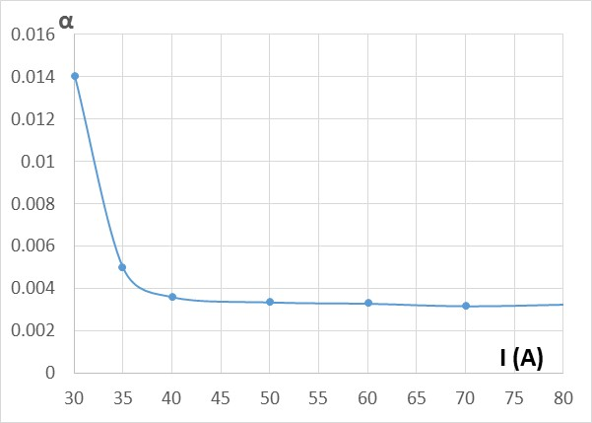
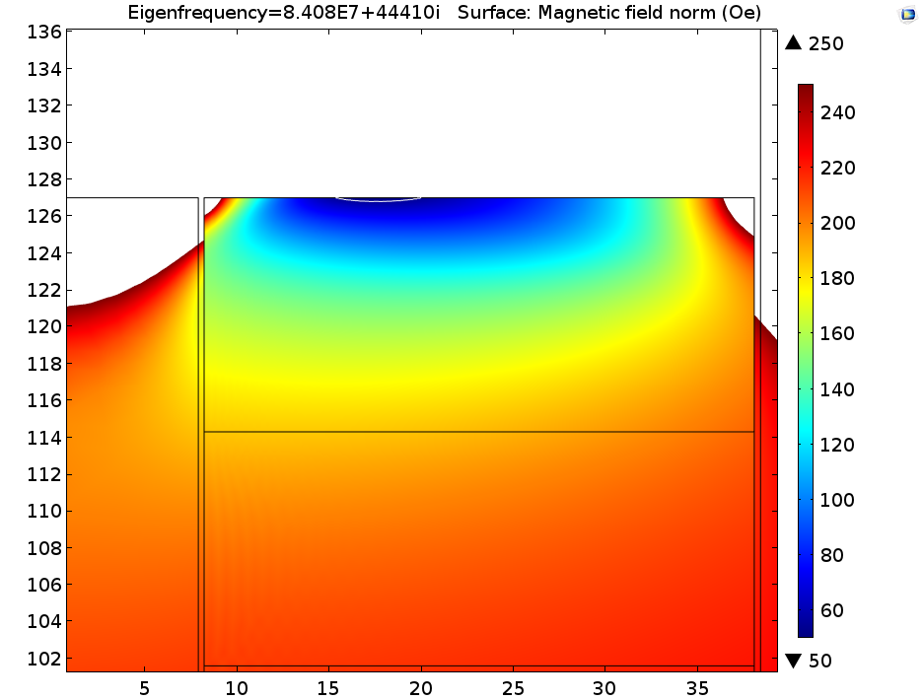
Early measurements (TD-15-005)
Steel plug to increase uniformity of the magnetic field
$$tg\left(δ_{M}\right)=\frac{μ^{″}}{μ^{′}}= \frac{αωω_{M}∙\left(ω_{0}^{2}+ω^{2}\right)}{\left(ω_{0}^{2}−ω^{2}\right)∙\left(ω_{0}^{2}−ω^{2}+ω_{M}ω_{0}\right)}$$
Precession frequency ω₀ is a function of magnetic field at the point of observation.
So, the loss tangent is also changes depending on the magnetic field in the garnet
ω₀ = µ₀γ·H₀ precession frequency
ω_{m} = µ₀γ·M_{S} gyrotropic frequency
γ = e/m_{e} gyromagnetic ratio
Cavity wall material - pure copper.

Slide 3
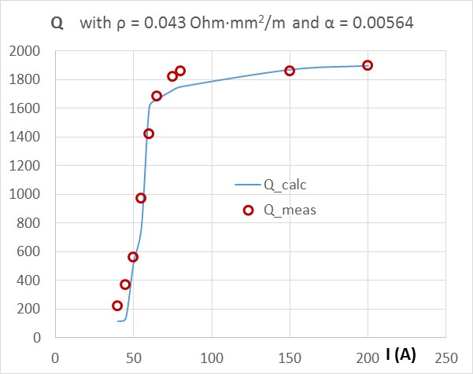
Verification measurements (TD-16-001)
Conclusion made based on the measurement results in TD-15-005:
The loss coefficient may be a material constant.
This is what previous studies made in TRIUMF and SSC tried to understand.
No definite conclusion has been made → uncertainty is high →
Verification test
The static magnetic properties of the garnet material found in TD-15-004 and the loss coefficient found in TD-15-005 were used to verify the measured frequency and the quality factor of a test cavity.
Fitting modeling provided satisfactory results only after correct line width of the used garnet material and the increased resistivity of the contact area in the cavity walls were taken into account.

Slide 4
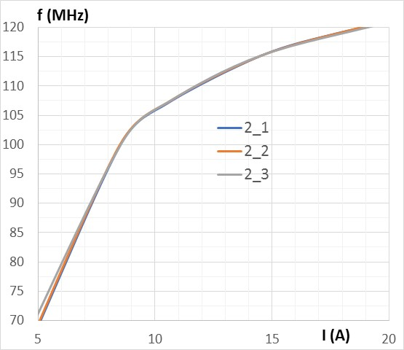
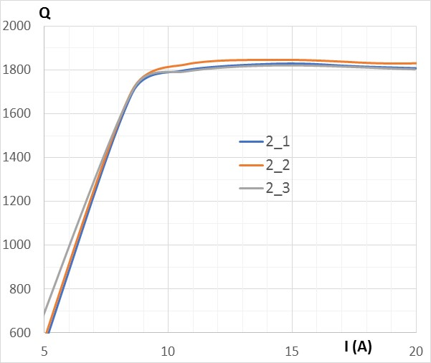
Ring Test Setup
Results of measurements presented by J. K. during the Aug. 31, 2017 meeting:
Wall
Garnet
Contact
Empty cavity f = 138.62 MHz, Q ≈ 1600.
Loaded cavity
Glue
Air
Alumina
Vendor’s provided the -3 dB line width ΔH = 26 Oe
This corresponds to α = 0.0039
Fitting modeling was made to find loss coefficients that would fit the data obtained by the measurements.

Slide 5
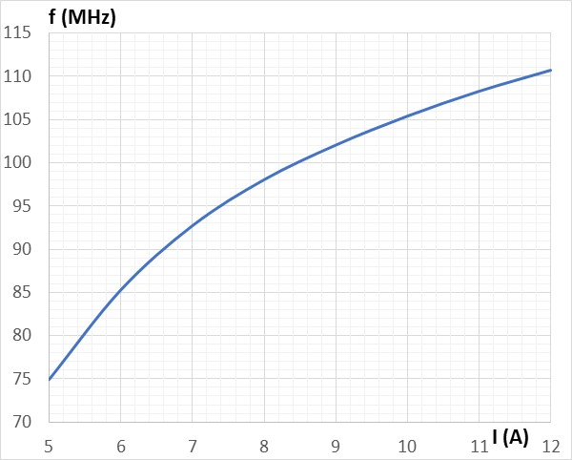
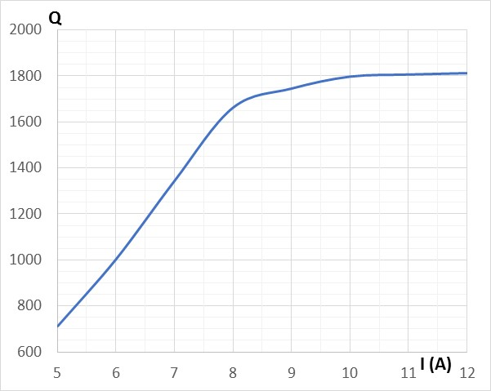
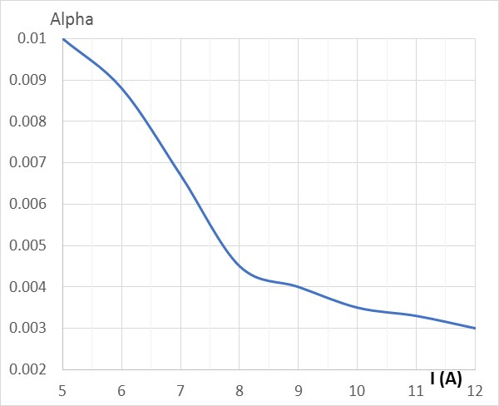
Fitting results for the case when the resistive losses are mainly due to the imperfect contact
Cavity walls: σ = 5E7 S/m;
Contact area: σ = 7E5 S/m;
Empty Cavity:
F = 139.67 MHz; Q = 1606
At each current level, the loss coefficient was found that results in the quality factor that fits the measurements
Vendor’s provided the -3 dB line width ΔH = 26 Oe
This corresponds to α = 0.0039

Slide 6
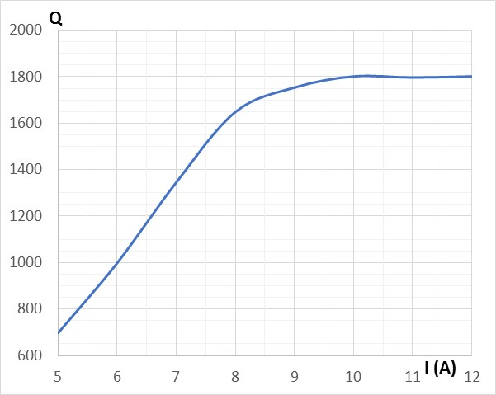
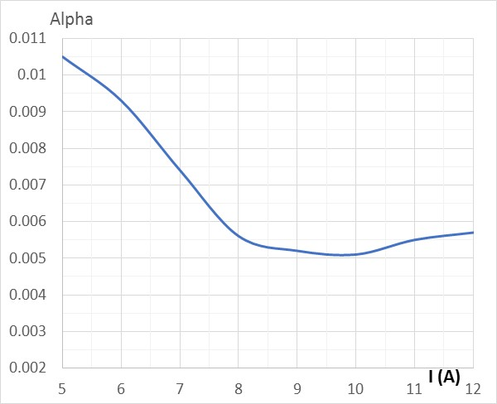
Fitting results for the case when the resistive losses are due the increased wall resistivity
Cavity walls: σ = 3.1E7 S/m;
Contact area: σ = 3.1E7 S/m;
Empty Cavity:
F = 139.67 MHz; Q = 1611
At each current level, the loss coefficient was found that results in the quality factor that fits the measurements
Vendor’s provided the -3 dB line width ΔH = 26 Oe
This corresponds to α = 0.0039

Slide 7
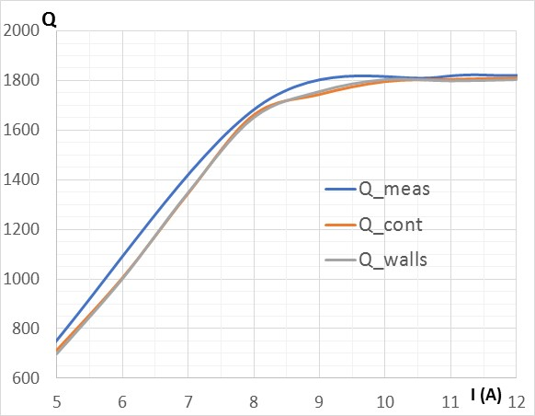
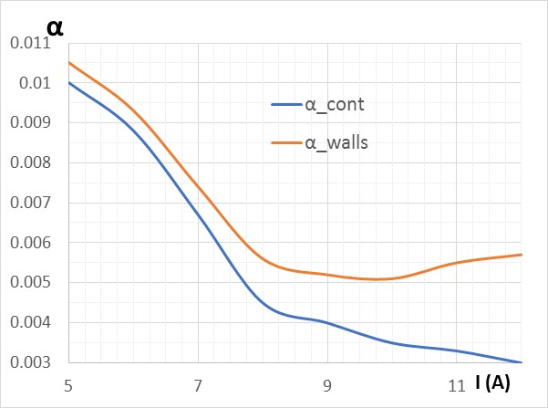
How the data corresponding the different location of the wall losses compare?
Vendor’s provided the -3 dB line width ΔH = 26 Oe
This corresponds to α = 0.0039

Slide 8
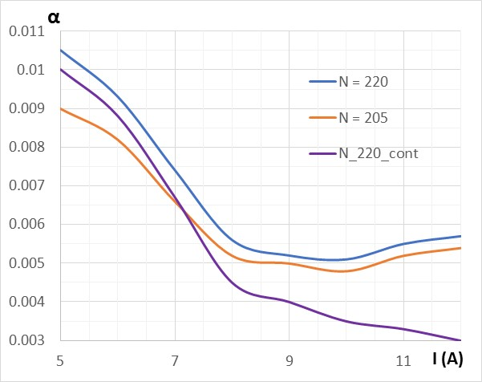
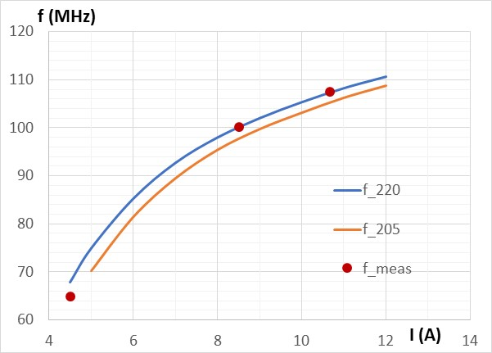
What if the number of turns we used (220) for the field calculation is not right?
Vendor’s provided the -3 dB line width ΔH = 26 Oe
This corresponds to α = 0.0039
Frequency data show that N = 220 is probably right number of turns

Slide 9
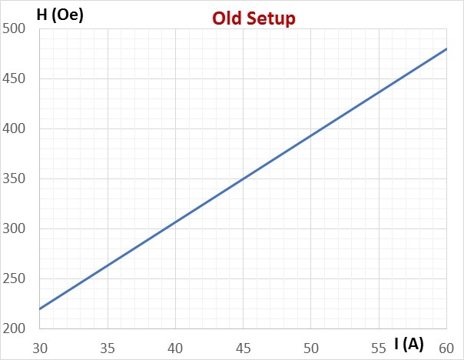
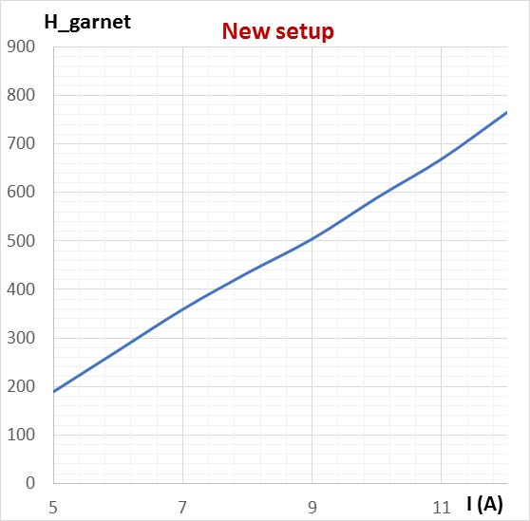
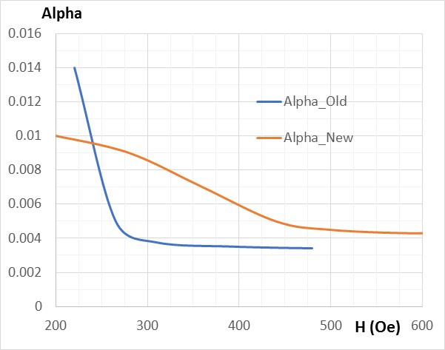
How to compare the old and the new set of the loss data? Let’s try using the magnetic field in the material as an independent variable
Poor field uniformity in the rings of garnet material → the field data is averaged (roughly). Not tremendously helpful for the loss power evaluation.

Slide 10
Conclusion
Still have little idea why the measurement data cannot be fitted by adjusting parameters of the model, like it was possible to make long time ago.
Next (maybe not last) resort is to improve the test cavity.

