Slide 1
Mechanical Update
Kevin Duel
Booster 2nd Harmonic Cavity
09 November 2017

Slide 2
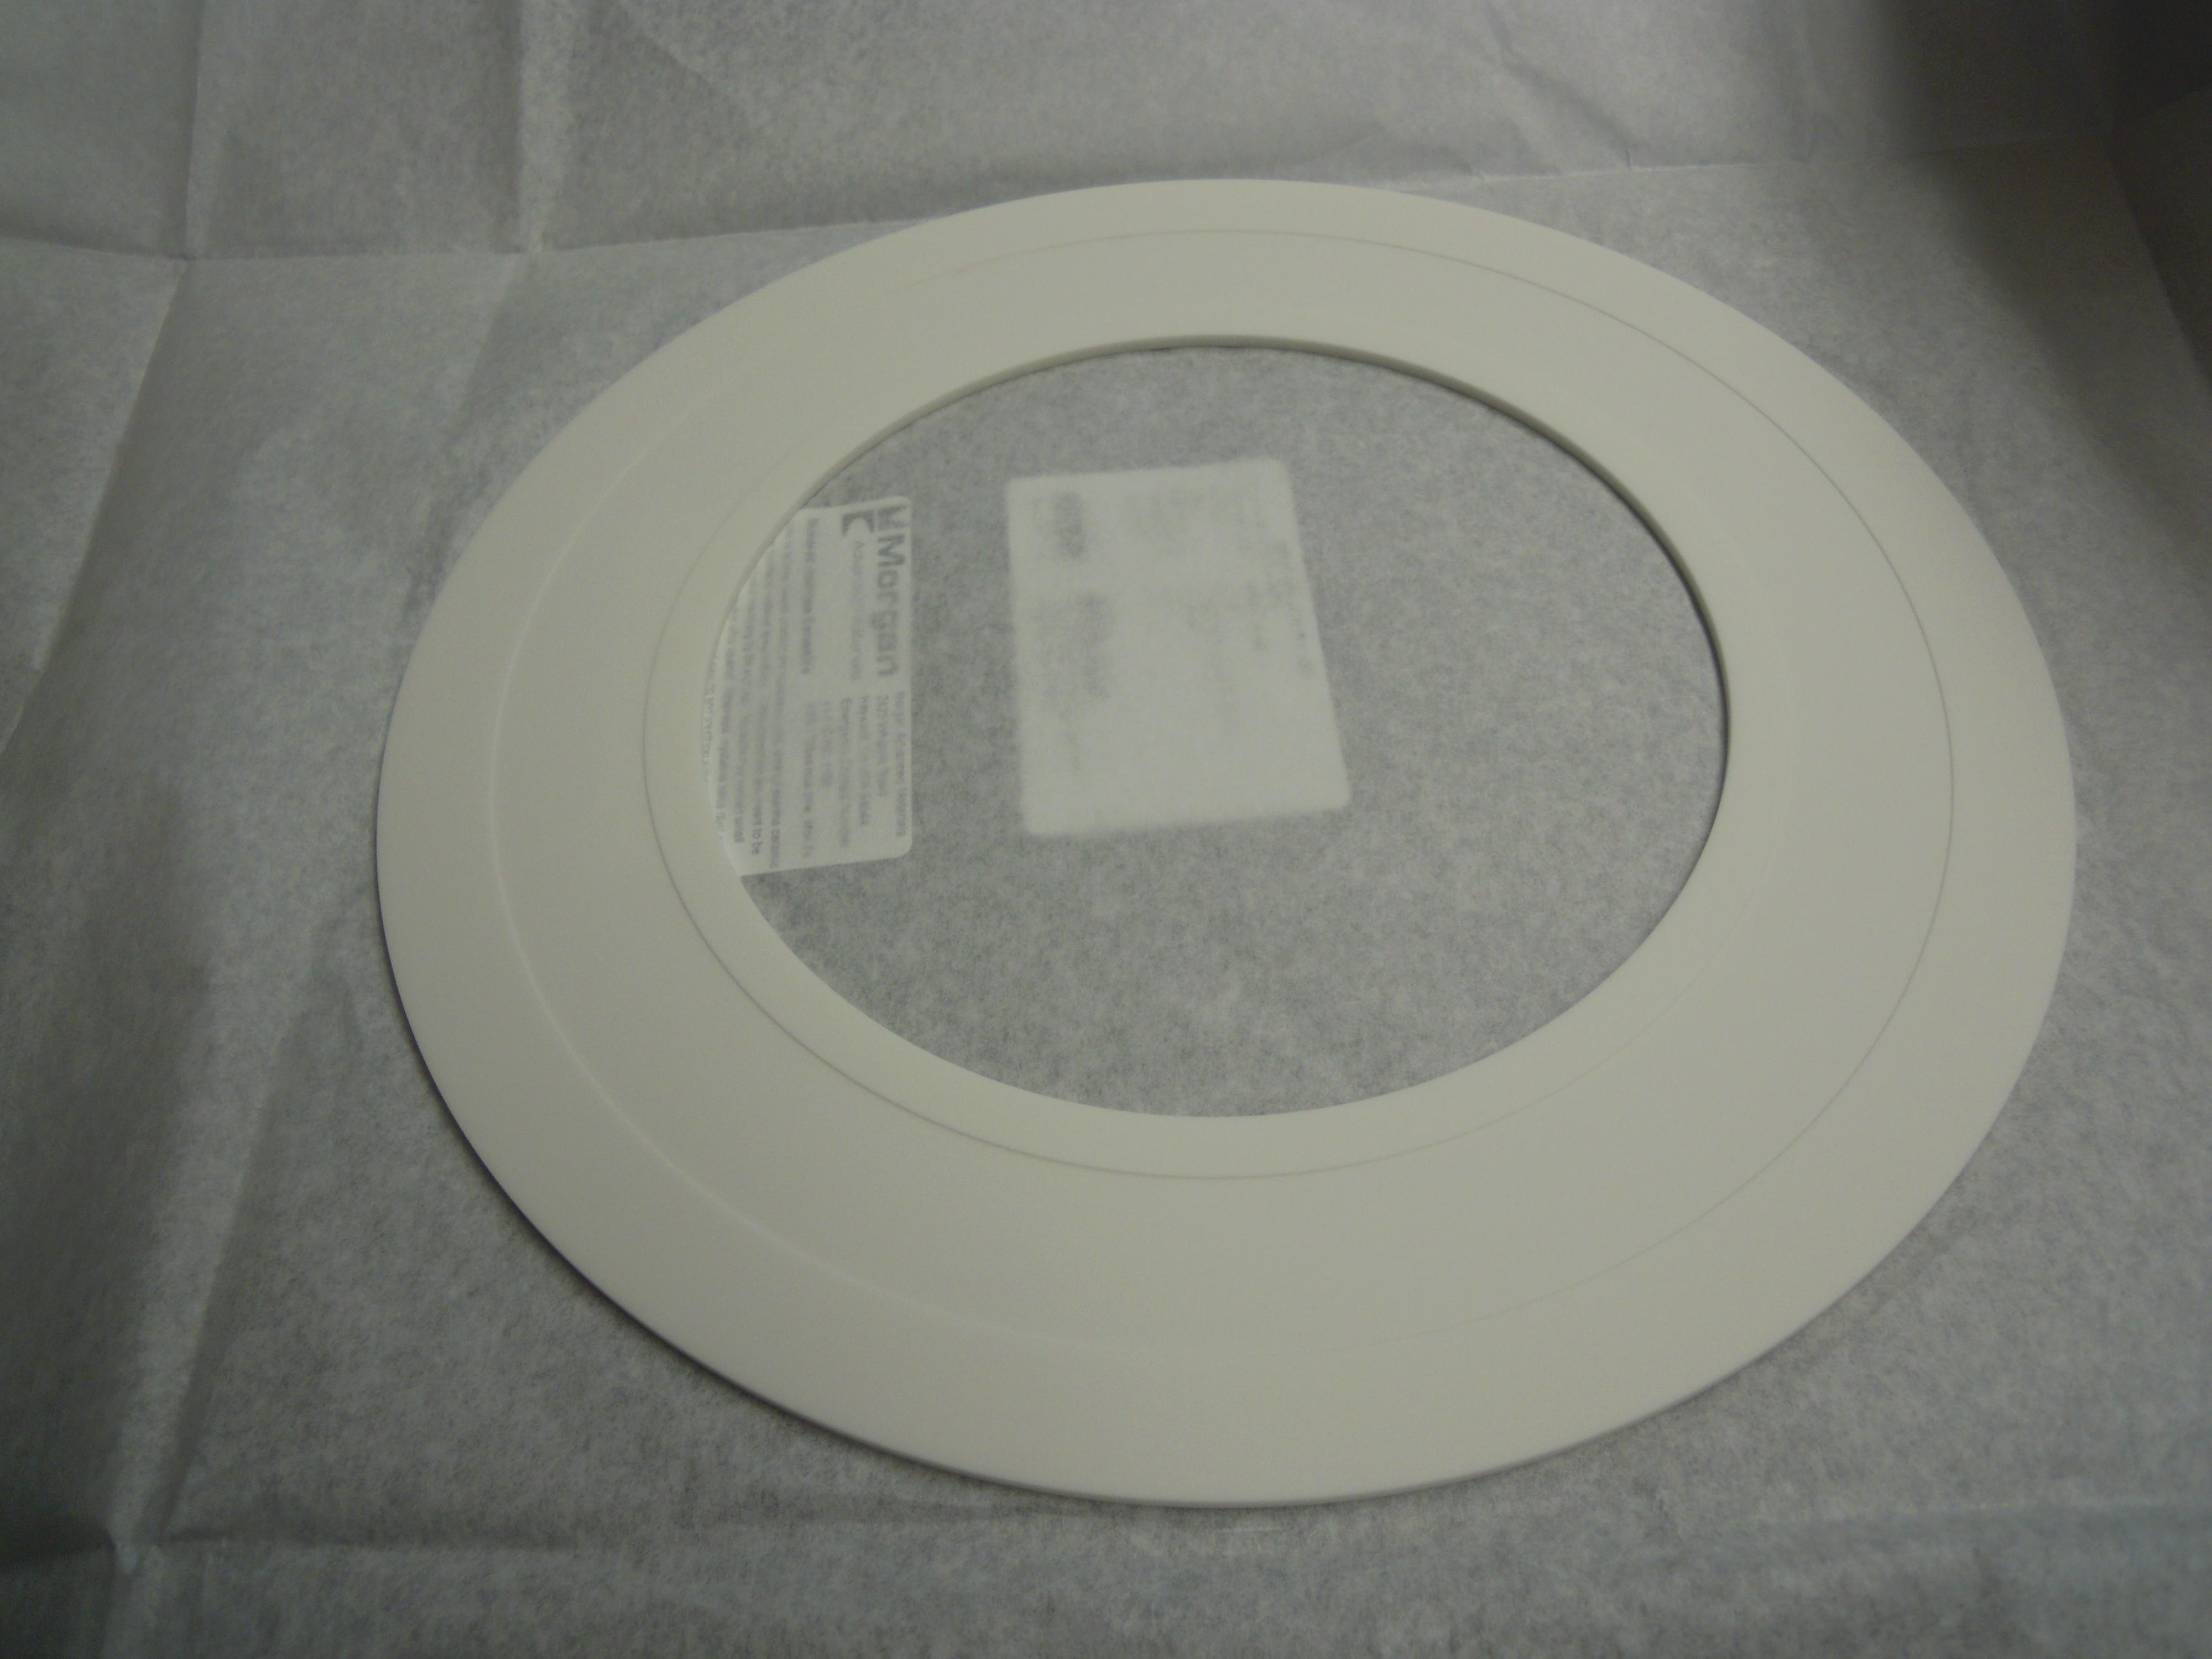
Garnet Ring Orders
Received alumina for shim pieces
Sent to NMG
Blocks are made, machining to take place in 1-2 weeks
Optimistically will have rings in December but more likely January
Shim rings to be ready February at the earliest
Ordering more glue for NMG

Slide 3
Cavity Parts Coming in and Starting Welding

